Slide 1
Establishing a Community-Derived Early Infrastructure Framework
December 14th, 2022
LSIC E&C Focus Group
Jibu Abraham
Athonu Chatterjee
Sarah Hasnain
Claudia Knez
Michael Nord
Sarah Hasnain & Jibu Abraham LSIC Excavation & Construction Focus Group Leads

Slide 2
Agenda
Welcome New LSIC E&C Leadership
Upcoming Events
Brief Summary of LSIC Fall Meeting 2022
Guest Speakers
Bechtel
ARUP
Breakout Session

Slide 3
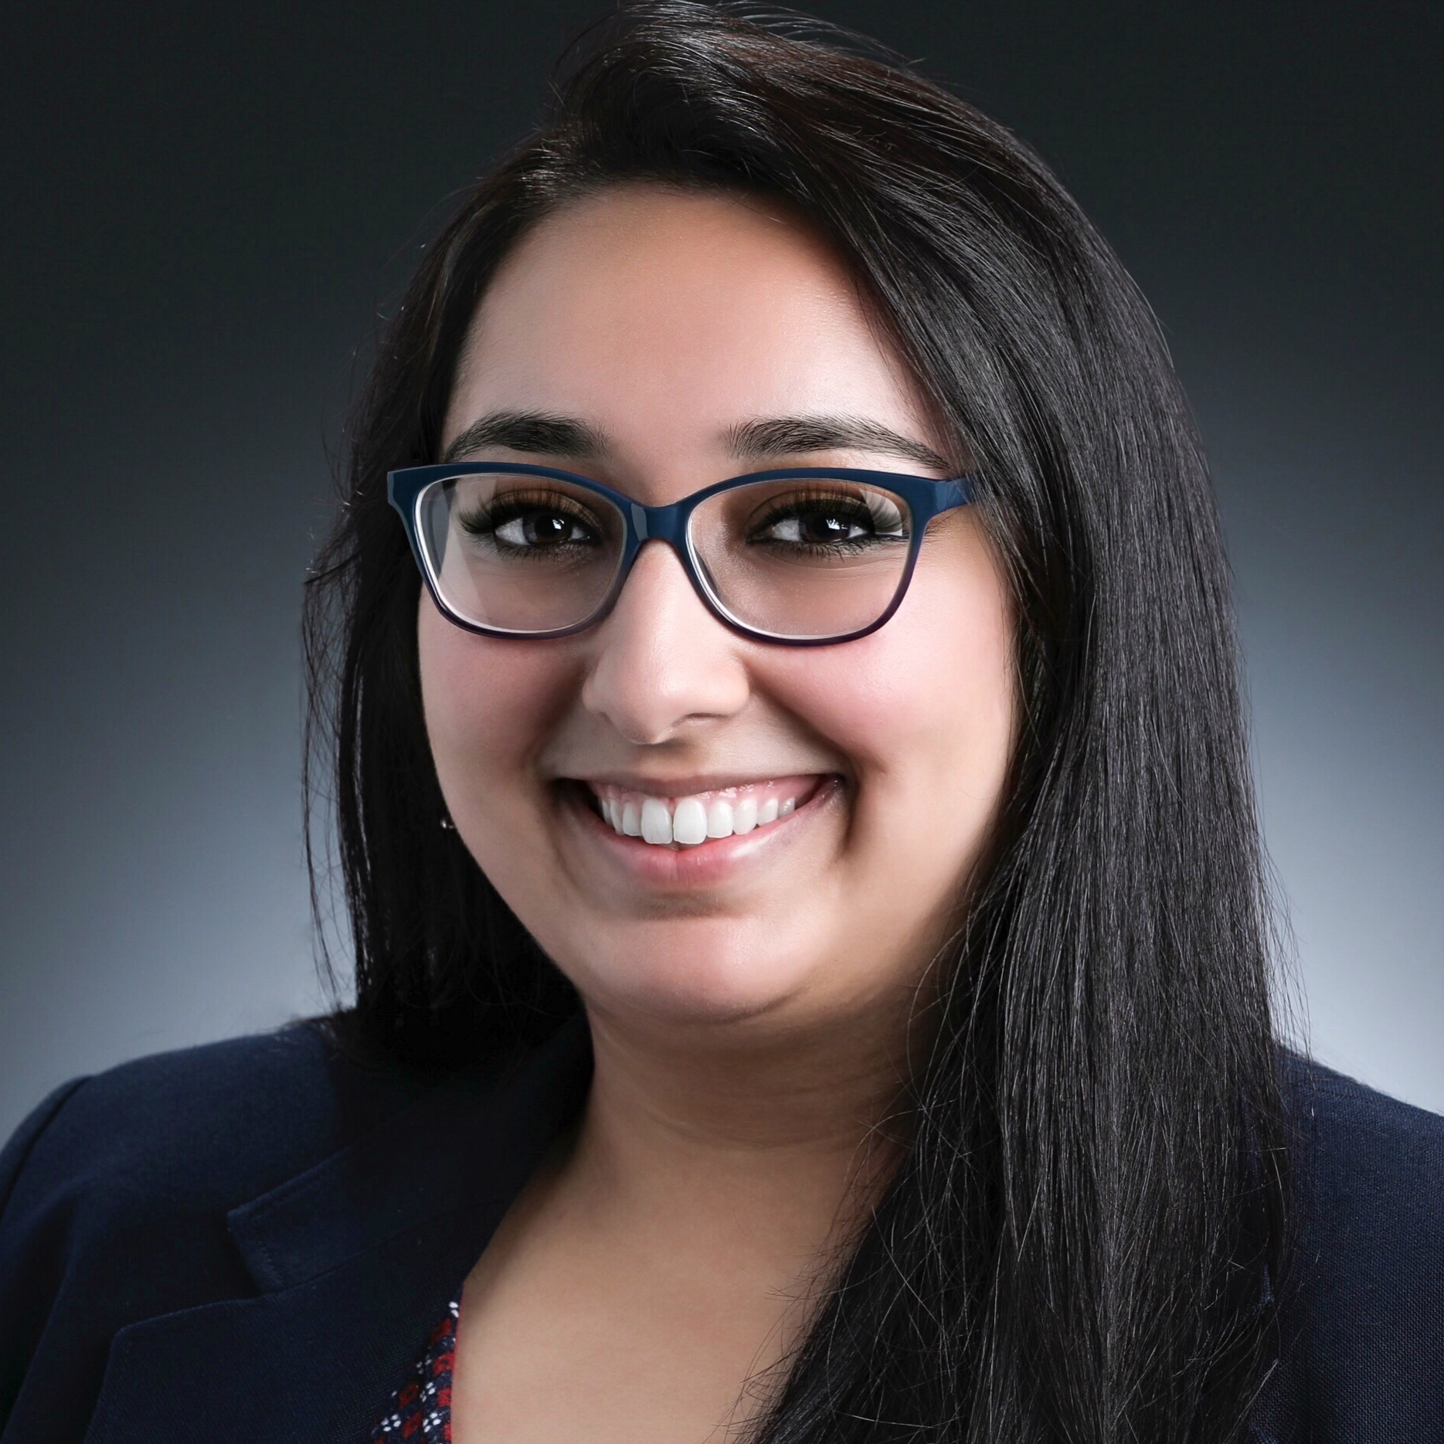
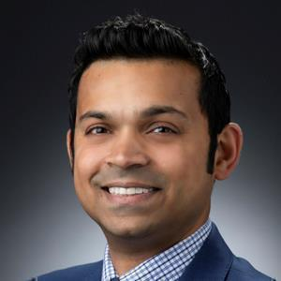
Welcome New LSIC E&C Leads
Sarah Hasnain
JHU / APL
Space Exploration Sector
Jibu Abraham
JHU / APL
Air & Missile Defense Sector
We thank Dr. Athonu Chatterjee for his leadership as the founding LSIC E&C Focus Group Lead, and are excited to engage with the community in this capacity!

Slide 4
Upcoming Events
NASA SMD – 2023 Technology Showcase for Future NASA Planetary Science Missions
January 9, 2023 – January 11, 2023
Galveston, Texas, USA
https://nasa-techshowcase.seti.org/
LSIC Spring Meeting 2023
March 29, 2023 – March 30, 2023
Hybrid: Zoom + Johns Hopkins University Applied Physics Laboratory (Laurel, Maryland, USA)
More details to come

Slide 5
Brief Summary of LSIC Fall Meeting 2022

Slide 6
Establishing a Community-Derived Early Infrastructure Framework

Slide 7
Community-Derived Early Infrastructure Framework
Part one of a two-month meeting series (December 2022 + January 2023)
Near-Term Goal: LSIC-Developed Whitepaper regarding the community’s vision for Lunar Early Infrastructure

Slide 8
Breakouts

