Slide 1


LSIC Surface Power Telecon
December 1st, 2022
Begins at 11:03
Matt Clement, Ph.D.
Johns Hopkins Applied Physics Laboratory
Space Exploration Sector
matt.clement@jhuapl.edu

Slide 2

LSIC | Agenda
Community Updates
  MOSA December telecon (Kristen Jaburek, JHU/APL)
  Artemis 1!
  Solicitations and Awards
  Conferences/Workshops
2022 Year in Review (Matt Clement, Sean Young, Samantha Andrade, Julie Peck, Joseph Kozak; JHU/APL)
Survey completion
Open Discussion
2

Slide 3
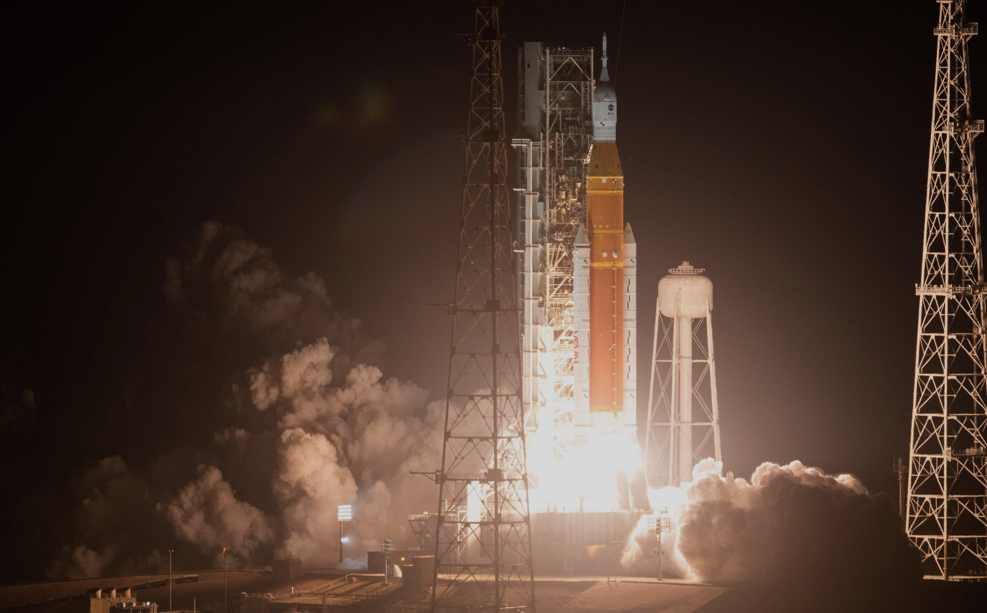
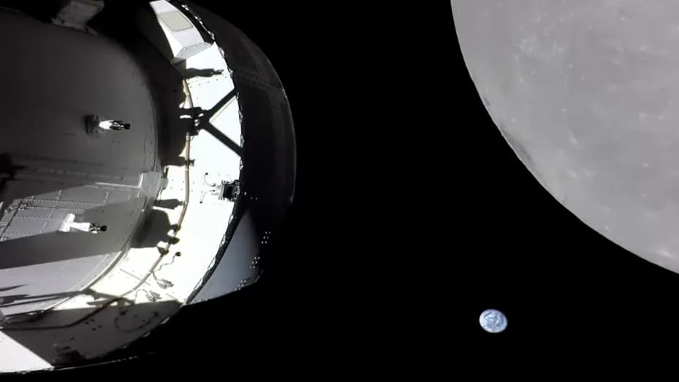
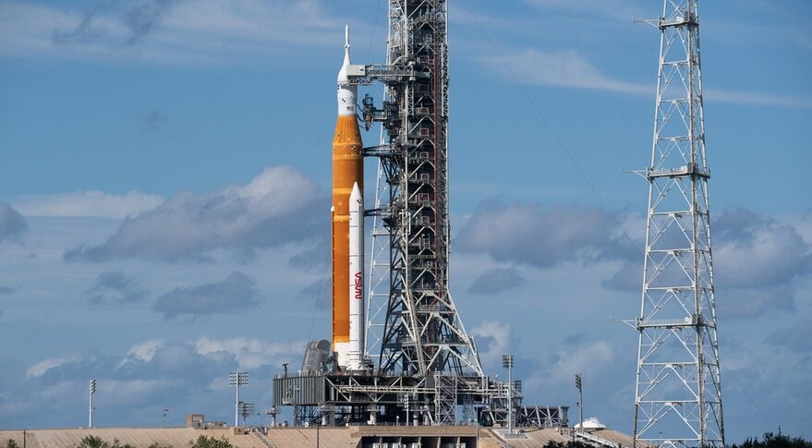
LSIC | Artemis 1
3

Slide 4
LSIC | Solicitations and Awards
Space Tech Solicitations (https://www.nasa.gov/directorates/spacetech/solicitations)
DARPA Space Power Conversion Electronics (SPCE)
Proposals due on December 6
NASA Innovative Advanced Concepts (NIAC) 2022 Phase II Call for Proposals
Proposal due December 15, 2022
NASA Innovation Corps Pilot
Next deadline: January 20, 2023
NASA Innovative Advanced Concepts (NIAC) 2023 Phasee I Call for Proposals
Solicitation release planned in December 2022
NASA SBIR/STTR Solicitations
Solicitation release planned in early 2023
Early Career Faculty STMD Research Grants
Solicitation release planned in February 2023
Early Stage Innovation Solicitation
Solicitation release planned in April 2023
4

Slide 5
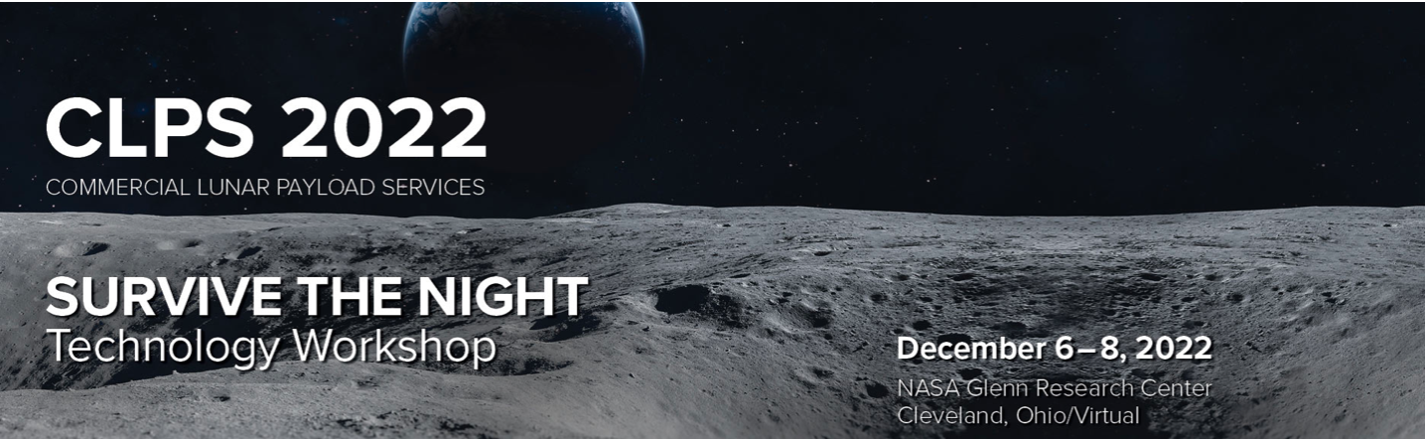
LSIC | CLPS Survive the Night
NASA’s Science Mission Directorate (SMD) and the Space Technology Mission Directorate (STMD) are pleased to announce a workshop to facilitate collaboration between lander and rover providers and technology developers to share technologies that can enable survival through the lunar night.
Virtual Registration remains open!!!
Be sure to check out the Nuclear Power Technical Session Day 1!
https://www.hou.usra.edu/meetings/clps2022/
5
Notes:
Tuesday—Thursday.. Lear your Tuesday afternoon!!!

Slide 6
LSIC | Upcoming Meetings and Workshops
AIAA SciTech
January 23-27, National Harbor, MD + Virtual
FAA Commercial Space Transportation Conference
February 8-9, Washington, DC
IEEE Aerospace Conference
March 4-11, Big Sky, MT
Lunar and Planetary Science Conference
March 13-17, The Woodlands, TX
Applied Power Electronics Conference
March 19-23, Orlando, FL
More complete calendar on LSIC website, email with additional events!
6
Notes:
AIAA Scitech is an expo of the latest and greatest in Aerospace R&D
FAA CSTC

Slide 7
LSIC | Next January Telecon
Due to the upcoming holidays, the next telecon will take place on
Thursday January 26, 2023 at 11:00AM ET.
Theme: NASA Fission Surface Power Phase 1
Rough Agenda:
Announcements and Community Updates
Fission Surface Power Perspectives
Question/Answer and Discussion with speakers
7

Slide 8
2022 Year in Review:
LSIC SP Team: Dr. Matt Clement, Dr. Sean Young, Julie Peck,
Sam Andrade, Dr. Joseph Kozak
Notes:
I can see we have some new people here today, so hopefully this will get a sense of the kinds of things we are talking about in this FG. I also know that Many of you were at our telecons, but I encourage you not to drop off!!! We wanted this to help jog everyones memories about what we have done over the past year… after this we will pass out a survey and stick around for your feedback on where we should go with this next year!!!

Slide 9
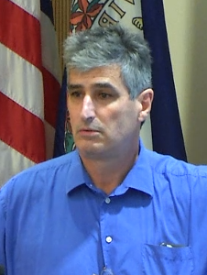
LSIC | Year in Review: January Telecon
Topic: Fission Surface Power (FSP)
Date: 27 January 2022
Primary Speaker: Dr. Anthony Calomino
  NASA Space Nuclear Technology Portfolio Manager
Attendees: 122
Other Topics Covered:
  Introduction to the Modular Open Systems Approach (MOSA) Working Group
  DARPA RFI on Rad-hard Electronics
9

Slide 10
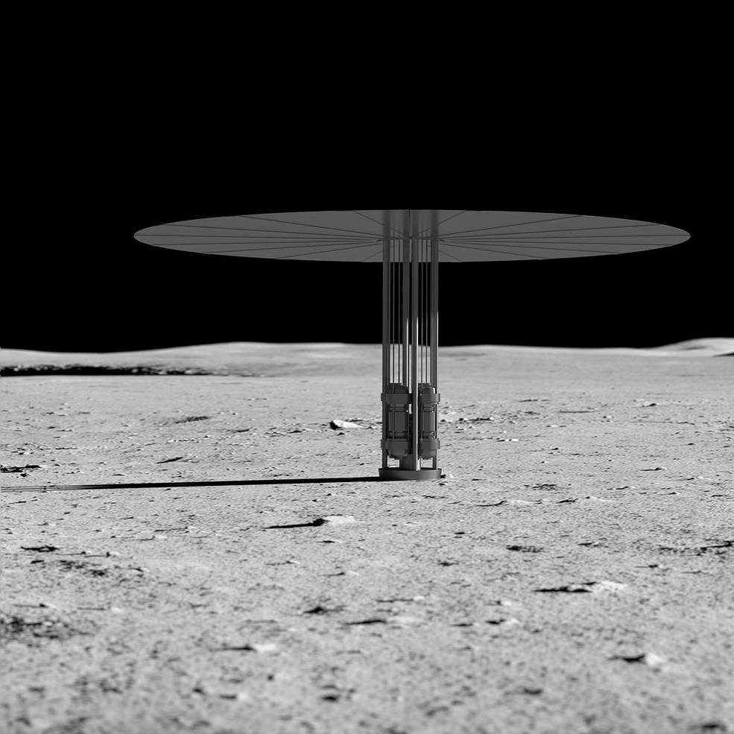
LSIC | Year in Review: January Telecon
Key Takeaways:
Fission Surface Power is NASA’s top nuclear priority:
Power target updated from 10 kW_{e} to 40 kW_{e}:
  Feedback from industry: <10 kW_{e} comes with criticality issues, and is also borderline for energy density tradeoffs with other power sources
  Focus on Metal-Hydride and Beryllium moderators for high temperature LEU solutions (DoE study)
Updates to federal policies and processes:
  NSPM-20 clarifies launch authorities: non-HEU missions can achieve approval through authorizing agency
  EO 13972 directs NASA to use common nuclear systems for exploration
NASA is heavily invested in power conversion (Stirling/Brayton) technology in the ~1-5 kW_{e} range
  Additional work needed to bring higher-power TRL up
10
Notes:
NSPM=national security presidential memorandums, executive orders and space policy orders…

Slide 11
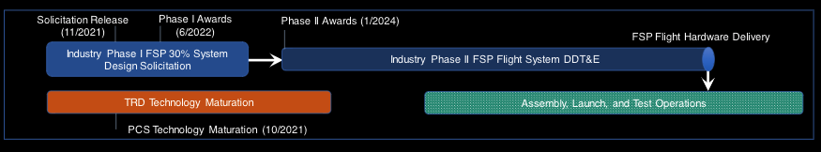
LSIC | Year in Review: January Telecon
Critical Discussion Point:
Question: The Navy has experience operating extremely-highly-enriched reactors in enclosed spaces for long periods of time, is NASA looking to draw on this expertise as it pursues its FSP goals?
Answer: We want to draw on the advice of our industry and DoE partners. If this is an avenue they think we need to be going down, we welcome that feedback.
Looking Forward:
FSP has been featured prominently with dedicated sessions in multiple recent conferences/workshops (APS4DS, ASCEND, NASA GRC Prometheus Workshop)
The SP Focus Group is currently developing plans for an FSP telecon in 2023
11

Slide 12
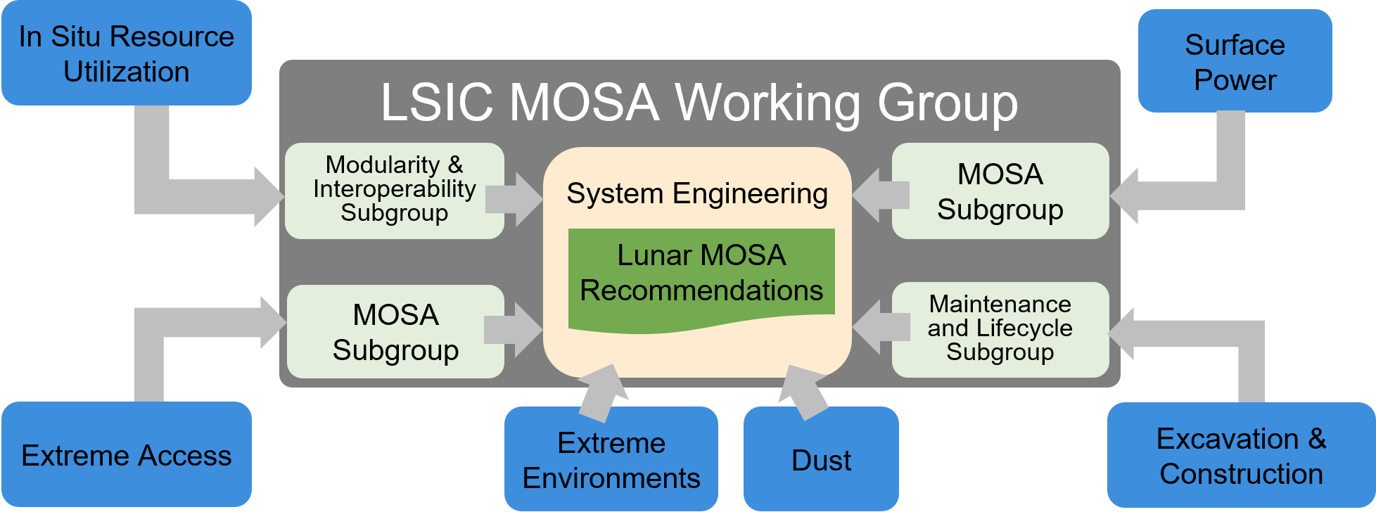
LSIC | Year in Review: February Telecon
Topic: MOSA Working Group Breakout Discussions
Date: 24 February 2022
Attendees: 122
Focus on new MOSA working group
  Introduction by James Mastandrea
  Breakout sessions into power capability
  area subgroups for Miro-based discussions
Other Topics Covered:
  Solicitations
    Watts on the Moon Phase 2
    Tipping Point/ACO (Announcement of Collaboration Opportunity)
12
Notes:
JULIE!!!

Slide 13
LSIC | Year in Review: February Telecon
MOSA (Modular Open System Approach) Working Group Introduction
James Mastandrea reviewed the working group goals, centered around identifying critical interfaces across focus areas and defining requirements needed to ensure interoperability
Each LSIC focus group has a designated point of contact for the MOSA group
Breakout Discussions
Participants split into subgroups based on power capability areas to answer the following MOSA-based questions via Miro boards:
  Within this capability area, what would you designate as a critical interface? What is the boundary that interfaces with the larger system?
  What are the existing efforts on standards/interoperability in this area? Are they applicable to the Moon?
  What do you want to get out of the MOSA working group?
Capability areas:
Nuclear (including FSP, RPS)
Rad-Hard Electronics
Power Transmission (cabled and power beaming)
Photovoltaics/Solar Power
Fuel Cells
Low-Temperature Battery Modules
13

Slide 14
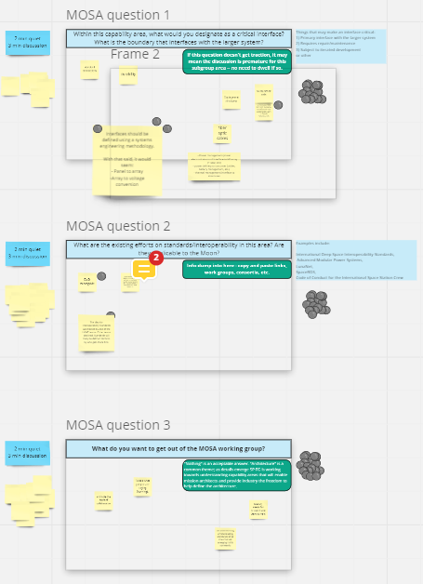
LSIC | Year in Review: February Telecon
Sample Breakout Results: Photovoltaics/Solar Power
Within this capability area, what would you designate as a critical interface? What is the boundary that interfaces with the larger system?
  Panel to array, array to voltage conversions
  Deployment structures
What are the existing efforts on standards/interoperability in this area? Are they applicable to the Moon?
  DoD microgrids
  Currently mixed opinions among teams developing VSAT technologies regarding setting up interoperability standards – these will likely be defined by who gets there first
What do you want to get out of the MOSA working group?
  Promote the spirit of collaboration
  Understand what new ideas are being discussed/worked within the community
  Identify needs for research and development
Theme across all subgroups: the MOSA working group should promote collaboration across both people and technology areas in the community
14
Notes:
Providing a sample of breakout room results just to communicate the general spirit and idea of this telecon, NOT to start a PV-specific discussion

Slide 15
LSIC | Year in Review: March Telecon
Topic: Fuel Cells and Hydrogen Technologies
Date: 24 March 2022
Primary Speaker: Ian Jakupca
  NASA GRC Fuel Cell Technology Lead
Attendees: 37
Other Topics Covered:
  Update on upcoming conferences and funding opportunities
  MOSA Working Group telecon
  LSIC SP Summer Workshop
15
Notes:
Back to Matt

Slide 16
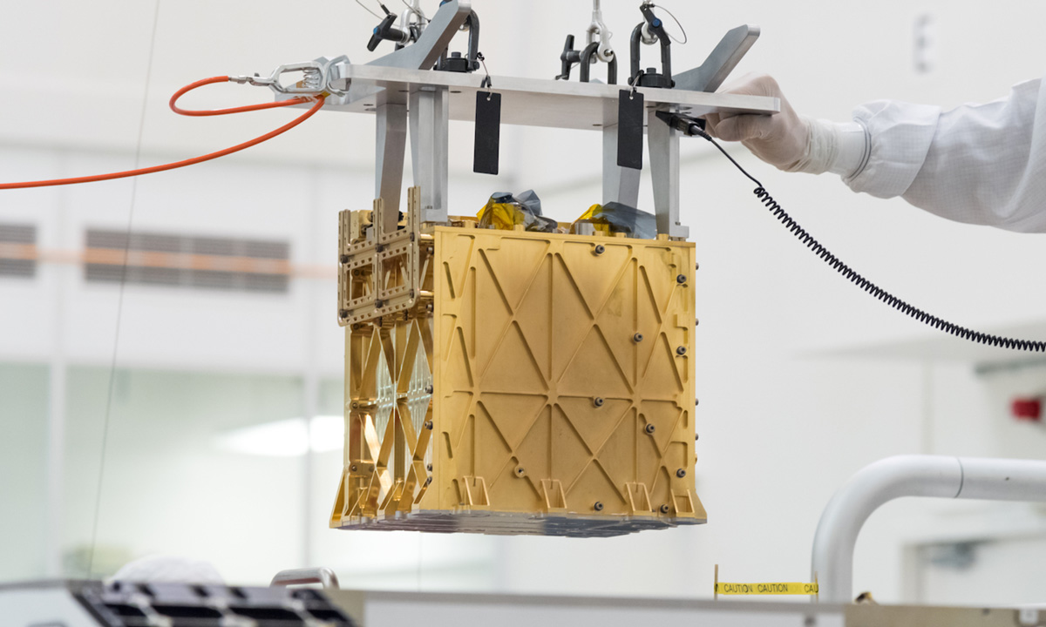
LSIC | Year in Review: March Telecon
Key Takeaways:
Fuel Cells 101:
    Trade-off between complexity of power electronics and safety for manned-missions required for types of technologies
NASA Plans for Fuel Cell Technologies:
  Sustainable power and in-situ resource utilization
  Funding primarily through Artemis Program
    CLPS, and Surface Systems
  Will need to develop and qualify new Fuel Cell systems because previous generation technology has been scrapped.
Electrochemical activities within NASA
  Reactant Generation, Reactant Transfer and Storage, Energy Storage
  Looking for various Lunar/Mars Landers including manned/unmanned applications
16
Notes:
TALK ABOUT MOXIE: 7 successvie runs each of which produced 6 grams of oxygen per hour

Slide 17
LSIC | Year in Review: March Telecon
Discussion Points:
Question: Repair and maintenance are a critical considerations, how is that being considered for these large MW level systems?
Answer: Maintenance is being investigated under the lunar surface habitat project. Filters will need to be changed, and various systematic components might need to be changed more frequently than in terrestrial systems.
Question: Is there a reason why NASA is considering primary fuel cells over RFCs?
Answer: The primary limitation is mass. NASA is focusing on the 100 W to 10 kW RFC to support missions on the lunar surface.
17
Notes:
How is NASA thinking about maintenance for the MW systems???

Slide 18
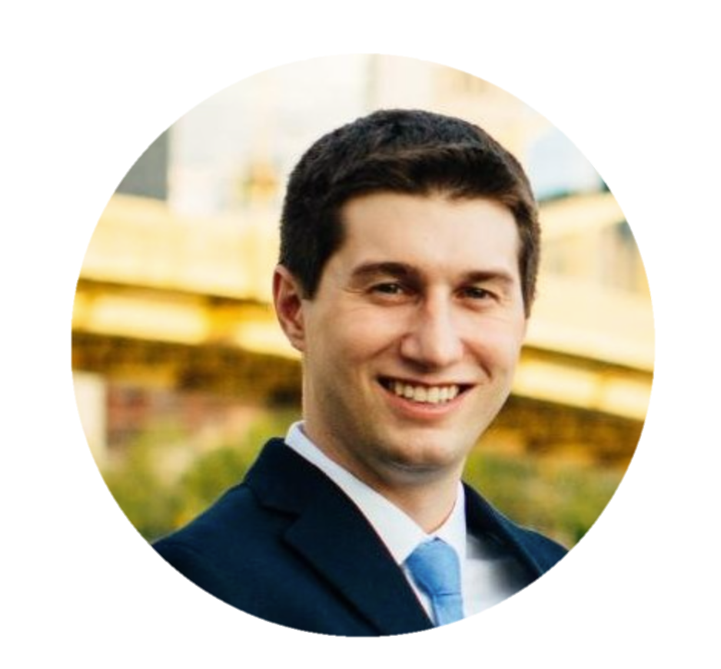
LSIC | Year in Review: April Telecon
Topic: Tethered Power Systems for Lunar Mobility and Power Transmission (TYMPO)
Date: 28 April 2022
Primary Speaker: Ansel Barchowsky
  PI TYMPO, NASA JPL
Attendees: 90
Other Topics Covered:
  MOSA Working Group update
18
Notes:
Over to Sean

Slide 19
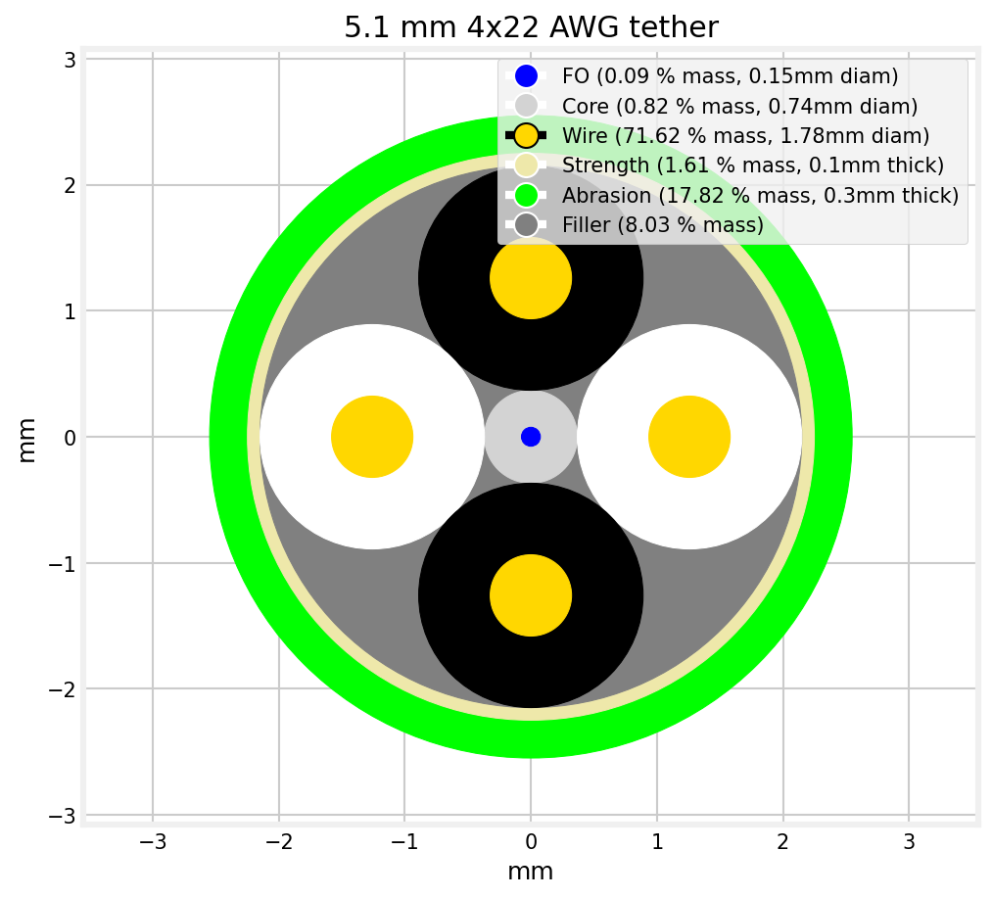
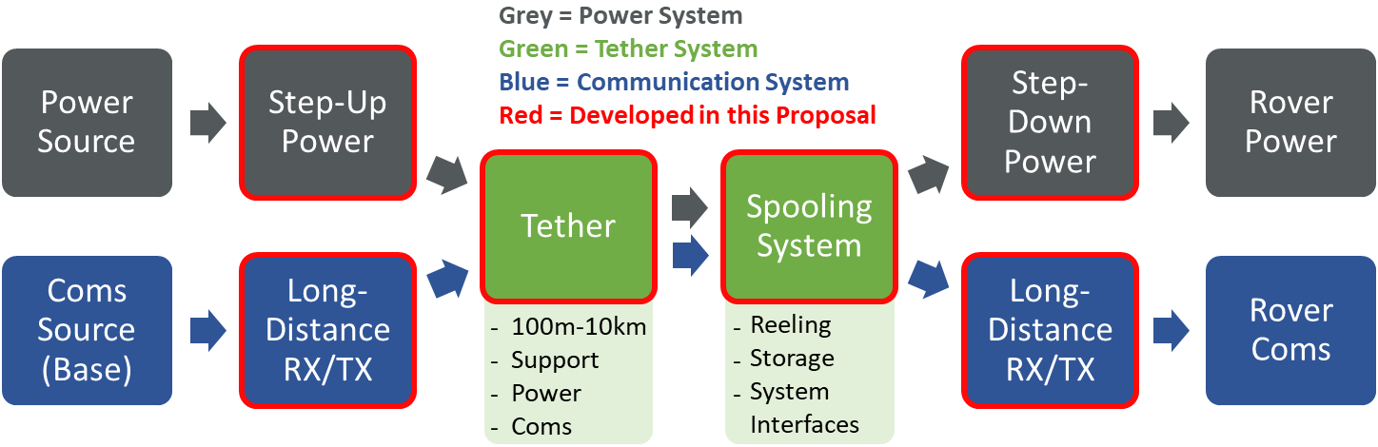
LSIC | Year in Review: April Telecon
Key Takeaways:
Need for power and communications for the Lunar surface, EA robotic applications on Moon and beyond
TYMPO team wanted a solution that could fly today
  5x staged 1:3 DC-DC converters using GaN devices for 1.5 kV output
  Designed to be swapped out with SiC
  High frequency to decrease SWAP
Point solutions, considering lunar environment including:
  Optical occlusion by radiation
  Regolith abrasion
  Thermal tolerance
19

Slide 20
LSIC | Year in Review: April Telecon
Critical Discussion Points:
Question: Concerns with lunar environment, particularly with thermal expansion and ductile-brittle transitions of disparate materials in a 5 km cable
  Answer: Analysis shows that this is a concern during deployment only. Not fully solved. Electronics assumed to be in a thermally controlled environment
Question: How well are the interfaces defined for swapping out DC-DC converters?
  Answer: Converters not attached to the stack at all; should be a standard interface and can use almost any converter type
Looking Forward:
Targeting TRL 6 in 2024, TRL 7 in 2026
20

Slide 21
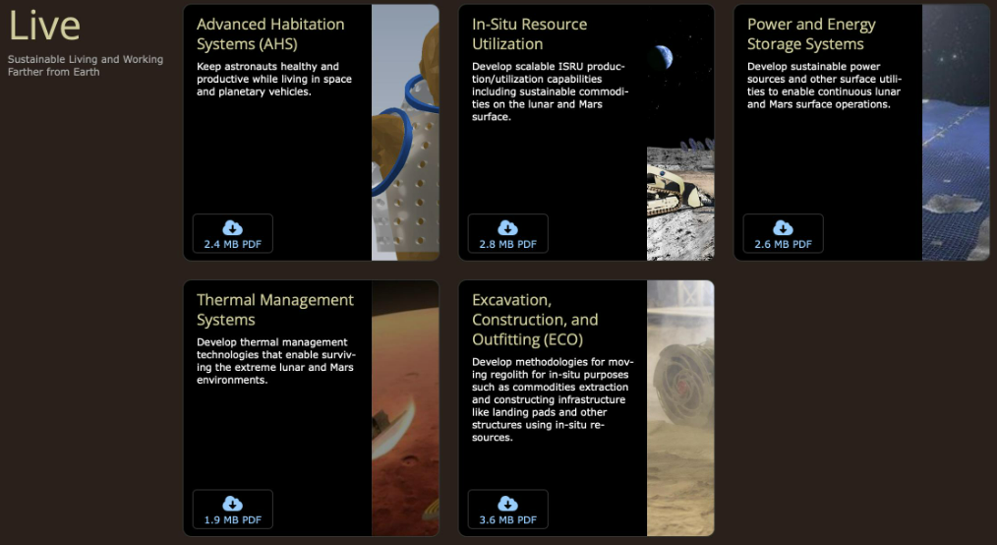
LSIC | Year in Review: May Telecon
Topic: NASA LIVE RFI Breakout Sessions
Date: 26 May 2022
Attendees: 95
Focus on soliciting feedback on the envisioned futures that comprise STMD’S Strategic Framework
  Introduction by Wes Fuhrman
  Breakout sessions organized by areas represented within the POWER Envisioned Future (Power Generation, Power and Energy Storage, PMAD)
Other Topics Covered:
  Watts on the Moon Phase 2
  Tipping Point/ACO (Announcement of Collaboration Opportunity)
  LSSW Workshop- Prosecting/Resource Evaluation
  LSIC SP Summer Workshop
21
Notes:
Sam!

Slide 22
LSIC | Year in Review: May Telecon
NASA “LIVE” Request for Information (RFI) Introduction
NASA’s STMD organizes the agency’s technology into the Strategic Framework, comprised of 18 Capability areas grouped into investments called Thrusts: Go, Land, Live, and Explore in order to address its desired outcomes in these areas through technology development.
NASA is engaging the community to validate and improve the end state described in these envisioned futures. Within “Live”, Power and Energy Storage Systems is the capability area of interest to the LSIC Surface Power Focus Group
Breakout Discussions
Participants were split into subgroups based on areas represented within the POWER Envisioned Future to answer the following questions via Miro boards:
  Is the Envisioned Futures chart inclusive of space community needs for this gap?
  Are the State-of-the-Art summaries complete and accurate or are there technologies that exist that we may not be aware of that satisfy these needs?
  Are the technology gaps stated in the Envisioned Futures chart inclusive of the work needed to reach these Envisioned Futures? What technology advances are not included that would be necessary to reach these goals?
Subgroups and corresponding technology gaps:
  Power Generation (Fission Surface Power, Photovoltaic Arrays, RPS)
  Power and Energy Storage (Grid-Scale Energy Storage, Low Temperature Batteries, Fuel Cells)
  PMAD (Rad-Hard Power Electronics, Transmission Cable Systems, Wireless Power Transmission)
22

Slide 23
LSIC | Year in Review: May Telecon
Key takeaways within each subgroup and technology area:
Power Generation
Power and Energy Storage:
PMAD
Fission Surface Power | Photovoltaic Arrays | RPS
Term ‘mobility’ needs to be clearly defined as well as regulatory obstacles. | Solar Thermal Power (STP) generation technologies should be addressed, as it is most efficient solar energy technology to date. | Thermal properties and heating of RPS systems should be addressed.
Grid-Scale Energy Storage | Low Temperature Batteries | Fuel Cells
Solar thermal energy storage should be addressed and ‘maintenance free’ needs to be clearly defined | Focus on thermal management solutions, or should there be a consideration for lower TRL alternatives to Li-ion batteries? | Is NASA willing to consider O2/H2 RFCs or only LO2/LCH4?
Rad-Hard Power Electronics | Transmission Cable Systems | Wireless Power Transmission
Need for rad hard gat drivers, power transistors and diodes, and electromagnetic switchgear components should be addressed as well as reason behind voltage limited to 1 kV. | AC vs DC power transmission should be addressed. | Dust mitigation should be addressed, as well as well as consideration of different sources, efficiency, and loss of power (wireless/wired, 75% make/break threshold of efficiency, and dissipation of losses in radiators).
23

Slide 24
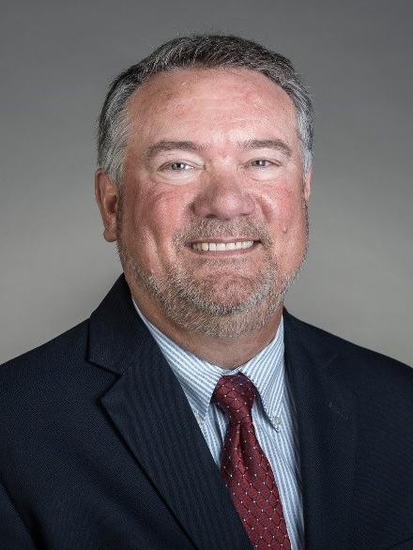
LSIC | Year in Review: June Telecon
Topic: Power Standards Governance Process
Date: 25 June 2022
Primary Speaker: Martin Narendorf Jr.
  Vice President of Engineering and Asset Optimization, Centerpoint Energy
Attendees: 110
Other Topics Covered:
  LSIC Survey
24
Notes:
Back to Sean

Slide 25

LSIC | Year in Review: June Telecon
Key Takeaways:
Large body of terrestrial power grid standards to draw upon
  Lunar surface requirements radically different, but could start with applicable subset in the early development
  Can be done in stages as grid grows in capacity
Interconnectivity between assets (generation, point-of-load converters, etc.) important for scalability
Robust grid-scale testing required; somewhat different than that needed for spacecraft (bespoke vs. production-scale)
Initial studies by Centerpoint Energy looked at a ring of power stations/transmission cables surrounding the Lunar South Pole
25

Slide 26
LSIC | Year in Review: June Telecon
Critical Discussion Points:
Centerpoint’s idea of a “Standard” may be more inclusive than those in LSIC; each should be mindful of the other
  Technologists focus on power quality, voltage, and connectors
  Grid operators have safety, geographic layout, and other metrics in mind
  Astronaut and asset safety concerns (e.g. how will cable crossing points be determined? )
  Who owns the grid? How will new participants be onboarded?
Looking Forward:
Centerpoint to continue working with NASA JSC on lunar power system design
26

Slide 27
LSIC | Year in Review: July – Low Temperature Workshop
Topic: Low Temperature Power and Energy Storage
Date: 28 July 2022
6-hour virtual workshop included:
  Overview of lunar thermal environments
  Panel discussion with representatives from various industry and academia perspectives
  Lightning talks to rapidly survey new technologies
  Presentation on low-temperature batteries from Dr. Marshall Smart at JPL
  3 breakout discussions targeting specific scenarios at different power regimes
Attendance Statistics:
  Registered: 204
    Academia: 33 (16%)
    Government: 60 (29%)
    Industry: 88 (43%)
    Nonprofit: 21 (10%)
    Other: 2 (1%)
  Attended: 129
    JHUAPL: 26
    NASA: 54
27
Notes:
Julie

Slide 28
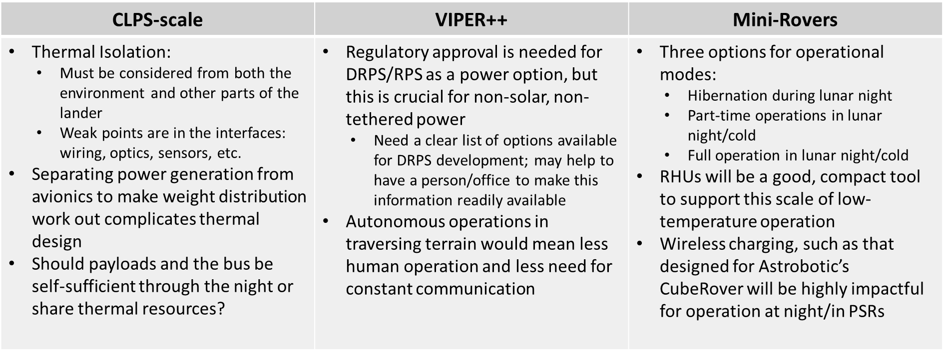
LSIC | Year in Review: July – Low Temperature Workshop
Breakout Scenario Takeaways: workshop participants collaborated via Miro boards to address challenges at different scales of power
28

Slide 29
LSIC | Year in Review: July – Low Temperature Workshop
Overall Workshop Themes:
  There is a need to probe the regulatory framework for launching alternative radioisotopes. The technology is understood and will be impactful once it clears regulatory hurdles.
  Delivering anything beyond modest levels of continuous power (10’s of W_{e}) through the lunar night will be hard in the near/mid-term.
  Minimal operational modes/survival would be viable at these and lower levels, and efforts towards achieving this will deliver high-value in the near term.
  If payloads can draw on small-scale power through the night and expect full power and comms to return, the scope of the possible opens up dramatically. This is possible in the near term.
Key Takeaway: We have solved the problem of surviving the lunar night/extreme cold temperatures. The community is now addressing the question of operating through these extremes, demonstrating an encouraging growth in goals for the problem of low-temperature power and energy storage.
29

Slide 30
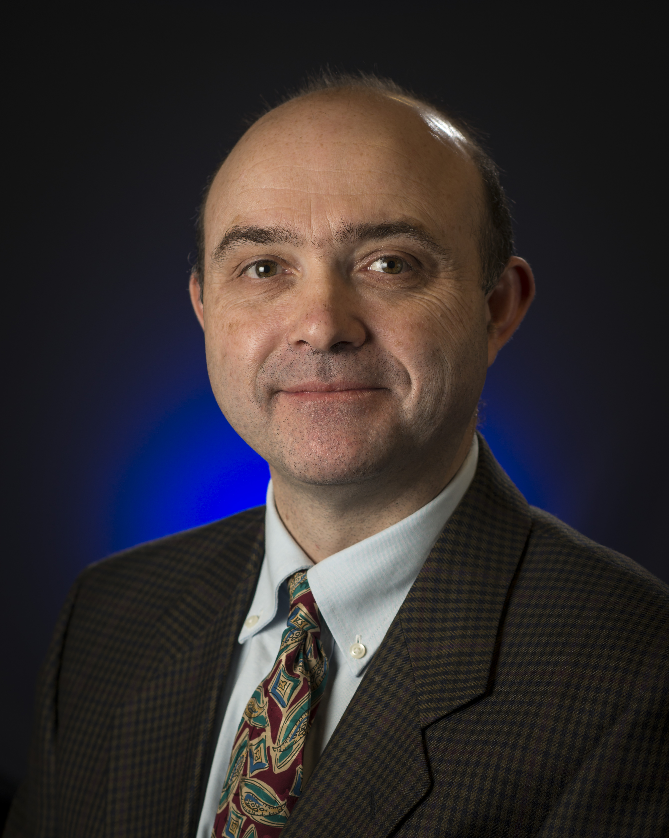
LSIC | Year in Review: August Telecon
Topic: Data Buys Rapid Networking
Date: 25 August 2022
Primary Speaker: Dr. Ben Bussey
  JHU/APL, LSII Lead
Attendees: 91
Other Topics Covered:
  Artemis Landing Sites announced
  VSAT Phase 2 Awards (Astrobotic Technology, Honeybee Robotics, Lockheed Martin)
  Watts on the Moon Phase 2 Challenge
  Low-Temperature Workshop Debrief (Julie Peck, JHU/APL)
30

Slide 31
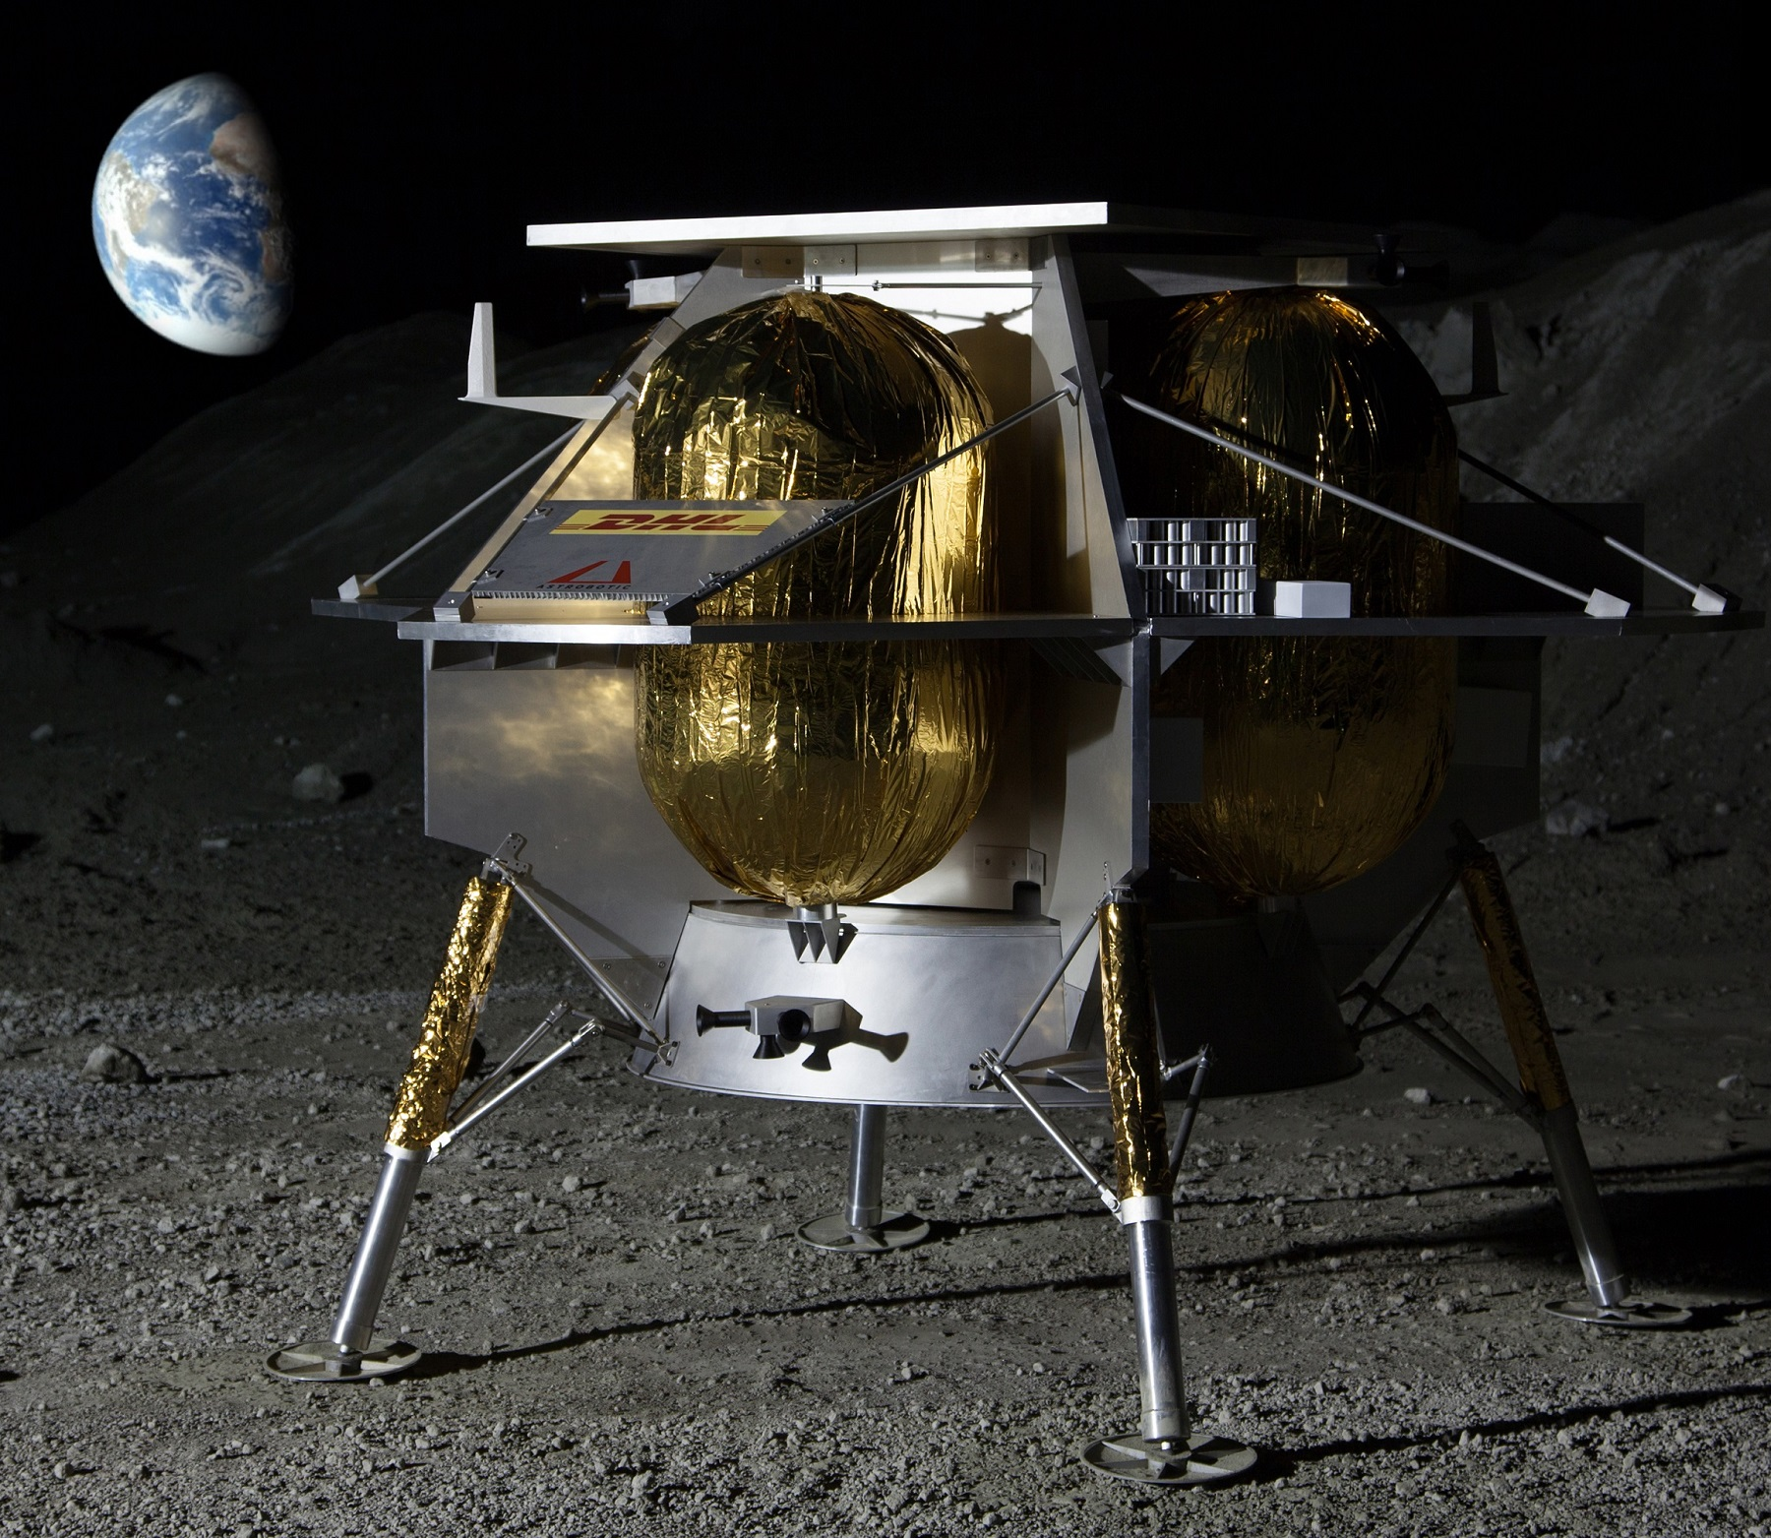
LSIC | Year in Review: August Telecon
Key Takeaways (Data Buys):
NASA keenly interested in conducting data buys from commercial providers:
  Data acquired as a by-product of landing
  Data from a specific instrument
Data types:
  Environmental
  Descent & Landing Imagery
  Landing & Post-landing effects (e.g.: plume)
  Technology/System performance
How is a data set valued?
  Is there a different financial value for different data qualities?
31
Notes:
2 types of data: by-produce of landing or specific instrument

Slide 32
LSIC | Year in Review: August Telecon
Critical Discussion Point:
John Scott: “I was surprised at how few of these (Watts on the Moon Phase 1 Awardees) were wireless. I think that had to do with the fact that we did not require them to follow a mobile target. (…)When you think about it, that’s kind of obvious. (…) It is a matter of how much you think your cable weighs versus the inefficiencies of the wireless system, there is a tradeoff there, but its still interesting how it came out”
Looking Forward:
The SP Focus Group is planning additional networking sessions for 2023
We are also working to build additional networking features and community engagement tools into the LSIC website
32
Notes:
In this Challenge, Teams will propose solutions for energy distribution, management, and/or storage that address NASA technology gaps

Slide 33

LSIC | Year in Review: September Telecon
Topic: Joint MOSA and Surface Power Telecon- ISPSIS Standards
Date: 22 September 2022
Primary Speakers: Nicolas Carbone and David Sadey
  AST, Electrical Power Systems, GRC
Attendees: 103
Other Topics Covered:
  Solicitations and Awards
  NASA RFIs
  APS4PS Conference Debrief
33
Notes:
Over to Sam

Slide 34
LSIC | Year in Review: September Telecon
International Deep Space Interoperability Standards (ISPSIS) Takeaways:
Purpose is to establish interoperable interfaces, terminology, and technique to facilitate collaborative endeavors of space exploration in cis-lunar and deep space environments.
The standards define a bus voltage power quality, and grounding approach to ensure commonality, reliability, safety , interchangeability, and interoperability for load applications between space application power systems.
  Applies to any space power system that utilizes 120Vdc and/or 28Vdc class power.
Defines requirements as well- general, normal, and abnormal.
Significant Changes from Revision A include:
  Changing large signal stability test and verification for 120V and added 28V.
  Numeric modifications to 120V EPS ripple voltage requirements.
  Addition of 28V requirements in addition to original 120V requirements.
Future work includes Revision B:
  Add regulated 120Vdc and 28Vdc EPS Performance
  Survey upcoming technology advancements and assess updates to Ripple Voltage System Requirements
34

Slide 35
LSIC | Year in Review: September Telecon
Critical Discussion Points:
Question: Are there plans for similar plans for larger voltages? Smaller voltages?
Answer: No, there are other programs that are looking at higher voltage applications as well as lower. ISPSIS is only concerned with 28-120V
Question: How will these standards be ‘enforced’?
Answer: Gateway has specification, and NASA made this for commonality-enforced programs and in order for the system to work, it has to abide by ISPSIS. Programs typically have lower level standards as well that also need to be acknowledged
ISPSIS will really help design systems if they want to interface with the Artemis moon base. If they don’t need to interface, there is more design freedom.
35
Notes:
Question: Are there any bounds for the max/min switching frequency of converters?
Answer: No, don’t define that specifically. It would have to go into the filter design to be compliant with the ripples spectrum limits provided
Question: Lessons learned were taken from ISS, could you elaborate on past issues that influence the current standards.
Answer: Wide voltage range wasn’t compliant with new system performance, effort on stability requirements was a result as well. Most of the requirements were enhanced by ISS requirements
Question: What types of equipment would abide by this standard?
Answer: Any equipment designed in the future should comply to this standard, that’s the goal.
Question: Are there plans for similar plans for larger voltages?
Answer: No, there are other programs that are looking at higher voltage applications.
Question: In regards to maintainance, is there management for autonomous systems for fault detection/prediction?
Answer: Not defined in ISPSIS, but issues are being researched within other efforts.
Question: How will these standards be ‘enforced’
Answer: Gateway has specification, and NASA made this for commonality purposed- enforced on programs and in order for the system to work, it has to abide by ISPSIS. Programs typically have lower level standards as well.

Slide 36
LSIC | Year in Review: October Telecon
Topic: Power Integration & Testing Perspectives
Date: 27 October 2022
Speaker: Annette Dolbow
  Johns Hopkins Applied Physics Laboratory, Integration & Test Group
Speakers: Lee Mason & Jeff Csank
  NASA Glenn Research Center
Attendees: 98
36
Notes:
Sean

Slide 37
LSIC | Year in Review: October Telecon
Key Takeaways (Power I&T perspectives):
Annette gave an overview of how power systems are tested for spacecrafts today
  Large body of knowledge to draw upon for power I&T for spacecraft
  Testing of individual components (sources, storage) coupled with testing of whole subsystems, coupling with other spacecraft systems, etc.
Critical Discussion Point:
Biggest risks that are non-technical tend to be schedule (e.g. depth of discharge battery testing)
Sometimes mass/mass distribution constraints force creative design solutions
37

Slide 38
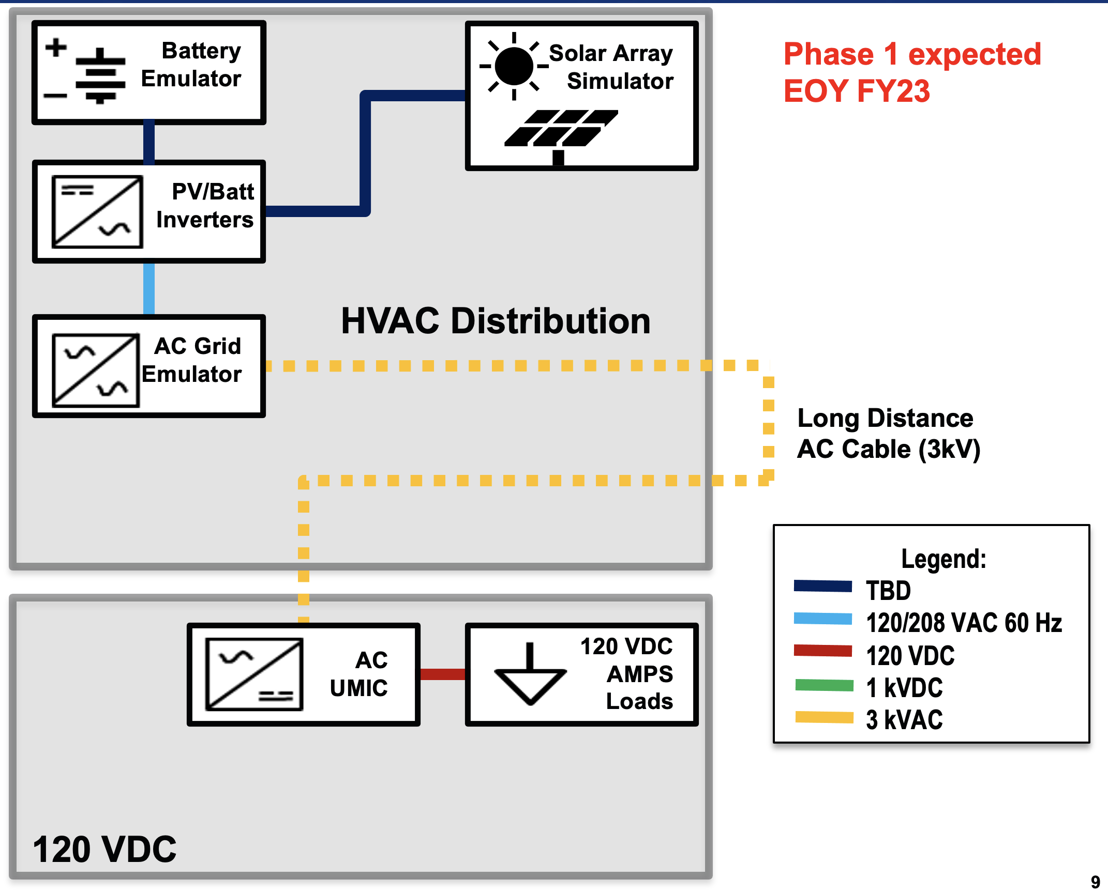
LSIC | Year in Review: October Telecon
Key Takeaways (ASPIRe):
ASPIRe to serve as a testbed for government, academia, and industry
Evaluate how various power projects will integrate into a Lunar power grid
Initial implementation over the next year, but will grow in capability over time
Looking Forward:
First testing capabilities targeted for the end of FY23
Provide feedback to Lee and Jeff:
  https://lsic-wiki.jhuapl.edu/display/SP/27+October+2022
  lee.s.mason@nasa.gov
  jeffrey.csank@nasa.gov
38

Slide 39

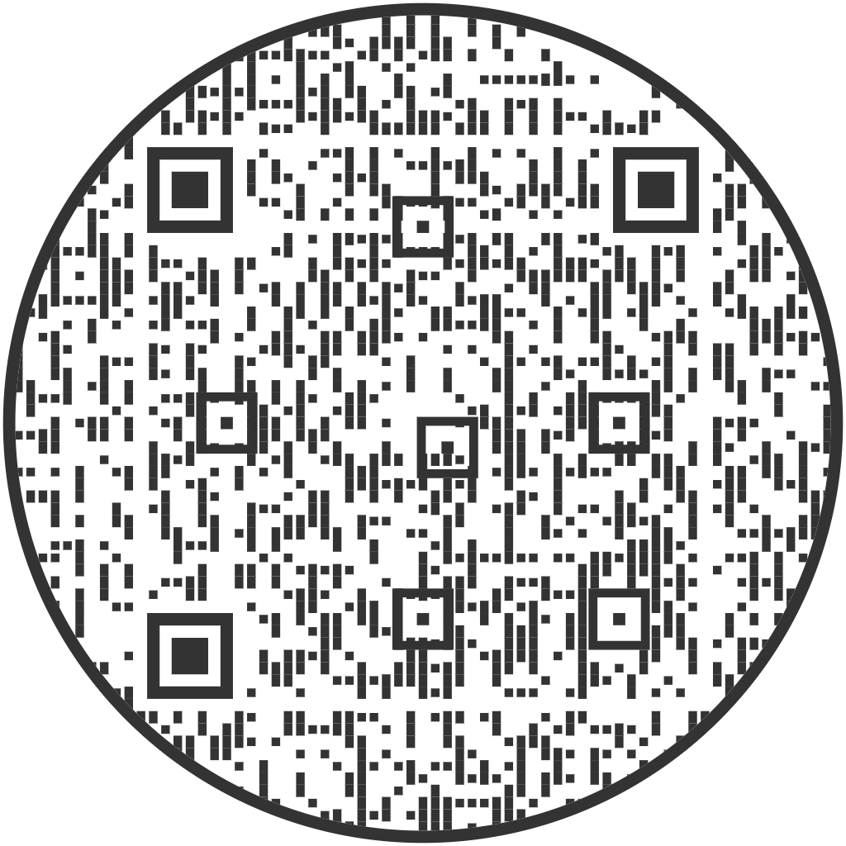
LSIC | LSIC Surface Power 2022 Survey
Please use the QR code, or follow the link in the chat to access our survey
39
Notes:
https://docs.google.com/forms/d/e/1FAIpQLSddxov3KmD6dDomdDpQkFJBQaoAKCmEYtnoDUeEAz2b2ZOJDQ/viewform?usp=sf_link
https://docs.google.com/forms/d/e/1FAIpQLSddxov3KmD6dDomdDpQkFJBQaoAKCmEYtnoDUeEAz2b2ZOJDQ/viewform?usp=sf_link

Slide 40
LSIC | Open Discussion
Is there a technology gap (or a gap within the gaps) that NASA is missing?
Do you see any parallel efforts (e.g.: DoD projects, NASA projects, commercial undertakings) in your industry/field, and is there a problematic potential for duplication of work?
40

