Slide 1
Extreme Access Focus Group Telecon
January 12, 2023
We’ll start around 3:03
Sarah Withee
Extreme Access Focus Group Facilitator
JHU Applied Physics Laboratory
Facilitator_ExtremeAccess@jhuapl.edu

Slide 2
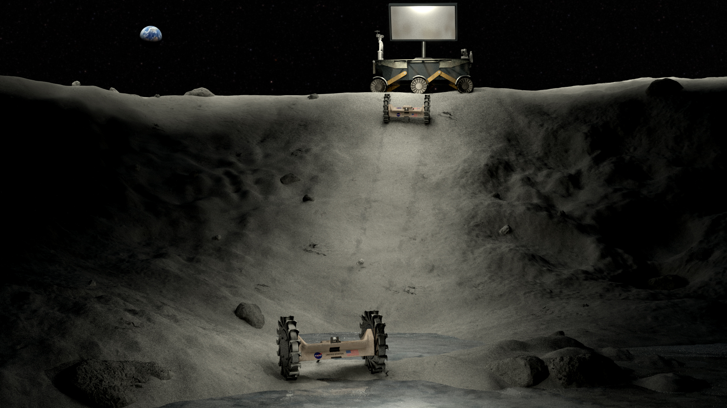
Today’s Agenda
LSIC EA Focus Group Updates
Announcements
Upcoming Meetings/Opportunities
NASA SBIR/STTR Webinar – Sonia Vohnout, Oppsspot

Slide 3
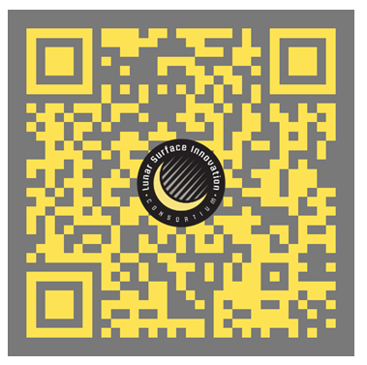
Save the Date! LSIC 2023 Spring Meeting
Wednesday March 29 – Thursday March 30, 2023
Abstracts Due: 03 February
Registration opens in February
Hybrid Meeting, in-person events taking place at Johns Hopkins University Applied Physics Lab in Laurel Maryland
More info:
https://lsic.jhuapl.edu/Events/Agenda/index.php?id=380

Slide 4
Subgroup updates
Comms subgroup meeting Wednesday January 18 4 pm ET – Erik Luther Cesium Astro
PNT subgroup Thursday January 19 3 pm – 5 pm ET – Lunar Trajectory Design workshop by John Carrico Space Exploration Engineering
PNT paper reading group Monday January 23 at 4 pm ET.
Paper is Lunar Navigation Beacons: Technology Development and Applications
Download from https://lsic-wiki.jhuapl.edu/display/EA/Paper+Suggestions
Or email Danielle.Mortensen@jhuapl.edu to get a copy if you don’t have access to Confluence
Mobility subgroup is meeting Thursday January 26 1 - 2:30 pm ET. Speaker is Kevin Kempton
https://lsic-wiki.jhuapl.edu/pages/viewpage.action?spaceKey=EA&title=Guest+Talks+-+Calendar+Year+2023

Slide 5
LSIC pilot mentorship program
LSIC is starting up a mentorship program, and we are looking for two people to serve as mentors in lunar PNT
Time commitment: one-two hours per month for six months starting in February
Application available at https://forms.gle/j68vPC7fN938ZfkA9

Slide 6
Funding Opportunities Spotlight
Sonia Vohnout, Oppsspot
NASA SBIR Proposals

