Slide 1
Extreme Environments Focus Group
January Meeting
January 10, 2023
Jamie Porter, PhD
Johns Hopkins Applied Physics Laboratory
Facilitator_ExtremeEnvironments@jhuapl.edu

Slide 2
Today’s Agenda
LSIC Updates
LSIC 2023 Spring Meeting
NASA SBIR/STTR Webinar
Featured Discussion
  Small Business Technology Transfer (STTR)
Miro Board

Slide 3
LSIC Updates
Funding Opportunities
NASA Innovation Corps Pilot
  https://nspires.nasaprs.com/external/solicitations/summary.do?solId=%7b1B42E782-61BB-9834-F20F-44CBEF13C0A6%7d&path=&method=init
  Proposals may be submitted at any time through March 29, 2023
  Applications will be reviewed in intervals but last date is Jan 20, 2023
NASA Innovative Advanced Concepts (NIAC) Phase II Call for Proposals
  https://nspires.nasaprs.com/external/solicitations/summary.do?solId={0DD3E590-F13D-B4D4-0D48-56D01BE377B9}&path=&method=init
  Proposals due: January 18, 2023
2023 Phase I SBIR and STTR Solicitations
  https://sbir.nasa.gov/solicitations
  Open on Jan. 10, 2023 & Closes on March 13, 2023
Please visit LSIC website for full list
http://lsic.jhuapl.edu/Resources/Funding-Opportunities.php

Slide 4


LSIC Spring Meeting
March 29th – 30th at Johns Hopkins Applied Physics Lab
Abstracts are due Feb. 3rd. Registration will open in Feb.!
*Please remember to utilize the abstract template provided on webpage…

Slide 5
EA NASA SBIR/STTR Webinar
Thursday January 12 @ 3 pm ET
Join this webinar to learn more about the program, how to apply, and how to write a compelling proposal to NASA.
The primary objectives of this workshop are to:
  Provide an overview of the SBIR/STTR program
  Introduce the NASA SBIR/STTR Solicitation and registrations
  Review the Proposal Package and Technical Proposal content
  Provide the basics to submit a full SBIR or STTR proposal to NASA
  Discuss Technical Merit and Evaluation Criteria
  Discuss other resources that the NASA SBIR/STTR program provides
If you are a US small business with an idea that can have a profound impact on people, industries and the world and space, don’t miss the opportunity to learn how you can be awarded to over $2 million dollars in non-dilutive funding and register today!

Slide 6
NASA SBIR/STTR Programs
Funding program eligible for small businesses with 500 or fewer employees or a non-profit research institution (RI), such as a university or a research laboratory
Research, development, and demonstration of innovative technologies that fulfill NASA needs and have significant potential for successful commercialization
  SBIR: Small Business Innovation Research ~$3.2 billion minimum spend each year
  STTR: Small Business Technology Transfer *Small business must formally partner with a research institution ~ $450 million minimum spend each year
Who, what, and how to qualify for SBIR/STTR?
  Company must be for profit, U.S. owned/operated, and under 500 people
  Work must be done in the U.S.
  Focus is on performing R&D – Not purchasing equipment, commercializing a technology that has already been developed, or one that has very low risk and only needs capital
Goals
  Meet federal research and development needs
  Increase private-sector commercialization of innovation derived from federal research and development funding
  Stimulate technological innovation
  Foster and encourage participation in innovation and entrepreneurship by women and socially/economically disadvantaged individuals
  Foster technology transfer through cooperative R&D between small businesses and research institutions (STTR)

Slide 7
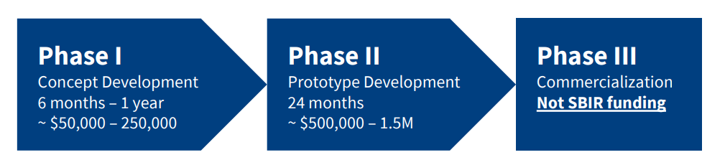
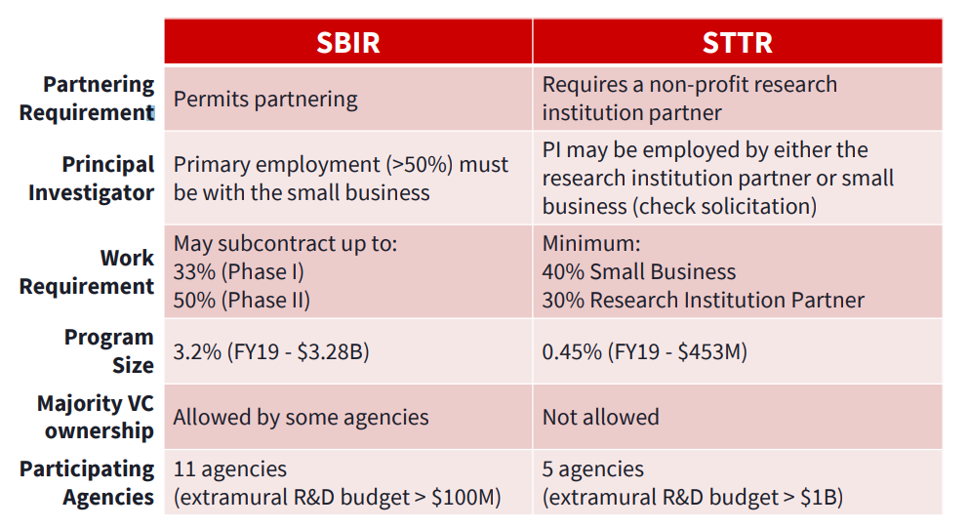
NASA SBIR/STTR Programs
Who are phases broken down?
What are the differences between SBIRs and STTRs?

Slide 8
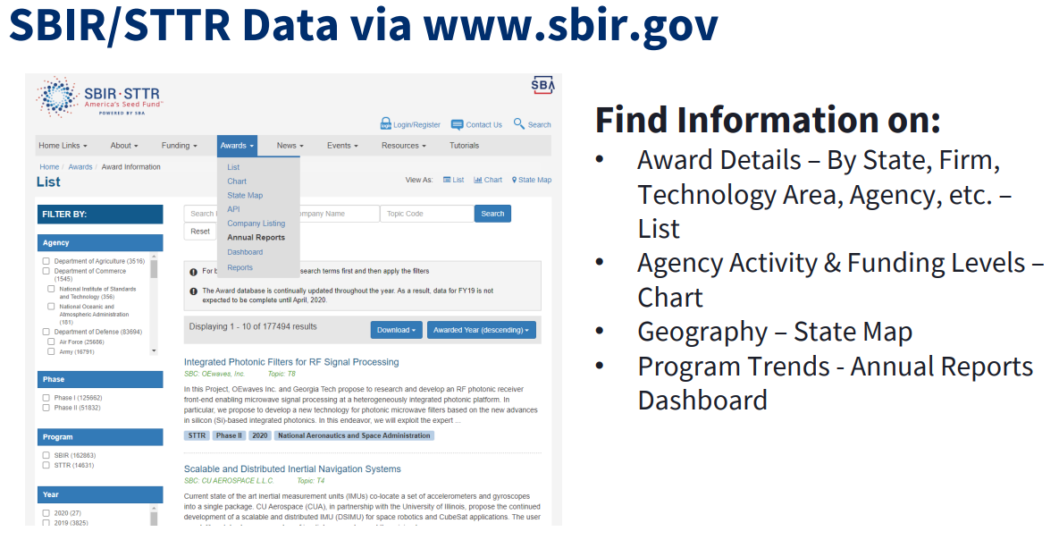
NASA SBIR/STTR Programs

Slide 9
Current Exercise
LSIC EE Goals
  Identify Space Technology Mission Directorate (STMD) subtopics that fall under the EE focus area
  Educate community on NASA calls and desirable technology concepts
  Discuss 2023 SBIR/STTR calls
  Host SBIR/STTR awardee talks on funded technology and development status
  Support community discussions and collaborations
2022 NASA STMD STTR Calls Under EE Umbrella
Textiles for Extreme Surface Environments and High Oxygen Atmospheres
T6.08
Lunar Surface Site Preparation
T7.04

Slide 10
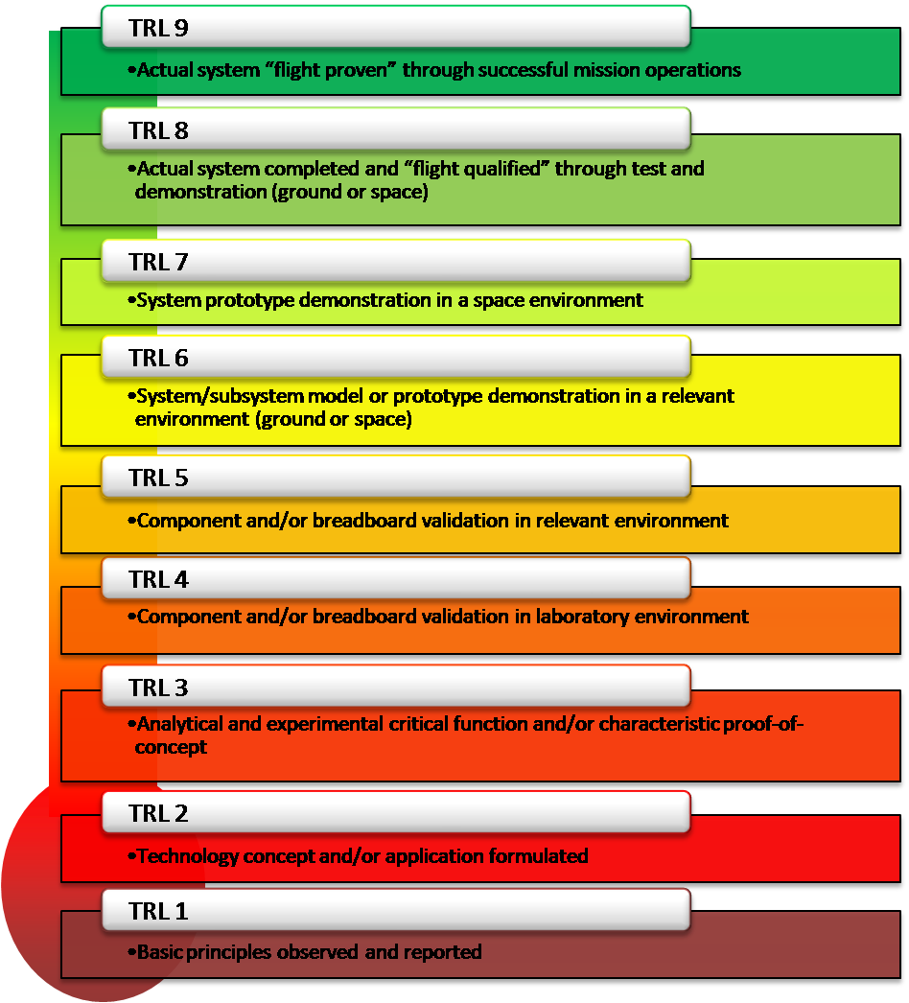
TRL Level Reminder

Slide 11
Lunar Surface Site Preparation
Develop lunar civil engineering technologies (designs, processes, etc.) that produce structures composed of bulk regolith and rocks, and to develop concepts of operations (ConOps) for their construction in the south polar region of the Moon.
Specific innovations being sought in this solicitation are described below:
  Bulk regolith-based launch/landing zones designed to minimize risks associated with landing/launching on unprepared surfaces for (Commercial Lunar Payload Services) CLPS and (Human Landing System) HLS vehicles
  Rocket Plume Surface Interaction (PSI) ejecta and blast protection structures
  Regolith base and subgrade for supporting hardened launch/landing pads, towers, habitats and other in situ constructed structures
  Pathways for improved trafficability
  Solar Particle Event (SPE) and Galactic Cosmic Ray (GCR) shielding structures
  Structures for access to subgrade (e.g., trenches, pits)
  Emplaced regolith overburden on structures and equipment
  Meteoroid impact protection structures
  Topographical features for terrain relative guidance for flight and surface vehicles
  Flat and level operational surfaces for equipment positioning, regularly accessed locations, and dust mitigation applications
  Sloped regolith ramps for access to challenging locations
  Utility corridors (e.g., electrical, comm, fluids)
  Shade structures
  Elevated operational surfaces
Expected TRL or TRL Range at completion of the Project: 2 to 5

Slide 12
Lunar Surface Site Preparation
Desirable Technology Concepts | 2018 | 2019 | 2020 | 2021 | 2022
Bulk regolith-based launch/landing zones designed to minimize risks associated with landing/launching on unprepared surfaces for CLPS and HLS vehicles |  |  |  |  | 
Rocket Plume Surface Interaction (PSI) ejecta and blast protection structures |  |  |  |  | 
Regolith base and subgrade for supporting hardened launch/landing pads, towers, habitats and other in situ constructed structures |  |  |  |  | 
Pathways for improved trafficability |  |  |  |  | 
Solar Particle Event (SPE) and Galactic Cosmic Ray (GCR) shielding structures |  |  |  |  | 
Structures for access to subgrade (e.g., trenches, pits) |  |  |  |  | 
Emplaced regolith overburden on structures and equipment |  |  |  |  | 
Meteoroid impact protection structures |  |  |  |  | 
Topographical features for terrain relative guidance for flight and surface vehicles |  |  |  |  | 
Flat and level operational surfaces for equipment positioning, regularly accessed locations, and dust mitigation applications |  |  |  |  | 
Sloped regolith ramps for access to challenging locations |  |  |  |  | 
Utility corridors (e.g., electrical, comm, fluids) |  |  |  |  | 
Shade structures |  |  |  |  | 
Elevated operational surface |  |  |  |  | 

Slide 13
New Textiles for Extreme Surface Environments & High Oxygen Atmospheres
NASA has been working on a new spacesuit to protect the astronauts from the harsh environment of space.
Designed for lunar surface exploration and operations in extreme environments.
Addresses the primary need to develop new textiles for the xEMU Environmental Protection Garment (EPG).
Specific requirements for EPG:
  Thermal:
    Ratio of solar absorptivity to infrared emissivity (α/ε) of 0.21
    Solar absorption of 0.18
  Physical:
    Priority on the outermost layer that limits dust accumulation and penetration.
    Properties such that the regolith particles of microns and submicrons sizes cannot penetrate the EPG
    External surface of the outermost layer shall have low energy and a nanotexture that prevents entrapment of most regolith particles.
    Opportunities for mass reduction for the entire EPG shall be investigated against the International Space Station (ISS) EMU3.
    All materials directly exposed to the lunar lander atmosphere are required to be flame retardant
  Mechanical with respect to mobility:
    EPG shall not significantly affect mobility of the suit
    EPG fabrics must be flexible with both low bending and low torsional stiffness to withstand exposure to the extreme temperatures of 260 °F (127 °C) to -292 °F (-180 °C)
    The EPG fabrics shall not outgas at vacuum.

Slide 14
New Textiles for Extreme Surface Environments and High Oxygen Atmospheres (continued)
Extreme Surface Environment requirements for EPG:
  Thermal:
    Extreme heat (260 °F, 127 °C)
    Extreme cold (-292 °F, -180 °C)
  Regolith Terrain
    EPG fabrics must have sufficient resistance to abrasion and tear to last for multiple uses.
    In the south pole region of the Moon, the regolith is:
      Highly abrasive; spacesuit must operate during prolonged exposure and operation in the dusty regolith environment.
      Elecrostatic and triboelectrostatic properties of the lunar dust particles are so averse to the outer layer of the EPG that they promote abrasion and wear necessitating the development of new EPG outer fabrics; there is a risk that these charged particles can be carried inside and contaminate the lunar lander.
  Radiation and Plasma
    Annual Galactic Cosmic Rays dose in milli-Sieverts (mSv) on the Moon is 380 mSv (solar minimum) and 110 mSv (solar maximum)
    The annual cosmic ionizing cosmic radiation on Earth is 2.4 mSv
    EPG layers and particularly the outer layer fabric must be durable over hundreds of hours of VUV radiation exposure without a reduction in functionality
  Atmosphere
    Oxygen rich environment
  Expected TRL or TRL Range at completion of the Project: 2 to 6

Slide 15
Test Facilities
Desirable Technology Concepts | Facility Type Required | Availability (Active or Not Available) | Comments
Active/Passive Dust Mitigation (brushing; electrostatic and electrodynamic removal; jets; spinning and/ vibrational surfaces)
Mechanisms for Extreme Environments (Actuators & power transfer components; Fastening, joining & securing components & hardware; Sealing materials & techniques for regolith & operate; Dust-tolerant fluid & electrical connectors; Moving component for dust protection; Tools and devices for exploration and ISRU; Material handling & transportation components)
Cryogenic Fluid Management (High-pressure-ratio compressor for on-orbit gas transfer of supercritical xenon and helium; Cryogenic flight-weight valve systems; Subgrid computational fluid dynamics (CFD) of the film condensation process; Heat flux sensors capable of measuring heat fluxes between 0.1 and 5.0 W/m2 for cryogenic applications)
Cryogenic Systems for Sensors and Detectors (Cryogenic/Rad-Hard Accelerometers; Ultra-lightweight Dewars; Low-Temperature/High-Efficiency Cryocoolers; Actuators and Other Cryogenic Devices; Miniaturized/Efficient Cryocooler Systems; Sub-Kelvin Cooling Systems)

Slide 16
Test Facilities (continued)
Desirable Technology Concepts | Facility Type Required | Availability (Active or Not Available) | Comments
Thermal Control Systems (Heat Pumps for High-Temperature Sink Environments; Advanced Manufacturing of Loop Heat Pipe Evaporator; Approaches and Techniques for Lunar Surface Payload Survival; Coatings for Lunar Regolith Dust Mitigation for Thermal Radiators and Extreme Environments)
Extreme Environments Technology (Wide-temperature-range precision mechanisms; Rad-hard electronics for precision actuators and sensors; Wide temperature range feedback sensors with sub-arc-second/nanometer precision; Long-life, long-stroke, low-power, and high-torque force actuators with sub-arcsecond/nanometer precision; Long-life bearings/tribological surfaces/lubricants; Low-power and wide-operating-temperature radiation-tolerant /radiation hardened RF electronics; Rad-hard electronics for space-borne system such as guidance and navigation avionics and instruments; Radiation-tolerant/radiation-hardened power electronics; Rad-hard electronic packaging)

Slide 17
Test Facilities (continued)
Desirable Technology Concepts | Facility Type Required | Availability (Active or Not Available) | Comments
Energy Storage (Primary and secondary battery systems spanning -230°C to +120°C with combined high specific energy and energy density; Mechanical or magnetic energy storage devices; Long duration energy storage with high-capacity, high-energy density and very high reliability; Primary and regenerative fuel cells and rechargeable batteries; Electrolyzers that generate sufficient reactant to support fuel cell operation with capability of >15% margin, efficiency >70% at 1,500 W/kg, sustained operational pressure of ≥ 2,000 psig, and long life; Radiation-hardened (1 Mrad TID) coulomb integration application-specific integrated circuits or hybrid circuits; Computational models that can predict state of charge/state of health for primary cells; Nondestructive instrumentation that can detect state of charge/state of health for primary and secondary cells)
Rad-Tolerant High-Voltage, High-Power Electronics (High-voltage, high power solutions for power distribution systems; High-voltage, low-power solutions for low-mass, low-leakage, high-efficiency applications; High-voltage, low- to medium-power solutions for peak-power solar tracking systems)

Slide 18
Test Facilities (continued)
Desirable Technology Concepts | Facility Type Required | Availability (Active or Not Available) | Comments
Lunar Surface Site Preparation ((Bulk regolith-based launch/landing zones designed to minimize risks associated with landing/launching on unprepared surfaces for CLPS & HLS vehicles; Rocket Plume Surface Interaction ejecta & blast protection structures; Regolith base & subgrade for supporting hardened launch/landing pads, towers, habitats & other in situ constructed structures ;Pathways for improved trafficability; Solar Particle Event & Galactic Cosmic Ray shielding structures ;Structures for access to subgrade (e.g., trenches, pits); Emplaced regolith overburden on structures & equipment; Meteoroid impact protection structures; Topographical features for terrain relative guidance for flight & surface vehicles ;Flat & level operational surfaces for equipment positioning, regularly accessed locations, & dust mitigation applications; Sloped regolith ramps for access to challenging locations; Utility corridors; Shade structures; Elevated operational surface)
Textiles for Extreme Surface Environments and High Oxygen Atmospheres (xEMU Environmental Protection Garment )

