Slide 1


LSIC Surface Power Telecon
January 26th, 2023
Begins at 11:03
Matt Clement, Ph.D.
Johns Hopkins Applied Physics Laboratory
Space Exploration Sector
matt.clement@jhuapl.edu

Slide 2

LSIC | Agenda
Community Updates
  Solicitations and Awards
  Conferences/Workshops
    LSIC Spring Meeting
  Surface Power 2022 Survey and 2023 activities
NASA Intro (Lee Mason)
Intuitive Machines/X-Energy Presentation (Peter McGrath)
Westinghouse Presentation (Joe Halackna)
Lockheed Martin Presentation (Mikaela Blood)
Panel Discussion and Q&A
2

Slide 3
LSIC | Solicitations and Awards
Space Tech Solicitations (https://www.nasa.gov/directorates/spacetech/solicitations)
NASA SBIR/STTR Solicitations
Proposals due March 13, 2023
LuSTR 2023 Opprotunities
NOIs due March 23, full proposals due April 24
NASA Innovative Advanced Concepts (NIAC) 2023 Phasee I Call for Proposals
Next Call for proposals in February 2023
Early Career Faculty STMD Research Grants
Solicitation release planned in February 2023
Early Stage Innovation Solicitation
Solicitation release planned in April 2023
3

Slide 4
LSIC | Upcoming Meetings and Workshops
FAA Commercial Space Transportation Conference
February 8-9, Washington, DC
IEEE Aerospace Conference
March 4-11, Big Sky, MT
Lunar and Planetary Science Conference
March 13-17, The Woodlands, TX
Applied Power Electronics Conference
March 19-23, Orlando, FL
LSIC Spring Meeting
April 24-25, Laurel, MD
More complete calendar on LSIC website, email with additional events!
4
Notes:
AIAA Scitech is an expo of the latest and greatest in Aerospace R&D
FAA CSTC

Slide 5
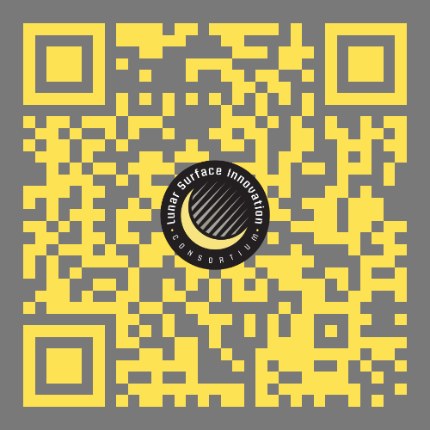
LSIC Spring Meeting
**NOW** April 24th – 25th at Johns Hopkins Applied Physics Lab
Abstracts are due Feb. 3rd. Registration will open in Feb.!
*Please remember to utilize the abstract template provided on webpage

Slide 6
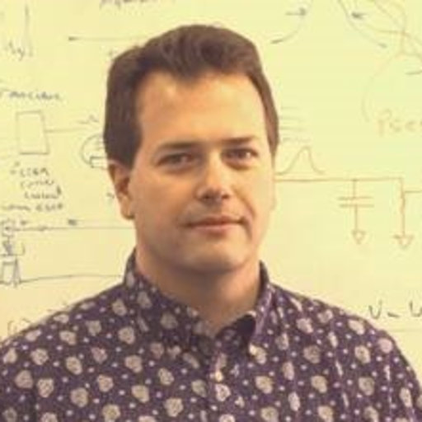
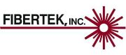
LSIC | February Telecon
We hope to see you all at our next telecon, which will take place on
Thursday February 23, 2023 at 11:00AM ET.
Theme: Power Beaming
Speaker: Mark Storm (Fibertek, Director of NASA Programs)
6

Slide 7
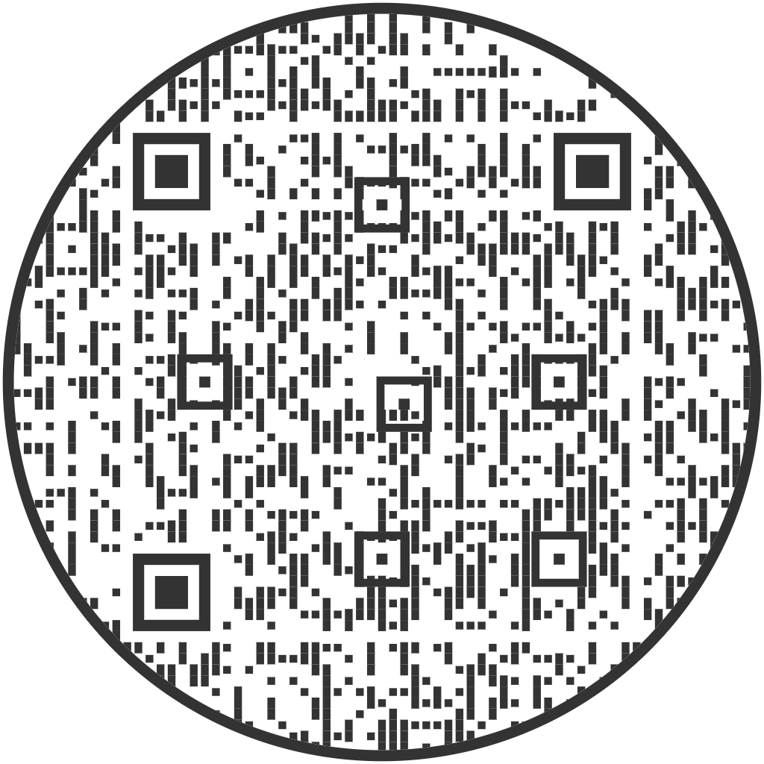
LSIC | LSIC Surface Power 2022 Survey and 2023 Activities
The 2022 Surface Power Survey is still live!
If you are interested in presenting at a future telecon, please contact:
  Matt.Clement@jhuapl.edu
  Sean.A.Young@jhuapl.edu
The APL Surface Power Team also does site visits, please don’t hesitate to reach out!
Please use the QR code, or follow the link in the chat to access our survey
7
Notes:
https://docs.google.com/forms/d/e/1FAIpQLSddxov3KmD6dDomdDpQkFJBQaoAKCmEYtnoDUeEAz2b2ZOJDQ/viewform?usp=sf_link
https://docs.google.com/forms/d/e/1FAIpQLSddxov3KmD6dDomdDpQkFJBQaoAKCmEYtnoDUeEAz2b2ZOJDQ/viewform?usp=sf_link

Slide 8
LSIC | FSP Presentations
NASA background (Lee Mason, Power Division Associate Chief)
Intuitive Machines/X-Energy (Peter McGrath; Vice President, Business Development)
Westinghouse (Joe Halackna; Deputy Director for Advanced Reactor Engineering & FSP Chief Technologist)
Lockheed Martin Presentation (Mikaela Blood; FSP Lead Nuclear Engineer)
8

Slide 19
eVinciTM Microreactor for Terrestrial & Space Applications
Clean & Reliable Energy for the 21st Century

Slide 20
Agenda
January 26, 2023
  Background
  eVinci Technical Features
  Fission Surface Power Overview
  Uranium Nitride Fuel
  Technology Development & Timeline
Westinghouse Non-Proprietary Class 3 | © 2023 Westinghouse Electric Company LLC. All Rights Reserved.

Slide 21
Who is Westinghouse
Westinghouse is the world’s leading supplier of safe, innovative nuclear technology. While our daily work entails providing nuclear energy technologies, products and services to utilities around the world, our mission is focused on a much broader goal: using the power of intellect, collaboration and innovation to build on the legacy of our founder, George Westinghouse, and to create a cleaner, safer and sustainable carbon-free future for generations to follow.
Today’s Westinghouse brand benefits our customer — and our customers’ customers – and is committed to a carbon-free future.

Slide 22
The world is recognizing and
reacting to climate change now:
Japan plans to reduce emissions to 46%
of 2013 levels by 2030
EU targets 55% reduction in emissions by 2030
United States sets goal of net-zero emissions by 2035
Canada aims to reach net-zero emissions by 2050
China declares intent to achieve carbon neutrality by 2060
To reach net-zero emissions by 2050, Britain is already putting nuclear power at the heart of its climate strategy

Slide 23
135 Years of
Innovation

Slide 24
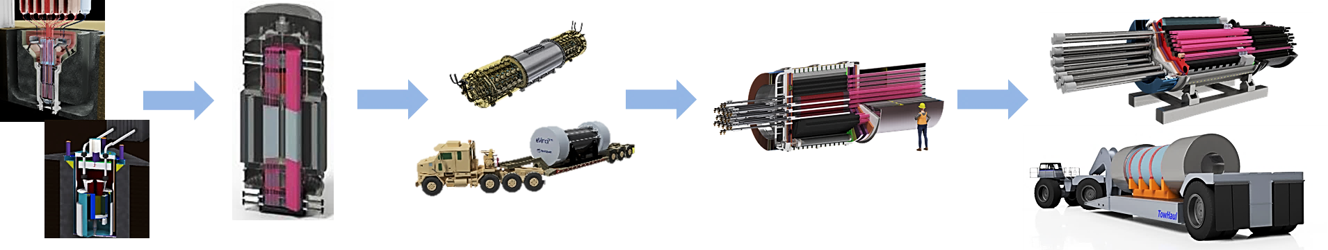
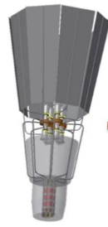
eVinci Microreactor – Developed from Decades of Research
Safety through passive heat pipe technology and a solid-state, very low-pressure design
Background and development to date
1980s to 2000 – heat pipe reactors developed for space due to simplicity, small size & passive cooling
2000 to 2015 – national laboratory led materials and reactor design development research
2015 – Westinghouse began development of heat pipe & microreactor concepts
2018 – U.S. national laboratory led demonstration of 5kW heat pipe reactor (KRUSTY)
2020 – completed construction of eVinci test facility & manufactured first sodium heat pipe
2021 – electrical demonstration of heat pipe core assembly at operating temperature
2022 – material compatibility testing & conceptual design completed; technical white papers & first topical reports delivered to U.S. NRC; produced first heat pipe for Nuclear Test Reactor (NTR)
Westinghouse Non-Proprietary Class 3 | © 2023 Westinghouse Electric Company LLC. All Rights Reserved.

Slide 25
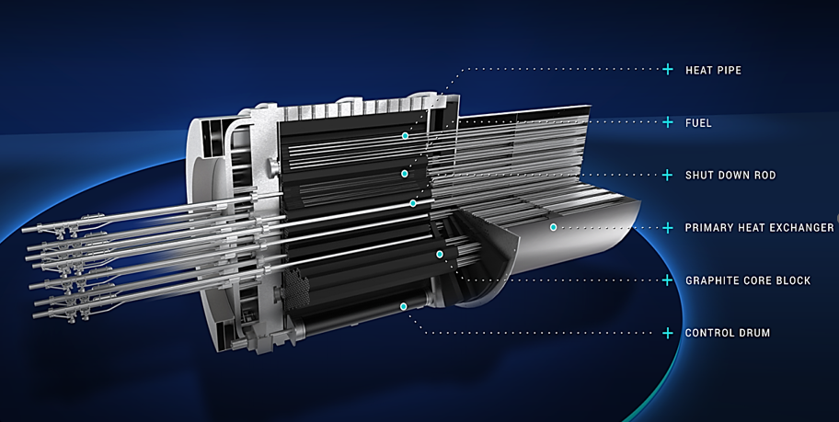
eVinci Microreactor – Technical Features
Clean energy beyond the grid
Technical Features
Nuclear battery designed for safe and reliable clean energy generation
  5 MWe with ~7MWth @ 200º C usable heat
Commercial deployment before end of decade
  8+ years of operation without refueling
  Transportable for ease of installation and elimination of spent fuel storage on site
  Cost-competitive plant lifecycle
  Minimal site construction and onsite personnel
  High speed load following capability
Westinghouse Non-Proprietary Class 3 | © 2023 Westinghouse Electric Company LLC. All Rights Reserved.

Slide 26

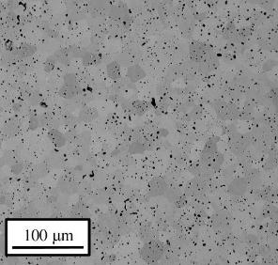
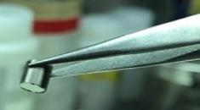
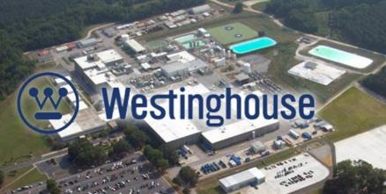
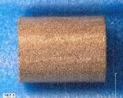
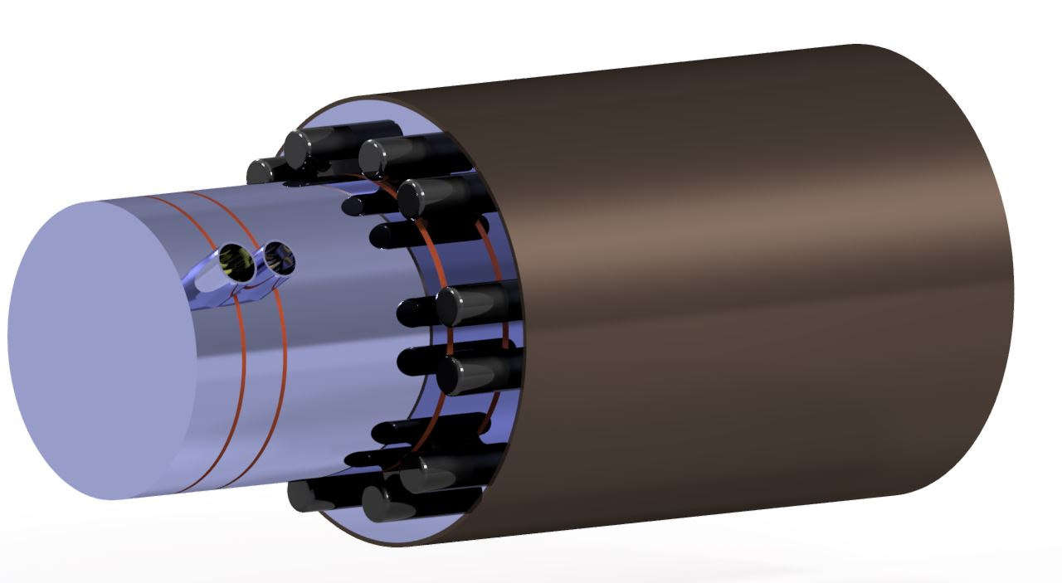
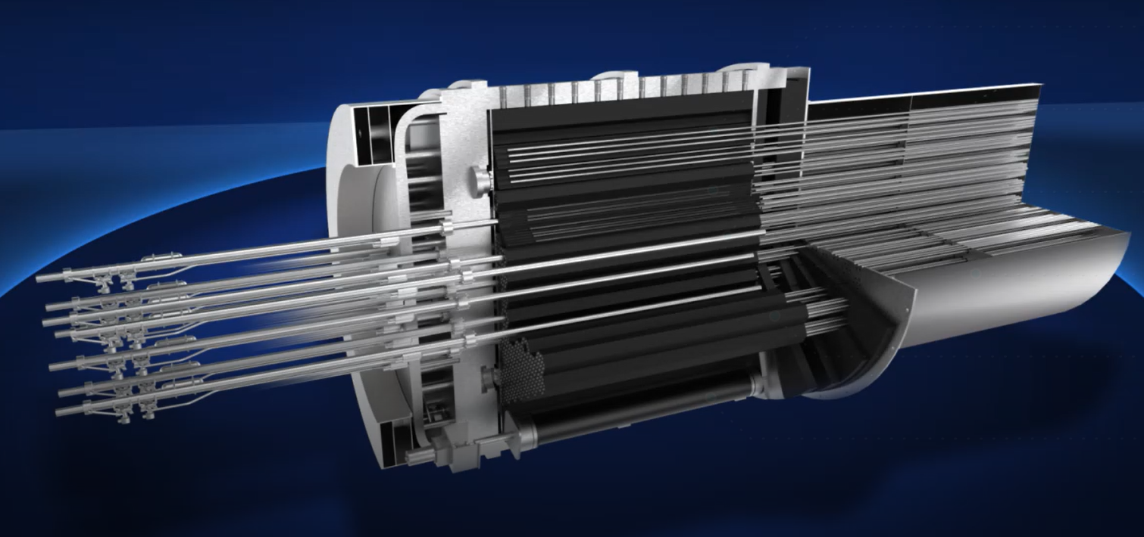
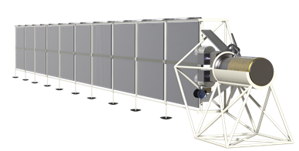
Fission Surface Power
Reliable, long-lasting energy for the Moon & Mars
Westinghouse Government Services in partnership with Aerojet-Rocketdyne, Los Alamos National Laboratory and others are excited about our team’s solution for Fission Surface Power leveraging the eVinci micro-reactor technology, Uranium Nitride fuel, and our combined experiences across terrestrial and space nuclear fission systems.
Our space reactor design is focused on advanced heat pipe technology, Uranium Nitride Fuel, and a Yttrium Hydride moderator designed to deliver more than 40kWe for 10 years.
Uranium
Nitride
Photos courtesy of
Los Alamos
National Laboratory
Westinghouse Non-Proprietary Class 3 | © 2023 Westinghouse Electric Company LLC. All Rights Reserved.

Slide 27
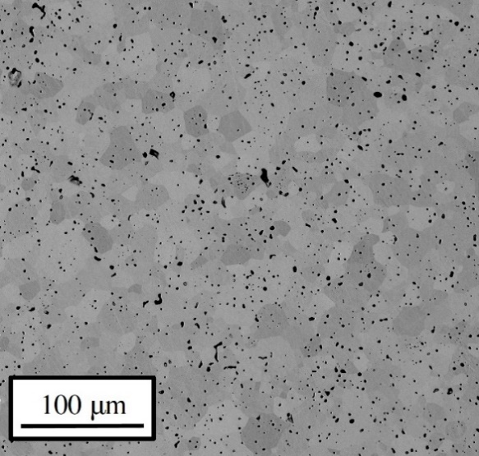
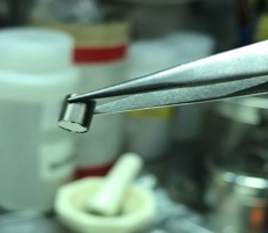
Uranium Nitride Fuel
UN has increased uranium density & significantly improved thermal properties compared to UO₂
Opportunities exist for current LWRs, Gen IV reactors, & Space power
Benefits:
  High Uranium density (longer cycle lengths, can achieve higher burnups); 40% higher Uranium density than UO₂
  High melting temperature
  Safety benefit due to the high thermal conductivity; 5-10x increase relative to UO₂ (lower stresses, potential for lower fission gas release, and potential for improved margins in loss of coolant accidents and beyond design basis accidents)
Current R&D focus:
  Material development using advanced modeling
  Accelerated burnup testing in BR-2 (NFIR Program)
  Developing scalable manufacturing process
  Leveraging partnerships with universities and national laboratories to develop nitride fuel
Accident Tolerant Fuel-A UK Perspective. NNL.
(http://www.nnl.co.uk/wp-content/uploads/2019/01/atf-position-paper-final-july-2018.pdf)
Westinghouse Non-Proprietary Class 3 | © 2023 Westinghouse Electric Company LLC. All Rights Reserved.

Slide 28
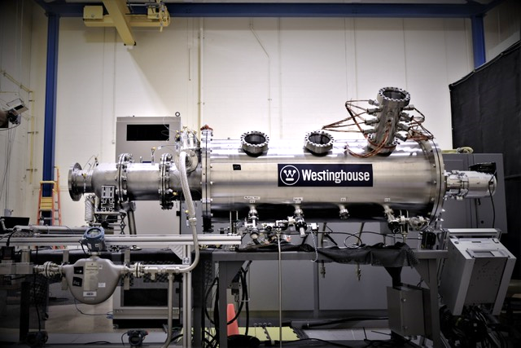
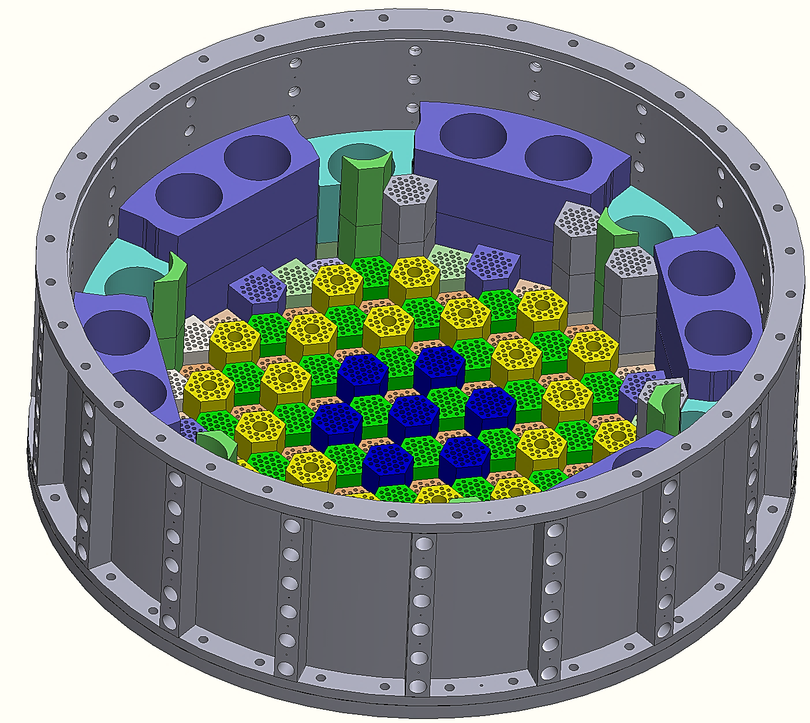
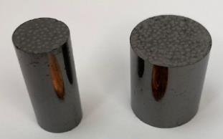
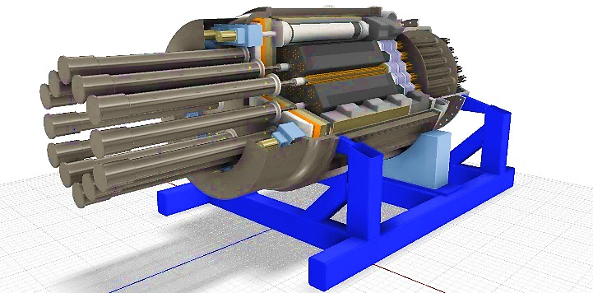
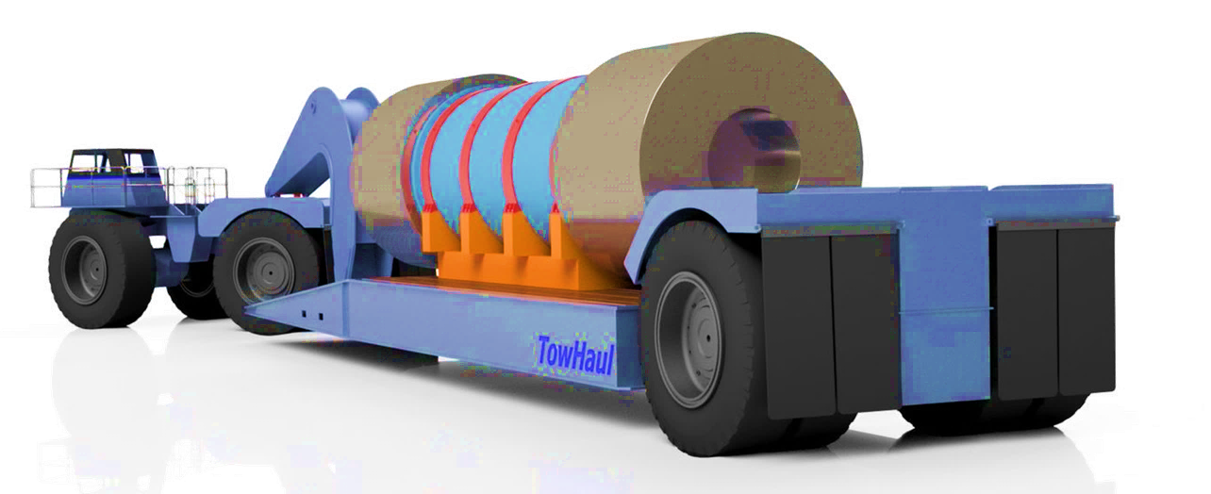
eVinci Microreactor – Technology Development & Timeline
Advanced reactor development and commercialization
Technology Development and Manufacturing
Conceptual design complete
Electrical demonstration unit operational
Initiated licensing engagement with US and Canadian regulators
NTR design for procurement
Integrated manufacturing demonstrations and prototyping
Separate effect and component testing
NTR component fabrication
Criticality, transient and irradiation testing
eVinci design for manufacturing
NTR assembly and operation
Analysis code validation
Initiate eVinci manufacturing
Power conversion system testing
eVinci design complete
Receive regulatory licensing approvals
Commercial unit delivery and operation
2021-2022
2023
2024
2025-2026
2027+
Licensing
US NRC pre-licensing engagement
(Technical papers & Topical report submittals)
Prepare & submit design license to NRC
NRC review & approve design certification
Canadian Nuclear Safety Commission (CNSC) vendor design review
Westinghouse Non-Proprietary Class 3 | © 2023 Westinghouse Electric Company LLC. All Rights Reserved.

Slide 29





Thank You
westinghousenuclear.com
westinghousenuclear.com
Westinghouse Non-Proprietary Class 3 | © 2023 Westinghouse Electric Company LLC. All Rights Reserved.

