Slide 1
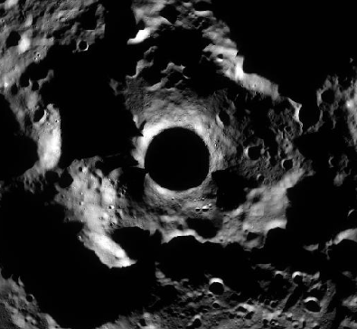
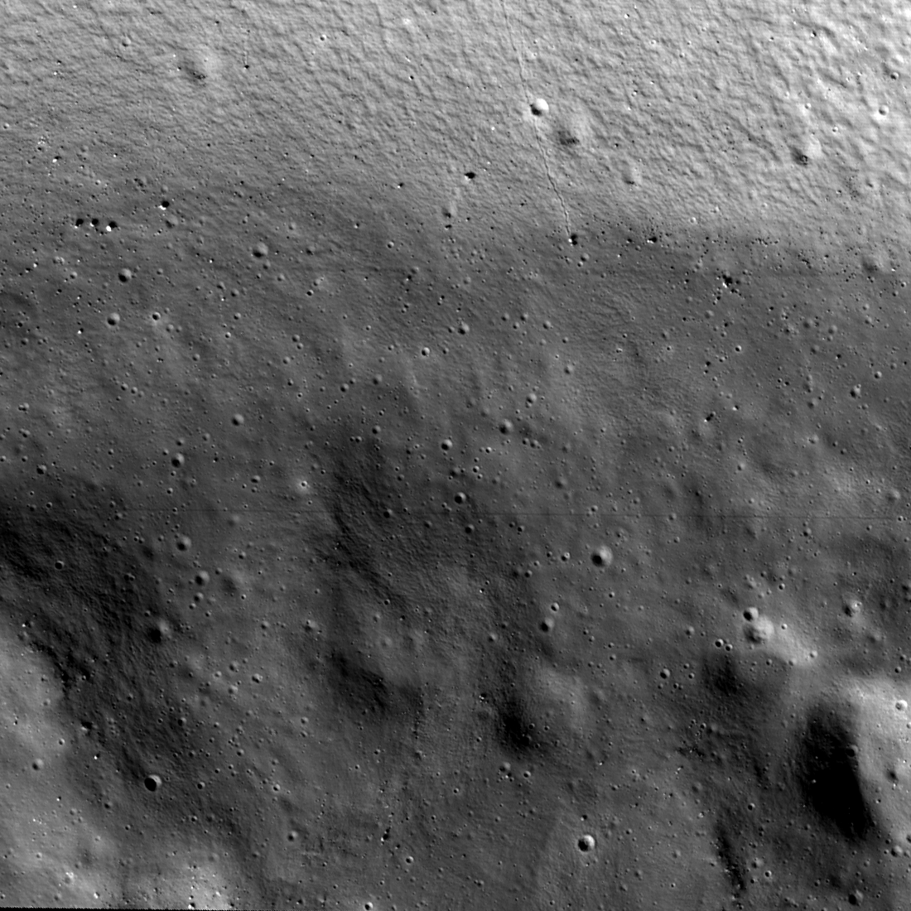
Lunar South Pole Geology from the Perspective of ISRU
The LSIC ISRU Focus Group
2023

Slide 2
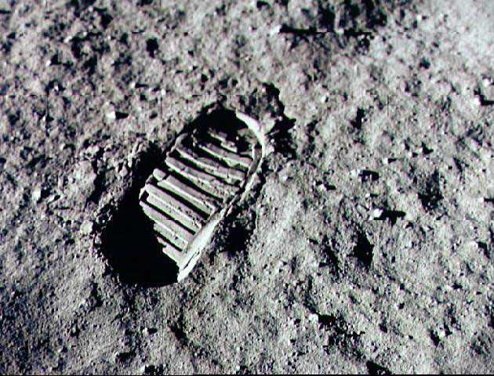
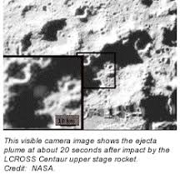
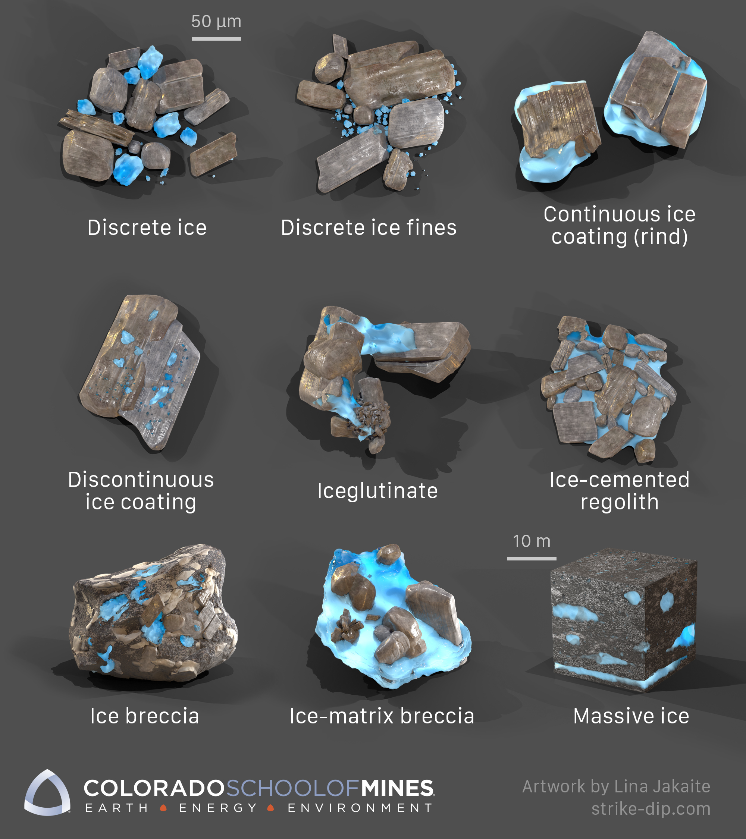
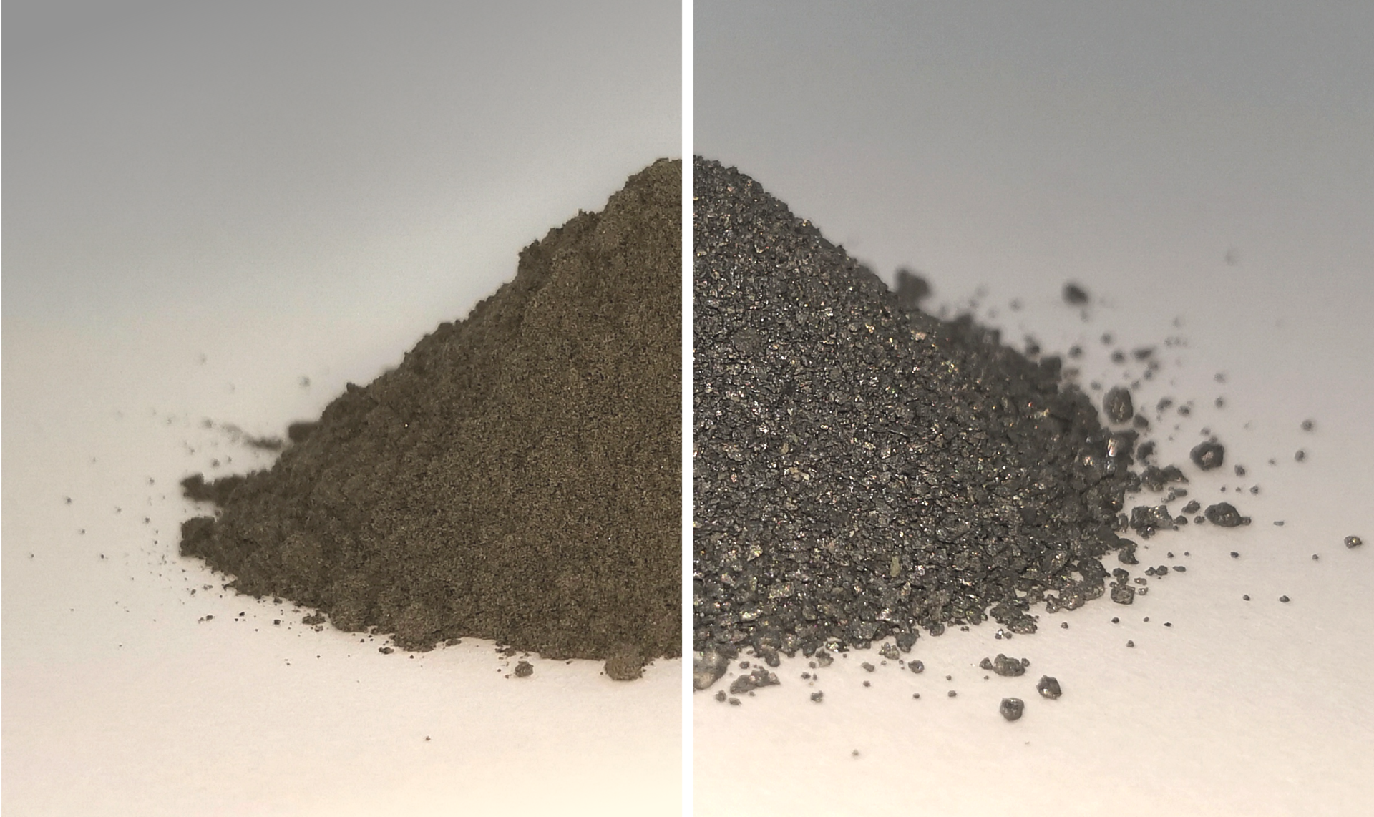
The ISRU Perspective
Two ISRU ‘resources’:
O₂ and metals from regolith. Regolith composition is important
Waterice in PSRs. What can the geology tell us about it?
Oxygen and Metals in Regolith everywhere
Water ice in PSRs
CaAl₂Si₂O₈
FeTiO₃
Al, Fe, Si, etc.
This visible camera image shows the ejecta plume at about 20 seconds after impact by the LCROSS Centaur upper stage rocket.
Credit: NASA

Slide 3
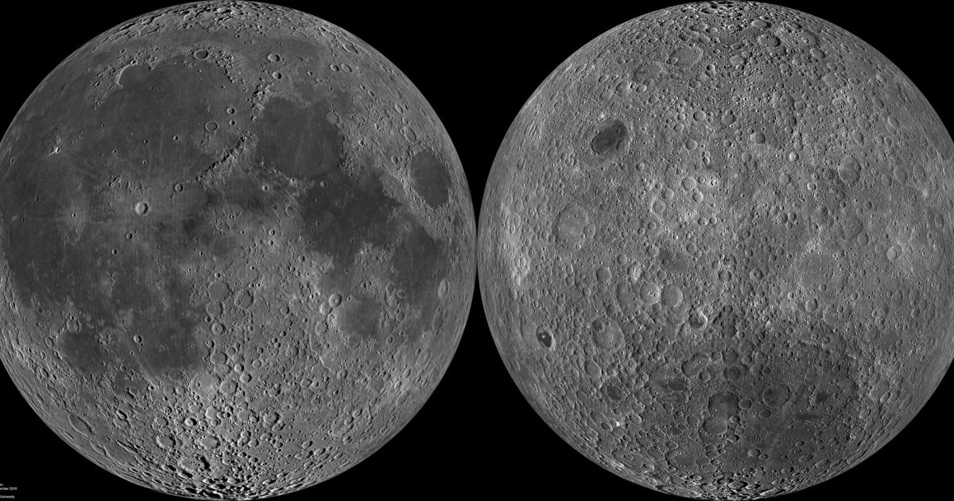
Oxygen and Metal sources on the Moon - everywhere
Earth-facing Near Side
Far Side
Notes:
Areas of Na rich highland would be extremely useful because it melts at a lower temperature.

Slide 4
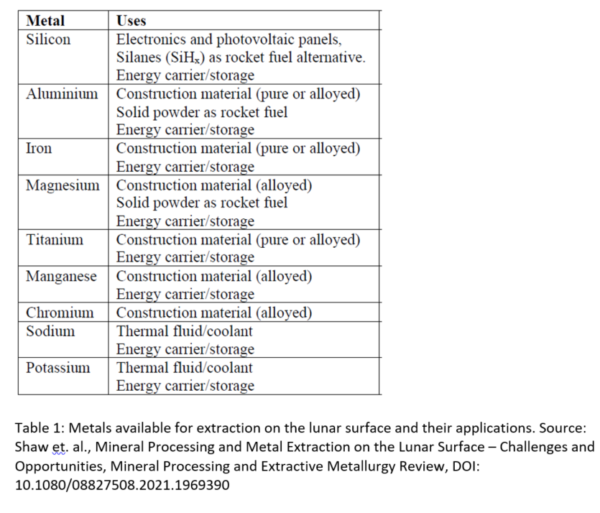
Oxygen and Metal sources on the Moon - everywhere
Metallic elements available from the regolith
Highland regolith and mare compositions. Both are dominated by silicate minerals.
Highland is dominated by aluminum, silicon, and calcium
Calcium
CaAl₂Si₂O₈
FeTiO₃
Al, Fe, Si, etc.
In Mare…
ESA/Univ of Glasgow
Notes:
Areas of Na rich highland would be extremely useful because it melts at a lower temperature.

Slide 5
Oxygen and Metal sources on the Moon - everywhere
Metallic elements available from the regolith
New LUSTR opportunity. $1M-$2M. University grant.
Theme 3: Extraction of Metals from Lunar Regolith for Additive Manufacturing.
Highland regolith and mare compositions. Both are dominated by silicate minerals.
Highland is dominated by aluminum, silicon, and calcium
Calcium
Theme 1: Active Dust Mitigation.
Theme 2: Lunar Extreme Access and Exploration via Cooperative Multi-Robots
(call driven by potentially hazardous terrain)
Notes:
Type and quality of in-situ derived metals for construction needs.
Do we need to develop lunar surface metal manufacturing processes? What are the challenges?
How can these activities help terrestrial technologies and businesses?

Slide 6
Geologic information needed for all polar operations
ShadowCam image of Shackleton Crater
Terrain Hazards (boulders, craters, steep slopes, loose regolith).
Understanding the ubiquitous dust
  May have some unique properties at the poles
Unique geology of PSR ices
  Surface ice: Large cold traps
  Surface ice: Micro cold traps – Depth matters! Shallow (<1m) are less likely to hold surface frost.
  Near surface
  Deep ice – preferential shallowing of pole facing walls in PSRs.
Notes:
Rubanenko et al., 2022 microcold traps (< 1km), in general, don’t hold suface ice more than a 1ga old because they are shallow. 50% are less than 1m deep. Even if cold, athermal processes such as micrometeroid and photodissociation and sputtering will ejects water to outside of the cold trap. However, this does not address ancient subsurface ice. Only surface ice.
Deutch et al., 2022. slopes of PF walls in PSRs are preferentially shallower than EF walls in PSRs and shallower thn slopes in illuminated craters. Over time, could be ice enabled mass movement, or volatile mobilized regolith.

Slide 7
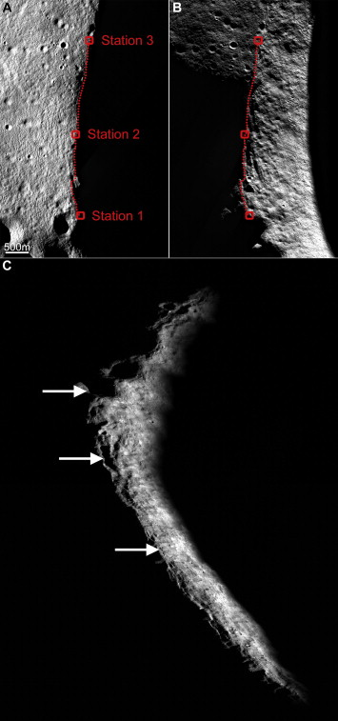
Shackleton Crater
ShadowCam image of Shackleton Crater
Eratosthenian age (1 to 3 Ga), probably closer to 3.6 Ga.
Has brighter floor than surrounding terrain.
But no NS anomaly associated with it (caveat spatial resolution)
The persistently shadowed interior of Shackleton does not look different from illuminated terrain on the Moon.
Speyerer and Robinson, 2013
Notes:
235km2 are shadowed.
From the illumination map presented in Fig. 5B, a small 0.01 km² region (89.740°S, 201.2°E) was identified as being illuminated in 71.6% of the LROC WAC images acquired during the lunar year examined with its longest period of eclipse lasting 145 h. Combined, at least one of the three stations was illuminated for 92.1% of the year and the longest period all three were in shadow was 43 h.

Slide 8
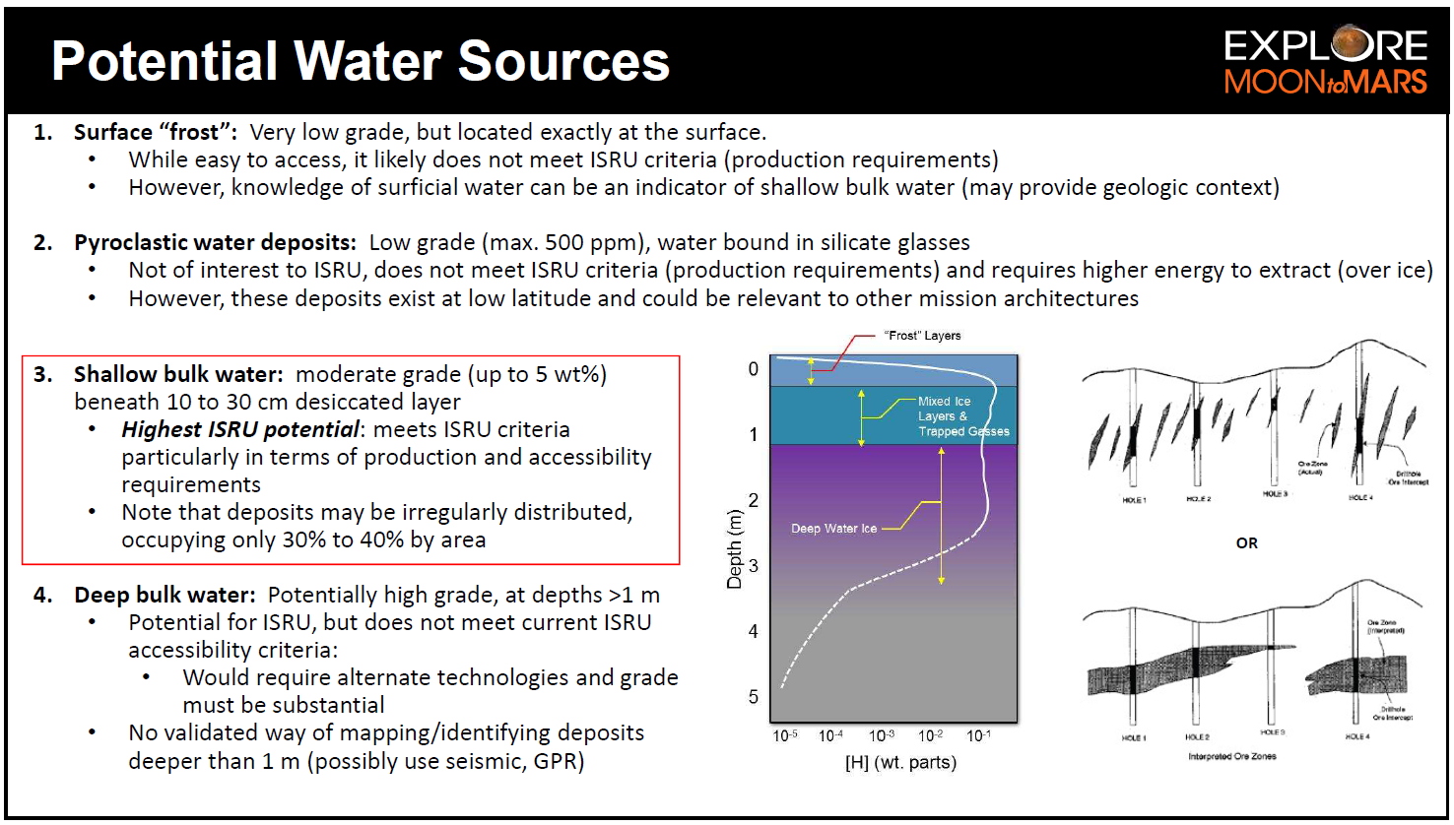
from Kleinhenz et al., 2020)

Slide 9
Crater Slopes
Morphology Matters!
Sequestered volatiles may allow more mass movement of the regolith and thus shallower slopes.
Or the shallower slopes may be directly indicative of a deposit forming after the equator.
Or there may another non-volatile explanation
Sunlight
Sunlight
Sunlight
Pole
Equator
A PSR Crater
(from Rubanenko et al., 2019)

Slide 10
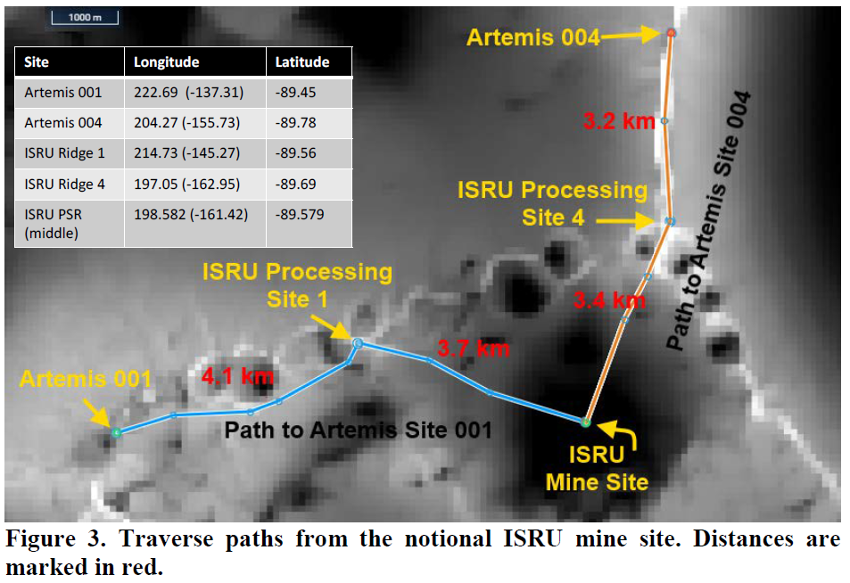
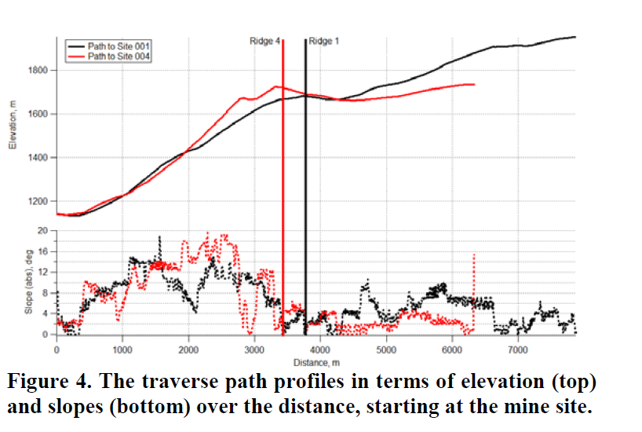
Crater Slopes
Successful Water Ice ISRU depends on knowing the morphology of the area around the Base Camp and Route to the Water Ice reserve.
Kleinhenz and Paz, 2020

Slide 11
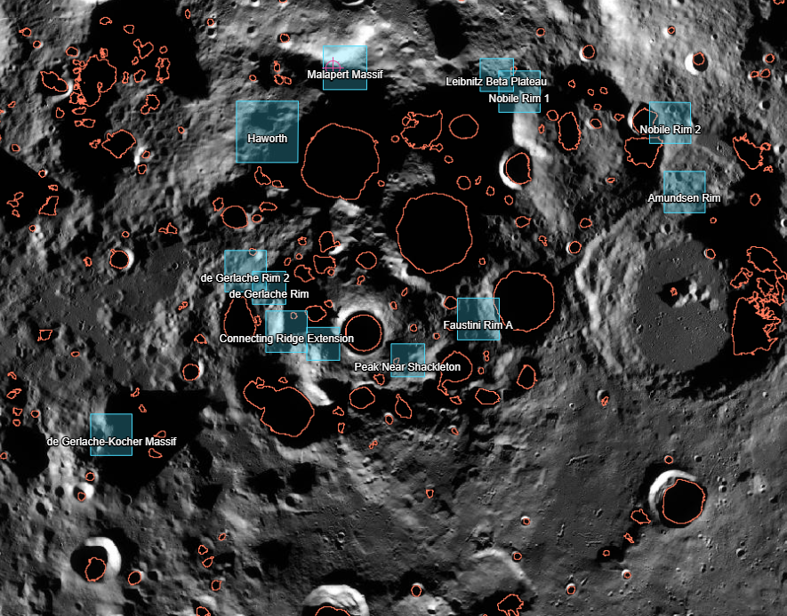
Candidate Artemis Landing sites and PSR outlines
PSRs
ref: C.25 Artemis III Geology Team (A3GT)
Notes:
https://nspires.nasaprs.com/external/solicitations/summary.do?solId=%7bF066E175-5EE0-5589-0B20-FB8615B3C758%7d&path=&method=init

Slide 13
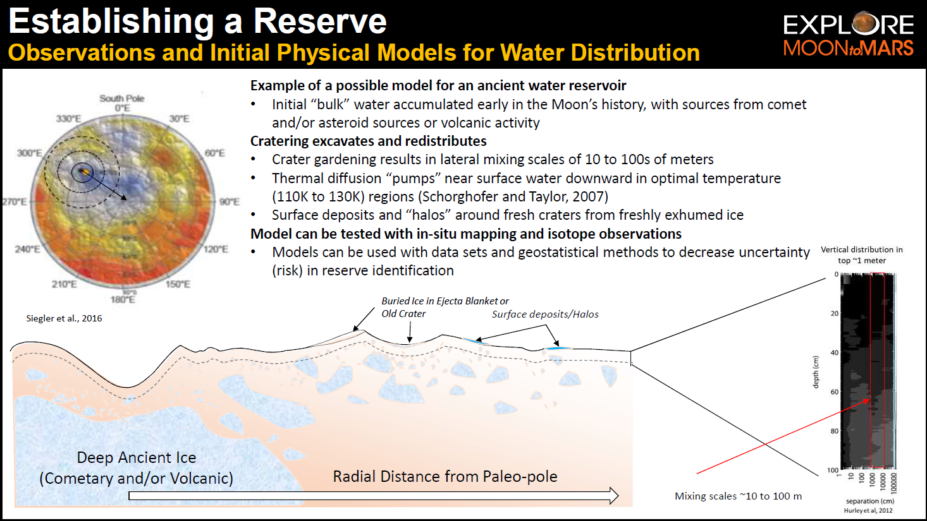
Geologic models of potential water ice reserves
Kleinhenz et al., (2020)

Slide 14
