Slide 1

LSIC ISRU Focus Group Monthly http://lsic.jhuapl.edu/ http://lsic-wiki.jhuapl.edu/ (Confluence sign-up required)
January 18, 2023
Dr. Jodi Berdis, Dr. Karl Hibbitts, Dr. Michael Nord, Dave Smith, Claire Trop, Dr. Rich Miller
Jodi.Berdis@jhuapl.edu, Karl.Hibbitts@jhuapl.edu, Michael.Nord@jhuapl.edu, David.Smith@jhuapl.edu, Claire.Trop@jhuapl.edu, Richard.S.Miller@jhuapl.edu

Slide 2
Agenda
General updates and house-keeping
  APL is happy to consult as appropriate with ISRU and related technologies. We can provide advice on how to build for launch and operate in extreme environments. This includes site visits!
  Upcoming Meetings
  Funding Opportunities
Lior Rubanenko (Stanford): “The abundance of subsurface ice near the lunar poles: lessons learned from the Moon and Mercury”
Anicia Arredondo (SwRI): “Detecting molecular water on the lunar surface through MIR spectroscopy”
Coffee and Donuts Discussion: Lunar Technology Community-Driven Whitepaper

Slide 3
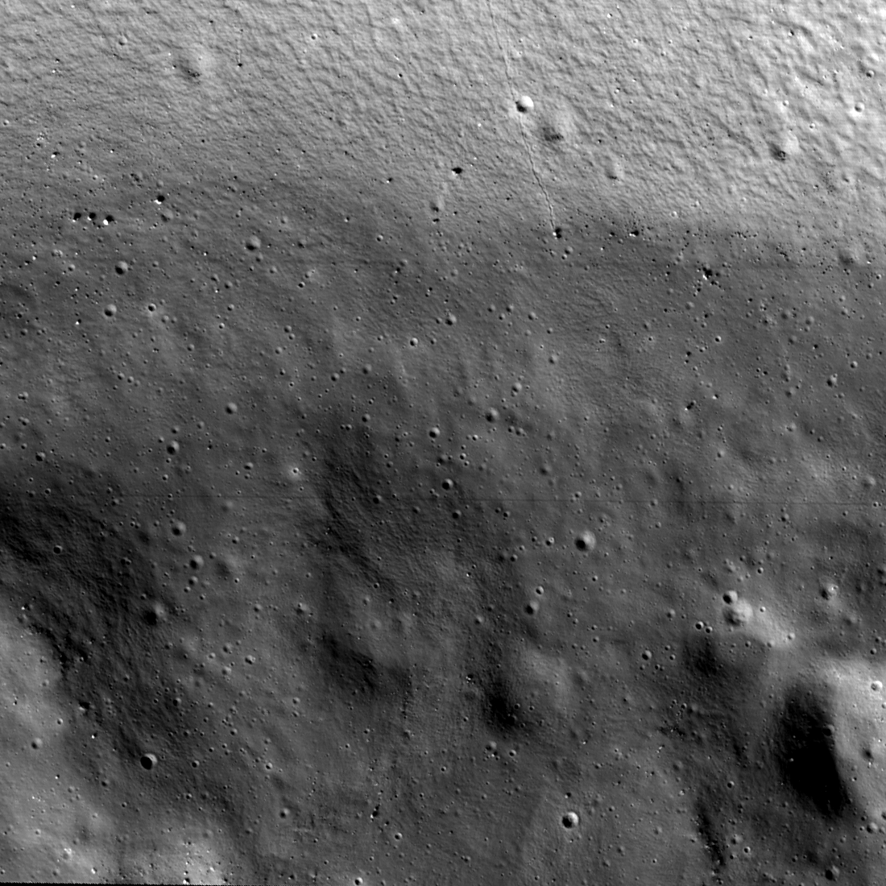
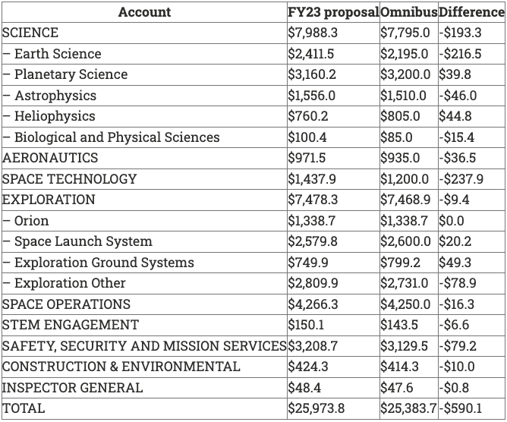
Notable News
NASA FY2023 Budget:
KPLO ShadowCam first image:
Shackleton Crater permanently shadowed wall and floor

Slide 4
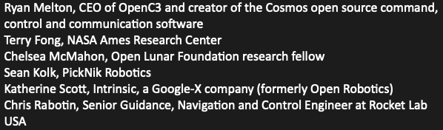
Upcoming Meetings
LSIC Spring Meeting Mar 29-30 April 24-25 (next slide):
  https://lsic.jhuapl.edu/Events/Agenda/index.php?id=380
  Abstracts due Feb 3
  Registration to open in Feb
EA/MOSA Joint Extended Telecon (Jan 24, 1pm ET)
  https://jhuapl.zoomgov.com/j/1603295700?pwd=YiswanY2MnQvTHZDWlVidytJS2tUQT09
Surface Power FG (Jan 26, 11am ET, following slide)
LSSW, “The First Steps in a Bold New Era of Human Discovery: Candidate Artemis III Landing Sites” (April 4-5)
  Abstract deadline March 1: https://www.hou.usra.edu/meetings/Artemis_III_2023/abstracts/
Space Resources Roundtable June 6-9
  Space-resource activities in cislunar space and the Moon, space manufacturing and construction, space infrastructure, commerce, international efforts, and legal and public policy issues
  March 24: abstract submission deadline; April 14: early-bird registration deadline
  Website coming soon

Slide 5

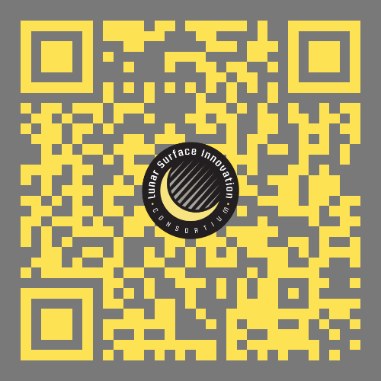
LSIC Spring Meeting
**NOW** April 24th – 25th at Johns Hopkins Applied Physics Lab
Abstracts are due Feb. 3rd. Registration will open in Feb.!
*Please remember to utilize the abstract template provided on webpage

Slide 6

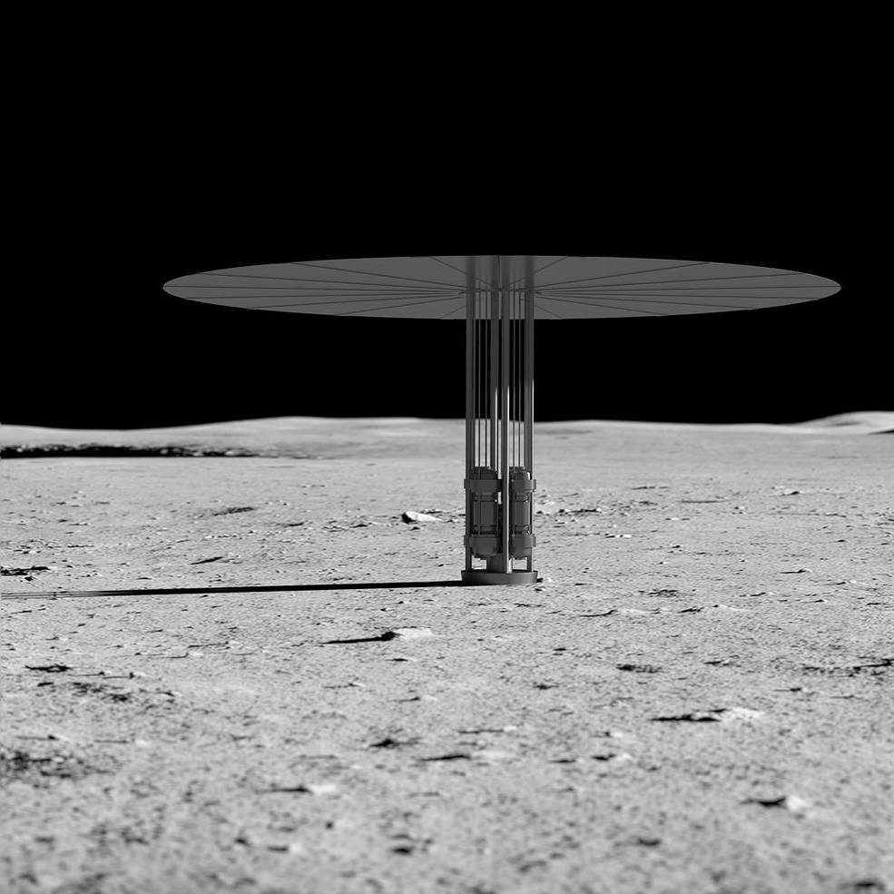
LSIC | Surface Power Focus Group January Telecon
Surface Power Telecon: January 26th 11:00 ET
Speakers: Peter McGrath (FSP Project Manager for Intuitive Machines and X-Energy)
Joe Halackna (Deputy Director for Reactor Engineering for Westinghouse)
TBD Lockheed Martin Speaker
Lee Mason (Power Division Associate Chief at NASA GRC)
Topic: NASA Fission Surface Power Phase I
Agenda:
Community Updates
Intuitive Machines/X-Energy presentation
Westinghouse presentation
Lockheed Martin presentation
Panel Discussion Q&A
Zoom Link for Jan 26th 11:00 ET:
https://jhuapl.zoomgov.com/j/1617206812?pwd=ZWhlaW5XRURsRmxJcWd4b1ZoeFFwUT09
LSIC Surface Power Telecon
6

Slide 7
Funding Opportunities
2023 NASA BIG Idea Challenge (grads/undergrads)
  Lunar Forge: Producing Metal Products on the Moon
  E.g., storage vessels for liquids and gases, extrusions, pipes, power cables, and supporting structures
  Proposals due Jan. 24: https://bigidea.nianet.org/
NASA Innovative Advanced Concepts (NIAC) Phase II Call for Proposals
  Proposals due Jan. 18: NSPIRES
FY 2023 Phase II SBIR and STTR Solicitations
  The 2022 Phase II SBIR solicitation (2022 Phase I SBIR awardees only) closes Jan. 25. Post-Phase II funding opportunities are only open to small businesses with Phase I or II awards.
  Proposals due Jan. 25: https://sbir.nasa.gov/
FY 2023 Phase I SBIR and STTR Solicitations
  The next Phase I opportunity closes March 13. The NASA Phase I SBIR and STTR solicitations are open to small businesses with 500 or fewer employees. To apply for an STTR, a small business must partner with a nonprofit research institution, such as a university or research laboratory.
  Proposals due March 13: https://sbir.nasa.gov/

Slide 8
Topical Discussion
Lior Rubanenko
Stanford University
“The abundance of subsurface ice near the lunar poles: lessons learned from the Moon and Mercury”

Slide 9
Topical Discussion
Anicia Arredondo
Southwest Research Institute
“Detecting molecular water on the lunar surface through MIR spectroscopy”

Slide 10

Coffee and Donuts
Lunar Technology Community-Driven Whitepaper: ISRU https://lsic-wiki.jhuapl.edu/x/PQUiAw
Notes:
https://forms.gle/tuhzwAUaQLDivQ2D7

