Slide 1
Extreme Environments Focus Group April Meeting
April 11, 2023
Jamie Porter
Extreme Environments Focus Group Lead
Facilitator_ExtremeEnvironments@jhuapl.edu
Extreme Environments Team: Alice Cocoros, Andrew Gerger, Milena Graziano, Benjamin Greenhagen, Karen Stockstill-Cahill, Samalis Santini De Leon

Slide 2
Today’s Agenda
Conferences and Funding Opportunities
Spring Meeting
Surface Power April Telecon
Featured Discussions
Ilya V. Ponomarev, Euclid
Single Event Burnout Hardened High-power Quasi-lateral Diamond Transistor
Brian Elliott, TDA Research
Rechargeable Batteries with Improved Discharge Capacity at 40ºC to 60ºC for Surviving the Lunar Night

Slide 3
Conferences and Funding Opportunities
2023 Lunar Development Conference - “Short-term needs and Long-term goals”
Saturday July 15 and Sunday July 16, 2023
Price of admission to the 2022 Lunar Development Conference is the same as the membership price
https://www.moonsociety.org/conferences/2023-ldc/
2023 NASA Exploration Science Forum
July 18 - 21, 2023 at The Hotel, University of Maryland in College Park Maryland
Abstracts are due by April 11, 2023
https://sservi.nasa.gov/nesf2023/
NSF SBIR and STTR
https://seedfund.nsf.gov/apply/get-started/
Windows: November 22, 2022 - March 1, 2023 March 2, 2023 - July 5, 2023 July 6, 2023 - November 1, 2023
Please visit LSIC website for full list
http://lsic.jhuapl.edu/Resources/Funding-Opportunities.php

Slide 4
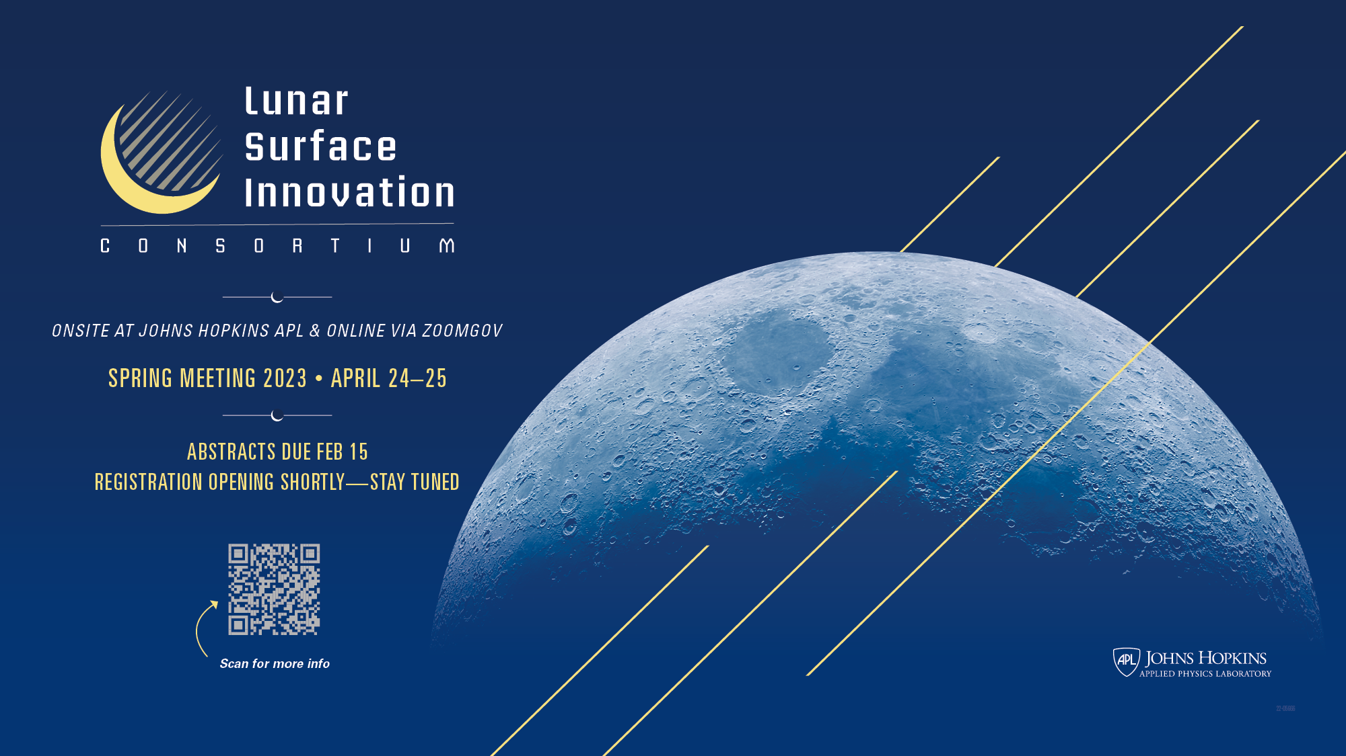
Registration Deadlines:
10 April (in-person attendance)
17 April (virtual attendance)

Slide 5
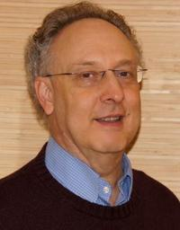
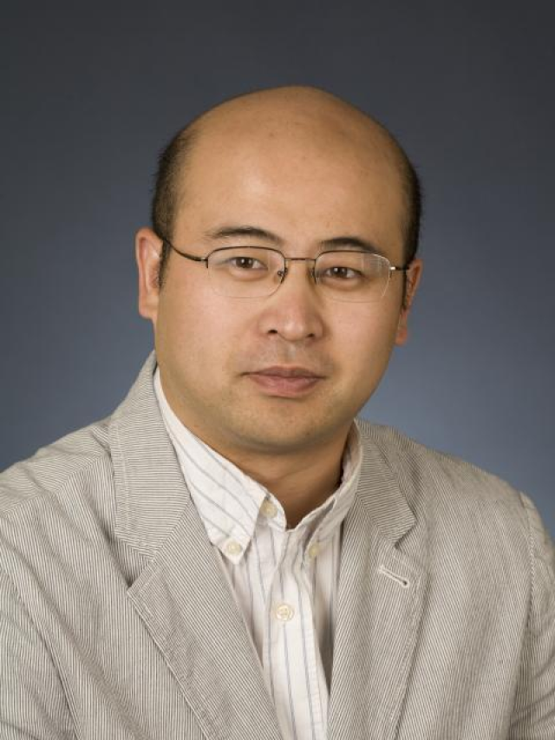
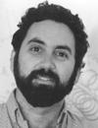
LSIC | Surface Power April Telecon
We hope to see you all at the next Surface Power telecon, which will take place on
Thursday April 13th, 2023 at 11:00AM ET.
Theme: LuSTR 2020 Power Awardees
Speakers:
Art Witulski (Vanderbilt): “SiC Power Components for NASA Lunar Surface Applications”
Jin Wang (OSU): “Flexible DC Energy Router based on Energy Storage Integrated Circuit Breaker”
Phillip Lubin (UCSB): “Moonbeam-Beamed Lunar Power”
Prof. Witulski Prof. Wang Prof. Lubin
5

Slide 6
Featured Discussions
Ilya V. Ponomarev, Euclid
Single Event Burnout Hardened High-power Quasi-lateral Diamond Transistor
Brian Elliott, TDA Research
Rechargeable Batteries with Improved Discharge Capacity at 40ºC to 60ºC for Surviving the Lunar Night

