Slide 1

LSIC ISRU Focus Group Monthly http://lsic.jhuapl.edu/ http://lsic-wiki.jhuapl.edu/ (Confluence sign-up required)
June 21, 2023
Dr. Jodi Berdis, Dr. Karl Hibbitts, Dr. Michael Nord, Dave Smith, Dr. Rich Miller
Jodi.Berdis@jhuapl.edu, Karl.Hibbitts@jhuapl.edu, Michael.Nord@jhuapl.edu, David.Smith@jhuapl.edu, Richard.S.Miller@jhuapl.edu

Slide 2
Agenda
General updates and house-keeping
  APL is happy to consult as appropriate with ISRU and related technologies. We can provide advice on how to build for launch and operate in extreme environments. This includes site visits!
  Upcoming Meetings
  Funding Opportunities
Süleyman Salihler (Polimak): "Reliable Regolith Handling: A Modular, Low-Power Conveying System for Handling Abrasive Materials in Space and Lunar Environments”
Sarah Withee (APL): “What You Need to Know About Lunar Communications”
Coffee & Donuts: What do you hope we’ll talk about at LPG Definition Workshop?

Slide 3
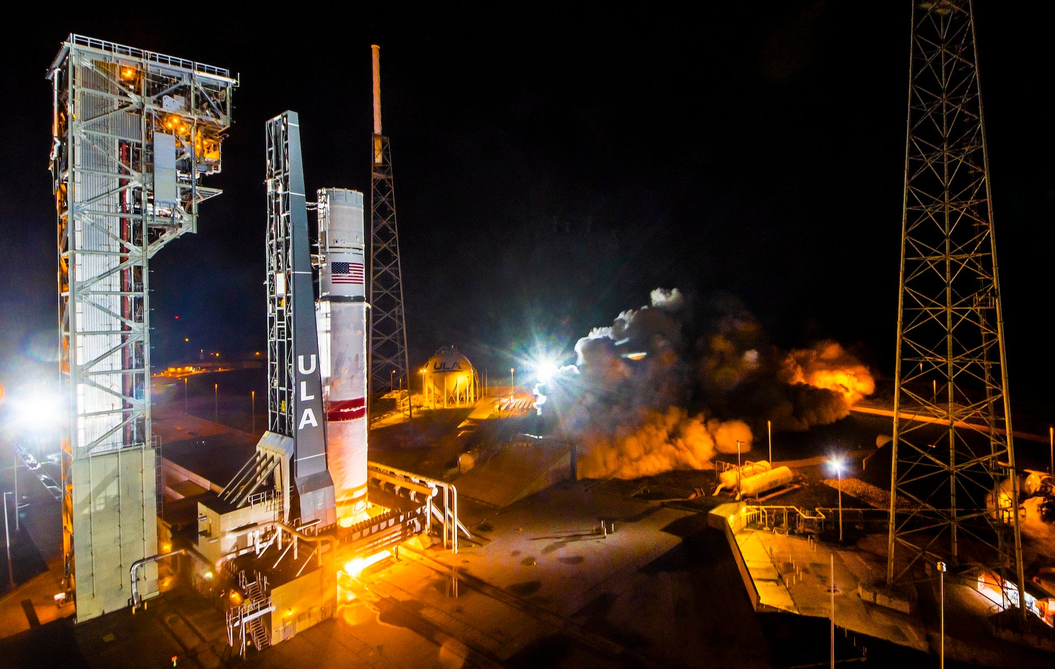
Notable News
ULA hot fire test for Vulcan first stage
March test blow-up cause: hydrogen tank steel skin too thin
Inaugural Vulcan launch will carry Astrobotic’s Peregrine for CLPS

Slide 4

Upcoming Meetings
Lunar Proving Grounds Definition Workshop (July 12-13)
  Hybrid; registration closes June 23!
  https://lsic.jhuapl.edu/Events/Agenda/index.php?id=460
Surface Power Reliability Workshop (July 26-27)
  Virtual; registration is open, and abstract submission closes July 1!
  https://lsic.jhuapl.edu/Events/Agenda/index.php?id=443
Surface Power Monthly Telecon (June 22, 11am ET)
  (separate slide advertisement)
Autonomy Workshop (August 21-22)
ASCEND (Oct 23-25)
  Paper/talk acceptance letters sent out, looking forward to seeing many of you there!
Next month’s ISRU telecon is canceled!

Slide 5
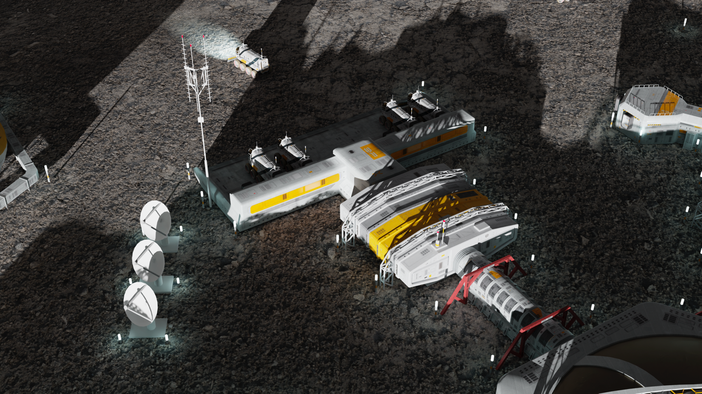

LSIC | Lunar Proving Grounds Definition Workshop
July 12-13, 2023
Summary:
The topic of facilities needed for testing hardware destined for the Moon and the need for Earth-based ‘Lunar Proving Grounds’ for testing systems has come up across all six Focus Areas of LSIC. While facilities exist for component- and instrument- level technology maturation (e.g., up to system/subsystem demo in relevant environments), and there are potential flight opportunities for component maturation to flight-qualified and even flight-proved systems, the Artemis Program vision for a sustained presence and transition to industry (e.g., the Moon to Mars Objectives and the LSIC “Path to an Enduring Lunar Presence” white paper) suggests an architecture of integrated systems and systems of systems more complex than Apollo or the International Space Station.
This is a discussion-based workshop, no abstracts will be solicited!
Registration is now open!
Objectives:
Define the role of a lunar proving ground on the Earth (and potentially on the Moon).
Collect/define needs, attributes, and performance capabilities of Lunar Proving Grounds from technology developer’s perspective.
Identify the programmatics and logistics required to implement the Lunar Proving Ground.

Slide 6
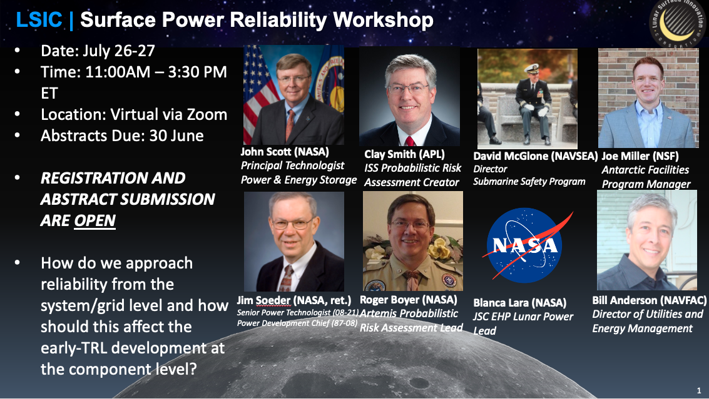

Slide 7
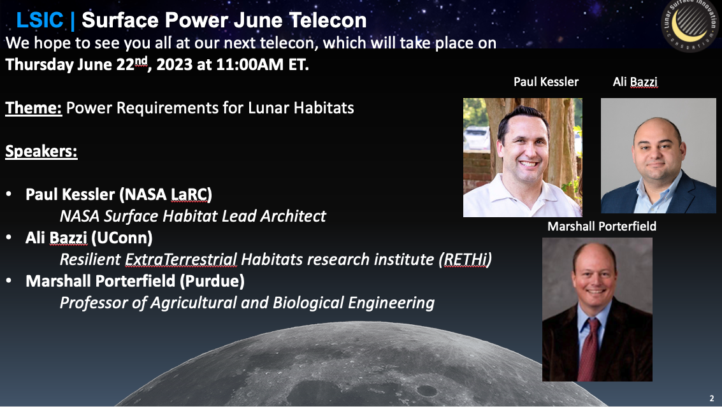

Slide 8

Autonomy Workshop (EA and E&C)
August 21-22, 2023
Full-days, Virtual
Registration open soon! Check back on the LSIC webpage.
Objective: The goal of this workshop is to gather the Lunar community to exchange ideas on autonomy, as well as identify technology gaps and use cases for establishing a sustainable presence on the Moon and Mars.
Day 1:
Morning - Autonomous Systems, Situational and Self Awareness, Reasoning and Acting
Afternoon - Collaborative Systems
Day 2:
Morning - Applications in Autonomy on Lunar Surface - Current Champions (e.g. Autonomous Construction & Assembly)
Afternoon - Challenges in Autonomy (Test & Evaluation, Cybersecurity, Dynamic Reasoning Models, Environmental Considerations)

Slide 9
LSIC 2023 Spring Meeting | White Paper Feedback
LSIC Whitepaper
The Path to an Enduring Lunar Presence
NASA Moon to Mars Whitepapers
Architecture Concept Review
Perspectives on key enabling actions that will help our nation and the world move together toward our shared use of the lunar surface.
Access White Paper:
https://lsic.jhuapl.edu/Resources/files/The%20Path%20to%20an%20Enduring%20Lunar%20Presence.pdf
Send feedback to: LSIC-Feedback@jhuapl.edu
Systems Analysis of Architecture Drivers
Why NRHO: The Artemis Orbit
Why Artemis will Focus on the Lunar South Polar Region
Gateway: The Cislunar Springboard for International and Sustainable Human Deep Space Exploration
Mars-Forward Capabilities to be Tested at the Moon
Mars Transportation
Access White Papers:
https://www.nasa.gov/MoonToMarsArchitecture

Slide 10
Funding Opportunities
NASA Innovative Advanced Concepts (NIAC) Phase I Step A Proposal Due June 28
  Concepts are solicited from any field of study that offers a radically different approach or disruptive innovation that may significantly enhance or enable new human or robotic science and exploration missions. View the solicitation and instructions for submitting a response here: https://nspires.nasaprs.com/external/solicitations/summary.do?solId=%7b2CD12700-25AC-C58C-7297-60C00036C5A6%7d&path=&method=init
NASA RFP: Lunar Terrain Vehicle Services
  Includes feasibility assessment special study, demonstration mission, and standard missions.
  Offers due July 10: https://sam.gov/opp/3edf669568124db29a60f9ecf07a7139/view
NASA REDDI: University SmallSat Technology Partnerships (USTP)
  Full proposal due July 18 (if invited from the preliminary proposal stage)
  https://nspires.nasaprs.com/
NASA REDDI: “TechFlights” full proposal due October 4
  “Topic 1” is of particular interest to the LSIC and ISRU community, as it “addresses demonstration of capabilities that support global lunar utilization leading to commercial commodities and services for a robust lunar economy.”
  https://nspires.nasaprs.com/
https://lsic.jhuapl.edu/Resources/Funding-Opportunities.php

Slide 11
Topical Discussion
Süleyman Salihler
Polimak
“Reliable Regolith Handling: A Modular, Low-Power Conveying System for Handling Abrasive Materials in Space and Lunar Environments”
Notes:
LSWG on LSIC public webpage:
https://lsic.jhuapl.edu/Our-Work/Working-Groups/Lunar-Simulants.php
LSWG on LSIC confluence page:
https://lsic-wiki.jhuapl.edu/display/LSWG/Lunar+Simulants+Working+Group+Home
Email Karen to be added to the LSWG List Serve
Karen.Stockstill-Cahill@jhuapl.edu

Slide 12
Topical Discussion
Sarah Withee
JHU/APL
“What You Need to Know About Lunar Communications”
Notes:
LSWG on LSIC public webpage:
https://lsic.jhuapl.edu/Our-Work/Working-Groups/Lunar-Simulants.php
LSWG on LSIC confluence page:
https://lsic-wiki.jhuapl.edu/display/LSWG/Lunar+Simulants+Working+Group+Home
Email Karen to be added to the LSWG List Serve
Karen.Stockstill-Cahill@jhuapl.edu

Slide 13


Coffee & Donuts:
What do you hope we’ll talk about at LPG Definition Workshop?
Notes:
https://forms.gle/tuhzwAUaQLDivQ2D7

Slide 14
LSIC | Lunar Proving Grounds Definition Workshop
July 12-13, 2023
Discussion:
What information would you most want to get out of this workshop, regarding specifically the definition of the needs, attributes, and performance capabilities that will be necessary for a future LPG?
  How will validation and verification of these systems and interactions, including human-robotic operations, be accomplished?
  What metrics need to be tested, and thus what capabilities will such a facility or facilities need?
  Which functionalities can be tested separately and which need to synergize?
  What can be the role of digital engineering?
What deliverables would you most want to see out of this workshop, e.g., that would be most useful in setting up a follow-on LPG Workshop aimed at decision-making amongst present and future facility owners?
What platform would make it most easy for you to voice your opinion during this workshop?

