Slide 1


LSIC Interoperability Working Group Telecon
May 3, 2023
Begins at 1:05
Kristin Jaburek
Johns Hopkins Applied Physics Laboratory
Space Exploration Sector
LSIC MOSA Working Group
Kristin.Jaburek@jhuapl.edu
James Mastandrea, PhD
Johns Hopkins Applied Physics Laboratory
Space Exploration Sector
LSIC MOSA Working Group
James.Mastandrea@jhuapl.edu
Pegah Pashai
Johns Hopkins Applied Physics Laboratory
Space Exploration Sector
LSIC MOSA Working Group
Pegah.Pashai@jhuapl.edu

Slide 2

LSIC | Agenda
Community Updates
Technical Talk
Question and Answer Session
2

Slide 3
LSIC | Spring Meeting Update
Successful completion of the LSIC 2023 Spring Meeting! With 300+ in-person attendees and another 200 folks online, our biggest meeting yet. For more information: https://lsic.jhuapl.edu/Events/Agenda/index.php?id=380
    LSIC Spring Meeting Day 1 Recording: https://www.youtube.com/watch?v=Cu5mL6nADR4
    LSIC Spring Meeting Day 2 Recording: https://www.youtube.com/watch?v=SpUTU8YYK8g
A lot of focus on the importance of interoperability! Particular talks that highlighted this theme included:
  Day 1 Keynote Speaker Kurt “Spuds” Vogel, Director of Space Architecture, NASA
  Day 1 Fireside Chat
  Day 1 White Paper Community Discussions
  Day 2 Keynote Speaker Pamela Melroy, Deputy Administrator, NASA
  Day 2 Keynote Speaker Matt Daniels, Assistant Director for Space Security and Special Projects, White House OSTP
  Day 2 Panel
The criticality of interoperability was a major theme.
  Critical for supporting a sustained and enduring human presence on the moon
  A clear need to establish a lunar interoperability laboratory/facility for tech assessment
  Marketplace for components that meet interoperable standards
  Lander/payloads marketplace for matching instruments or experiments with flights or landers
3

Slide 4
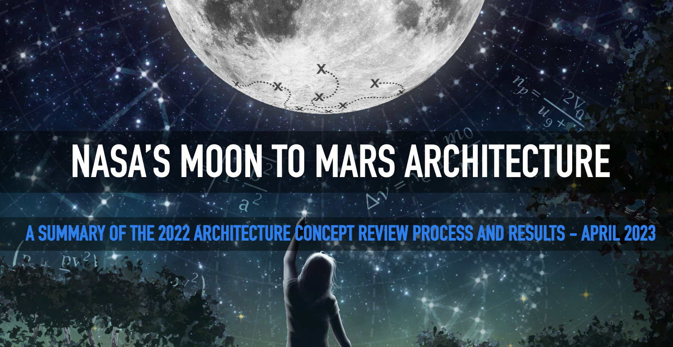
LSIC | Moon to Mars Architecture
In April NASA released a Moon to Mars Architecture document!
One stop shop link: https://www.nasa.gov/MoonToMarsArchitecture
4

Slide 5
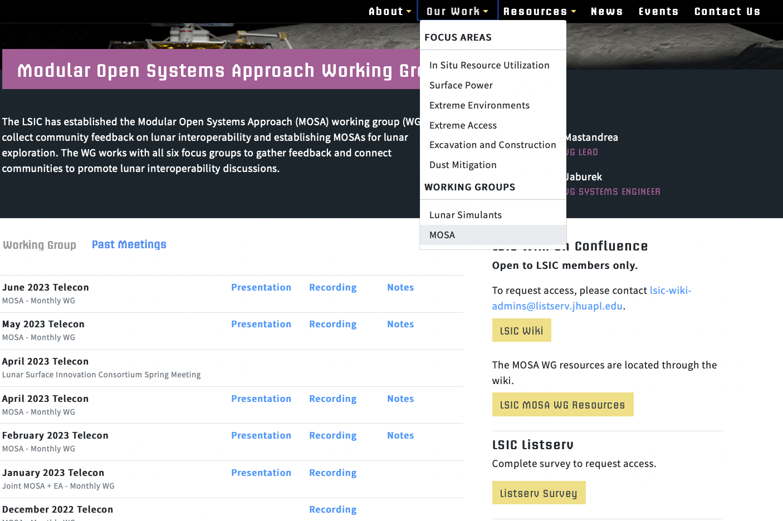
LSIC | Interoperability WG Updates
We’re re-branding to Interoperability WG to reflect our broader scope of interests related to interoperability.
June Telecon
  6/7 @ 1 PM Eastern
  David LaBranche, a Geospatial Information Officer from USG, will be presenting on the DoD's Spatial Data Standards for Facilities, Infrastructure, and Environment (SDSFIE) and how it could potentially be used for the moon
July Telecon
  It could be you! Please let us know if you are interested in presenting
Re-brand In Progress
5

Slide 6
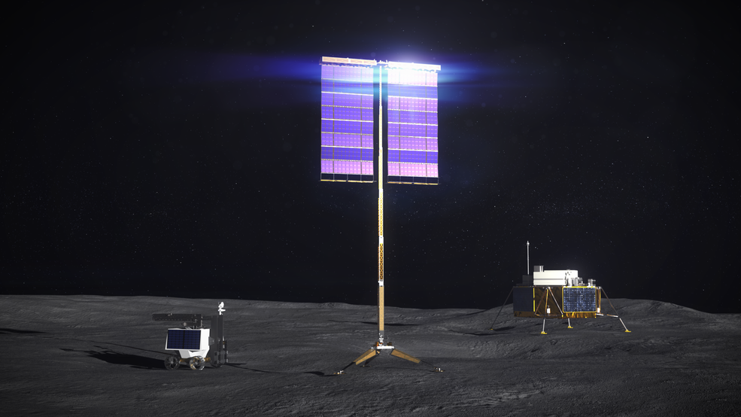
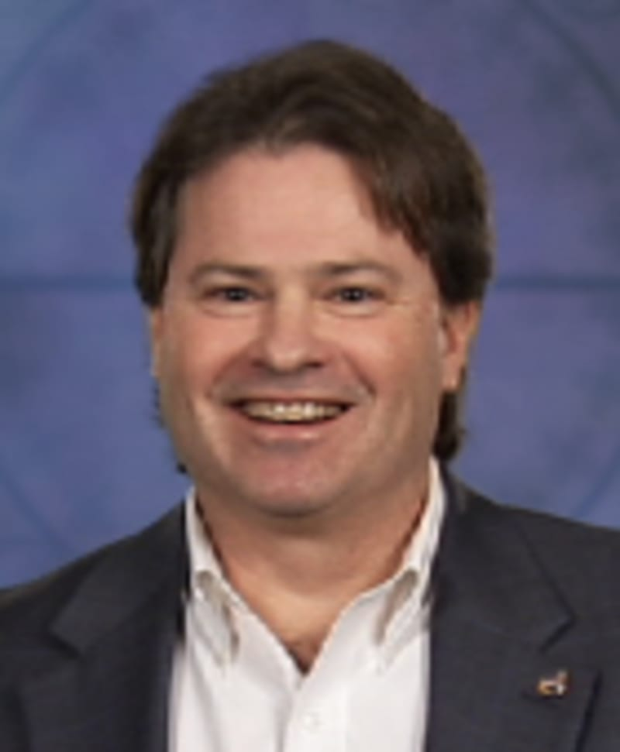
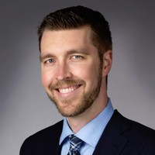

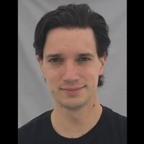
LSIC | May Telecon
We hope to see you all at our next telecon, which will take place on
Thursday May 25th, 2023 at 11:00AM ET.
Theme: NASA VSAT Phase 2
Speakers:
Chuck Taylor
VSAT PM, NASA
Ryan Wiseman
VSAT Business Lead, Lockheed Martin
Dean Bergman
VSAT PI, Honeybee Robotics
John Landreneau
VSAT PM, Astrobotic
Chuck Taylor Ryan Wiseman
Dean Bergman John Landreneau
6

Slide 7
LSIC | Technical Talk
LM’s Lunar Mobility Vehicle
Ben Pearson
Strategic Planner at Lockheed Martin Space
7
Notes:
Bio:
Ben Pearson is a Strategic Planner at Lockheed Martin (LM) Space based in Littleton, Colorado. His primary role is business and architecture development of lunar and cislunar infrastructures, with a focus on commercial lunar power, in situ resource utilization, communications networks, and surface mobility. He has contributed to several Advanced Programs development projects including the Starlab space station, DRACO NTP, and LM’s Space 2050 initiative, and he currently leads scientific augmentation and commercialization efforts for the LM Lunar Mobility Vehicle. Ben has degrees in Political Science & International Affairs, Aerospace Engineering, and Engineering Management from the University of Colorado, Boulder.

