Slide 1
Extreme Access Focus Group Telecon
June 8, 2023
We’ll start around 3:03
Angela Stickle (Focus Area Lead), Mario Lento (EA Facilitator), Danielle Mortensen, Stacy Teng, Alice Cocoros, Sarah Withee
Angela.Stickle@jhuapl.edu, Mario.Lento@jhuapl.edu, Danielle.Mortensen@jhuapl.edu, Stacy.Teng@jhuapl.edu, Alice.Cocoros@jhuapl.edu, Sarah.Withee@jhuapl.edu

Slide 2
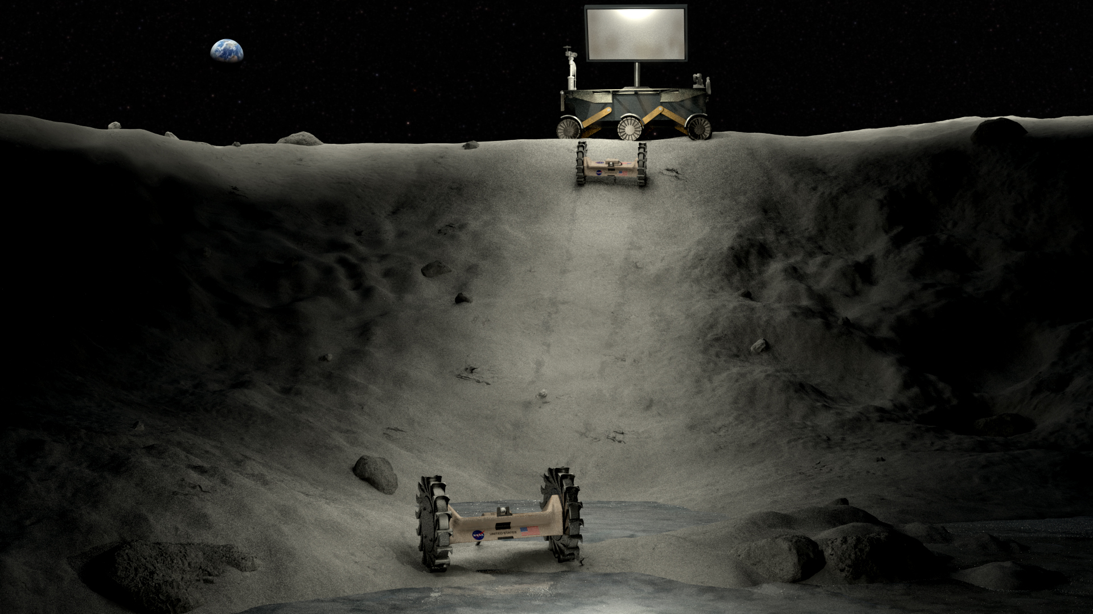
Today’s Agenda
Introductions & General Updates
Subgroup Updates
Danielle Mortensen, JHUAPL – NASA Techport Introduction
Sarah Withee, JHUAPL – ”What You Need to Know About Lunar Communications”

Slide 3
Introductions & General Updates
New LSIC EA members
Mario Lento, new LSIC Extreme Access Focus Area Facilitator
Dr. Alhassan Yasin, Lead POC for new Autonomy Subgroup
Autonomy Workshop
August 21-22, 2023
Fully virtual
More information on agenda and registration will be forthcoming!
Questions on the workshop can be directed to Mario Lento (Mario.Lento@jhuapl.edu) or Danielle Mortensen (Danielle.Mortensen@jhuapl.edu)

Slide 4
Subgroup Updates
Subgroup | Lead POC | Recurrence | Next Meeting
Position, Navigation, and Timing | Marshall Eubanks, Space Initiatives Inc. | 3rd Th @ 3PM ET | 6/15 @ 3PM ET
Communications | Sam Peterson, Swedish Space Corp | 3rd W @ 4PM ET | 6/21 @ 4PM
Autonomy | Alhassan Yasin, JHUAPL | 4th W @ 1PM ET | 6/28 @ 1PM
Mobility Technologies | Maneesh Verma, Stellar Space Industries | Th (Variable) @ 1PM ET | 6/29 @ 1PM
NEW!
Mobility Technologies Subgroup will be feature Joseph Peris from Stells Space giving a talk about the challenges faces by emerging companies in the industry.
Autonomy subgroup will launch this month with its first meeting on Wednesday, June 28th at 1PM. Dr. Alhassan Yasin will be the lead POC and he will spend this first meeting on a general introduction to Autonomy Subgroup.

Slide 5
NASA TechPort Introduction
Danielle Mortensen, Johns Hopkins University Applied Physics Laboratory
Notes:
Chuck is currently a Senior Professional Staff engineer with the JHU-APL Force Projection Sector. During his 40-year career, he has worked on space based, airborne and surface-based RF systems for remote sensing, electronic warfare, and communications at companies including: SRI International, Northrop Grumman, L3Harris, and Lockheed Martin. Among his many duties, he was the Chief Systems Architect on the Space Fence program for the Space Surveillance Network. He has an MSEE from the University of Pennsylvania and an SB from the Massachusetts Institute of Technology. Chuck is an avid astronomer, STEM lecturer for the NASA Jet Propulsion Laboratory. Chuck has published and presented papers on satellite constellation design, space surveillance, multi-channel high bandwidth RF Systems and both airborne and surface based radar. This work was funded as part of an internal research and development program.

Slide 6
NASA TechPort
What is TechPort?
https://techport.nasa.gov/about
NASA portfolio of active and completed technology projects
Specifically looking at “applied research and experimental development”
Use cases for technology developers, researchers, managers, academia, and industry
“Each project in TechPort lists the names and contact details for the program and project managers, as well as the principal investigators and industry/academia partners that worked on the project.”
Contact the TechPort team: hq-techport@mail.nasa.gov

Slide 7
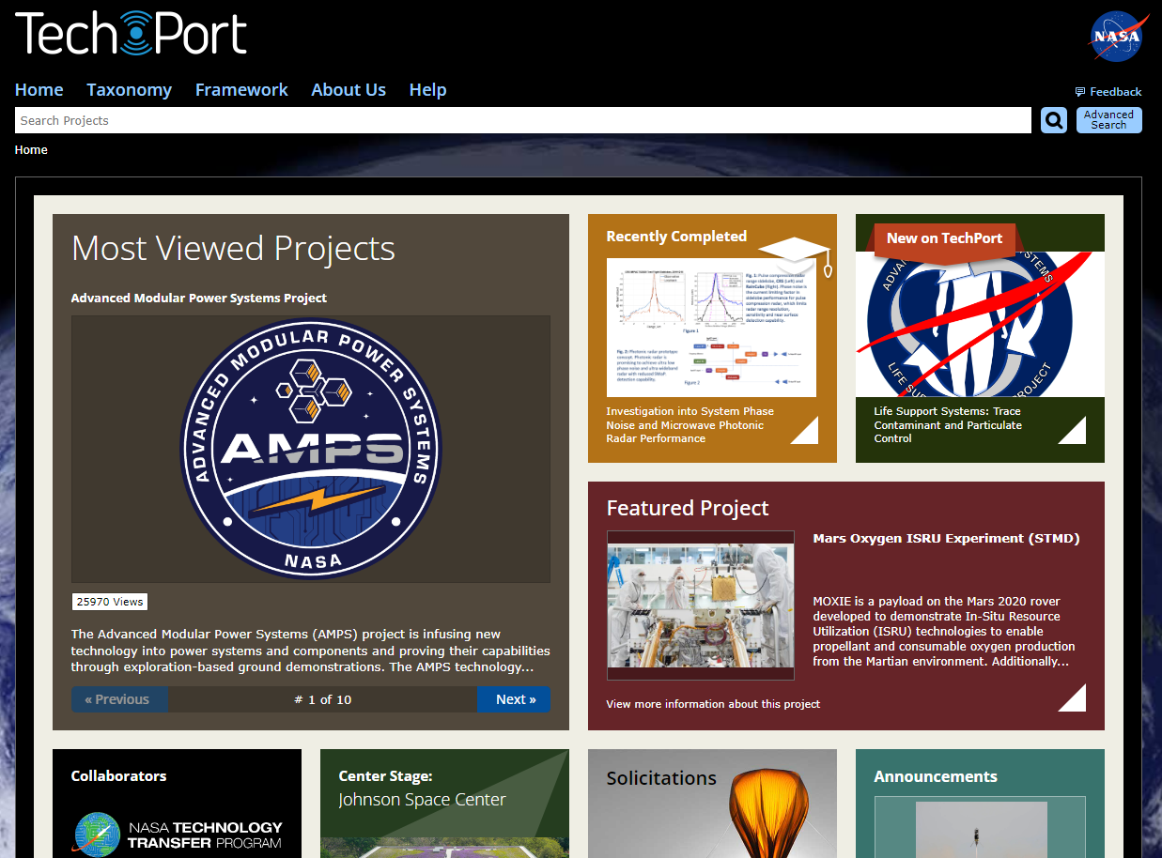
Home
Information
https://techport.nasa.gov/home
Includes:
2020 NASA Technology Taxonomy
Strategic Framework
Funding Opportunities

Slide 8
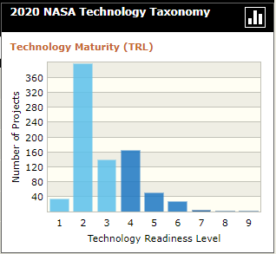
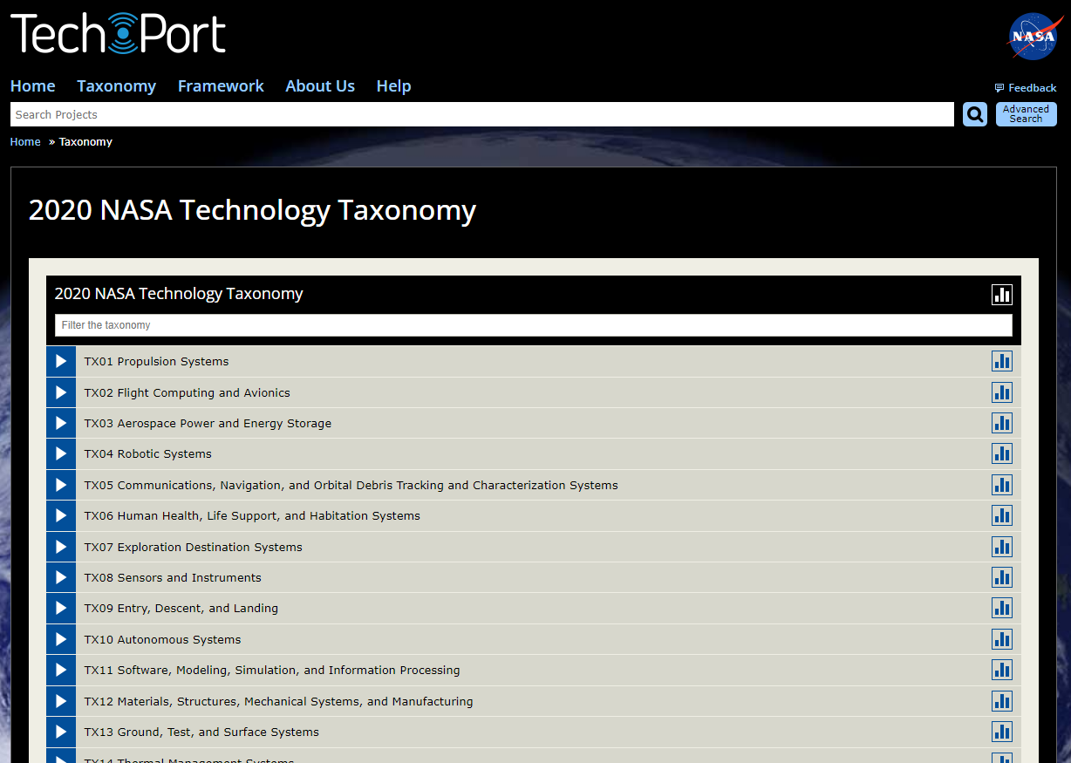
2020 NASA Technology Taxonomy
Information
https://techport.nasa.gov/view/taxonomy
View TRL levels at any point in the taxonomy
Understand where your technology development falls in the overall architecture
View revolutionary technologies in your any field

Slide 9
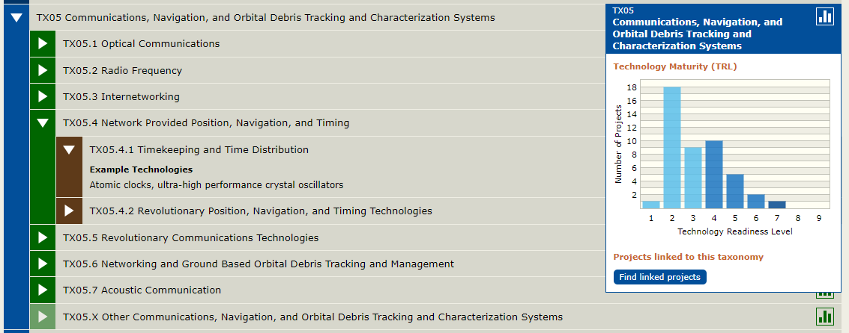
2020 NASA Technology Taxonomy Cont’d
EA is directly present in the following taxonomies:
TX04 Robotic Systems
TX05 Communications, Navigation, and Orbital Debris Tracking and Characterization Systems
TX08 Sensors and Instruments
TX10 Autonomous Systems
TX17 Guidance, Navigation, and Control (GN&C)

Slide 10
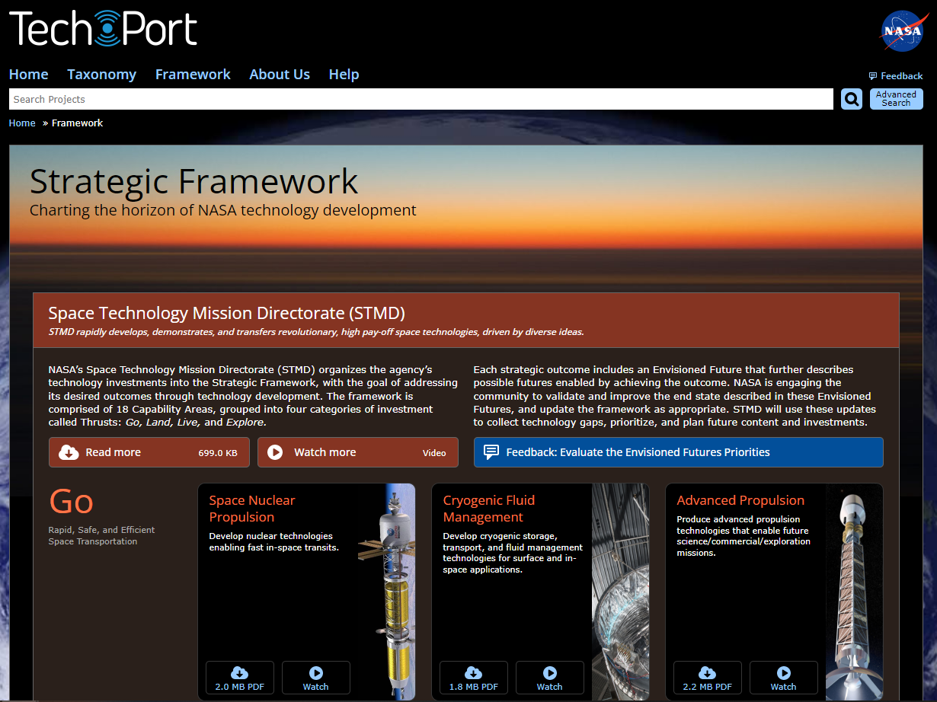
Strategic Framework
Information
https://techport.nasa.gov/framework
18 Capability Areas grouped into areas of investment called “Trusts: Go, Land, Live, and Explore”
Includes opportunities for feedback on Envisioned Futures Priorities

Slide 11
Strategic Framework Cont’d
GO
LAND
Rapid, Safe, and Efficient Space Transportation
Expanded Access to Diverse Surface Destinations
Space Nuclear Propulsion
Cryogenic Fluid Management
Advanced Propulsion
Precision Landing and Hazard Avoidance
Entry, Descent, and Landing to Enable Science Missions
20t Payloads and Lunar/Mars Global Access
LIVE
EXPLORE
Sustainable Living and Working Farther from Earth
Transformative Missions and Discoveries
Advanced Habitation Systems (AHS)
In-Situ Resource Utilization
Power and Energy Storage Systems
Thermal Management Systems
Excavation, Construction, and Outfitting (ECO)
Advanced Avionics
Advanced Manufacturing
Autonomous Systems and Robotics
Communications and Navigation
In-Space Servicing, Assembly, and Manufacturing (ISAM) and Rendezvous, Proximity Operations, and Capture (RPOC)
Small Spacecraft Technologies

Slide 12
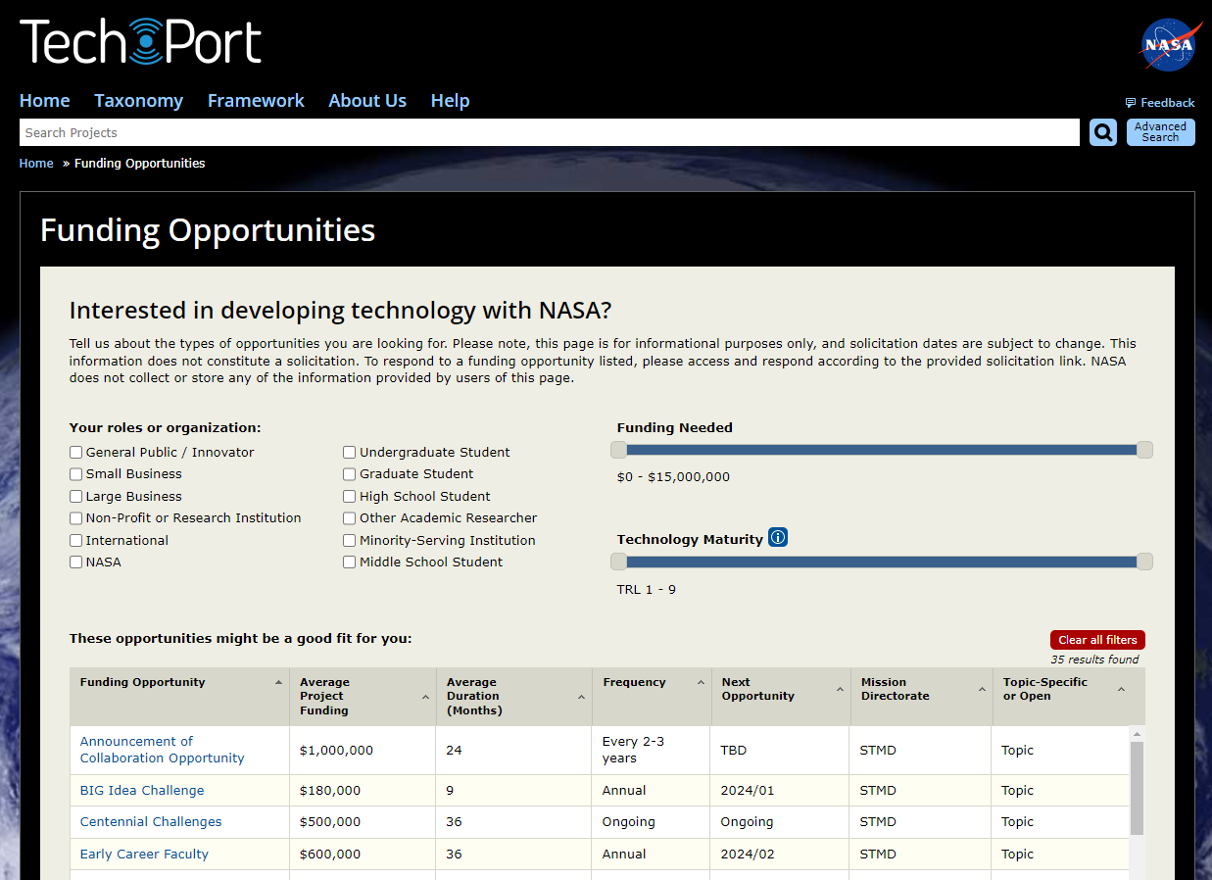
Funding Opportunities
Information
https://techport.nasa.gov/opportunities
Accounts for:
Your role/organization
Funding needed
TRL
Funding up to $15M
TRL 1-9 considered

Slide 13
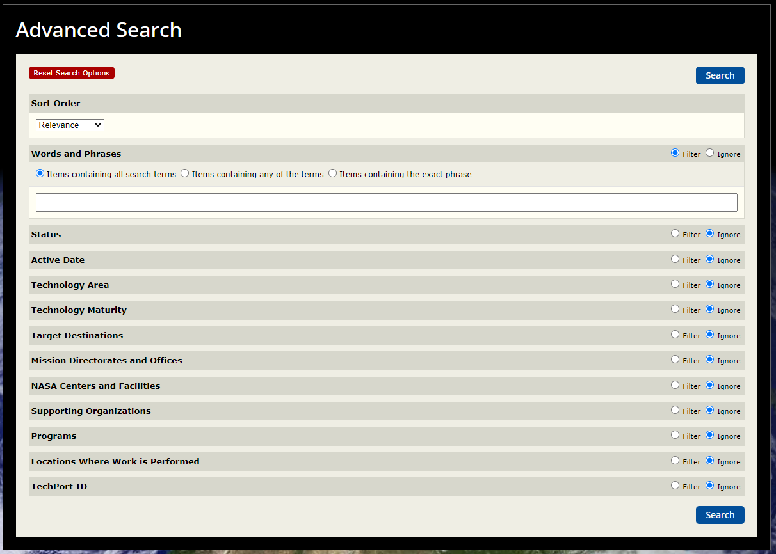
Advanced Search
Information
https://techport.nasa.gov/resetSearchOptions
Search via:
Technology Area
TRL
Target destination
Supporting Organizations
And more!

Slide 14
What You Need to Know about Lunar Comms
Sarah Withee, Johns Hopkins University Applied Physics Laboratory
Notes:
Chuck is currently a Senior Professional Staff engineer with the JHU-APL Force Projection Sector. During his 40-year career, he has worked on space based, airborne and surface-based RF systems for remote sensing, electronic warfare, and communications at companies including: SRI International, Northrop Grumman, L3Harris, and Lockheed Martin. Among his many duties, he was the Chief Systems Architect on the Space Fence program for the Space Surveillance Network. He has an MSEE from the University of Pennsylvania and an SB from the Massachusetts Institute of Technology. Chuck is an avid astronomer, STEM lecturer for the NASA Jet Propulsion Laboratory. Chuck has published and presented papers on satellite constellation design, space surveillance, multi-channel high bandwidth RF Systems and both airborne and surface based radar. This work was funded as part of an internal research and development program.

Slide 15
Presentation overview
Terrestrial vs lunar comms
Earth to Moon/Moon to Earth
Factors limiting availability of comms
Blackouts
Delays
Implications of lunar comms constraints for mission planning and conops
Surface-to-surface comms on the Moon
Relay providers
Concluding thoughts

Slide 16
Terrestrial Comms: Our Day-to-Day
Choose a cellphone provider
Choose pre-built hardware (iPhone, Android, etc) that works with the network
Sign contract with provider and pay fees
Call anyone with a phone number, anywhere, at any time without reservations or blackouts, even if they have a different service provider. Pay a flat rate for voice comms and a certain amount of data.
Notes:
Image credit:
https://www.istockphoto.com/illustrations/cell-phone-tower-drawing
https://www.creativefabrica.com/product/cell-phone-glyph-icon/
https://www.istockphoto.com/photo/contract-signing-female-customer-sign-papers-in-dealership-office-closeup-shot-gm1331285518-414469077
https://techcrunch.com/2021/09/29/lynk-demos-global-satellite-connection-for-ordinary-phones-and-prepares-for-commercial-launch/

Slide 17
Lunar Comms: Current Process
Analyze radio propagation characteristics and communications availability of your operating location
Select a ground station service provider
Select hardware: Radio, Antenna, Amplifier
Develop link budget & Apply to spectrum licensing for transmit (1-2 yrs min.)
Launch & communicate with your provider during scheduled time periods (no 24/7 comms)
RF compatibility testing with your service provider
Sign contract with provider and pay fees
Integrate hardware
Notes:
Image credit:
https://sciencephotogallery.com/featured/1-lunar-landscape-nasascience-photo-library.html
https://www.investopedia.com/best-cell-phone-providers-5093726
https://spaceplace.nasa.gov/dsn-antennas/en/
https://en.wikipedia.org/wiki/Spectrum_management
https://news.mit.edu/2022/communications-system-achieves-fastest-laser-link-space-yet-1130
https://www.istockphoto.com/photo/contract-signing-female-customer-sign-papers-in-dealership-office-closeup-shot-gm1331285518-414469077
https://www.bisinfotech.com/rf-testing-and-measurement-market-in-nutshell/
https://spaceplace.nasa.gov/launching-into-space/en/

Slide 18
Factors Limiting Availability of Lunar Comms
Direct to Earth (DTE) Comms
Relay Comms
Location on the Moon
Do you have a view of Earth?
Does lunar topography permit communication (i.e. no mountain blocking your signal)?
Is your Earth ground station in view?
Just because you can see the Earth doesn’t mean you can see your ground station
Is it your allotted time to communicate with your provider?
Ground station service providers generally utilize a time-division model for comms
Radio frequency interference
We’ve seen this already at Mars, and that was with only ~13 missions operating
Are there relays that service your location on the Moon?
Initial services are focused on South Pole
Is the relay satellite in view?
Relay services will provide comms to multiple clients
This may limit time available to any one client for comms
Radio frequency interference
We’ve seen this already at Mars, and that was with only ~13 missions operating
At present there is no “roaming” from one provider to another. This may change, but for now, your mission can only communicate with your comms provider and no one else.

Slide 19
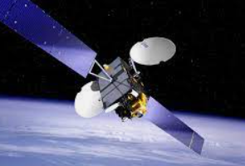
Blackouts of Comms Services at Various Locations on the Moon
South Pole Direct to Earth (DTE)
South Pole relay
Far Side – no DTE, relay only
8-14 day comms blackouts depending on location at the Pole
ESA Lunar Pathfinder best case 10 hours on 2 hours off for South Pole (starting in 2026)
Parsec
No blackouts as long as you have a view of the sky (starting in 2025, according to LSIC comms subgroup presentation 5-17-2023)
Availability and duration of relay services will depend on provider
In all locations, local topography will also affect comms availability
Notes:
Assumptions: you have an unobstructed view of the sky. If a mountain is in between you and Earth/relay satellite, you won’t be able to communicate.
Equatorial and North Pole locations will have different constraints on comms. Understanding your operating location and environment is critical to setting up a successful comms plan.

Slide 20
Terrestrial vs Lunar Comms Availability, Accessibility, and Duration
Lunar
Terrestrial
Set up contact schedule with your provider, most likely for limited duration communications (minutes to hours at a time). At present, you can only contact your service provider. There is no network to connect you to other users.
Call anyone with a phone number, anywhere, at any time without reservations or blackouts and talk for however long you wish
Notes:
Image credit:
https://www.space.com/17638-how-big
https://www.scientificamerican.com/article/what-time-is-it-on-the-moon/-is-earth.html

Slide 21
Delays
Delays will be part of the system, so plan for them!
Includes light time delays and travel time from ground stations to mission ops centers.
Earth-to-Moon
~2.6 seconds round trip light time
Notes:
Implications of delays for mission operations – teleoperation “They show that 400 ms latency is acceptable (they are able to perform stents), delays between 100 and 250 ms did not make a significant difference from no delay, and more than 400 ms delay affected the surgeon's performance.” https://www.frontiersin.org/articles/10.3389/frobt.2020.578805/full

Slide 22
Implications for Mission Planning and CONOPS
DTE comms blackout and lunar night do NOT always occur at the same time
If you are using DTE and you are solar powered/need light to operate, you may not be able to communicate during light periods
Delays of 2.6 seconds are substantial for teleoperation
Delays of greater that 0.4 to 0.5 seconds significantly degrade the performance of human operators
Need to account for the performance hit due to time delay
Rover missions will have different (and more complicated) comms issues than stationary installations
Comms availability depends on your location and whether you are doing DTE or relay.
Notes:
The comms landscape is changing rapidly.
DTE comms blackout and lunar night do NOT always occur at the same time
Is your mission stationary or roving?
If your mission is launching in 2025 or later and you are landing at the lunar South Pole, you will likely have access to one or more relay services. If you are landing elsewhere on the Moon, you will need to contact relay provider to find out if there is any service at your location. Understanding your operating location and environment is critical to setting up a successful comms plan. Region of the moon has an effect on availability, but even within a particular region, there will be differences. For example, various south pole locations have DTE comms blackouts that range from 8 to 14 days. You need to know where you are
Delays will affect teleoperation. Longest delay that seems “real time” to a nhuman is about half a second. Any longer than that you see negative effects on performance. Doesn’t mean you cant do teleoperation but it does mean you need to take that effect into account.

Slide 23
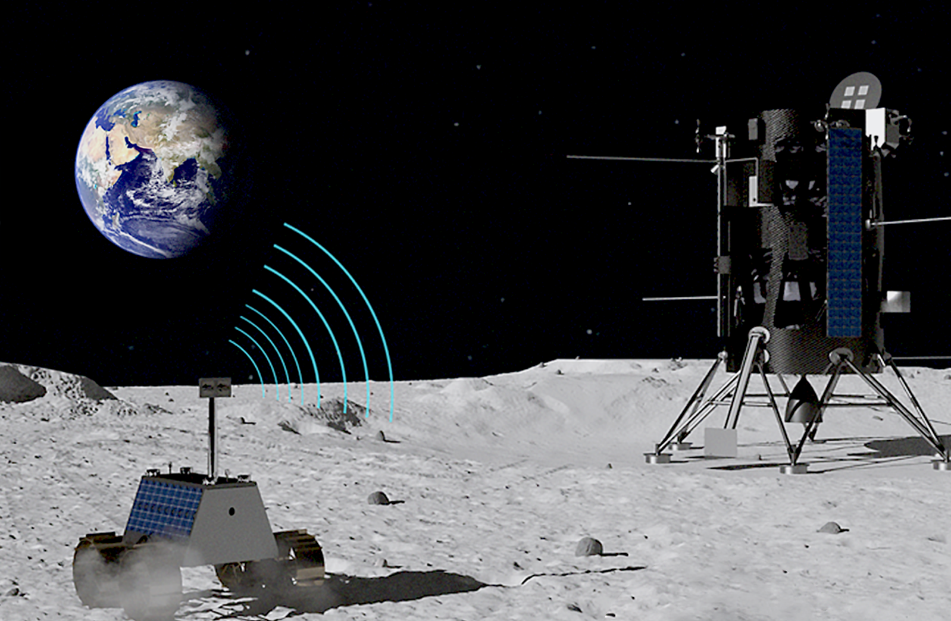
Surface-to-Surface Comms
Currently limited to line of sight (~2 km or less depending on topography)
Due to lack of atmosphere for bouncing signal
Network infrastructure is in very early stages of development
Tech demo from Nokia of LTE/4G tech happening in sometime in 2023
Mission will gather data needed on RF propagation and regolith properties to help validate models used to design cell networks
Notes:
Image credit:
https://www.nokia.com/about-us/newsroom/articles/nokia-aims-for-the-moon-with-lte4g/

Slide 24
Questions to Ask Your Comms Service Provider
Recommend reviewing the Lunar Pathfinder Services Guide to get an idea of what questions to ask:
https://www.sstl.co.uk/getmedia/ea388951-1330-4746-b641-72b7cd65f05a/Lunar-Pathfinder-Services-Service-Guide-V2-3.pdf
What is your pricing model?
Per bit? Per minute? Something else?
Do you provide…
A comms terminal? Or is the mission responsible for providing radio hardware?
Spectrum licensing? Or will the mission be responsible for filing the paperwork for a transmit license?

Slide 25
Upcoming Lunar Relays (Subject to Change)
Lunar Pathfinder (ESA)
Khon2 (Intuitive Machines)
COMMSTAR-1 (CommStar Space)
Operations planned to start in ~2023
Relay services for spacecraft in cislunar space and on the Lunar surface
Plan to have 5 data relay satellites in a variety of orbits
Khon satellites developed by York Space Systems, but owned and operated by IM
COMMSTAR-1 anticipated to arrive by 2023
Optical and radio frequency relay services
“For commercial and government users on and around the Moon”
Working with industry to “permit ‘On-Net’ access to an existing, privately-financed, multi-billion-dollar, diverse global infrastructure – space, ground, fiber, cloud storage, hardware, and software”

Slide 26
Upcoming Lunar Relays (Subject to Change) Cont’d
Parsec (Lockheed Martin)
Near Space Network
Lunar Gateway
Services missions on the Far Side and Lunar South Pole
Two commsats in place by 2025
Low and high data rate options
Real time and store-and-forward options
Also provides Doppler and two way ranging for positioning
Supporting human crewed missions to lunar South Pole
Can support up to 3 simultaneous lunar surface users
Notes:
Image credit:
https://www.nasa.gov/directorates/heo/scan/services/networks/near_space_network/about
https://www.nasa.gov/sites/default/files/thumbnails/image/50494831352_68325590d5_k.jpg

