Slide 1
SMELT Project Smelting with Microwave Energy for Lunar Technologies
Presenter - Alex Baumgartle – Project Co-lead
Faculty Advisors Dr. Sven Bilén Dr. Aleksandra Radlińska
Additional Advisors
Michael R. Fiske (Jacobs/NASA MSFC)
SMELT Team Leaders (Undergraduates) Jack Pierce Alex Baumgartle Patrick Moore SMELT Team Members Samuel Highfield
Colton Washburn
James Connelly
Marisa Tommarello
Craig Olouch
Dokuparthi Avimukta
Chiranjeev Singh

Slide 2
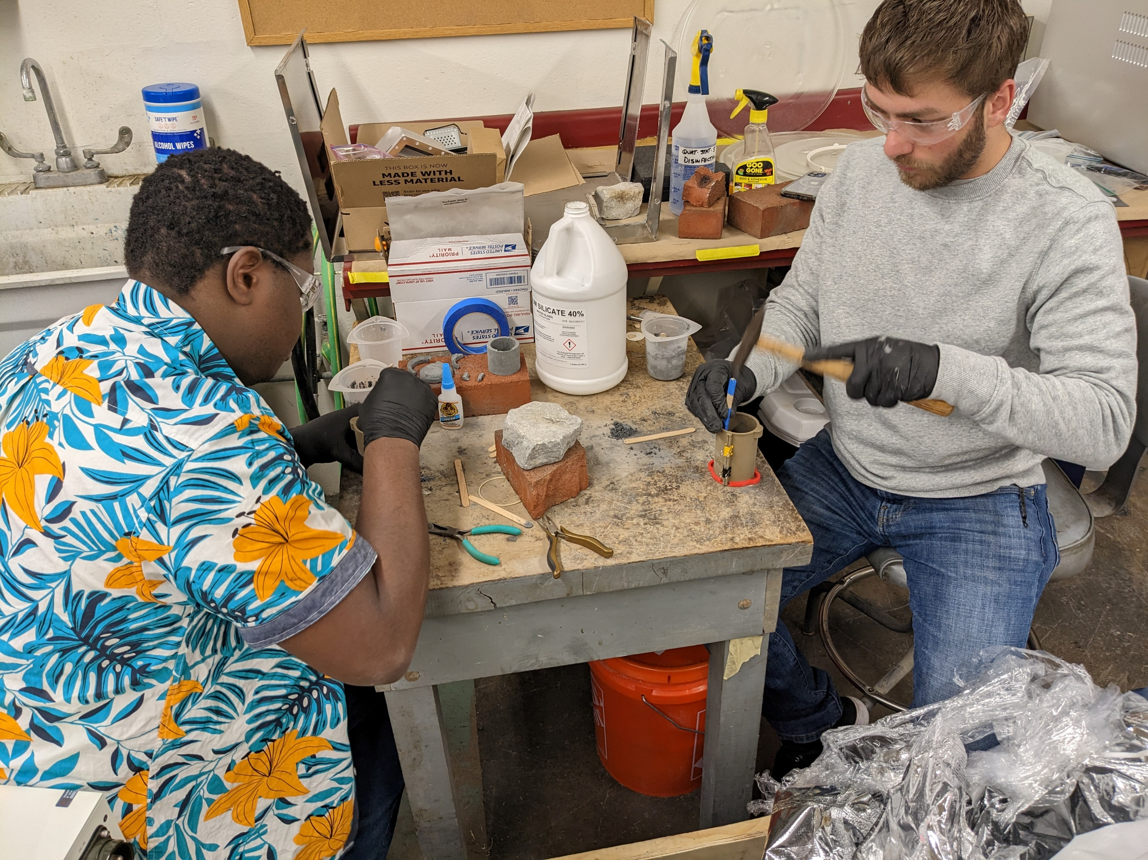
We are!

Slide 3
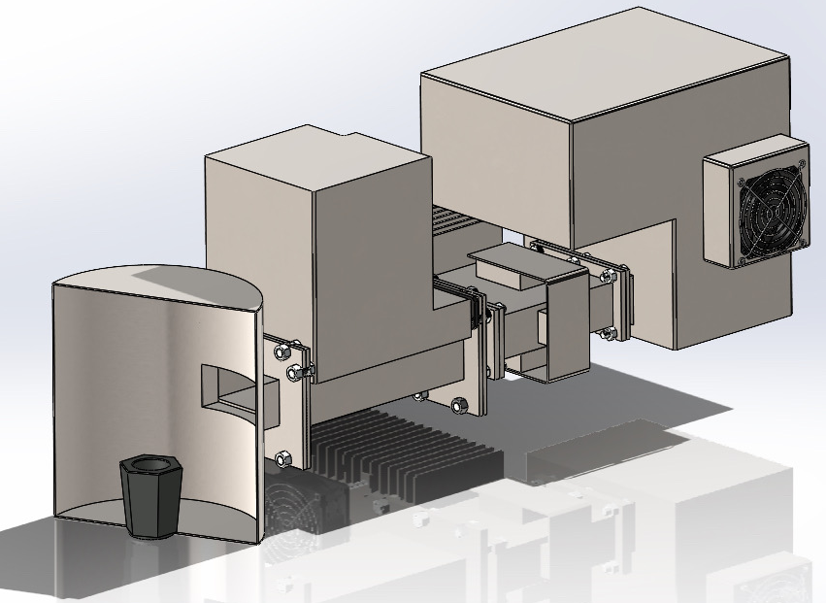
SMELT Project Goals
Utilize microwave radiation to rapidly liquify prepared in-situ materials
Create a device to demonstrate the feasibility of microwave smelting
Explore the benefits of using microwaves as a heat source
Electrically Powered
Minimize consumable materials
Flexibility

Slide 4
SMELT – Three Major Systems
SMELT – Three Major Systems
Four
Microwave System
RF network
Resonance heating cavity
Conveyance System
Improve usability in a lunar environment
Control System
Monitors and controls the microwave system, conveyance system, temperature sensors, and safety features.
Crucibles

Slide 5
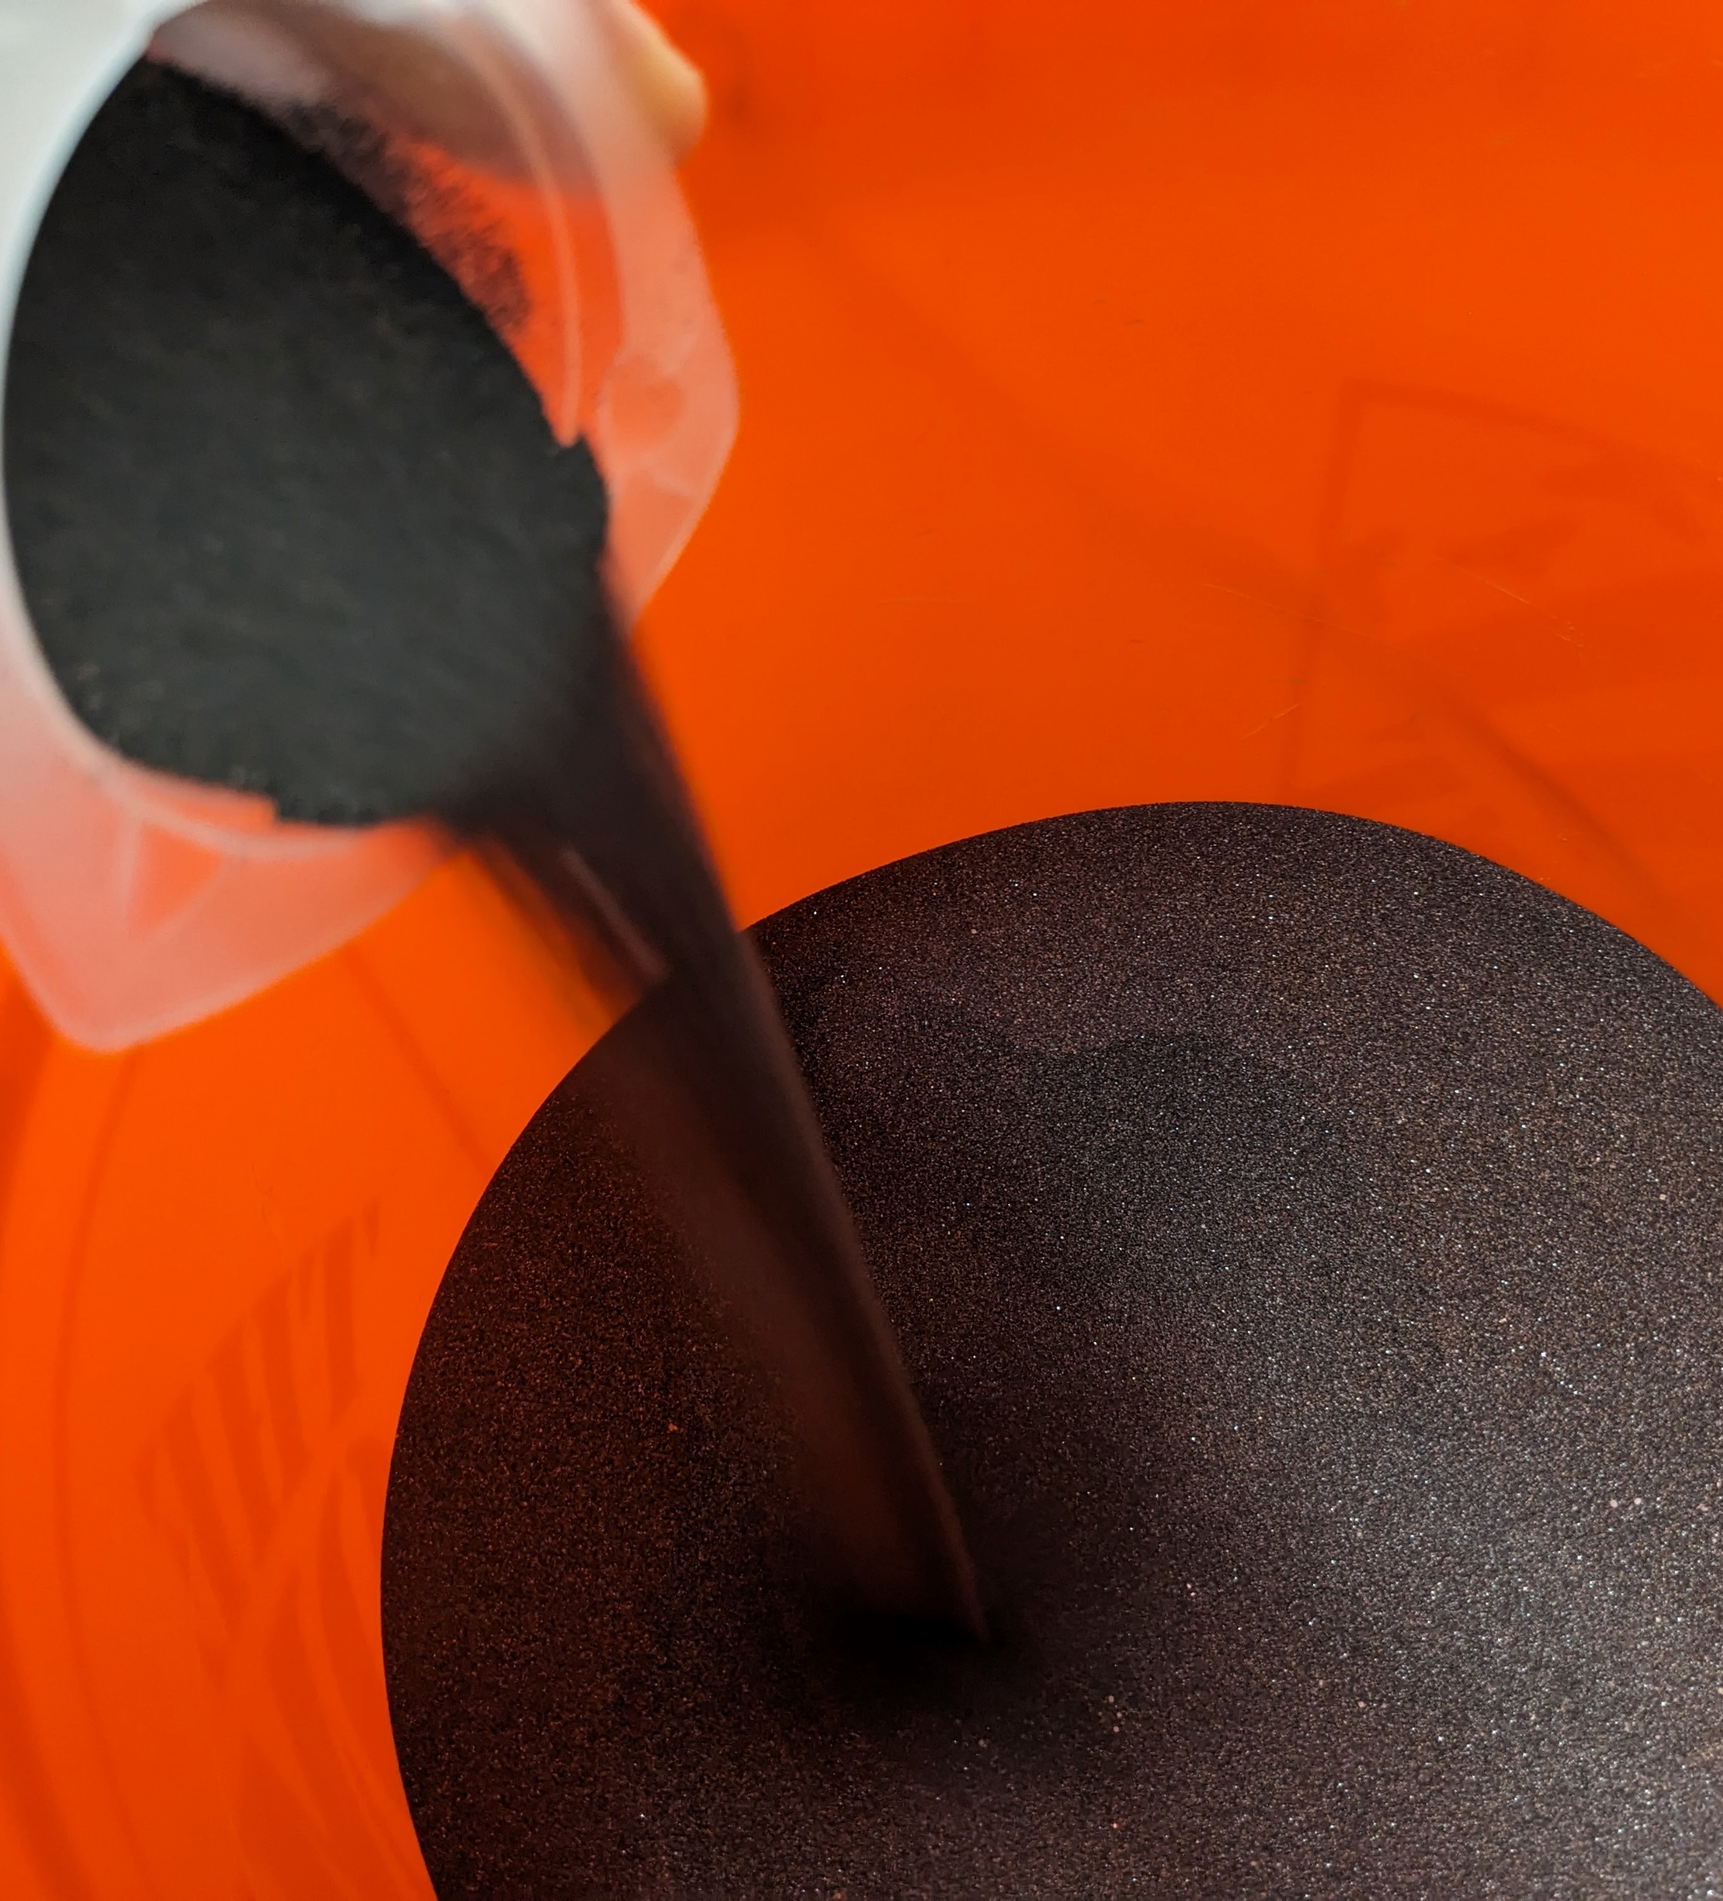
Target Materials
Ilmenite (FeTiO₃)
Recommended by NASA
Iron, Titanium, Oxygen, sources
Semi-conductor
Moderately high melting temperature (1050°C)
Anorthite (CaAl₂Si₂O₈)
Aluminum source
Considered in the design
Higher melting temperature (1550­°C)

