Slide 1
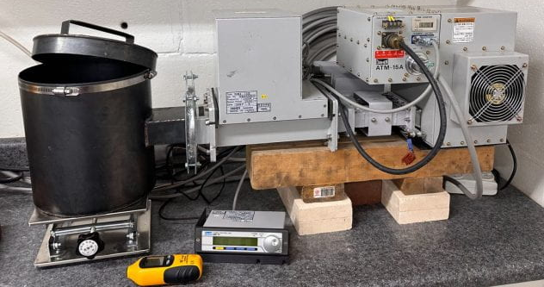
Microwave System
1.5 kW Microwave System
6 kW Solid State Microwave Source

Slide 2
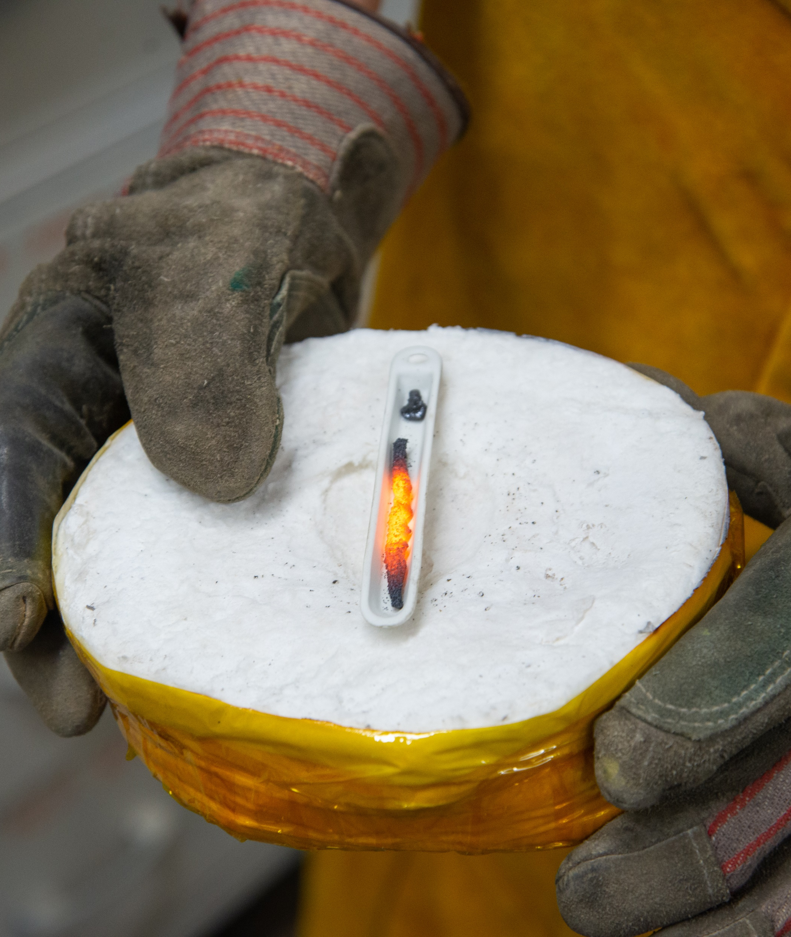
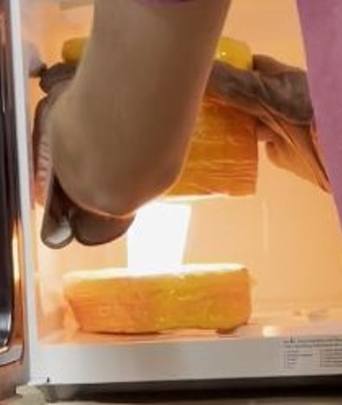
2 Potential Heating Methods
Direct Heating
Conductive Heating

Slide 3
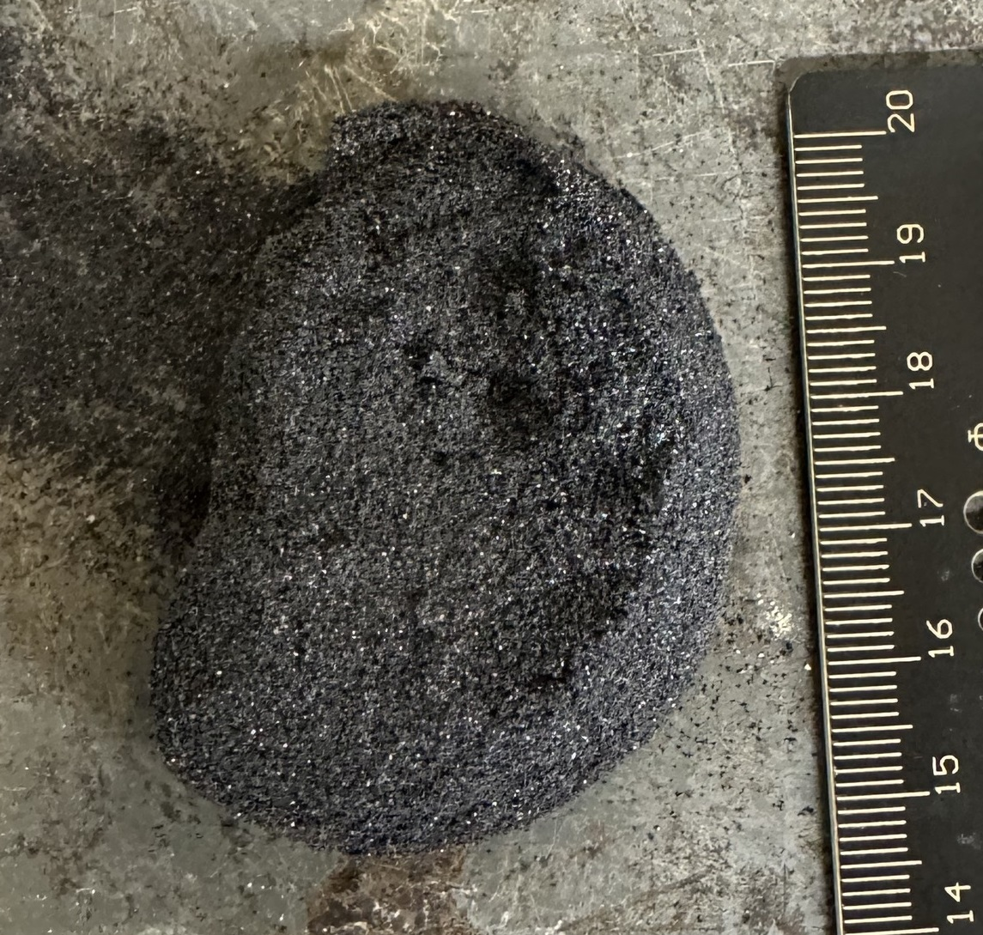
Direct Heating
Use microwave energy to heat the material itself
Just like standard microwave ovens
Very fast!
Dramatic reactions within seconds
Not applicable to metals
Reflect MW rather than absorb them (See ElectroBOOM’s video)
Scalability issues
Localized heating
Best bulk result after 1.5 hours was a sintered mass

Slide 4
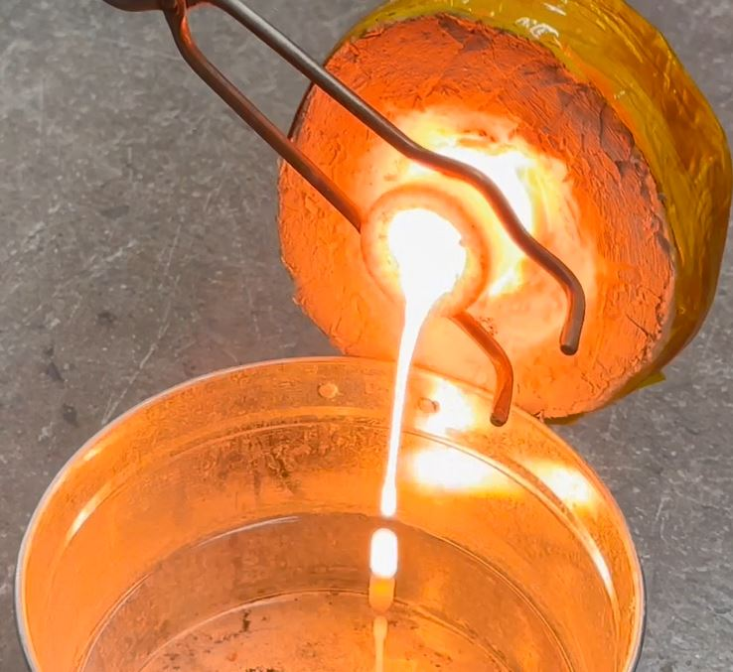
Conductive Heating
Create crucible that heats due to microwave energy
Slower
Melting 10-20 grams takes 15-20 minutes
Applicable to almost anything
The MW energy is absorbed by the crucible material (SiC)
Scalability
Crucible can scale to heat larger loads
Larger chambers present new challenges

Slide 5
Crucibles
Hand-made
Lower-cost
We ruin crucibles
Can make dozens of crucibles for the price of one
Quick Turn-around
3 days from idea to reality
Customization
Size
Shape
Silicon Carbide
Known to heat up due to microwaves

Slide 6
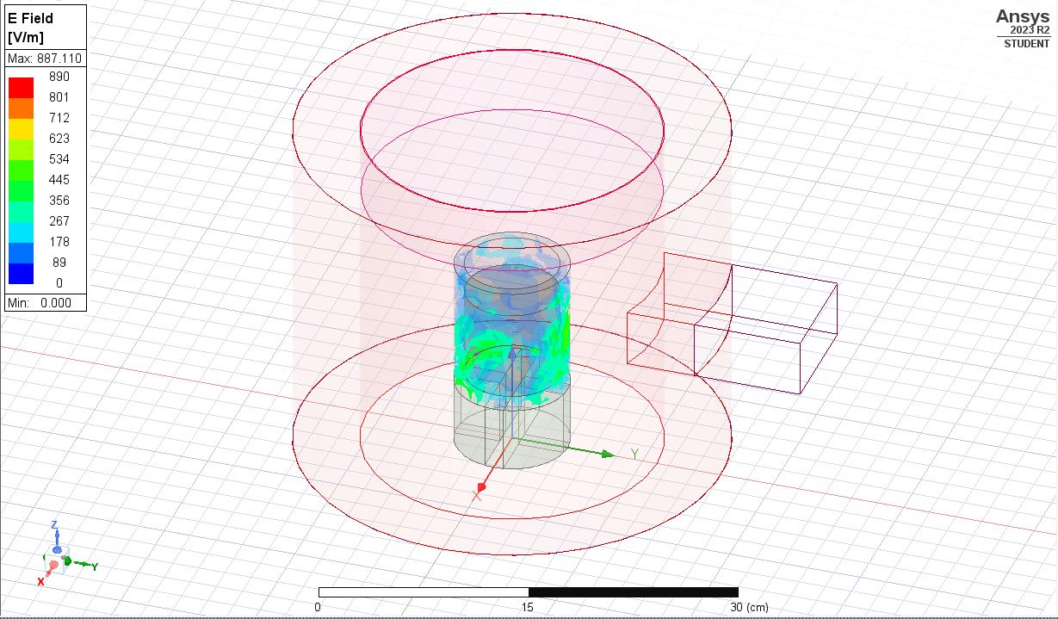
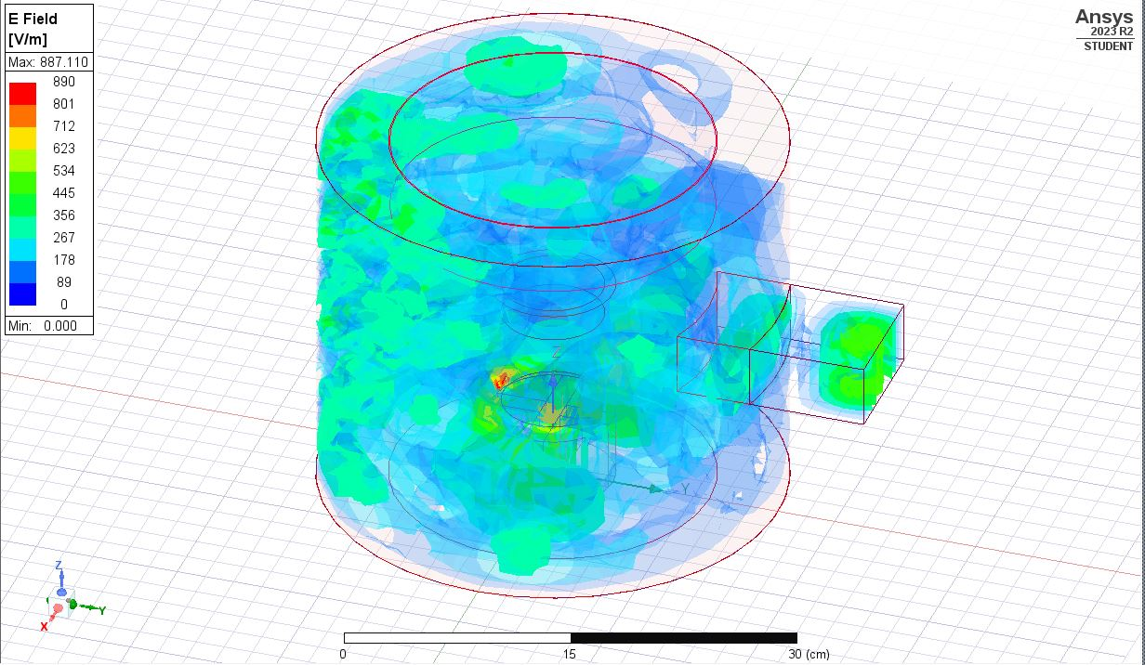
Final Cavity Design
Target mass: 2kg
height: 10cm (~3.9”)
radius: 4.5cm inner (~2.05”)
thickness: 1.25cm (~0.5”)
Ansys Optimization
Radius
Height
Insulation Thickness
Waveguide Location

Slide 7
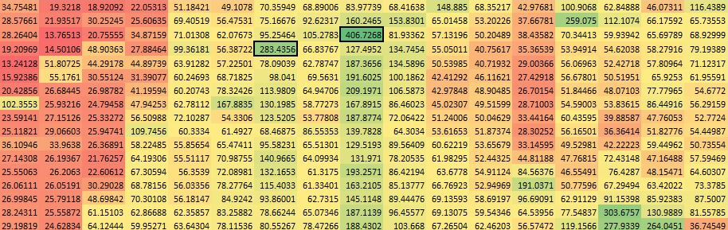
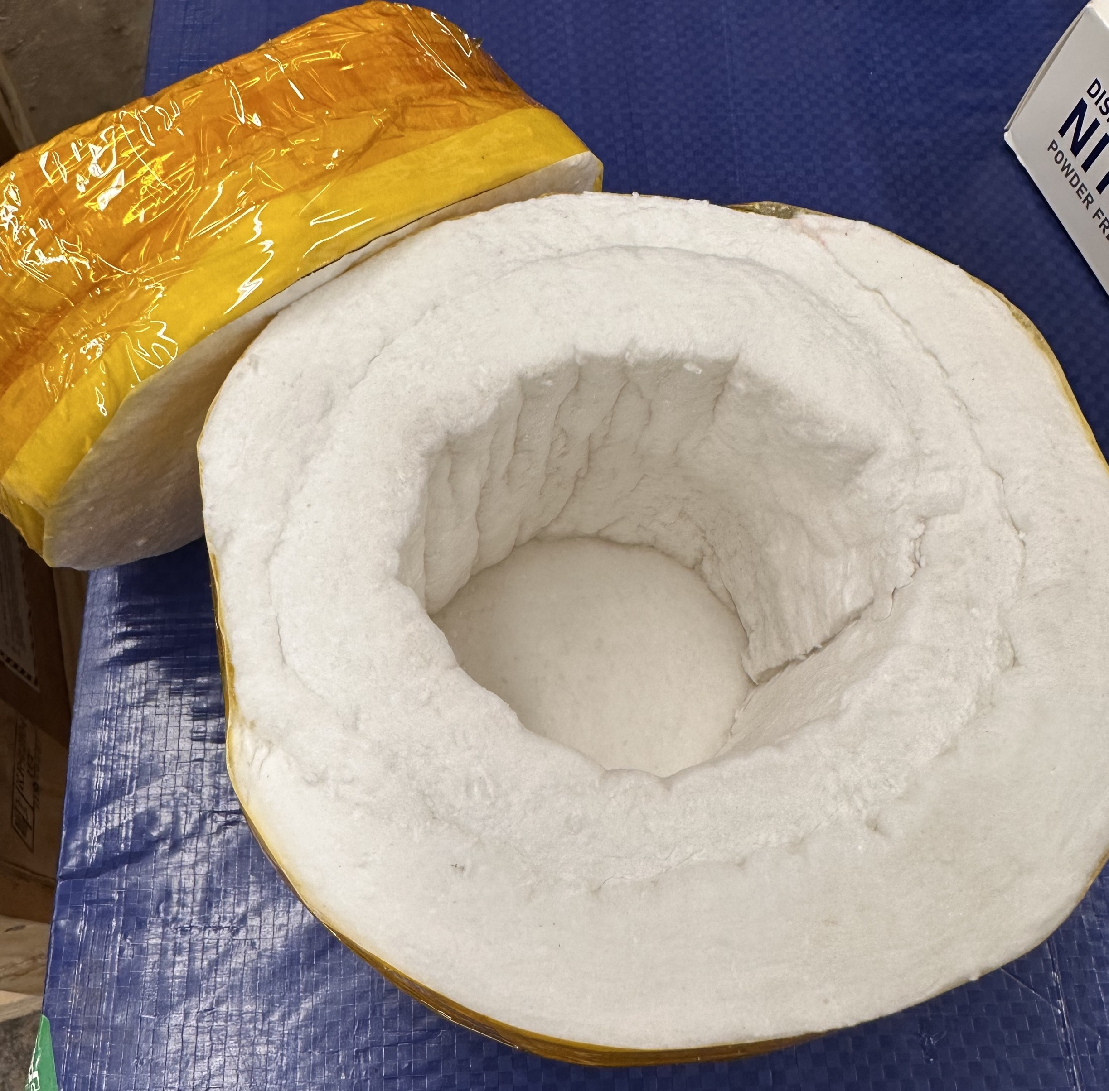
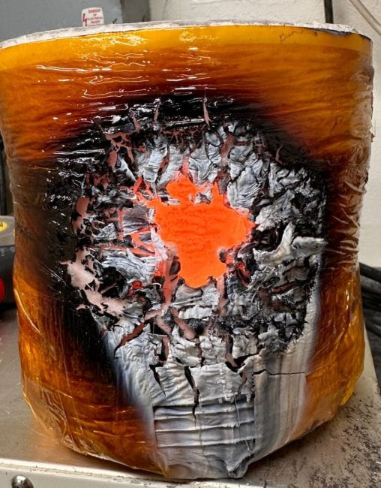
Final Cavity Design
Goals
Maximize E-field in crucible
Minimize S parameter (reflectance)
Account for manufacturing tolerance/error
Insulation
Manage high temperatures
Not heat up from microwaves
Not create microwave traps
Notes:
Ideal radius is 16cm, ideal height is 26.4cm

Slide 8
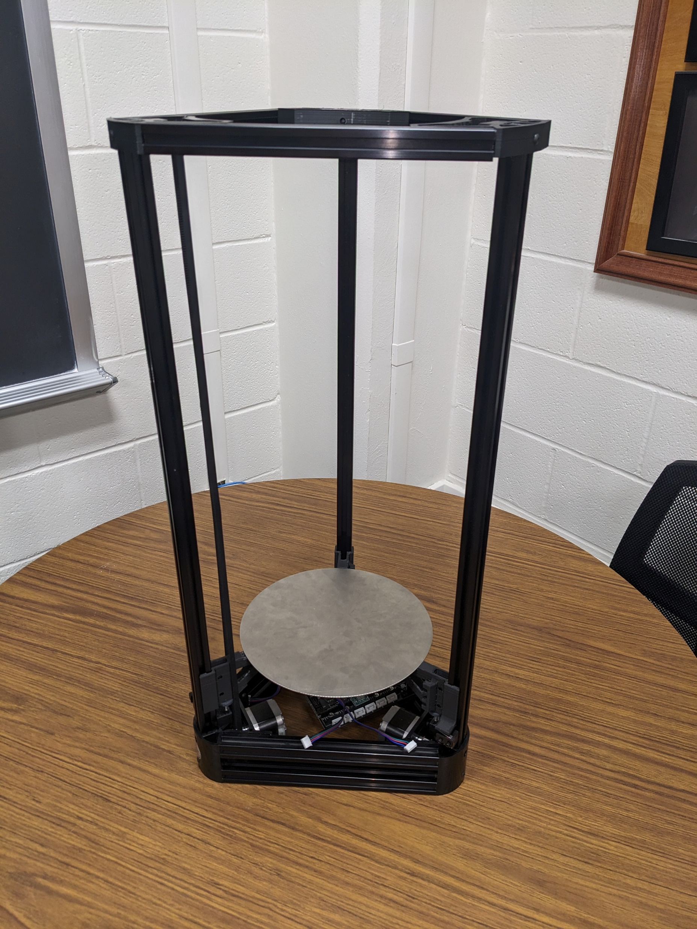
Conveyance System
Ease access to the chamber
Bottom drops out of the cavity
Repurposed 3d printer components
Structure provides framework for microwave leakage safety system
Notes:
Controlled with a toggle switch and limit switches

Slide 9
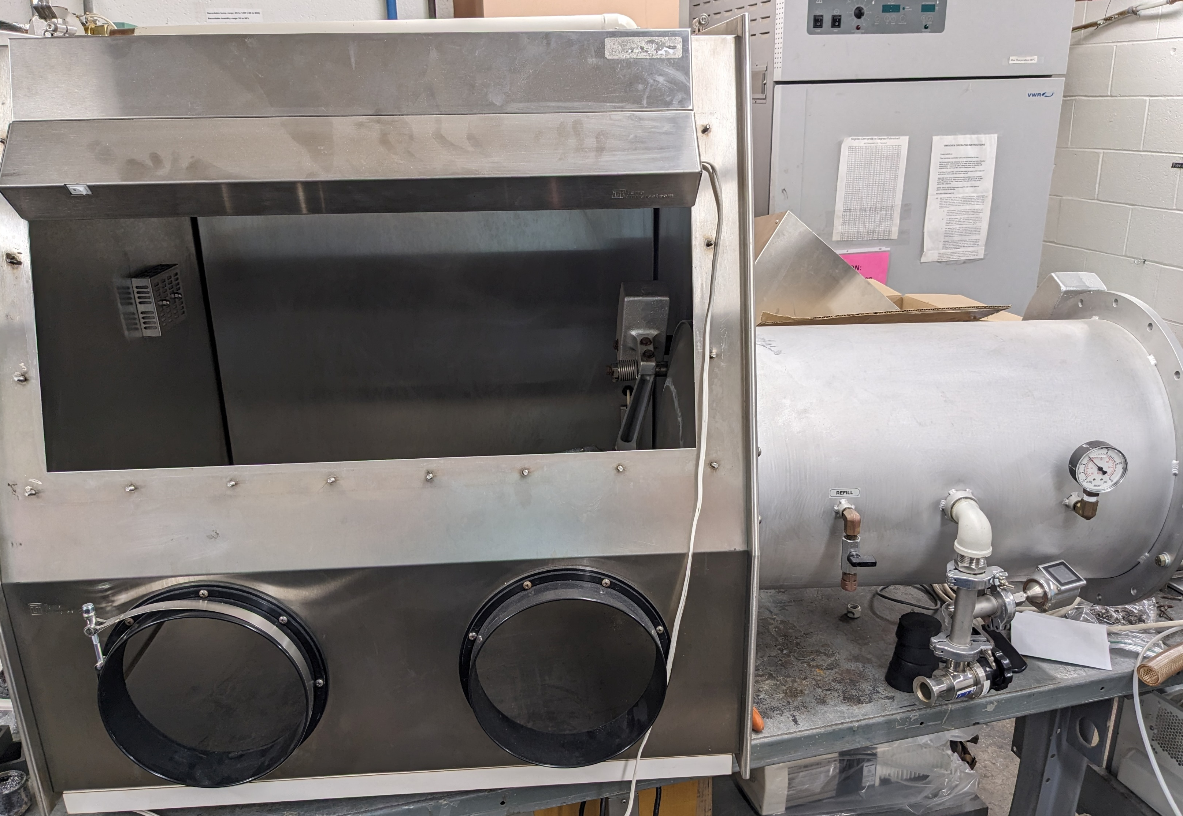
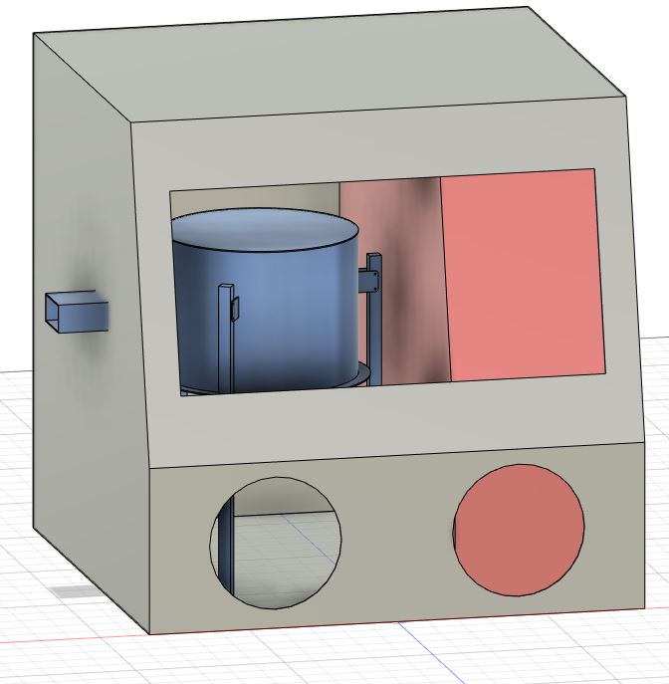
Current Objectives
Energy efficiency testing
A key component to the technology’s lunar viability
Preparing simulated Lunar environment
Lunar environment offers potential benefits
Fabricating final chamber
Ease of access
User-friendliness
Safety features

