Slide 1
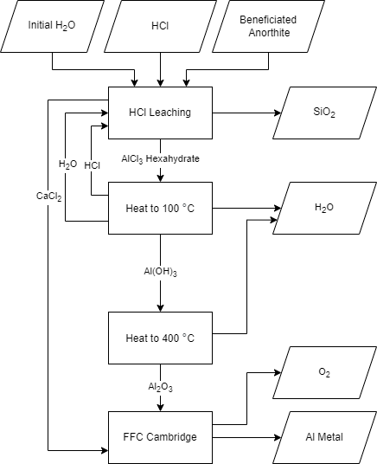
Lunar In-Situ Aluminum Production through Molten Salt Electrolysis (LISAP-MSE)
J. N. Ortega, J. Smith, F. Rezaei, D. Bayless, W. Schonberg, D. Stutts, and D. Han (handao@mst.edu)
Missouri University of Science and Technology, Rolla, MO 65409

Slide 2
Motivation
Artemis base camp
AM application
100% ISRU

Slide 3
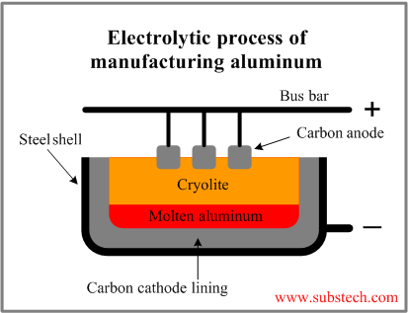
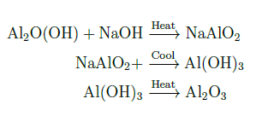
Current SOA on Earth
Current state of the art Bauxite (Al2O(OH)) Sodium aluminate (NaAlO2) Aluminum hydroxide (Al(OH)3) Alumina (Al2O3) Cryolite (Na3AlF6)

Slide 4
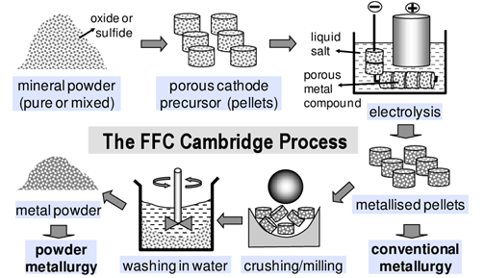
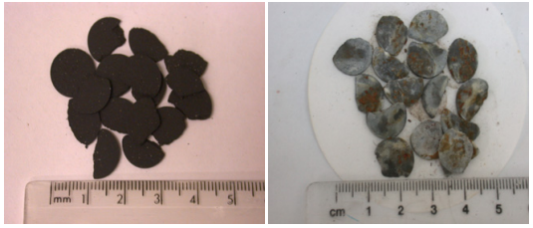
FFC Cambridge Method
Well defined starting point
Tested for numerous oxides Ti, Fe, Zn

Slide 5
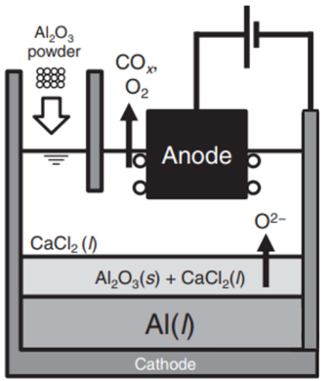
LISAP-MSE Method
LuSTR21
LuSTR23

Slide 6
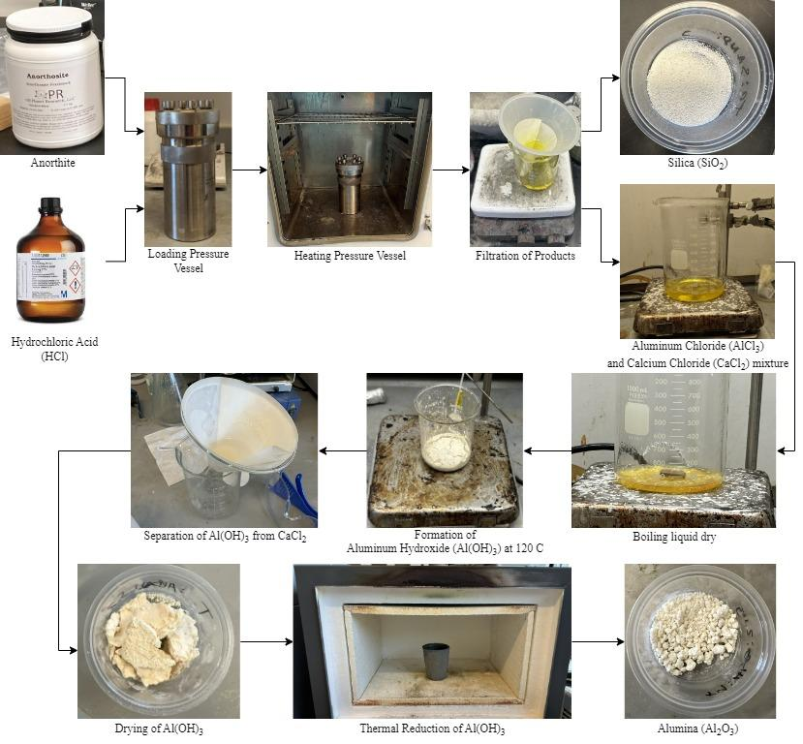
Current Results

Slide 7
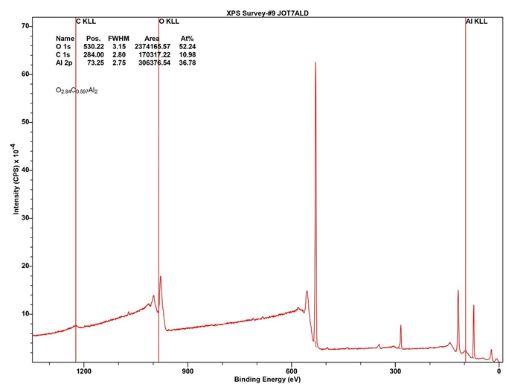
Leaching Characterization Data
O 1s
O_{2.84}C_{0.507}Al₂
Al 2s
Al 2p
C 1s

Slide 8
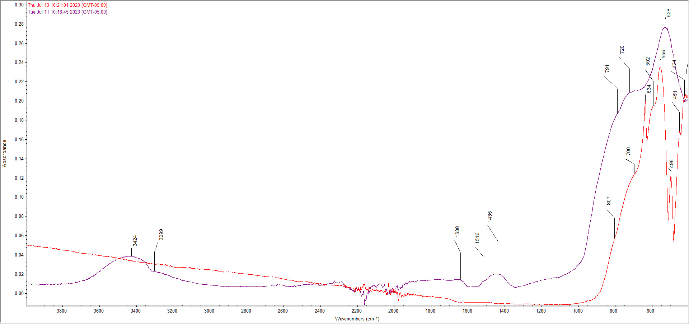
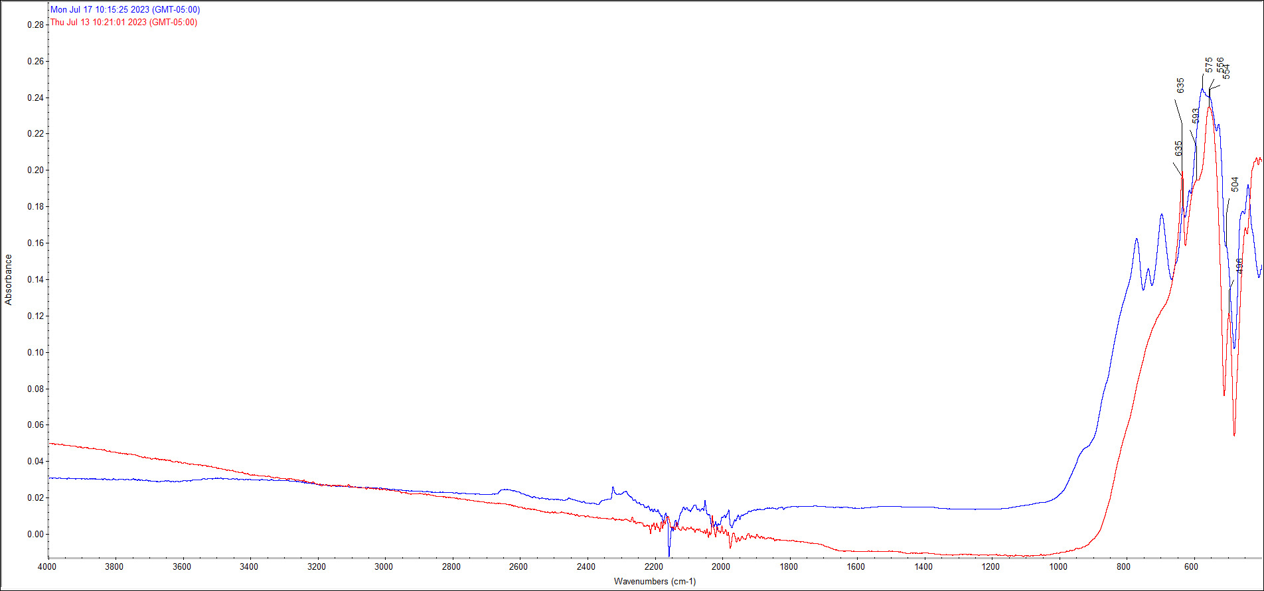
Al-O-Al
Stock Alumina
Reduction at 850 C
Reduction at 1200 C
OH
Al-O-Al

Slide 9
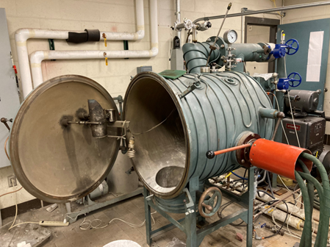
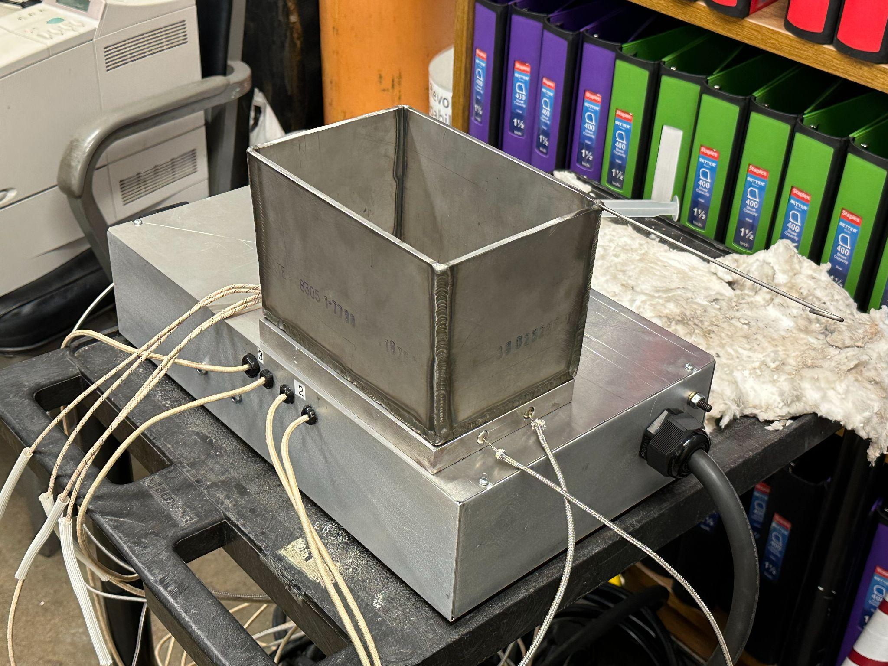
Planned Tests
Electrolysis
MRC characterization: XPS/XRF/XRD/ICP-OES

Slide 10
Acknowledgements
NASA BIG Idea Competition
Kummer Innovation and Entruepreneural Fellowship
Missouri Space Grant Consortium
Dr. Daoru Han and Numerous Undergraduate Researchers

Slide 11
References
Bodner Research Web. Electrolytic Cells. https://chemed.chem.purdue.edu/genchem/topicreview/bp/ch20/faraday.php. Accessed 1/16/2023.
G. Z. Chen. The FFC Cambridge Process for Metal Production: Principle, Practice, and Prospect. In Proceedings of the Third International Slag Valorisation Symposium, March 2013.
K. C. T. Kilby, L. Centeno, G. Doughty, S. Mucklejohn, and D. Fray. The Electrochemical Production of Oxygen and Metal via the FFC-Cambridge Process. Space Resources Roundtable, 8:64–65, 01 2006

Slide 12
Questions?

