Slide 1
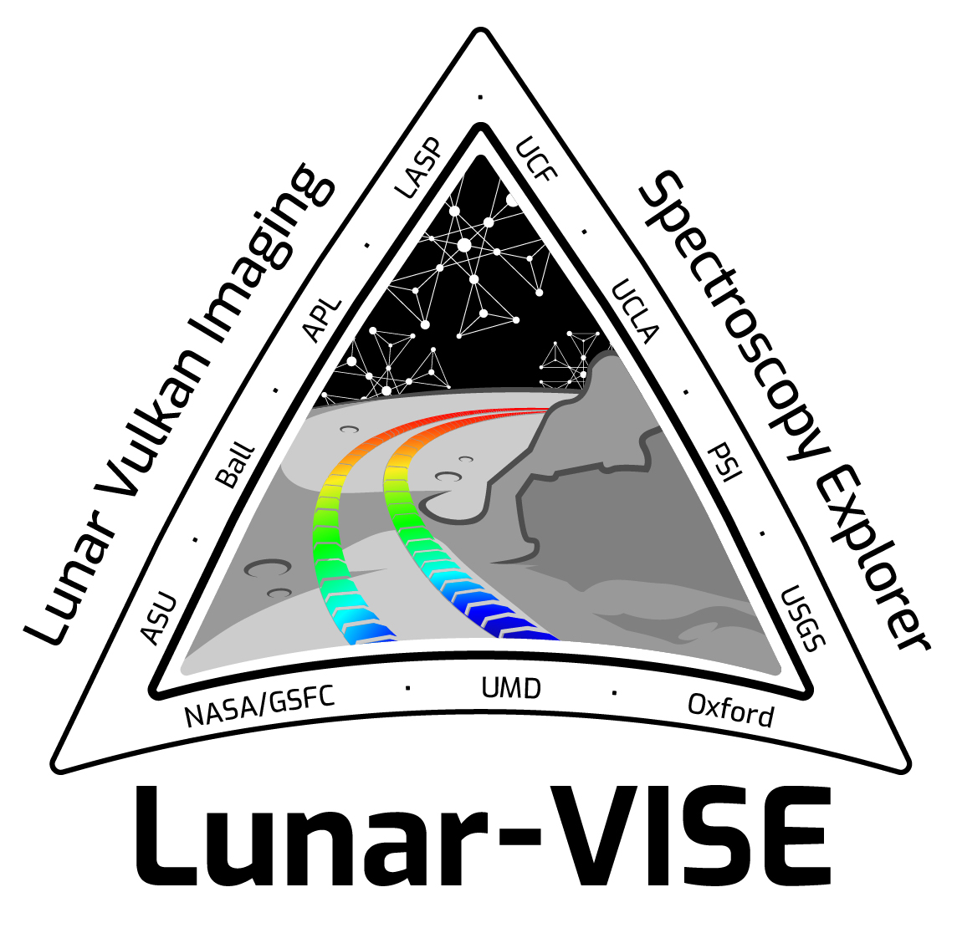
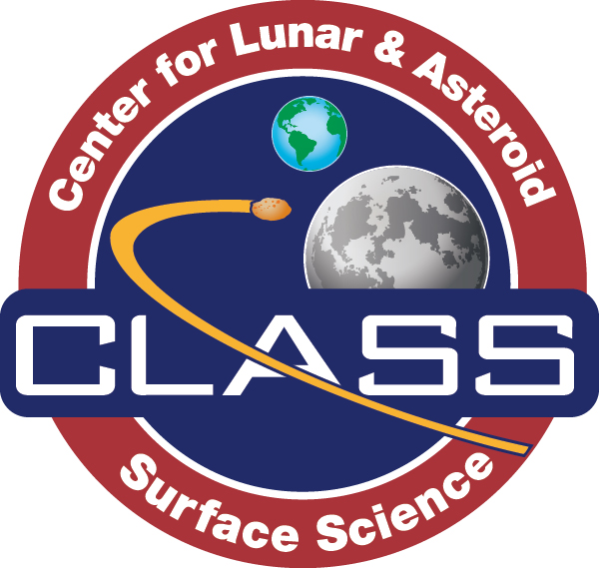
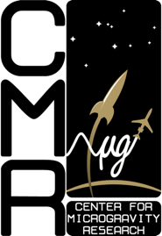
Dr. Addie Dove
Planetary Scientist
Research driven by the links between science and exploration, and how
scientific understanding can enhance and enable human and robotic exploration
Research focuses on:
dust charging and dynamics on planetary surfaces,
plasma interactions with planetary and spacecraft surfaces
planet formation
Significant projects/awards:
Deputy PI, Center for Lunar and Asteroid Surface Science
Deputy PI, Lunar-VISE mission selected through NASA PRISM
PI of UCF’s first flown CubeSat (SurfSat – launched Sept 2018)
NASA Flight Opportunities Awards for parabolic, suborbital flights
Involvement in a series of ISS Flight Experiments
NASA SSERVI Neibur Early Career Award 2017
UCF Luminary Award 2018
UCF Reach for the Stars Award 2021
UCF Research Incentive Award 2021
https://sciences.ucf.edu/physics/microgravity
https://sciences.ucf.edu/class
https://planets.ucf.edu

Slide 2
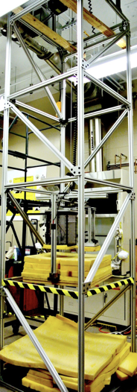
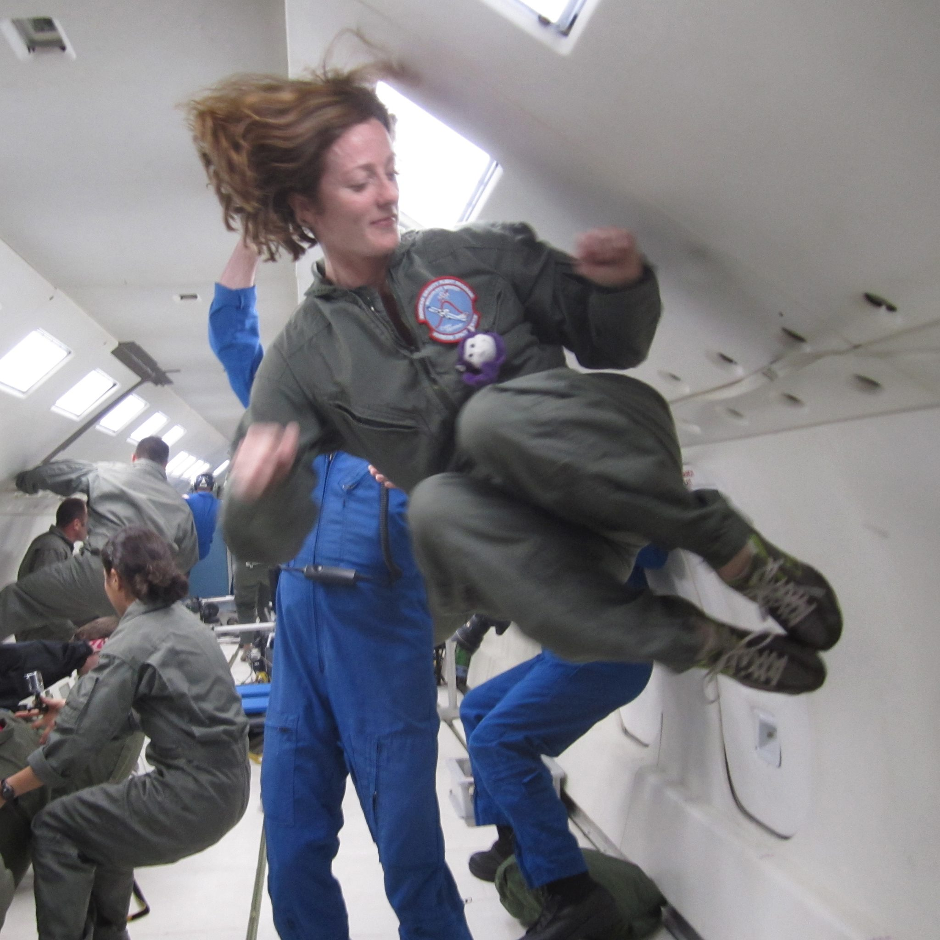
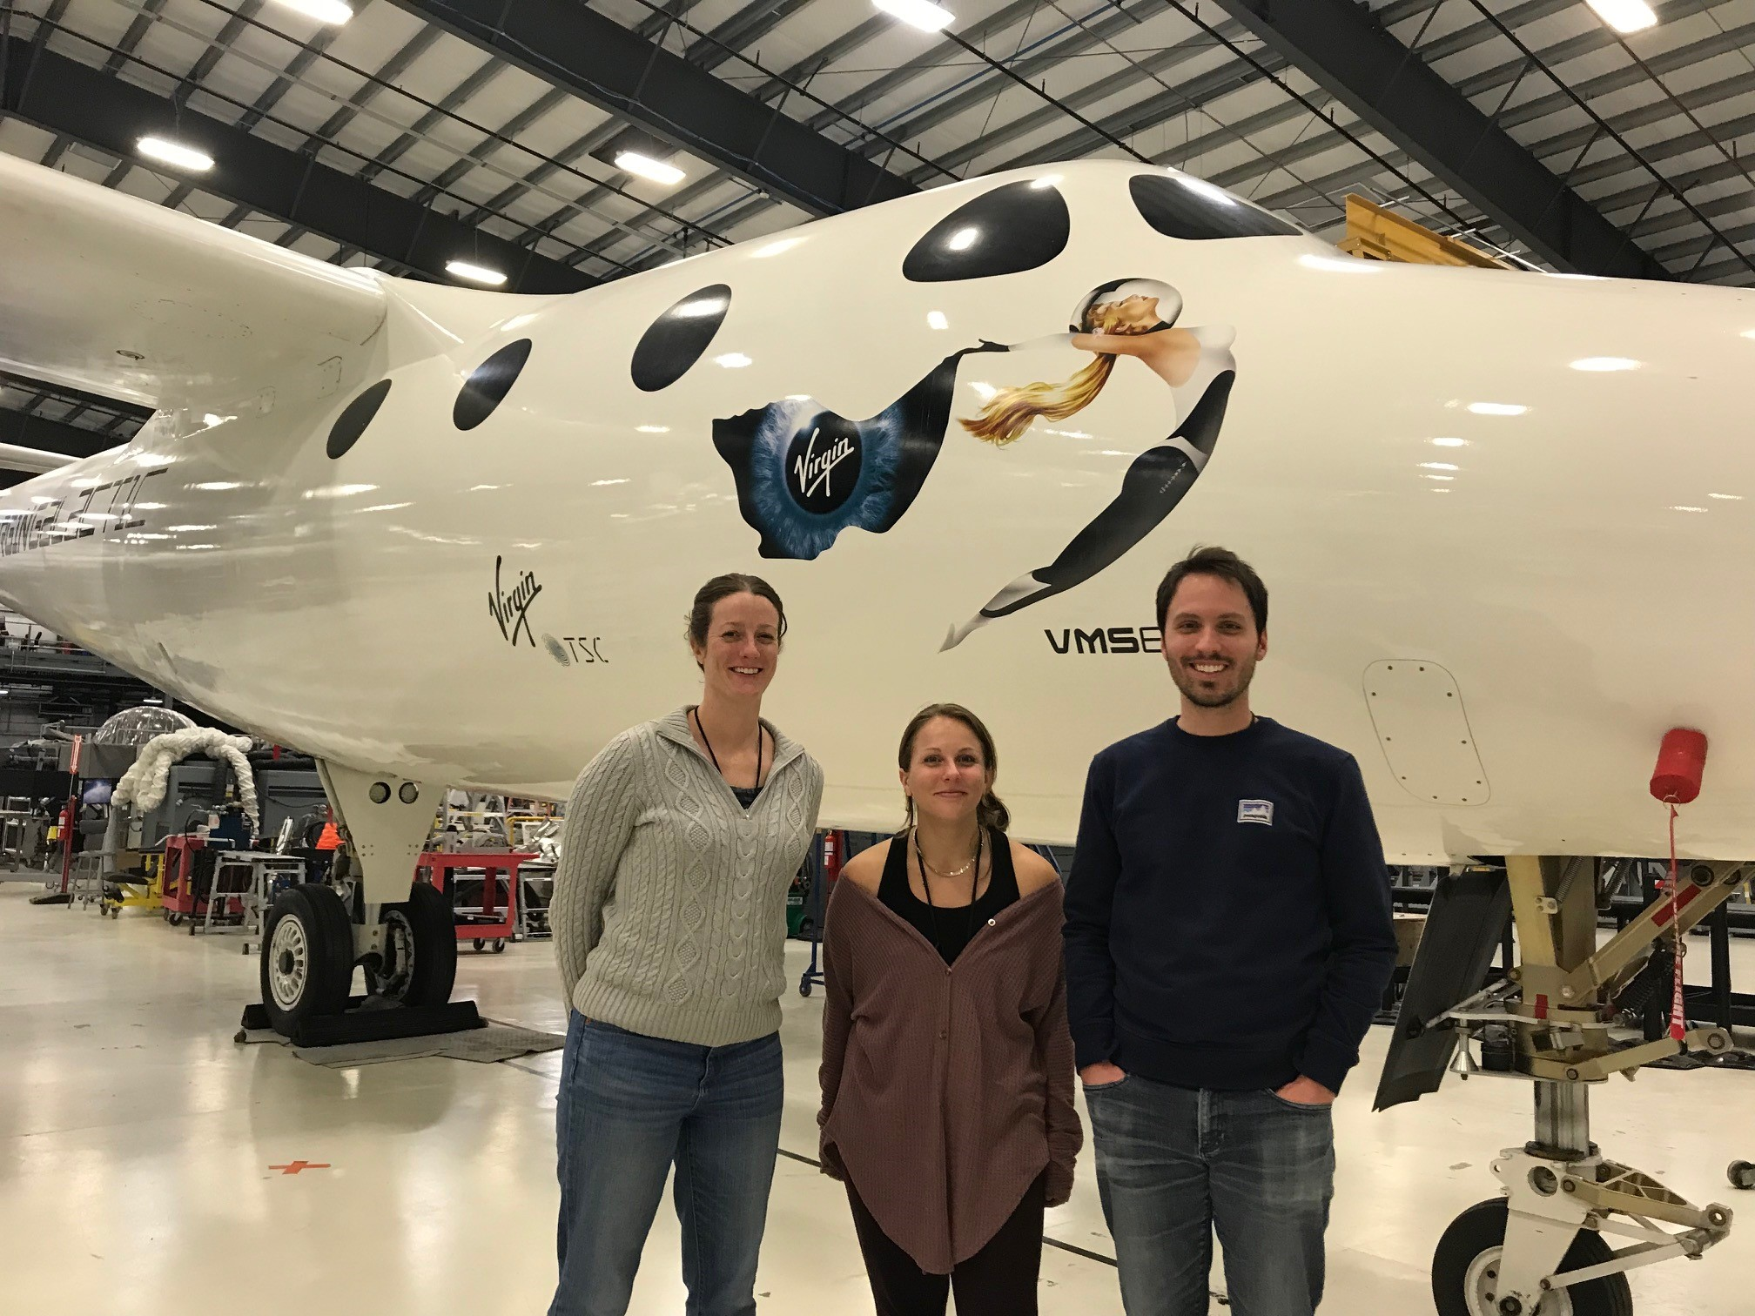
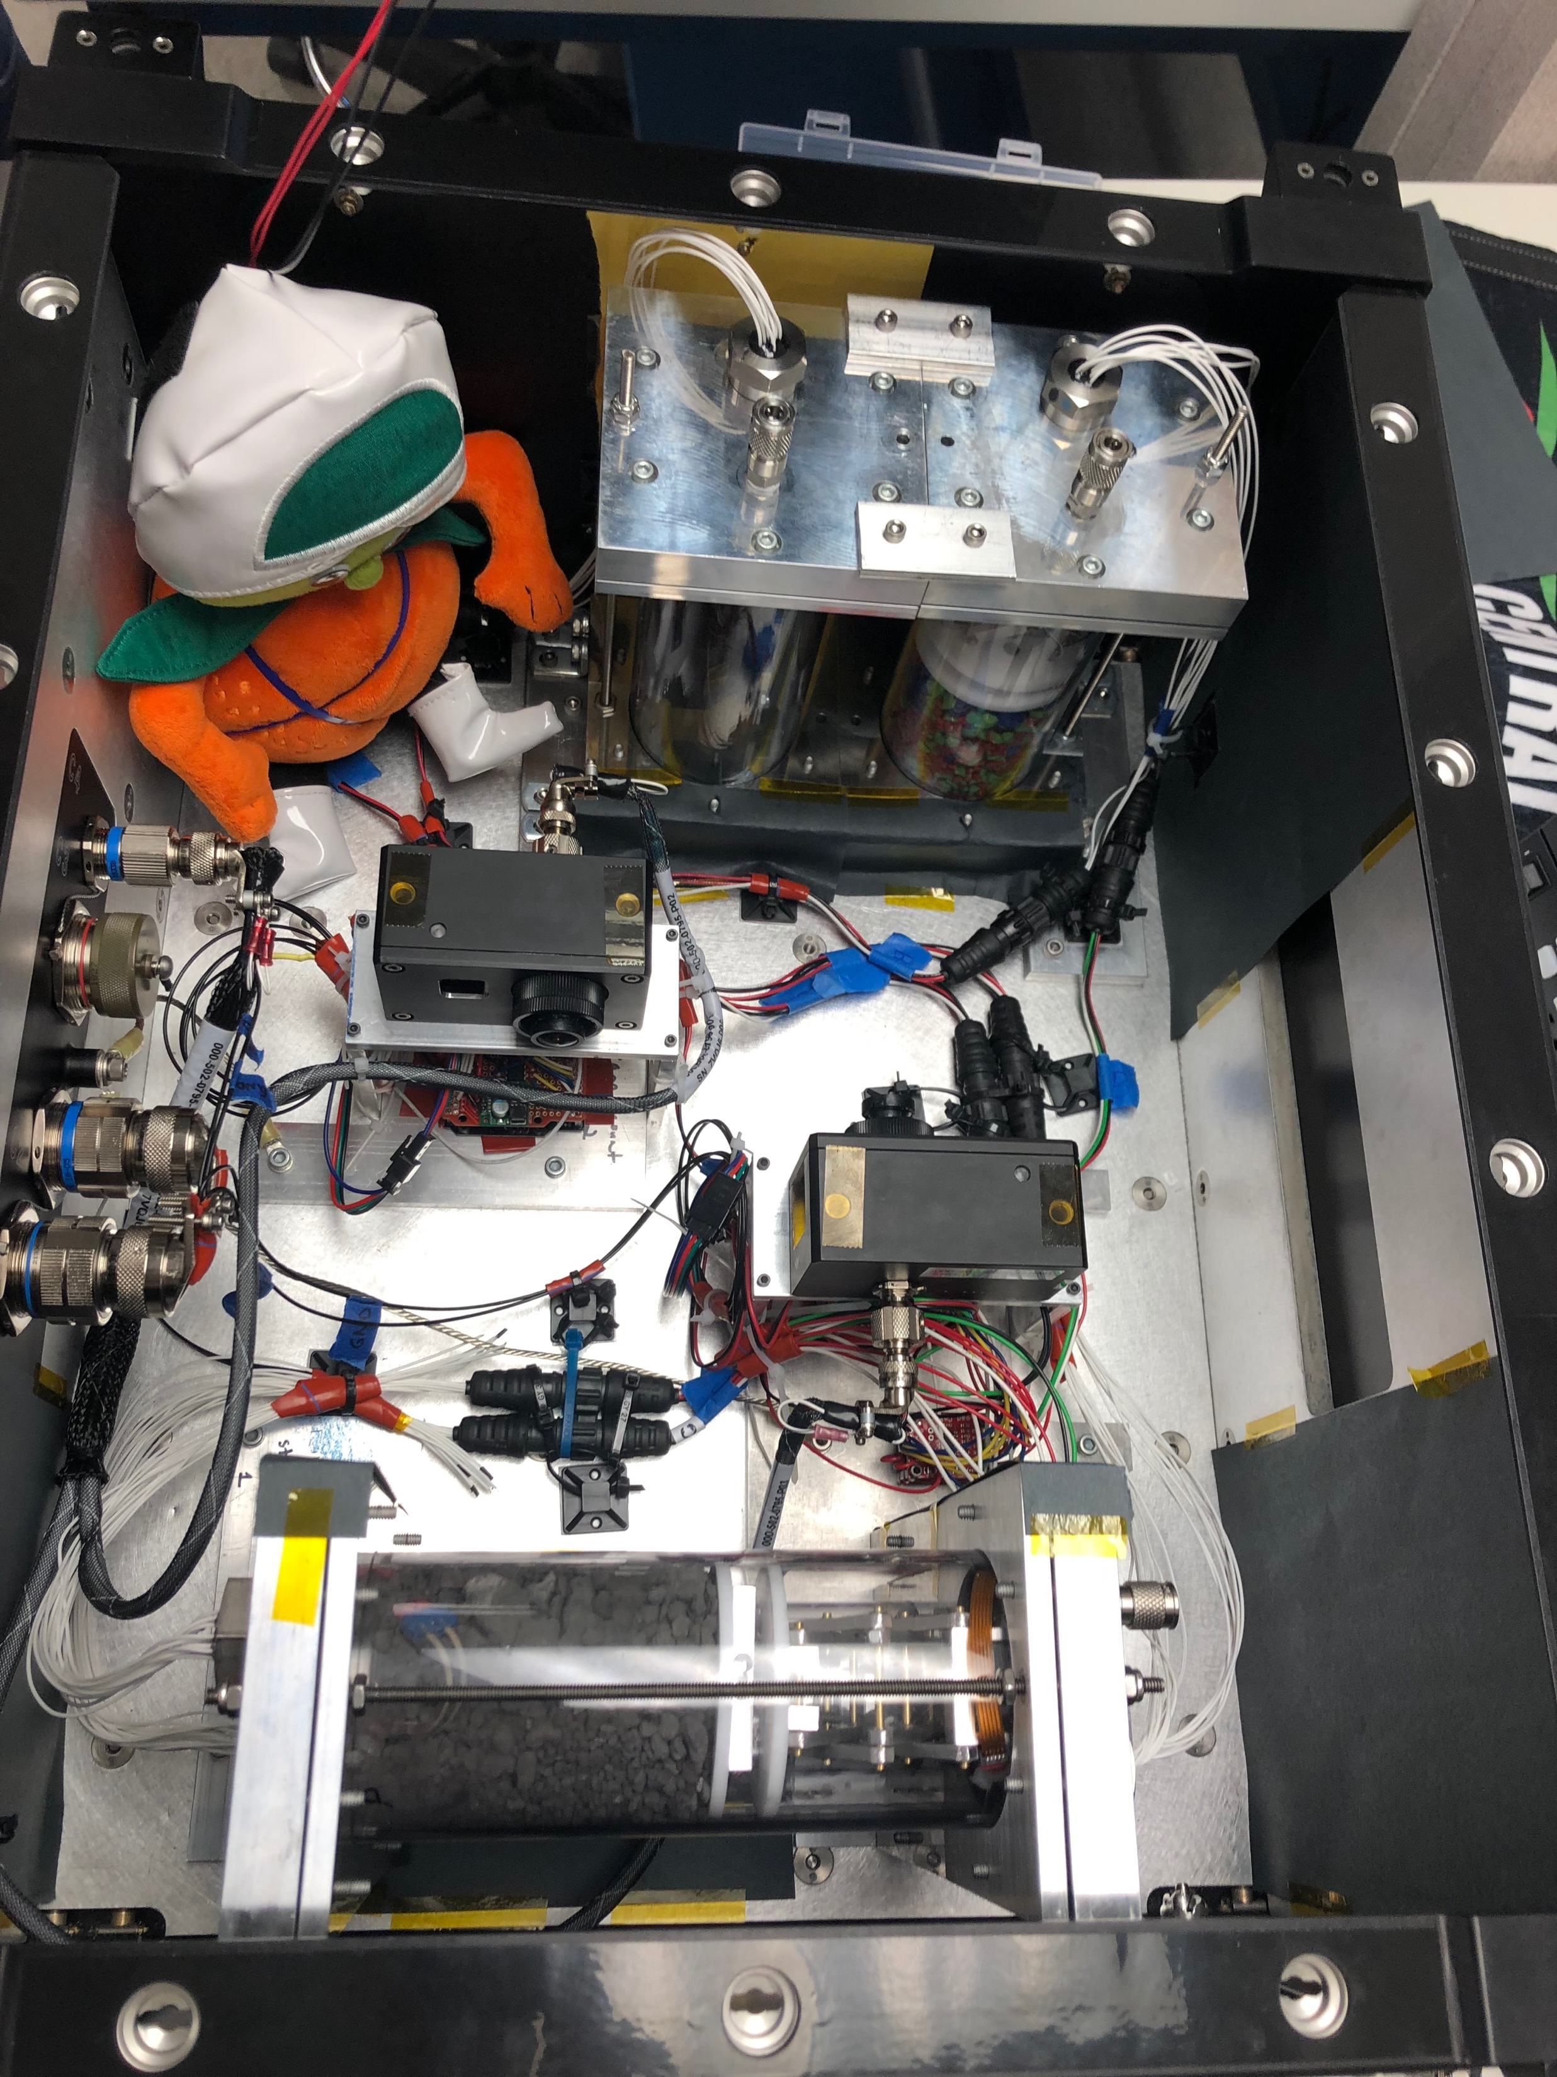
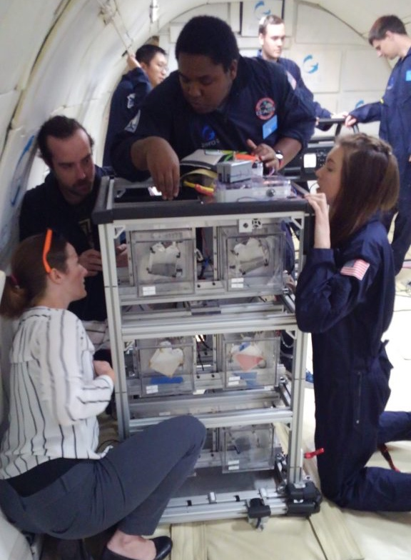
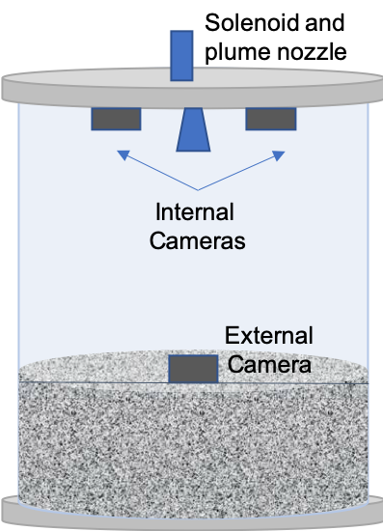
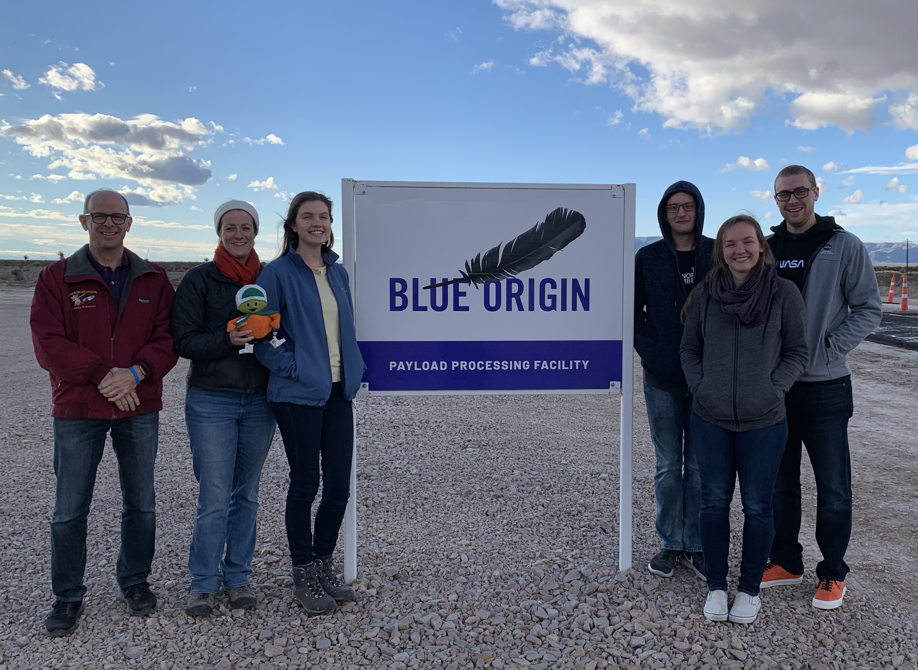
Microgravity, Regolith Experiments
https://sciences.ucf.edu/physics/microgravity

Slide 3
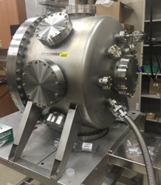
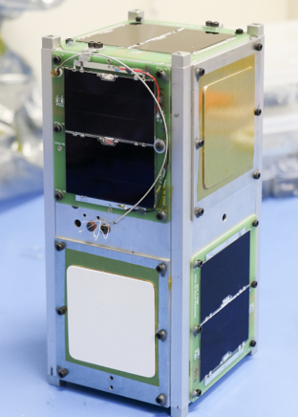
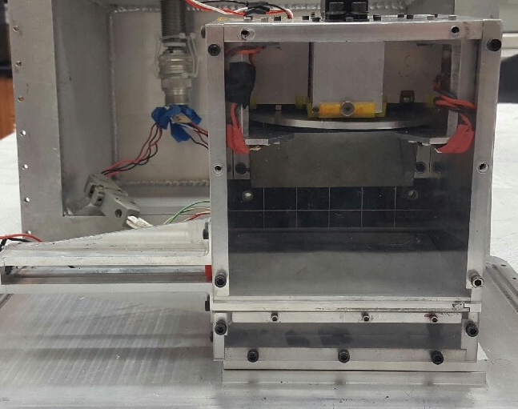
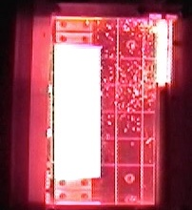
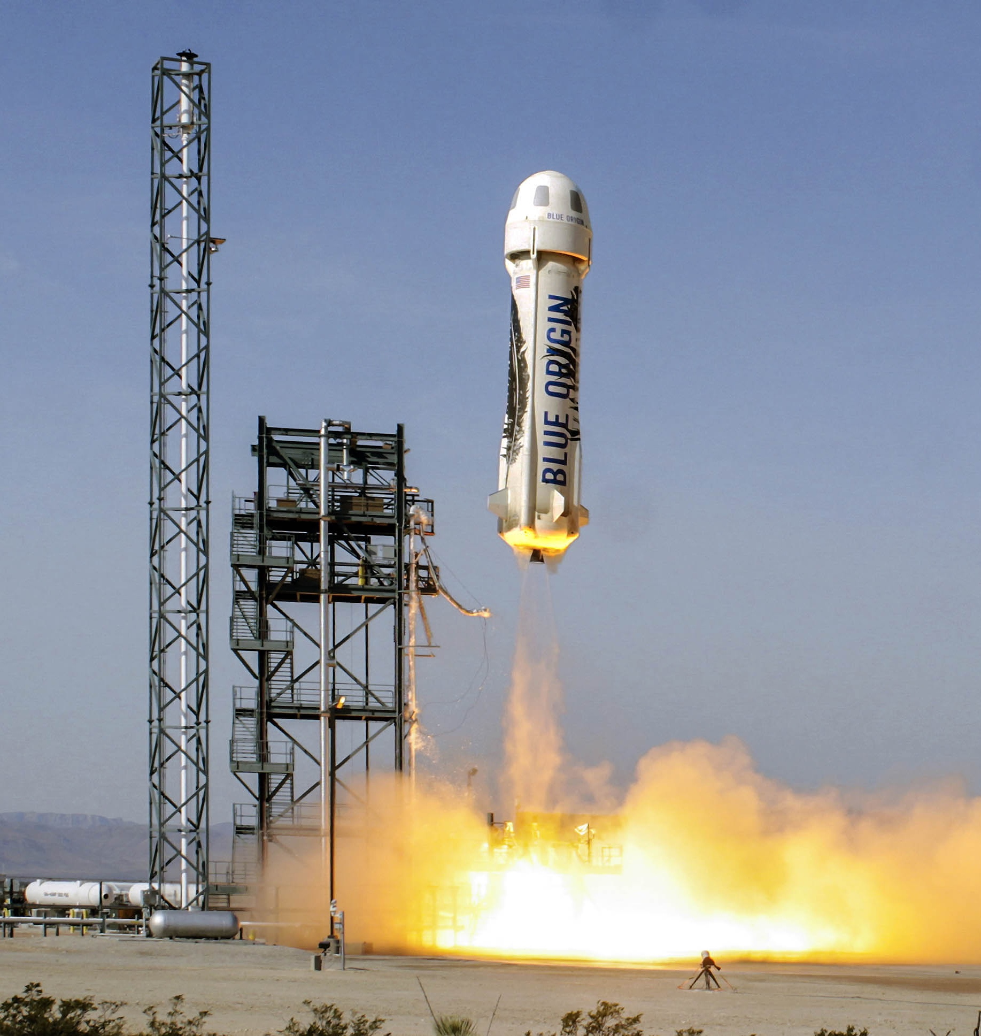
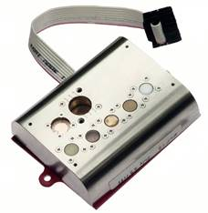
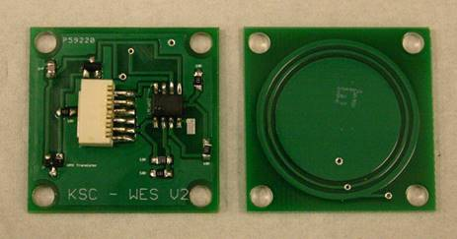
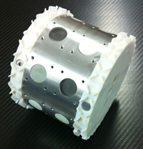
Dust and Spacecraft Charging Experiments
Graphic Goes Here
charged dust
door
tray
https://sciences.ucf.edu/physics/microgravity

