Slide 1

LSIC Dust Mitigation Focus Group
Monthly Meeting
October 19th, 2023
Jorge Núñez, Sarah Hasnain, Lindsey Tolis,
Richard Miller, Stephen Izon, Timothy Cole
Facilitator_DustMitigation@jhuapl.edu

Slide 2
Agenda
Welcome
Upcoming Opportunities
New NASA Lunar Dust Mitigation Publication
  Lunar Dust Mitigation: A Guide and Reference, First Edition (2021)
LSIC DM-EE Workshop
Featured Speakers:
  Dr. Cecily Sunday (University of Maryland) - PSI Modeling
  Jason Achilles (Zandef Deksit Inc.) - ExoCam
Discussion

Slide 3
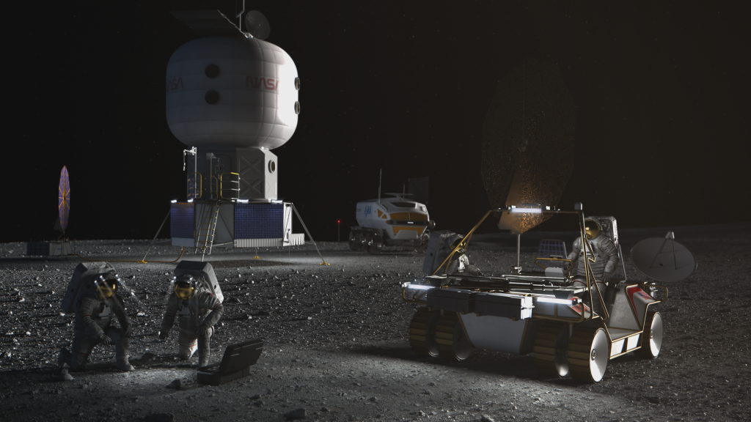
NASA Space Technology Graduate Research Opportunities (NSTGRO)
“This call for graduate student space technology research proposals, titled NASA Space Technology Graduate Research Opportunities – Fall 2024 (NSTGRO24), solicits proposals on behalf of individuals pursuing or planning to pursue master’s or doctoral (PhD) degrees in relevant space technology disciplines at accredited U.S. universities.
It is NASA’s desire to infuse the university-developed space technology through sustained interaction with the student and their faculty advisor. NASA Space Technology Graduate Research Fellows will perform research at their respective campuses and also at NASA Centers. Each recipient will be matched with a technically relevant and community-engaged NASA researcher who will serve as the research collaborator on the award. Through this collaboration, graduate students will be able to take advantage of broader and/or deeper space technology research opportunities directly related to their academic and career objectives, acquire a more detailed understanding of the potential end applications of their space technology efforts, and directly disseminate their research results within the NASA community.
Awards resulting from this solicitation will be made in the form of grants to accredited U.S. universities with the faculty advisor as the Principal Investigator (PI). “
Proposal Due November 1, 2023; Letters of Recommendation Due November 6, 2023
https://nspires.nasaprs.com/external/solicitations/summary.do?solId=%7B4FB626AC-C4FA-72A6-9FDB-C5305D6F5E38%7D&path=&method=init

Slide 4
Human Lander Challenge
Through the 2024 HuLC competition, NASA’s Human Landing System (HLS) Program provides college students the opportunity to explore innovations and potential solutions to lunar Plume-Surface Interaction (PSI) risks and challenges.
NASA’s HLS Program is responsible for the transportation in deep space to carry humans to and from the surface of the Moon for NASA’s Artemis lunar exploration program. Crews will board the HLS in lunar orbit and descend to the surface where they will collect samples, perform science experiments, and observe the lunar environment before returning to orbit in the HLS.
Teams are invited to submit proposals for innovative, systems-level solutions to understand, mitigate, and manage the impacts of lunar PSI that can be implemented within 3-5 years. The potential solutions teams can propose to could include, but are not limited to, the following categories:
  Trade Studies on Landing Trajectories that Minimize PSI
  Reduction / Mitigation of Erosion (Cratering) and Ejecta during Descent, Landing, and Ascent
  Development of PSI Flight Instrumentation / Measurement Methods and Concepts
  Tracking Dust During Descent, Landing, and Ascent
  Instrumentation Performance Through the Dust Cloud During Landing
  HLS Asset Safety (ejecta damage, excessive lander heating, etc.)
  PSI Modeling and Validation
Notice of Intent (NOI) Due October 22, 2023; Full Proposal Due March 4, 2024
https://hulc.nianet.org/challenge_details/

Slide 5
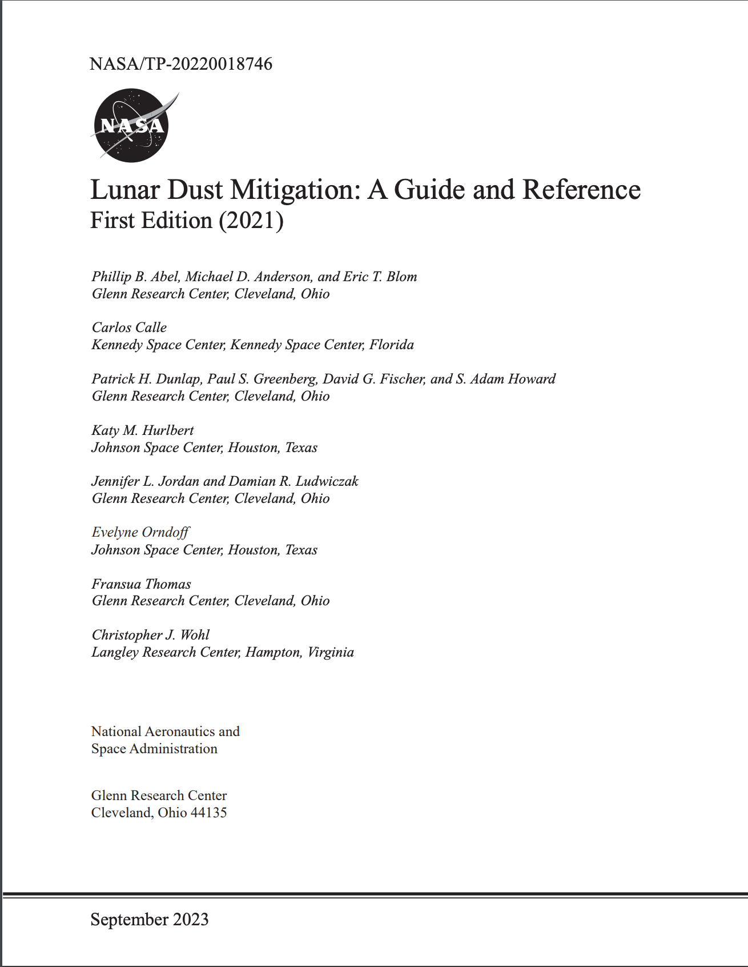
New NASA Lunar Dust
Mitigation Publication!
Lunar Dust Mitigation: A Guide and Reference, First Edition (2021)
94-page document published publicly on October 2nd, 2023
“As this specific document nears public release, NASA is on the cusp of generating and capturing new information about previously unexplored regions of the Moon, with potential implications for human exploration over many years to come. Lunar dust mitigation has been written about since the Apollo Program and is far from a demonstrated ‘solved’ problem. So, a thank you is due to all of the contributors responsible for helping lay out what we do know, with the expectation and request that as we collectively learn more, that knowledge will be shared to the benefit of all.”
“This publication provides a snapshot of advice from topical experts for specific areas of concern to systems targeted for deployment on the lunar surface.”
https://ntrs.nasa.gov/citations/20220018746

Slide 6
Path to Sustainable Technologies in the Lunar Surface Environment Workshop
DM & EE Joint Workshop - November 7, 2023 - Interactive, Virtual Workshop
We will focus on the qualification path to fielding long-lived technologies on the lunar surface. Stakeholders across industry, academia, and NASA will come together in a collaborative format to discuss the current state of the art, as well as essential knowledge and technology gaps related to the combined lunar and dust environment.
Topics
  Existing Standards and Facilities
  Stakeholder Needs
    NASA panel
    Industry & Academia Panel
  Town Hall on Next Steps
  Q&As for all presentations
Registration is free, and required. Closes October 24th. https://lsic.jhuapl.edu/Events/Agenda/index.php?id=481

Slide 7




  Today’s Featured Presentations
  Dr. Cecily Sunday (University of Maryland) - PSI Modeling
  Jason Achilles (Zandef Deksit Inc.) - ExoCam

Slide 9
Space Technology Funding Opportunities
Current Tech Development Opportunities
NSF SBIR and STTR »
  NSF recommends treating the submission window like a deadline, but you can submit anytime within a year of receiving an official invitation from NSF. (NSF uses submission windows to help gather and review proposals, but sometimes proposals are reviewed as they are received.) Windows: March 2, 2023 - July 5, 2023 July 6, 2023 - November 1, 2023
NASA Innovation Corps Pilot »
  Proposals may be submitted at any time through July 22, 2022, but applications will be reviewed in intervals on the following dates: Sept. 16, 2022; Nov. 17, 2022; and Jan 20, 2023
Technology Advancement Utilizing Suborbital and Orbital Flight Opportunities “TechFlights” »
  Mandatory Preliminary Proposals Due - 6/7/2023 Full Proposals Due - 10/4/2023
Human Lander Challenge
  Notice of Intent (NOI) Due October 22, 2023; Full Proposals Due March 4, 2024
NASA's 2024 BIG Idea Challenge »
  Notice of Intent Deadline – September 20, 2023; Q&A Session for Interested Teams – October 12, 2023; Proposal Deadline – January 23, 2024; 2024 BIG Idea Forum – November 5-7, 2024
Future Solicitation and Opportunities
NASA Innovative Advanced Concepts (NIAC) 2024 Phase I Call for Proposals »
  The NIAC program supports visionary research ideas through multiple progressive phases of study. Phase I studies are nine-month efforts to explore the overall viability and advance the technology readiness level (TRL). Eligible recipients of Phase I awards can propose for a follow-on Phase II study.

Slide 10
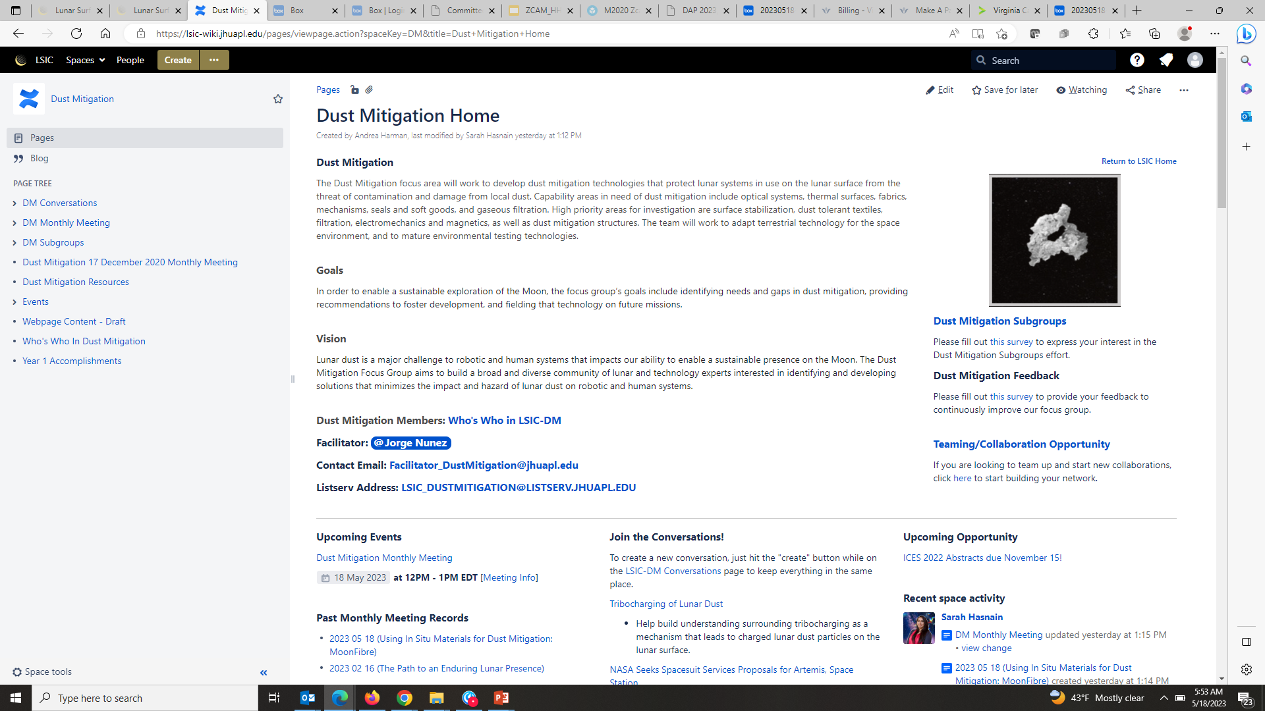
LSIC Dust Mitigation Wiki Page
To request access, please contact lsic-wiki-admins@listserv.jhuapl.edu
Dust Mitigation Discussion page and wiki
https://lsic-wiki.jhuapl.edu/display/DM/Dust+Mitigation+Home

Slide 11
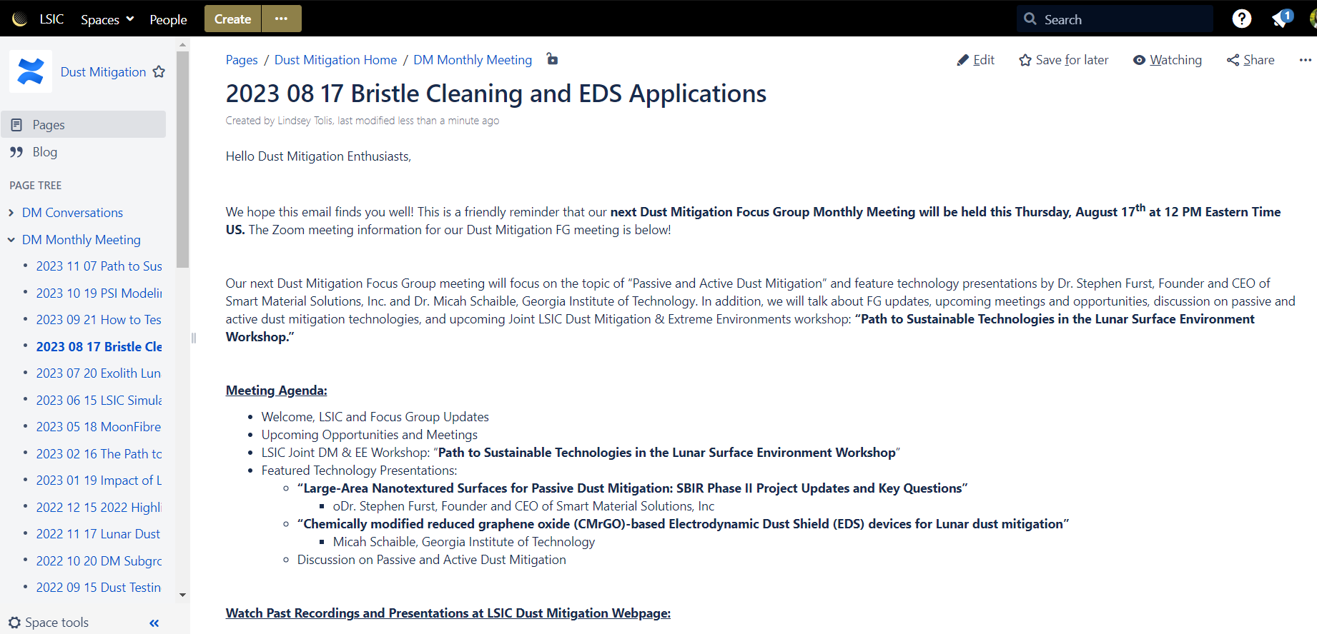
Join the Discussion on our Wiki Page
To request access, please contact lsic-wiki-admins@listserv.jhuapl.edu
Dust Mitigation Discussion page and wiki
Sign-in to add a comment at bottom of page
You can comment before, during, or after today’s meeting
Today’s meeting
https://lsic-wiki.jhuapl.edu/x/GoAZ

Slide 12
Get Involved with Dust Mitigation
Sign-up to Receive LSIC and Dust Mitigation FG Updates:
  Fill out the LSIC Sign Up
  Indicate interest in Dust Mitigation to receive news and event invitations
Help us improve the Dust Mitigation Focus Group: Feedback survey
Interested in Teaming/Collaborating with Others?
  Add yourself to our Confluence Who’s Who page
Looking for info on lunar dust or dust mitigation resources?
  Checkout our Confluence resources page
Join one of the Dust Mitigation Subgroups!
  Subgroup Membership/Leaders survey
  Still looking for subgroup leads!

Slide 13
Dust Mitigation FG Subgroups
Standards & Interoperability [Subgroup Lead: Dan Hawk]
  Standards and interoperability across testing and operational use cases
Isolation Technologies [Subgroup Lead: Ron Creel]
  Technologies that keep dust out
Materials & Coatings
  Optical Systems – Viewports, camera lenses, solar panels, space suit visors, mass spectrometers, other sensitive optical instruments
  Thermal Surfaces – Thermal radiators, thermal painted surfaces, thermal connections
  Fabrics – Space suit fabrics, soft wall habitats, mechanism covers
  Seals and Soft Goods – Space suit interfaces, hatches, connectors, hoses
Mechanisms & Connectors
  Mechanisms – Linear actuators, bearings, rotary joints, hinges, quick disconnects, valves, linkages
  Dust-tolerant connectors
Modeling & Monitoring
  Gaseous Filtration – Atmosphere revitalization, ISRU processes
  Dust monitoring – Cabin and external dust monitoring
  Dust plume modeling
Interested in leading a Dust Mitigation Subgroup?
Fill out our survey!
https://forms.gle/AGpyJcNZBd6ihdaq7

Slide 14

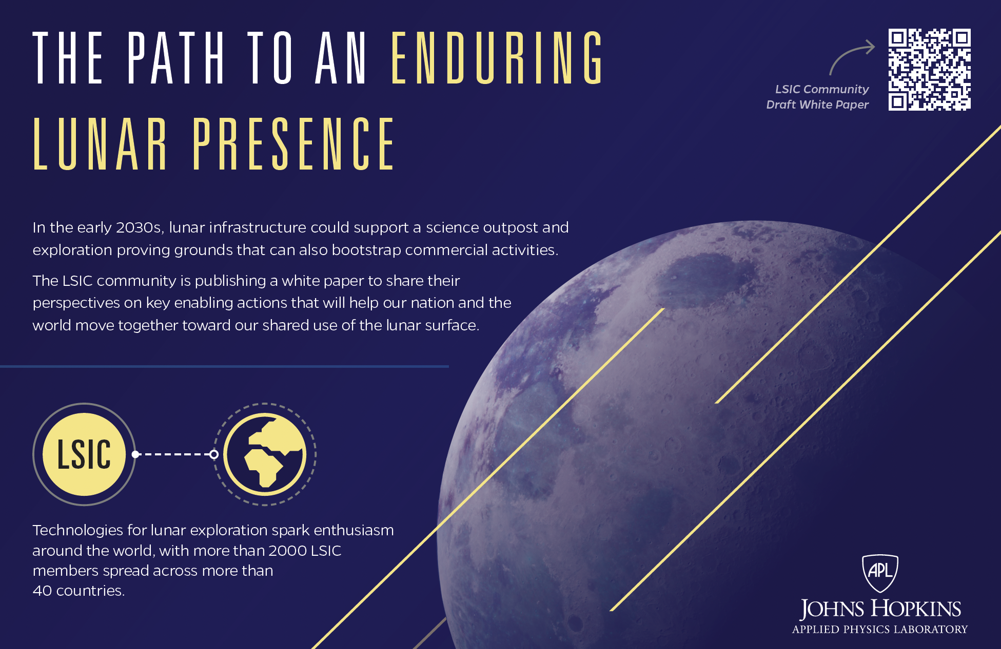
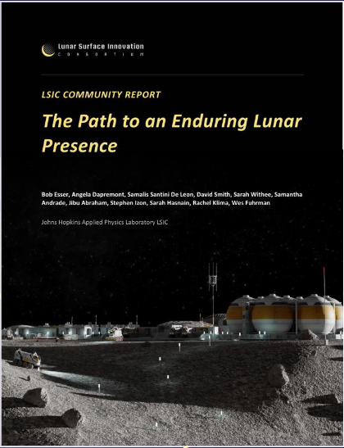
The Path to an Enduring Lunar Presence
LSIC Community Derived White Paper

Slide 15
LSIC White Paper and M2M Feedback
LSIC Whitepaper
The Path to an Enduring Lunar Presence
NASA Moon to Mars Whitepapers
Architecture Concept Review
Perspectives on key enabling actions that will help our nation and the world move together toward our shared use of the lunar surface.
Access White Paper:
https://lsic.jhuapl.edu/Resources/files/The%20Path%20to%20an%20Enduring%20Lunar%20Presence.pdf
Send feedback to: LSIC-Feedback@jhuapl.edu
Systems Analysis of Architecture Drivers
Why NRHO: The Artemis Orbit
Why Artemis will Focus on the Lunar South Polar Region
Gateway: The Cislunar Springboard for International and Sustainable Human Deep Space Exploration
Mars-Forward Capabilities to be Tested at the Moon
Mars Transportation
Access White Papers:
https://www.nasa.gov/MoonToMarsArchitecture

