Slide 1


LSIC Surface Power Telecon
October 26th, 2023
Begins at 11:03
Dr. Sean Young, Dr. Matt Clement
Sam Andrade, Julie Peck, Dr. Joseph Kozak, Abigail Wagner
Johns Hopkins Applied Physics Laboratory
Space Exploration Sector
LSIC Surface Power Facilitator POC: matt.clement@jhuapl.edu

Slide 2

LSIC | Agenda
Community Updates
  LSIC Fall Meeting and Transition to Commercial Workshop Summary
  Solicitations and Awards
  Conferences/Workshops/Telecons
    November 7: LSIC Path to Sustainable Technologies in the Lunar Surface Environment Workshop (Joint DM/EE)
    Upcoming 2022/2023 Surface Power Telecons
Speakers:
  Eric Maxeiner (Rolls Royce)
  Dr. Jonathan Adams (Rolls Royce)
Q&A
2

Slide 3
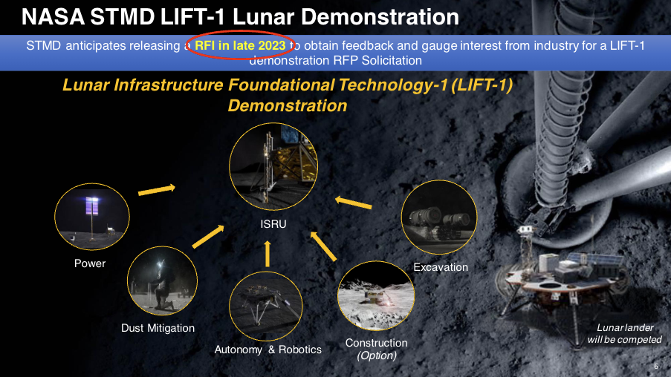
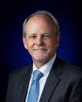
LSIC | Fall Meeting Summary
Walt Engelund STMD LIFT-1 RFI Announcement
3

Slide 4
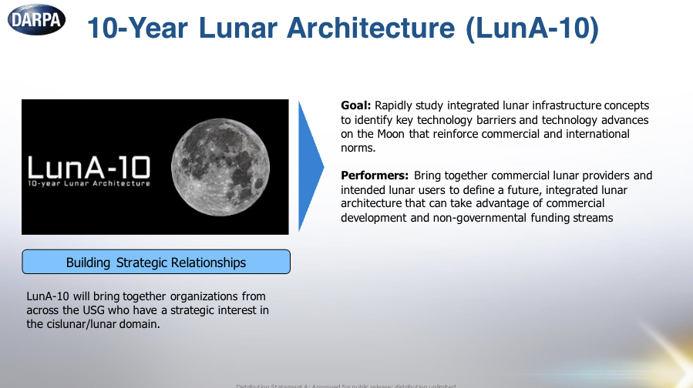
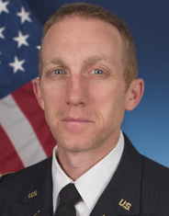
LSIC | Fall Meeting Summary
Phil Root LSIC/DARPA Announcement
4

Slide 5
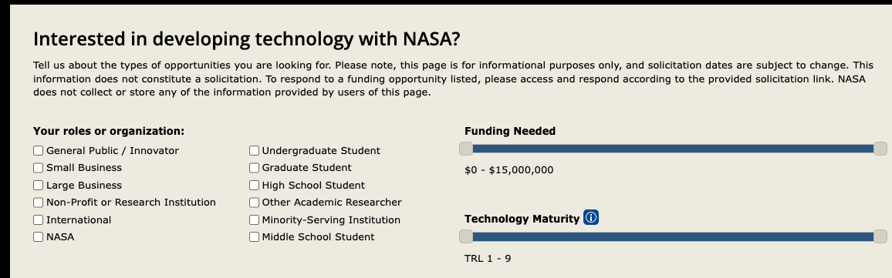
LSIC | Solicitations and Awards
Upcoming Due Dates:
NASA Space Technology Graduate Research Opprotunities 2024
Proposals Due: November 1, 2023
Detect, Track, and Remediate: The Challenge of small space Debris
Proposals Due: November 15, 2023
Space Tech Solicitations (NEW SITE LIVE: techport.nasa.gov/opportunities/stmd):
5

Slide 6
LSIC | Upcoming Meetings and Workshops
LSIC Path to Sustainable Technologies in the Lunar Surface Environment Workshop
November 7, Virtual
4th Annual Cislunar Security Conference
December 5-7, Laurel, MD
Applied Power Electronics Conference
February 25-29, Long Beach, CA
FAA Commercial Space Transportation Conference
February 21-22, Washington, DC
IEEE Aerospace Conference
March 2-9, Big Sky, MT
Lunar and Planetary Science Conference
March 11-15, The Woodlands, TX
More complete calendar on LSIC website, email with additional events!
6

Slide 7
Announcing DM & EE Joint Workshop!
Path to Sustainable Technologies in the Lunar Surface Environment
  We will focus on the qualification path to fielding long-lived technologies on the lunar surface. Stakeholders across industry, academia, and NASA will come together in a collaborative format to discuss the current state of the art, as well as essential knowledge and technology gaps related to the combined lunar and dust environment.
November 7, 2023
Interactive, Virtual Workshop
Topics
  Existing Standards and Facilities
  Stakeholder Needs
    NASA panel
    Industry & Academia Panel
  Town Hall on Next Steps
  Q&As for all presentations
Registration is now open!
  https://lsic.jhuapl.edu/Events/Agenda/index.php?id=481

Slide 8
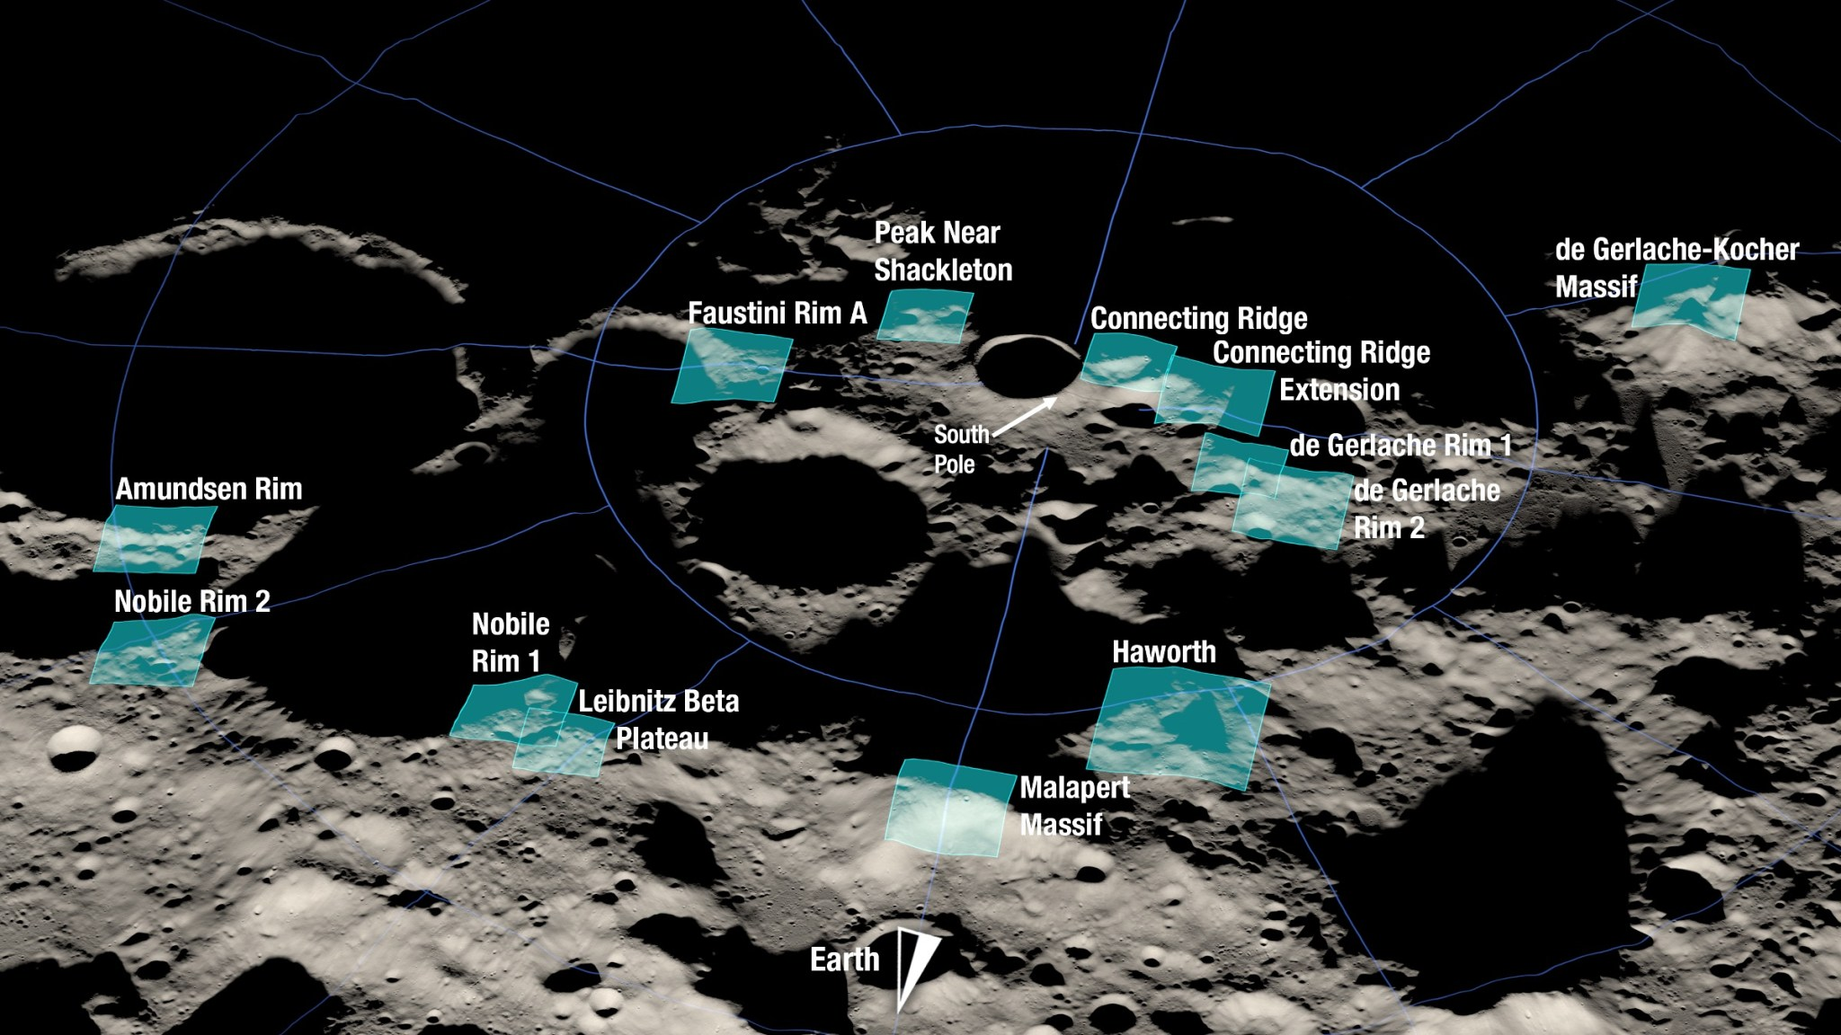
LSIC | Upcoming Surface Power Telecons
We hope to see you all at our upcoming telecons. As a reminder, Surface Power Telecons typically take place on the fourth Thursday of every month at 11AM ET.
Thursday December 7 (OFF SCHEDULE)
Topic: Year in Review
Speakers: APL Surface Power Team
Thursday January 17 (OFF SCHEDULE)
Topic: Site Selection (JOINT WITH ISRU)
Speakers: Giovanni Leone (Univ. De Atacama),
Kori Hough (Astrobotic)
Thursday February 24
Topic: Rad-Hard Electronics
Speakers: Bob Kaplar and Jason Neely (Sandia National Laboratory)
Thursday March 28
Topic: Modular Power Generation and Delivery Systems from Programmable Metamaterials
Speakers: Olivia Formoso (NASA Ames Research Center)
8

Slide 9
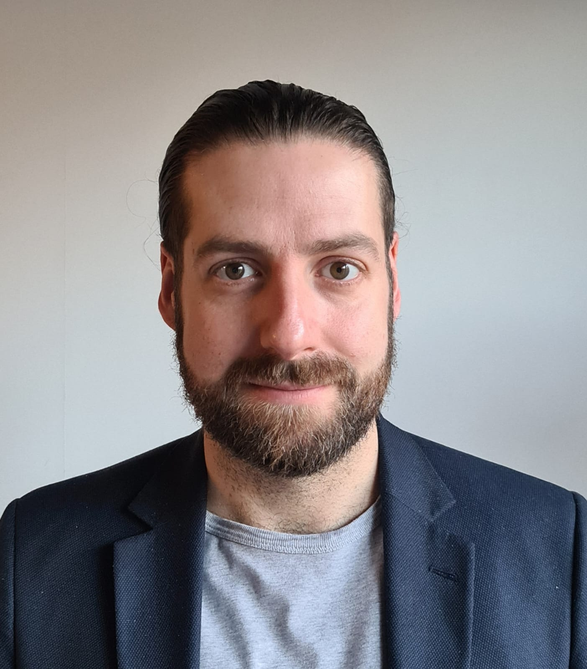
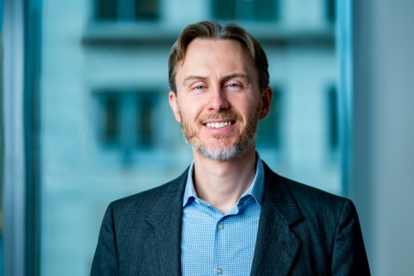

LSIC | October Speakers
Dr. Eric Maxeiner
VP Business Development
Rolls-Royce Defense
Dr. Jonathan Adams
Novel Nuclear Assistant Chief
Engineer
Rolls-Royce
9

