Slide 1
LSIC Excavation & Construction July Monthly Meeting
July 26th, 2023
LSIC E&C Focus Group
Athonu Chatterjee
Jibu Abraham
Sarah Hasnain
Claudia Knez
Raymond Lu
Michael Nord
Gus Terlaje
Sarah Hasnain & Jibu Abraham LSIC Excavation & Construction Focus Group Co-Facilitators
NASA Lead
Dr. Mark Hilburger

Slide 2
Agenda
LSIC Sign-Ups & Call for Speakers
Upcoming LSIC Workshops
Guest Speakers
Excavation & Construction Insights from:
Steve Indyk, Director Space Systems at Honeybee Robotics
Dr. Yuto Nakanishi, Chief Robotics Officer @ Gitai
Jared Long-Fox, Chief Scientist @ Exolith Lab
No August Meeting due to Joint EA/EC Autonomy Workshop
No Subgroup Meeting

Slide 3
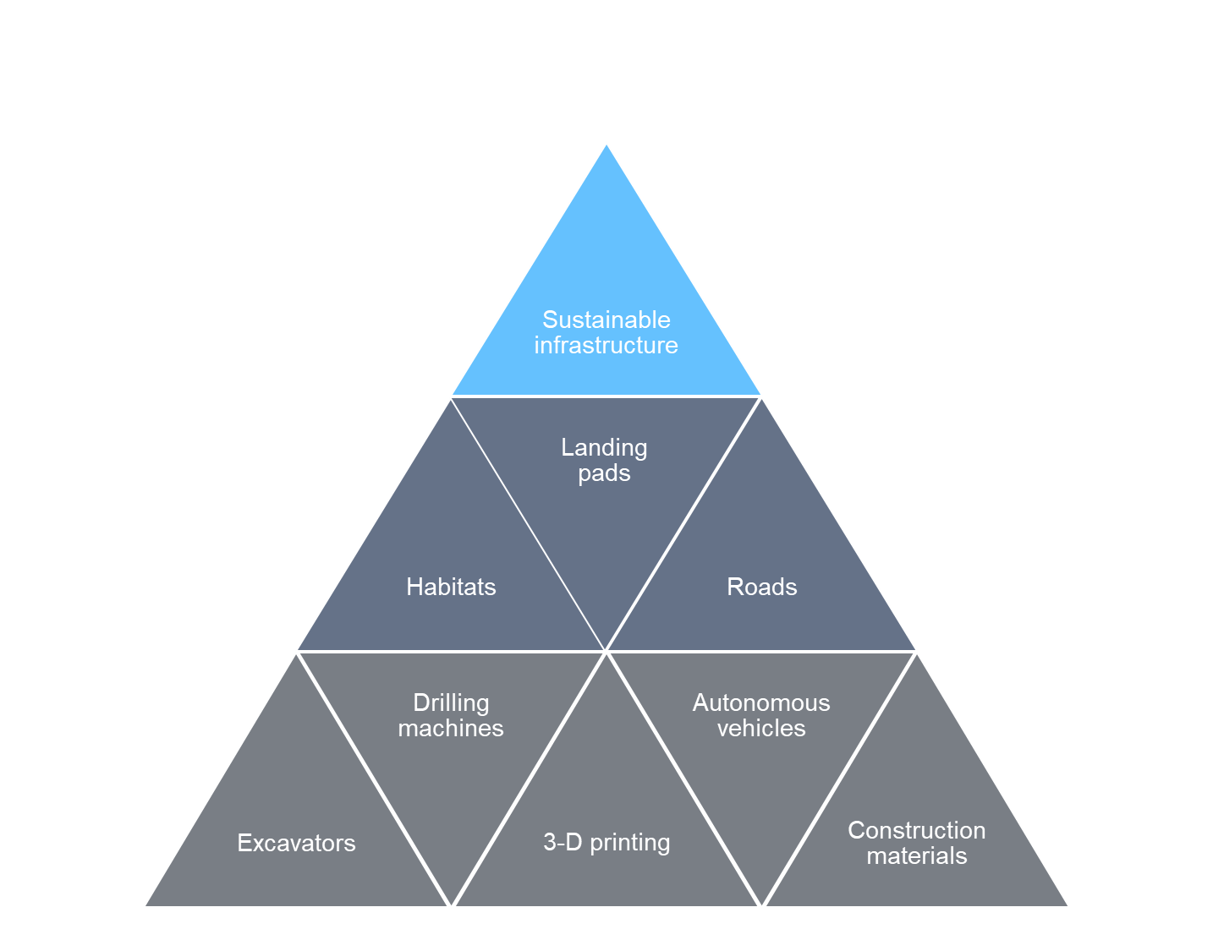
E &C Focus Areas
Infrastructure:
Landing and Launch Pads
Habitats: In-situ and deployable
Roads, Berms, etc.
Space architecture – urban planning and governance.
Technology:
Additive Construction
Autonomous Construction technologies
High-fidelity excavation tools for lunar applications
Manufacturing technologies : sintering, regolith processing, additive manufacturing
In-situ Repair and Outfitting
Maintaining and refurbishing the infrastructure.
Spare parts : in-situ fabrication vs. sending from earth
Outfitting requirements
Assist NASA in developing technologies that enable affordable, robust, autonomous, construction of infrastructure on the lunar surface to establish a sustained human presence

Slide 4
LSIC | Upcoming Workshops
Lunar Proving Grounds Workshop (Hybrid), July 12-13th
Surface Power Reliability Workshop (Zoom), July 26-27th
E&C - EA Autonomy Workshop, (Zoom), August 21st – 22nd 2023
Dust Mitigation Workshop, Nov 7-8
2023 LSIC Fall Meeting – Oct. 10-12th, 2023 (Hybrid) & Transition to Industry Workshop
Hosted by Community College of Allegheny County, Pittsburgh, PA
Notes:
https://lsic.jhuapl.edu/Events/Agenda/index.php?id=380

Slide 5
LSIC | Lunar Proving Grounds Definition Workshop, July 12-13th, 2023
The Lunar Surface Innovation Consortium (LSIC) hosted a Lunar Proving Grounds (LPG) Definition Workshop that brought together stakeholders across NASA/Academia/Commercial and more to discuss possible manifestations of an LPG as well as the technical and programmatic needs to achieve system-of-systems testing in pursuit of an enduring Lunar presence.
300+ individuals (100 in-person) attended the meeting over the course of two days in the first LSIC hybrid workshop. Detailed results from the workshop will be presented at ASCEND 2023.
Meeting Content Included panels with extended Q&A, small-group discussions on targeted topics, and preliminary discussions of major insights. The hybrid format was widely-praised and was the top-voted format for future meetings.
Takeaways and Community Feedback:
An LPG should focus on integration, validation, lifecycle testing, and humans-in-the-loop. An LPG is critical for technology needed to enable sustained presence and operational validation.
An LPG should include interoperable infrastructure representative of the operational space.
Deconflicted and coordinated facilities can serve many of the component-level testing in advance of the need for an LPG, while reducing administrative burden and building efficiencies.
Digital engineering tools can meet a sub-set of LPG elements, but there is need to detail the appropriate technologies and environments.
An LPG should have a pathway for international access to facilities, which should be considered during planning.
Notes:
Highlight - fi

Slide 6
Autonomy Workshop (EA and E&C) August 21-22, 2023 2 Full Days, Virtual
Objective: The goal of this workshop is to gather the Lunar community to exchange ideas on autonomy, as well as identify technology gaps and use cases for establishing a sustainable presence on the Moon and Mars.
Day 1:
Morning - Autonomous Systems, Situational and Self Awareness, Reasoning and Acting
Afternoon - Collaborative Systems
Day 2:
Morning - Applications in Autonomy on Lunar Surface - Current Champions (e.g. Autonomous Construction & Assembly)
Afternoon - Challenges in Autonomy (Test & Evaluation, Cybersecurity, Dynamic Reasoning Models, Environmental Considerations)

Slide 7
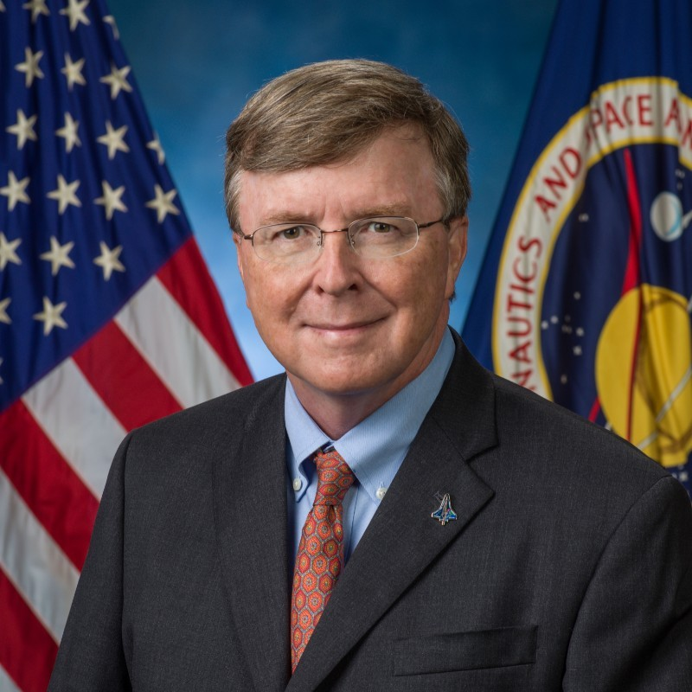
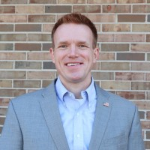
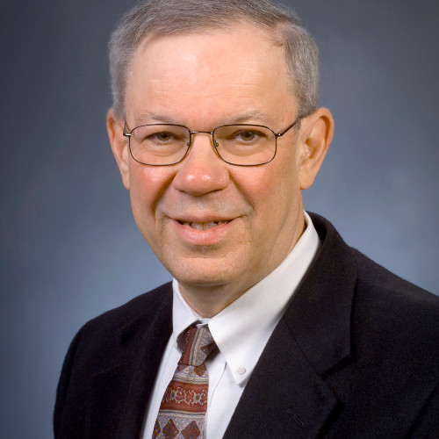
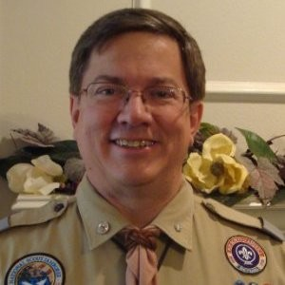
LSIC | Surface Power Reliability Workshop
Date: July 26-27
Time: 11:00AM – 3:30 PM ET
Location: Virtual via Zoom
How do we approach reliability from the system/grid level and how should this affect the early-TRL development at the component level?
John Scott (NASA)
Principal Technologist
Power & Energy Storage
Clay Smith (APL)
ISS Probabilistic Risk Assessment Creator
David McGlone (NAVSEA)
Director
Submarine Safety Program
Joe Miller (NSF)
Antarctic Facilities Program Manager
Jim Soeder (NASA, ret.)
Senior Power Technologist (08-21)
Power Development Chief (87-08)
Roger Boyer (NASA)
Artemis Probabilistic
Risk Assessment Lead
Blanca Lara (NASA)
JSC EHP Lunar Power
Lead
Bill Anderson (NAVFAC)
Director of Utilities and Energy Management
7
Notes:
Link to Register for the Surface Power Reliability Workshop: https://lsic.jhuapl.edu/Events/Agenda/index.php?id=443

Slide 8
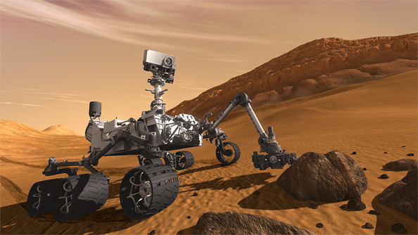
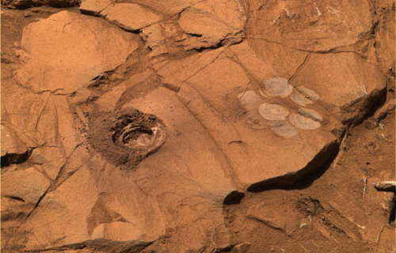
Steve Indyk / Honeybee Robotics
Stephen Indyk is Director of Space Systems at Honeybee Robotics. Mr. Indyk has worked on robotics research projects at NASA's Goddard Space Flight Center, Johns Hopkins Applied Physics Laboratory and Rutgers University. Mr. Indyk received a M.S. in Mechanical Engineering from Rutgers University.

Slide 9
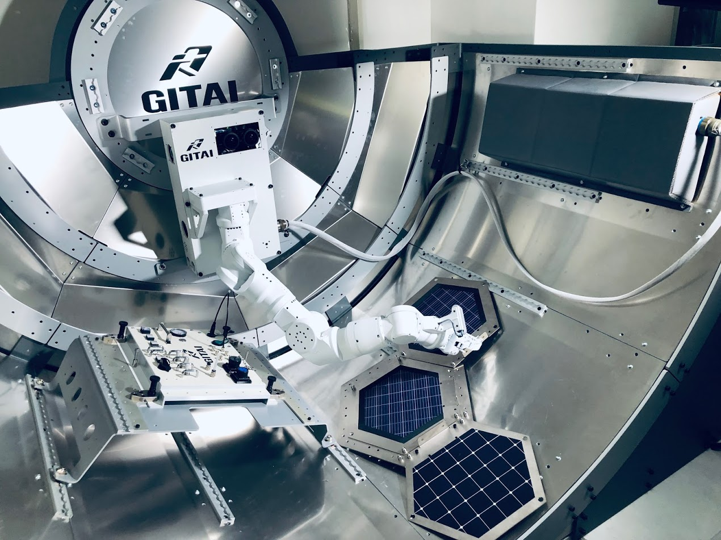
Dr. Yuto Nakanishi / GITAI
Dr. Yuto Nakanishi is the Chief Robotics Officer of GITAI. Former Founder & CEO of SCHAFT. After retiring as an assistant professor at the University of Tokyo Graduate School of Information Science and Technology (JSK Lab)
He founded the bipedal robot startup, SCHAFT, the champion of DARPA Robotics Challenge Trials in 2013. He later sold the company to Google in 2013, and had led Tokyo biped platforms development team under Google X for 5 years.
Now, he joined GITAI to develop space robots to build moon base.

Slide 10
Jared Long-Fox / EXOLITH Lab
Jared Long-Fox, is a Planetary Exploration Research Scientist at the Center for Lunar and Asteroid (CLASS) SSERVI node at the University of Central Florida. He earned his MS and BS Geology degrees with minors in both Mathematics and Geospatial Technology from the South Dakota School of Mines and Technology. Jared's research focuses on physical properties of planetary regolith in extreme environments to enable safe and efficient surface operations such as roving, in situ site characterization and preparation, material acquisition/processing, and infrastructure development. Jared is the Vice Chair of the ASCE Aerospace Division's Regolith Operations, Mobility, and Robotics Technical Committee and is also the Vice Chair of the Education and Outreach Subcommittee of the AIAA Space Resources Technical Committee.

