Slide 1
Crosscutting Capabilities Kickoff!
February 2024
Lindsey Tolis – CC LSIC Lead
Danielle Mortensen – Deputy CC LSIC Lead
Mario Lento – Interoperability SI Lead
Angela Stickle – EA, Robotics & Autonomy SI Lead
Milena Graziano – EE, Dust, and Simulants SI Lead

Slide 2
Agenda
Spring Meeting
LinkedIn
LOGIC
Opportunities
LSIC Focus Groups
Crosscutting Capabilities Topic Areas
Crosscutting Capabilities Team
Logistical Information
Confluence Summary
Special Topic Meetings
Foundational Technologies Collaboration
Overview of Lunar Engineering 101
Schedule Look-Ahead

Slide 4
Notes:
$110 to sponsor a student, covers the $45 each of the first 2 days plus $20 on final day.

Slide 6
LOGIC
Utilizing DARPA’s 10-Year Lunar Architecture (LUNA-10) capability study, DARPA has established the Lunar Operating Guidelines for Infrastructure Consortium (LOGIC), bringing together stakeholders from commercial corporations, academia, and government entities to rapidly develop foundation technology concepts and standards for:
Power
Communications / Position, Navigation, Timing
Mobility
In-Situ Resource Utilization (ISRU) / Mining
Robotics / Construction
Market Analysis
The first LOGIC Working Group Meeting will be happening on March 12, 2024 at 1:00PM ET!
Topics: Comms, PNT, Power
https://logic.jhuapl.edu

Slide 7
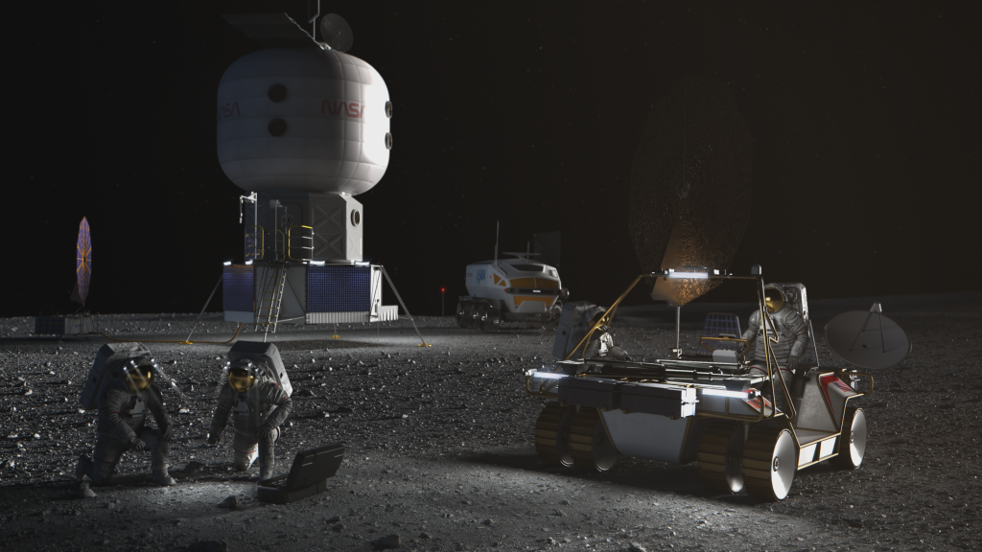
Human Lander Challenge
Through the 2024 HuLC competition, NASA’s Human Landing System (HLS) Program provides college students the opportunity to explore innovations and potential solutions to Lunar Plume-Surface Interaction (PSI) risks and challenges.
NASA’s HLS Program is responsible for the transportation in deep space to carry humans to and from the surface of the Moon for NASA’s Artemis lunar exploration program. Crews will board the HLS in lunar orbit and descend to the surface where they will collect samples, perform science experiments, and observe the lunar environment before returning to orbit in the HLS.
Teams are invited to submit proposals for innovative, systems-level solutions to understand, mitigate, and manage the impacts of lunar PSI that can be implemented within 3-5 years. The potential solutions teams can propose to could include, but are not limited to, the following categories:
Trade Studies on Landing Trajectories that Minimize PSI
Reduction / Mitigation of Erosion (Cratering) and Ejecta during Descent, Landing, and Ascent
Development of PSI Flight Instrumentation / Measurement Methods and Concepts
Tracking Dust During Descent, Landing, and Ascent
Instrumentation Performance Through the Dust Cloud During Landing
HLS Asset Safety (ejecta damage, excessive lander heating, etc.)
PSI Modeling and Validation
Notice of Intent (NOI) Due October 22, 2023; Full Proposal Due March 4, 2024
https://hulc.nianet.org/challenge_details/

Slide 8
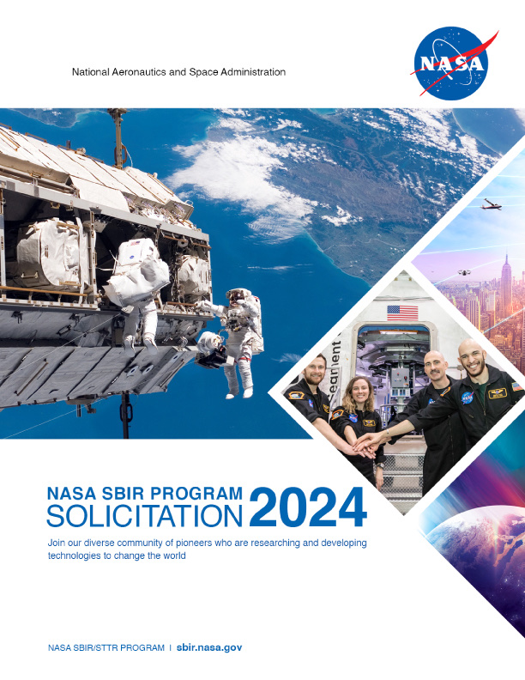
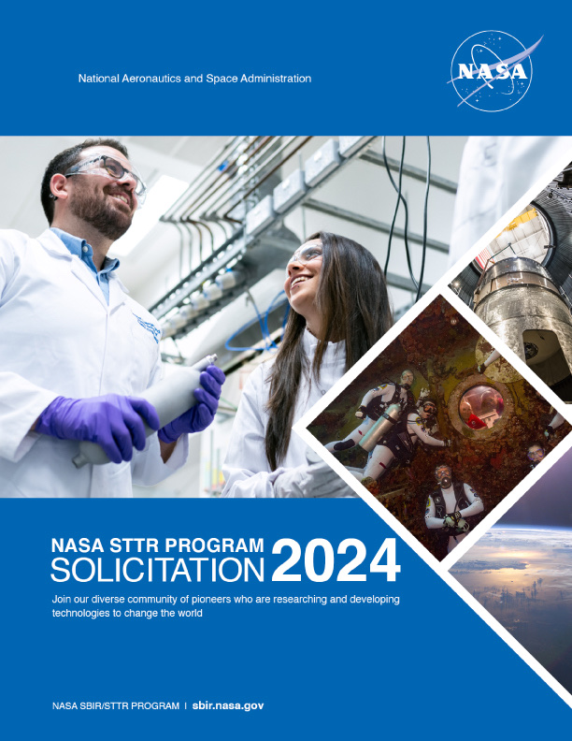
Small Business Innovation Research (SBIR) & Technology Transfer (STTR)
NASA SBIRs
SBIR and STTR 2024 solicitations were released on Jan 9!
https://sbir.nasa.gov/solicitations
Step 1 due 11 March 2024
NSF SBIRs
Phase I solicitations close 04 March 2024
https://www.nsf.gov/pubs/2023/nsf23515/nsf23515.htm
Phase II solicitations close 04 March 2024
https://www.nsf.gov/pubs/2023/nsf23516/nsf23516.htm
SBIRs and STTRs
Open SBIRs and STTRs can be found here: https://www.sbir.gov/solicitations/open

Slide 9
LSIC Focus Areas
2024

Slide 10
Former LSIC Organization
6 Focus Areas
+
2 Working Groups
+
32 Subgroups
Excavation & Construction
Surface Power
Dust Mitigation
Extreme Access
Extreme Environments
In-Situ Resource Utilization
Interoperability
Lunar Simulants
Working Groups

Slide 11
Current LSIC Structure
Excavation & Construction
Surface Power
Crosscutting Capabilities
In-Situ Resource Utilization
Notes:
We are all aligned in similar activities, but CT will start to look into discussion on supporting the technologies of the other groups.

Slide 12
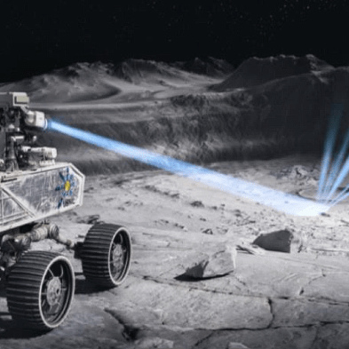
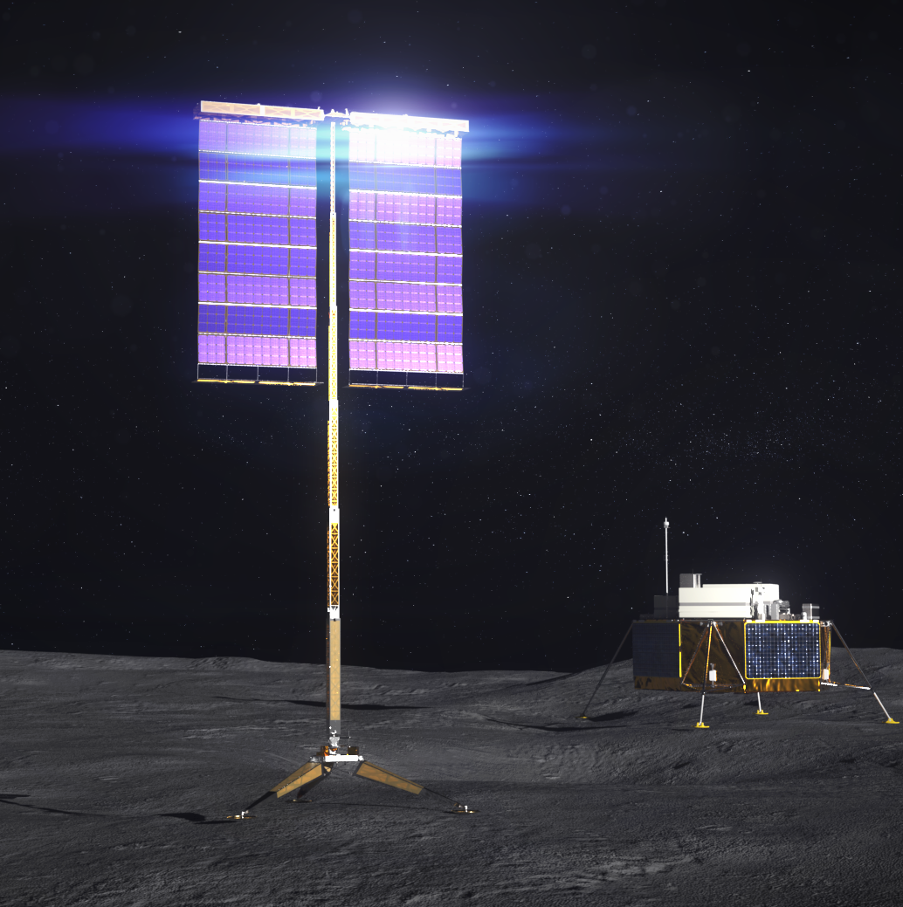
LSIC Focus Areas
Crosscutting Capabilities
In Situ Resource Utilization
Excavation & Construction
Surface Power
The Crosscutting Capabilities focus group will provide expertise on an array of topics which feed into the goals of the Foundational Technologies group and promote collaboration amongst internal and external stakeholders.
The ISRU focus group will advance technologies for the collection, processing, storing, and use of material found or manufactured on other astronomical objects.
The Excavation & Construction focus group will assist NASA in evaluating technologies that enable affordable, robust, autonomous manufacturing and construction on the lunar surface.
The surface power focus group will provide specific recommendations to NASA for rapidly achieving appropriate-scale power-related technologies needed to enable sustained presence and exploration.

Slide 13
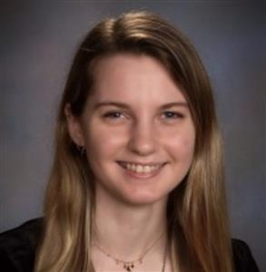
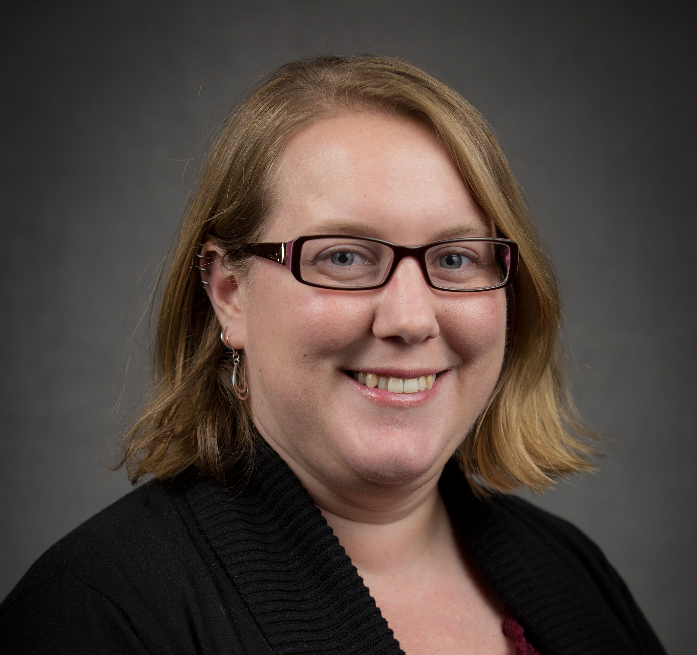
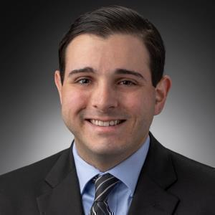
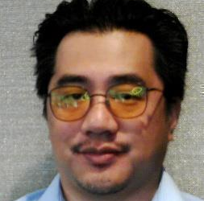
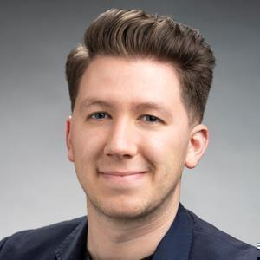
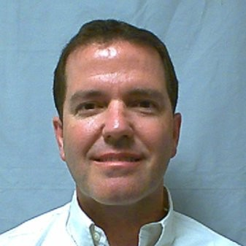
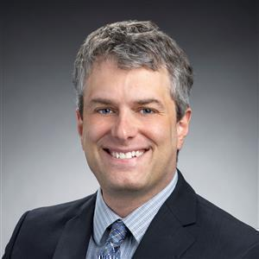
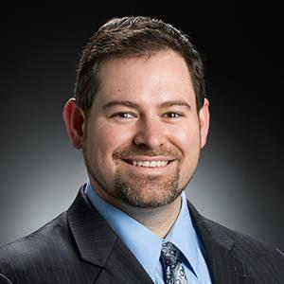
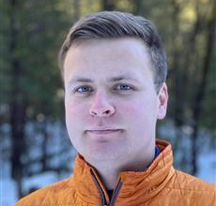
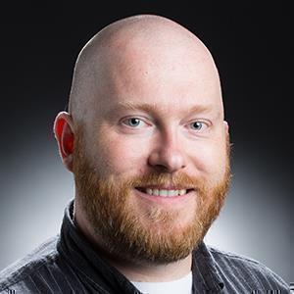
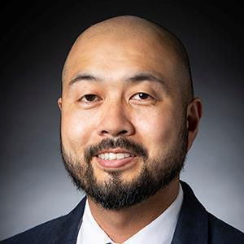
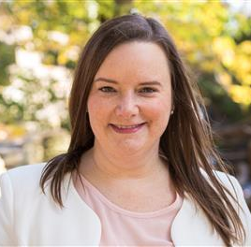
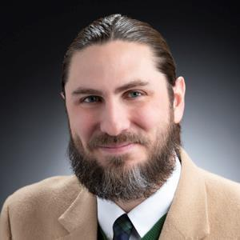
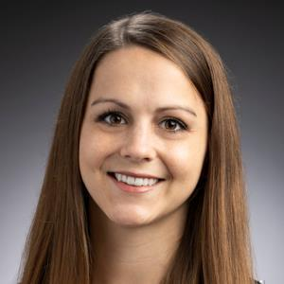
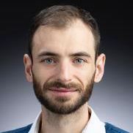
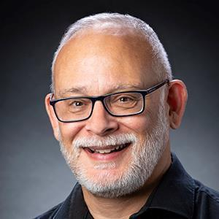
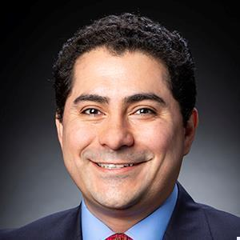
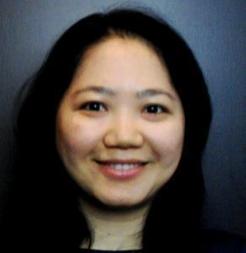
Crosscutting Capabilities Team!
Lindsey Tolis
Danielle Mortensen
Angela Stickle
Milena Graziano
Mario Lento
LSIC Leads
Systems Integration Leads
Team Staff & Subject Matter Experts
Jason Arcido
Luke Barbano
Tim Cole
Caleb Fasset
Andrew Gerger
Kurt Gonter
Ben Greenhagen
Sarah Hasnain
Stephen Izon
Kristin Jaburek
Justin Likar
Anna Martin
James Mastandrea
Rick Miller
Jorge Núñez
Pegah Pashai
Stacy Teng
Alhassan Yasin

Slide 14
Logistical Information
Crosscutting Capabilities Confluence Wiki
Website and Confluence
Website updates are live!
https://lsic.jhuapl.edu/Our-Work/Focus-Areas/index.php?fg=Crosscutting%20Capabilities
Extreme Environments, Extreme Access, Dust Mitigation, Interoperability, and Lunar Simulants pages still available
Old pages to be archived this summer
Listserv and Email
Everyone on the DM, EE, EA, Interoperability, and Simulants listservs will be automatically added to the CC listserv.
Normal opt-out options available
Legacy facilitator emails still active
Archived this summer
Meetings
Nominal monthly cadence
Mix of joint with FTs and CC-only
Joint meetings will take place during normal FT meeting dates and times
Agendas announced in advance
How to Contact us!
Facilitators_Crosscutting@jhuapl.edu
Need Confluence Access?
lsic-wiki-admins@listserv.jhuapl.edu

Slide 15
Confluence Summary
Main Page
Meetings
Resources
Who’s Who
CC Statement & Goals
Leadership Team
Upcoming CC Events
Other Upcoming Events
Title
Date
Recording
Slides
Old FG Pages
SpaceNews
Publications
Articles
Name / Institution
Contact Information
Website Links
Topic Areas
Networking
01
02
03
04

Slide 16
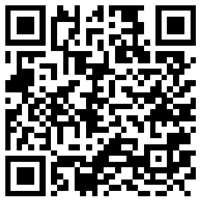
Confluence Resources
01 Resources
Contains links to Dust Mitigation, Extreme Access, Extreme Environments, Lunar Simulants, and Interoperability resources pages.
02 Publications and Articles
Contains lists of LSIC Community Publications, Other Publications, and Relevant Articles.
03 News Articles
Running list of lunar-related SpaceNews, NASA, etc. articles.

Slide 17
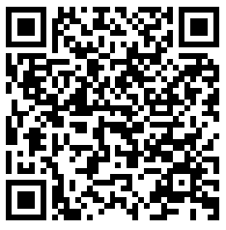
Confluence Who’s Who
01
Name / Title / Institution
02
Contact Information / Website Link
03
Topic Areas / What You Do
04
What you want others to know…
05
Other Notes!

Slide 18
Special Topic Meetings
01
05
Radiation Environment
Lawrence Heilbronn
Vacuum / Exosphere
Stephen Indyk
02
06
Regolith / Surface Interface and Dust Mitigation
Melissa Roth
Autonomy
Alhassan Yasin
03
07
Plasma Environment
Michael Zimmerman
Mobility Technology
Maneesh Verma
04
08
Thermal & Illumination
Andre Benard
Your Topic Here!
If you think a CC topic needs a one-off or regularly scheduled meeting, please reach out!

Slide 19
Foundational Technologies Collaboration
01
Foundational Technology Topic
02
Use Case
03
Input from Crosscutting Capabilities
04
Systems-level analysis
This Photo by Unknown Author is licensed under CC BY-NC

Slide 20
Example
01
Foundational Technology Topic
02
Use Case
03
Input from Crosscutting Capabilities
04
Systems-level analysis
01
In-Situ Resource Utilization
02
Transporting regolith to processing plants
03
Do you have the right rover capabilities to move enough regolith?
How will your rovers be protected from radiation?
What dust mitigation efforts will keep contaminants from entering your habitat?
04
What interoperability considerations do you need to acquire, move, and hand over regolith?
What technical gaps will need to be filled to accomplish this?
How can we balance a simplified architecture with demonstrating innovative technologies?
This Photo by Unknown Author is licensed under CC BY-NC

Slide 21
Lunar Engineering 101
(formerly ECLIPSE)
POC – Milena Graziano

Slide 22
Schedule Look-Ahead!
March 20th
11:00AM ET
Joint telecon with ISRU
April 23rd – 25th
Spring Meeting
May 29th
2:00PM ET
Joint telecon with E&C

Slide 23
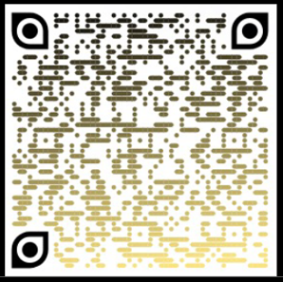
Spring Meeting
Student Sponsorship
LSIC LinkedIn
LOGIC
CC Confluence
CC Resources
CC Who’s Who
LSIC Sign Up

