Slide 1
Extreme Environments Focus Group
December Meeting
December 13, 2022
Jamie Porter, PhD
Johns Hopkins Applied Physics Laboratory
Facilitator_ExtremeEnvironments@jhuapl.edu

Slide 2
Today’s Agenda
LSIC Updates
MOSA December Telecon
Fall Meeting Summary
Featured Discussion
  Small Business Innovation Research (SBIR)
Breakout Rooms

Slide 3
LSIC Updates
Funding Opportunities
NASA Innovation Corps Pilot
  https://nspires.nasaprs.com/external/solicitations/summary.do?solId=%7b1B42E782-61BB-9834-F20F-44CBEF13C0A6%7d&path=&method=init
  Proposals may be submitted at any time through March 29, 2023
  Applications will be reviewed in intervals but last date is Jan 20, 2023
NASA Innovative Advanced Concepts (NIAC) Phase II Call for Proposals
  https://nspires.nasaprs.com/external/solicitations/summary.do?solId={0DD3E590-F13D-B4D4-0D48-56D01BE377B9}&path=&method=init
  Proposals due: January 18, 2023
Please visit LSIC website for full list
  http://lsic.jhuapl.edu/Resources/Funding-Opportunities.php

Slide 4

LSIC | MOSA December Telecon
MOSA Telecon: Dec 14th 10:00 ET
Speaker: Wesley Powell, NASA’s Principle Technologist for Avionics
Topic: Recommendations to Enhance Interoperability within SpaceVPX –based Avionics Systems
Abstract:
NASA has recently completed a study that provides recommendations to enhance interoperability within SpaceVPX-based avionics systems (https://ntrs.nasa.gov/citations/20220013983). This applies to several of the technologies listed in the STMD Advanced Avionics Envisioned Future Priorities (https://techport.nasa.gov/file/144877) and is and applicable to lunar exploration.
There will also be discussion on the process used for the study and next steps.
Following the presentation, the speakers will participate in a question-and-answer session
Zoom Link for Dec 14th 10:00 ET:
https://jhuapl.zoomgov.com/j/1616958072?pwd=NkRmc3JieEFpbzEvc2xVRDhBS1pZUT09
LSIC MOSA Telecon
4

Slide 5
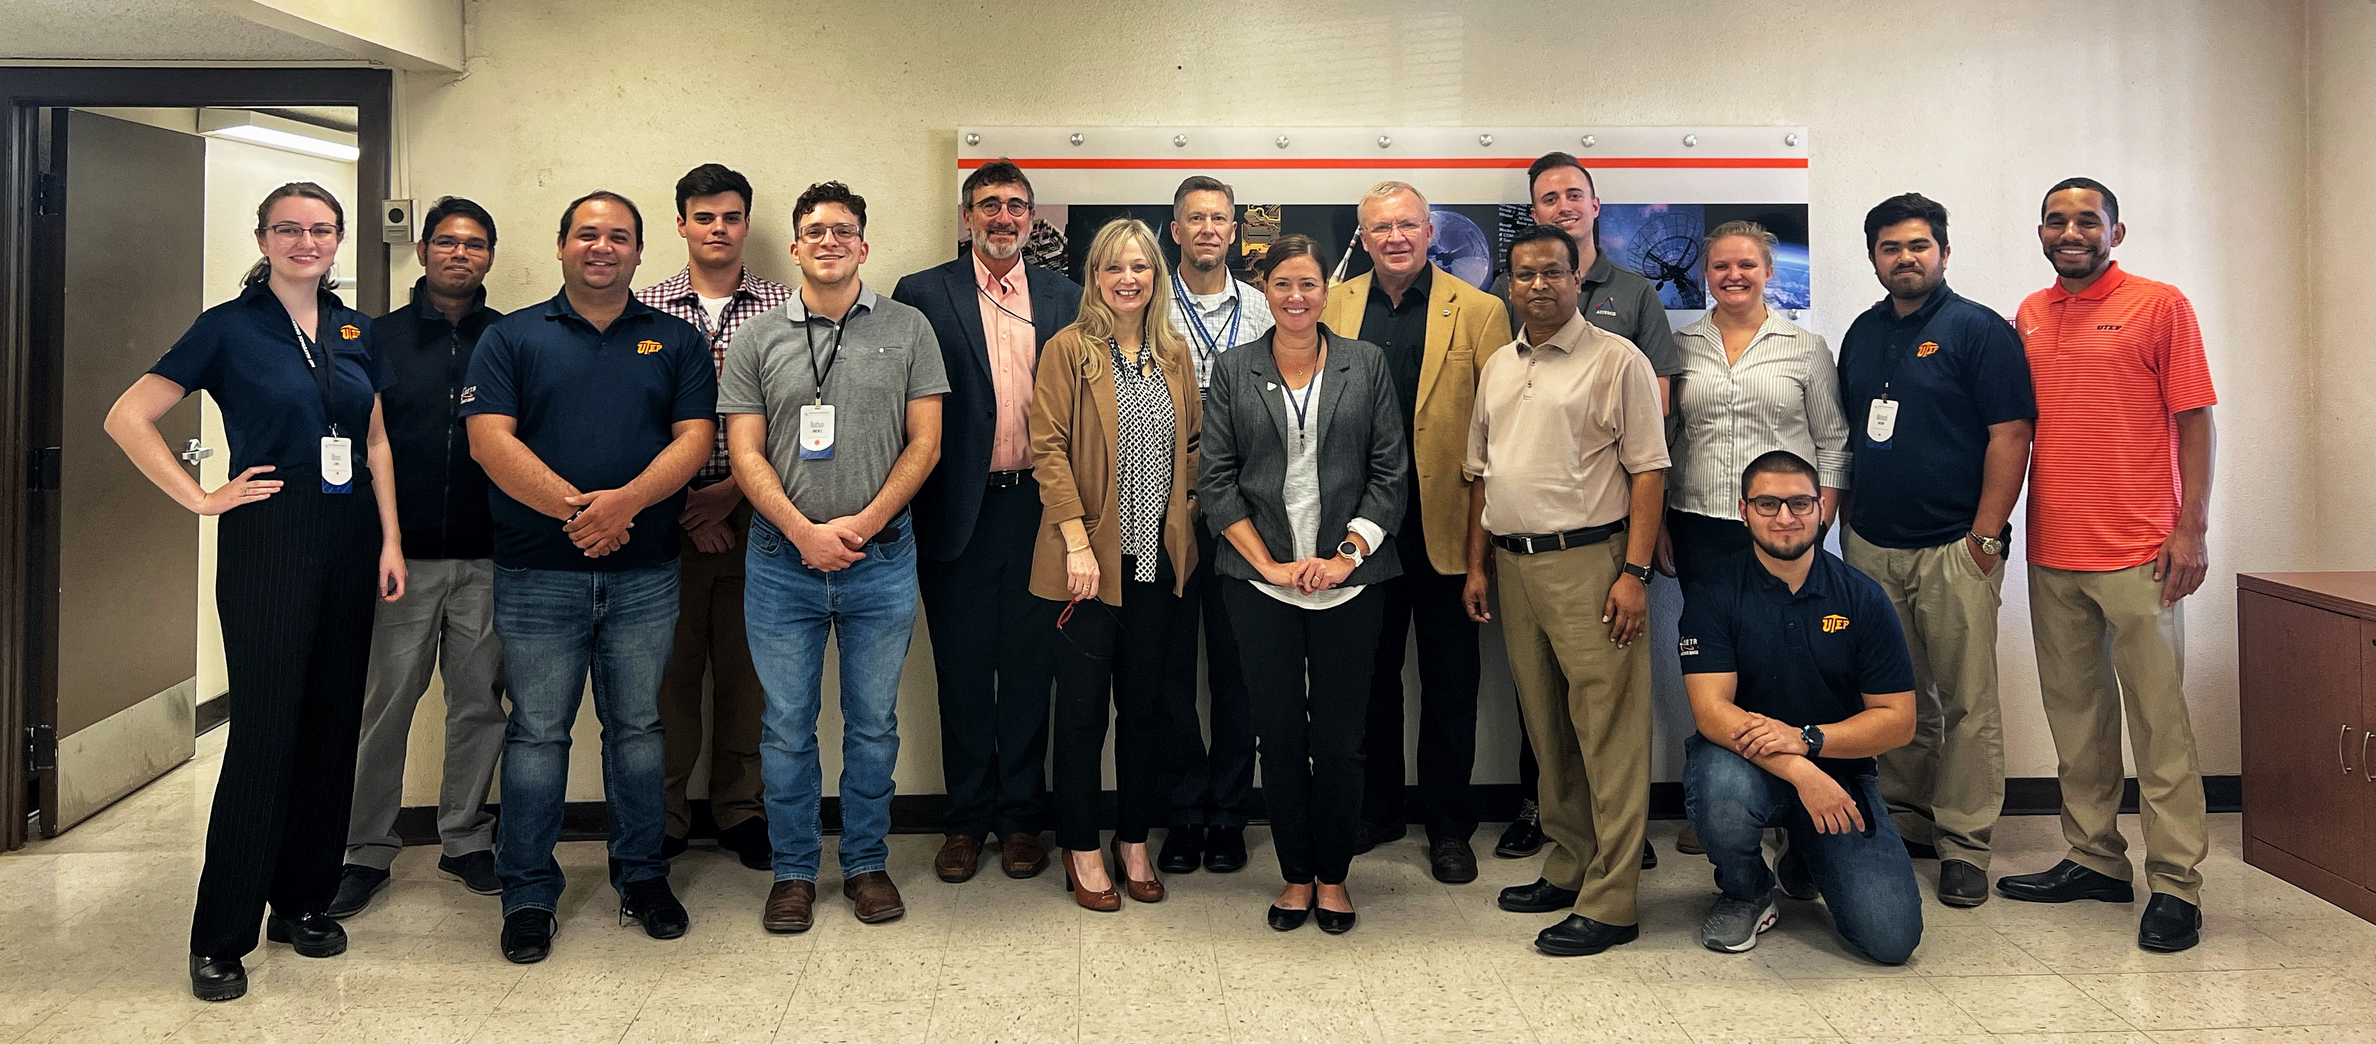
LSIC | Spring Meeting, Nov 2nd-3rd 2022
The Lunar Surface Innovation Consortium (LSIC) Fall Meeting, hosted by the University of Texas at El Paso (UTEP), provided a forum for NASA and the community to discuss technology development for establishing a sustained presence on the Moon, specifically focusing on lunar excavation and construction.
Over the course of two days, 443 individuals, representing >170 institutions attended. Nearly half (49%) of those who attended have not worked with NASA’s Space Tech before.
Meeting Highlights:
Congresswoman Veronica Escobar introduced the Keynote by NASA‘s Associate Administrator for Space Technology, Jim Reuter
Former astronaut and current professor at UC Davis, Dr. Steve Robinson, shared a keynote about the Space Technology Research Institute (STRI) Habitats Optimized for Missions of Exploration (HOME)
UTEP’s Aerospace Center, shared their mission and success preparing students from UTEP (>80% Hispanic, majority first-gen) for high-paying jobs in the aerospace industry
Technical talks and panels on topics including applying terrestrial lessons to lunar excavation, proving grounds, early infrastructure, lunar resources, and emerging technology and space law
Tours of UTEP facilities, laboratories, and proving grounds, highlighted student’s applied research with numerous opportunities for discussion between the students and attendees
A breakout discussion group between student attendees and Space Tech leadership
Local tours to visit 3-D printed barracks at Fort Bliss and testing facilities at White Sands
11/17/2022

Slide 6
NASA SBIR/STTR Programs
Funding program eligible for small businesses with 500 or fewer employees or a non-profit research institution (RI), such as a university or a research laboratory
Research, development, and demonstration of innovative technologies that fulfill NASA needs and have significant potential for successful commercialization
  SBIR: Small Business Innovation Research ~$3.2 billion minimum spend each year
  STTR: Small Business Technology Transfer *Small business must formally partner with a research institution ~ $450 million minimum spend each year
Who, what, and how to qualify for SBIR/STTR?
  Company must be for profit, U.S. owned/operated, and under 500 people
  Work must be done in the U.S.
  Focus is on performing R&D – Not purchasing equipment, commercializing a technology that has already been developed, or one that has very low risk and only needs capital
Goals
  Meet federal research and development needs
  Increase private-sector commercialization of innovation derived from federal research and development funding
  Stimulate technological innovation
  Foster and encourage participation in innovation and entrepreneurship by women and socially/economically disadvantaged individuals
  Foster technology transfer through cooperative R&D between small businesses and research institutions (STTR)

Slide 7
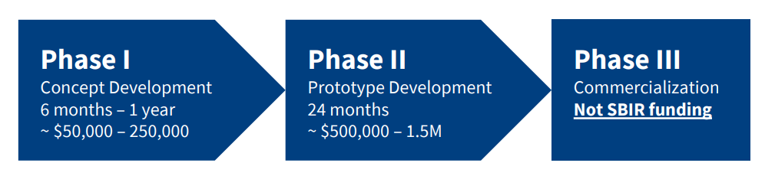
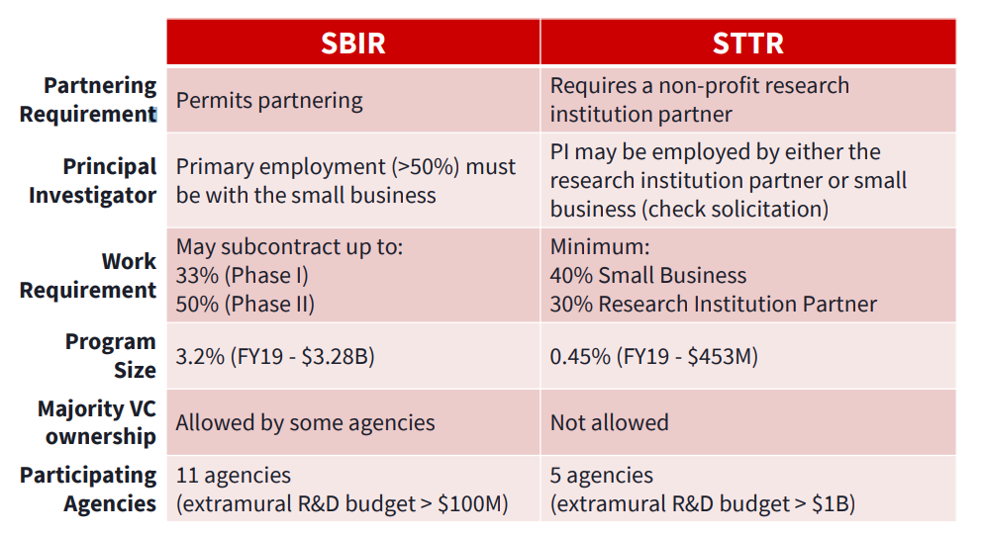
NASA SBIR/STTR Programs
Who are phases broken down?
What are the differences between SBIRs and STTRs?

Slide 8
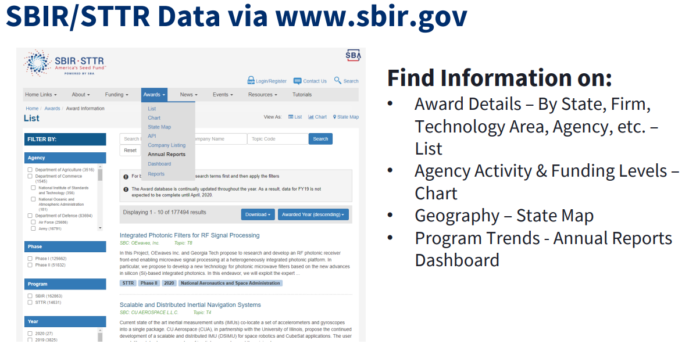
NASA SBIR/STTR Programs

Slide 9
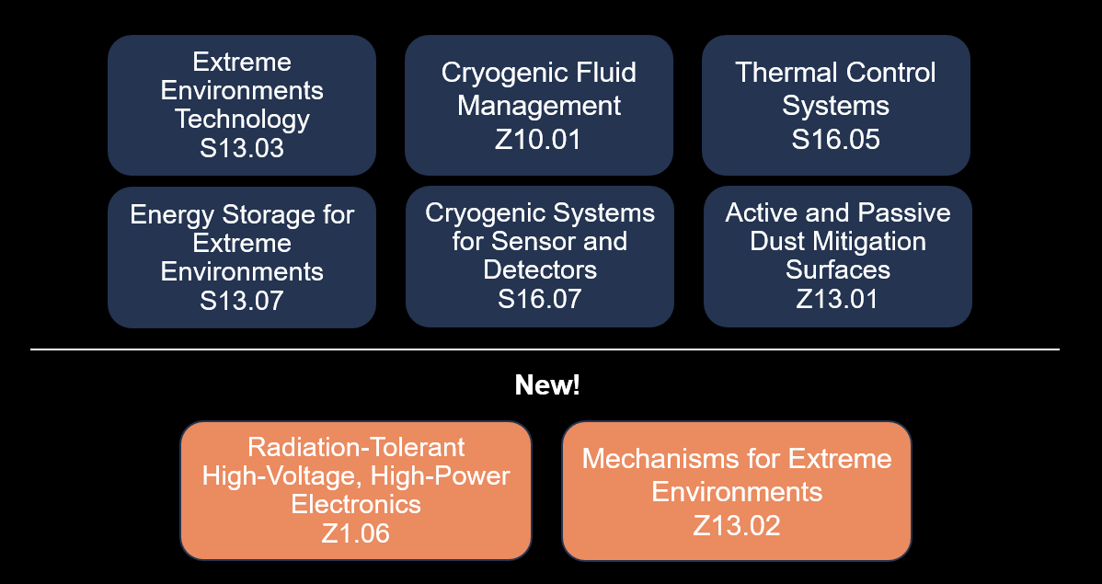
Current Exercise
LSIC EE Goals
  Identify Space Technology Mission Directorate (STMD) subtopics that fall under the EE focus area
  Educate community on NASA calls and desirable technology concepts
  Host SBIR/STTR awardee talks on funded technology and development status
  Support community discussions and collaborations
2022 NASA STMD SBIR Calls Under EE Umbrella

Slide 10
Active/Passive Dust Mitigation
Addresses NASA’s to develop dust mitigation and extreme lunar environment mitigation technologies that can be incorporated into space exploration systems
Passive and active dust mitigation technologies and novel engineering design are needed to form a complete dust mitigation strategy
Strong proposals are those that identify the active dust removal strategy in coordination with other dust prevention and removal methods
Subtopic solicits proposals in the following areas:
  Advanced Technologies for Active Dust Mitigation
    Brushing: A self-cleaning brush to mechanically remove dust from surfaces. The brush can be mechanically operated using power or can be temperature activated, such as shape memory alloys
    Electrostatic removal: Methods to use direct-current (DC) electric fields to remove dust from surfaces, either internal to the surface (embedded) or external using a removed high-voltage source
    Vacuum: Methods to remove particles from surfaces using suction of gases
    Jets: High-velocity gas jet that blows dust particles from surfaces
    Spinning surfaces: Surface rotates in a manner that does not allow collection of dust on it
    Vibrational surfaces: Vibrating surface bounces the particles off of the surface
    Electrodynamic removal: The surface contains embedded electrodes with varying high-voltage signals applied to lift and transport dust off of the surface
  Advanced Technologies for Passive Dust Mitigation
    Nanotechnology in permanently shadowed regions
    Flexible materials with adhesion and abrasion resistance demonstrated across the thermal range of the lunar surface, -170 to 125 °C
    Nonisotropic materials with directional dust adhesion control
    Dust removal technologies integrated with passive dust mitigation materials
    Materials and technologies for transition spaces from surface operations to habitat interior spaces
  Expected TRL or TRL Range at completion of the Project: 3 to 6

Slide 11
Active/Passive Dust Mitigation Call Five-Year Evolution
Desirable Technology Concepts | 2018 | 2019 | 2020 | 2021 | 2022
Advanced Technologies for Active Dust Mitigation |  |  |  |  | 
Advanced Technologies for Passive Dust Mitigation |  |  |  |  | 
Brushing |  |  |  |  | 
Electrostatic removal |  |  |  |  | 
Vacuum |  |  |  |  | 
Jets |  |  |  |  | 
Spinning surfaces |  |  |  |  | 
Vibrational surfaces |  |  |  |  | 
Electrodynamic removal |  |  |  |  | 

Slide 12
New! Mechanisms for Extreme Environments (MEE) Call
Mechanical system technologies for long-term operations in the lunar environment that consider the unique physical properties and other characteristics of lunar regolith, including dust
Must have operational extended service 10 to 100 months with limited or no maintenance, function throughout lunar radiation and thermal (between -238°C and 127°C) environments
Must function with a coating of lunar regolith (simulant) on exposed mechanism surfaces
Special interest in the following technologies:
  Actuators and power transfer components
  Fastening, joining and securing components and hardware
  Sealing materials and techniques that keep our regolith and operate in the harsh Moon environment
  Dust-tolerant fluid and electrical connectors
  Moving component for dust protection
  Tools and devices for exploration and ISRU
  Material handling and transportation components
Expected TRL or TRL Range at completion of the Project: 2 to 6

Slide 13
Cryogenic Fluid Management (CFM) Call
Addresses NASA technology needs related to cryogenic propellant (e.g., hydrogen, oxygen, methane) storage and transfer to support NASA's space exploration goals
Includes a wide range of applications, scales, and environments consistent with future NASA missions
Subtopic solicits proposals in the following areas, in order of priority:
  High-pressure-ratio compressor for on-orbit gas transfer of supercritical xenon and helium
    Capable of increasing low-pressure fluid to 3,000 psia with continuous flow of up to 15 g/s, allowing for on-orbit transfer of gases for applications of refueling
    Compressor must be capable of surviving launch-load vibrations, be able to function accurately in microgravity and vacuum environment (10-5 torr), and be able to maintain gas cleanliness to Level A/10 for nonvolatile residue
  Cryogenic flight-weight valve systems (minimum Cv >50, goal to Cv of ~100)
    For low-pressure (500 cycles with a goal of 5,000 cycles) to maximize the lifetime of the valve
    Can include metallic or nonmetallic sealing elements
  Subgrid computational fluid dynamics (CFD) of the film condensation process
    For 1g and low gravity (lunar) to be implemented into commercial industry standard CFD codes
    Formation and growth of the liquid layer as well as its movement along a wall boundary and should implement the volume of fluid (VOF) scheme
  Heat flux sensors capable of measuring heat fluxes between 0.1 and 5.0 W/m2 for cryogenic applications
    Target uncertainty of 2% full scale or less at temperatures as high as 300 K and at least as low as 77 K with a goal of 20 K
Expected TRL or TRL Range at completion of the Project: 2 to 4

Slide 14
CFM Call Five-Year Evolution
Desirable Technology Concepts | 2018 | 2019 | 2020 | 2021 | 2022
Reliable cryogenic screen channel acquisition devices | 
New/improved technologies for densification of cryogenic propellants | 
Advanced numerical design tools for cryogenic propellant management systems in relevant low-gravity (low-acceleration) environments | 
Insulation that reduces the heat leak in the annulus located over a liquid hydrogen tank but under a broad area cooled (BAC) shield at 90 K for space applications | 
Electric Pump technologies with low power (<40-50 kW) | 
System/stage cryogenic valves or cryogenic flight-weight valve systems |  |  |  |  | 
Broad area cooling methods for cryogenic thin-walled metallic and/or composite propellant tanks |  |  | 
Cryogenic transfer line thermal coatings for 0.5’’ to 3’’ OD tubing |  | 
Lightweight all composite spherical tanks for cryogenic propellants |  | 
Sub-grid CFD model of the nucleate boiling process for 1-g and low-g to be implemented into commercial industry standard CFD codes |  | 
Cryogenic mass flow meters applicable to liquid oxygen and methane |  |  |  | 
Cryogenic liquid/vapor phase separators |  |  | 
Integrated cryogenic propellant gas generation system for lander vehicles and supporting architecture |  |  |  | 
Integrated refrigeration cycles for a combination of hydrogen and oxygen liquefaction on the lunar surface |  |  |  | 
Subgrid computational fluid dynamics (CFD) of the film condensation process |  |  |  |  | 
High-pressure-ratio compressor for on-orbit gas transfer of supercritical xenon and helium |  |  |  |  | 
Heat flux sensors for cryogenic applications |  |  |  |  | 

Slide 15
Cryogenic Systems for Sensors and Detectors
Addresses NASA’s need for devices for cryogenic instruments
Subtopic solicits proposals in the following areas:
  Actuators and Other Cryogenic Devices
    Small, precise motors and actuators, preferably with superconducting windings, that operate with extremely low power dissipation; operate above 5 K
    Cryogenic heat pipes for heat transport within instruments
    Heat pipes using hydrogen, neon, oxygen, argon, and methane are of interest
    Devices that have reduced gravitational dependence and that can be made low profile, or integrated into structures such as radiators, are of particular interest
Expected TRL or TRL Range at completion of the Project: 3 to 4

Slide 16
Cryogenic Systems for Sensors and Detectors Call Five-Year Evolution
Desirable Technology Concepts | 2018 | 2019 | 2020 | 2021 | 2022
Cryogenic/Rad-Hard Accelerometers |  | 
Ultra-lightweight Dewars |  |  |  | 
Low-Temperature/High-Efficiency Cryocoolers |  |  |  |  | 
Actuators and Other Cryogenic Devices |  |  |  |  | 
Miniaturized/Efficient Cryocooler Systems |  |  |  |  | 
Sub-Kelvin Cooling Systems |  |  |  |  | 

Slide 17
Thermal Control Systems
Addresses NASA’s need for novel solutions, components, and system design techniques, for both active and passive thermal systems
Intended goal for any advanced thermal development is to enable new mission concepts while maintaining minimal impact to thermal system mass, volume, and power to maintain a spacecraft at specific temperature limits
Subtopic solicits proposals in the following areas:
  Heat Pumps for High-Temperature Sink Environments
    Expected TRL or TRL Range at completion of the Project: 2 to 5
  Advanced Manufacturing of Loop Heat Pipe Evaporator
    Expected TRL or TRL Range at completion of the Project: 4 to 6
  Approaches and Techniques for Lunar Surface Payload Survival
    Expected TRL or TRL Range at completion of the Project: 3 to 4
  Coatings for Lunar Regolith Dust Mitigation for Thermal Radiators and Extreme Environments
    Expected TRL or TRL Range at completion of the Project: 2 to 5

Slide 18
Thermal Control Systems Call Five-Year Evolution
Desirable Technology Concepts | 2018 | 2019 | 2020 | 2021 | 2022
High efficiency lightweight radiators | 
Advanced heat exchangers and coldplates | 
Condensate separators | 
Phase change materials | 
High heat flux acquisition and transport devices |  | 
Variable heat rejection technologies | 
Closed-loop space suit thermal systems | 
High efficiency miniature pumped fluid systems | 
Improved thermal math modeling tools | 
Body mounted radiators that provide effective micrometeoroid protection | 
Advanced Thermal Devices |  | 
Flexible Cryogenic Heat Pipe |  | 
Software Improvements for Integrated Thermal-Structural-Optical Performance Analysis |  |  | 
Advanced Thermoelectric Converter |  | 
Approaches and Techniques for Surface Payload Survival through the Lunar Day/Night Cycle |  |  |  |  | 
Lunar Lander Technology Development |  |  |  |  | 
Dust Mitigation Thermal Coatings |  |  | 
Advanced Manufacturing of Loop Heat Pipe Evaporator |  |  |  | 
Thermal management approaches, techniques, and hardware components to enable the accommodation of lunar temperature extremes encountered in the lunar environment |  |  | 
Two-Phase Deployable Radiators |  |  | 
Global Access Lunar Technology Development |  |  | 
Coatings for Lunar Regolith Dust Mitigation for Thermal Radiators and Extreme Environments |  |  |  |  | 
Heat Pumps for High-Temperature Sink Environments |  |  |  |  | 
Closed-Loop EVA Thermal Technologies |  |  |  | 

Slide 19
Extreme Environments Technology (EET) Call
Addresses NASA's need to develop space systems that can operate without environmental protection
Key performance parameters of interest are survivability and operation under the following conditions:
  Very low temperature environments (e.g., permanently shadowed craters on the Moon)
  Combination of low-temperature and radiation
Proposals are sought for technologies that are suitable for low-temperature environments such as those of the Moon
Special interest lies in development of the following technologies:
  Wide-temperature-range precision mechanisms: for example, beam-steering, scanner, linear, and tilting multi-axis mechanisms
  Radiation-tolerant/radiation-hardened low-power, low-noise, mixed-signal mechanism control electronics for precision actuators and sensors
  Wide-temperature-range feedback sensors with sub-arcsecond/nanometer precision
  Long-life, long-stroke, low-power, and high-torque force actuators with sub-arcsecond/nanometer precision
  Long-life bearings/tribological surfaces/lubricants
  Low-power and wide-operating-temperature radiation-tolerant/radiation-hardened radio-frequency (RF) electronics
  Radiation-tolerant/radiation-hardened low-power/ultralow-power, wide-operating-temperature, low-noise mixed-signal electronics for spaceborne systems such as guidance and navigation avionics and instruments
  Radiation-tolerant/radiation-hardened wide-operating-temperature power electronics
  Radiation-tolerant/radiation-hardened electronic packaging (including shielding, passives, connectors, wiring harness, and materials used in advanced electronics assembly)
Expected TRL or TRL Range at completion of the Project: 3 to 5

Slide 20
EET Call Five-Year Evolution
Desirable Technology Concepts | 2018 | 2019 | 2020 | 2021 | 2022
Wide-temperature-range precision mechanisms |  |  |  |  | 
Rad-hard electronics for precision actuators and sensors |  |  |  |  | 
Wide temperature range feedback sensors with sub-arc-second/nanometer precision |  |  |  |  | 
Long-life, long-stroke, low-power, and high-torque force actuators with sub-arcsecond/nanometer precision |  |  |  |  | 
Long-life bearings/tribological surfaces/lubricants |  |  |  |  | 
Low-power and wide-operating-temperature radiation-tolerant /radiation hardened RF electronics |  |  |  |  | 
Rad-hard electronics for space-borne system such as guidance and navigation avionics and instruments |  |  |  |  | 
Radiation-tolerant/radiation-hardened power electronics* |  |  |  |  | 
Rad-hard electronic packaging |  |  |  |  | 
*Added “wide-temperature-operating” to 2022 call

Slide 21
Energy Storage Call
Addresses NASA’s need for low-mass/-volume energy storage that can effectively operate in extreme environments
Special interest in the following technologies:
  Battery systems with combined high specific energy and energy density
    Primary: >800 Wh/kg and >1,000 Wh/L
    Secondary: >250 Wh/kg, and >500 Wh/L
  Operation at temperature range of -230°C to +120°C and during 14-day eclipses for lunar night survival and operations
  Novel battery-pack designs and technologies that enhance thermal management, battery reliability and safety
  Combinations of cell-level improvements and/or battery-system-level improvement for enhanced temperature capability
  Instrumentation or modeling that can accurately determine state of charge and/or health (for non-rechargeable primary batteries)
Expected TRL or TRL Range at completion of the Project: 3 to 5
Notes:
2018, 2019: S3.03 Power Electronics and Management, and Energy Storage (SBIR)
2019: Z1.04 Long Duration Lunar Energy Storage and Discharge (SBIR)
2020, 2021: S3.03 Energy Storage for Extreme Environments (SBIR)
2022: S13.07 Energy Storage for Extreme Environments (SBIR) –Moon to Mars and CLPS (not in 2021 or before)

Slide 22
Energy Storage Call Five-Year Evolution
Desirable Technology Concepts | 2018 | 2019 | 2020 | 2021 | 2022
Primary and secondary battery systems spanning -230°C to +120°C with combined high specific energy and energy density (>200 Wh/kg and >200 Wh/l) | x | x | x
Mechanical or magnetic energy storage devices (alternate to batteries) | x | x | x
Long duration energy storage with high-capacity, high-energy density and very high reliability (power range from 500 W to 10 kW for 354-hour lunar night prior to recharge) |  | x
Primary and regenerative fuel cells and rechargeable batteries (power range from 100 W to 1kW; specific power > 2,000 W/kg, and efficiency >60% at 1,500 W/kg) |  | x
Electrolyzers that generate sufficient reactant to support fuel cell operation with capability of >15% margin, efficiency >70% at 1,500 W/kg, sustained operational pressure of ≥ 2,000 psig, and long life (>10,000 hours) |  | x
Primary and secondary battery systems spanning -230°C to +120°C with combined high specific energy and energy density (cell level goals >250 Wh/kg and >500 Wh/l for secondary; >800 Wh/kg and >1,000 Wh/L for primary) |  |  |  | x | x
Radiation-hardened (1 Mrad TID) coulomb integration application-specific integrated circuits or hybrid circuits, with >1% accuracy over 1 to 20 A, operating over 24 to 36 V |  |  |  | x | x
Computational models that can predict state of charge/state of health for primary cells |  |  |  | x | x
Nondestructive instrumentation that can detect state of charge/state of health for primary and secondary cells |  |  |  | x | x

Slide 23
New! Rad-Tolerant High-Voltage, High-Power Electronics Call
Dedicated call to facilitate the understanding of mechanisms of heavy-ion radiation-induced single event effects (SEE) degradation and catastrophic failure of wide bandgap (WBG) power transistors and diodes and arrive at the development of radiation hardened devices
Proposals are sought for technologies that are suitable for low-temperature environments such as those of the Moon
Special interest lies in development of the following technologies:
  High-voltage, high power solutions for power distribution systems: 1200 V / 40 A minimum diodes with fast recovery < 50 ns, and 600 V / 40 A minimum transistors with < 24 mohm on-state drain-source resistance
  High-voltage, low-power solutions for low-mass, low-leakage, high-efficiency applications such as lidar Q-switch drivers, mass spectrometers, and electrostatic analyzers: 1000 V, <50 ns turn-on and turn-off times transistors and 2 kV to 5k V, <50 ns recovery time diodes with forward voltage drop that is less than 150% that of state-of-the-art unhardened diodes
  High-voltage, low- to medium-power solutions for peak-power solar tracking systems: 600 V min transistors with < 50 ns turn-on and turn-off times, current ranging from low to > 20 A
Expected TRL or TRL Range at completion of the Project: 4 to 5

