Slide 1

LSIC ISRU Focus Group Monthly http://lsic.jhuapl.edu/ http://lsic-wiki.jhuapl.edu/ (Confluence sign-up required)
February 15, 2023
Dr. Jodi Berdis, Dr. Karl Hibbitts, Dr. Michael Nord, Dave Smith, Claire Trop, Dr. Rich Miller
Jodi.Berdis@jhuapl.edu, Karl.Hibbitts@jhuapl.edu, Michael.Nord@jhuapl.edu, David.Smith@jhuapl.edu, Claire.Trop@jhuapl.edu, Richard.S.Miller@jhuapl.edu

Slide 2
Agenda
General updates and house-keeping
  APL is happy to consult as appropriate with ISRU and related technologies. We can provide advice on how to build for launch and operate in extreme environments. This includes site visits!
  Upcoming Meetings
  Funding Opportunities
LSIC ISRU FG Future: Vision 2023 Polls and Discussion
Lunar Technology Community-Driven Whitepaper

Slide 3
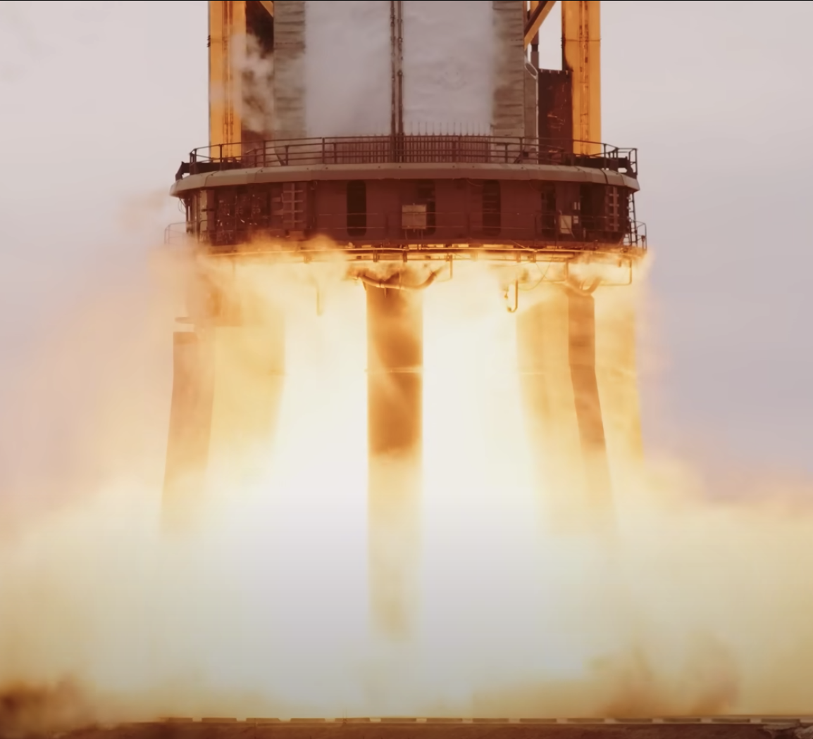
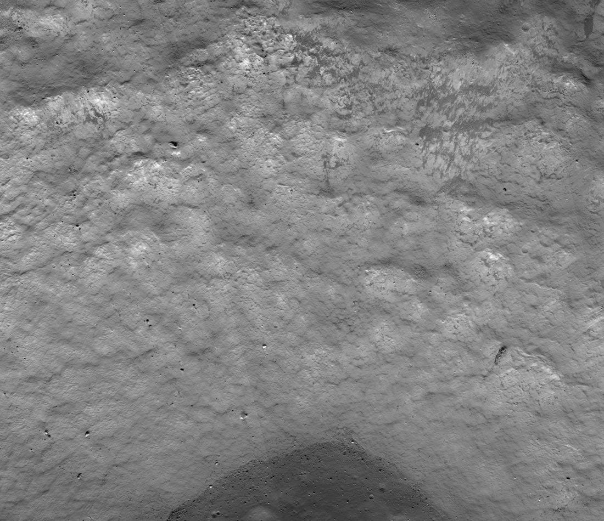
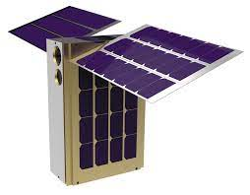
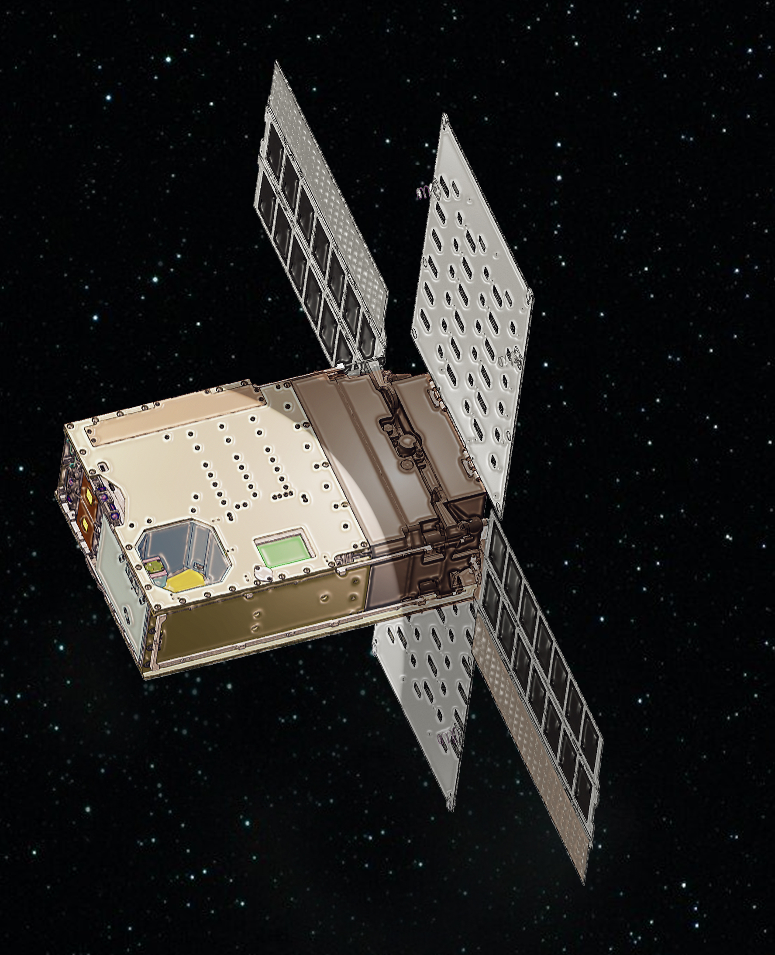
Notable News
SpaceX successfully ignites 31 Raptor engines on Starship’s Super Heavy stage
Another really awesome PSR image from ShadowCam
LunaH-Map and Lunar Flashlight both unfortunately unable to get into desired orbits ☹

Slide 4
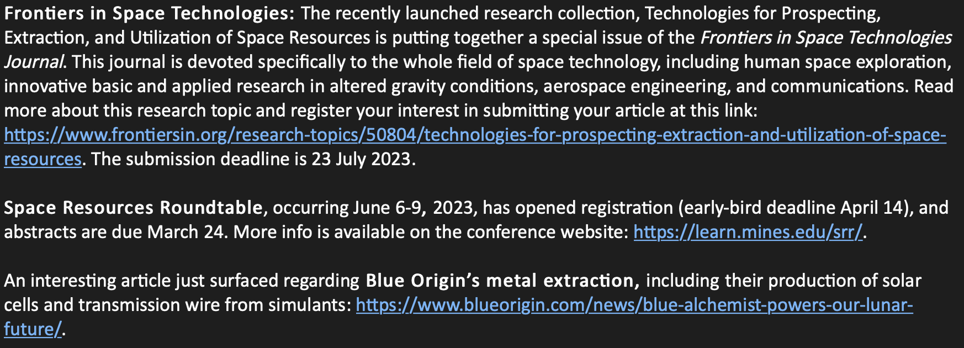
Notable News #2

Slide 5
Upcoming Meetings
LSIC Spring Meeting Mar 29-30 April 24-25 (next slide):
  https://lsic.jhuapl.edu/Events/Agenda/index.php?id=380
  Abstracts due Feb 15 (TODAY!)
  Registration opening soon…
LSSW, “The First Steps in a Bold New Era of Human Discovery: Candidate Artemis III Landing Sites” (April 4-5)
  Abstract deadline March 1: https://www.hou.usra.edu/meetings/Artemis_III_2023/abstracts/
Space Resources Roundtable June 6-9
  Space-resource activities in cislunar space and the Moon, space manufacturing and construction, space infrastructure, commerce, international efforts, and legal and public policy issues
  March 24: abstract submission deadline; April 14: early-bird registration deadline
  https://learn.mines.edu/srr/
Surface Power February 23 11AM ET Telecon (next next slide)

Slide 6
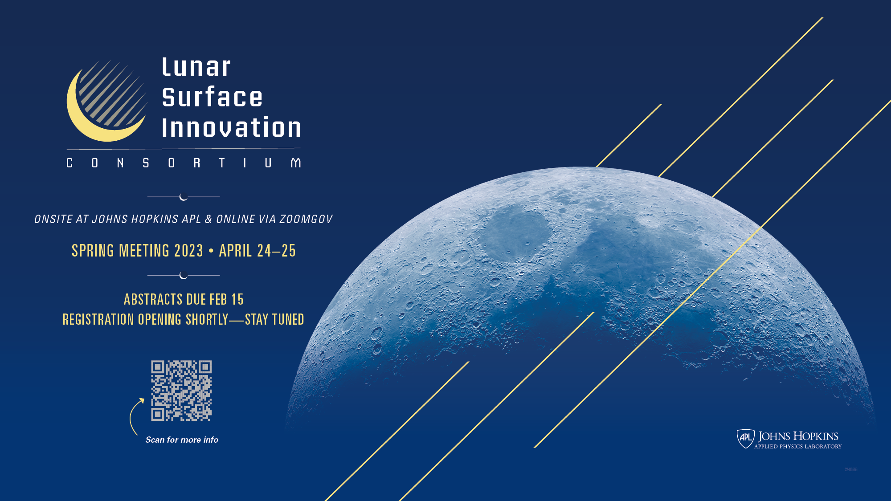

Slide 7

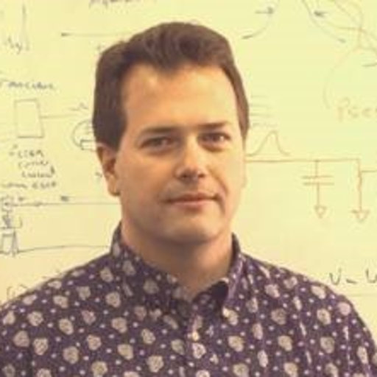

LSIC | Surface Power - February Telecon
We hope to see you all at our next Surface Power, which will take place on Thursday February 23, 2023 at 11:00AM ET.
Topic: High-TRL, tech-demo ready 300 W power beaming technology
Speaker: Mark Storm (Fibertek)
Director of NASA programs including space optical communications, Earth LIDAR, LISA and other astrophysics missions
Fibertek delivers laser and LIDAR systems for application-specific requirements
Space-qualified systems include NASA’s CALIPSO lasers (> 14 years on orbit) and ICESat-2 laser system (2 years on orbit)
Current space work includes 24/7 remote sensing satellites, ISS, lunar orbiter, small-satellites, deep space and future planetary exploration
7

Slide 8
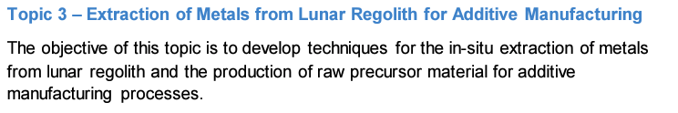
Funding Opportunities
FY 2023 Phase I SBIR and STTR Solicitations
  The next Phase I opportunity closes March 13. The NASA Phase I SBIR and STTR solicitations are open to small businesses with 500 or fewer employees. To apply for an STTR, a small business must partner with a nonprofit research institution, such as a university or research laboratory.
  Proposals due March 13: https://sbir.nasa.gov/
Lunar Surface Technology Research (LuSTR) Opportunities
  ISRU is a specific topic/challenge in this call, and more specifically, the Extraction of Metals from Lunar Regolith for Additive Manufacturing.
  Awards are for up to 2 years, up to $2M total, and are limited to PI’s at US universities, though teaming with industries and non-profits is encouraged.
  NOIs Due: March 22, 2023
  Proposals Due: April 24, 2023
  https://tinyurl.com/NASA-LuSTR23

Slide 9



LSIC ISRU FG Future: Vision 2023
Slido.com
Code: #LSIC-ISRU-Vision2023 https://app.sli.do/event/nbbLazCN8ER4EKcXi7vC7w
Notes:
https://forms.gle/tuhzwAUaQLDivQ2D7

Slide 10
Lunar Technology Community-Driven Whitepaper: ISRU https://lsic-wiki.jhuapl.edu/x/PQUiAw
Notes:
https://forms.gle/tuhzwAUaQLDivQ2D7

Slide 11
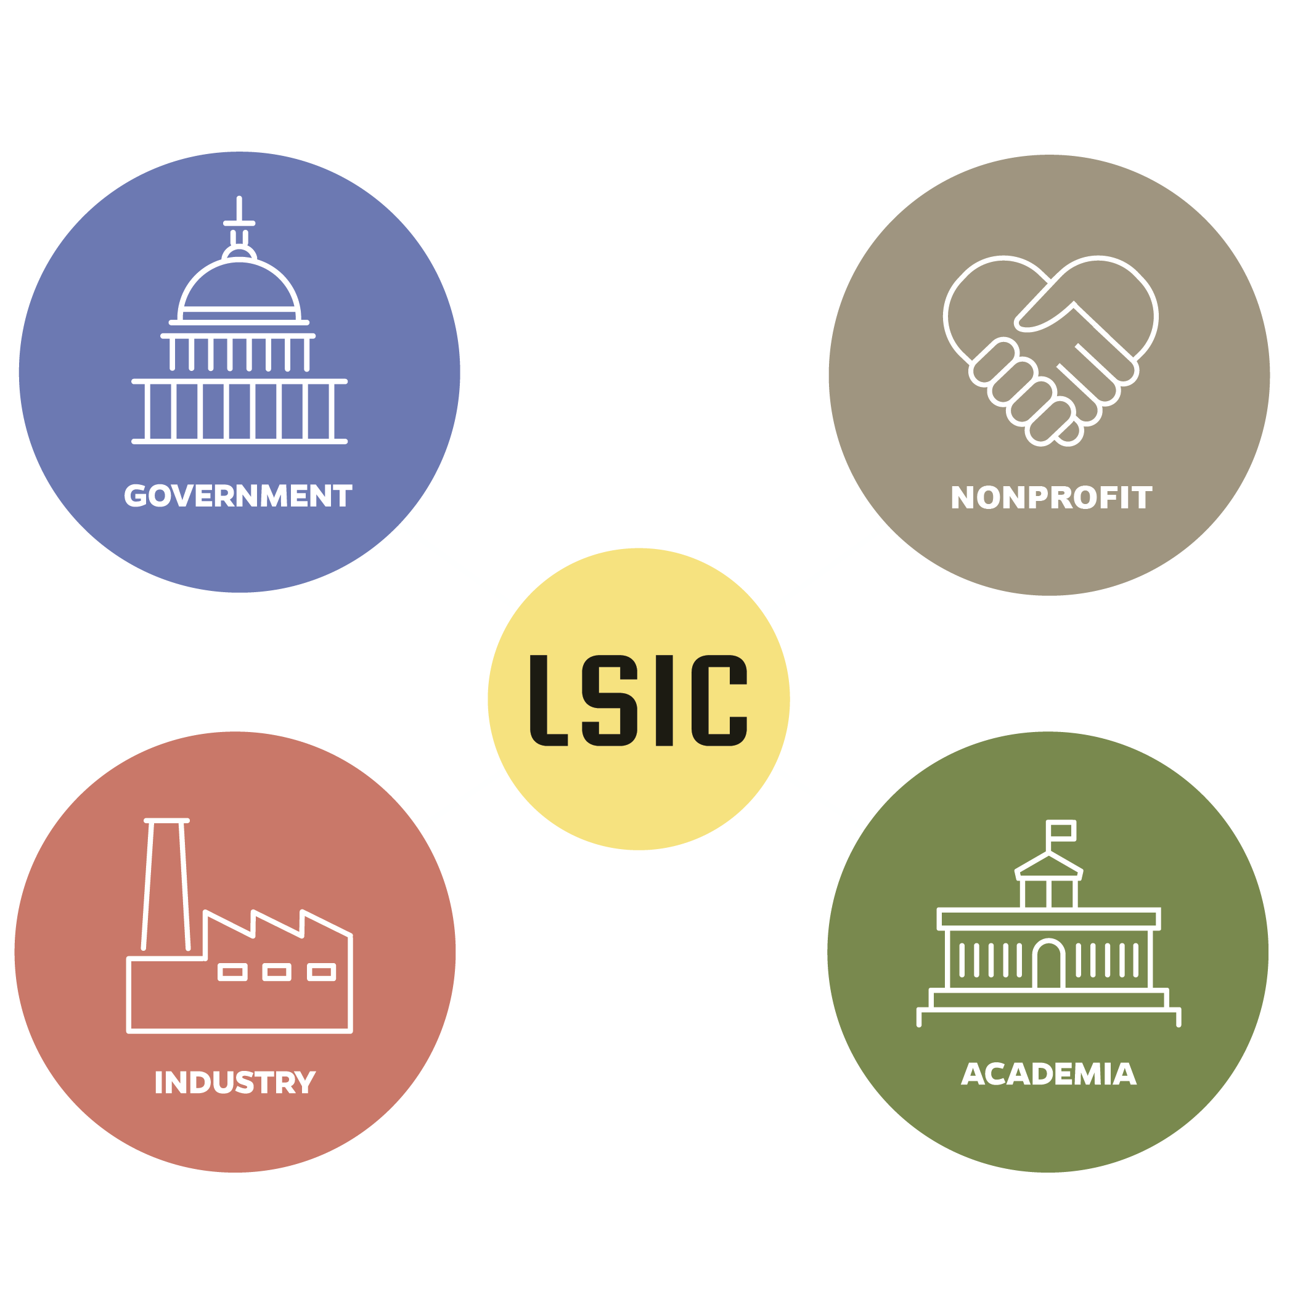
LSIC | White Paper: The Path to an Enduring Lunar Presence
  Decisions we make now are critically important to achieve the 10+ year goals of the Nation on the Moon and beyond
  APL with LSIC is developing a community-derived white paper on the path from early NASA missions to an Enduring Lunar Presence with a robust lunar ecosystem
    “In satisfying NASA’s baseline objectives, how do we ensure robust participation from industry that also enables a transition away from NASA as a sole customer?”
  Stakeholder alignment – NASA will not achieve all goals alone
  Phased development and key early investments/decisions
  Opportunities for “systems of systems” tech demos – terrestrial or lunar
11

Slide 12
LSIC | White Paper: The Path to an Enduring Lunar Presence
  Structure of the paper:
    Estimated 10 pages – high level, in family with M2M Objectives and OSTP Cislunar document
    Identify key infrastructure from industry’s perspective
      What enables the evolution of the Moon into an exploration proving grounds?
      What are the technologies that have shared applicability across all stakeholders and how do we best motivate their development?
      The 6 LSII focus areas are integrated in the process – not independent efforts
    What combined tech demos could retire key questions?
12

Slide 13
LSIC | White Paper: The Path to an Enduring Lunar Presence
  Early insights from prior LSII engagements/breakouts:
“The Moon as a proving ground” means many things
  For proving out science and exploration technologies
  Demonstrates unity of purpose and commitment to achieving long-term goals
  To test and mature acquisition strategies that can amplify NASA’s investments and show that we can work in a “whole-of-nation” fashion
Preliminary take-aways from breakouts,
  Translational technologies abound and offer multiplier on NASA’s investments
  Multi-stakeholder involvement provides a key signal of stability for industry
  If NASA cannot succeed on this, there is little confidence in the community for taking humans to Mars
    How do we know when we’re ready to move on to Mars?
13

Slide 14
Topical Discussion
Lior Rubanenko
Stanford University
“The abundance of subsurface ice near the lunar poles: lessons learned from the Moon and Mercury”

