Slide 1


LSIC Surface Power Telecon
February 23rd, 2023
Begins at 11:03
Dr. Matt Clement, Dr. James Mastandrea, Dr. Sean Young,
Sam Andrade, Julie Peck, Dr. Joe Kozak, Claire Trop
Johns Hopkins Applied Physics Laboratory
Space Exploration Sector
LSIC Surface Power POC: matt.clement@jhuapl.edu

Slide 2

LSIC | Agenda
Community Updates
  Solicitations and Awards
  Conferences/Workshops
    LSIC Spring Meeting
  March Telecon
  Surface Power 2022 Survey Debrief
  LSIC Community White Paper
Presentation: Mark Storm (Fibertek)
Q&A
2

Slide 3
LSIC | Solicitations and Awards
Space Tech Solicitations (https://www.nasa.gov/directorates/spacetech/solicitations)
MUREP Space Technology Artemis Research
(M-STAR)
Pre-proposal Webinar: Today 4:00-5:30 PM ET
Proposals Due: April 10, 2023
NASA SBIR/STTR Phase I
Proposals due March 13, 2023
LuSTR 2023 Opprotunities
NOIs due March 23
Full proposals due April 24
NASA Innovative Advanced Concepts (NIAC) Phase III Call for Proposals
Mandatory Preliminary Proposals due: March 8
Final Proposals Due: May 17
Early Career Faculty STMD Research Grants
Solicitation release imminent
Early Stage Innovation Solicitation
Solicitation release planned in April 2023
3
Notes:
MUREP= Minority University Reserarch and Education Project: Through MUREP, NASA provides financial assistance via competitive awards to Minority Serving Institutions (MSIs), including Alaska Native and Native HawaiianServing Institutions, American Indian Tribal Colleges and Universities, Asian American and Native American Pacific Islander Serving Institutions, Hispanic-Serving Institutions, Historically Black Colleges and Universities, Native American-Serving Nontribal Institutions and other MSIs, as required by the MSI-focused Executive Orders (EOs).
LuSTR= Lunar Surface Technology Research Opprotunities
https://nspires.nasaprs.com/external/solicitations/summary.do?solId=%7b2644B211-4765-F748-70E5-F429AEBC81B7%7d&path=&method=init

Slide 4
LSIC | Upcoming Meetings and Workshops
IEEE Aerospace Conference
March 4-11, Big Sky, MT
Lunar and Planetary Science Conference
March 13-17, The Woodlands, TX
Applied Power Electronics Conference
March 19-23, Orlando, FL
ASCENDx
March 29-30, Houston, TX
LSIC Spring Meeting
April 24-25, Laurel, MD
More complete calendar on LSIC website, email with additional events!
4
Notes:
AIAA Scitech is an expo of the latest and greatest in Aerospace R&D
FAA CSTC

Slide 5
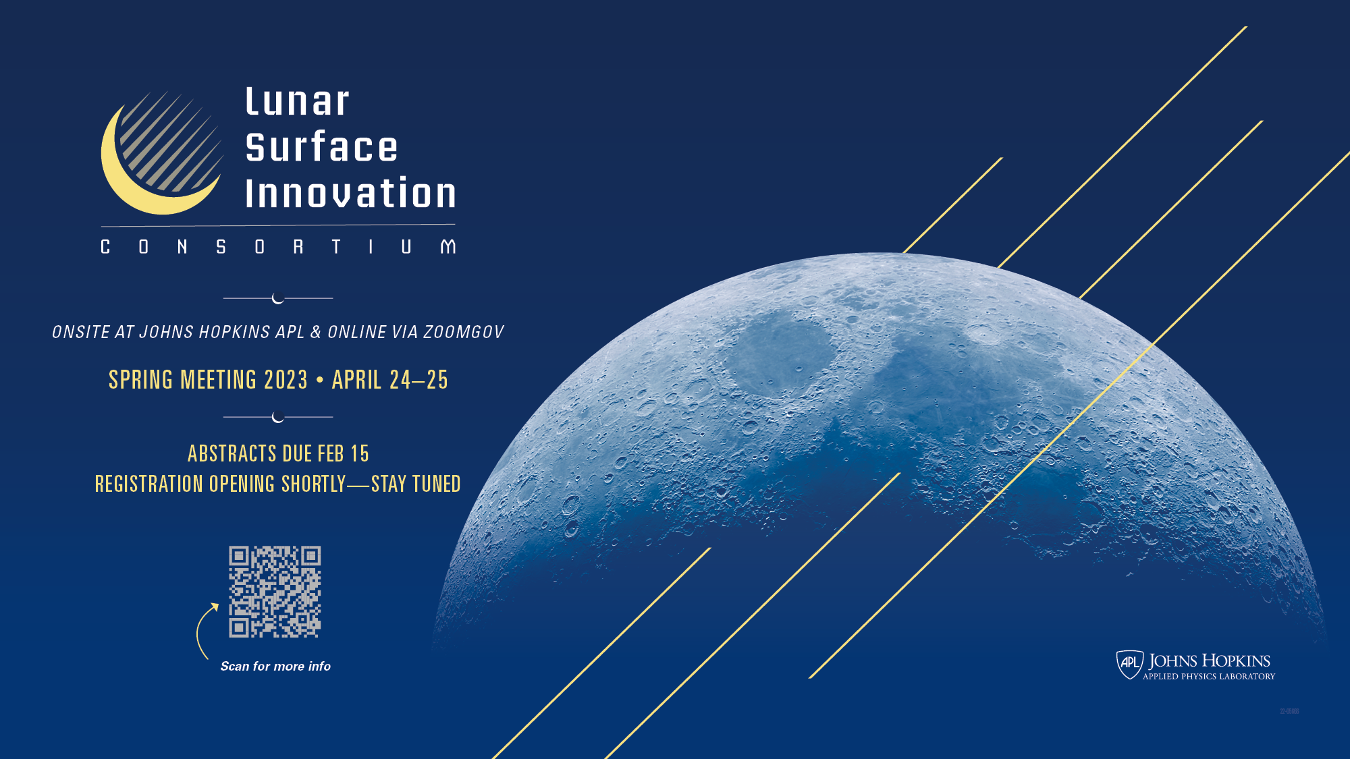
Notes:
https://lsic.jhuapl.edu/Events/Agenda/index.php?id=380
Day 1 Featured Speakers:
Kurt "Spuds" Vogel, NASA Director of Space Architecture
James Reuter, NASA Associate Administrator for the Space Technology Mission Directorate
Day 2 Featured Speakers:
Pam Melroy, NASA Deputy Administrator
Matt Daniels, Assistant Director of the White House’s Office of Science and Technology Policy for Space Security and Special Projects
Stefanie Tompkins, Director of the Defense Advanced Research Projects Agency (DARPA)

Slide 6
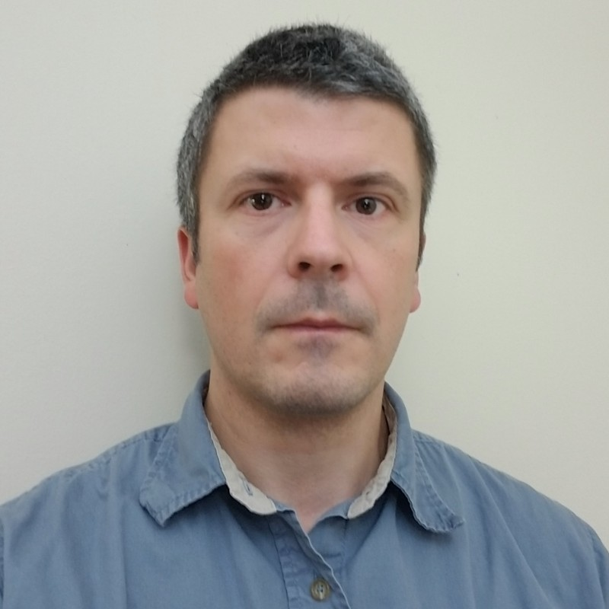

LSIC | March Telecon
We hope to see you all at our next telecon, which will take place on
Thursday March 16, 2023 at 11:00AM ET.
Theme: Radiation Testing of Electronics
Speaker: Akin Akturk (CoolCAD Electronics, Vice President)
6

Slide 7
LSIC | LSIC Community Whitepaper
7

Slide 8
LSIC | Surface Power Community Survey Results
We are listening to your feedback!
The top requested technology gaps for additional focus in 2023 were:
  13%: Fission Surface Power
    January Telecon: X-Energy, Westinghouse, Lockheed Martin
  13%: Power Beaming
    February Telecon: Fibertek
  10%: Rad-Hard Electronics
    March Telecon: CoolCAD
  10%: Photovoltaics
    May Telecon: VSAT Phase II
8

Slide 9
LSIC | Surface Power Community Survey Results
Sufficient Private capital exists to fund development in my industry/field and supplement NASA/federal funding and mature my technology in accordance with NASA’s timeline:
    77% neutral, disagree or strongly disagree
There are many parallel efforts (e.g.: DoD projects, NASA projects, commercial undertakings) in my industry/field, and I see duplication of work as a potential problem
    72% neutral, disagree or strongly disagree
Most Interesting 3 telecons from 2022:
  March: Ian Jakupca (NASA) on Hydrogen and Fuel Cell Technology Development
  October: Annette Dolbow (JHU/APL) and Lee Mason (NASA) on Integration and Testing
  April: Ansel Barchowsky (JPL) on Tethered Power Systems
9

Slide 10

LSIC | Presentation
Speaker: Mark Storm, Fibertek
  Director of NASA Programs
10
Notes:
Mark Storm has 25 year experience developing space laser, lidar and laser communications technology for NASA including over 90 publications. His career included stops at Naval Research Laboratory, NASA and Fibertek. He is the Director of NASA Programs for Fibertek. He has a particular expertise in space fiber laser which will be discussed today.

Slide 11

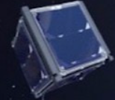

Space Laser Technology for Lunar Power Beaming
Mark Storm
Director of NASA Programs
LSIC Surface Power Monthly Telecon
February 23, 2023

Slide 12
Who is Fibertek?
Small Aerospace Company – Northern Virginia
Core Competency in
  Space Laser, Lidar, and Laser Communication Systems
NASA Space Laser and Lidar Supplier for over 25 years.

Slide 13
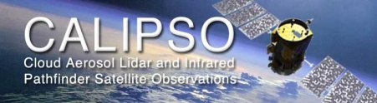
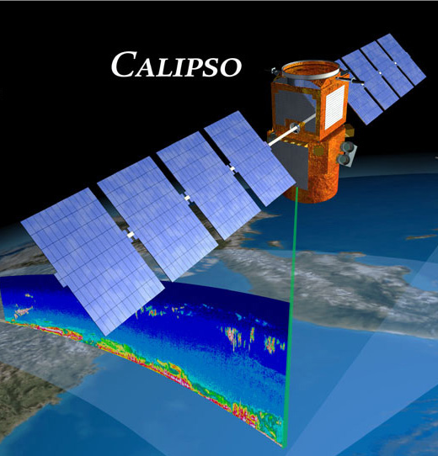
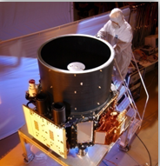
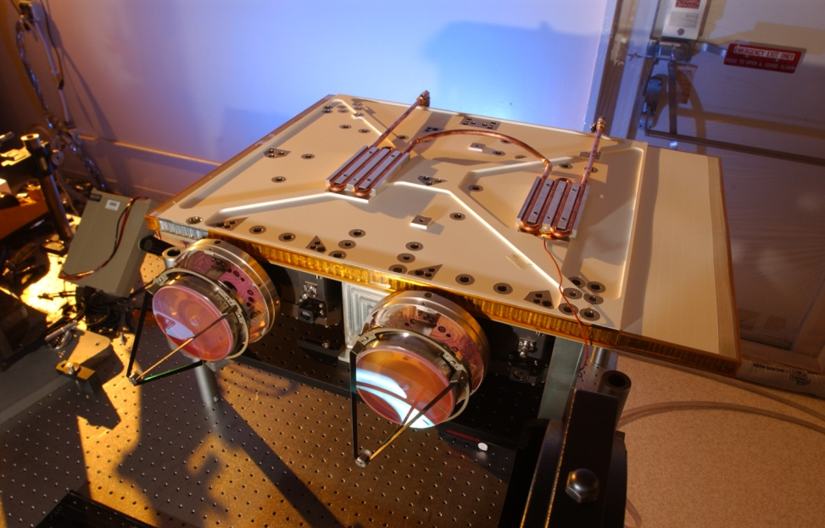
CALIPSO
NASA /BATC, Cloud and Aerosol Lidar Mission
Fibertek provided spaceflight laser
NASA ESSP 3-year mission
17 years of 24/7 365 days/year since 2006.
Still operational.
Expect 2 more years

Slide 14
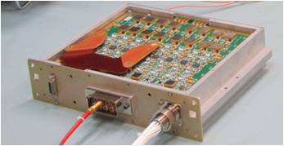
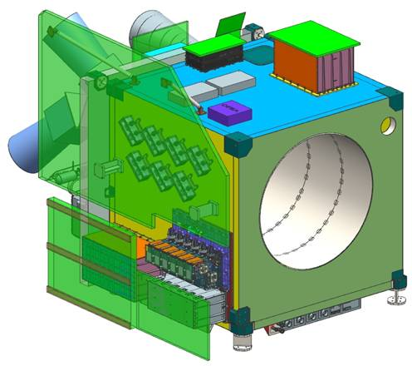
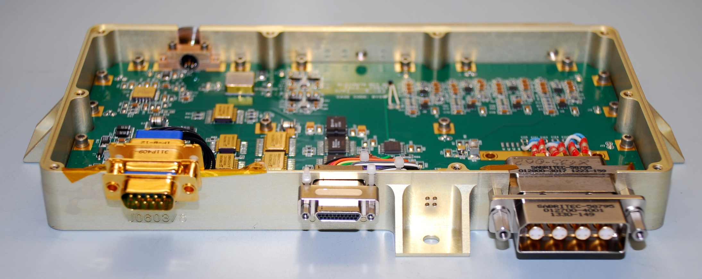
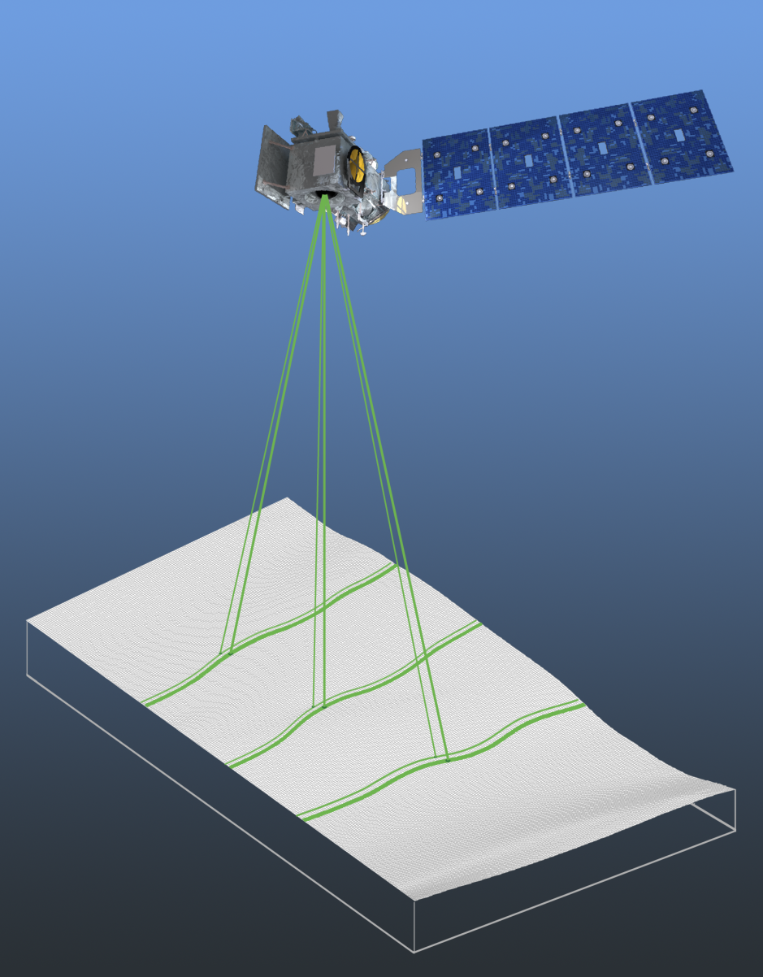
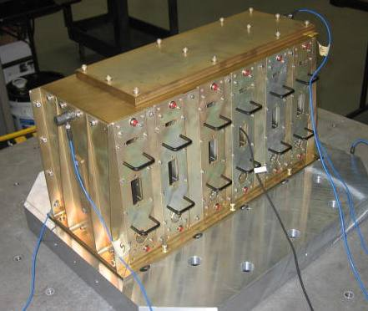
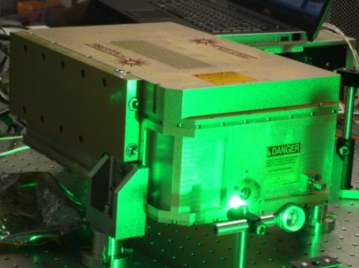
Fibertek ICESat-2 Contributions
Fibertek provided the Space Flight Lasers, Detector & Start Pulse Electronics
NASA ICESat-2 Operational Since Sept 2018 (24/7/365)
  Start Pulse Detector
  Altimeter T_{o} Signal
  NASA ICESat-2 Instrument
  Laser Wavelength Control Electronics
  Photon Counting Electronics
  RF CFD circuits , (120 PMT Channels)
  Few ps Jitter
Lasers

Slide 15
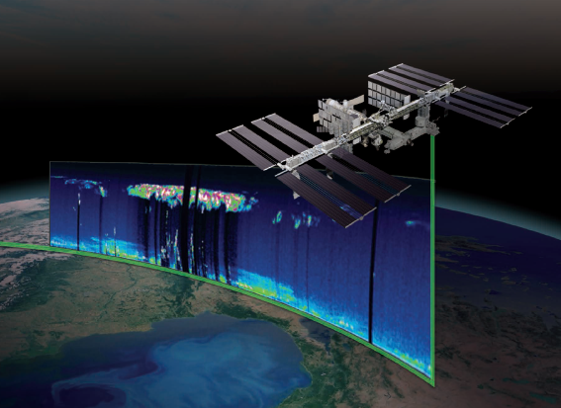
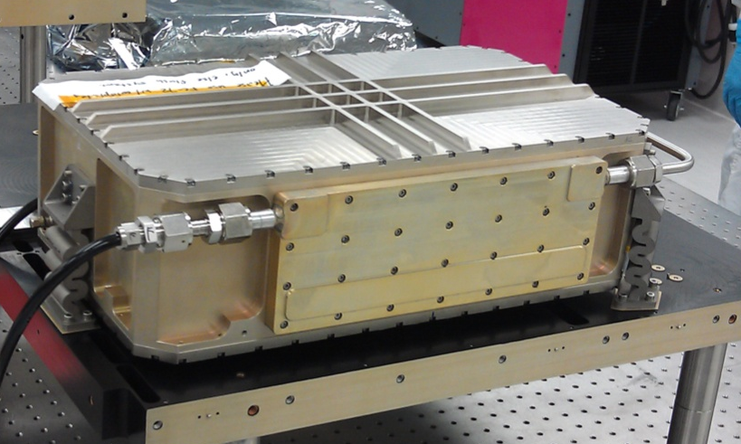
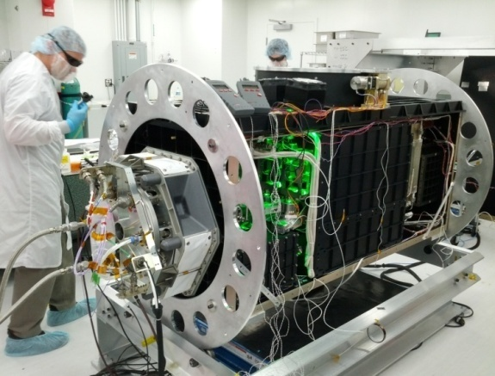
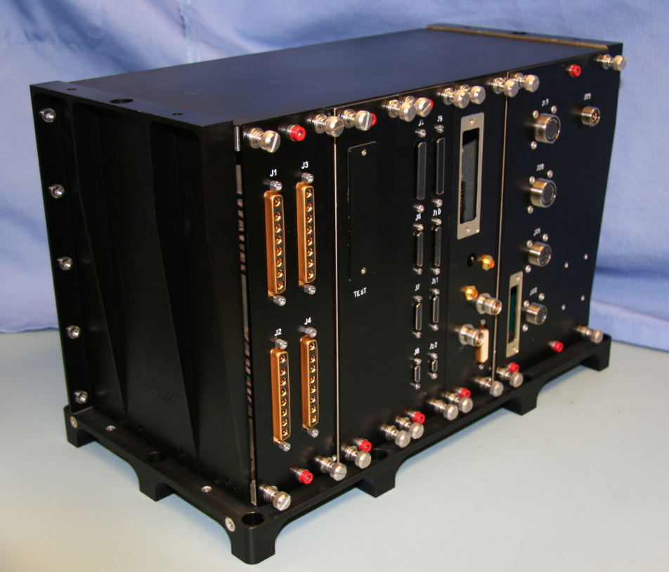
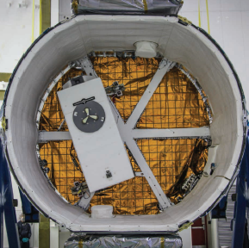
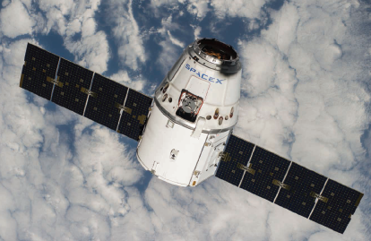
NASA ISS CATS Aerosol Lidar
Ultra Low Cost ($14M) - ISS Aerosol Lidar
Rapid development (24 months)
Fibertek provided
  State of the Art Lasers
  Lidar Controller
  Operation SW Interface
  Intelligent Power
Success - Completed 3-year mission
CATS in Dragon ISS resupply vehicle, CRS-5

Slide 16
Presentation Outline
Lunar Applications
Space Fiber Lasers
  Powers from 3 – 150W
Laser Pointing and Tracking
Checklist to Lunar power beaming (Partial)

Slide 17
Lunar Power Beaming Applications

Slide 18
Lunar Applications
Power a Rover inside a Lunar Permanently shadowed Region (PRS)
  Science – What's down there.
  ISRU – Look for Ices that can be converted to Fuel, Water Ice.
  Batteries a -200C don’t last long, survive well.
  100+ W ?, 200 -1000 meters?
Power Transport from Eternally Sun south pole location
  Collect power with solar power
  Transport to – partial sunlight, Dark locations.
  Power when darkness comes – short days.
  ~ 1-15 km range
  100’s to 1000’s Watts.

Slide 19
Power Beaming Basic
Subsystems to Optimize: Laser, Laser Pointing, and Receiver
Things to Optimize: Efficiency, Mass, Reliability, Flexibility, Cost
  Environmental : Thermal Op -50 to -200C
Net Results - Has to be better than a cable. (Cu or Fiber)
  Rover – Hard to drag around a cable.
  Power Transport from Solar Panels - Large Long Cable.
Power Source
Laser
Efficiency
Laser pointing
system
Receiver
Efficiency
Power Beaming Challenges:
  Thermal : -50 to -200C. Survival & Operation. Power dissipation during operation.
  SWaP – C. Has to be transportable, not too massive, Affordable.
  Reliable & Simple – Work years on the lunar surface, not to complex

Slide 20
Good New
Space Fiber Lasers do exist

Slide 21
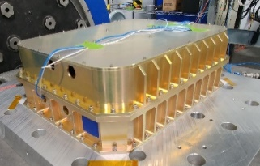
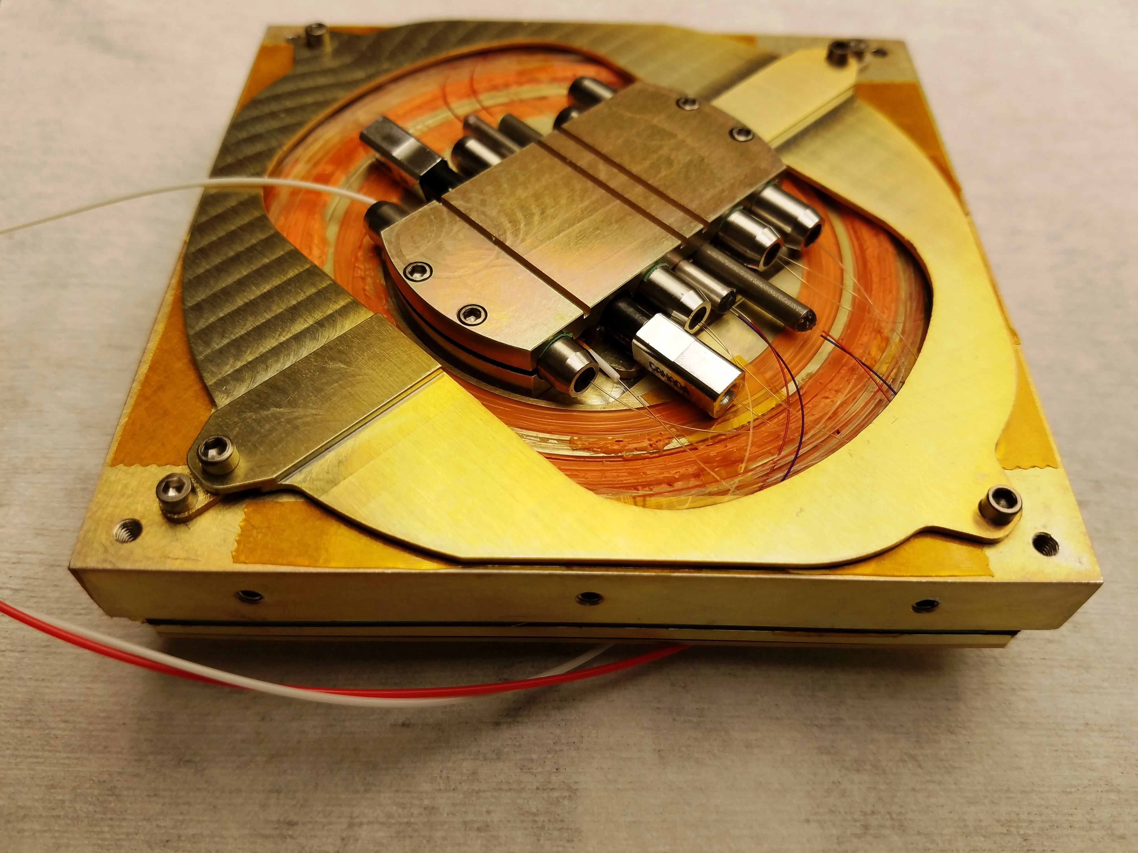
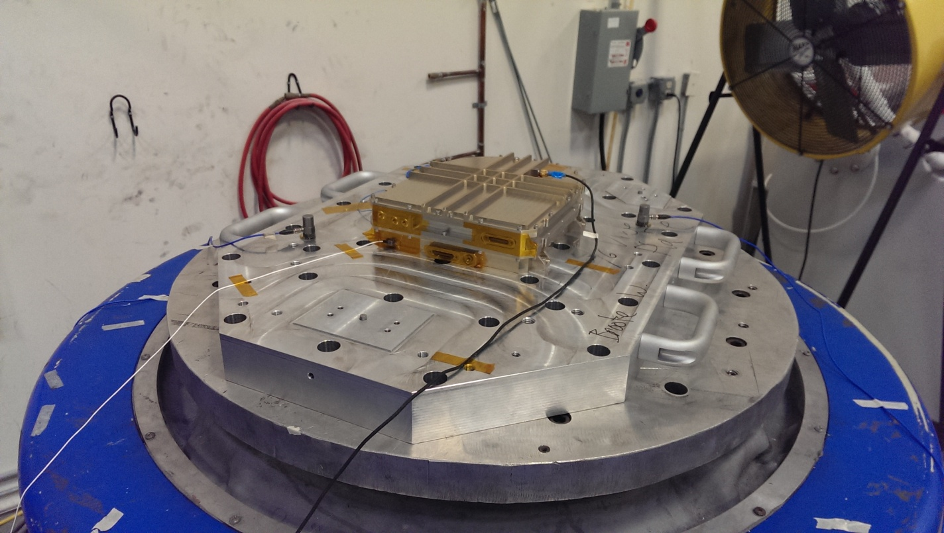
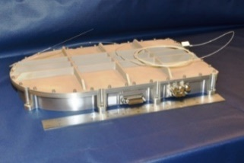
High TRL Space Lasers available up to 150W
High Reliability Space-based transmitter available across a wide range of Sizes
Reliability 5+ years
High TRL readiness (TRL 5-6) in all cases.
Versions : 1064nm, 1550nm, 2000 nm
Very high efficiency - optical to optical.
  Optimized – ~ 40% Yb fiber laser
Compact
100 W, TRL 6, NASA GEVS
13 kg
Compact
25 W
6 kg
CubeSat: 0.5 to 3W
10cm x 10 cm x 3 cm
Compact , 4-12W

Slide 22
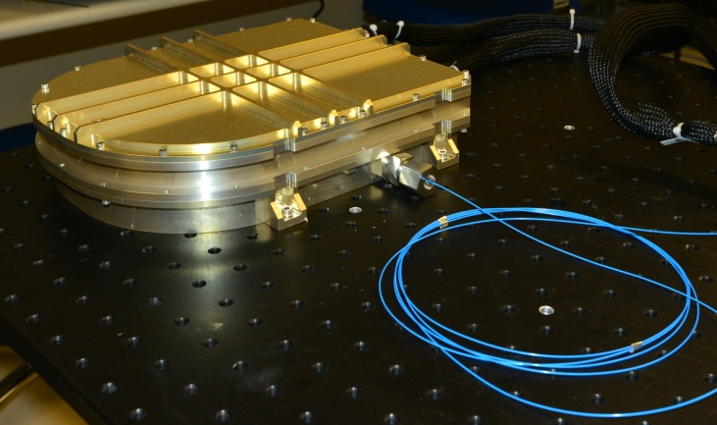
NASA JPL Optical Com - TRL6
Low SWaP, 6W, 1550nm Transmitter
  Size: 10” x 8” x 2.375.”
  Mass: 4kg
Environmentally Tested TRL 6
  TVAC and Vibration tested.
  Radiation testes
Tested to 6W,
Package Capable up 12W
Designed for 24/7/365, 7 years

Slide 23
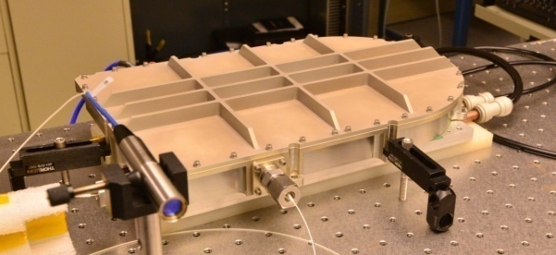
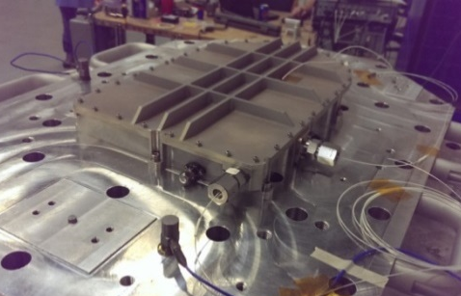
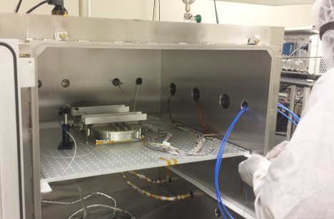
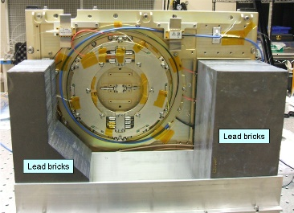
20 W Amplifier – NASA Lidar, Lasercom
Baseline Characterization
  20 W output power
  M2 ≤ 1.3
  Size : 8.5”x13.5”x 1.6”
  Mass: 6 kg
NASA GEVS Vibration
Thermal Vacuum
Radiation

Slide 24
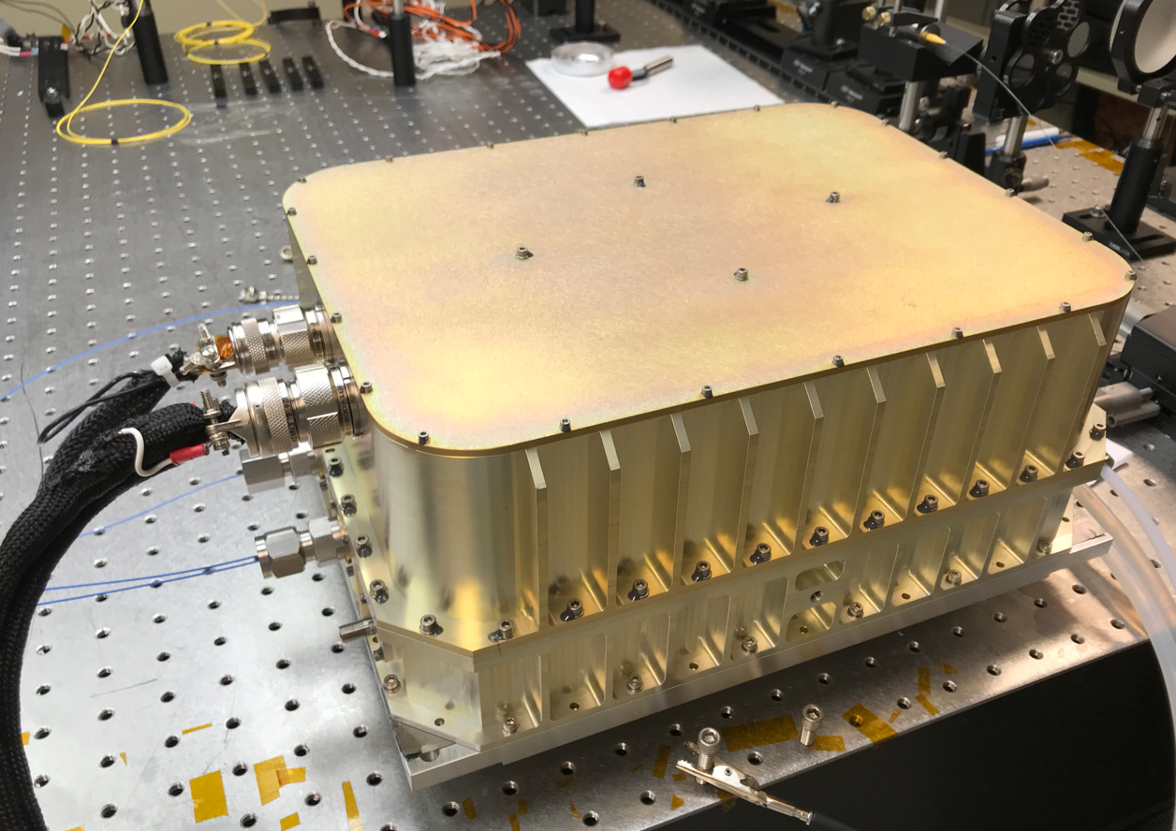
50 W Fiber Laser
Size: 10.6” x 13.8” x 5.3”
Weight : 13.1 kg, 28.7 lbs
Specialized Deep Space communications laser.
Can be greatly simplified for Power beaming.

Slide 25
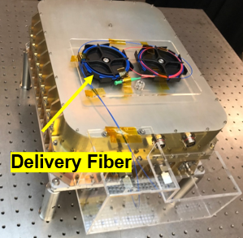
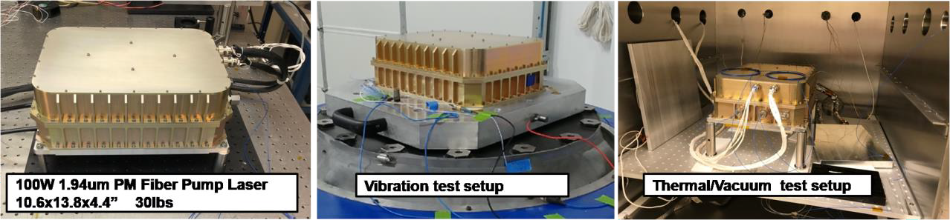
100W Fiber Laser
Fibertek designed, built and TRL6 tested a 100 W average power Tm fiber laser.
Designed for 95% reliability over 5 year assuming 24/7/365 operation
Package would support 150W Yb fiber laser
13 kg

Slide 26
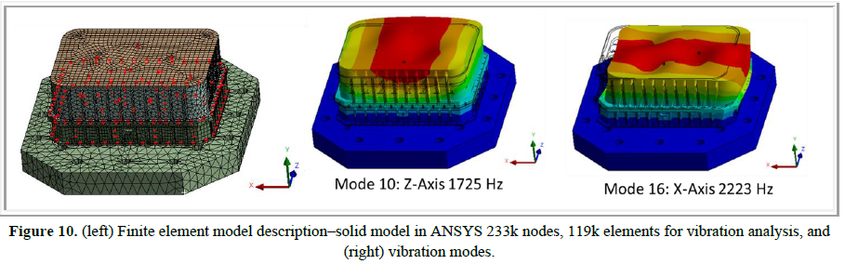
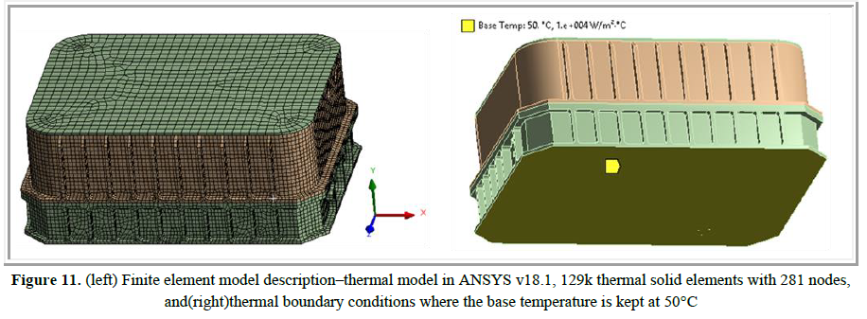
Structural and Thermal Analysis
Structural Analysis Conducted at NASA GEVs Qualification – 14.1 Grms
Operational Temperature : 0-50C
Survival : -25 C
Proc. SPIE 11678, doi:10.1117/12.2577276

Slide 27
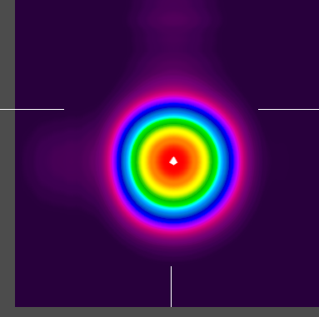
1064 nm, 85% to 90% Efficiency feasible
500W M2 ~1.1
Data for Ground Based Program
Average Power: 525 W
Peak Power : > 2 kW, Pulsed Operation
Efficiency: >75% O-O
Robust diffraction limited beam quality
For Optimizes Yb Space Fiber laser would expect near 40% Electrical to Optical Efficiency.

Slide 28
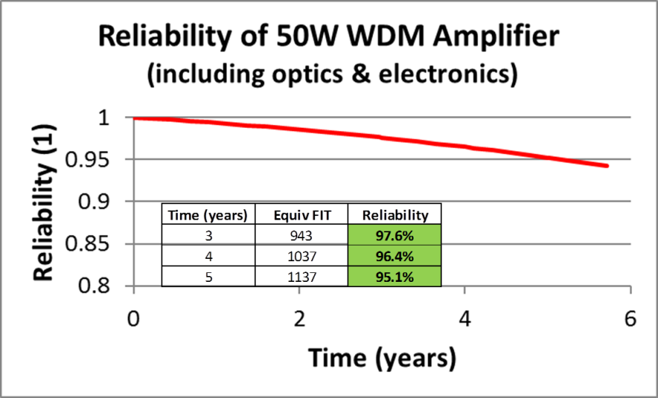
Reliability – 50W, 100W
Designed for 5-year Space Mission
Reliability: 24/7/365 operation
  95% over 5 years
  90% over 10 years.
Reliability can be improved to 15 year
  Add additional redundancy
Reliability can be reduced for lower SWaP.

Slide 29
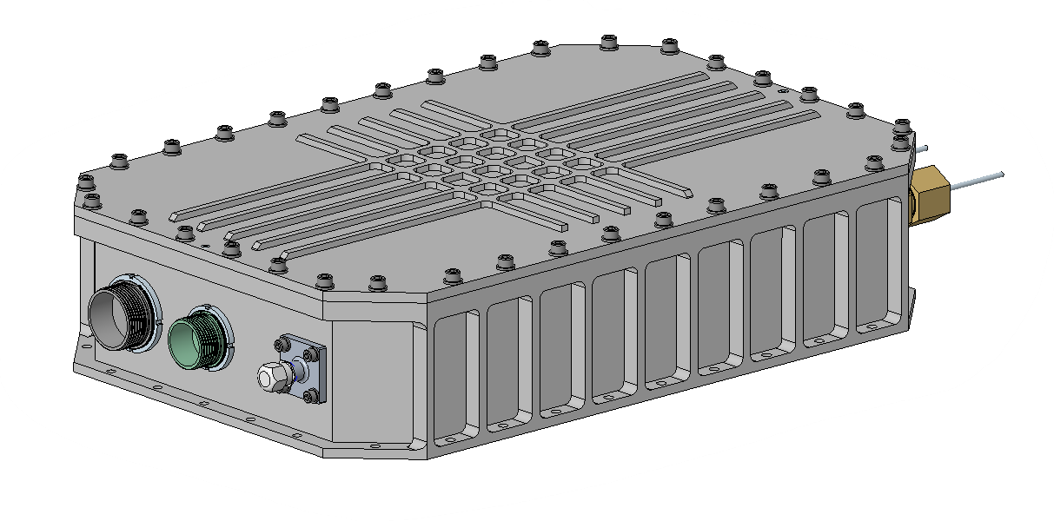
For Power Beaming –
Can make smaller 40-100W Packages
Power beaming does not need the communications functionality.
Package can get smaller for missions not 24/7/365.
Simpler HW design, less optical/electrical parts, less touch time.
Lower cost to manufacture.
~ 7-9 kg, Reduced SWaP
13.8”
9.8”
3.5”

Slide 30
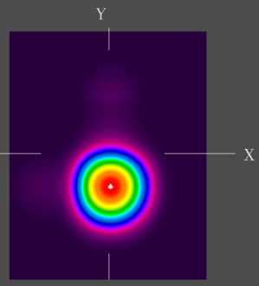
Laser Pointing System
100W
M² ~ 1.1

Slide 31
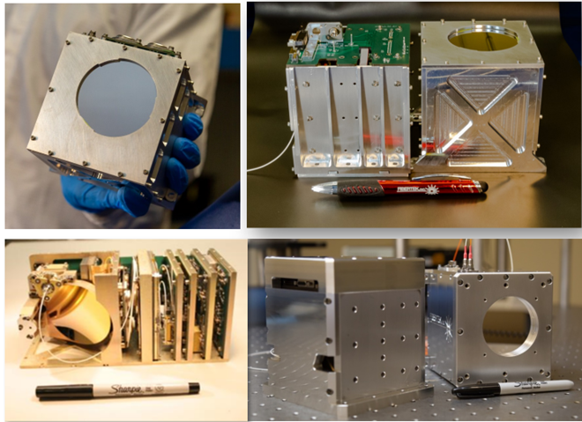
Space 6.4 cm diameter telescope, Pointing
2U CubeSat size. complete system.
Includes 6.4 cm telescope, 3W laser
Right scale for Power beaming.
Includes Pointing, Acquisition and Tracking (PAT) systems to Receiver
Telescope could be mounted on a gimbal.

Slide 32
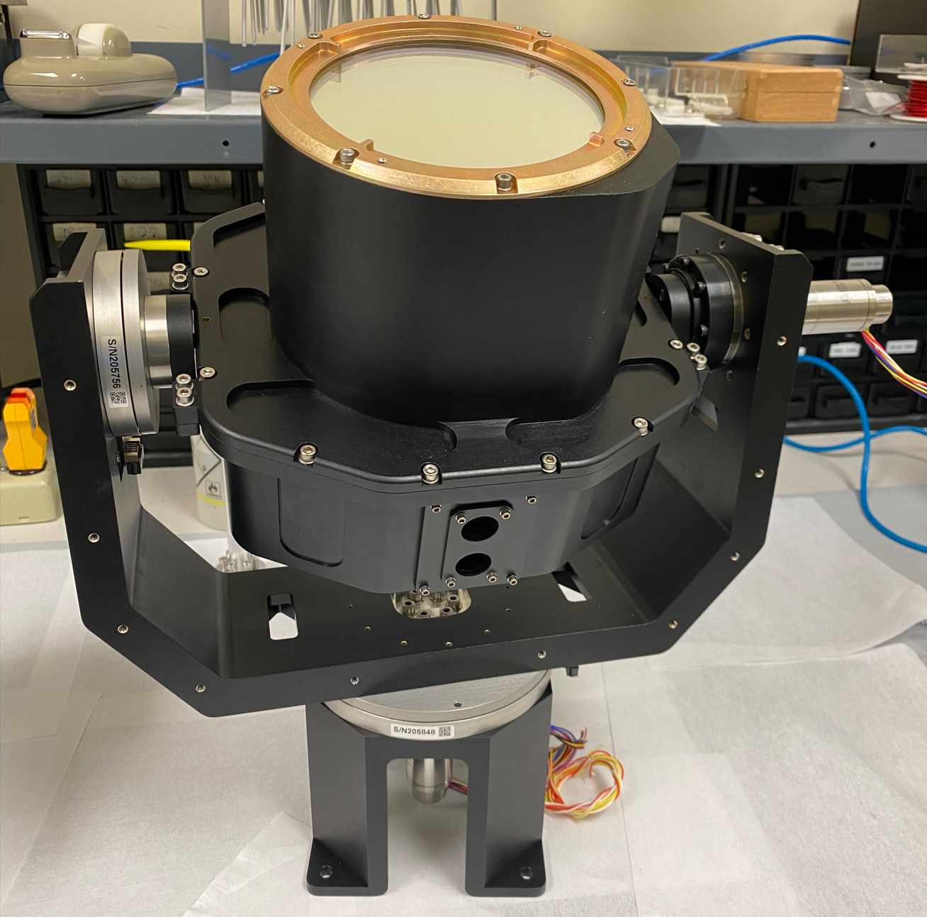
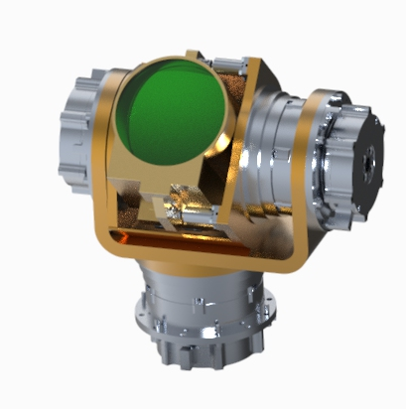
Artemis Orbiter, 10 Cm gimbal
Laser com systems - Includes Pointing and Tracking camera
10 cm telescope

Slide 33
Checklist to space (partial)
Matched laser and detectors
Thermal
  Survive and Operate from -50C to -200C.
  Manage Thermal heat dissipation. Heat could be used elsewhere?
Smaller laser packages – Easy to transport on the moon.
Lower Cost (vs Optical Com)
Simplified Beam Steering Optics vs optical communications.
Optimize power electronics

Slide 34
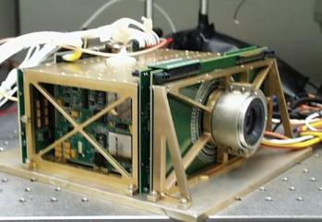
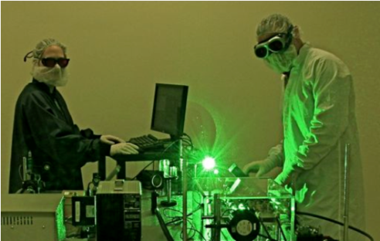
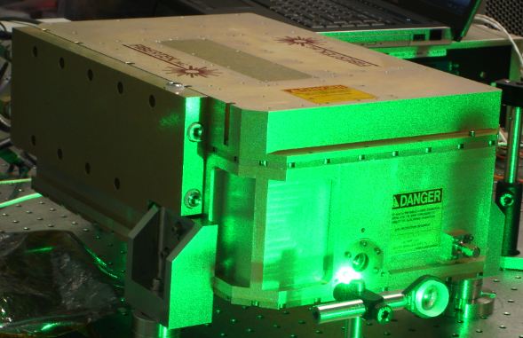
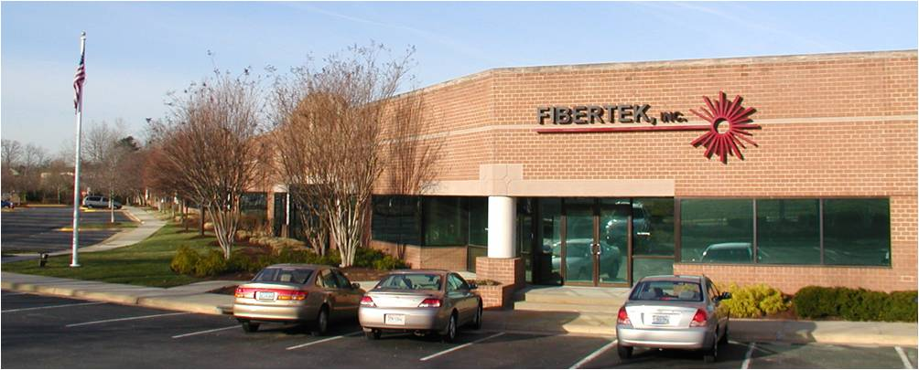
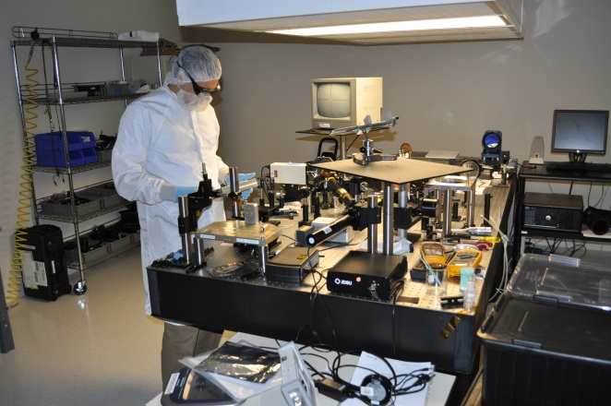
Thanks

