Slide 1

LSIC ISRU Focus Group Monthly http://lsic.jhuapl.edu/ http://lsic-wiki.jhuapl.edu/ (Confluence sign-up required)
March 22, 2023
Dr. Jodi Berdis, Dr. Karl Hibbitts, Dr. Michael Nord, Dave Smith, Claire Trop, Dr. Rich Miller
Jodi.Berdis@jhuapl.edu, Karl.Hibbitts@jhuapl.edu, Michael.Nord@jhuapl.edu, David.Smith@jhuapl.edu, Claire.Trop@jhuapl.edu, Richard.S.Miller@jhuapl.edu

Slide 2
Agenda
General updates and house-keeping
  APL is happy to consult as appropriate with ISRU and related technologies. We can provide advice on how to build for launch and operate in extreme environments. This includes site visits!
  Upcoming Meetings
  Funding Opportunities
Karen Stockstill-Cahill (JHU/APL): “2022 LSIC Simulants Assessment Report: Implications for ISRU”
Coffee & Donuts: Recommendations from February “ISRU Vision” Telecon

Slide 3
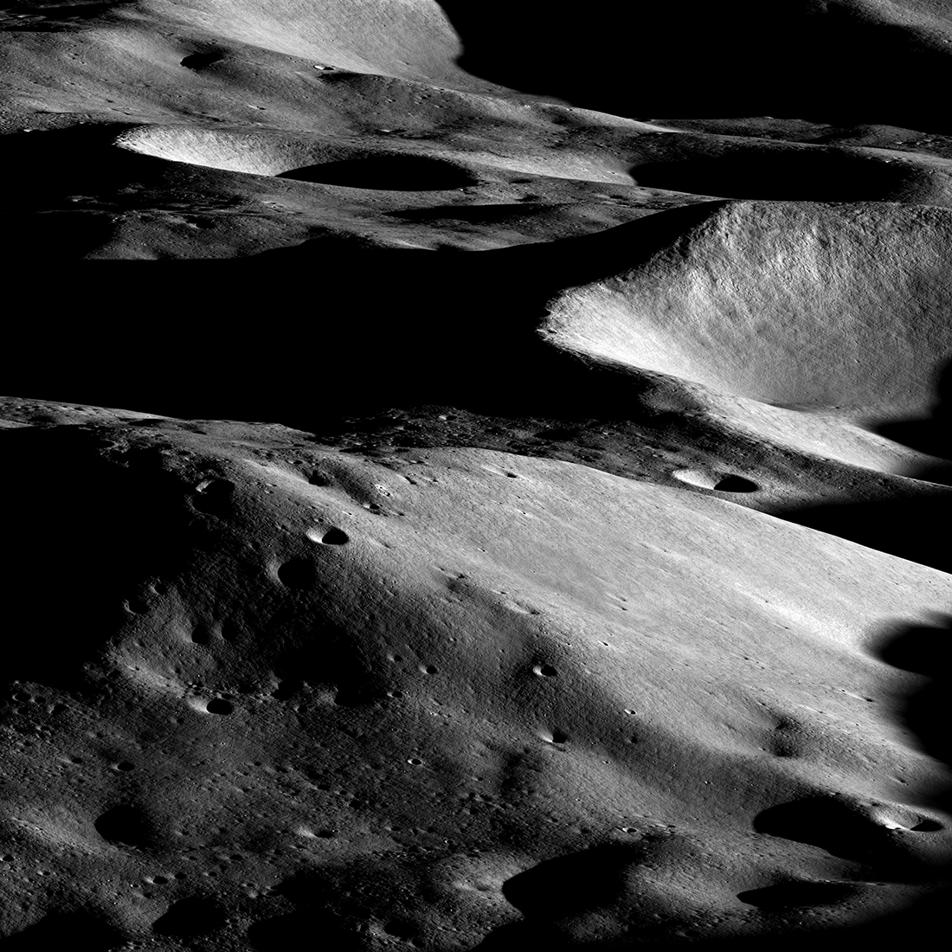
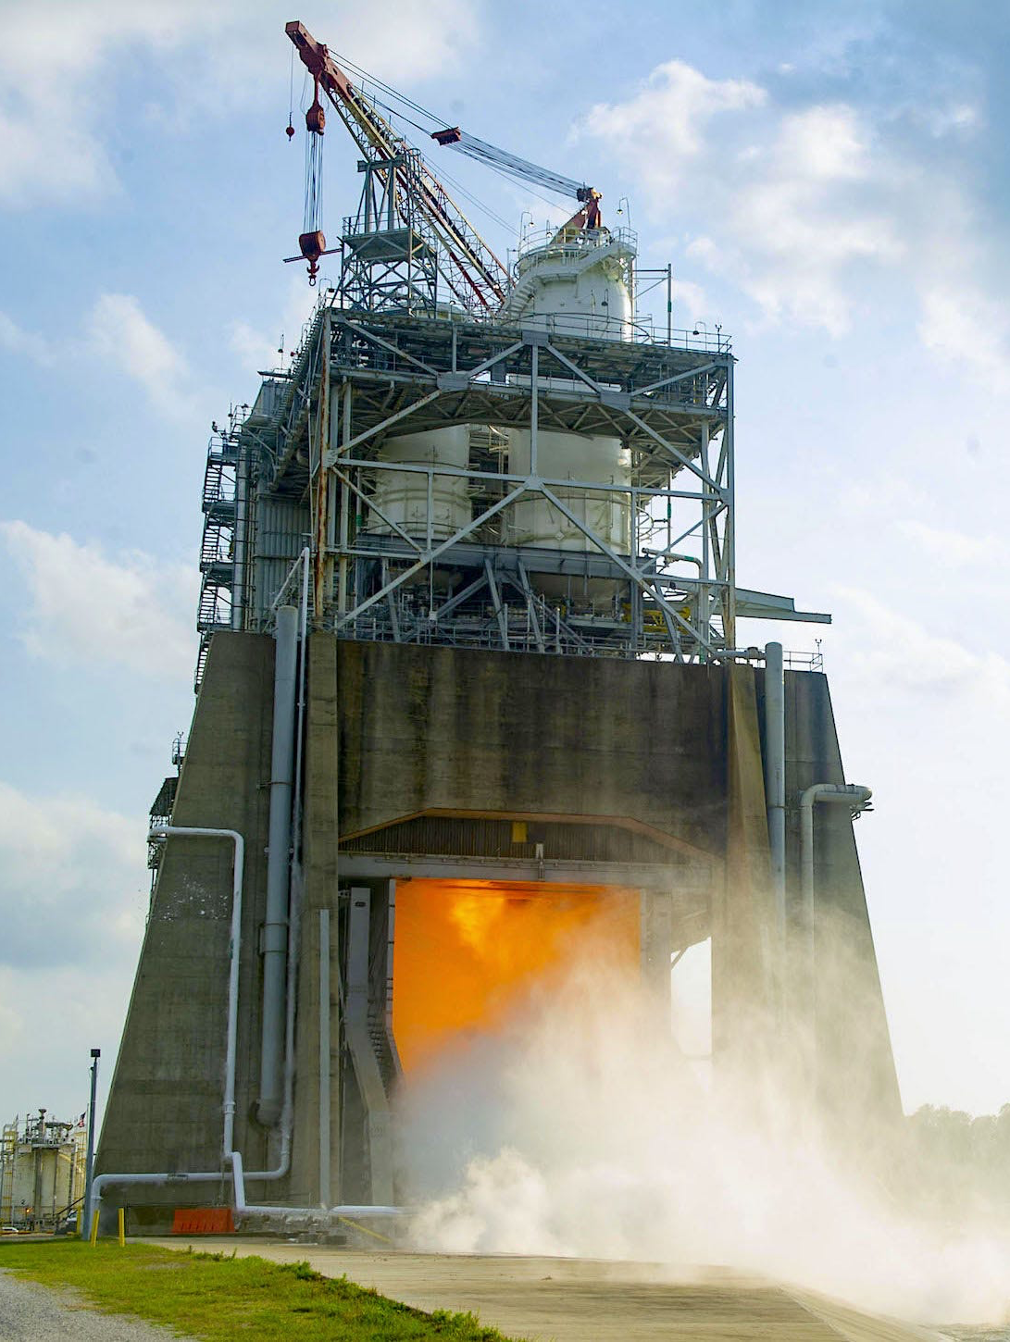
Notable News
Exciting LROC Image
Malapert Massif: Artemis 3 candidate landing region
Third hot fire test of future SLS RS-25 engine

Slide 4
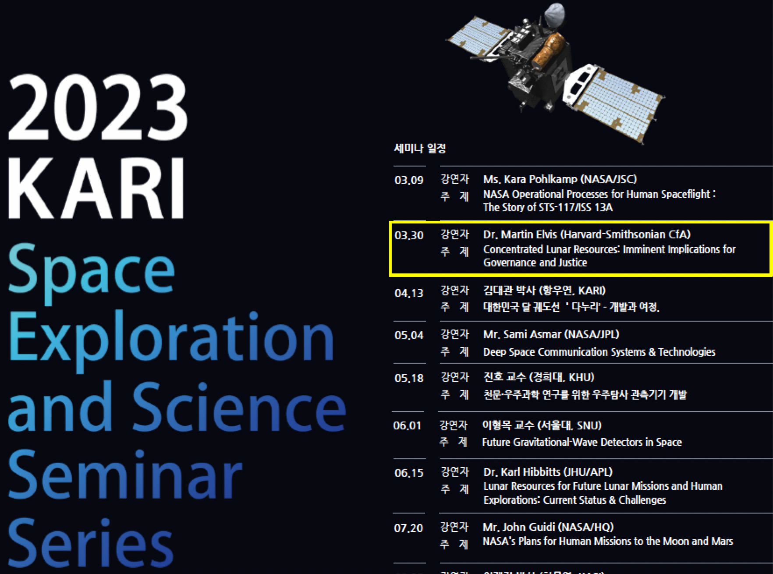
Upcoming Meetings
LSIC Spring Meeting (April 24-25):
  https://lsic.jhuapl.edu/Events/Agenda/index.php?id=380
  Registration closes April 10 (in-person) and April 17 (virtual)
LSIC Space Technology Competitive Opportunities Workshop (April 26):
  https://lsic.jhuapl.edu/Events/Agenda/index.php?id=441
  Registration closes April 12 (in-person) and April 17 (virtual)
Space Resources Week (April 19-21):
  Registration open!
Space Resources Roundtable (June 6-9):
  March 24: abstract submission deadline; April 14: early-bird registration deadline
  https://learn.mines.edu/srr/
ASCEND (Oct 23-25):
  Deadline for session and talk proposal extended to March 22 (TODAY!)
  https://www.ascend.events/
9pm EDT, March 29

Slide 5


Slide 6
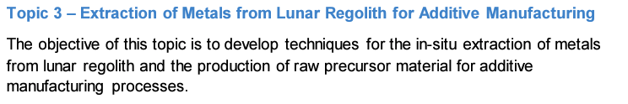
Funding Opportunities
NASA REDDI “TechFlights” solicitation to be released on April 7, pre-solicitation summary here: https://sam.gov/opp/300aaf5cb2b54f3ea3855d6b428d3f2d/view
  “Topic 1” is of particular interest to the LSIC and ISRU community, as it “addresses demonstration of capabilities that support global lunar utilization leading to commercial commodities and services for a robust lunar economy.”
Lunar Surface Technology Research (LuSTR) Opportunities
  ISRU is a specific topic/challenge in this call, and more specifically, the Extraction of Metals from Lunar Regolith for Additive Manufacturing.
  Awards are for up to 2 years, up to $2M total, and are limited to PI’s at US universities, though teaming with industries and non-profits is encouraged.
  NOIs Due: March 22, 2023 (TODAY!)
  Proposals Due: April 24, 2023
  https://tinyurl.com/NASA-LuSTR23
M-STAR: MUREP Space Technology Artemis Research due April 10
  Proposers must be at an MSI
  Maximum budget $300k/year, 3 years
  https://tinyurl.com/mr7jk83k

Slide 7
Topical Discussion
Karen Stockstill-Cahill
JHU/APL
“2022 LSIC Simulants Assessment Report: Implications for ISRU”
Notes:
LSWG on LSIC public webpage:
https://lsic.jhuapl.edu/Our-Work/Working-Groups/Lunar-Simulants.php
LSWG on LSIC confluence page:
https://lsic-wiki.jhuapl.edu/display/LSWG/Lunar+Simulants+Working+Group+Home
Email Karen to be added to the LSWG List Serve
Karen.Stockstill-Cahill@jhuapl.edu

Slide 8


Coffee & Donuts: Recommendations from February “ISRU Vision” Telecon
Notes:
https://forms.gle/tuhzwAUaQLDivQ2D7

