Slide 1
Extreme Access Focus Group Telecon
April 13, 2023
We’ll start around 3:03
Angela Stickle (focus area lead), Mario Lento, Danielle Mortensen, Stacy Teng, Alice Cocoros, Sarah Withee
Angela.stickle@jhuapl.edu, Mario.lento@jhuapl.edu, Danielle.mortensen@jhuapl.edu, stacy.teng@jhuapl.edu, Alice.Cocoros@jhuapl.edu, sarah.withee@jhuapl.edu

Slide 2
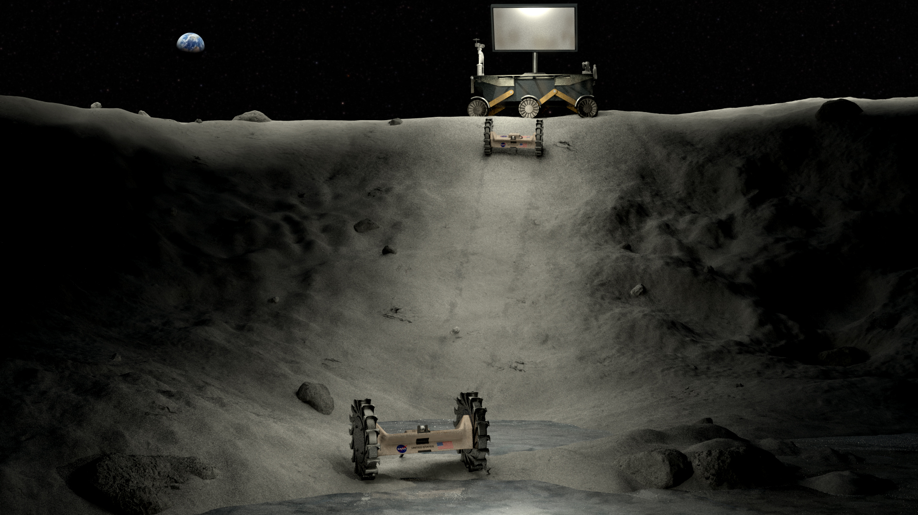
Today’s Agenda
Spring meeting
Community-driven whitepaper
Upcoming Meetings/Opportunities
Subgroup updates
Chuck Quintero – Conceptual Design for a Communications Network for Earth-Lunar Communications

Slide 4
Funding opportunities and RFIs
Space Technology Competitive Opportunities workshop
A funding workshop centered around NASA STMD (i.e., SpaceTech) solicited proposal opportunities and community resources is set to take place following the 2023 LSIC Spring Meeting. Workshop content will focus on:
The components and requirements of various NASA STMD proposal opportunities
An advice-based panel discussion and Q&A from previously successful SpaceTech proposal awardees
General knowledge about the NASA funding process.
https://events.jhuapl.edu/LSICworkshop2023
In-person registration has closed, but registration for virtual session is open through April 17
Complete list of opportunities available at https://lsic.jhuapl.edu/Resources/Funding-Opportunities.php

Slide 5
Subgroup updates
Comms subgroup met Wednesday April 5 pm ET (reschedule of March meeting) – Kevin Lynaugh from Vulcan Wireless
PNT subgroup will not be meeting this month
PNT paper reading cancelled for this month, due to spring meeting.
Mobility subgroup is meeting Thursday April 27 1 - 2:30 pm ET. Speaker is Raewyn Duvall and topic will be IRIS lunar rover
https://lsic-wiki.jhuapl.edu/pages/viewpage.action?spaceKey=EA&title=Guest+Talks+-+Calendar+Year+2023
Autonomy subgroup has a lead and anticipates first meeting in June 2023. If you are interested, please add your name to the comments at https://lsic-wiki.jhuapl.edu/display/EA/Autonomy+subgroup

Slide 6
Conceptual Design for a Communications Network for Earth-Lunar Communications
Chuck Quintero, Johns Hopkins University Applied Physics Laboratory
Notes:
Chuck is currently a Senior Professional Staff engineer with the JHU-APL Force Projection Sector. During his 40-year career, he has worked on space based, airborne and surface-based RF systems for remote sensing, electronic warfare, and communications at companies including: SRI International, Northrop Grumman, L3Harris, and Lockheed Martin. Among his many duties, he was the Chief Systems Architect on the Space Fence program for the Space Surveillance Network. He has an MSEE from the University of Pennsylvania and an SB from the Massachusetts Institute of Technology. Chuck is an avid astronomer, STEM lecturer for the NASA Jet Propulsion Laboratory. Chuck has published and presented papers on satellite constellation design, space surveillance, multi-channel high bandwidth RF Systems and both airborne and surface based radar. This work was funded as part of an internal research and development program.

