Slide 1

LSIC ISRU Focus Group Monthly http://lsic.jhuapl.edu/ http://lsic-wiki.jhuapl.edu/ (Confluence sign-up required)
May 17, 2023
Dr. Jodi Berdis, Dr. Karl Hibbitts, Dr. Michael Nord, Dave Smith, Dr. Rich Miller, Claire Trop
Jodi.Berdis@jhuapl.edu, Karl.Hibbitts@jhuapl.edu, Michael.Nord@jhuapl.edu, David.Smith@jhuapl.edu, Richard.S.Miller@jhuapl.edu, Claire.Trop@jhuapl.edu

Slide 2
Agenda
General updates and house-keeping
  APL is happy to consult as appropriate with ISRU and related technologies. We can provide advice on how to build for launch and operate in extreme environments. This includes site visits!
  Upcoming Meetings
  Funding Opportunities
Richard Wainner (PSI): "Efficient Orbital Structures Manufactured using Melted Regolith Simulant”
Randy Villahermosa (SpinLaunch): "SpinLaunch for ISRU"
Coffee & Donuts: Thoughts from the LSIC Spring Meeting and the Industry Whitepaper

Slide 3
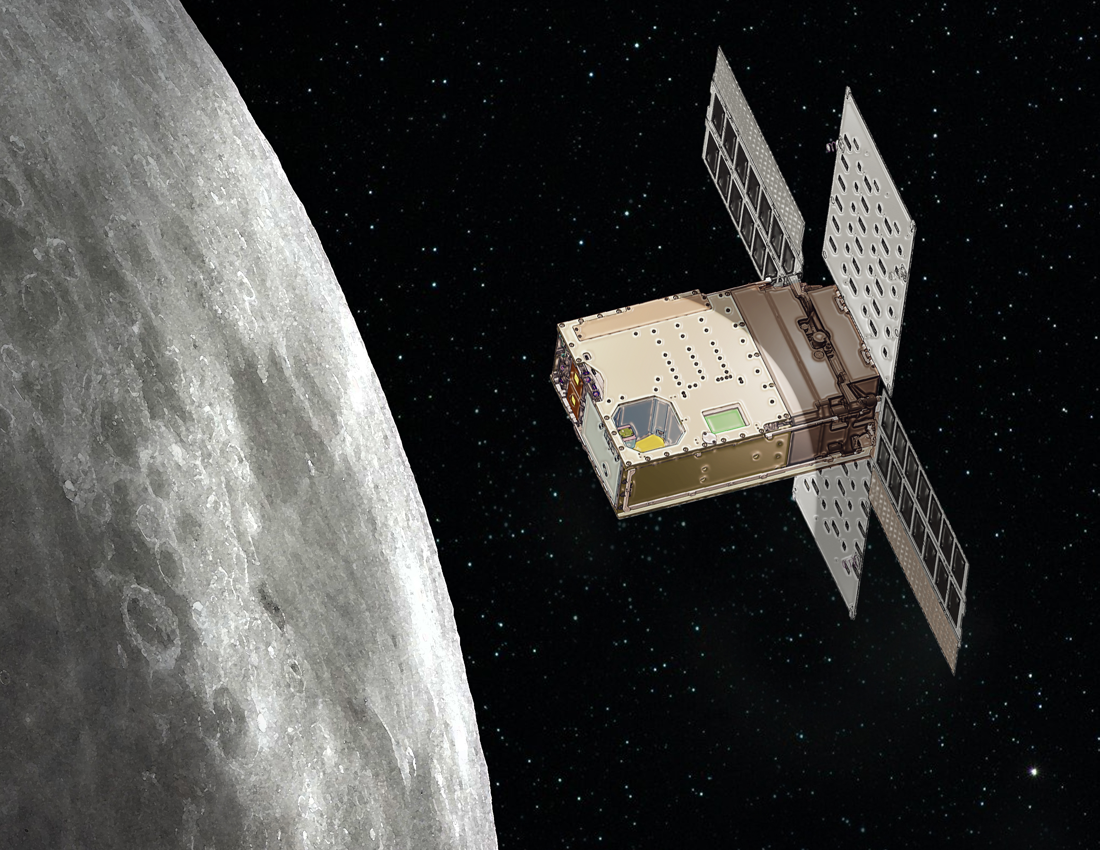
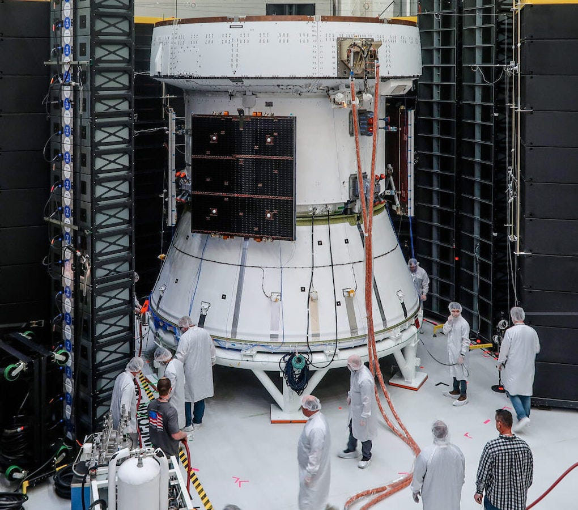
Notable News
NASA completed acoustic testing of European Space Module (provides life to Orion)
Lunar Flashlight (study SP water ice): End of Mission ☹
3 of the 4 thrusters underperforming

Slide 4
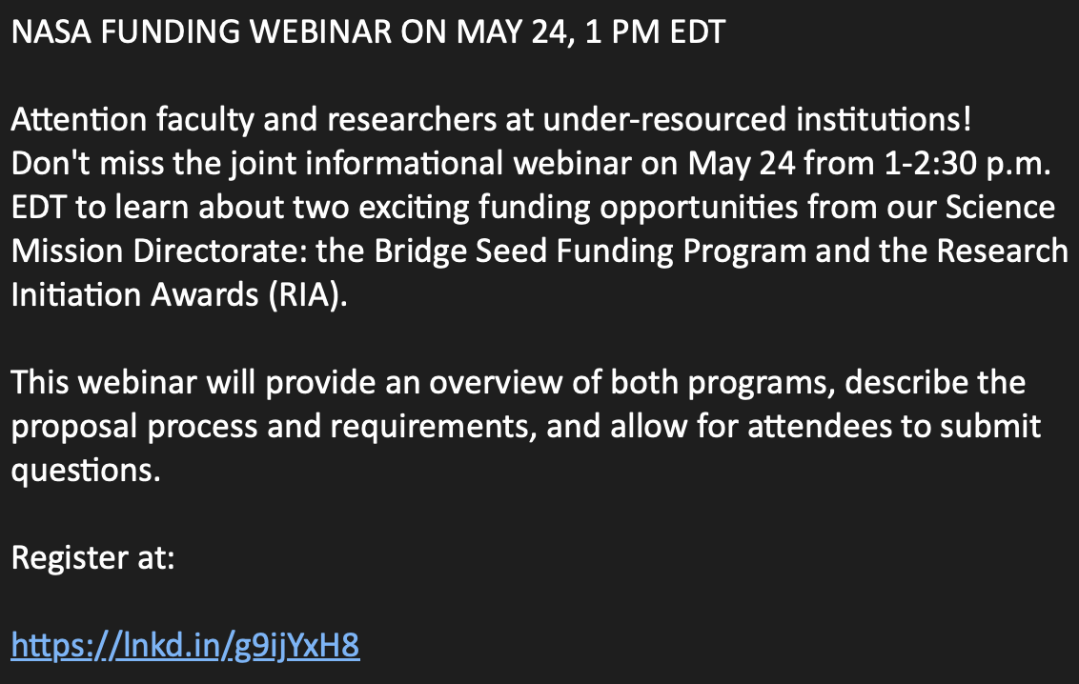
Upcoming Meetings
Space Resources Roundtable (June 6-9):
  Registration is open, space is limited!
  https://learn.mines.edu/srr/
NASA Funding Webinar (May 24, 1pm ET)
  https://lnkd.in/g9ijYxH8
Lunar Proving Grounds Definition Workshop (July 12-13)
  Registration opening soon!
Surface Power Reliability Workshop, July 26-27
  Registration is open, and soliciting abstracts!
  https://lsic.jhuapl.edu/Events/Agenda/index.php?id=443
Upcoming FG Meetings
  Dust Mitigation, May 18, 12pm ET, Fibercoat presenting on their “MoonFibre” technology made out of regolith material.
  Surface Power, May 25, 11am ET

Slide 5
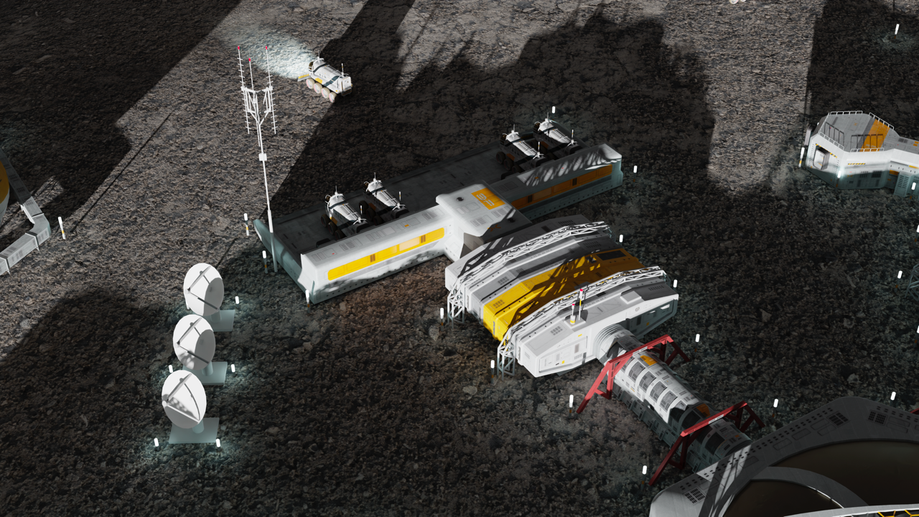
LSIC | Lunar Proving Grounds Definition Workshop
July 12-13, 2023
Summary:
The topic of test facilities and Earth-based Lunar Proving Grounds has come up across all six Focus Areas of LSIC, and component- and instrument- level testing has been developed extensively at various facilities across the US. However, an integrated testing facility (or network of testing locations) where technology developers can verify and validate their technologies in conjunction with other dependent technologies at the larger system-level, specifically to ensure system readiness for flight and operation on the lunar surface, still requires development. Over the course of this two-day Lunar Proving Grounds (LPG) Definition Workshop, we intend to dive into these topics and explore the requirements and characteristics that will be necessary for a unified LPG.
This is a discussion-based workshop, no abstracts will be solicited!
Save The Date sent out last month (April), registration to open in May with tentative agenda to follow.
Objectives:
Define the role of a lunar proving ground on the Earth (and potentially on the Moon).
Collect/define needs, attributes, and performance capabilities of Lunar Proving Grounds from technology developer’s perspective.
Identify the programmatics and logistics required to implement the Lunar Proving Ground.

Slide 6

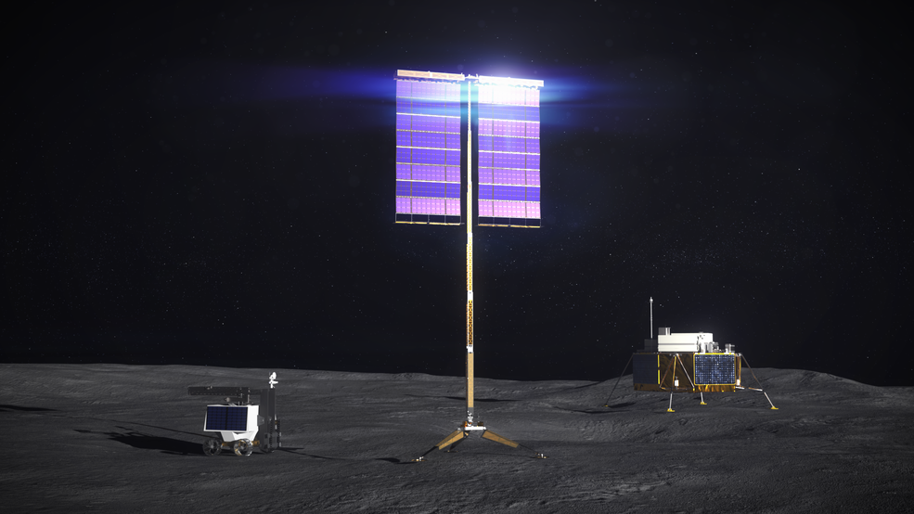
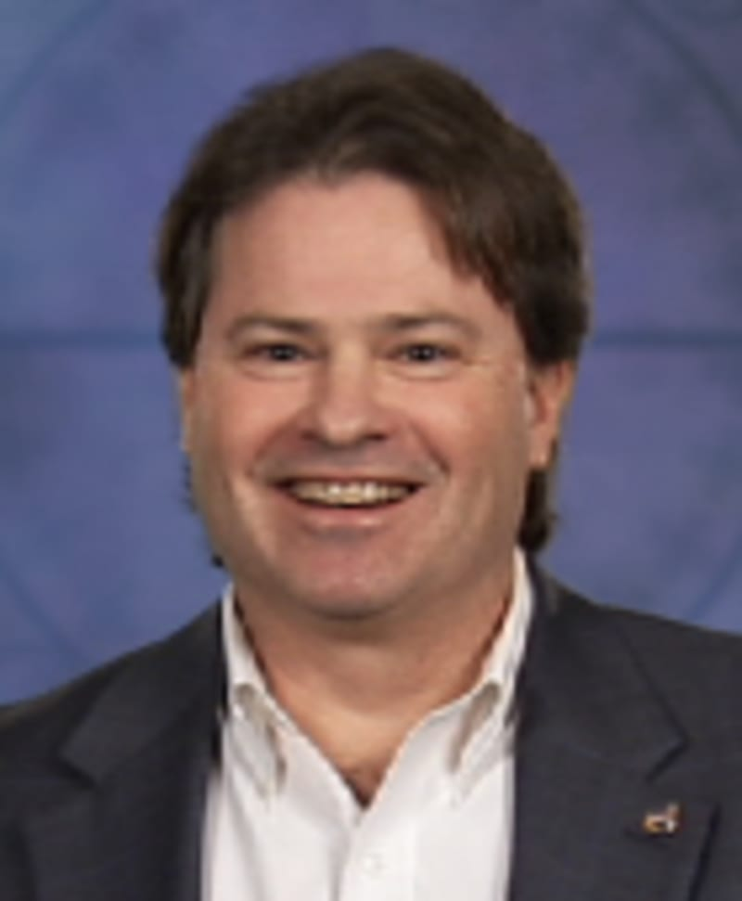


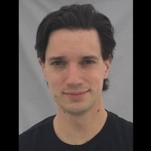
LSIC | May Telecon
We hope to see you all at our next telecon, which will take place on
Thursday May 25th, 2023 at 11:00AM ET.
Theme: NASA VSAT Phase 2
Speakers:
Chuck Taylor
VSAT PM, NASA
Ryan Wiseman
VSAT Business Lead, Lockheed Martin
Dean Bergman
VSAT PI, Honeybee Robotics
John Landreneau
VSAT PM, Astrobotic
Chuck Taylor Ryan Wiseman
Dean Bergman John Landreneau
6

Slide 7




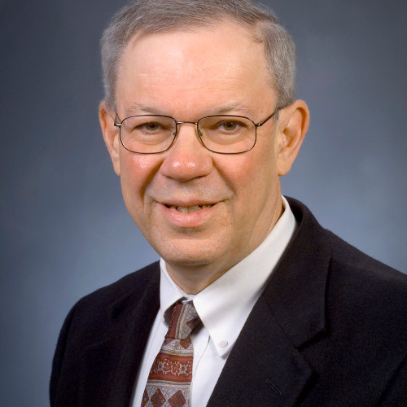

LSIC | Surface Power Reliability Workshop: July 26-27
John Scott (NASA)
Principal Technologist
Power & Energy Storage
Clay Smith (APL)
ISS Probabilistic Risk Assessment Creator
Jim Soeder (NASA, retired)
Senior Power Technologist (08-21)
Power Development Chief (87-08)
David McGlone (NAVSEA07)
Director
Submarine Safety Program
11:00AM – 3:30 PM ET via ZOOM
How do we quantify and design for reliability?
How should reliability be approached from the system/grid level and how should this affect the early-TRL development at the component level?
Bring in Different Perspectives
  ESDMD, STMD, Industry, Terrestrial Grids, Microgrids, DoD, and you!

Slide 8
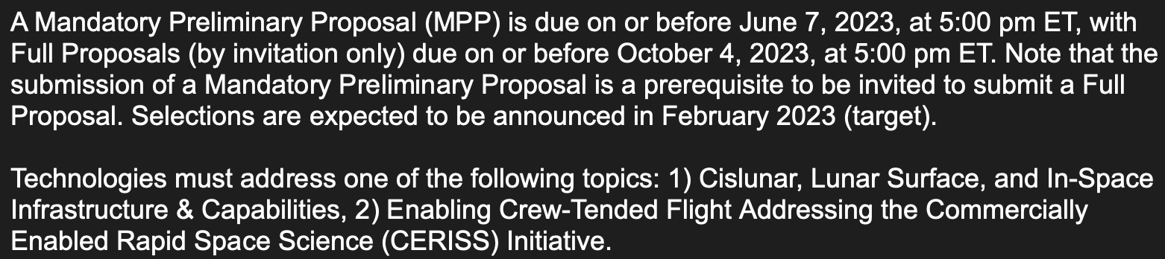

Funding Opportunities
NASA REDDI “TechFlights” now open! Preliminary Proposal due June 7
  “Topic 1” is of particular interest to the LSIC and ISRU community, as it “addresses demonstration of capabilities that support global lunar utilization leading to commercial commodities and services for a robust lunar economy.”
  https://nspires.nasaprs.com/
NASA REDDI “Early Stage Innovations” now open!
  Notices of Intent due June 7, 2023, proposals due July 6, 2023
  https://nspires.nasaprs.com/

Slide 9
Lunar SDI Solicits Standards Input
The Lunar Spatial Data Infrastructure Working Group (Lunar SDI) requests input on a draft set of community standards for Lunar Analysis Ready Data. These standards are aimed at data producers, data providers, and users.
Lunar SDI Working Group facilitates the common use of a set of standards for Lunar Analysis Ready Data.
The draft standards proposed describe spatial, cartographic, data, and metadata standards. We are seeking input on these standards before requesting their common adoption by data producers and providers.
If you are a data producer, provider, or user that generates, serves, or uses higher level data, please consider providing feedback by commenting on the standards page(s) directly.
Please provide feedback by May 31, 2023.
Lunar SDI Website:
https://bit.ly/lunarsdi
The draft standards can be found at:
https://bit.ly/lunarstandards

Slide 10
Topical Discussion
Richard Wainner
PSI
“Efficient Orbital Structures Manufactured using Melted Regolith Simulant”
Notes:
LSWG on LSIC public webpage:
https://lsic.jhuapl.edu/Our-Work/Working-Groups/Lunar-Simulants.php
LSWG on LSIC confluence page:
https://lsic-wiki.jhuapl.edu/display/LSWG/Lunar+Simulants+Working+Group+Home
Email Karen to be added to the LSWG List Serve
Karen.Stockstill-Cahill@jhuapl.edu

Slide 11



Coffee & Donuts:
Thoughts from the LSIC Spring Meeting and the Industry Whitepaper
https://lsic.jhuapl.edu/Resources/files/The%20Path%20to%20an%20Enduring%20Lunar%20Presence.pdf
Notes:
https://forms.gle/tuhzwAUaQLDivQ2D7

Slide 12
LSIC 2023 Spring Meeting | Major Takeaways
Community
  Record-breaking attendance:
    Online: 200+, In-Person: 300+
International Lunar Year
Moon to Mars Initiative
  Moon as a proving ground offers stability
  Importance and relevance to other NASA efforts
Commercial Lunar Payload Services (CLPS)
  Block buys of landers
  Expansion of services
Lunar Surface Technology Research (LuSTR) Program
Whole Government Engagement in Maturing Cislunar Ecosystem and Policy
  International engagement for lunar operations
Commercial Sector Engagement
  Desirable to refine business cases and/or value propositions for terrestrial expert organizations
Interoperability
  Critical; clear need to establish a lunar interoperability laboratory/facility for tech assessment
  Marketplace for components that meet interoperable standards
Lunar Environment Considerations
  ECLIPSE: Essential Compilation of Lunar Information in Preparation of Sustained Exploration – Coming Sept 2023!
  Dust mitigation and thermal management for component and next higher assemblies
Autonomy
  Needs further development, such as stakeholder-wide definition and frameworks that evaluate capability autonomy levels

Slide 13
LSIC 2023 Spring Meeting | White Paper Feedback
LSIC Whitepaper
The Path to an Enduring Lunar Presence
NASA Moon to Mars Whitepapers
Architecture Concept Review
Perspectives on key enabling actions that will help our nation and the world move together toward our shared use of the lunar surface.
Access White Paper:
https://lsic.jhuapl.edu/Resources/files/The%20Path%20to%20an%20Enduring%20Lunar%20Presence.pdf
Send feedback to: LSIC-Feedback@jhuapl.edu
Systems Analysis of Architecture Drivers
Why NRHO: The Artemis Orbit
Why Artemis will Focus on the Lunar South Polar Region
Gateway: The Cislunar Springboard for International and Sustainable Human Deep Space Exploration
Mars-Forward Capabilities to be Tested at the Moon
Mars Transportation
Access White Papers:
https://www.nasa.gov/MoonToMarsArchitecture

Slide 14
Lunar Proving Grounds Definition Workshop
Objectives:
Define the role of a lunar proving ground on the Earth (and potentially on the Moon).
Collect/define needs, attributes, and performance capabilities of Lunar Proving Grounds from technology developer’s perspective.
Identify the programmatics and logistics required to implement the Lunar Proving Ground.
Agenda:
Keynote: What is the motivation for a Lunar Proving Ground?
Kick-off Discussion: What is an LPG to you?
Panel 1: What capabilities and features does the proving ground need to possess?
Open Discussion 1: Based on these conversations, what do we need facility owners to know?
Panel 2: What are the attributes for being able to work with other hardware providers, e.g., legal agreements, interfaces/integration, etc.?
Open Discussion 2: Given these attributes, what are the logistical characteristics that technology developers desire in an LPG?

