Slide 1


LSIC Interoperability Working Group Telecon
June 7, 2023
Begins at 1:05
Kristin Jaburek
Johns Hopkins Applied Physics Laboratory
Space Exploration Sector
LSIC Interoperability Working Group
Kristin.Jaburek@jhuapl.edu
James Mastandrea, PhD
Johns Hopkins Applied Physics Laboratory
Space Exploration Sector
LSIC Interoperability Working Group
James.Mastandrea@jhuapl.edu
Pegah Pashai
Johns Hopkins Applied Physics Laboratory
Space Exploration Sector
LSIC Interoperability Working Group
Pegah.Pashai@jhuapl.edu

Slide 2

LSIC | Agenda
Community Updates
Technical Talk
Question and Answer Session
2

Slide 3
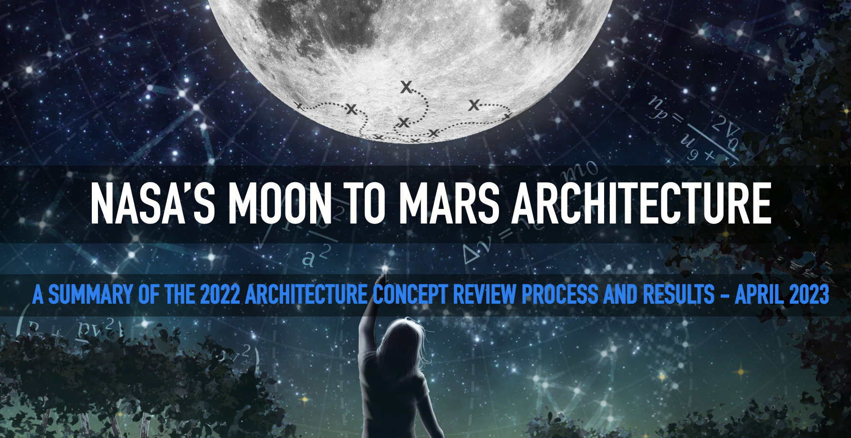
LSIC | Moon to Mars Architecture
In April NASA released a Moon to Mars Architecture document!
One stop shop link: https://www.nasa.gov/MoonToMarsArchitecture
Watch the recording of the May 22 webinar briefing
Submit comments to NASA
3

Slide 4
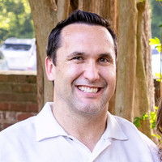
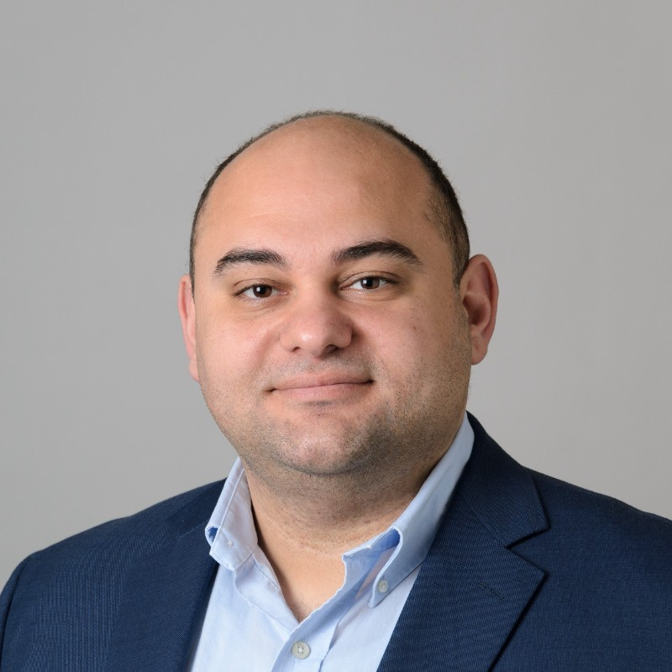
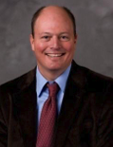
LSIC | Surface Power June Telecon
We hope to see you all at our next telecon, which will take place on
Thursday June 22nd, 2023 at 11:00AM ET.
Theme: Power Requirements for Lunar Habitats
Speakers:
Paul Kessler (NASA LaRC)
NASA Surface Habitat Lead Architect
Ali Bazzi (UConn)
        Resilient ExtraTerrestrial Habitats research institute (RETHi)
Marshall Porterfield (Purdue)
Professor of Agricultural and Biological Engineering
Paul Kessler Ali Bazzi
Marshall Porterfield
4

Slide 5
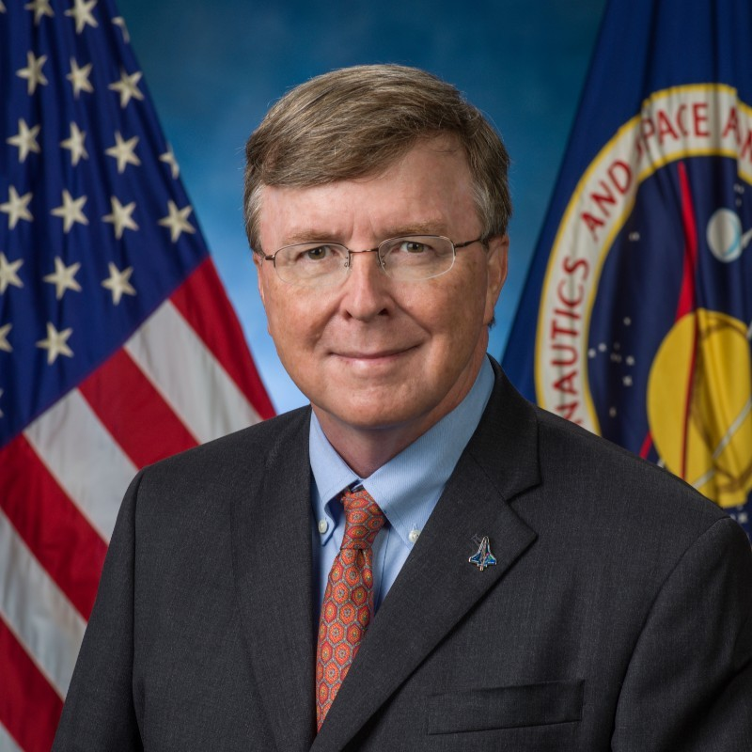
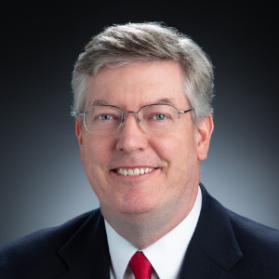
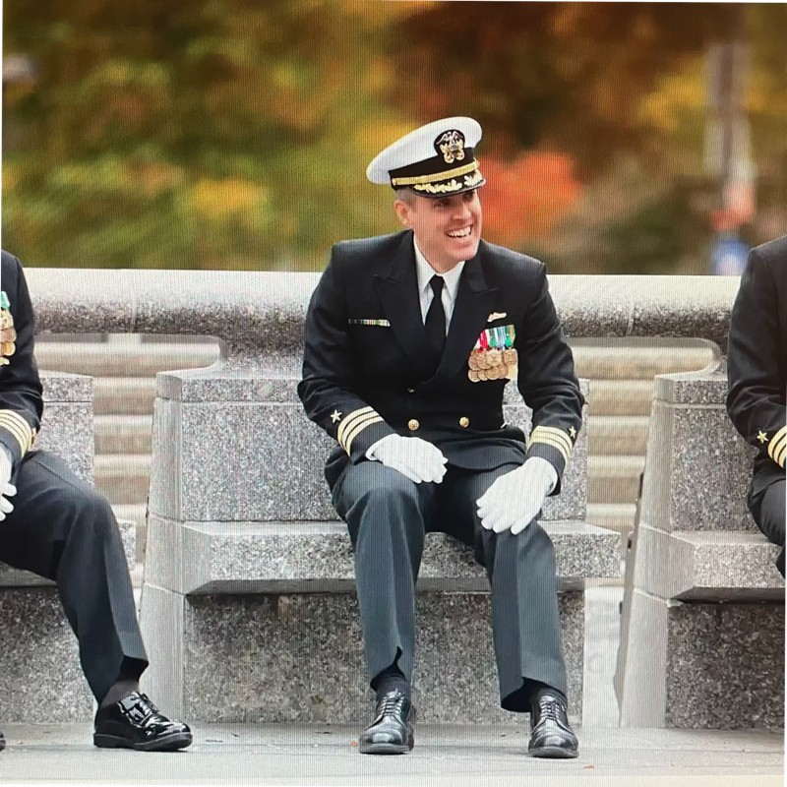
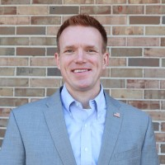
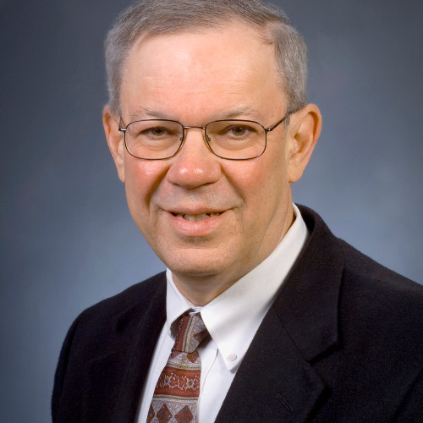
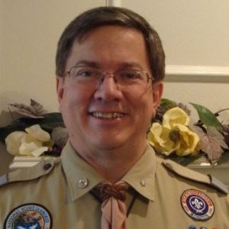
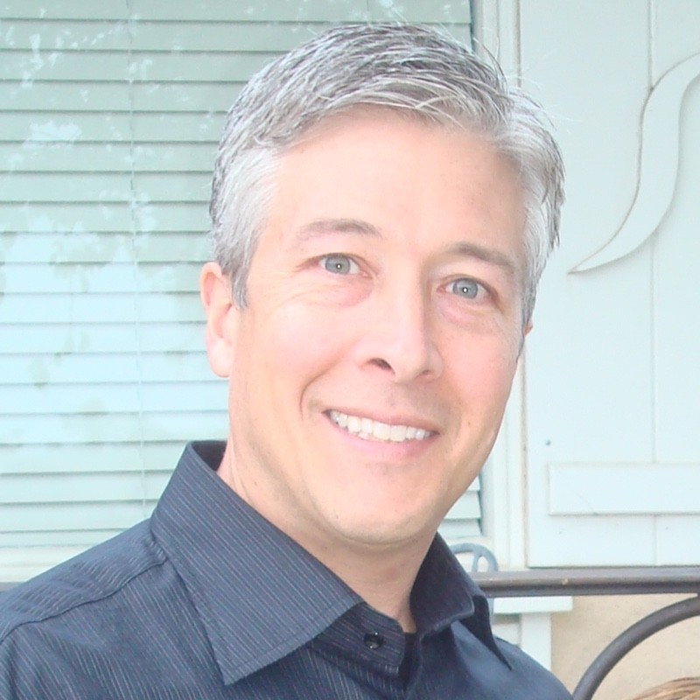

LSIC | Surface Power Reliability Workshop
Date: July 26-27
Time: 11:00AM – 3:30 PM ET
Location: Virtual via Zoom
Abstracts Due: 30 June
REGISTRATION AND ABSTRACT SUBMISSION ARE OPEN
How do we approach reliability from the system/grid level and how should this affect the early-TRL development at the component level?
John Scott (NASA)
Principal Technologist
Power & Energy Storage
Clay Smith (APL)
ISS Probabilistic Risk Assessment Creator
David McGlone (NAVSEA)
Director
Submarine Safety Program
Joe Miller (NSF)
Antarctic Facilities Program Manager
Jim Soeder (NASA, ret.)
Senior Power Technologist (08-21)
Power Development Chief (87-08)
Roger Boyer (NASA)
Artemis Probabilistic
Risk Assessment Lead
Blanca Lara (NASA)
JSC EHP Lunar Power
Lead
Bill Anderson (NAVFAC)
Director of Utilities and Energy Management
5
Notes:
Link to Register for the Surface Power Reliability Workshop: https://lsic.jhuapl.edu/Events/Agenda/index.php?id=443

Slide 6
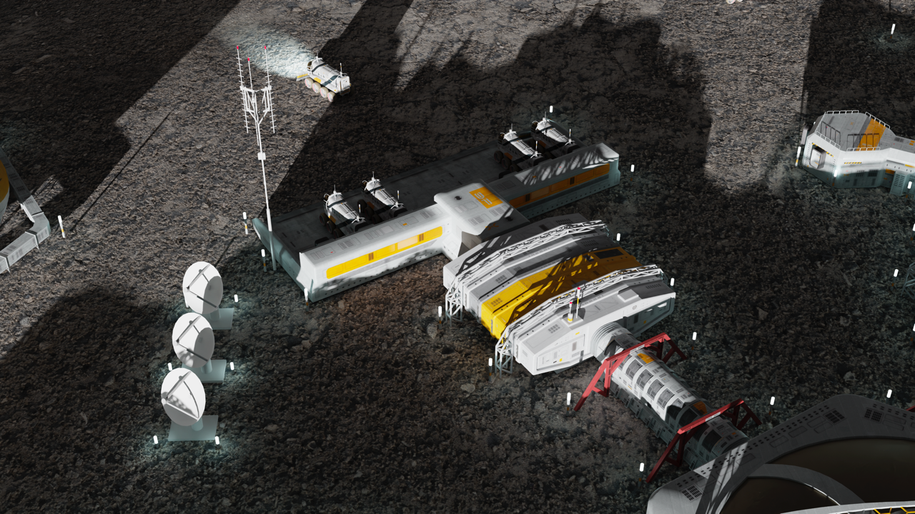


LSIC | Lunar Proving Grounds Definition Workshop
July 12-13, 2023
Summary:
The topic of facilities needed for testing hardware destined for the Moon and the need for Earth-based ‘Lunar Proving Grounds’ for testing systems has come up across all six Focus Areas of LSIC. While facilities exist for component- and instrument- level technology maturation (e.g., up to system/subsystem demo in relevant environments), and there are potential flight opportunities for component maturation to flight-qualified and even flight-proved systems, the Artemis Program vision for a sustained presence and transition to industry (e.g., the Moon to Mars Objectives and the LSIC “Path to an Enduring Lunar Presence” white paper) suggests an architecture of integrated systems and systems of systems more complex than Apollo or the International Space Station.
This is a discussion-based workshop, no abstracts will be solicited!
Registration is now open!
Objectives:
Define the role of a lunar proving ground on the Earth (and potentially on the Moon).
Collect/define needs, attributes, and performance capabilities of Lunar Proving Grounds from technology developer’s perspective.
Identify the programmatics and logistics required to implement the Lunar Proving Ground.

Slide 7
LSIC | Technical Talk
DoD's Spatial Data Standards for Facilities, Infrastructure, and Environment (SDSFIE)
David LaBranche
USG Geospatial Information Officer
7
Notes:
Mr. David LaBranche has served since 2008 as the Geospatial Information Officer (GIO) in the Office of the Assistant Secretary of Defense for Energy, Installations, and Environment. His principal duties include development and governance of geospatial data standards for DoD installations, data quality management, and location intelligence support for a variety of missions executed by the Office of the Secretary of Defense.

