Slide 1

LSIC ISRU Focus Group Monthly http://lsic.jhuapl.edu/ http://lsic-wiki.jhuapl.edu/ (Confluence sign-up required)
September 27, 2023 @ 11am ET
Dr. Jodi Berdis, Dr. Karl Hibbitts, Dr. Michael Nord, Dave Smith, Dr. Rich Miller
Jodi.Berdis@jhuapl.edu, Karl.Hibbitts@jhuapl.edu, Michael.Nord@jhuapl.edu, David.Smith@jhuapl.edu, Richard.S.Miller@jhuapl.edu

Slide 2
Agenda
General updates and house-keeping
  APL is happy to consult as appropriate with ISRU and related technologies. We can provide advice on how to build for launch and operate in extreme environments. This includes site visits!
  Upcoming Meetings
  Funding Opportunities
Danielle Mortensen (JHU/APL): “NASA TechPort Overview”
Andy Krebs (ArgoSpace): “Low Concentration Water Harvesting from Lunar Regolith”
Coffee and Donuts Discussion: Looking Forward to LSIC Fall Meeting 2023

Slide 3
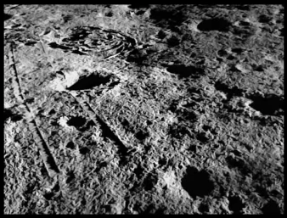
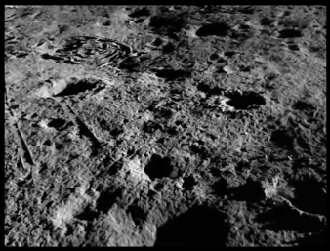
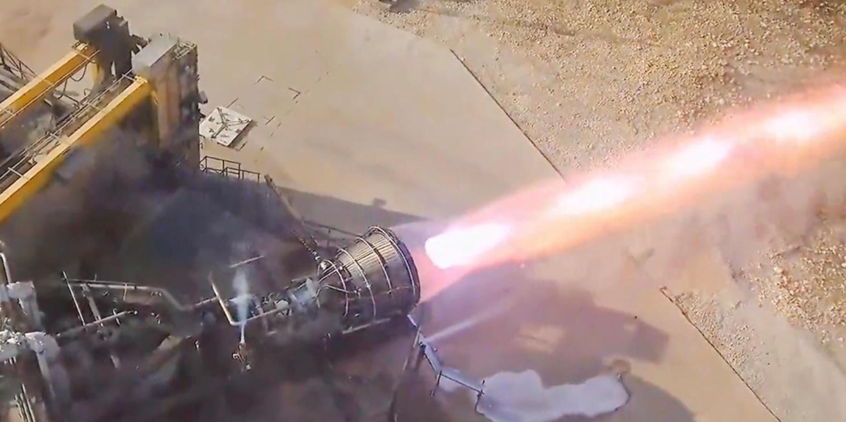
Notable News
Before
After
More Starship Raptor engine test firing – prepping for coasting phases
Image Credit: ISRO
ISRO Vikram Lander hop!
Image Credit: SpaceX

Slide 4
Upcoming Meetings
2023 LSIC Fall Meeting (October 10-11)
  https://lsic.jhuapl.edu/Events/Agenda/index.php?id=464
  Community College of Allegheny County, Pittsburgh, PA & Hybrid
  Registration just closed!
Transition to Commercial Lunar Operations Workshop (October 12)
  https://lsic.jhuapl.edu/Events/Agenda/index.php?id=478
ASCEND (Oct 23-25)
  Lots of LSIC representation will be there, looking forward to seeing you there!
  “Moon 2035: Living Off the Land” Roundtable
DM/EE Joint Workshop: Path to Sustainable Technologies in the Lunar Surface Environment (Nov 7)
  Path to Sustainable Technologies in the Lunar Surface Environment
  Registration is open! https://lsic.jhuapl.edu/Events/Agenda/index.php?id=481
ISRU FG Meetings moving to third Wednesdays at 11am ET

Slide 5

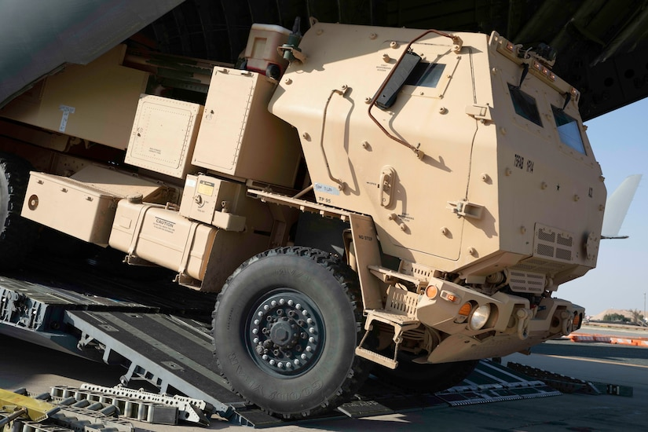
LSIC | September Telecon: Joint Power-Interoperability
We hope to see you all at our next telecon, which will take place on
Thursday September 28th, 2023 at 11:00AM ET.
Topic: DoD/US Army Tactical Microgrid Standard
Speakers: Jeff Csank (NASA GRC)
Tom Bozada (US Army Engineer Research and
Development Center
Dan Herring (MIT Lincoln Laboratory)
Description: The Army Tactical Microgrid Standard is a protocol that allows a mobile grid to optimally distribute power from a variety of sources (e.g. batteries, vehicles, diesel generators). Terrestrially, the capability is designed to better enable multi-domain operations, however the principles of interoperability in the system are extremely applicable to lunar operations as well.
5

Slide 6

ASCEND 2023 Roundtable
Moon 2035: Living off the Land
APL LSII/LSIC team will organize a special session titled “Moon 2035: Living off the Land” on October 25th at 11 AM (Pacific) on emerging topics related to sustained presence
Living off the land will be the key to a long-term sustainable presence on the Moon. This session with four roundtables will focus on the following four aspects of this goal:
  Lunar Surface Manufacturing
  Lunar Proving Grounds
  Responsible Lunar Presence
  Lunar Value Chain
Participants can engage in multiple topics. Your participation will be extremely beneficial.

Slide 7
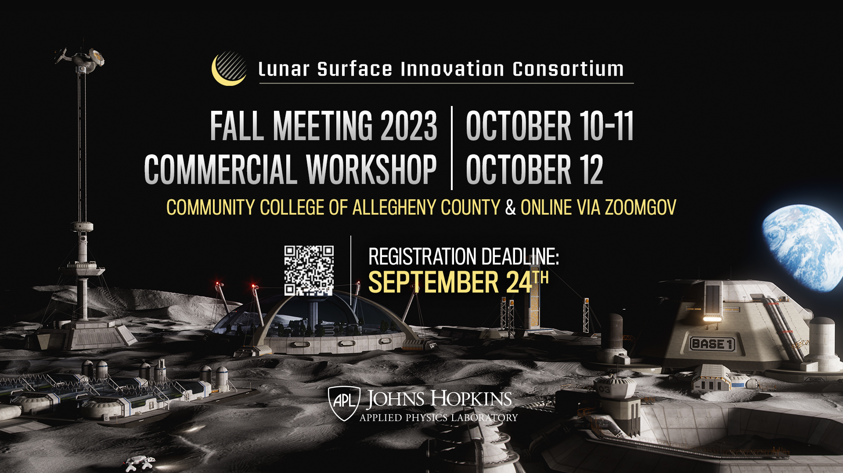

Slide 8


Slide 9
DM & EE Joint Workshop
Path to Sustainable Technologies in the Lunar Surface Environment
  We will focus on the qualification path to fielding long-lived technologies on the lunar surface. Stakeholders across industry, academia, and NASA will come together in a collaborative format to discuss the current state of the art, as well as essential knowledge and technology gaps related to the combined lunar and dust environment.
November 7, 2023
Interactive, Virtual Workshop
Topics
  Existing Standards and Facilities
  Stakeholder Needs
    NASA panel
    Industry & Academia Panel
  Town Hall on Next Steps
  Q&As for all presentations
Registration is now open!
  https://lsic.jhuapl.edu/Events/Agenda/index.php?id=481

Slide 10
Funding Opportunities
NASA Space Technology Graduate Research Opportunities (NSTGRO24) due November 1
  MS & PhD students
  https://tinyurl.com/NSTGRO24
NASA TechRise Student Challenge ideas due October 20
  6th to 12th graders: design experiment for high-altitude balloon or rocket-powered lander
  https://www.futureengineers.org/nasatechrise
NASA 2024 BIG Idea Challenge proposal due January 23(?)
  Q&A session: October 12
  Guidelines have been delayed, deadline dates may change!
  https://bigidea.nianet.org/
NASA REDDI: “TechFlights” full proposal due October 4
  “Topic 1” is of particular interest to the LSIC and ISRU community, as it “addresses demonstration of capabilities that support global lunar utilization leading to commercial commodities and services for a robust lunar economy.”
  https://nspires.nasaprs.com/
https://lsic.jhuapl.edu/Resources/Funding-Opportunities.php

Slide 11
Topical Discussion
Danielle Mortensen
JHU/APL
“NASA TechPort Overview”
Notes:
LSWG on LSIC public webpage:
https://lsic.jhuapl.edu/Our-Work/Working-Groups/Lunar-Simulants.php
LSWG on LSIC confluence page:
https://lsic-wiki.jhuapl.edu/display/LSWG/Lunar+Simulants+Working+Group+Home
Email Karen to be added to the LSWG List Serve
Karen.Stockstill-Cahill@jhuapl.edu

Slide 12
Topical Discussion
Andy Krebs
ArgoSpace
“Low Concentration Water Harvesting from Lunar Regolith”
Notes:
LSWG on LSIC public webpage:
https://lsic.jhuapl.edu/Our-Work/Working-Groups/Lunar-Simulants.php
LSWG on LSIC confluence page:
https://lsic-wiki.jhuapl.edu/display/LSWG/Lunar+Simulants+Working+Group+Home
Email Karen to be added to the LSWG List Serve
Karen.Stockstill-Cahill@jhuapl.edu

Slide 13


Coffee & Donuts:
Looking Forward to LSIC Fall Meeting 2023:
What are you excited about?
What do you think really needs to be talked about at this meeting?

