Slide 1
LSIC ISRU/Surface Power Focus Group Monthly http://lsic.jhuapl.edu/ http://lsic-wiki.jhuapl.edu/ (Confluence sign-up required)
January 17, 2023
ISRU: Dr. Jodi Berdis, Dr. Karl Hibbitts, Dr. Michael Nord, Dr. Rich Miller
SP: Sam Andrade, Dr. Sean Young, Dr. Joseph Kozak, Julie Peck
Jodi.Berdis@jhuapl.edu, Karl.Hibbitts@jhuapl.edu,
Samantha.Andrade@jhuapl.edu, Sean.Young@jhuapl.edu

Slide 2
Agenda
General updates and house-keeping
Upcoming Meetings
Funding Opportunities
ISRU End-Of-Year Survey Reminder
Surface Power End-Of-Year Survey Reminder
Giovanni Leone (Universidad de Atacama): "Sverdrup-Henson crater: A candidate location for the first lunar South Pole settlement”
Ebrahim Mohammadi & Theodore Lincoln (Astrobotic): "LunaRay: Lunar Illumination and Terrain Simulation Software”
Luis Carrio (Lockheed Martin): "Integrated System-of-Systems Modeling Tools for Site Selection”
Panel and Q&A

Slide 3
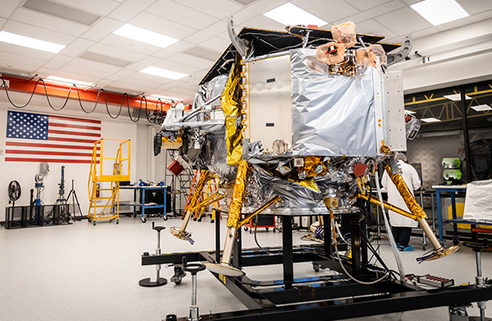
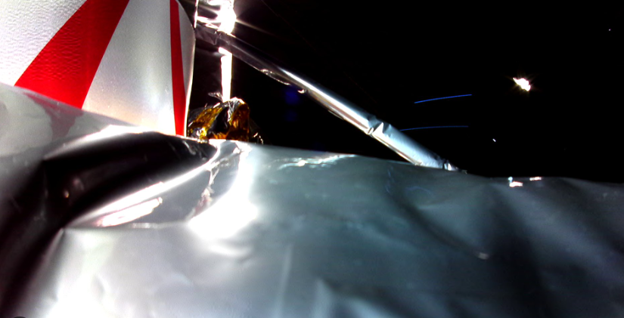
Notable News
Congratulations to NIAC’s 2024 selections for Phase I!
https://www.nasa.gov/general/niac-2024-selections/
https://www.nasa.gov/news-release/funding-future-tech-nasa-names-2024-innovative-concept-studies/
Astrobotic’s Peregrine Mission One launch, 1/8/24
On Thursday, January 18, 2024, at NOON ET, Astrobotic is hosting a teleconference with NASA for major mission updates and will be streamed on select NASA channels: https://www.astrobotic.com/update-15-for-peregrine-mission-one/

Slide 4
Upcoming Meetings
Small Business, BIG Opportunities: Pathways to Procurement at NASA (Jan 25, 2024, 1pm ET)
https://www.eventbrite.com/e/small-business-big-opportunities-pathways-to-procurement-at-nasa-tickets-750764706447
Small Business, BIG Opportunities: Pathways to Procurement at NASA, where small businesses will have the open opportunity to connect with NASA representatives, industry experts, and fellow entrepreneurs. This event is primarily focused on fostering meaningful networking while providing valuable insights into federal government contracting opportunities.
IEEE Aerospace Conference (March 2-9, 2024)
https://www.aeroconf.org/
Big Sky, Montana
Space Resources Week (March 25-27, 2024)
https://www.spaceresourcesweek.lu/
European Convention Center Luxembourg & Virtual
Abstract submission just closed, registration opening soon.
2024 LSIC Spring Meeting (April 23-24, 2024)
https://lsic.jhuapl.edu/Events/Agenda/index.php?id=465
JHU/APL Kossiakoff Center, Laurel, MD & Virtual
Stay tuned for details!
International Conference on Environmental Systems (ICES) (July 21-25, 2024)
https://www.ices.space/call-for-paper-2024/
Sessions include: “Advanced Technologies for In-Situ Resource Utilization”, “Space Architecture”, “Planetary and Spacecraft Dust Properties and Mitigation Technologies”, “Human/Robotics System Integration”
Abstract deadline November 20

Slide 5
Funding/Employment Opportunities
NASA 2024 BIG Idea Challenge proposals due February 1
https://bigidea.nianet.org/
Theme: Inflatable Systems for Lunar Operations
NASA Small Business Innovation Research (SBIR) & Small Business Technology Transfer (STTR) Program Phase I proposals due March 11, 5pm EST
https://sbir.nasa.gov/solicitations
https://lsic.jhuapl.edu/Resources/Funding-Opportunities.php
https://lsic.jhuapl.edu/Resources/Opportunities.php?f=Job

Slide 6
ISRU End-Of-Year Survey
With 2023 wrapping up, we're hoping to get a sense for what worked, what didn't work, and what you'd like to see in 2024 for the In-Situ Resource Utilization (ISRU) Focus Group in LSIC. Feel free to fill out as much of the survey as you feel comfortable.
This survey is completely anonymous, and we will not share any user data.
The survey closes January 19!
https://forms.gle/gZxGPxArwJHWFZ2C9

Slide 7
Surface Power End-Of-Year Survey
https://docs.google.com/forms/d/1Bl9c9q502BemDx6Fh7-lad7hh8yFvaGsCmPz-earv9A/edit
This survey is completely anonymous, and we will not share any user data.
Responses help us help you!

Slide 8
Topical Discussion: Lunar Site Selection
"Sverdrup-Henson Crater: A Candidate Location for the First Lunar South Pole Settlement”
Giovanni Leone (Universidad de Atacama)

Slide 9
Topical Discussion: Lunar Site Selection
"LunaRay: Lunar Illumination and Terrain Simulation Software”
Ebrahim Mohammadi & Theodore Lincoln (Astrobotic)

Slide 10
Topical Discussion: Lunar Site Selection
"Integrated System-of-Systems Modeling Tools for Site Selection”
Luis Carrio (Lockheed Martin)

