Slide 1

LSIC ISRU Focus Group Monthly http://lsic.jhuapl.edu/ http://lsic-wiki.jhuapl.edu/ (Confluence sign-up required)
December 13, 2023
Dr. Jodi Berdis, Dr. Karl Hibbitts, Dr. Michael Nord, Dr. Rich Miller
Jodi.Berdis@jhuapl.edu, Karl.Hibbitts@jhuapl.edu, Michael.Nord@jhuapl.edu, Richard.S.Miller@jhuapl.edu

Slide 2
Agenda
Vlada Stamenković (Blue Origin): “Space Resources at Blue Origin”
Q&A
General updates and house-keeping
  APL is happy to consult as appropriate with ISRU and related technologies. We can provide advice on how to build for launch and operate in extreme environments. This includes site visits!
  Upcoming Meetings
  Funding Opportunities
ISRU End-Of-Year Survey!
Open Discussion: Thoughts on Monthly Meeting Structure

Slide 3
Topical Discussion
Vlada Stamenković
Blue Origin
“Space Resources at Blue Origin”
Notes:
LSWG on LSIC public webpage:
https://lsic.jhuapl.edu/Our-Work/Working-Groups/Lunar-Simulants.php
LSWG on LSIC confluence page:
https://lsic-wiki.jhuapl.edu/display/LSWG/Lunar+Simulants+Working+Group+Home
Email Karen to be added to the LSWG List Serve
Karen.Stockstill-Cahill@jhuapl.edu

Slide 4
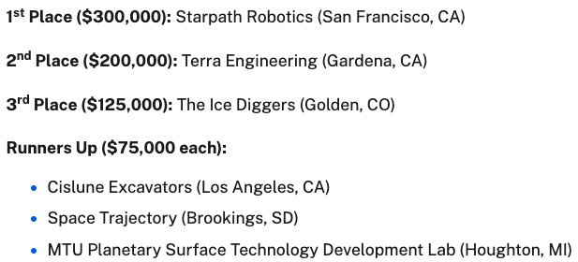

Notable News
Congratulations to the winners of the Break the Ice Lunar NASA Centennial Challenge!
https://www.nasa.gov/directorates/stmd/stmd-prizes-challenges-crowdsourcing-program/centennial-challenges/six-finalists-named-in-nasas-3-5-million-break-the-ice-challenge/

Slide 5
Upcoming Meetings
Small Business, BIG Opportunities: Pathways to Procurement at NASA (Jan 25, 2024, 1pm ET)
  https://www.eventbrite.com/e/small-business-big-opportunities-pathways-to-procurement-at-nasa-tickets-750764706447
  Small Business, BIG Opportunities: Pathways to Procurement at NASA, where small businesses will have the open opportunity to connect with NASA representatives, industry experts, and fellow entrepreneurs. This event is primarily focused on fostering meaningful networking while providing valuable insights into federal government contracting opportunities.
2024 LSIC Spring Meeting (Week of April 22, 2024)
  https://lsic.jhuapl.edu/Events/Agenda/index.php?id=465
  JHU/APL Kossiakoff Center, Laurel, MD & Virtual
  Stay tuned for details!
Space Resources Week (March 25-27, 2024)
  https://www.spaceresourcesweek.lu/
  European Convention Center Luxembourg & Virtual
  Abstract submission just closed, registration opening soon.
International Conference on Environmental Systems (ICES) (July 21-25, 2024)
  https://www.ices.space/call-for-paper-2024/
  Sessions include: “Advanced Technologies for In-Situ Resource Utilization”, “Space Architecture”, “Planetary and Spacecraft Dust Properties and Mitigation Technologies”, “Human/Robotics System Integration”
  Abstract deadline November 20
ISRU FG Meetings moving to third Wednesdays at 11am ET

Slide 6
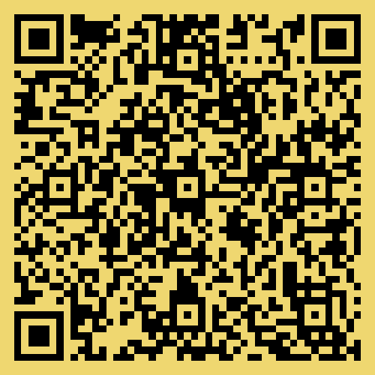
Funding/Employment Opportunities
NASA STMD RFI for LIFT-1 ISRU Demonstration due December 18
  https://www.nasa.gov/directorates/stmd/nasa-lift-1-request-for-information/
  https://nspires.nasaprs.com/external/solicitations/summary.do?solId=%7b23D0FE0E-099D-77A8-3E06-2C516D900762%7d&path=&method=init
NASA 2024 BIG Idea Challenge proposals due February 1
  https://bigidea.nianet.org/
  Theme: Inflatable Systems for Lunar Operations
https://lsic.jhuapl.edu/Resources/Funding-Opportunities.php
https://lsic.jhuapl.edu/Resources/Opportunities.php?f=Job

Slide 7
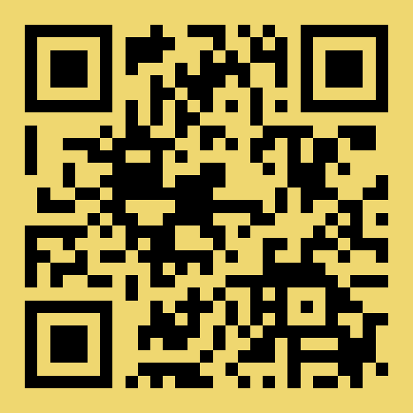
ISRU End-Of-Year Survey
With 2023 wrapping up, we're hoping to get a sense for what worked, what didn't work, and what you'd like to see in 2024 for the In-Situ Resource Utilization (ISRU) Focus Group in LSIC. Feel free to fill out as much of the survey as you feel comfortable.
This survey is completely anonymous, and we will not share any user data.
https://forms.gle/gZxGPxArwJHWFZ2C9

Slide 8


Open Discussion: Thoughts on Monthly Meeting Structure
https://forms.gle/gZxGPxArwJHWFZ2C9
ISRU End-Of-Year Survey
Seminar-style: 1-2 talks from members of the community
Working-style: discussing priorities relevant to a specific gap, and trying to determine a path to closing that gap
Networking-style: free-for-all breakout rooms to network and collaborate
Notes:
Seminar-style: 1-2 talks from members of the community
Working-style: discussing priorities relevant to a specific gap, and trying to determine a path to closing that gap
Networking-style: free-for-all breakout rooms to network and collaborate

