Slide 1
Extreme Access Focus Group Telecon
Dec 8, 2022
We’ll start around 3:03
Sarah Withee
Extreme Access Focus Group Facilitator
JHU Applied Physics Laboratory
Facilitator_ExtremeAccess@jhuapl.edu

Slide 2
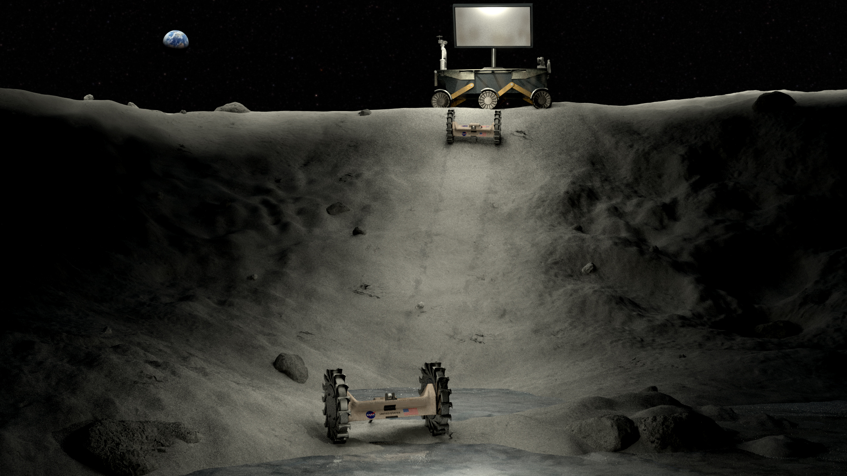
Today’s Agenda
LSIC EA Focus Group Updates
Announcements
Subgroup updates
SBIR info
Upcoming Meetings/Opportunities
Tech spotlights
John Carrico, Space Exploration Engineering, Trajectory Design for Lunar Missions
Jim Schier, NASA Space Communications and Navigation, LunaNet

Slide 3
Announcements
For spring 2023, LSIC is planning a series of workshops around applying for NASA funding opportunities. To help us ensure the workshops meet community needs, we are asking interested members to complete a short survey. The survey will be available through Wednesday December 21. Thank you to everyone who has already completed it!
https://jhuapl.az1.qualtrics.com/jfe/form/SV_bkqcFLt4oO1CQEm

Slide 4
Announcements
MOSA working group

Slide 5
Subgroup updates
Marshall Eubanks will be taking over as the PNT subgroup lead.
Next meeting of the PNT subgroup paper reading group will be in January. If you’re interested in joining, please sign up on Confluence at https://lsic-wiki.jhuapl.edu/display/EA/PNT+reading+group
Mobility and comms subgroups will not be meeting in December; meetings will resume in January

Slide 6
NASA Small Business Innovation Research (SBIR) Phase I Fiscal Year 2022 Solicitation
Completed Proposal Package Due Date and Time:
March 9, 2022 - 5:00 p.m. ET

Slide 7
Other opportunities
NASA Innovation Corps Pilot »
Proposals may be submitted at any time through March 29, 2023, but applications will be reviewed in intervals on the following dates: July 22, 2022; Sept. 16, 2022; Nov. 17, 2022; and Jan 20, 2023
https://lsic.jhuapl.edu/Resources/Funding-Opportunities.php

Slide 8
Trajectory Design for Lunar Missions
John Carrico, Space Exploration Engineering

Slide 9
LunaNet
Jim Schier, NASA Space Communications and Navigation (SCaN)

