Slide 1
Extreme Environments Focus Group March Meeting
March 14, 2023
Jamie Porter
Extreme Environments Focus Group Facilitator
Facilitator_ExtremeEnvironments@jhuapl.edu
Extreme Environments Team: Alice Cocoros, Andrew Gerger, Milena Graziano, Benjamin Greenhagen, Karen Stockstill-Cahill, Samalis Santini De Leon

Slide 2
Today’s Agenda
Funding Opportunities
Spring Meeting
Surface Power - March Telecon
Introduction of new Extreme Environments Facilitator
Featured Discussions
Dr. Lauryn Baranowski, TDA Research
Low Temperature Durable Siloxane/epoxy Nanocomposite Coating for Drastic Reduction in Lunar Particulate Adhesion
Corey Wilson, ThermAvant Technologies
Cryogenic Oscillating Heat Pipes

Slide 3
Funding Opportunities
Lunar Surface Technology Research (LuSTR) Opportunities
https://nspires.nasaprs.com/external/solicitations/summary.do?solId=%7b5210B8C6-EFF3-BBE0-66BA-FEFD9DC44179%7d
NOIs Due: March 22, 2023; Proposals Due: April 24, 2023
NASA Innovation Corps Pilot
https://nspires.nasaprs.com/external/solicitations/summary.do?solId=%7b1B42E782-61BB-9834-F20F-44CBEF13C0A6%7d&path=&method=init
Proposals may be submitted at any time through March 29, 2023
MUREP Space Technology Artemis Research (M-STAR)
https://nspires.nasaprs.com/external/solicitations/summary.do?solId=%7b2644B211-4765-F748-70E5-F429AEBC81B7%7d&path=&method=init
Optional Pre-proposal Webinar: March 14, 2023, 4:00 – 5:00 PM ET
Proposals Due: April 10, 2023
NSF SBIR and STTR
https://seedfund.nsf.gov/apply/get-started/
Windows: November 22, 2022 - March 1, 2023 March 2, 2023 - July 5, 2023 July 6, 2023 - November 1, 2023
Please visit LSIC website for full list
http://lsic.jhuapl.edu/Resources/Funding-Opportunities.php

Slide 4
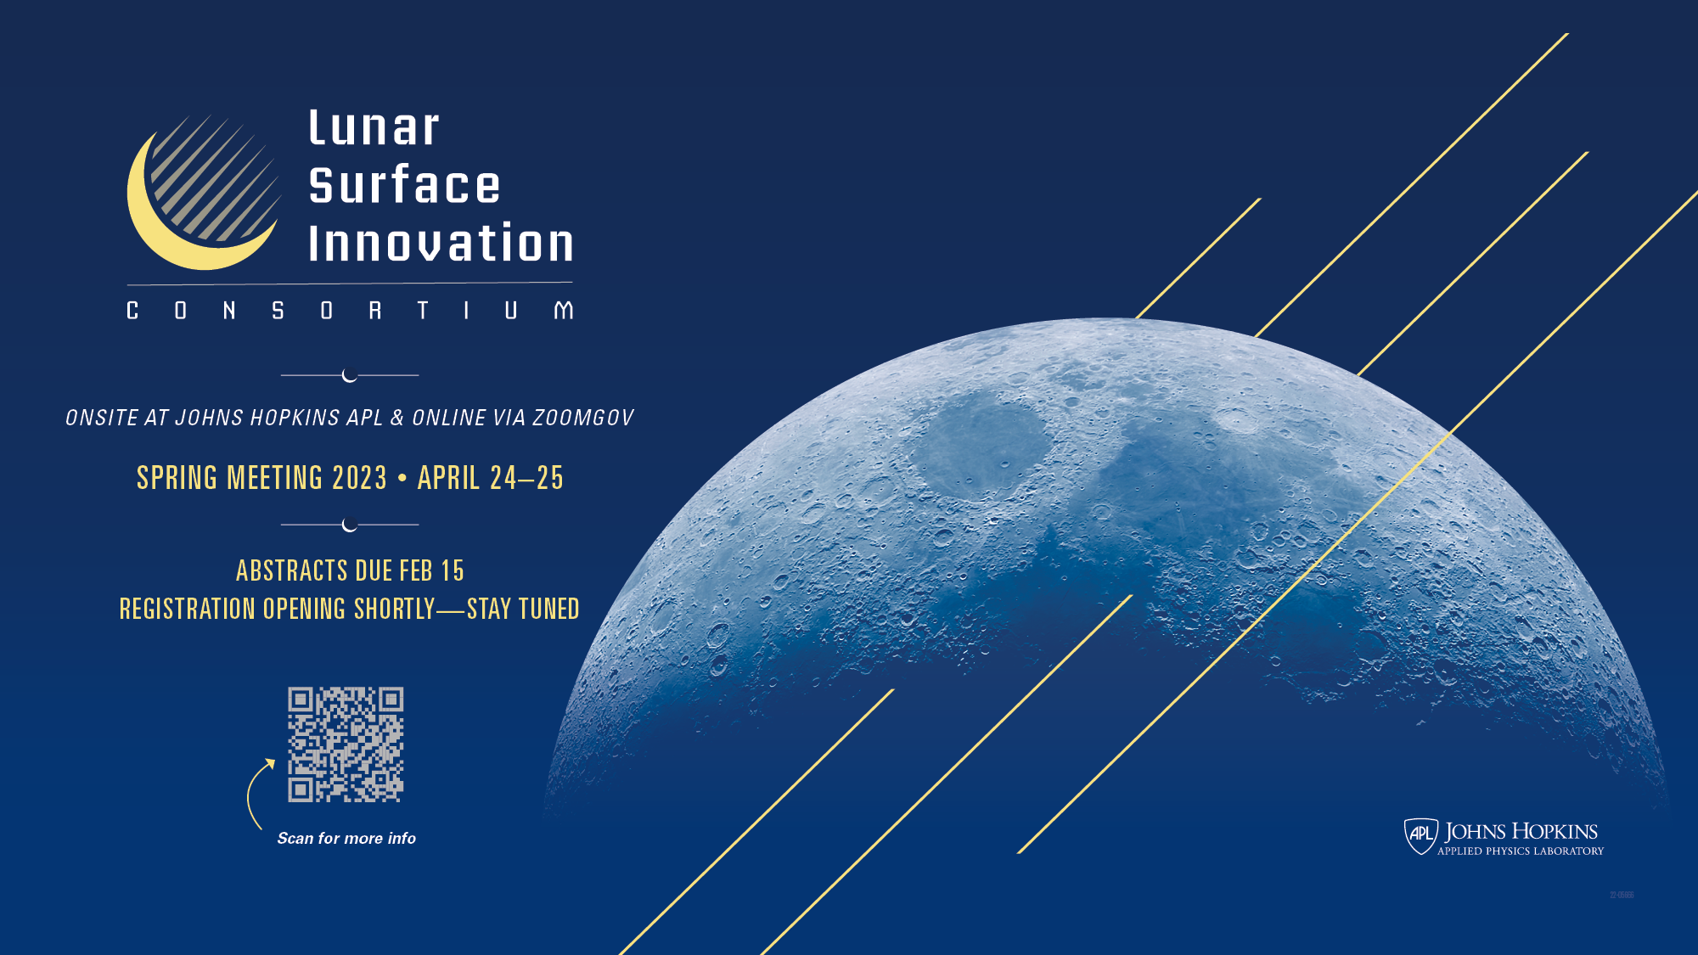
Registration Deadlines:
10 April (in-person attendance)
17 April (virtual attendance)

Slide 5
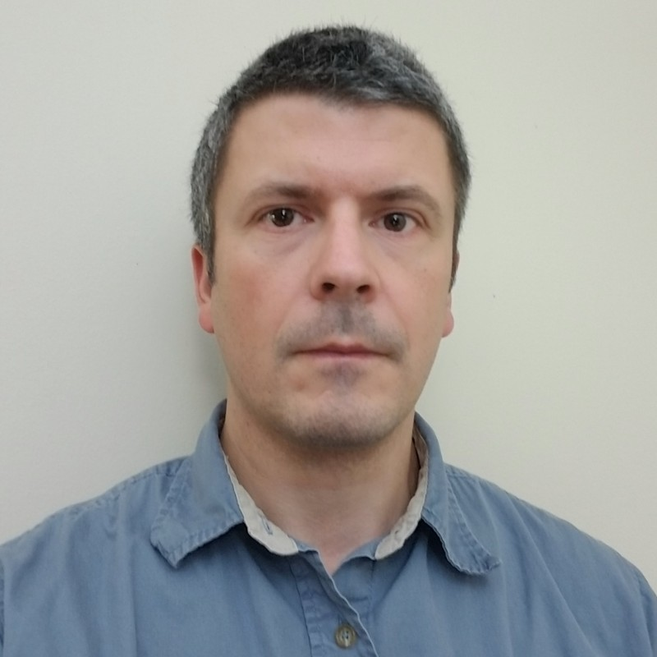
LSIC | Surface Power March Telecon
The next Surface Power Telecon will take place on
Thursday March 16, 2023 at 11:00AM ET.
Theme: Radiation Testing of Electronics
Speaker: Dr. Akin Akturk (CoolCAD Electronics, Vice President)
CoolCAD designs and builds wide bandgap silicon carbide (SiC) semiconductor transistors for many applications including space electronics and extreme operating conditions.
Dr. Akturk specializes in both cryogenic and radiation (gamma, neutron and heavy ion) testing of electronics, as well as thermal modeling of SiC systems.
5

Slide 6
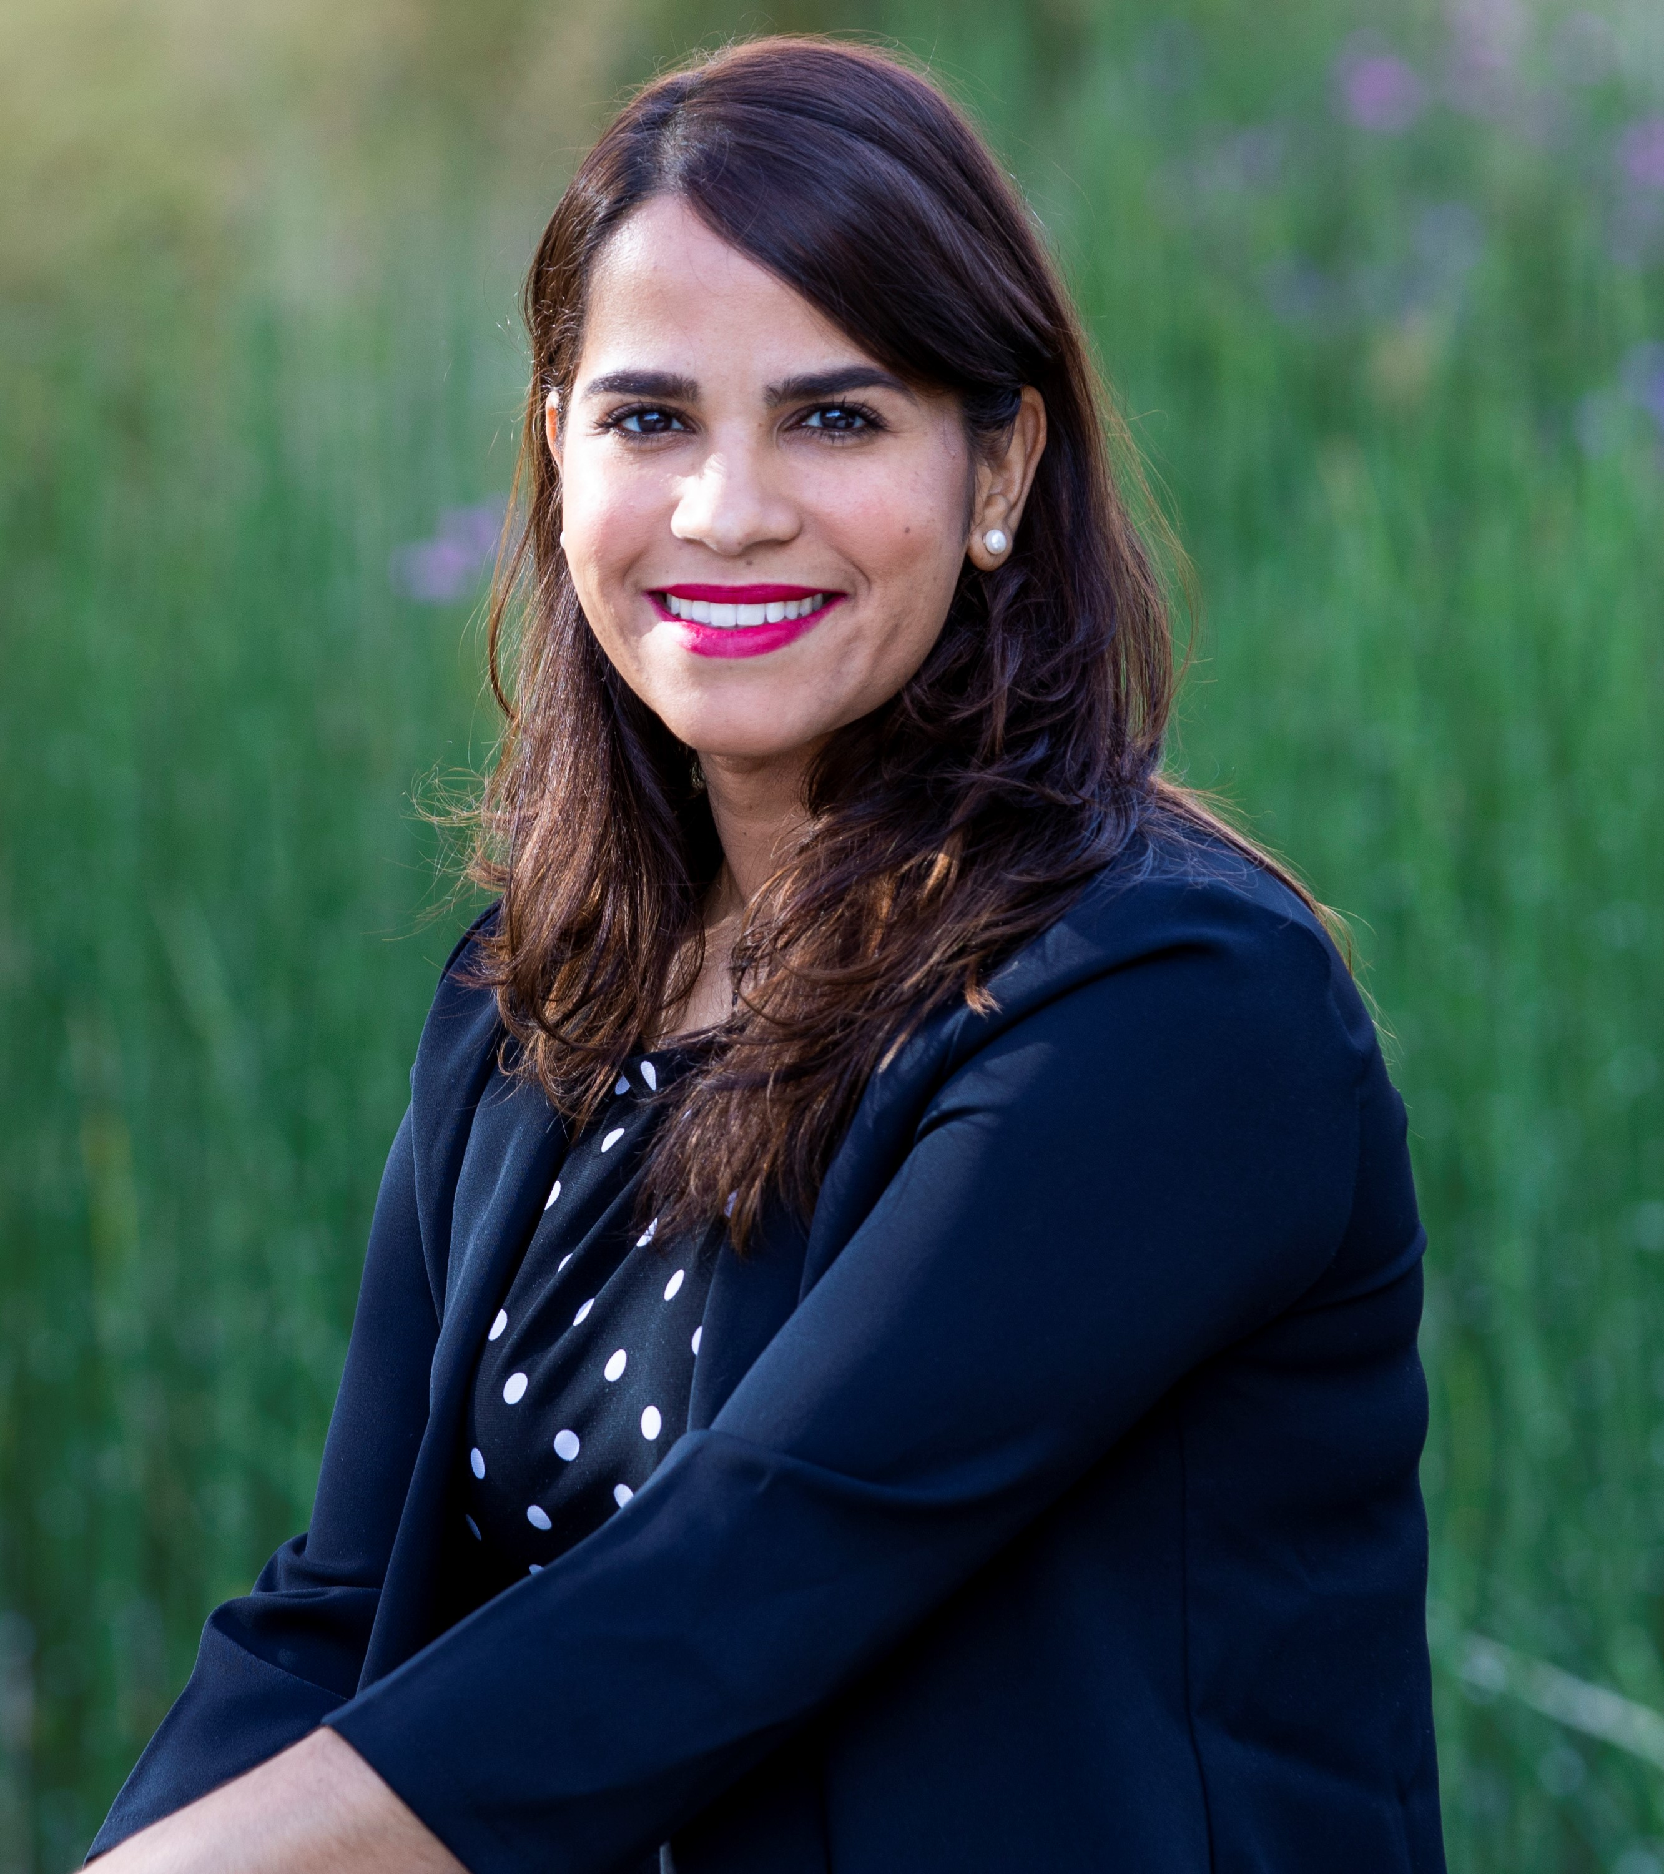
EE Focus Group Facilitator
What is my day job?
Verifying suitability of flight hardware materials to target space environments, including thermal, vacuum, and radiation
What is my backstory?
PhD in Materials Science and Engineering (2015)
Graduate research focused on materials characterization for wide bandgap semiconductor substrates and films
Post-doctorate in Army Research Laboratory (2016 - 2018)
Materials and Processes (M&P) engineer for Space Exploration Sector (2018 – Present)
What are my interests?
Synergistic environmental effects on materials properties
Development of environmental testing and qualification processes
Why am I here?
To ensure fruitful communication between the LSIC-EE community and NASA STMD in bridging the technology gaps for successful operation in the lunar environment
Where will I start?
Updates of lunar surface environments – what have we learn in recent years?
Status on technology gaps and efforts for safe system operation in lunar conditions
Address LSIC EE community needs (workshops, seminars)
Contact:
Facilitator_ExtremeEnvironments@jhuapl.edu
Milena Bobea Graziano
Johns Hopkins University
Applied Physics Laboratory
Laurel, MD

