Slide 1
Extreme Access Focus Group Telecon
March 9, 2023
We’ll start around 3:03
Sarah Withee
Extreme Access Focus Group Facilitator
Facilitator_ExtremeAccess@jhuapl.edu
Angela Stickle (focus area lead), Mario Lento, Danielle Mortensen, Stacy Teng, Alice Cocoros
Angela.stickle@jhuapl.edu, Mario.lento@jhuapl.edu, Danielle.mortensen@jhuapl.edu, stacy.teng@jhuapl.edu, Alice.Cocoros@jhuapl.edu

Slide 2
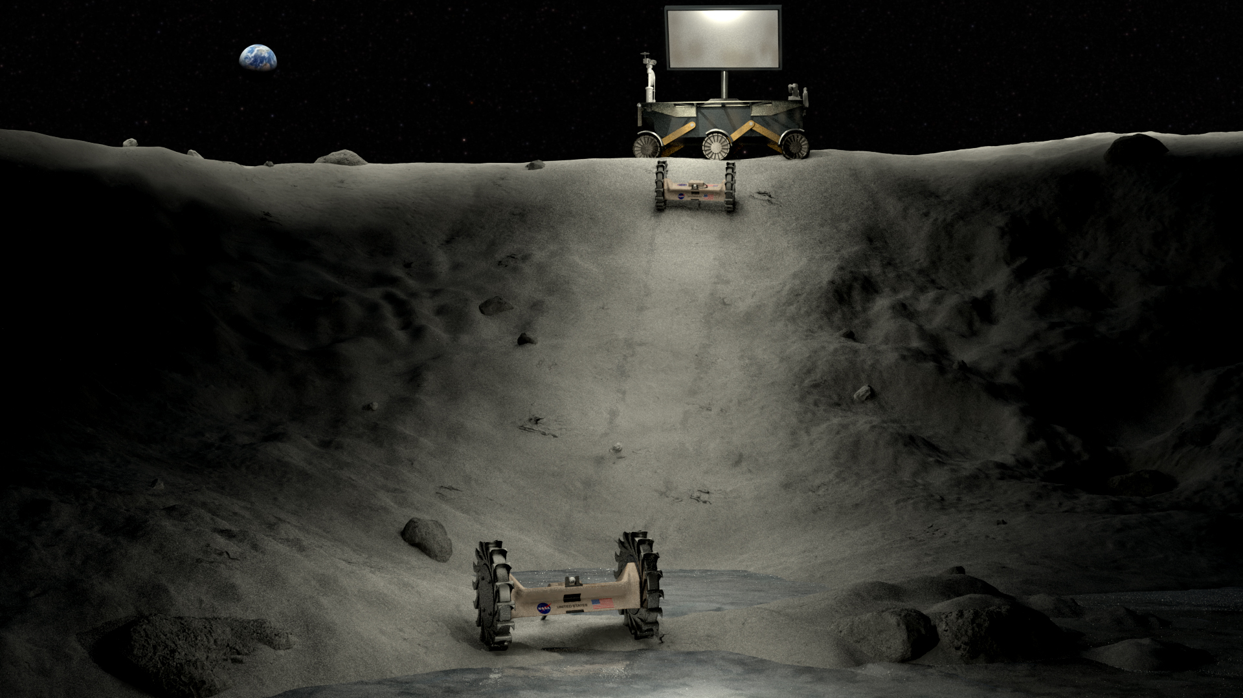
Today’s Agenda
Surface power telecon
Community-driven whitepaper
Upcoming Meetings/Opportunities
Subgroup updates
Ed Birrane – Delay Tolerant Networking

Slide 3
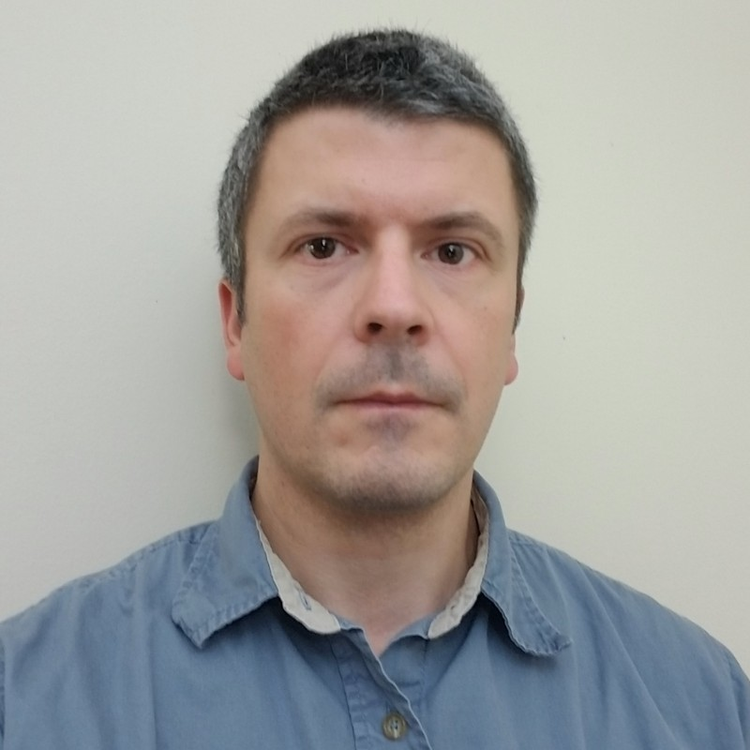
LSIC | Surface Power March Telecon
The next Surface Power Telecon will take place on
Thursday March 16, 2023 at 11:00AM ET.
Theme: Radiation Testing of Electronics
Speaker: Dr. Akin Akturk (CoolCAD Electronics, Vice President)
CoolCAD designs and builds wide bandgap silicon carbide (SiC) semiconductor transistors for many applications including space electronics and extreme operating conditions.
Dr. Akturk specializes in both cryogenic and radiation (gamma, neutron and heavy ion) testing of electronics, as well as thermal modeling of SiC systems.
3

Slide 4
Community-driven whitepaper
Draft available for review at spring meeting
Soliciting input via subgroups and Confluence
https://lsic-wiki.jhuapl.edu/display/EA/Community-driven+whitepaper

Slide 5
Funding opportunities and RFIs
Early Career Faculty 2023 https://nspires.nasaprs.com/external/solicitations/summary.do?solId=%7B387AF918-4121-2269-FF12-EEBE5F0F9FEC%7D&path=&method=init
Notices of Intent Due: March 16, 2023 Proposals Due: April 13, 2023
Lunar Surface Technology Research (LuSTR)
https://nspires.nasaprs.com/external/solicitations/summary.do?solId=%7b5210B8C6-EFF3-BBE0-66BA-FEFD9DC44179%7d
NOI due March 22, 2023
Suborbital/Hosted Orbital Flight and Payload Integration Services 4 Solicitation (RFI)
https://sam.gov/opp/2176096a71374aa6895be8fad47c5141/view
Feedback deadline: March 11, 2023
Complete list of opportunities available at https://lsic.jhuapl.edu/Resources/Funding-Opportunities.php

Slide 6
Subgroup updates
Comms subgroup meeting Wednesday March 15 4 pm ET – Kevin Lynaugh from Vulcan Wireless
PNT paper reading group Monday March 27 at 4 pm ET.
Paper is Passive Positioning, Navigation, and Timing (PPNT) in Cislunar Space Using Earth-based Transmitters
Download from https://lsic-wiki.jhuapl.edu/display/EA/Paper+Suggestions
Or email Danielle.Mortensen@jhuapl.edu to get a copy if you don’t have access to Confluence
Mobility subgroup is meeting Thursday March 23 1 - 2:30 pm ET.
https://lsic-wiki.jhuapl.edu/pages/viewpage.action?spaceKey=EA&title=Guest+Talks+-+Calendar+Year+2023
Autonomy subgroup is being formed. If you are interested in participating, please let add your name to the comments at https://lsic-wiki.jhuapl.edu/display/EA/Autonomy+subgroup

Slide 7
Delay Tolerant Networking at the Moon
Ed Birrane, Johns Hopkins University Applied Physics Laboratory

