Slide 1


LSIC MOSA Telecon
April 5, 2023
Begins at 1:05
Kristin Jaburek
Johns Hopkins Applied Physics Laboratory
Space Exploration Sector
LSIC MOSA Working Group
Kristin.Jaburek@jhuapl.edu
James Mastandrea, PhD
Johns Hopkins Applied Physics Laboratory
Space Exploration Sector
LSIC MOSA Working Group
James.Mastandrea@jhuapl.edu
Pegah Pashai
Johns Hopkins Applied Physics Laboratory
Space Exploration Sector
LSIC MOSA Working Group
Pegah.Pashai@jhuapl.edu

Slide 2

LSIC | Agenda
Community Updates
Technical Talk
Question and Answer Session
2

Slide 3


Slide 4
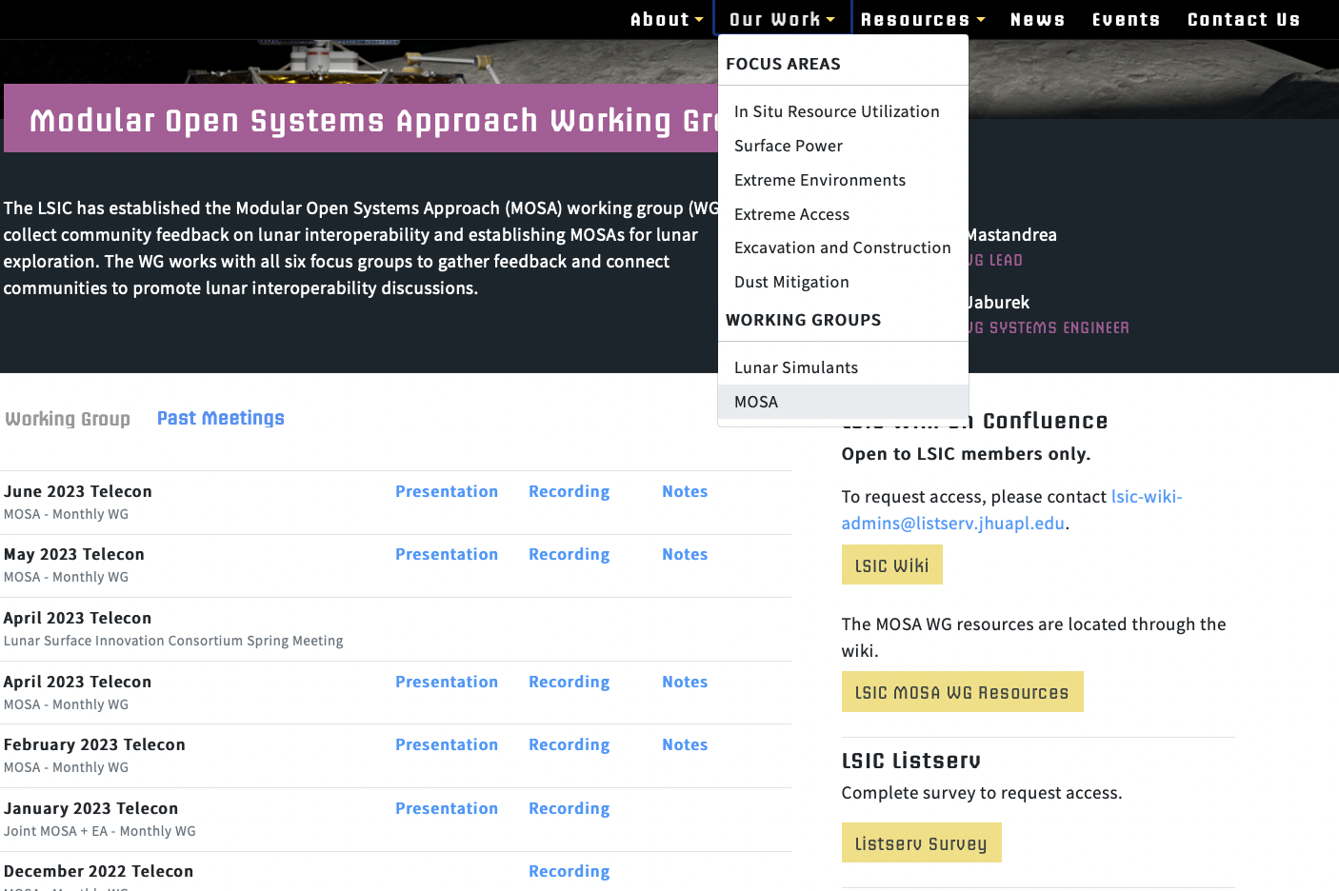
LSIC | MOSA WG Updates
February MOSA Telecon recording is up:
  Jaret Matthews from Astrolab
May Telecon
  5/3 @ 1 PM Eastern
  Ben Pearson, Strategic Planner at Lockheed Martin Space, will be presenting on LM's Lunar Mobility Vehicle and its modular payload hosting capabilities.
June Telecon
  6/7 @ 1 PM Eastern
  David LaBranche, a Geospatial Information Officer from USG, will be presenting on the DoD's Spatial Data Standards for Facilities, Infrastructure, and Environment (SDSFIE) and how it could potentially be used for the moon.
4

Slide 5
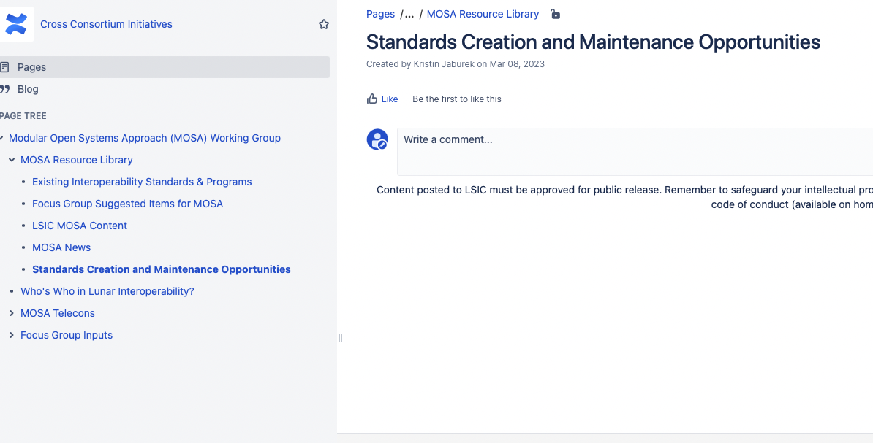
LSIC | MOSA WG Updates
New Confluence Wiki Page
Opportunities for Standards Creation and Maintenance. Post your request in the comments!
5

Slide 6
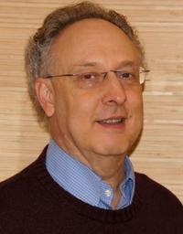
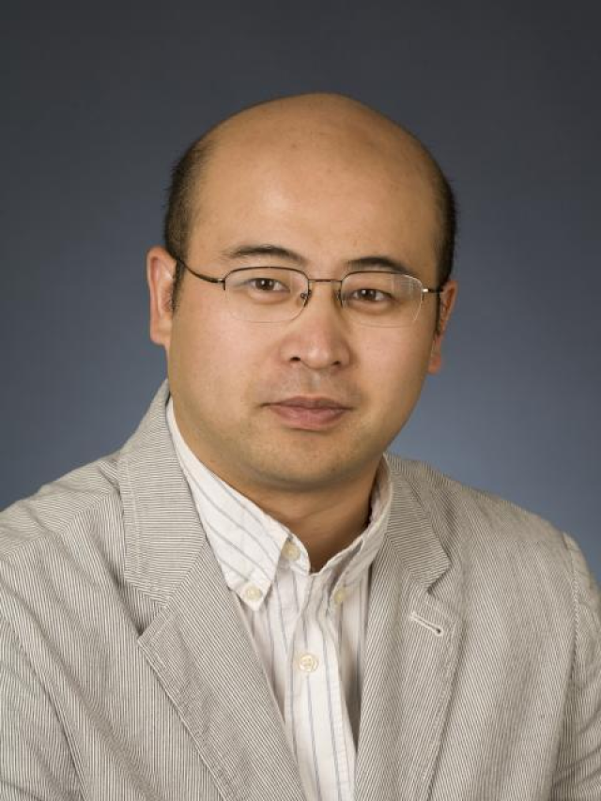
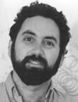
LSIC | Surface Power April Telecon
We hope to see you all at the next Surface Power telecon, which will take place on
Thursday April 13th, 2023 at 11:00AM ET.
Theme: LuSTR 2020 Power Awardees
Speakers:
Art Witulski (Vanderbilt): “SiC Power Components for NASA Lunar Surface Applications”
Jin Wang (OSU): “Flexible DC Energy Router based on Energy Storage Integrated Circuit Breaker”
Phillip Lubin (UCSB): “Moonbeam-Beamed Lunar Power”
Prof. Witulski Prof. Wang Prof. Lubin
6

Slide 7
LSIC | Technical Talk
VICTORY
Travis Thompson
Program Manager of R&D - SwRI
7

