Slide 1

LSIC Dust Mitigation Focus Group
Monthly Meeting
August 17, 2023
Jorge Núñez, Sarah Hasnain, Lindsey Tolis, Richard Miller,
Stephen Izon, Timothy Cole
Facilitator_DustMitigation@jhuapl.edu

Slide 2
Agenda
Welcome
LSIC and Focus Group Updates
Upcoming Opportunities and Meetings
Featured Technology Presentations:
    “Large-Area Nanotextured Surfaces for Passive Dust Mitigation: SBIR Phase II Project Updates and Key Questions”
      Dr. Stephen Furst, Founder and CEO of Smart Material Solutions, Inc.
    “Chemically modified reduced graphene oxide (CMrGO)-based Electrodynamic Dust Shield (EDS) devices for Lunar dust mitigation”
      Dr. Micah Schaible, Georgia Institute of Technology
Discussion

Slide 3
LSIC Updates and Communications
Monthly LSIC newsletter – New edition came out August 7, 2023
  POC: Josh Cahill
DM Mailing list
  The listserv goes to all participants. Use with caution. But feel free to use!
  Please make sure to add LSIC_DUSTMITIGATION@LISTSERV.JHUAPL.EDU to safe senders list.
  If we need smaller, focused lists we can set those up
LSIC DM webpage
  Notes, slides, recordings from telecons posted here
LSIC Wiki
  Confluence is free to you and available to all registered LSIC members
  To request access, please contact lsic-wiki-admins@listserv.jhuapl.edu
Lightning Talks at monthly focus group meetings
  Anyone can volunteer to give a featured talk (~15 mins)
  Email us if you want to sign up: Facilitator_DustMitigation@jhuapl.edu
Follow the Code of Conduct for all Focus Group communications
https://lsic.jhuapl.edu/Resources/LSIC-Resources.php

Slide 4
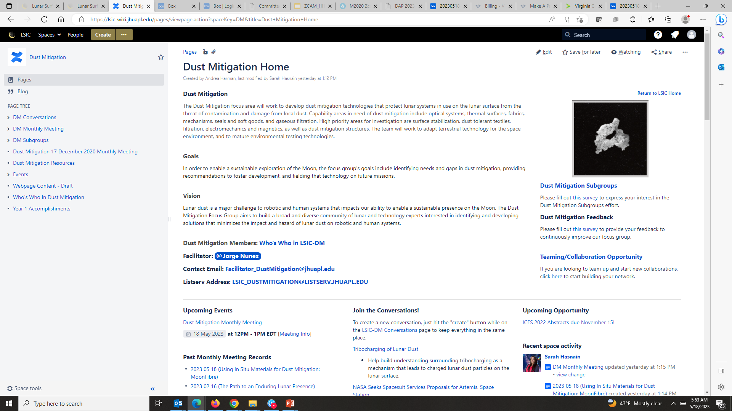
LSIC Dust Mitigation Wiki Page
To request access, please contact lsic-wiki-admins@listserv.jhuapl.edu
Dust Mitigation Discussion page and wiki
https://lsic-wiki.jhuapl.edu/display/DM/Dust+Mitigation+Home

Slide 5
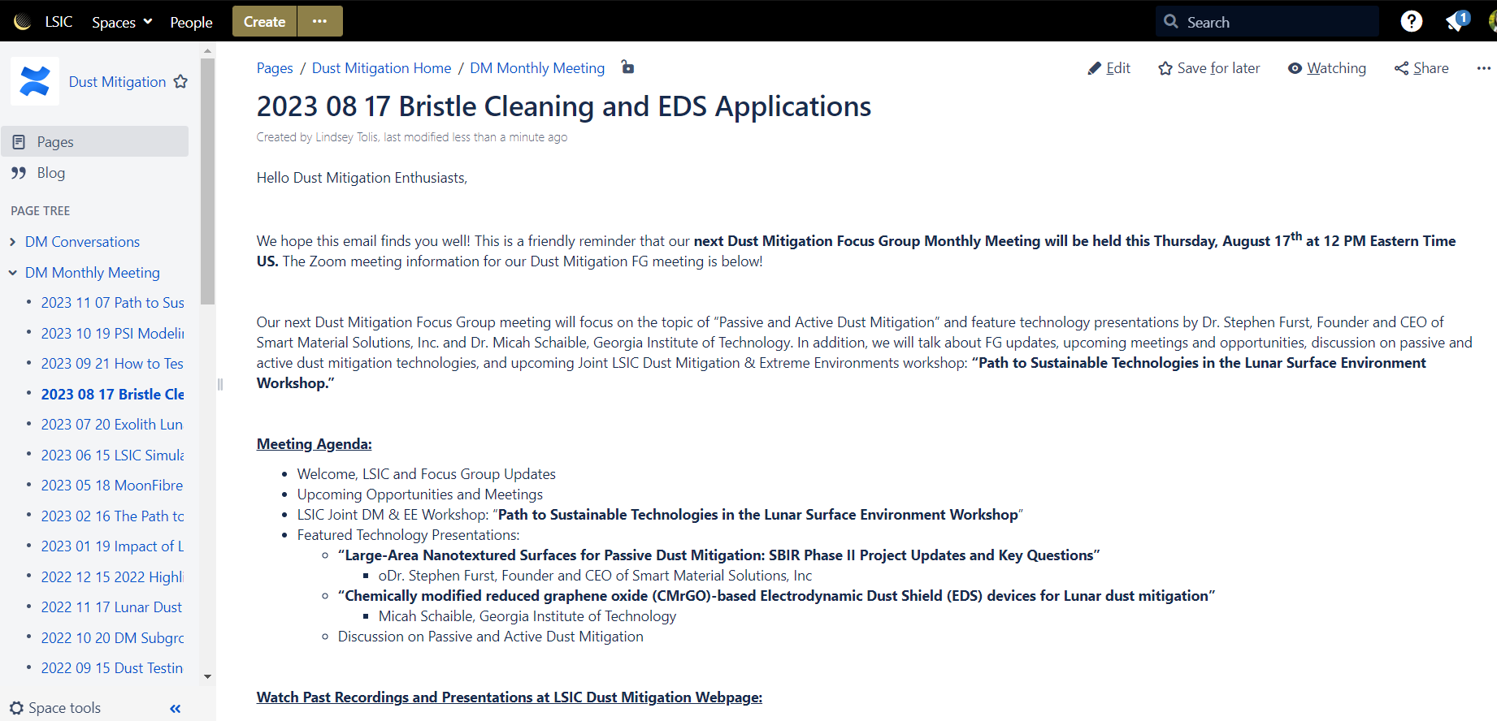
Join the Discussion on our Wiki Page
To request access, please contact lsic-wiki-admins@listserv.jhuapl.edu
Dust Mitigation Discussion page and wiki
Sign-in to add a comment at bottom of page
You can comment before, during, or after today’s meeting
Today’s meeting
https://lsic-wiki.jhuapl.edu/x/GoAZ

Slide 6
Get Involved with Dust Mitigation
Sign-up to Receive LSIC and Dust Mitigation FG Updates:
  Fill out the LSIC Sign Up
  Indicate interest in Dust Mitigation to receive news and event invitations
Help us improve the Dust Mitigation Focus Group: Feedback survey
Interested in Teaming/Collaborating with Others?
  Add yourself to our Confluence Who’s Who page
Looking for info on lunar dust or dust mitigation resources?
  Checkout our Confluence resources page
Join one of the Dust Mitigation Subgroups!
  Subgroup Membership/Leaders survey
  Still looking for subgroup leads!

Slide 7
Dust Mitigation FG Subgroups
Standards & Interoperability [Subgroup Lead: Dan Hawk]
  Standards and interoperability across testing and operational use cases
Isolation Technologies [Subgroup Lead: Ron Creel]
  Technologies that keep dust out
Materials & Coatings
  Optical Systems – Viewports, camera lenses, solar panels, space suit visors, mass spectrometers, other sensitive optical instruments
  Thermal Surfaces – Thermal radiators, thermal painted surfaces, thermal connections
  Fabrics – Space suit fabrics, soft wall habitats, mechanism covers
  Seals and Soft Goods – Space suit interfaces, hatches, connectors, hoses
Mechanisms & Connectors
  Mechanisms – Linear actuators, bearings, rotary joints, hinges, quick disconnects, valves, linkages
  Dust-tolerant connectors
Modeling & Monitoring
  Gaseous Filtration – Atmosphere revitalization, ISRU processes
  Dust monitoring – Cabin and external dust monitoring
  Dust plume modeling
Interested in leading a Dust Mitigation Subgroup?
Fill out our survey!
https://forms.gle/AGpyJcNZBd6ihdaq7

Slide 8
Space Technology Funding Opportunities
Current Tech Development Opportunities
NSF SBIR and STTR »
  NSF recommends treating the submission window like a deadline, but you can submit anytime within a year of receiving an official invitation from NSF. (NSF uses submission windows to help gather and review proposals, but sometimes proposals are reviewed as they are received.) Windows: March 2, 2023 - July 5, 2023 July 6, 2023 - November 1, 2023
NASA Innovation Corps Pilot »
  Proposals may be submitted at any time through July 22, 2022, but applications will be reviewed in intervals on the following dates: Sept. 16, 2022; Nov. 17, 2022; and Jan 20, 2023
Technology Advancement Utilizing Suborbital and Orbital Flight Opportunities “TechFlights” »
  Mandatory Preliminary Proposals Due - 6/7/2023 Full Proposals Due - 10/4/2023
Human Lander Challenge
  Notice of Intent (NOI) Due October 22, 2023; Full Proposals Due March 4, 2024
NASA's 2024 BIG Idea Challenge »
  Notice of Intent Deadline – September 20, 2023; Q&A Session for Interested Teams – October 12, 2023; Proposal Deadline – January 23, 2024; 2024 BIG Idea Forum – November 5-7, 2024
Future Solicitation and Opportunities
NASA Innovative Advanced Concepts (NIAC) 2024 Phase I Call for Proposals »
  The NIAC program supports visionary research ideas through multiple progressive phases of study. Phase I studies are nine-month efforts to explore the overall viability and advance the technology readiness level (TRL). Eligible recipients of Phase I awards can propose for a follow-on Phase II study.

Slide 9
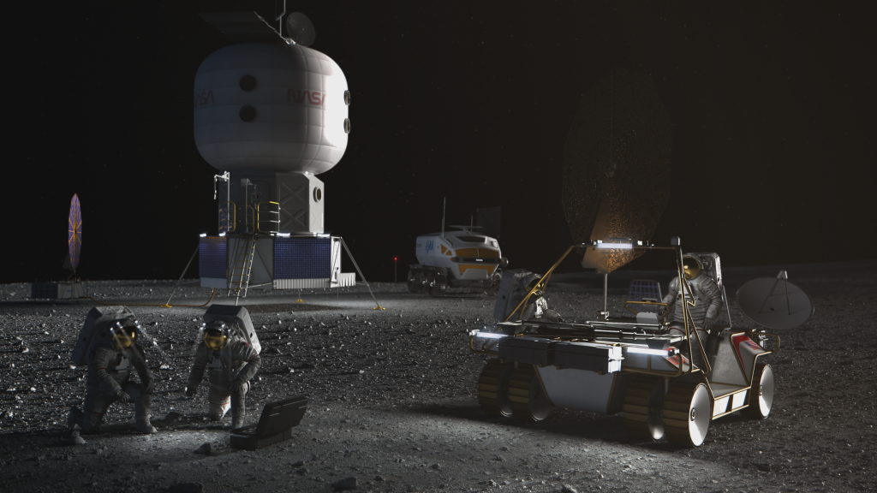
Human Lander Challenge
Through the 2024 HuLC competition, NASA’s Human Landing System (HLS) Program provides college students the opportunity to explore innovations and potential solutions to lunar Plume-Surface Interaction (PSI) risks and challenges.
NASA’s HLS Program is responsible for the transportation in deep space to carry humans to and from the surface of the Moon for NASA’s Artemis lunar exploration program. Crews will board the HLS in lunar orbit and descend to the surface where they will collect samples, perform science experiments, and observe the lunar environment before returning to orbit in the HLS.
Teams are invited to submit proposals for innovative, systems-level solutions to understand, mitigate, and manage the impacts of lunar PSI that can be implemented within 3-5 years. The potential solutions teams can propose to could include, but are not limited to, the following categories:
  Trade Studies on Landing Trajectories that Minimize PSI
  Reduction / Mitigation of Erosion (Cratering) and Ejecta during Descent, Landing, and Ascent
  Development of PSI Flight Instrumentation / Measurement Methods and Concepts
  Tracking Dust During Descent, Landing, and Ascent
  Instrumentation Performance Through the Dust Cloud During Landing
  HLS Asset Safety (ejecta damage, excessive lander heating, etc.)
  PSI Modeling and Validation
Notice of Intent (NOI) Due October 22, 2023; Full Proposal Due March 4, 2024
https://hulc.nianet.org/challenge_details/

Slide 10
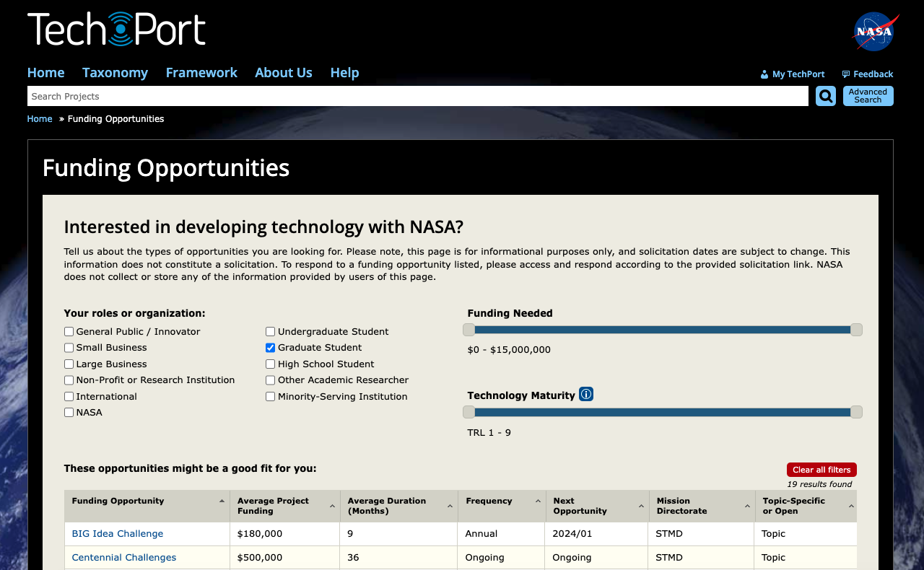
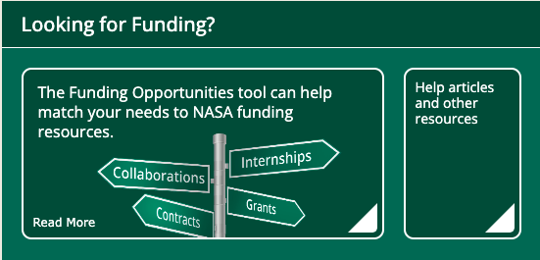
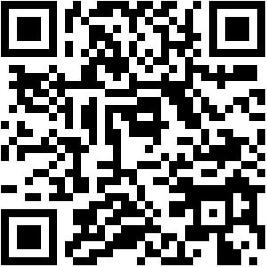
https://techport.nasa.gov/opportunities

Slide 11
LSIC Activities
Upcoming LSIC Meetings and Workshops (https://lsic.jhuapl.edu/Events/)
Autonomy Workshop (August 21-22, 2023)
  Registration is closed!
  https://lsic.jhuapl.edu/Events/Agenda/index.php?id=474
LSIC Fall Meeting (October 10-11, 2023)
  Community College of Allegheny County, Pittsburgh, PA
  Registration is open!
  Abstract Submission Deadline: August 18, 2023 (tomorrow!)
    Use template on event page
  https://lsic.jhuapl.edu/Events/Agenda/index.php?id=464
Transition to Commercial Lunar Services (October 12, 2023)
  Community College of Allegheny County, Pittsburgh, PA
  Registration is open!
  https://lsic.jhuapl.edu/Events/Agenda/index.php?id=478
LSIC Dust Mitigation & Extreme Environments Workshop (November 7, 2023)
  Registration is open!
  https://lsic.jhuapl.edu/Events/Agenda/index.php?id=481
Other Upcoming Dust Mitigation Related Workshop and Meetings
Annual Meeting of the Lunar Exploration Analysis Group Meeting (September 20-22, 2023)
  Laurel, MD
  https://www.lpi.usra.edu/leag/
2023 ASCEND Meeting (October 23-25, 2023)
  Las Vegas, NV
  2023 ASCEND

Slide 12

Autonomy Workshop (EA and E&C)
August 21-22, 2023
10:00 am – 5:00 pm EDT, Virtual
Objective: The goal of this workshop is to gather the Lunar community to exchange ideas on autonomy, as well as identify technology gaps and use cases for establishing a sustainable presence on the Moon and Mars.
  Day 1:
  Morning - Autonomous Systems, Situational and Self Awareness, Reasoning and Acting
  Afternoon - Collaborative Systems
  Day 2:
  Morning - Applications in Autonomy on Lunar Surface - Current Champions (e.g. Autonomous Construction & Assembly)
  Afternoon - Challenges in Autonomy (Test & Evaluation, Cybersecurity, Dynamic Reasoning Models, Environmental Considerations)
Full agenda: https://lsic.jhuapl.edu/Events/Agenda/index.php?id=474

Slide 13


LSIC | August Telecon
We hope to see you all at our next telecon, which will take place on
Thursday August 24th, 2023 at 11:00AM ET.
Topic: A High Temperature Heat Rejection System for Fission Power Generation
Speakers: Alex Miller (ThermAvant Technologies)
Description: ThermAvant Technologies (ThermAvant) has used a NASA Phase II SBIR to develop of an intermediate temperature, large format, high-capacity Oscillating Heat Pipe (OHP) embedded radiator panel to significantly improve the size, weight and power density of a future kilowatt class Fission Power Systems (FPS). More specifically, their work aims to construct thin profile radiator panels, (>1 m² scale and 2-3mm thick), to reject waste heat from the reactor system, and get the technology positioned for implementation.
13

Slide 14
Announcing DM & EE Joint Workshop!
Path to Sustainable Technologies in the Lunar Surface Environment
  We will focus on the qualification path to fielding long-lived technologies on the lunar surface. Stakeholders across industry, academia, and NASA will come together in a collaborative format to discuss the current state of the art, as well as essential knowledge and technology gaps related to the combined lunar and dust environment.
November 7, 2023
Interactive, Virtual Workshop
Topics
  Existing Standards and Facilities
  Stakeholder Needs
    NASA panel
    Industry & Academia Panel
  Town Hall on Next Steps
  Q&As for all presentations
Registration is now open!
  https://lsic.jhuapl.edu/Events/Agenda/index.php?id=481

Slide 15

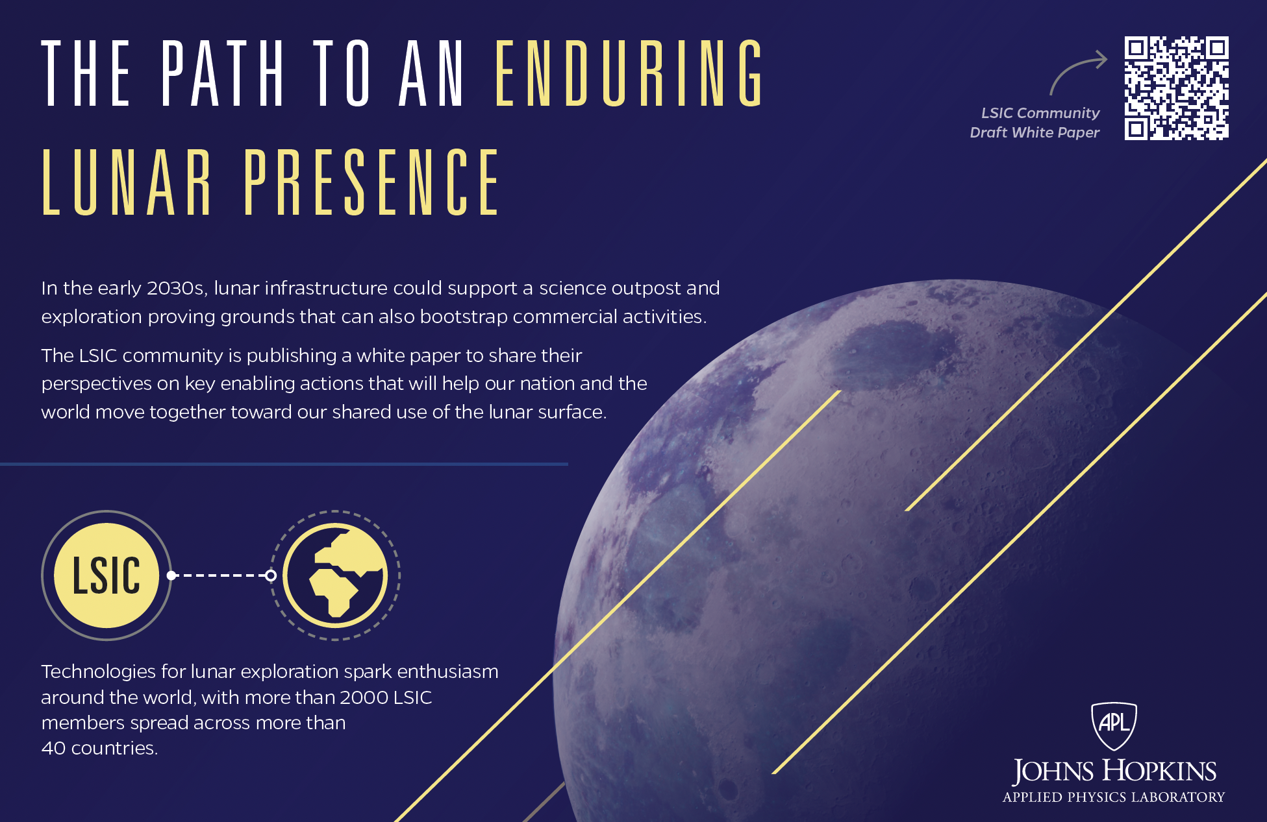
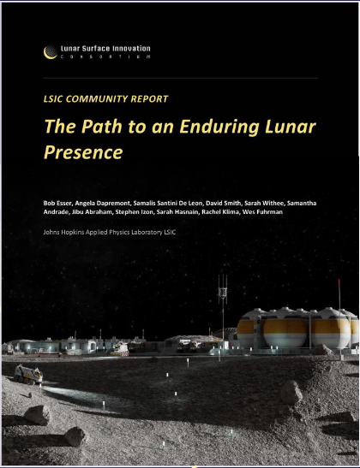
The Path to an Enduring Lunar Presence
LSIC Community Derived White Paper

Slide 16
LSIC White Paper and M2M Feedback
LSIC Whitepaper
The Path to an Enduring Lunar Presence
NASA Moon to Mars Whitepapers
Architecture Concept Review
Perspectives on key enabling actions that will help our nation and the world move together toward our shared use of the lunar surface.
Access White Paper:
https://lsic.jhuapl.edu/Resources/files/The%20Path%20to%20an%20Enduring%20Lunar%20Presence.pdf
Send feedback to: LSIC-Feedback@jhuapl.edu
Systems Analysis of Architecture Drivers
Why NRHO: The Artemis Orbit
Why Artemis will Focus on the Lunar South Polar Region
Gateway: The Cislunar Springboard for International and Sustainable Human Deep Space Exploration
Mars-Forward Capabilities to be Tested at the Moon
Mars Transportation
Access White Papers:
https://www.nasa.gov/MoonToMarsArchitecture

Slide 17
Today’s Technology Presentation
“Large-Area Nanotextured Surfaces for Passive Dust Mitigation: SBIR Phase II Project Updates and Key Questions”
Dr. Stephen Furst
Founder and CEO
Smart Material Solutions, Inc
furst@smartmaterialsolutions.com

Slide 18

Today’s Technology Presentation
“Chemically modified reduced graphene oxide (CMrGO)-based Electrodynamic Dust Shield (EDS) devices for Lunar dust mitigation”
Micah Schaible
Georgia Tech
mjschaible@gatech.edu

Slide 19
Discussion on Passive & Active Dust Mitigation Technologies
What gaps exist in our understanding of lunar dust and regolith?
What data do we still need to help improve our understanding of lunar dust and regolith?
Do upcoming CLPS missions help get the data we need? If so, what kind of data is needed?
Do Lunar Regolith simulants approximate lunar dust sufficiently for dust mitigation testing needs? If not, what properties are missing?
What is the goal percentage of passive dust mitigation technologies?
What is the scalability of current passive and active dust mitigation technologies?
How will we know when mitigation is sufficient?

Slide 21
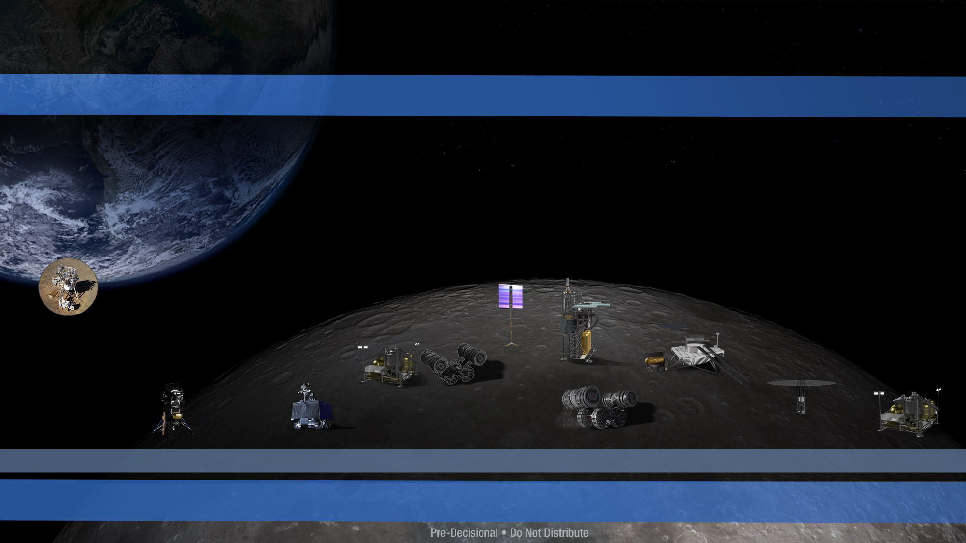
Lunar Surface Technology Demonstration Strategy
Power, ISRU, Autonomy, Robotics, Excavation, Construction
Early lunar surface demonstrations will increase technology readiness for key infrastructure capabilities
with opportunities for collaboration with OGAs, industry, academia, and international partners
CT-1 Space Tech CLPS Demo
CT-2 Space Tech CLPS Demo
CT Candidate Technologies (in formulation):
ISRU Subscale Demo
Power (e.g. Vertical Solar Array, Power Beaming, Fuel Cells)
Dust Mitigation
Autonomy & Robotics (e.g. Mobility, Navigation, etc.)
Excavation
Construction
IM-2 Demo (on CLPS IDIQ)
Polar Resources Ice Mining Experiment (PRIME-1)
Nokia 4G LTE Communications
Intuitive Machines Deployable
Hopper (TP)
Fission
Surface
Power Demo
Oxygen Extraction Ground Demo
ISRU Pilot
Plant
Volatiles Investigating Polar Exploration Rover (VIPER)
(Science Mission Directorate)
Space Tech Lunar Surface Demo
2023
2033
21
TP = Tipping Point

Slide 22

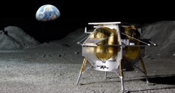
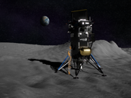
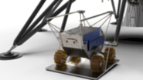
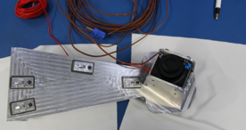
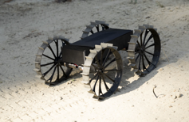
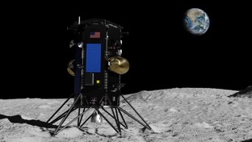
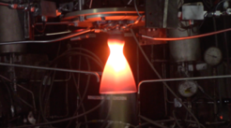
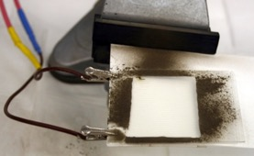
Near-term Lunar Technology Demos
  Early lunar surface demonstrations, via the Commercial Lunar Payload Services (CLPS) Program,
  are opportunities to mature the capabilities required for NASA and industry
Astrobotic Peregrine-1 Mission
Launch date under assessment
Intuitive Machines (IM)-2 Mission
Planned for Q4 CY23
Launch date under assessment
CLPS 19D Mission (Firefly)
Planned for Mid-CY24
Launch date under assessment
CLPS CP11 Mission (IM)
Early/Mid 2024
Polar Resources Ice-Mining Experiment
(PRIME-1)
LTE Proximity Comms
(Tipping Point
w/Nokia)
Astrobotic Terrain Relative Navigation (ATRN) - Tipping Point with Astrobotic
Stereo Camera for Lunar Plume Surface Studies (SCALPSS)
Cooperative Autonomous
Distributed Robotic Explorers
(CADRE)
Thruster for Advancement of Low
Temperature Operations in Space (TALOS)
Deployable Lunar Hopper
(Tipping Point w/ IM)
Electrodynamic Dust Shield (EDS)
22

