Slide 1

LSIC ISRU Focus Group Monthly http://lsic.jhuapl.edu/ http://lsic-wiki.jhuapl.edu/ (Confluence sign-up required)
August 16, 2023
Dr. Jodi Berdis, Dr. Karl Hibbitts, Dr. Michael Nord, Dave Smith, Dr. Rich Miller
Jodi.Berdis@jhuapl.edu, Karl.Hibbitts@jhuapl.edu, Michael.Nord@jhuapl.edu, David.Smith@jhuapl.edu, Richard.S.Miller@jhuapl.edu

Slide 2
Agenda
General updates and house-keeping
  APL is happy to consult as appropriate with ISRU and related technologies. We can provide advice on how to build for launch and operate in extreme environments. This includes site visits!
  Upcoming Meetings
  Funding Opportunities
BIG Idea Challenge Winners 2023 (~10 min. each)
  Colorado School of Mines
    “Lunar Alloy Metal Production Plant (LAMPP)”
  Massachusetts Institute of Technology with Honeybee Robotics
    “Artemis Steelworks: Advancing Reactor Technologies for Electrolytic Manufacturing of In-Situ Steel”
  Missouri University of Science and Technology
    “Lunar In-Situ Aluminum Production Through Molten Salt Electrolysis (LISAP-MSE)”
  Northwestern University with Wearifi, Inc.
    “ACRE: Autonomous Casting RovEr”
  Pennsylvania State University with RFHIC and Jacobs Space Exploration Group
    “Development of the Smelting with Microwave Energy for Lunar Technologies (SMELT) System for In-Situ Resource Processing”
  University of North Texas with Advanced Materials and Manufacturing Processes Institute, UNT, Enabled Engineering
    “Solid-state Integrated Manufacturing Process for Lunar Environment (SIMPLE)”
  University of Utah with Powder Metallurgy Research Laboratory
    “Production of Steel from Lunar Regolith through Carbonyl Iron Refining (CIR)”
Extended Q&A and Discussion Period

Slide 3
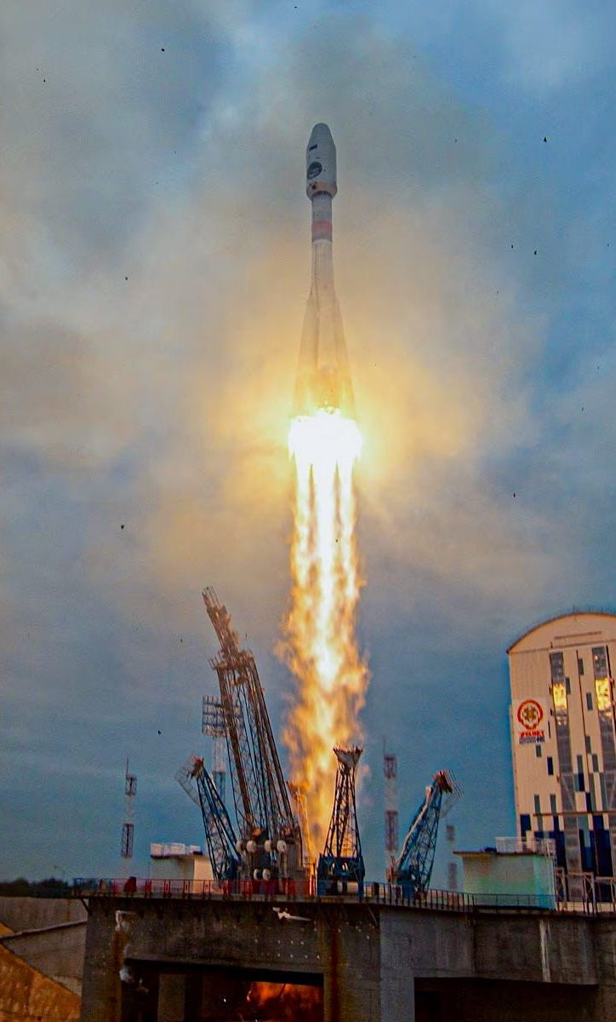
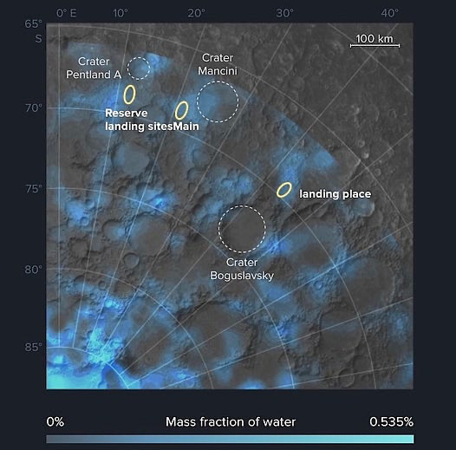
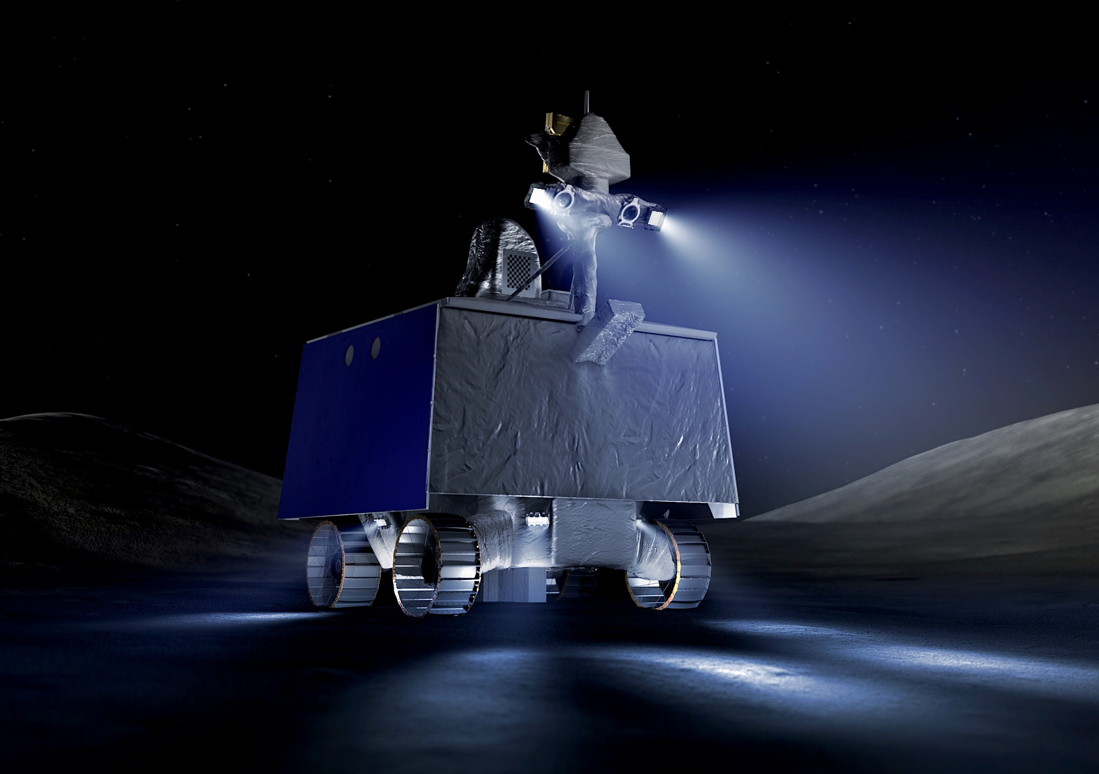
Notable News
Luna 25 – successful launch to the Moon
VIPER passed NASA’s gate review, may now begin building flight hardware
Luna 25 – Planned landing site

Slide 4
Upcoming Meetings
Autonomy Workshop (August 21-22)
  https://lsic.jhuapl.edu/Events/Agenda/index.php?id=474
2023 LSIC Fall Meeting (October 10-11)
  https://lsic.jhuapl.edu/Events/Agenda/index.php?id=464
  Community College of Allegheny County, Pittsburgh, PA & Hybrid
  Abstract deadline Aug 18!
  Registration opening soon.
Transition to Commercial Lunar Operations Workshop (October 12)
  https://lsic.jhuapl.edu/Events/Agenda/index.php?id=478
ASCEND (Oct 23-25)
  Paper/talk acceptance letters sent out, looking forward to seeing many of you there!
DM/EE Joint Workshop (Nov 7)
  Path to Sustainable Technologies in the Lunar Surface Environment
  Registration open! https://lsic.jhuapl.edu/Events/Agenda/index.php?id=481
ISRU FG Meetings moving to third Wednesdays at 11am ET

Slide 5
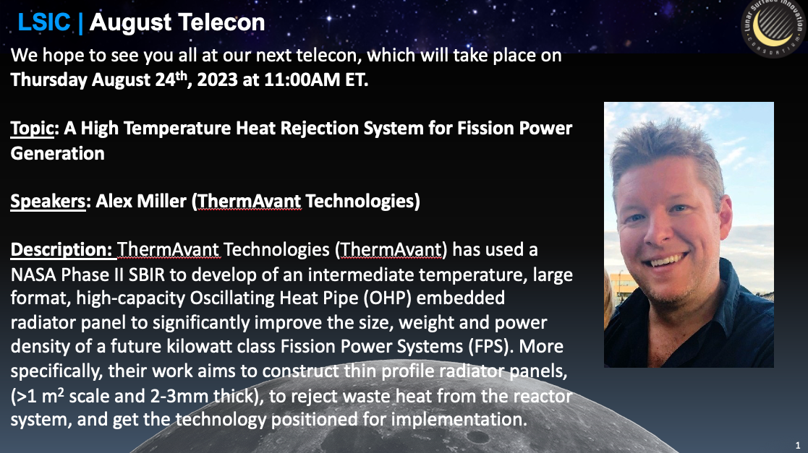

Slide 6


Autonomy Workshop (EA and E&C)
August 21-22, 2023
2 Full Days, Virtual
Tentative Schedule Here: https://lsic.jhuapl.edu/Events/Agenda/index.php?id=474
Registration closed!
Objective: The goal of this workshop is to gather the Lunar community to exchange ideas on autonomy, as well as identify technology gaps and use cases for establishing a sustainable presence on the Moon and Mars.
Day 1:
Morning - Autonomous Systems, Situational and Self Awareness, Reasoning and Acting
Afternoon - Collaborative Systems
Day 2:
Morning - Applications in Autonomy on Lunar Surface - Current Champions (e.g. Autonomous Construction & Assembly)
Afternoon - Challenges in Autonomy (Test & Evaluation, Cybersecurity, Dynamic Reasoning Models, Environmental Considerations)

Slide 7


Slide 8


Slide 9
Announcing DM & EE Joint Workshop!
Path to Sustainable Technologies in the Lunar Surface Environment
  We will focus on the qualification path to fielding long-lived technologies on the lunar surface. Stakeholders across industry, academia, and NASA will come together in a collaborative format to discuss the current state of the art, as well as essential knowledge and technology gaps related to the combined lunar and dust environment.
November 7, 2023
Interactive, Virtual Workshop
Topics
  Existing Standards and Facilities
  Stakeholder Needs
    NASA panel
    Industry & Academia Panel
  Town Hall on Next Steps
  Q&As for all presentations
Registration is now open!
  https://lsic.jhuapl.edu/Events/Agenda/index.php?id=481

Slide 10
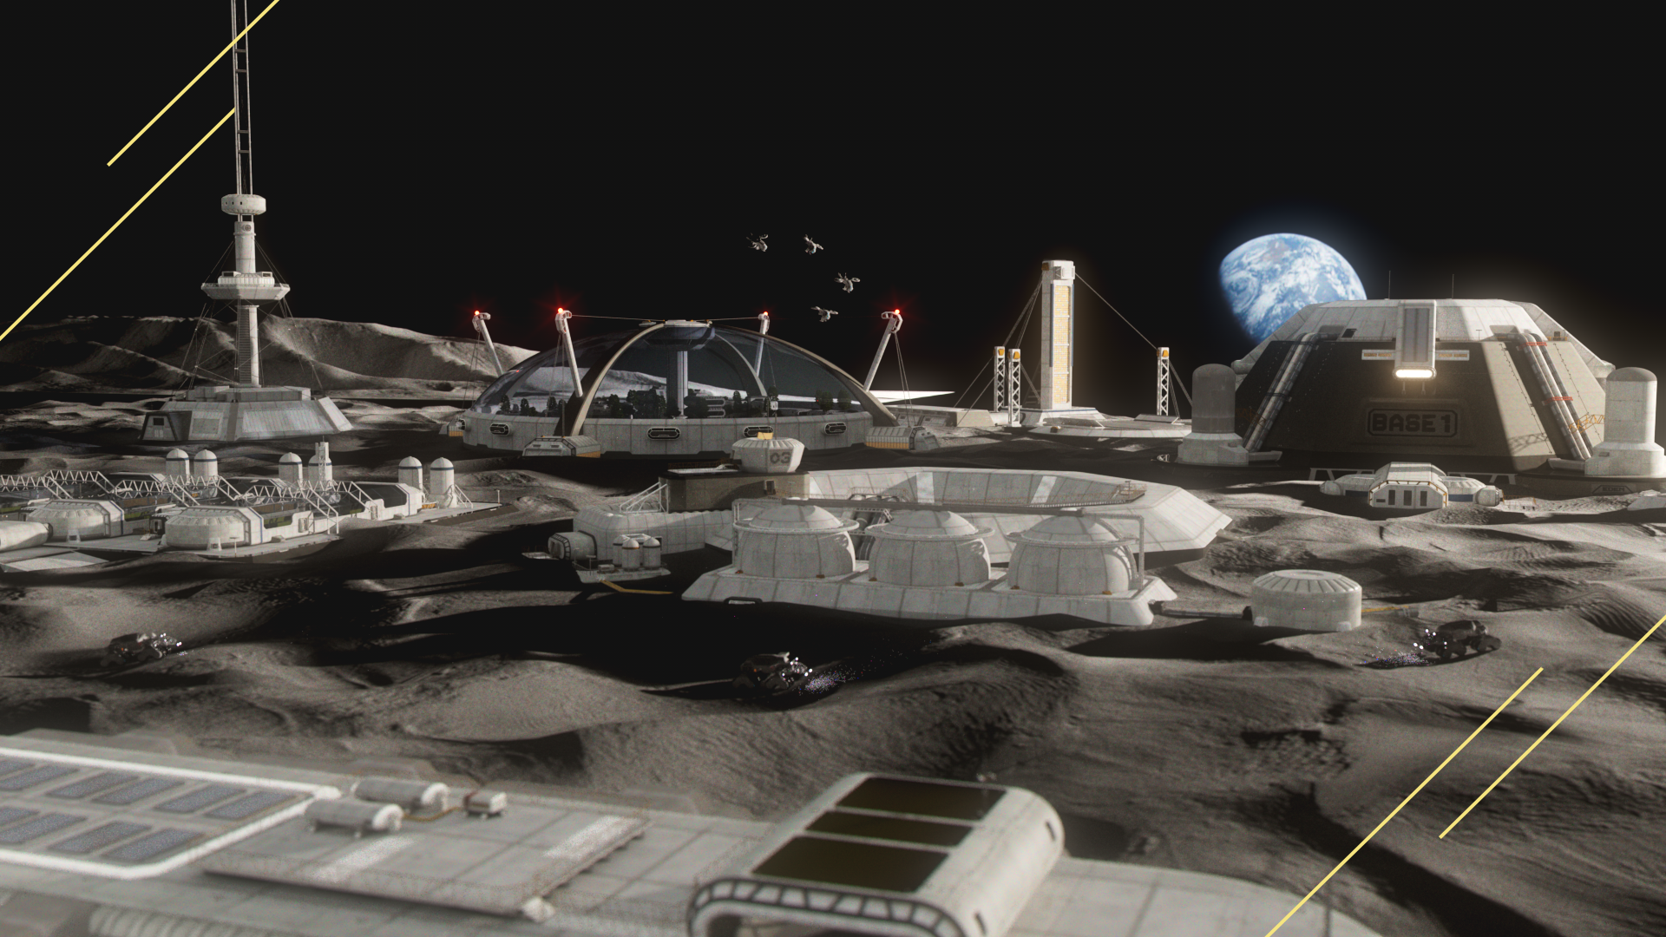
LSIC | Lunar Proving Grounds Definition Workshop, July 12-13th, 2023
The Lunar Surface Innovation Consortium (LSIC) hosted a Lunar Proving Grounds (LPG) Definition Workshop that brought together stakeholders across NASA/Academia/Commercial and more to discuss possible manifestations of an LPG as well as the technical and programmatic needs to achieve system-of-systems testing in pursuit of an enduring Lunar presence.
300+ individuals (100 in-person) attended the meeting over the course of two days in the first LSIC hybrid workshop. Detailed results from the workshop will be presented at ASCEND 2023.
Meeting Content Included panels with extended Q&A, small-group discussions on targeted topics, and preliminary discussions of major insights. The hybrid format was widely-praised and was the top-voted format for future meetings.
Takeaways and Community Feedback:
An LPG should focus on integration, validation, lifecycle testing, and humans-in-the-loop. An LPG is critical for technology needed to enable sustained presence and operational validation.
An LPG should include interoperable infrastructure representative of the operational space.
Deconflicted and coordinated facilities can serve many of the component-level testing in advance of the need for an LPG, while reducing administrative burden and building efficiencies.
Digital engineering tools can meet a sub-set of LPG elements, but there is need to detail the appropriate technologies and environments.
An LPG should have a pathway for international access to facilities, which should be considered during planning.
Notes:
Highlight - fi

Slide 11
Funding Opportunities
RFP for Suborbital/Hosted Orbital Flight and Payload Integration Services proposal due Aug. 28
  Provides space on commercial flights for technology payloads for the Flight Opportunities Program and Small Spacecraft Technology (SST) programs.
  Objective is to fly these payloads aboard platforms that provide high altitude, reduced gravity, or other relevant environments required to test the technologies and advance their readiness.
  https://sam.gov/opp/a665d191eef14ab7966484b9d59584d6/view
NASA 2024 BIG Idea Challenge Notice of Intent due September 20
  Challenge description soon to be announced!
  https://bigidea.nianet.org/
DARPA AO: 10-Year Lunar Architecture (LunA-10) Capability Study due September 25
  https://sam.gov/opp/54586656144548e598d75adea4d129b7/view
NASA REDDI: “TechFlights” full proposal due October 4
  “Topic 1” is of particular interest to the LSIC and ISRU community, as it “addresses demonstration of capabilities that support global lunar utilization leading to commercial commodities and services for a robust lunar economy.”
  https://nspires.nasaprs.com/
https://lsic.jhuapl.edu/Resources/Funding-Opportunities.php

Slide 12
BIG Idea Challenge Awardee (1/7)
Colorado School of Mines
“Lunar Alloy Metal Production Plant (LAMPP)”
Notes:
Colorado School of Mines
“Lunar Alloy Metal Production Plant (LAMPP)”
Massachusetts Institute of Technology with Honeybee Robotics
“Artemis Steelworks: Advancing Reactor Technologies for Electrolytic Manufacturing of In-Situ Steel”
Missouri University of Science and Technology
“Lunar In-Situ Aluminum Production Through Molten Salt Electrolysis (LISAP-MSE)”
Northwestern University with Wearifi, Inc.
“ACRE: Autonomous Casting RovEr”
Pennsylvania State University with RFHIC and Jacobs Space Exploration Group
“Development of the Smelting with Microwave Energy for Lunar Technologies (SMELT) System for In-Situ Resource Processing”
University of North Texas with Advanced Materials and Manufacturing Processes Institute, UNT, Enabled Engineering
“Solid-state Integrated Manufacturing Process for Lunar Environment (SIMPLE)”
University of Utah with Powder Metallurgy Research Laboratory
“Production of Steel from Lunar Regolith through Carbonyl Iron Refining (CIR)”

Slide 13
BIG Idea Challenge Awardee (2/7)
Massachusetts Institute of Technology with Honeybee Robotics
“Artemis Steelworks: Advancing Reactor Technologies for Electrolytic Manufacturing of In-Situ Steel”
Notes:
Colorado School of Mines
“Lunar Alloy Metal Production Plant (LAMPP)”
Massachusetts Institute of Technology with Honeybee Robotics
“Artemis Steelworks: Advancing Reactor Technologies for Electrolytic Manufacturing of In-Situ Steel”
Missouri University of Science and Technology
“Lunar In-Situ Aluminum Production Through Molten Salt Electrolysis (LISAP-MSE)”
Northwestern University with Wearifi, Inc.
“ACRE: Autonomous Casting RovEr”
Pennsylvania State University with RFHIC and Jacobs Space Exploration Group
“Development of the Smelting with Microwave Energy for Lunar Technologies (SMELT) System for In-Situ Resource Processing”
University of North Texas with Advanced Materials and Manufacturing Processes Institute, UNT, Enabled Engineering
“Solid-state Integrated Manufacturing Process for Lunar Environment (SIMPLE)”
University of Utah with Powder Metallurgy Research Laboratory
“Production of Steel from Lunar Regolith through Carbonyl Iron Refining (CIR)”

Slide 14
BIG Idea Challenge Awardee (3/7)
Missouri University of Science and Technology
“Lunar In-Situ Aluminum Production Through Molten Salt Electrolysis (LISAP-MSE)”
Notes:
Colorado School of Mines
“Lunar Alloy Metal Production Plant (LAMPP)”
Massachusetts Institute of Technology with Honeybee Robotics
“Artemis Steelworks: Advancing Reactor Technologies for Electrolytic Manufacturing of In-Situ Steel”
Missouri University of Science and Technology
“Lunar In-Situ Aluminum Production Through Molten Salt Electrolysis (LISAP-MSE)”
Northwestern University with Wearifi, Inc.
“ACRE: Autonomous Casting RovEr”
Pennsylvania State University with RFHIC and Jacobs Space Exploration Group
“Development of the Smelting with Microwave Energy for Lunar Technologies (SMELT) System for In-Situ Resource Processing”
University of North Texas with Advanced Materials and Manufacturing Processes Institute, UNT, Enabled Engineering
“Solid-state Integrated Manufacturing Process for Lunar Environment (SIMPLE)”
University of Utah with Powder Metallurgy Research Laboratory
“Production of Steel from Lunar Regolith through Carbonyl Iron Refining (CIR)”

Slide 15
BIG Idea Challenge Awardee (4/7)
Northwestern University with Wearifi, Inc.
“ACRE: Autonomous Casting RovEr”
Notes:
Colorado School of Mines
“Lunar Alloy Metal Production Plant (LAMPP)”
Massachusetts Institute of Technology with Honeybee Robotics
“Artemis Steelworks: Advancing Reactor Technologies for Electrolytic Manufacturing of In-Situ Steel”
Missouri University of Science and Technology
“Lunar In-Situ Aluminum Production Through Molten Salt Electrolysis (LISAP-MSE)”
Northwestern University with Wearifi, Inc.
“ACRE: Autonomous Casting RovEr”
Pennsylvania State University with RFHIC and Jacobs Space Exploration Group
“Development of the Smelting with Microwave Energy for Lunar Technologies (SMELT) System for In-Situ Resource Processing”
University of North Texas with Advanced Materials and Manufacturing Processes Institute, UNT, Enabled Engineering
“Solid-state Integrated Manufacturing Process for Lunar Environment (SIMPLE)”
University of Utah with Powder Metallurgy Research Laboratory
“Production of Steel from Lunar Regolith through Carbonyl Iron Refining (CIR)”

Slide 16
BIG Idea Challenge Awardee (5/7)
Pennsylvania State University with RFHIC and Jacobs Space Exploration Group
“Development of the Smelting with Microwave Energy for Lunar Technologies (SMELT) System for In-Situ Resource Processing”
Notes:
Colorado School of Mines
“Lunar Alloy Metal Production Plant (LAMPP)”
Massachusetts Institute of Technology with Honeybee Robotics
“Artemis Steelworks: Advancing Reactor Technologies for Electrolytic Manufacturing of In-Situ Steel”
Missouri University of Science and Technology
“Lunar In-Situ Aluminum Production Through Molten Salt Electrolysis (LISAP-MSE)”
Northwestern University with Wearifi, Inc.
“ACRE: Autonomous Casting RovEr”
Pennsylvania State University with RFHIC and Jacobs Space Exploration Group
“Development of the Smelting with Microwave Energy for Lunar Technologies (SMELT) System for In-Situ Resource Processing”
University of North Texas with Advanced Materials and Manufacturing Processes Institute, UNT, Enabled Engineering
“Solid-state Integrated Manufacturing Process for Lunar Environment (SIMPLE)”
University of Utah with Powder Metallurgy Research Laboratory
“Production of Steel from Lunar Regolith through Carbonyl Iron Refining (CIR)”

Slide 17
BIG Idea Challenge Awardee (6/7)
University of North Texas with Advanced Materials and Manufacturing Processes Institute, UNT, Enabled Engineering
“Solid-state Integrated Manufacturing Process for Lunar Environment (SIMPLE)”
Notes:
Colorado School of Mines
“Lunar Alloy Metal Production Plant (LAMPP)”
Massachusetts Institute of Technology with Honeybee Robotics
“Artemis Steelworks: Advancing Reactor Technologies for Electrolytic Manufacturing of In-Situ Steel”
Missouri University of Science and Technology
“Lunar In-Situ Aluminum Production Through Molten Salt Electrolysis (LISAP-MSE)”
Northwestern University with Wearifi, Inc.
“ACRE: Autonomous Casting RovEr”
Pennsylvania State University with RFHIC and Jacobs Space Exploration Group
“Development of the Smelting with Microwave Energy for Lunar Technologies (SMELT) System for In-Situ Resource Processing”
University of North Texas with Advanced Materials and Manufacturing Processes Institute, UNT, Enabled Engineering
“Solid-state Integrated Manufacturing Process for Lunar Environment (SIMPLE)”
University of Utah with Powder Metallurgy Research Laboratory
“Production of Steel from Lunar Regolith through Carbonyl Iron Refining (CIR)”

Slide 18
BIG Idea Challenge Awardee (7/7)
University of Utah with Powder Metallurgy Research Laboratory
“Production of Steel from Lunar Regolith through Carbonyl Iron Refining (CIR)”
Notes:
Colorado School of Mines
“Lunar Alloy Metal Production Plant (LAMPP)”
Massachusetts Institute of Technology with Honeybee Robotics
“Artemis Steelworks: Advancing Reactor Technologies for Electrolytic Manufacturing of In-Situ Steel”
Missouri University of Science and Technology
“Lunar In-Situ Aluminum Production Through Molten Salt Electrolysis (LISAP-MSE)”
Northwestern University with Wearifi, Inc.
“ACRE: Autonomous Casting RovEr”
Pennsylvania State University with RFHIC and Jacobs Space Exploration Group
“Development of the Smelting with Microwave Energy for Lunar Technologies (SMELT) System for In-Situ Resource Processing”
University of North Texas with Advanced Materials and Manufacturing Processes Institute, UNT, Enabled Engineering
“Solid-state Integrated Manufacturing Process for Lunar Environment (SIMPLE)”
University of Utah with Powder Metallurgy Research Laboratory
“Production of Steel from Lunar Regolith through Carbonyl Iron Refining (CIR)”

Slide 19
Topical Discussion
Sarah Withee
JHU/APL
“What You Need to Know About Lunar Communications”
Notes:
LSWG on LSIC public webpage:
https://lsic.jhuapl.edu/Our-Work/Working-Groups/Lunar-Simulants.php
LSWG on LSIC confluence page:
https://lsic-wiki.jhuapl.edu/display/LSWG/Lunar+Simulants+Working+Group+Home
Email Karen to be added to the LSWG List Serve
Karen.Stockstill-Cahill@jhuapl.edu

Slide 20


Coffee & Donuts:
What do you hope we’ll talk about at LPG Definition Workshop?
Notes:
https://forms.gle/tuhzwAUaQLDivQ2D7

