Slide 1

LSIC ISRU Focus Group Monthly http://lsic.jhuapl.edu/ http://lsic-wiki.jhuapl.edu/ (Confluence sign-up required)
November 15, 2023
Dr. Jodi Berdis, Dr. Karl Hibbitts, Dr. Michael Nord, Dr. Rich Miller
Jodi.Berdis@jhuapl.edu, Karl.Hibbitts@jhuapl.edu, Michael.Nord@jhuapl.edu, Richard.S.Miller@jhuapl.edu

Slide 2
Agenda
General updates and house-keeping
  APL is happy to consult as appropriate with ISRU and related technologies. We can provide advice on how to build for launch and operate in extreme environments. This includes site visits!
  Upcoming Meetings
  Funding Opportunities
Kathryn Hadler (ESRIC): “Overview of Activities at the European Space Resources Innovation Centre”
Q&A, Open Discussion, Walk-On Topics

Slide 3
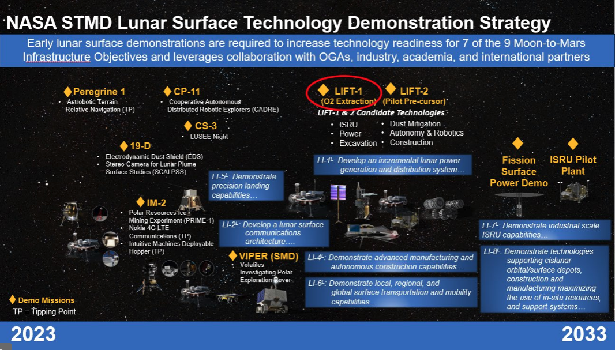
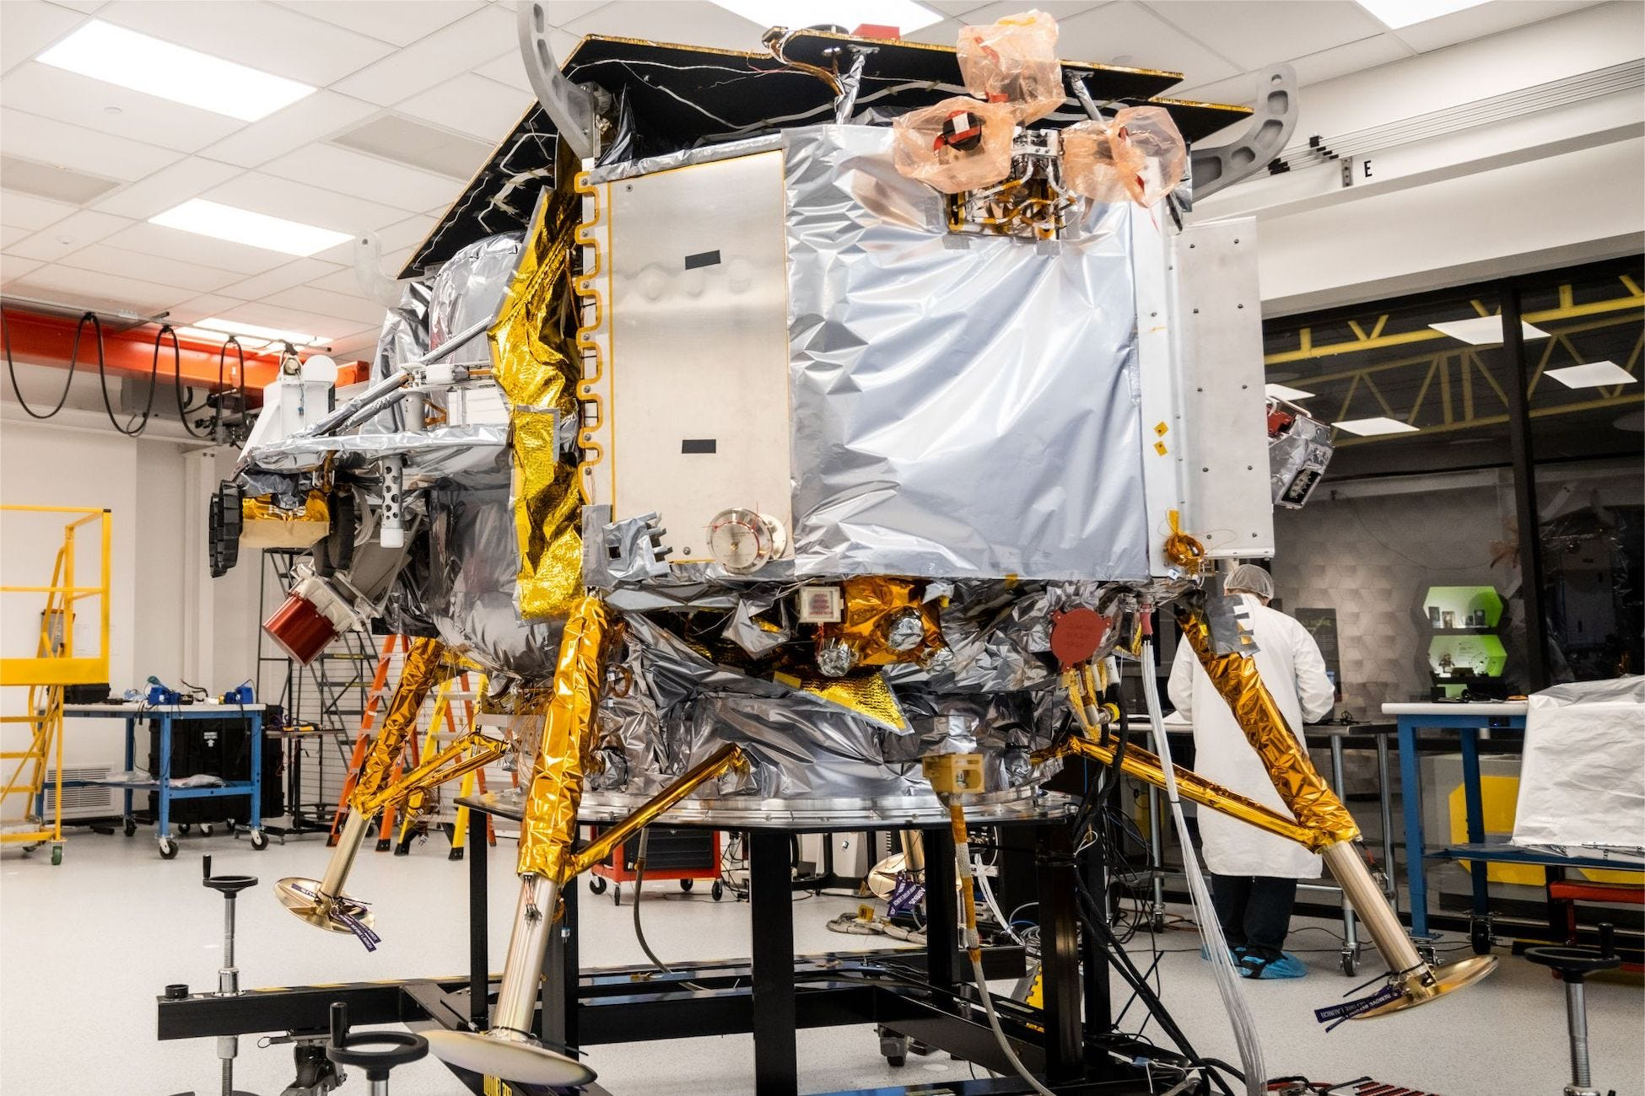

Notable News
LIFT-1 RFI Released!
Launch date for Astrobotic’s Peregrine: December 24!

Slide 4
Upcoming Meetings
2024 LSIC Spring Meeting (Week of April 22, 2024)
  https://lsic.jhuapl.edu/Events/Agenda/index.php?id=465
  JHU/APL Kossiakoff Center, Laurel, MD & Virtual
  Stay tuned for details!
Space Resources Week (March 25-27, 2024)
  https://www.spaceresourcesweek.lu/
  European Convention Center Luxembourg & Virtual
  Abstract submission just closed, registration opening soon.
International Conference on Environmental Systems (ICES) (July 21-25, 2024)
  https://www.ices.space/call-for-paper-2024/
  Sessions include: “Advanced Technologies for In-Situ Resource Utilization”, “Space Architecture”, “Planetary and Spacecraft Dust Properties and Mitigation Technologies”, “Human/Robotics System Integration”
  Abstract deadline November 20
ISRU FG Meetings moving to third Wednesdays at 11am ET

Slide 5
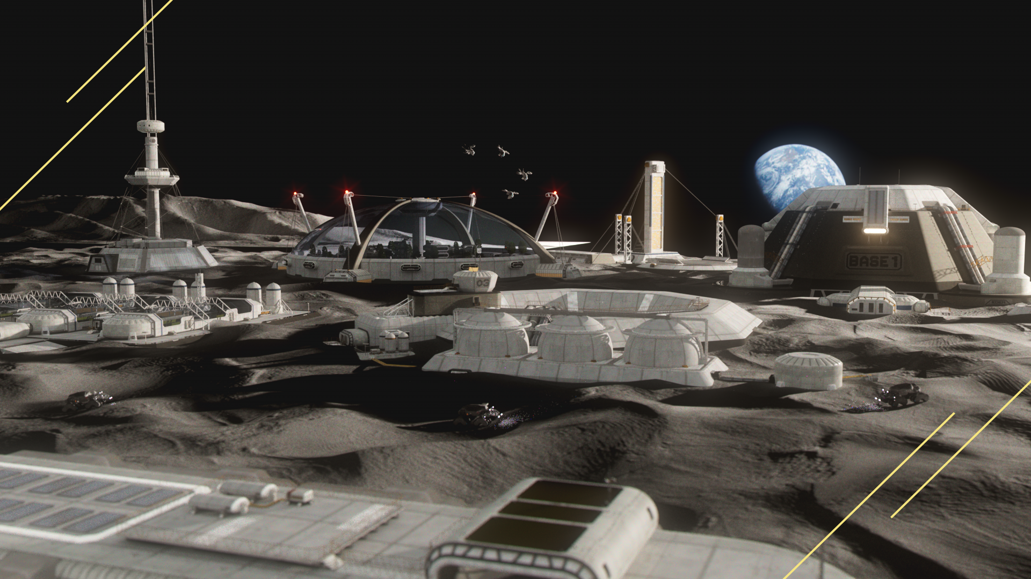
LSIC | 2023 Fall Meeting
The Lunar Surface Innovation Consortium (LSIC) held their biannual Fall Meeting from Oct. 10-11, 2023, at the Community College of Allegany County (CCAC) in Pittsburgh, PA. The meeting was themed on autonomy/robotic needs for sustained lunar presence, content included plenary talks, panels, breakouts, networking opportunities, and tour of Carnegie Mellon University labs and mission operations spaces that support IRIS and Moon Ranger rovers. A reception was hosted by partners Moonshot Museum, Astrobotic, and Keystone Space Collaborative.
Announcements:
NASA announcement of an RFI for a technology-forward ISRU demonstration, LIFT-1 (Lunar Infrastructure Foundational Technology)
DARPA announcement of the LunA-10 winners, as well as a new effort on interoperability, LOGIC (Lunar Operating Guidelines for Interoperability Consortium)
Breakout Takeaways Feedback Highlights:
Supply Chains - Consider the development of a supply chain for repair and maintenance, recognizing the need for towing services, repair shops, and a strategic approach for old equipment, including recycling and the use of in-situ materials
Embrace automation and autonomous AI development for building lunar infrastructure while understanding and defining the roles and tasks for humans, machines, and human-machine teams. Address the significant technological, organizational, and cultural dimensions involved
We learn from failure. Information about failures should be shared across all participants in the lunar economy. It may be a challenge for all vendors/companies to agree to this
Take-Aways:
Community appreciated candid remarks/discussion
Questions remain on coordination and continued growth of LSIC in respect to LOGIC
Calls for LIFT-1 follow-on details (through slido and in person conversation)
Continued calls for more networking (formal and informal)
Attendees:
236 In-person
289 Webinar Day 1
230 Webinar Day 2
900+ YouTube
Registrants:
280 In-person
561 virtual

Slide 6
LSIC | 2023 Transition to Commercial Lunar Operations Workshop
In collaboration with several NASA stakeholders and Prof. Clive Neal from Notre Dame, an “add-on” workshop to the LSIC Fall Meeting offered an opportunity for commercial partners to come together and discuss with key stakeholders on issues regarding their participation in developing and operating infrastructure in the cislunar ecosystem.
Data-buy pathfinders include sharing of environmental data, data that supports underwriters, insurers, etc., and resource prospecting through data-buys
Data value is easily lost and value needs subsidies/support beyond just industry interest
Public perception remains an essential factor for success (a shared need across stakeholders)
More calls for specifics on landings/operation sites, “infrastructure is not location agnostic”
Commercial desires continued movement towards capabilities/services, “Missions to Markets”
  Commercial services need missions for which they are critical-path
Calls for LIFT-1 to be followed by an evolvable acquisition model, more details on future plans, emphasis on programmatic continuity, and potential for re-use of assets
Commercial-enabling ideas: Tolled landing pad, strategic reserves, data-buys via prospecting
On-going questions on how to align communities. Other OGAs to engage includes Dept. Commerce, DOE, State Department, NOAA, USGS, etc., especially for terrestrial understanding
Registrants:
219 In-person
460 virtual
Attendees:
115+ In-person
128 Webinar
“The virtual breakout sessions for the T2CLO workshop were the best and most active sessions I’ve participated in so far at an LSIC event”
Community greatly appreciated STMD’s support of commercial onramps and the unique experiences afforded by LSIC events. Continue efforts to encourage buy-in beyond STMD and commitment to longer-term industry involvement.
Notes:
Highlight - fi

Slide 7
Funding Opportunities
NASA STMD RFI for LIFT-1 ISRU Demonstration due December 18
  https://www.nasa.gov/directorates/stmd/nasa-lift-1-request-for-information/
  https://nspires.nasaprs.com/external/solicitations/summary.do?solId=%7b23D0FE0E-099D-77A8-3E06-2C516D900762%7d&path=&method=init
NASA 2024 BIG Idea Challenge proposals due February 1
  https://bigidea.nianet.org/
  Theme: Inflatable Systems for Lunar Operations
https://lsic.jhuapl.edu/Resources/Funding-Opportunities.php
https://lsic.jhuapl.edu/Resources/Opportunities.php?f=Job

Slide 8
NASA BIG Idea Challenge Final Presentations
(Context: The ISRU FG hosted the 7 winners of the 2023 challenge in August for an extended telecon)
Tune in to NASA’s BIG Idea Challenge final presentations, where 7 collegiate teams share their designs for various components of a metal pipeline on the Moon – from extracting metal from lunar minerals to creating structure and tools.
Nov. 16th, 8:30 – 4:05 PM ET
https://livestream.com/viewnow/bigideachallenge
The teams’ digital posters will be viewable beginning November 14 on the BIG Idea Challenge website: https://bigidea.nianet.org/2023-forum-results/

Slide 9
Topical Discussion
Kathryn Hadler
ESRIC
“Overview of Activities at the European Space Resources Innovation Centre”
Notes:
LSWG on LSIC public webpage:
https://lsic.jhuapl.edu/Our-Work/Working-Groups/Lunar-Simulants.php
LSWG on LSIC confluence page:
https://lsic-wiki.jhuapl.edu/display/LSWG/Lunar+Simulants+Working+Group+Home
Email Karen to be added to the LSWG List Serve
Karen.Stockstill-Cahill@jhuapl.edu

Slide 10


Open Discussion and Walk-On Topics
Notes:
https://forms.gle/tuhzwAUaQLDivQ2D7

