Slide 1

LSIC ISRU Focus Group Monthly http://lsic.jhuapl.edu/ http://lsic-wiki.jhuapl.edu/ (Confluence sign-up required)
February 21, 2024
Dr. Jodi Berdis, Dr. Karl Hibbitts, Dr. Michael Nord, Dr. Rich Miller, Anthony Coburger
Jodi.Berdis@jhuapl.edu, Karl.Hibbitts@jhuapl.edu, Michael.Nord@jhuapl.edu, Richard.S.Miller@jhuapl.edu
Anthony.Coburger@jhuapl.edu

Slide 2
Agenda
General updates and house-keeping
  APL is happy to consult as appropriate with ISRU and related technologies. This includes site visits!
  Upcoming Meetings
  Funding Opportunities
Results from the ISRU End-Of-Year-2023 Survey
Path Forward for ISRU: Addressing Gaps
Open Discussion: Gap Prioritization

Slide 3
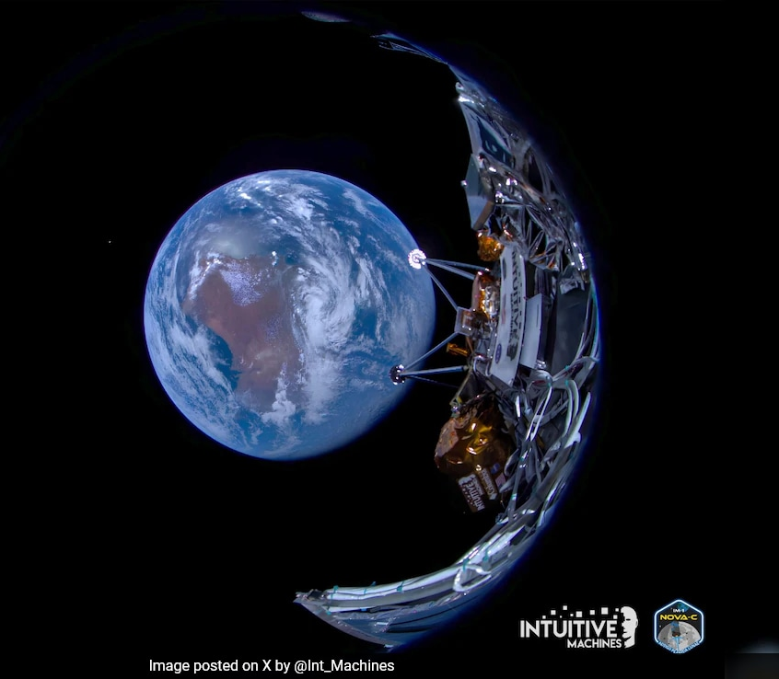
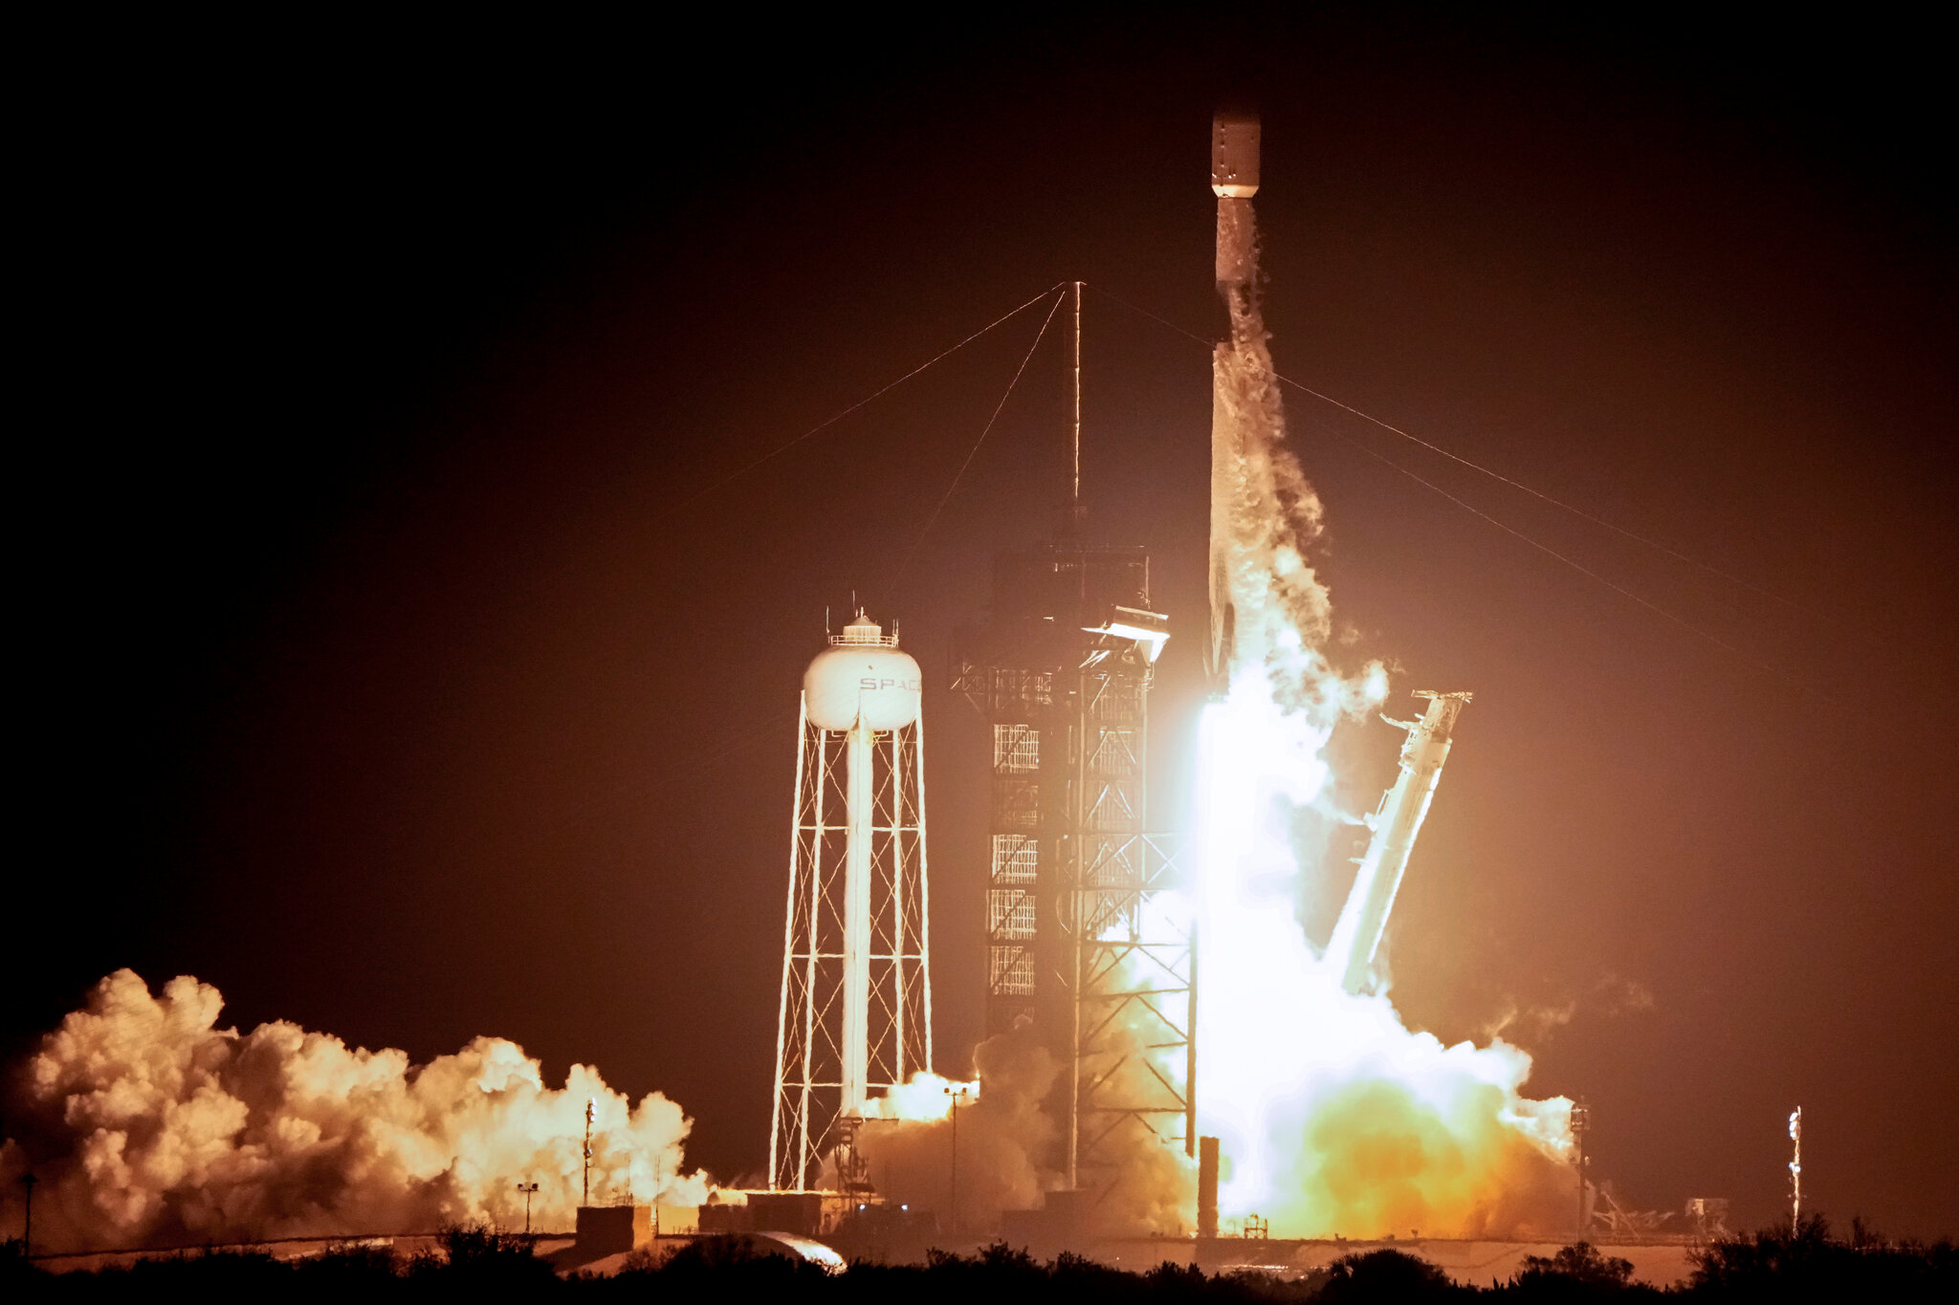
Notable News
Intuitive Machines IM-1 Odysseus successful launch!
(Could be the first private company ever to land, and also the first American lander since Apollo)

Slide 4
Upcoming Meetings
Space Resources Week (March 25-27)
  https://www.spaceresourcesweek.lu/
  European Convention Center Luxembourg & Virtual
2024 LSIC Spring Meeting (April 23-25)
  https://lsic.jhuapl.edu/Events/Agenda/index.php?id=465
  JHU/APL Kossiakoff Center, Laurel, MD & Virtual
  Registration and abstract portal are open!
Space Resources Roundtable (June 4-7)
  https://learn.mines.edu/srr/
  Registration is open!
  Abstracts due March 15
International Conference on Environmental Systems (ICES) (July 21-25)
  https://www.ices.space/call-for-paper-2024/
  Sessions include: “Advanced Technologies for In-Situ Resource Utilization”, “Space Architecture”, “Planetary and Spacecraft Dust Properties and Mitigation Technologies”, “Human/Robotics System Integration”
ISRU FG Meetings moving to third Wednesdays at 11am ET

Slide 5


Slide 6
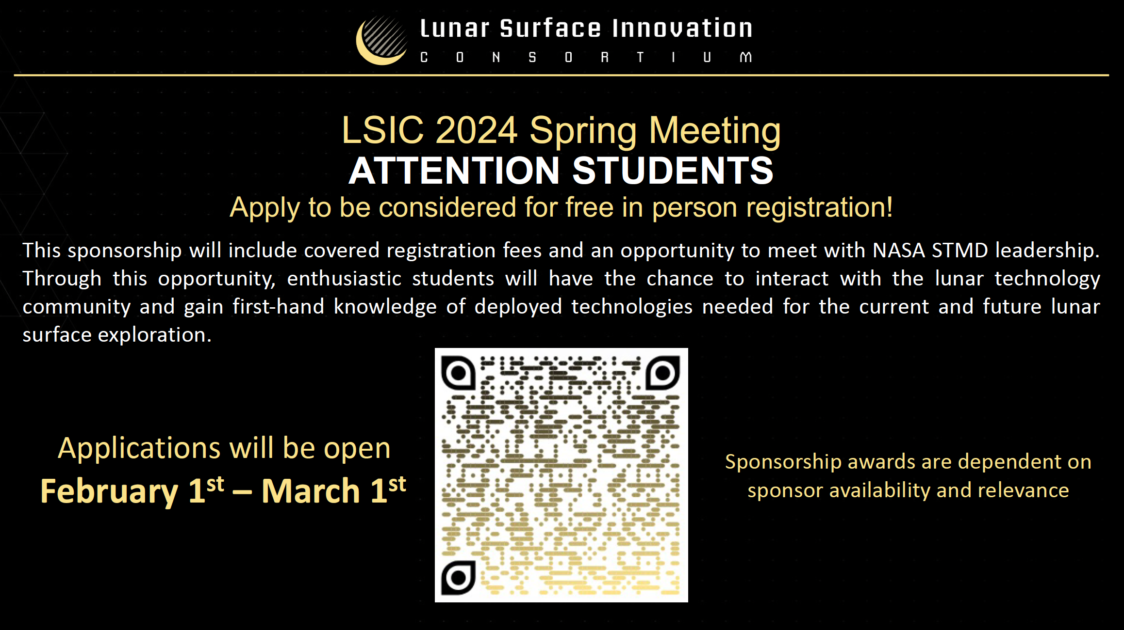

Slide 7
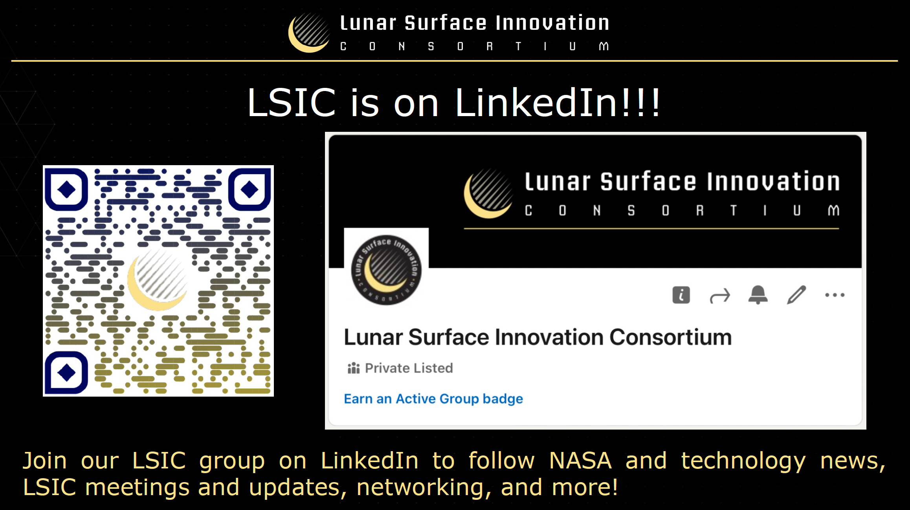

Slide 8
Funding/Employment Opportunities
NASA Small Business Innovation Research (SBIR) & Small Business Technology Transfer (STTR) Program Phase I proposals due March 11
  https://sbir.nasa.gov/solicitations
https://lsic.jhuapl.edu/Resources/Funding-Opportunities.php
https://lsic.jhuapl.edu/Resources/Opportunities.php?f=Job
Notes:
https://lsic.jhuapl.edu/Resources/Funding-Opportunities.php
https://lsic.jhuapl.edu/Resources/Opportunities.php?f=Job

Slide 9
LSIC Organization Change Overview
Danielle Mortensen

Slide 10
History and Context
History
When LSIC started there was no Moon2Mars, Envisioned Futures and Priorities, etc.
Now LSIC includes:
  Nation-wide, agency, and STMD clarity on exploration plans
  Large and eager/engaged community
  Understanding of community needs based on 3 years of feedback
  More connections to outside stakeholders
Motivation for Changes
Remap to the needs that have developed
Meet community needs with efficiency
Facilitate sustainable growth
Bolster crosscutting needs and discussions

Slide 11
Current LSIC Organization
6 Focus Areas
+
2 Working Groups
+
32 Subgroups
Excavation & Construction
Surface Power
Dust Mitigation
Extreme Access
Extreme Environments
In-Situ Resource Utilization
Interoperability
Lunar Simulants
Working Groups

Slide 12
New LSIC Structure
4 Focus Groups
Excavation & Construction
Surface Power
Crosscutting Capabilities
In-Situ Resource Utilization
Notes:
We are all aligned in similar activities, but CT will start to look into discussion on supporting the technologies of the other groups.

Slide 13
In Summary…
Merging into one Crosscutting Capabilities area:
Lunar Infrastructure Foundational Technologies Focus Areas Remain:
Allowing us to:
Extreme Environments
Dust Mitigation
Extreme Access, Autonomy & Robotics
Lunar Simulants
In-Situ Resource Utilization (ISRU)
Excavation & Construction
Surface Power
Engaging the needs of the community
Interoperability (formerly MOSA)
Emphasizing interoperability
Cross-collaboration
Discussing specific use cases
Enable systems discussions across the board
21 February 2024
13

Slide 14
LSIC Reorganization: Implications for ISRU
While the ISRU Focus Group structure should be largely unaffected by the re-org, we can benefit immensely from it!
This re-org re-emphasizes the need for system-level integration and cross-FG communications.
  The ISRU Focus Group will ramp-up efforts of cross-FG work, and focus more heavily on systems-level thinking/discussions this year.
We have already started working closely with the Crosscutting Capabilities Focus Group to plan our March telecon (and will host another joint-telecon with them in July).
We highly recommend ISRU folks sign up for the CC listserv and attend their telecons, as the information they share is invaluable to the success of ISRU technologies.

Slide 15
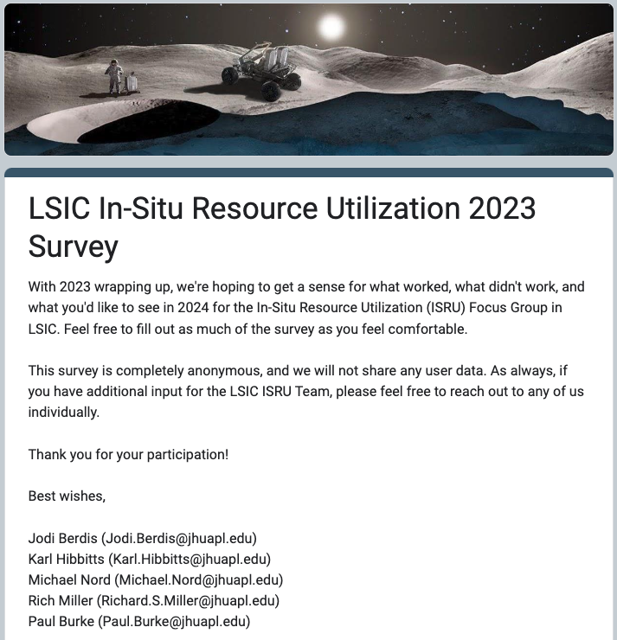
ISRU End-Of-Year Survey
A brief look at the highlights…

Slide 16
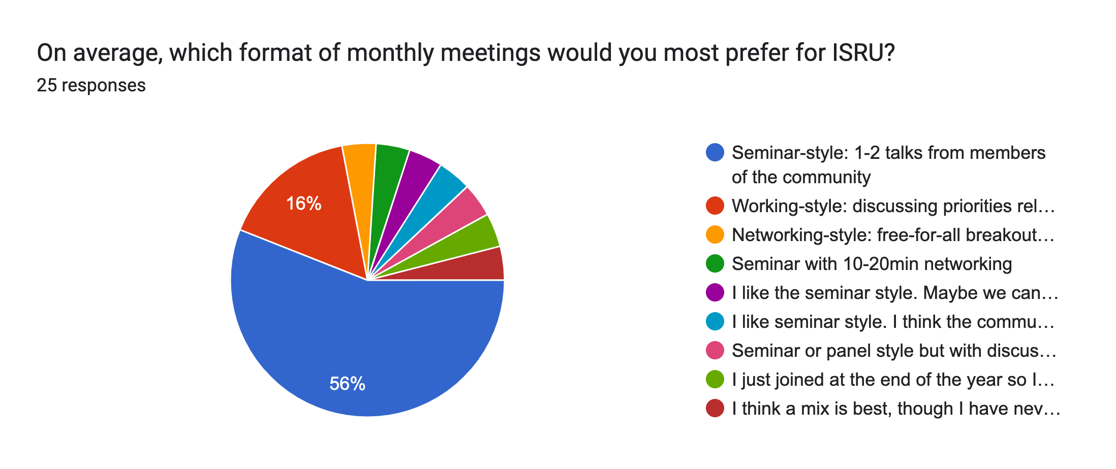
Survey: Meeting Style
A majority of respondents like the seminar style, and many are interested in working-style meetings with plenty of time for networking.

Slide 17
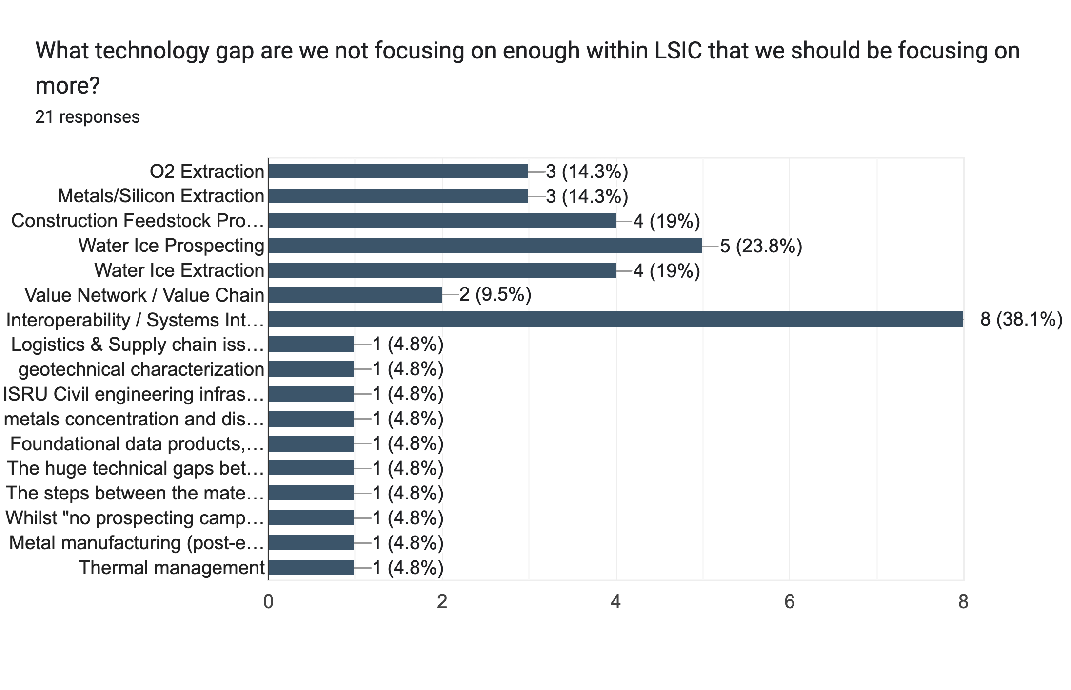
Survey: Tech Gap Focus
Interoperability and Systems Integration likely need more emphasis this year.

Slide 18
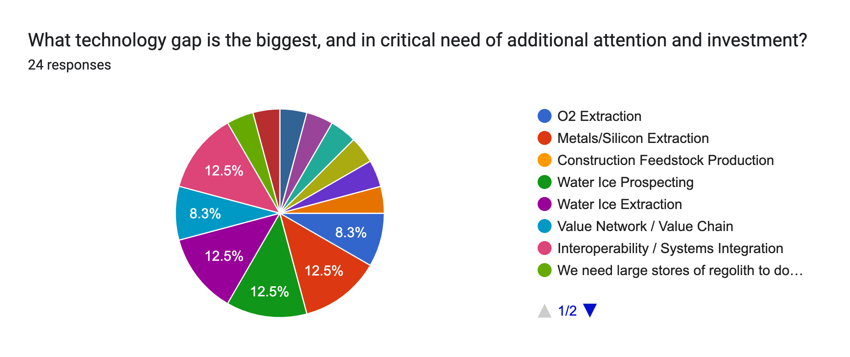
Survey: Tech Gap Focus
All of ISRU is important! :D

Slide 19
Survey Results Continued
Is there a technology gap (or a gap within the gaps) that NASA is missing?
Sustainable lunar food systems
Need for city planning
Prioritizing the currently identified gaps
There are no impartial, validated, and permanently, centrally curated foundational data products for the Moon when it comes to ISRU
Actionable international cooperation/interoperability
Lunar dust mitigation
Technical gaps between making ISRU materials and actually using them for structures
Assessing the nature of regolith with entrained water ice, in particular hardness
Structural assessment of the material behavior and its use for structural designs
Aligning resource characterization (multi-hyper-physical remote sensing) with metal/ alloys processing indicators
Consider lunar and Martian simulants / proving grounds / terrestrial analogues
Real world data on thermal conditions at the Lunar poles and in craters
Use of biology and the role of biology in these systems
Gap prioritization needed (master planning, foundational data products, international interoperability, ISRU system-of-systems gaps, thermal conditions, biology (food, microbes, etc.))
Notes:
Is there a technology gap (or a gap within the gaps) that NASA is missing? Please explain!

Slide 20
Survey Results Continued
What topics from the ISRU Focus Group would you find valuable to support O₂fR goals & objectives?
All of the topics can contribute to oxygen production
Virtually all - they all tie into lunar oxygen production and infrastructure development.
See above.
Understanding how ISRU Missions support focus groups beyond o2 extraction
Figuring out where things are; resource distribution as a key initial step to do any meaningful engineering.
Without foundational data products, there are significant risks associated with O2fR activities.
What infrastructure will be available for supporting the lunar activities.
Interoperability, metals extraction and processing, greater local resource heterogeneity characterization using remote sensing methods.
Thermal control
More focus on integrated infrastructure to support ISRU and less about specific tech. Want to create opportunities for many ISRU tech
resource extraction
Resource distribution, foundational data products, interoperability (integrated infrastructure), resource characterization.

Slide 21
Path Forward from the Survey
As a result of these survey results, we intend to substitute in several “working” monthly meetings intermixed throughout the traditional seminar monthly meetings dedicated to addressing open technical and knowledge gaps in ISRU, especially system-level gaps.
(Plus a meeting in the summer dedicated to networking, featuring lightning talks from you, members of the community. More to come on this ☺ )
We are considering options such as a public white paper, to include inputs from the community, outlining a concrete path toward overcoming/closing these system-level gaps. Is this something you all would be interested in?
So … How do we identify and prioritize these gaps?

Slide 22
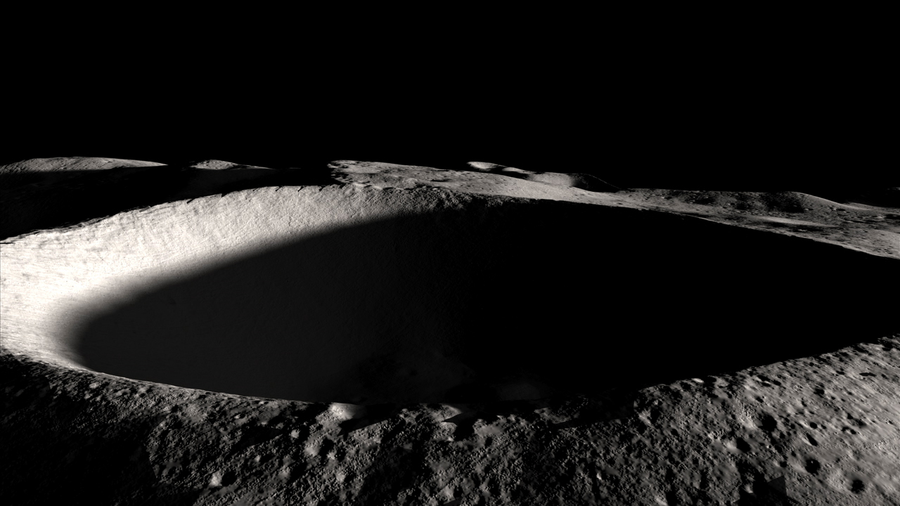
Technology Projects for Oxygen Extraction ISRU Pilot Plant
(Technology Categories)
Excavation & Delivery
Hoppers and Transfer Mechanisms
Regolith Processing to Produce and Remove Oxygen & Optionally Metal
O₂ Conditioning
Liquefaction
Zero-boiloff Storage
Lunar Presence
Power Source
Scooping, shoveling, drilling, etc.
Conveyers, buckets, etc.
Drying, Purifying, Characterizing, Cooling, etc.
Compressing, Heat rejection, etc.
Reactant Regeneration
Capturing
the O₂
Tapping
the Metal
Removing Waste
Etc.

Slide 23
2024 ISRU Monthly Telecons
Meetings will still take place every third Wednesday at 11am ET
  This change has already seen in increase in participation from our international colleagues, and we’re excited that they’re able to join us and be a part of the conversation
Meetings will still last an hour (we’ll try to keep on time as best we can, no worries if you need to leave to head to other things!)
We’ll still have some Seminar-style meetings, as these have always been widely well-received. These are great resources for the community, both for those listening and learning, and for those presenting and sharing their work.
We’ll begin incorporating more discussions and “Working-style” meetings, including break-out rooms to have deep dive conversations, and potentially also off-cycle conversations through Confluence to continue working.
We’ll have more panels, and more encouraged interactions between speakers and audience.
We highly encourage you all to turn your cameras on and unmute your mics whenever possible, these meetings are for YOU!
(We plan to survey your feedback in ~3 months to check-in on how these meetings are going and if any improvements to format can be made.)

Slide 24
DRAFT ISRU Schedule 2024
Month | Style | Topic | Speaker(s) | Notes
January | Seminar (Joint) | Lunar South Pole Landing Site Selection | Giovanni Leone (U of Atacama), Ebrahim Mohammadi & Theodore Lincoln (Astrobotic), Luis Carrio (Lockheed Martin) | Joint hosting with Surface Power
February | Seminar/ Working | ISRU 2024 Game Plan: defining/prioritizing gaps / interface challenges. O2/Metals extraction/processing uncertainties and unknowns | Karl Hibbitts & Jodi Berdis (JHU/APL)
March | Panel | Gap: Mechanisms and mobility components for long-duration operations with abrasive regolith in lunar environmental conditions | TBD | Joint hosting with Crosscutting Capabilities
April | Seminar | Talk Title: Iterative development of PSR-access & regolith-processing hardware Additional talk by: TBD | David Aden (StarPath)
May | Working | Gap: Mineral separation/beneficiation methods for long term ISRU operations | TBD | Short talk by guest speaker, then working meeting.
June | Lightning Talks | One-slide each, one-minute each, sign up in advance | Community Members | Requested by community in year-end survey
July | Panel | Gap: Excavation of granular (surface) regolith material for ISRU consumables production | TBD | Joint hosting with Crosscutting Capabilities and Excavation & Construction
August | Working | Gap: Regolith tolerant valves for high temperatures | TBD | Short talk by guest speaker, then working meeting.
September | None | Canceled for Proposed ISRU Workshop: O₂ Pilot Plant Path Forward | --
October | Seminar | Gap: Cryogenic propellant storage / In-situ cryogenic fluid liquefaction | TBD
November | Working | Gap: TBD | TBD | Short talk by guest speaker, then working meeting.
December | Networking | Themed break-out groups for collaborating and networking | Community Members | Requested by community in year-end survey
Draft topics in consideration, subject to change. Any feedback?
** Communications will be sent out ~week in advance about topics and discussion points, to allow time to think on them and prepare if necessary.
Notes:
Ask them for ideas on themes and topics not to specific systems, but interfaces, the in-betweens.
Ask for suggested speakers for each.

Slide 25



Open Discussion: Thoughts on Monthly Meeting Structure
https://forms.gle/gZxGPxArwJHWFZ2C9
ISRU End-Of-Year Survey
Seminar-style: 1-2 talks from members of the community
Working-style: discussing priorities relevant to a specific gap, and trying to determine a path to closing that gap
Networking-style: free-for-all breakout rooms to network and collaborate
Notes:
Seminar-style: 1-2 talks from members of the community
Working-style: discussing priorities relevant to a specific gap, and trying to determine a path to closing that gap
Networking-style: free-for-all breakout rooms to network and collaborate

Slide 26
Topical Discussion
Vlada Stamenković
Blue Origin
“Space Resources at Blue Origin”
Notes:
LSWG on LSIC public webpage:
https://lsic.jhuapl.edu/Our-Work/Working-Groups/Lunar-Simulants.php
LSWG on LSIC confluence page:
https://lsic-wiki.jhuapl.edu/display/LSWG/Lunar+Simulants+Working+Group+Home
Email Karen to be added to the LSWG List Serve
Karen.Stockstill-Cahill@jhuapl.edu

