Slide 1

LSIC ISRU/CC
Focus Group Monthly http://lsic.jhuapl.edu/ http://lsic-wiki.jhuapl.edu/ (Confluence sign-up required)
March 20, 2024
ISRU: Jodi Berdis, Karl Hibbitts, Michael Nord, Rick Miller, Anthony Coburger
CC: Lindsey Tolis, Danielle Mortensen, Angela Stickle, Milena Graziano, Mario Lento
Jodi.Berdis@jhuapl.edu, Karl.Hibbitts@jhuapl.edu
Lindsey.Tolis@jhuapl.edu, Danielle.Mortensen@jhuapl.edu

Slide 2
Agenda
General updates and house-keeping
  APL is happy to consult as appropriate with ISRU and CC related technologies. This includes site visits!
  Upcoming Meetings
  Funding Opportunities
Panel: “Finding, Excavating, and Moving Regolith for ISRU Use”
  Michelle Keegan (AROSE)
  Micah Schaible (Georgia Institute of Technology)
  Terry Fong (NASA Ames)
  Melissa Roth (Off Planet Research)
Open Discussion with Community
  Bring your questions and ideas! Much of this meeting is reserved for audience Q&A and open discussion.

Slide 3
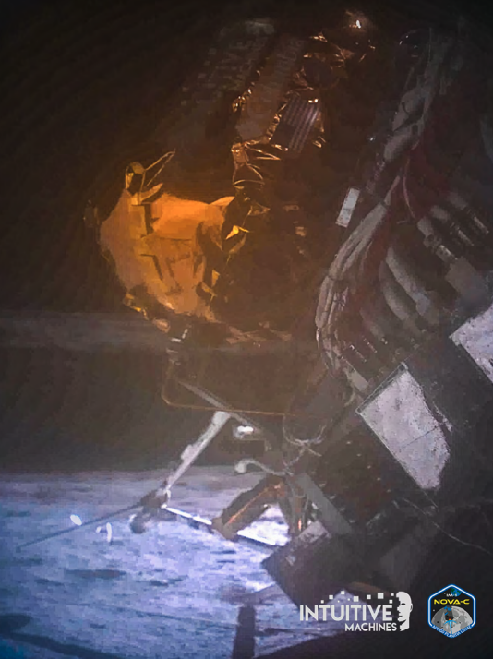
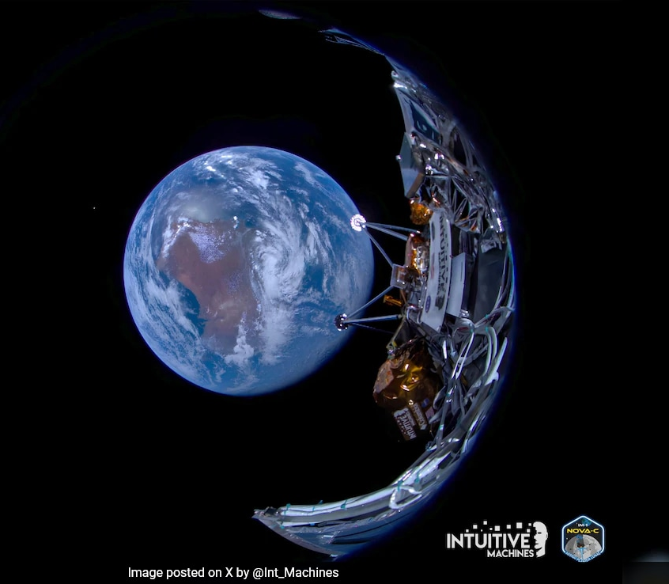
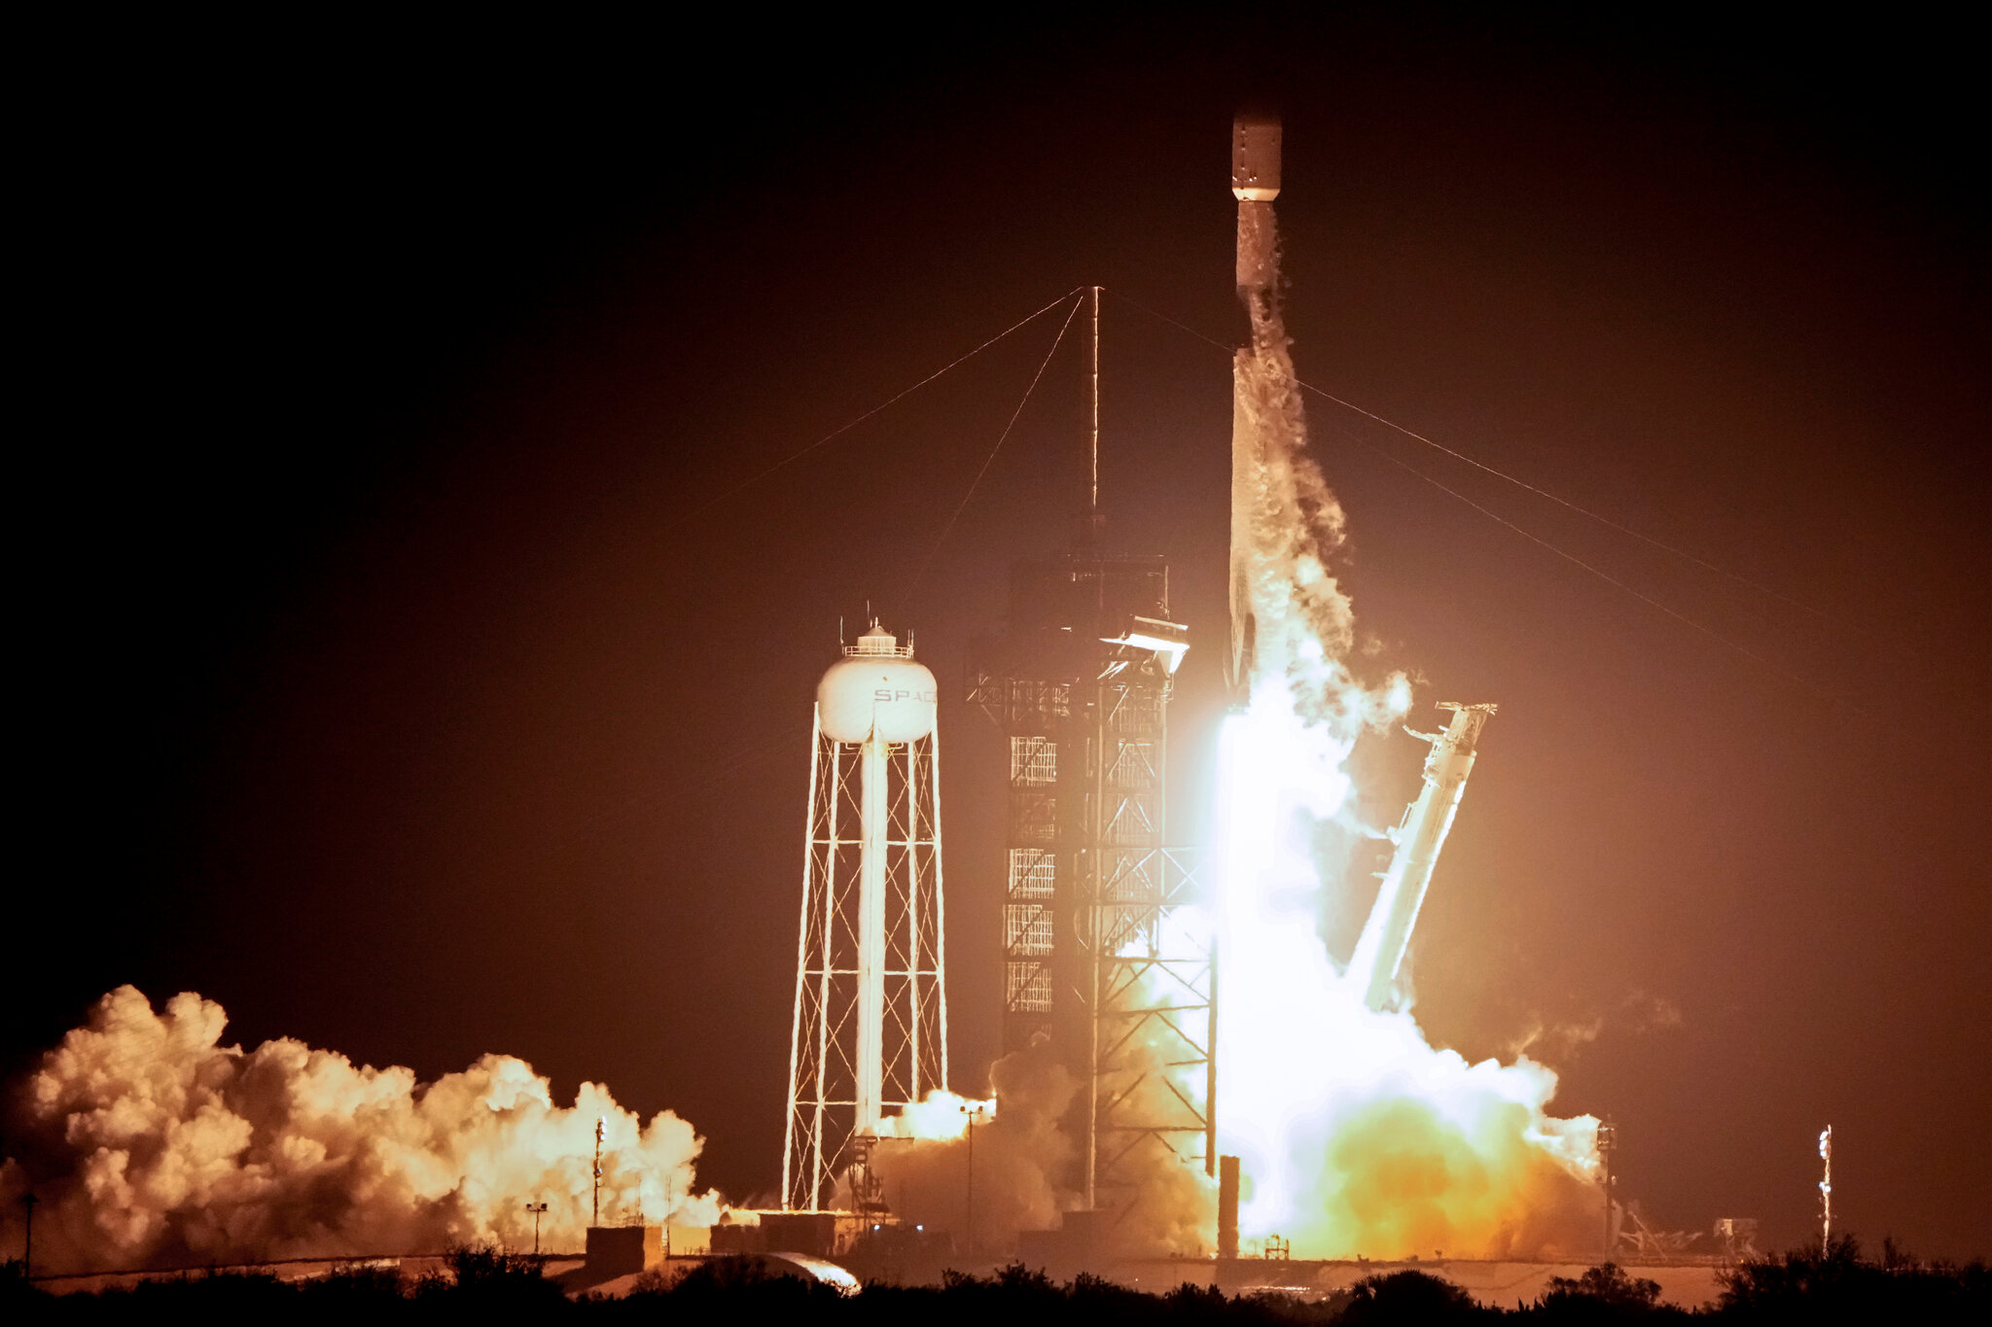
Notable News
Intuitive Machines IM-1 Odysseus successful landing!
(First private company ever to land, and also the
first US lander since Apollo)

Slide 4
Upcoming Meetings
Space Resources Week (March 25-27)
  https://www.spaceresourcesweek.lu/
  European Convention Center Luxembourg & Virtual
2024 LSIC Spring Meeting (April 23-25)
  https://lsic.jhuapl.edu/Events/Agenda/index.php?id=465
  JHU/APL Kossiakoff Center, Laurel, MD & Virtual
  Registration closes April 7!
Space Resources Roundtable (June 4-7)
  https://learn.mines.edu/srr/
  Registration is open!
  Abstracts deadline extended! Due March 22!
International Conference on Environmental Systems (ICES) (July 21-25)
  https://www.ices.space/call-for-paper-2024/
  Sessions include: “Advanced Technologies for In-Situ Resource Utilization”, “Space Architecture”, “Planetary and Spacecraft Dust Properties and Mitigation Technologies”, “Human/Robotics System Integration”
ISRU FG Meetings moving to third Wednesdays at 11am ET

Slide 5


Slide 6


Slide 7



Crosscutting Capabilities Schedule Look-Ahead!
April 23rd – 25th
Spring Meeting
May 29th
2:00PM ET
Joint telecon with E&C
Topic: Lunar Community Master Plan
June 27th
11:00 am ET
Joint telecon with Surface Power

Slide 8

Crosscutting Capabilities Logistical Information
How to Contact us!
Facilitator_Crosscutting@jhuapl.edu
Crosscutting Capabilities Confluence Wiki
Website
https://lsic.jhuapl.edu/Our-Work/Focus-Areas/index.php?fg=Crosscutting%20Capabilities
Confluence
https://lsic-wiki.jhuapl.edu/pages/viewpage.action?spaceKey=CC&title=Crosscutting+Capabilities+Home
Email listserv
https://lsic.jhuapl.edu/News/Sign-Up.php
Update your registration if you change organizations!
Need Confluence Access?
lsic-wiki-admins@listserv.jhuapl.edu

Slide 9
Funding/Employment Opportunities
NASA 2024 Minority University Research Education Project (MUREP) Partnership Learning Annual Notification (MPLAN): Deadline April 15
  https://www.herox.com/NASAMPLAN
  MPLAN Awards provide resources to MSIs to further develop ideas, facilitate research and development, and engage stakeholders
ROSES 2024: F.21 Economic, Social, and Policy Analyses of Lunar Surface Sustainability: Deadline May 17
  https://nspires.nasaprs.com/external/solicitations/summary.do?solId=%7b48D6B21B-0171-D79D-E111-BCDFCC02E0F0%7d&path=&method=init
  Solicitation for proposals to evaluate the economic, social, and political elements of lunar surface sustainability
SBIRs and STTRs
  Open SBIRs and STTRs can be found here: https://www.sbir.gov/solicitations/open
https://lsic.jhuapl.edu/Resources/Funding-Opportunities.php
https://lsic.jhuapl.edu/Resources/Funding-Opportunities.php
Notes:
https://lsic.jhuapl.edu/Resources/Funding-Opportunities.php
https://lsic.jhuapl.edu/Resources/Opportunities.php?f=Job

Slide 10
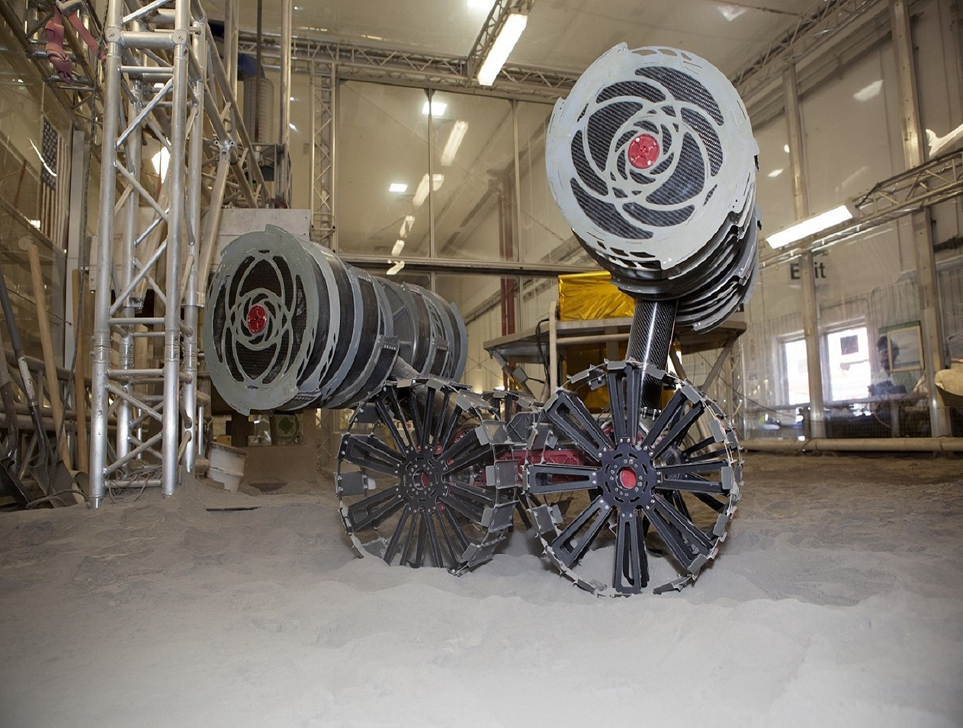
Finding, Excavating, and Moving Regolith for ISRU Use
NASA RASSOR
Notes:
Agenda:
Introductions from panelists
Individual panel questions
Questions for the whole panel + Zoom poll
Questions from the audience for the panel
Community Discussion (responses collected via zoom chat, zoom poll, or direct unmuting)

Slide 11
Brief Panel Discussion
Michelle Keegan
Australian Remote Operations for Space and Earth (AROSE)
Micah Schaible
Georgia Institute of Technology
Terry
Fong
NASA Ames Research Center
Melissa
Roth
Off Planet Research

Slide 12
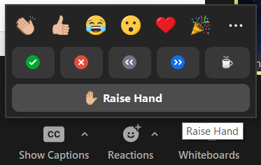
Discussion Etiquette
Please remain muted when not speaking
Welcome to turn on video at your discretion
Content Reminders
  This is a public, international forum
  Respect other speakers and points of view
  No sharing CUI, proprietary, intellectual property, etc.
Questions for Panel
  Write them in the chat
  Raise hand to unmute and ask

Slide 13


Open Discussion with Community
Do your operations require a rover? What attributes will your rover need?
(e.g., speed, carrying volume, charging needs, SWaP)
Notes:
Seminar-style: 1-2 talks from members of the community
Working-style: discussing priorities relevant to a specific gap, and trying to determine a path to closing that gap
Networking-style: free-for-all breakout rooms to network and collaborate

Slide 14
Open Discussion with Community
If finding, excavating, and moving regolith is its own capability box, what interfaces do you need to consider?
(e.g., Is your rover tall enough to dump regolith into your hopper?)
Notes:
Seminar-style: 1-2 talks from members of the community
Working-style: discussing priorities relevant to a specific gap, and trying to determine a path to closing that gap
Networking-style: free-for-all breakout rooms to network and collaborate

Slide 15
Open Discussion with Community
What kinds of standards are you using / need to start developing for an interoperable system?
Notes:
Seminar-style: 1-2 talks from members of the community
Working-style: discussing priorities relevant to a specific gap, and trying to determine a path to closing that gap
Networking-style: free-for-all breakout rooms to network and collaborate

Slide 16
Open Discussion with Community
For ISRU people: What experts would you consult for the pre-processing operations for O2 extraction?
For Crosscutting people: How do you see your work being integrated into finding, excavating, and moving regolith?
Notes:
Seminar-style: 1-2 talks from members of the community
Working-style: discussing priorities relevant to a specific gap, and trying to determine a path to closing that gap
Networking-style: free-for-all breakout rooms to network and collaborate

Slide 17
Open Discussion with Community
How would your technology / capability (or future technology / capability) mitigate risk for operations for finding, excavating, and moving regolith?
Notes:
Seminar-style: 1-2 talks from members of the community
Working-style: discussing priorities relevant to a specific gap, and trying to determine a path to closing that gap
Networking-style: free-for-all breakout rooms to network and collaborate

Slide 18

Open Discussion: Thoughts on Monthly Meeting Structure
https://forms.gle/gZxGPxArwJHWFZ2C9
ISRU End-Of-Year Survey
Seminar-style: 1-2 talks from members of the community
Working-style: discussing priorities relevant to a specific gap, and trying to determine a path to closing that gap
Networking-style: free-for-all breakout rooms to network and collaborate
Notes:
Seminar-style: 1-2 talks from members of the community
Working-style: discussing priorities relevant to a specific gap, and trying to determine a path to closing that gap
Networking-style: free-for-all breakout rooms to network and collaborate

Slide 19
Topical Discussion
Vlada Stamenković
Blue Origin
“Space Resources at Blue Origin”
Notes:
LSWG on LSIC public webpage:
https://lsic.jhuapl.edu/Our-Work/Working-Groups/Lunar-Simulants.php
LSWG on LSIC confluence page:
https://lsic-wiki.jhuapl.edu/display/LSWG/Lunar+Simulants+Working+Group+Home
Email Karen to be added to the LSWG List Serve
Karen.Stockstill-Cahill@jhuapl.edu

