Slide 1

LSIC ISRU Focus Group Monthly http://lsic.jhuapl.edu/ http://lsic-wiki.jhuapl.edu/ (Confluence sign-up required)
April 17, 2024
Jodi Berdis, Karl Hibbitts, Michael Nord, Rick Miller, Anthony Coburger
Jodi.Berdis@jhuapl.edu, Karl.Hibbitts@jhuapl.edu, Michael.Nord@jhuapl.edu, Richard.S.Miller@jhuapl.edu, Anthony.Coburger@jhuapl.edu

Slide 2
Agenda
General updates and house-keeping
  APL is happy to consult as appropriate with ISRU and CC related technologies. This includes site visits!
  Upcoming Meetings
  Funding Opportunities
David Aden & Mihir Gondhalekar (Starpath): “Iterative development of PSR-access & regolith-processing hardware”
Open Discussion with Community
  Bring your questions and ideas! Much of this meeting is reserved for audience Q&A and open discussion.
  We’ll have Zoom polls toward the end to help propel the conversation.

Slide 3

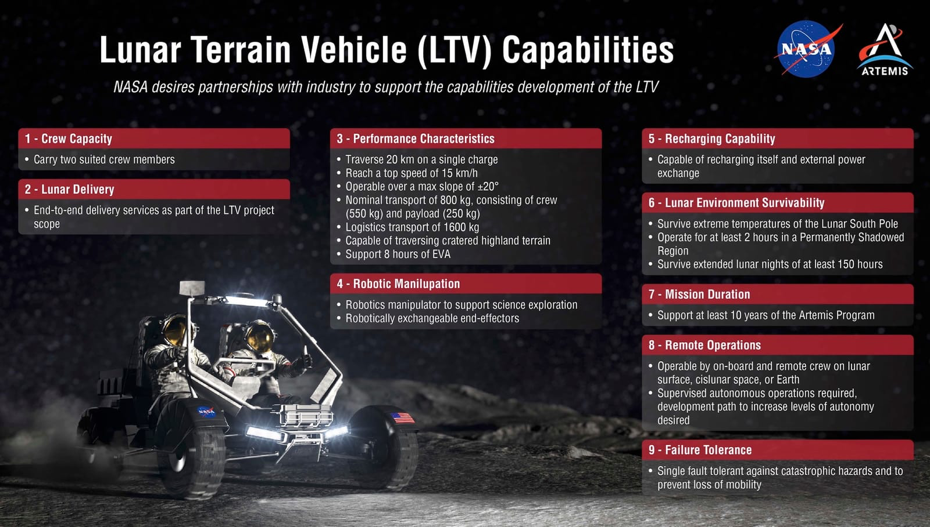
Notable News
North American Total Eclipse!
NASA Selected Lunar Terrain Vehicle teams for design maturation (Intuitive Machines, Lunar Outpost, Venturi Astrolab)

Slide 4
Upcoming Meetings
2024 LSIC Spring Meeting (April 23-25)
  https://lsic.jhuapl.edu/Events/Agenda/index.php?id=465
  JHU/APL Kossiakoff Center, Laurel, MD & Virtual
  Registration closes April 7!
NASA-USGS Workshop: Planetary subsurface exploration for science and resources (May 21-22)
  NASA and USGS combined workshop of ISRU that will be held in Moffett Field, California on May 21-22.
  You can register at: https://sservi.nasa.gov/nasa-usgs-workshop/
Space Resources Roundtable (June 4-7)
  https://learn.mines.edu/srr/
  Registration is open!
  Abstracts deadline extended! Due March 22!
International Conference on Environmental Systems (ICES) (July 21-25)
  https://www.ices.space/call-for-paper-2024/
  Sessions include: “Advanced Technologies for In-Situ Resource Utilization”, “Space Architecture”, “Planetary and Spacecraft Dust Properties and Mitigation Technologies”, “Human/Robotics System Integration”
ISRU FG Meetings have moved to third Wednesdays at 11am ET

Slide 5
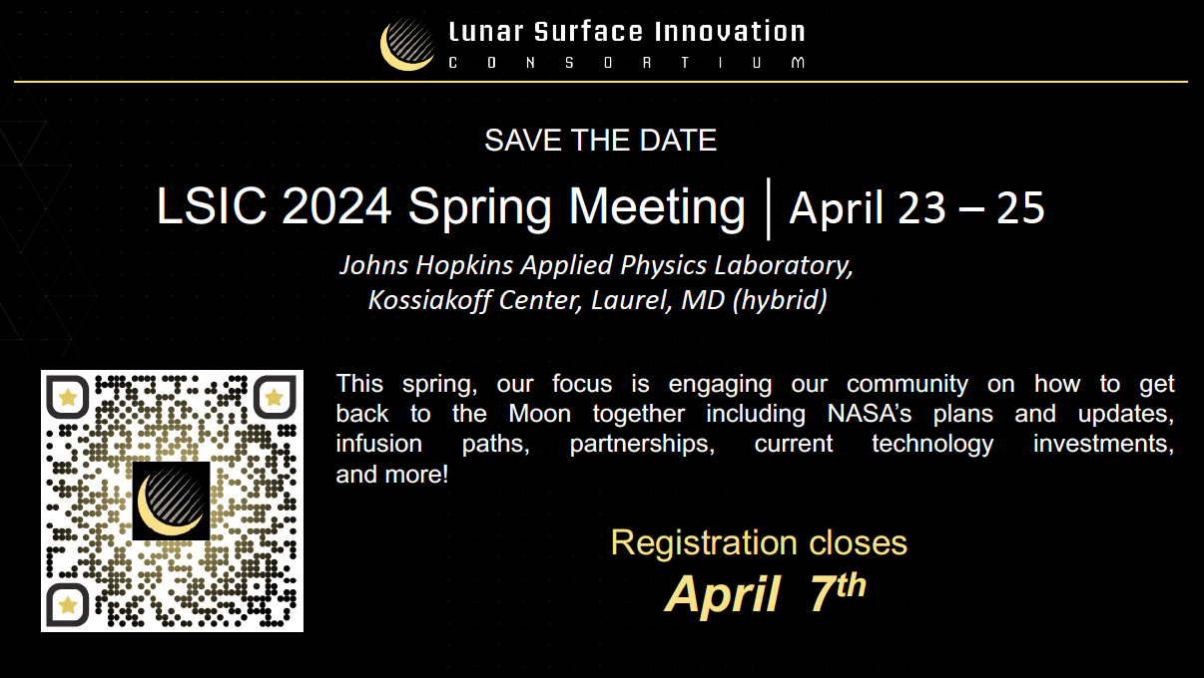
Registration has closed!
Some talks will be live-streamed through YouTube.
Wednesday, April 24 - 1:15pm EDT
STMD Lunch & Learn: Technology Shortfall Feedback & Prioritization Process with Spuds Vogel and Alesyn Lowry, Director of Strategic Planning and Integration, NASA STMD
The LSIC keynote introduced NASA’s strategy for establishing national tech base priorities. Join us to learn more about the process underway to collect feedback about technology shortfalls based on stakeholders’ prioritized needs (including yours!). STMD will show the initial shortfall list and descriptions, discuss desired feedback, and answer questions.

Slide 6
Funding & Opportunities
ROSES 2024: F.21 Economic, Social, and Policy Analyses of Lunar Surface Sustainability: Deadline May 17
  https://nspires.nasaprs.com/external/solicitations/summary.do?solId=%7b48D6B21B-0171-D79D-E111-BCDFCC02E0F0%7d&path=&method=init
  Solicitation for proposals to evaluate the economic, social, and political elements of lunar surface sustainability
SBIRs and STTRs
  Open SBIRs and STTRs can be found here: https://www.sbir.gov/solicitations/open
SpaceTech REDDI: Early Stage Innovations solicitation: NOIs due May 9; proposal due June 6.
  Topic 1 – Computational Materials Engineering for Lunar Metals Welding
  Topic 2 – Passive Lunar Dust Control through Advanced Materials and Surface Engineering
  https://tinyurl.com/NASA-ESI24
NASA STMD seeking SMEs to serve as peer reviewers of proposals submitted to the recently released Early Stage Innovations (ESI) 2024 solicitation (above link)
  If you are interested in serving as a peer reviewer for the ESI24 solicitation, please fill out the following form: https://forms.gle/qj2KYkDeUVp6TrwU6
https://lsic.jhuapl.edu/Resources/Opportunities.php?f=Job
https://lsic.jhuapl.edu/Resources/Funding-Opportunities.php
Notes:
https://lsic.jhuapl.edu/Resources/Funding-Opportunities.php
https://lsic.jhuapl.edu/Resources/Opportunities.php?f=Job
"While DARPA’s traditional purview has been programs in support of national security, as America and its allies return to the Moon, DARPA will support United States Government civil space activities to develop technology purely for non-military applications, to include use by civil space activities on the surface of the Moon."

Slide 7
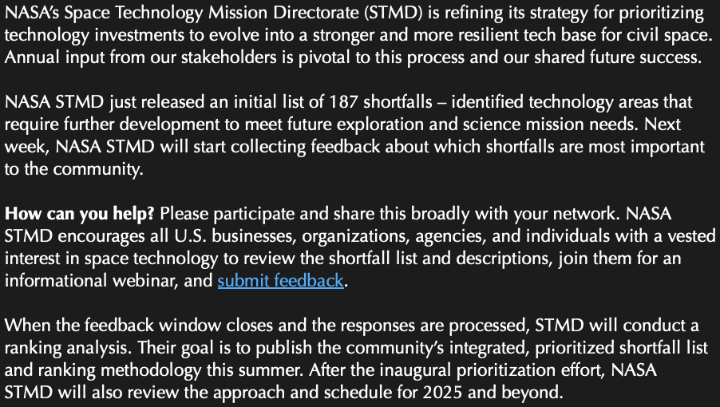
NASA STMD “Shortfalls” List
https://www.nasa.gov/spacetechpriorities/
https://techport.nasa.gov/strategy
Feedback open
Apr 16 – May 13
Info Townhall: Wednesday, April 17 at 4 p.m. EDT Register:
https://nasaevents.webex.com/weblink/register/rcae59bd2d9d8c4fbc63255f0f0acd28d

Slide 8
10 ISRU Shortfalls
Perform resource reconnaissance to locate and characterize resources and estimate reserves
Extraction and separation of water from extraterrestrial surface material
Extraction and separation of non-water volatile resources from Lunar regolith
Extraction and separation of oxygen from extraterrestrial minerals
Extraction and separation of extraterrestrial atmospheric resources and gaseous products/reactants
Extraction and separation of metals/metalloids from extraterrestrial minerals
Produce propellants and mission consumables from extracted in-situ resources
Produce manufacturing and construction feedstock from extracted in-situ resources
ISRU System Modeling
Extraterrestrial surface environmental simulators, test facilities, and test sites
https://techport.nasa.gov/strategy

Slide 9
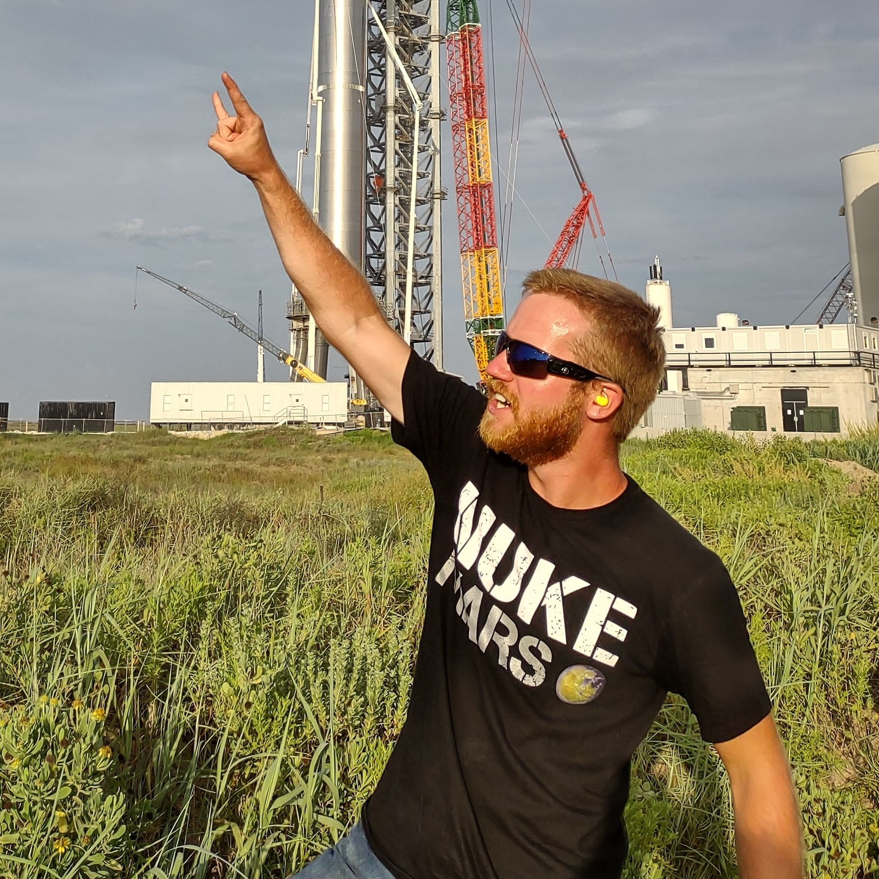

“Iterative development of PSR-access & regolith-processing hardware”
David Aden (Starpath)
David Aden is a Lead Mechanical Engineer at Starpath, where he heads up the development of the regolith-to-propellant conversion system. He got a Bachelor's degree in Mechanical Engineering and a Master's degree in Materials Science & Engineering from Virginia Tech, and is currently pursuing a PhD in Space Resources at Colorado School of Mines. Before joining Starpath in August of 2023, he was part of the Starship Orbital Launch Mount team, working out of Starbase, TX.
Saurav Shroff (Starpath)
Saurav Shroff serves as the Chief Executive Officer of Starpath. He attended the University of California, Berkeley, where he obtained his Bachelor's degree in Computer Science. Following time on the Starship Avionics team at SpaceX, he founded Starpath in March 2022, where he splits his time between running the company and getting his hands dirty doing hardware design & build.

Slide 10
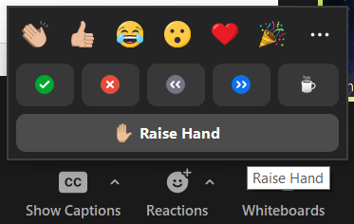
Discussion Etiquette
Please remain muted when not speaking
Welcome to turn on video at your discretion
Content Reminders
  This is a public, international forum
  Respect other speakers and points of view
  No sharing CUI, proprietary, intellectual property, etc.
Questions for Panel
  Write them in the chat
  Raise hand to unmute and ask

Slide 11


Open Discussion with Community
What aspect of designing an ISRU system to operate in PSRs is most challenging?
Thermal Management
Interactions with systems outside the PSR
Material selection
Maintenance (Fully autonomous vs. humans-in-the-loop, system repair in a PSR, etc.)
Navigation/autonomous driving/comms

Slide 12
Open Discussion with Community
a. Which approach would you take to address the uncertainty in the form of ice in regolith when designing an ISRU system?
Generalized design to extract water from many different ice forms.
Specialized tools to work with or select with particular ice forms.
b. What operational changes to an ISRU system could accommodate new knowledge of the ice in regolith once the system is on the moon?

Slide 13
Open Discussion with Community
a. When designing a full-stack ISRU system, which interfaces between subsystems would you expect to prompt the most design consideration?
Excavation & Delivery -> Hoppers/Transfer
Hoppers/Transfer -> Water Extraction from Regolith
Water Extraction from Regolith -> H20 Separation, Capture, & Transfer
Water Electrolysis -> Cryogenic Liquefaction
Cryogenic Liquefaction -> Zero-boiloff Storage
Other
b. If only one subsystem of a full-stack ISRU system is selected, what considerations would you take into account when integrating it with other unknown subsystems?

