Slide 1

LSIC ISRU Focus Group Monthly http://lsic.jhuapl.edu/ http://lsic-wiki.jhuapl.edu/ (Confluence sign-up required)
May 15, 2024
Jodi Berdis, Karl Hibbitts, Michael Nord, Rick Miller, Anthony Coburger
Jodi.Berdis@jhuapl.edu, Karl.Hibbitts@jhuapl.edu, Michael.Nord@jhuapl.edu, Richard.S.Miller@jhuapl.edu, Anthony.Coburger@jhuapl.edu

Slide 2
Agenda
General updates and house-keeping
  APL is happy to consult as appropriate with ISRU related technologies. This includes site visits!
  Upcoming Meetings
  Funding Opportunities
Beneficiation Speakers and Topics:
  Chris Tolton (Colorado School of Mines): Intro to beneficiation and lunar beneficiation, including use cases, industrial scale, and challenges
  Kevin Cannon (Colorado School of Mines): Lunar soil classification system
  David Butler (SLB): MCSifter lunar beneficiation tool
  Xu Wang (University of Colorado, Boulder): CLIFF DIVER lunar beneficiation tool
Open Discussion with Community
  Bring your questions and ideas! Much of this meeting is reserved for audience Q&A and open discussion.
  We’ll have Zoom polls toward the end to help propel the conversation.

Slide 3
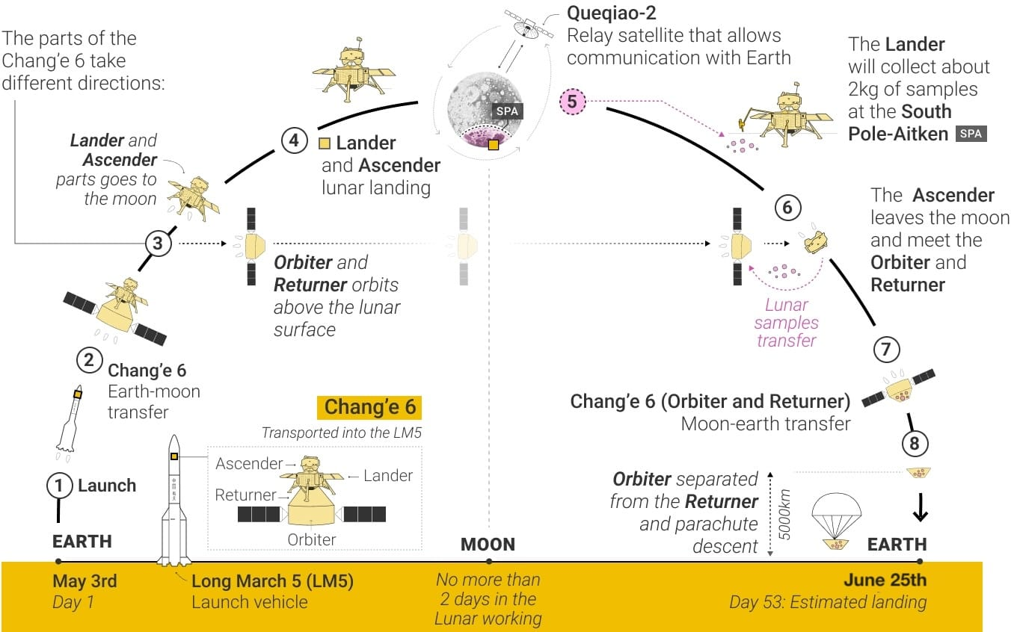
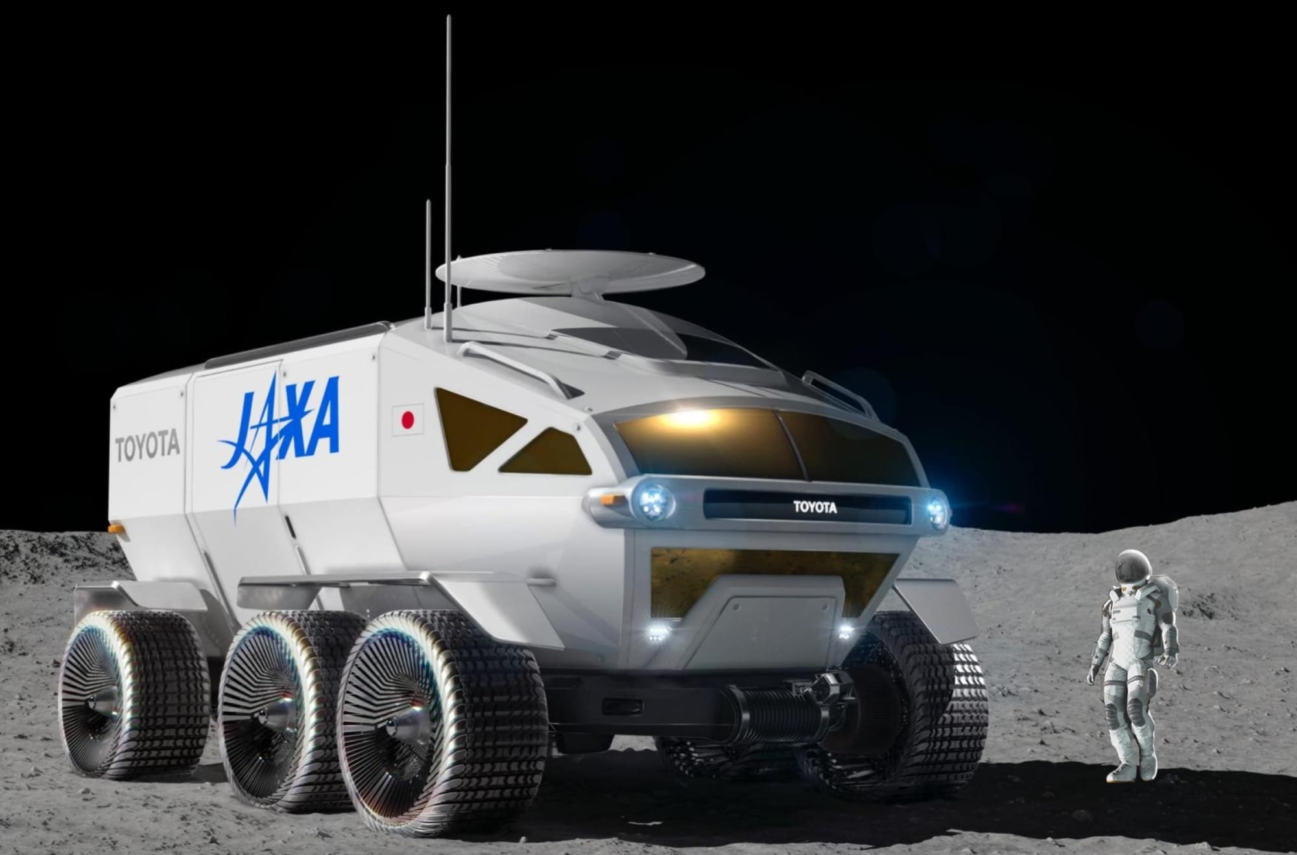
Notable News
NASA and Japan Sign Agreement
NASA to send 2 Japanese Astronauts to the Moon and JAXA to design rover with mobile habitat and laboratory
Chang’e 6 Sample Return Launch

Slide 4
Upcoming Meetings
NASA-USGS Workshop: Planetary subsurface exploration for science and resources (May 21-22)
  NASA and USGS combined workshop of ISRU that will be held in Moffett Field, California on May 21-22.
  You can register at: https://sservi.nasa.gov/nasa-usgs-workshop/
Paris Open Science (May 23-25 – dates potentially being postponed!)
  Space science & technology, fusion energy, robotics & AI, etc.
  http://paris-open-science.org
Space Resources Roundtable (June 4-7)
  https://learn.mines.edu/srr/
  Looking forward to seeing you all there!
International Conference on Environmental Systems (ICES) (July 21-25)
  https://www.ices.space/call-for-paper-2024/
  Sessions include: “Advanced Technologies for In-Situ Resource Utilization”, “Space Architecture”, “Planetary and Spacecraft Dust Properties and Mitigation Technologies”, “Human/Robotics System Integration”
ISRU FG Meetings have moved to third Wednesdays at 11am ET

Slide 5
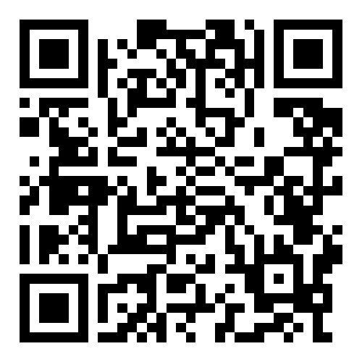
ISRU June Telecon: Lightning Talks!
On June 19, the ISRU Focus Group will host a telecon dedicated to community lightning talks and networking.
  First half: lightning talks from you!
  Second half: each lightning talk speaker will have their own Zoom breakout room to host their own mini-Q&A, networking, collaboration discussions and opportunities, etc.
Lightning talk: One slide, two minutes.
Slide submission deadline: June 16, 2024 (end of day).
https://jhuapl.app.box.com/f/2e7560300642496c8835457b4830caff

Slide 6
Funding & Opportunities
ROSES 2024: F.21 Economic, Social, and Policy Analyses of Lunar Surface Sustainability: Deadline May 17
  https://nspires.nasaprs.com/external/solicitations/summary.do?solId=%7b48D6B21B-0171-D79D-E111-BCDFCC02E0F0%7d&path=&method=init
  Solicitation for proposals to evaluate the economic, social, and political elements of lunar surface sustainability
ROSES 2024: C.8 Lunar Data Analysis Program: Deadline April 30, 2025
  https://nspires.nasaprs.com/external/solicitations/summary!init.do?solId={CD554FF5-5F05-3833-5120-985C271695D7}&path=open
  More science than tech, but likely still relevant to many in community: analysis of data from missions for use in lunar science investigations.
SBIRs and STTRs
  Open SBIRs and STTRs can be found here: https://www.sbir.gov/solicitations/open
SpaceTech REDDI: Early Stage Innovations solicitation: Deadline June 6
  Topic 1 – Computational Materials Engineering for Lunar Metals Welding
  Topic 2 – Passive Lunar Dust Control through Advanced Materials and Surface Engineering
  https://tinyurl.com/NASA-ESI24
NASA STMD seeking SMEs to serve as peer reviewers of proposals submitted to the Early Stage Innovations (ESI) 2024 solicitation (above link)
  If you are interested in serving as a peer reviewer for the ESI24 solicitation, please fill out the following form: https://forms.gle/qj2KYkDeUVp6TrwU6
https://lsic.jhuapl.edu/Resources/Opportunities.php?f=Job https://lsic.jhuapl.edu/Resources/Funding-Opportunities.php
Notes:
https://lsic.jhuapl.edu/Resources/Funding-Opportunities.php
https://lsic.jhuapl.edu/Resources/Opportunities.php?f=Job
"While DARPA’s traditional purview has been programs in support of national security, as America and its allies return to the Moon, DARPA will support United States Government civil space activities to develop technology purely for non-military applications, to include use by civil space activities on the surface of the Moon."

Slide 7
OTPS Lunar Non-Interference Questionnaire
NASA’s Office of Technology, Policy, and Strategy (OTPS) https://www.nasa.gov/otps/ is asking members of the lunar community to respond to a new Lunar Non-Interference Questionnaire that will inform the development of a framework for further work on non-interference of lunar activities.
In 2016, a roadmap exploring the prioritization of lunar science activities, and designating which science objectives could be adversely impacted by further lunar exploration was developed. “The Lunar Exploration Roadmap: Exploring the Moon in the 21st Century: Themes, Goals, Objectives, Investigations, and Priorities, 2016,” is available at https://www.lpi.usra.edu/leag/LER-2016.pdf. Lunar interference and contamination concerns have since been broadly identified and expanded, however, there is no consensus in the lunar scientific or technical community on key questions such as the breadth of interference and contamination concerns, how to understand the potential value of lunar sites, how to mitigate the impacts of interference or contamination at such sites, and how to determine the change in value of a lunar site should certain interference or contamination activities occur.
Please see the Questionnaire at https://www.nasa.gov/organizations/otps/otps-seeks-input-from-the-lunar-community-to-inform-a-framework-for-further-work-on-non-interference-of-lunar-activities/ and direct any questions to the PoC at NASA HQ below. Answers to the questionnaire are due Friday, June 7th, 2024.

Slide 8
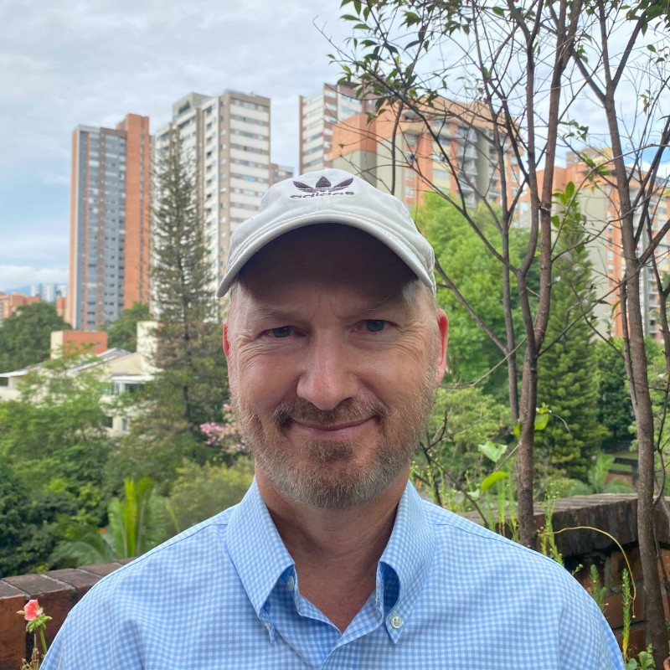


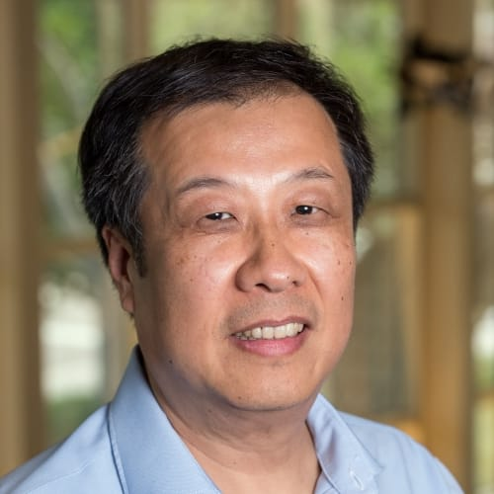
Lunar Beneficiation
Chris Tolton (Colorado School of Mines)
Co-Founder of space startup Orbital Mining Corporation (OMC) in Golden, Colorado.
Graduate student in Space Resources at Colorado School of Mines. Currently building a lunar electrical transmission and storage system under NASA’s Watts on the Moon Challenge (1 of 4 remaining teams). Former US Naval Intelligence Officer with a background in remote sensing. He also holds an MBA from Oxford University.
Kevin Cannon (Colorado School of Mines)
Dr. Kevin Cannon is an Assistant Professor, Geology and Geological Engineering at the
Colorado School of Mines. He holds a Ph.D in Geological and Earth Sciences/Geosciences from Brown University.
David Butler (Schlumberger)
Senior Geophysicist at Schlumberger
Graduate student in Space Resources at Colorado School of Mines (graduated 9 May)
Presenting MCSiFTER (Mines Centrifugal Size Filtering Tool Employing Rotating sieves), a Commercial Payload System payload design for demonstrating beneficiation using nested, centrifugal sieves in a lunar environment. He holds an MS in Geology from the University of Kentucky.
Xu Wang (University of Colorado, Boulder)
Dr. Xu Wang is a research scientist at Laboratory for Atmospheric and Space Physics (LASP) and is affiliated with NASA/SSERVI’s Institute for Modeling Plasma, Atmospheres and Cosmic Dust (IMPACT) at the University of Colorado Boulder. Dr. Wang’s research interests include dust charging and transport, plasma interactions with airless bodies, plasma and dust instrument development, and ISRU and dust mitigation technologies for lunar exploration. He holds a Ph.D in Engineering Physics from the University of Wisconsin (Madison).

Slide 9
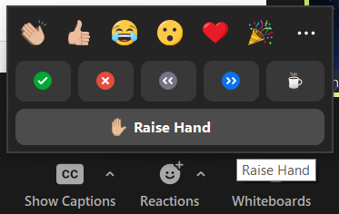
Discussion Etiquette
Please remain muted when not speaking
Welcome to turn on video at your discretion
Content Reminders
  This is a public, international forum
  Respect other speakers and points of view
  No sharing CUI, proprietary, intellectual property, etc.
Questions for Panel
  Write them in the chat
  Raise hand to unmute and ask

Slide 10


Open Discussion with Community
Do you think beneficiation will be required initially for lunar mining?

Slide 11
Open Discussion with Community
Which beneficiation method(s) do you believe will lead to industrial level ISRU mining of the Moon, and what infrastructure will be required beforehand?

Slide 12
Open Discussion with Community
Which will happen first: Oxygen production from MRE/MSE/Carbothermal Reduction or water ice mining in PSRs?
A. Oxygen production from MRE/MSE/Carbothermal Reduction
B. Water ice mining in PSRs

Slide 13
Open Discussion with Community
What program/mission objective would most benefit from a beneficiation testbed? (E.g., CLPS Lander, Artemis Astronauts, etc.)?

Slide 14
Open Discussion with Community
Do you think Rare Earth Element mining on the Moon is feasible?

Slide 15
Open Discussion with Community
Which ISRU system interface considerations are critical to beneficiation system design (flow rates, regolith size, thermal management, etc.)?

