Slide 1


LSIC Surface Power Telecon
March 28th, 2024
Begins at 11:03
Samantha Andrade, Dr. Sean Young
Jacob Gehrett, Dr. Joseph Kozak, Julie Peck
Johns Hopkins Applied Physics Laboratory
Space Exploration Sector
LSIC Surface Power Facilitator POC: samantha.andrade@jhuapl.edu

Slide 2

LSIC | Agenda
Community Updates:
  LSIC Spring Meeting
  DARPA RFI- SHALE
  LOGIC
  Conferences/Workshops/Telecons
    Upcoming 2024 Surface Power Telecons
  LSIC Resources
Today’s Topic: “Modular Power Systems”
  Olivia Formoso (NASA Ames)
  Greenfield Trinh (NASA Ames)
2

Slide 3
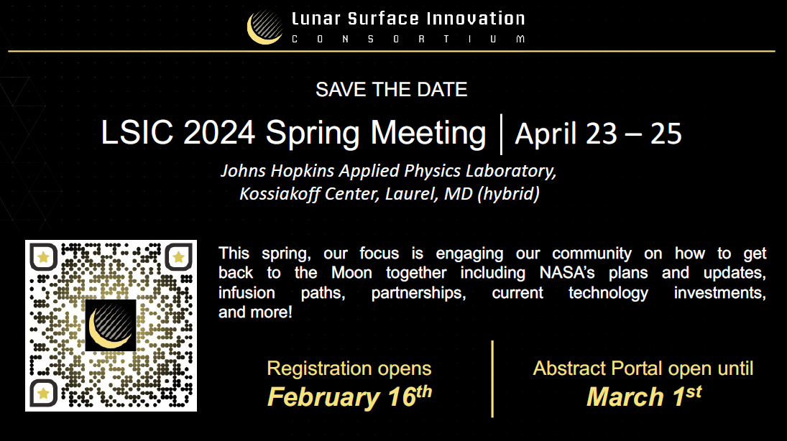
LSIC | Upcoming Meetings and Workshops
Registration Deadlines:
April 7 for in-person attendees AND foreign nationals (in-person and virtual)
April 14 for virtual attendees (US citizens)
3
Notes:
*Replace abstract portal with box with following info*:
April 7 deadline for in-person and foreign nationals
April 14 deadline for vritual

Slide 4
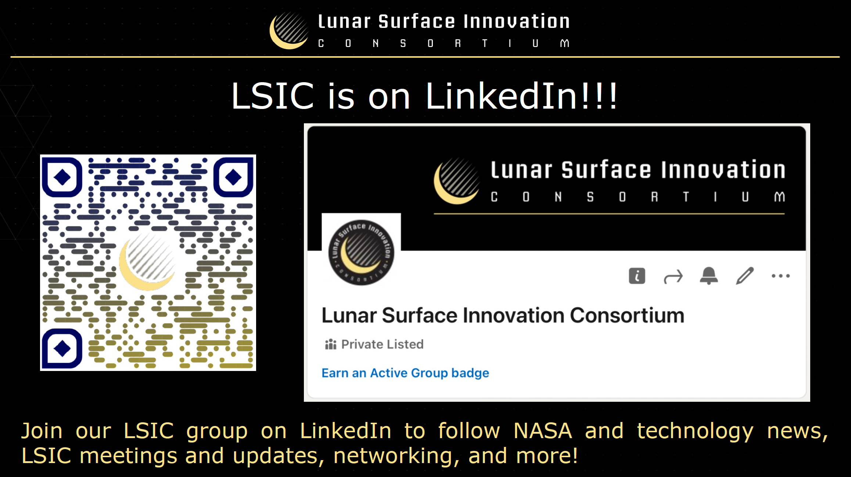

Slide 5
LSIC | DARPA RFI- SHALE
The Defense Advanced Research Projects Agency (DARPA) has a Request for Information (RFI): Six Hypotheses for Accelerating the Lunar Economy (SHALE).
The LunA-10 study has identified six key hypothesis where the lunar economy can be accelerated if improvements in technology can be made. These focus areas are:
  1) Centralized thermal rejection and generation as a service,
  2) Widespread orbital lunar prospecting and surveying,
  3) Creating large silicon wafers for microsystems on the Moon,
  4) Biomanufacturing to accelerate lunar construction,
  5) New concepts to increase refinement rates in low gravity,
  6) New concepts for Lunar position, navigation and timing
White papers can be submitted no later than 4:00 pm EST, April 15, 2024
A DARPA-sponsored seminar series is planned for the week of April 22, 2024
More information can be found here: https://sam.gov/opp/909fd645b59c47988201485b58a72d1f/view#history
5

Slide 6

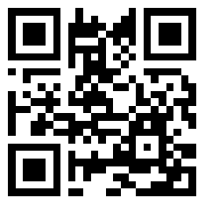
LSIC | LOGIC Sign Up
The Lunar Operating Guidelines for Infrastructure Consortium (LOGIC) is a catalyst for developing a set of guidelines and standards that enable lunar interoperability.
First LOGIC Working Group Meeting was on March 12.
  You can access the past meeting slides, including
  information and announcements, here:
  https://logic.jhuapl.edu/Events/Agenda/index.php?id=3
Next Working Group Meeting is:
Tuesday, April 9thfrom 1:00-2:00pm EST
To attend, you need to be a member of LOGIC to receive Zoom details (no advance registration is required) https://logic.jhuapl.edu
6

Slide 7
LSIC | Upcoming Meetings and Workshops
Space Power Workshop (SPW)
April 23-25, Torrance, CA
Register by April 22: https://spw.aerospace.org/
LSIC 2024 Spring Meeting
April 23-25, Laurel, MD (hybrid)
Register by April 7/14: https://lsic.jhuapl.edu/Events/Agenda/index.php?id=465
Nuclear and Emerging Technologies for Space (NETS)
  May 6-10, Santa Fe, NM
  Early Bird Registration ends April 12: https://www.ans.org/meetings/nets2024/
Space Resources Roundtable (SRR)
June 4-7, Colorado School Of Mines
    Early bird registration ends April 22: https://learn.mines.edu/srr/registration/
ASCEND
  July 30-August 1, Las Vegas, NV
  Early Bird Registration ends June 10: https://www.ascend.events/
Check out the LSIC website for a more complete calendar (and add your events, too!)
7
Notes:
SRR- June 4-7
ASCEND- July 30-Aug 1

Slide 8
LSIC | Upcoming Surface Power Telecons
We hope to see you all at our upcoming telecons. As a reminder, Surface Power Telecons typically take place on the fourth Thursday of every month at 11AM ET.
April (Spring Meeting)
NO TELECON
May 23rd
Topic: Laser Power Beaming on the Moon
Speaker: Tom Nugent (PowerLight Technologies)
June 27th
Joint telecon with the Crosscutting Capabilities (CC) Focus Area- Stay Tuned!
8

Slide 9
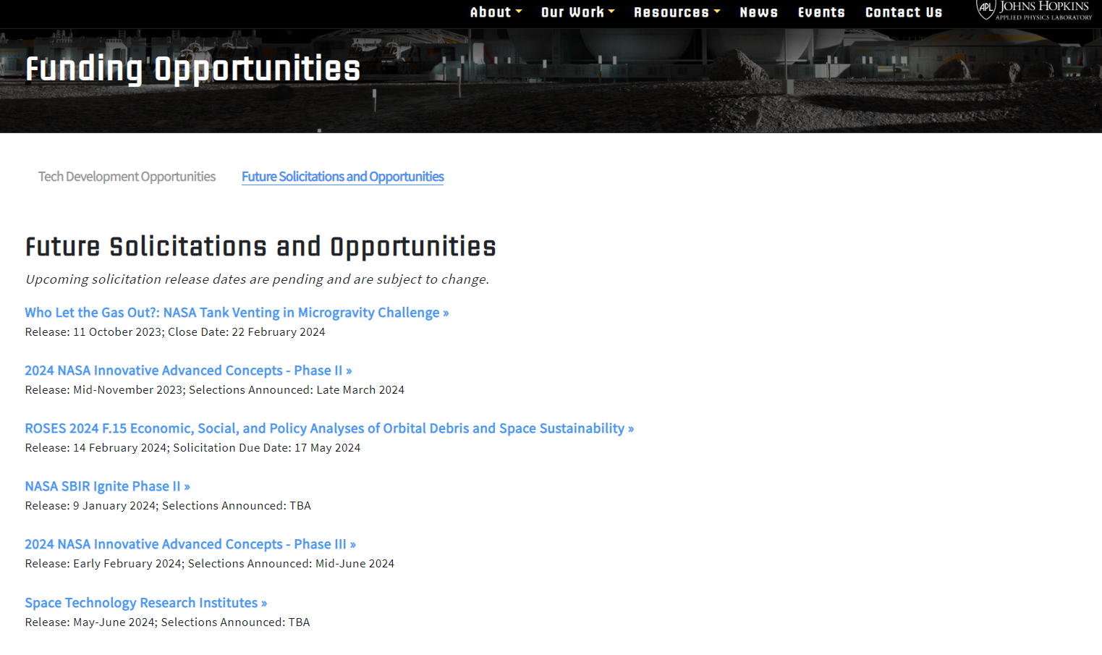
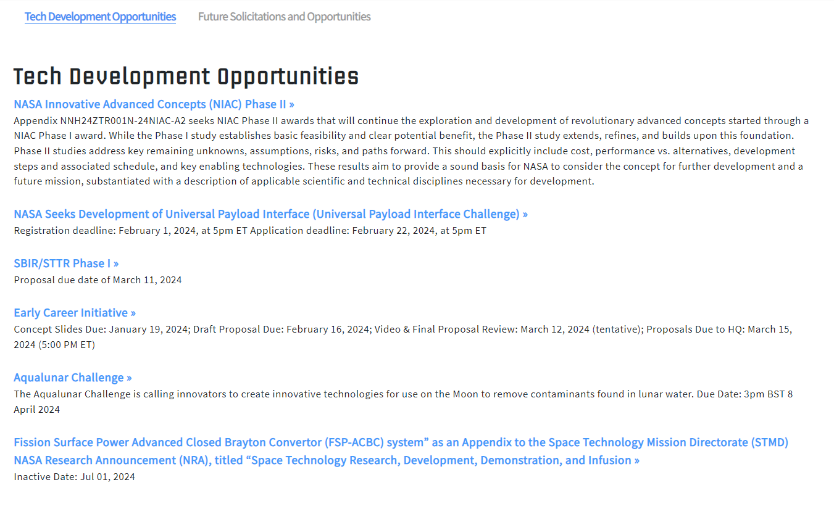
LSIC | Funding Opportunities
Check out our website! https://lsic.jhuapl.edu/Resources/Funding-Opportunities.php

Slide 10
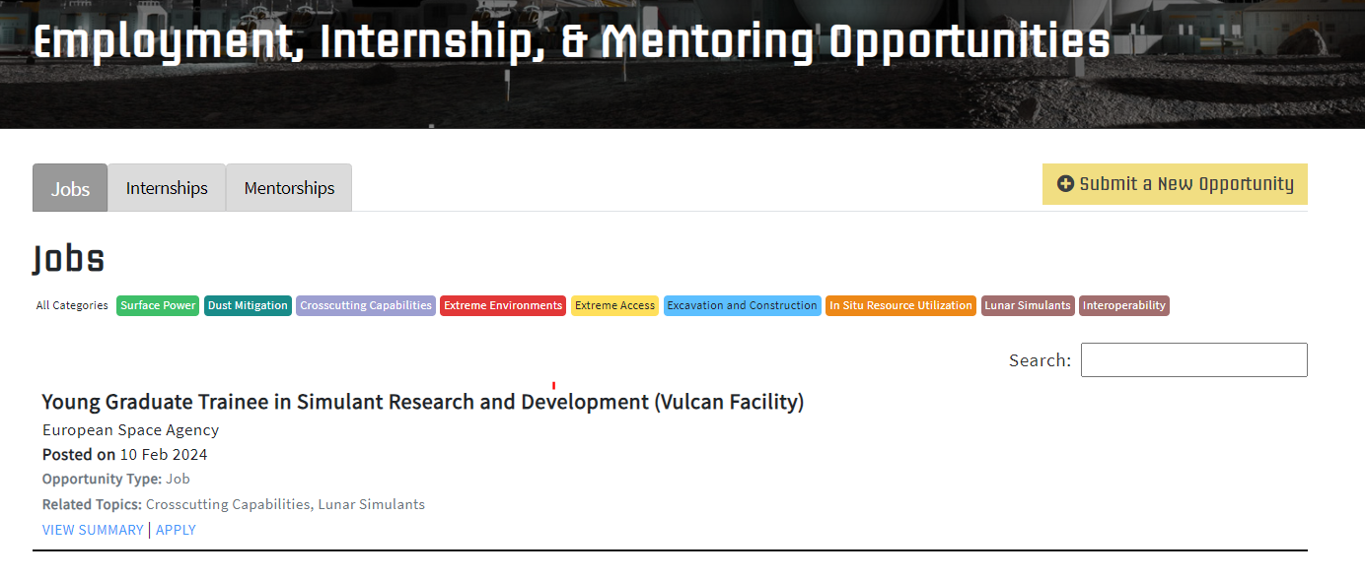
LSIC | Employment, Internship, and Mentoring Opportunities
Check out our website! https://lsic.jhuapl.edu/Resources/Opportunities.php?f=Job

Slide 11
LSIC | March Speakers
Modular Power Systems
Olivia Formoso & Greenfield Trinh (NASA Ames)
11

