Slide 1


LSIC Surface Power Telecon
May 23rd, 2024
Begins at 11:03
Samantha Andrade, Dr. Sean Young
Jacob Gehrett, Dr. Joseph Kozak, Julie Peck
Johns Hopkins Applied Physics Laboratory
Space Exploration Sector
LSIC Surface Power Facilitator POC: samantha.andrade@jhuapl.edu

Slide 2

LSIC | Agenda
Community Updates:
  LSIC Spring Meeting Recap
  Upcoming Events and Funding Opportunities
  LSIC Resources
Today’s Topic: Lunar Surface Power Beaming Update
  Tom Nugent (PowerLight Technologies)
2

Slide 3
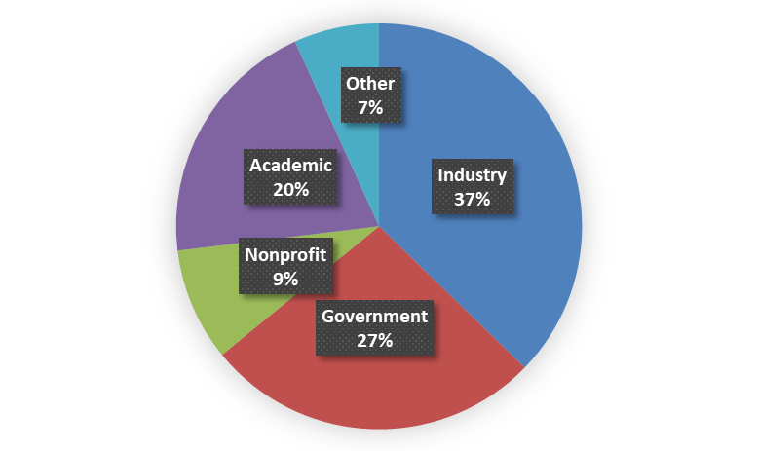
LSIC | Spring Meeting Recap
April 23-25- (hybrid) Johns Hopkins University Applied Physics Lab in Laurel, MD
Key Announcements:
NASA STMD Shortfalls and survey specifics through “lunch and learn”
DARPA brief out of the LunA-10 winners
In a Nutshell:
  Updates on NASA’s Moon 2 Mars Architecture
  LSII/LSIC Updates
  Lunar Surface Technology Research (LuSTR) 2021 Updates
  Commercial Lunar Payload Services (CLPS) 2024 Manifest Panel
  Partnership Panel that included the international perspective
  Technology Showcase Panel
  Defense Advanced Research Projects Agency’s (DARPA) 10-Year Lunar Architecture Capability Study (LunA-10) Updates
  Poster Session, lightning talks, dedicated networking, student luncheon, and technology “show and tell”
Registrants:
460 In-person
577 virtual
* Pie chart represented registrants not attendees

Slide 4
LSIC | Spring Meeting Recap- Surface Power Goals
Surface Power 2024 Goals
  Encourage development of system-level power solutions by: 1) refining current and evolving power capability areas; 2) identifying gaps in capability and scalability within power systems; and 3) identifying connections to ISRU, E&C, and mobility users of power.
  Address power technologies that are most in need of prioritization.
  Facilitate new ways to connect power providers to power users (within and outside the Surface Power community) and encourage information sharing between providers and users to achieve common objectives
Did you miss the Spring Meeting?
Agenda and recordings are here: https://lsic.jhuapl.edu/Events/Agenda/index.php?id=465
4

Slide 5
LSIC | To Add to Your Calendars:
Upcoming Meetings:
  AIAA SciTech Forum
    January 6-10, Orlando, FL
    Deadline for ABSTRACTS- May 23: https://www.aiaa.org/SciTech/call-for-content?utm_source=AIAA&utm_medium=popup&utm_campaign=SciTech2025&utm_content=CFC
  Space Resources Roundtable (SRR)
June 4-7, Colorado School Of Mines
    https://learn.mines.edu/srr/registration/
  ASCEND
  July 30-August 1, Las Vegas, NV
  Early Bird Registration ends June 10: https://www.ascend.events/
Upcoming Telecon:
  Extended Joint Telecon with Crosscutting Capabilities
    Thursday, June 27- 11AM-12:30PM EST
    topic: Power Transmission and Environmental Effects. Details will be emailed soon!
Check out the LSIC website for a more complete calendar (and add your events, too!)
5
Notes:
SRR- June 4-7
ASCEND- July 30-Aug 1
Advanced power for space exploration

Slide 6
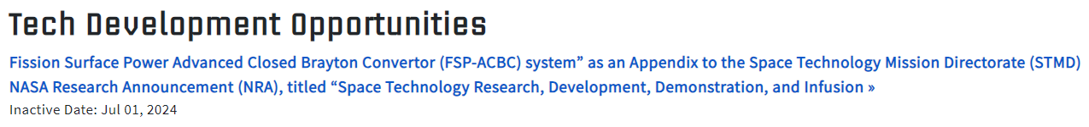
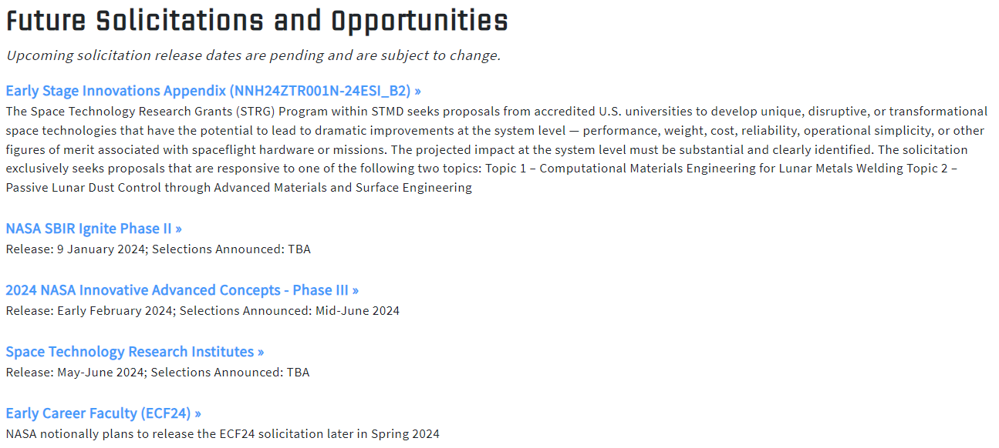
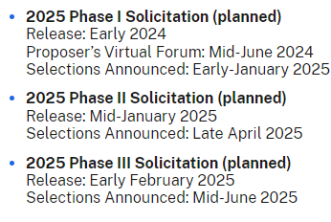
LSIC | Funding Opportunities
Check out our website! https://lsic.jhuapl.edu/Resources/Funding-Opportunities.php
Get prepared for 2024 SBIR Ignite Phase I solicitation- June, 2024!
6
Notes:
Release of a solicitation, titled “Fission Surface Power Advanced Closed Brayton Convertor (FSP-ACBC) system” as an Appendix to the Space Technology Mission Directorate (STMD) NASA Research Announcement (NRA), titled “Space Technology Research, Development, Demonstration, and Infusion - 2023 (SpaceTech-REDDI-2023),” on or about July 7, 2023. Once the Appendix is posted, complete details (to include due dates) can be accessed via the following steps:
The intent of this appendix is to push the state of the art in space closed cycle Brayton technology to leverage future higher temperature space reactors and radiators.

Slide 7
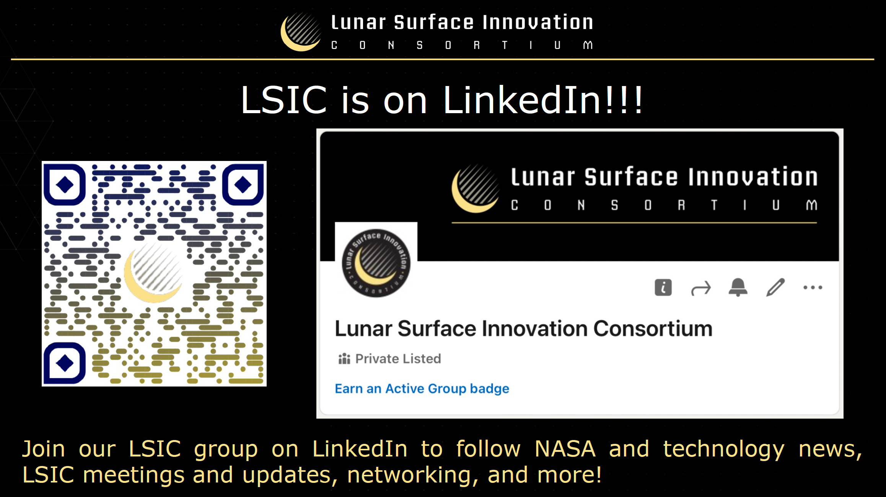
7

Slide 8
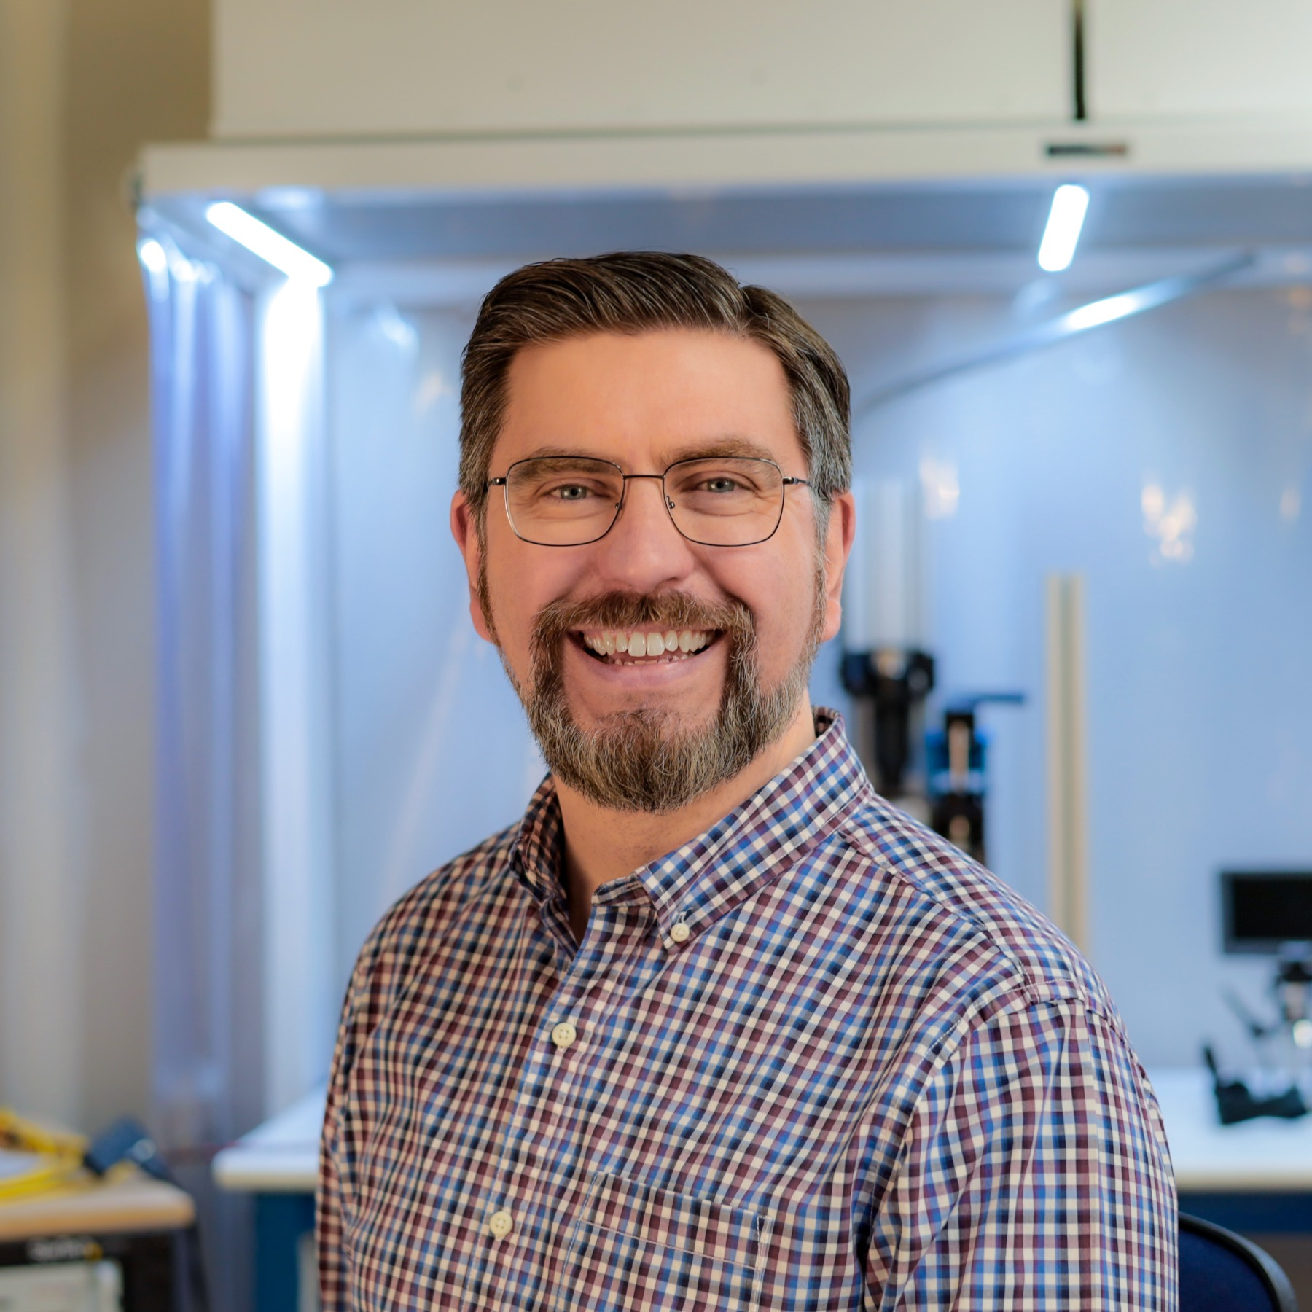

LSIC | May Speaker
Lunar Surface Power Beaming Update
PowerLight Technologies as part of Blue Origin team for the DARPA LunA-10 Project
Tom Nugent
8

