Slide 1
LSIC Surface Power / Crosscutting Focus Group Monthly
June 27, 2024
Power: Sam Andrade, Sean Young, Julie Peck, Joseph Kozak, and Jacob Gehrett
CC: Lindsey Tolis, Danielle Mortensen, Angela Stickle, Milena Graziano, Mario Lento, Andrew Gerger, and team!
Facilitator_Power@jhuapl.edu
Facilitator_Crosscutting@jhuapl.edu

Slide 2
Agenda
General updates and house-keeping – 10 minutes
Logistical Information
Upcoming Meetings
Funding Opportunities
Overview Presentation – 10 minutes
Kristen John (NASA), Ansel Barchowsky (NASA)
Power Transmission – 20 minutes
Matt Zamborsky (Astrobotic), Stephen Indyk (Honeybee)
Dust Impact – 20 minutes
Brian Troutman (NASA)
Joint Discussion / Q&A – 20 minutes

Slide 3
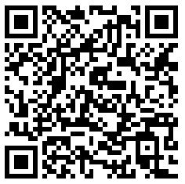
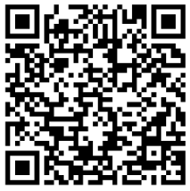
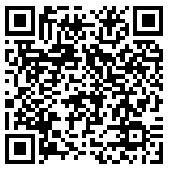
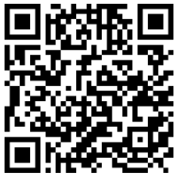
Logistical Information
How to Contact us!
Facilitator_Power@jhuapl.edu
Facilitator_Crosscutting@jhuapl.edu
CC Website
Power Website
New email!
Need Confluence Access?
ses-lsic-wiki-admins@jhuapl.edu
CC Confluence
Power Confluence

Slide 4
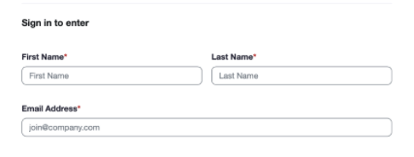
LSIC Monthly Meetings Update New Zoom Links
LSIC is updating our zoom sign-in! To better serve the community and contact attending members, our zoom links will now require First and Last Name and email addresses. This will not affect how the monthly meetings are attended, and no passcode will be required. If you have any questions or concerns, please reach out to your Focus Area Lead.
New Zoom links start
July 1st

Slide 5
Upcoming Conferences / Workshops
International Conference on Environmental Systems (ICES) (July 21-25)
https://www.ices.space/call-for-paper-2024/
Sessions include: “Advanced Technologies for In-Situ Resource Utilization”, “Space Architecture”, “Planetary and Spacecraft Dust Properties and Mitigation Technologies”, “Human/Robotics System Integration”
Registration open!
NASA Solar System Exploration Virtual Institute (SSERVI) (July 23-25)
https://sservi.nasa.gov/nesf2024/
Registration open! (General registration closes 7/11)
ASCEND (July 30- August 1)
https://www.ascend.events/
Registration open!
Planetary Crater Consortium Meeting (August 7-9)
https://www.hou.usra.edu/meetings/crater2024/
Registration open!
Abstract Submission deadline July 8, 2024
Terrestrial Analogs Workshop (August 12-14)
https://www.hou.usra.edu/meetings/terrestrialanalogs2024/
Registration open!

Slide 6
Upcoming Conferences / Workshops
LEAG (October 28-30)
https://www.lpi.usra.edu/leag/meetings/upcoming/
Registration open!
Space Photovoltaic Research and Technology (SPRAT) Conference in Cleveland, OH (Sept 4-6, 2024)
Hosted by NASA Glenn Research Center
Please email your abstracts to Meghan Bush (meghan.bush@nasa.gov). Instructions for abstract submissions are attached and can also be found on the SPRAT website here: https://www1.grc.nasa.gov/sprat/
Abstracts are due June 28, 2024
2025 IEEE Aerospace Conference in Big Sky, Montana (March 1-8, 2025)
https://www.aeroconf.org/paper-submission
Abstracts are due July 1, 2024
IEEE Applied Power Electronics Conference (APEC) in Atlanta, GA (March 16-20, 2025)
https://apec-conf.org/speakers/ts-author-info/
Submission portal closes August 9, 2024

Slide 7
Future CC Meetings
July 24, 2024
Crosscutting Telecon
Feedback and Special Topic Meetings
August 28, 2024
Joint Telecon with CC, E&C, and ISRU
September 26, 2024
Joint Telecon with CC and Surface Power
October 01, 2024
Crosscutting South Pole Challenges (extended meeting)

Slide 8
Future SP Meetings
July 25, 2024
Energy Storage Telecon- Speakers TBA
August 22, 2024 (1/2 day event)
M2M Power Trades Virtual Workshop
Registration will be announced over email
September 26, 2024
Joint Telecon with CC and Surface Power
October 24, 2024
TBD

Slide 9
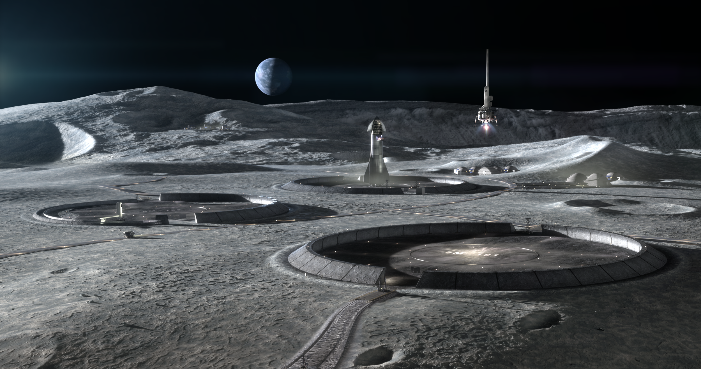
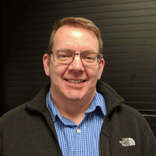
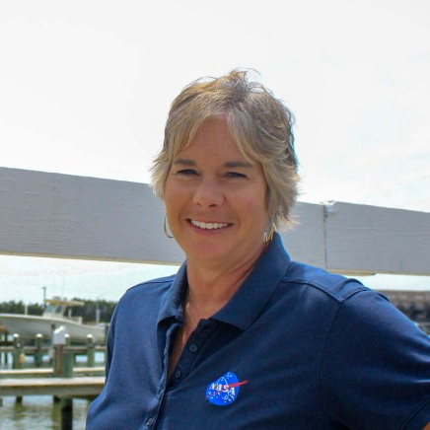
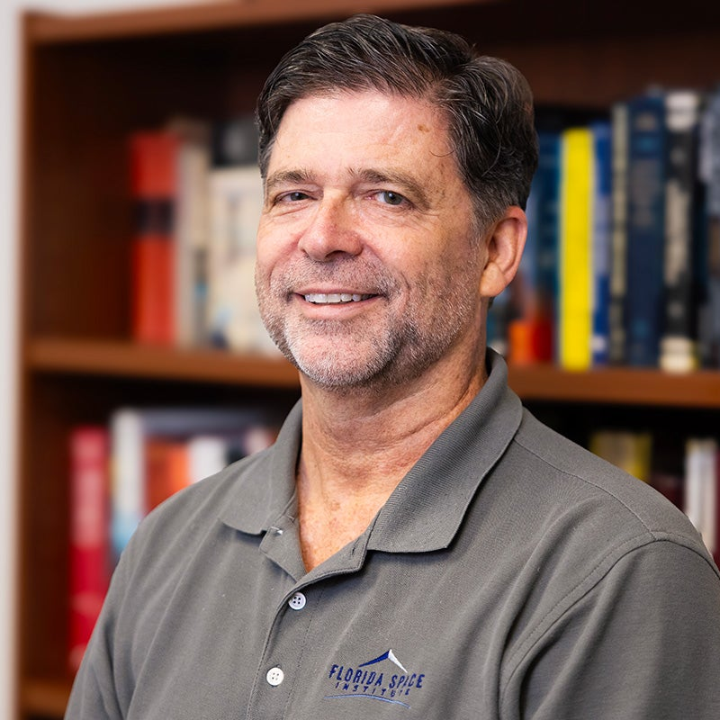
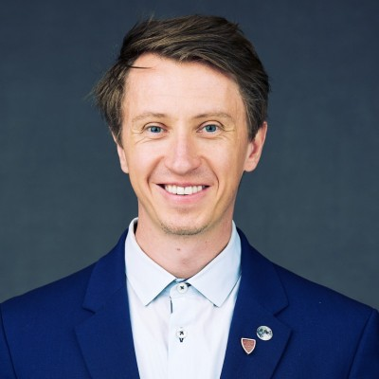
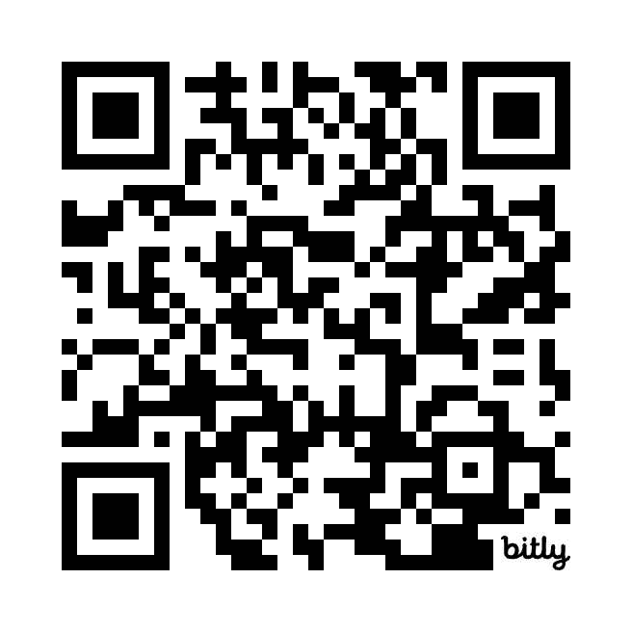
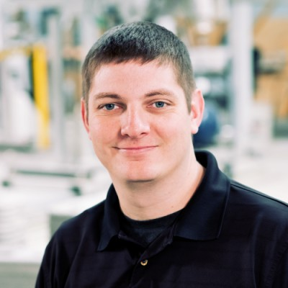
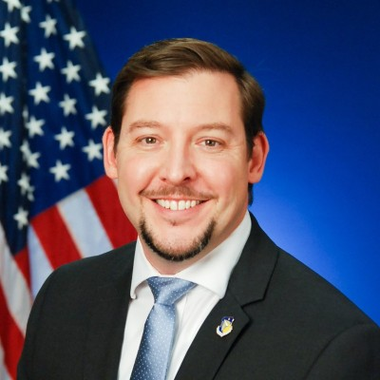
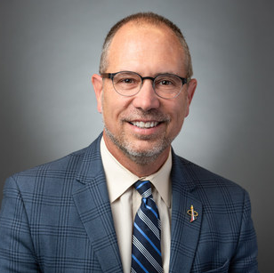
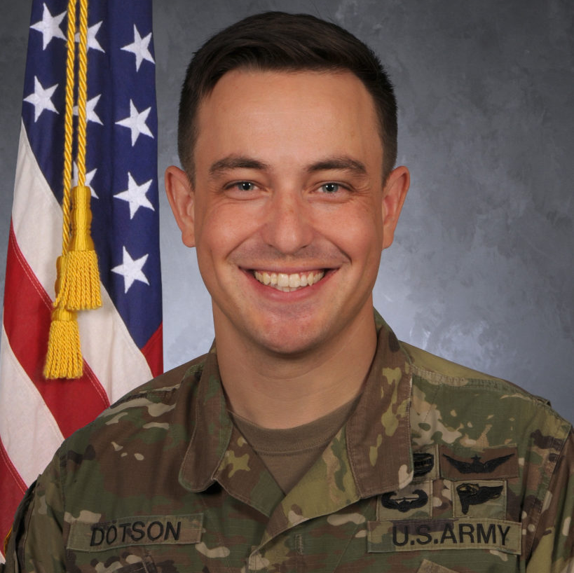
LSIC Excavation and Construction Focus Area Virtual Lunar Launch and Landing Facilities Workshop (07/23)
AGENDA:
Vision for Deploying Landing and Launch Facilities for a sustained presence on the Moon
Top Level Design Expectations for LLF
LLF Trade Space Considerations
State of the Art Landing Pad Analyses - Plume Surface Interaction Analyses and Failure Modes
Construction Options and Supporting Infrastructure
Credit: ICON Technology
Join LSIC - LSIC.JHUAPL.EDU
Mark Hilburger
(NASA-LARC)
Michelle Munk
(NASA-HQ)
Sam Ximenes
(Astroport)
Phil Metzger
(Univ Central FL)
Ian Jehn
(Colorado School of Mines)
Registration is free and required – Closes July 11th
Evan Jensen
(ICON)
Jason Foley
(AFRL)
Greg Autry
(ASU)
Brandon Dotson
(Univ Central FL)
You?
Interested in Presenting? Email Jibu.Abraham@jhuapl.edu or Sarah.Hasnain@jhuapl.edu

Slide 10
Funding & Opportunities
SBIRs and STTRs
Open SBIRs and STTRs can be found here: https://www.sbir.gov/solicitations/open
Lunar Mapping Program
https://nspires.nasaprs.com/external/solicitations/summary!init.do?solId={83A89224-E78F-56D5-F16C-04775814C47A}&path=open
Proposals Due June 12th 2024
Analog Activities to Support Artemis Lunar Operations
https://nspires.nasaprs.com/external/viewrepositorydocument/cmdocumentid=983490/solicitationId=%7B36590CEF-D30A-DFDA-EE45-F6C56E9460D5%7D/viewSolicitationDocument=1/C.23%20Analog%20Activities.pdf
Closes December 4th 2024
10 awards, $0.4M each, 1 year duration
Lunar Data Analysis Program (LDAP)
https://nspires.nasaprs.com/external/viewrepositorydocument/cmdocumentid=983466/solicitationId=%7BCD554FF5-5F05-3833-5120-985C271695D7%7D/viewSolicitationDocument=1/C.08%20LDAP_POCupdate052424.pdf
Closes April 30th 2025
Must include analysis of lunar data from at least one mission, or non-data analysis tasks that either require the use of lunar mission data or significantly enhance the use, or facilitate the interpretation, of data from a lunar mission
Lunar Terrain Vehicle Instruments Program
https://nspires.nasaprs.com/external/viewrepositorydocument/cmdocumentid=983533/solicitationId=%7B564C34E1-AD06-31DB-6E0D-4CDB3B1B4B66%7D/viewSolicitationDocument=1/F.13%20LTV_TBD.pdf
Closes February 14th 2025
Investigations that include a suite of science instruments that address decadal-level science objectives, for integration onto the Lunar Terrain Vehicle that is anticipated to be delivered to the lunar surface in mid-2028

Slide 11
Funding & Opportunities
NASA Innovative Advanced Concepts (NIAC) Phase I Proposals
Phase I Proposals can be found here: https://nspires.nasaprs.com/external/solicitations/summary.do?solId=%7BB3EDCD65-2646-B638-1A4B-9C1A09B87C7A%7D&path=&method=init
For complete information, guidelines and announcements regarding NIAC solicitations, visit the NASA Solicitation and Proposal Integrated Review and Evaluation System (NSPIRES) website: https://nspires.nasaprs.com/external/
Proposals are due July 1
STMD Early Career Faculty (ECF) Opportunity Released:
The solicitation exclusively seeks proposals that are responsive to one of the following two topics:
Topic 1 – Transformational Advanced Energetic Propulsion
Topic 2 – Power Systems to Enable Small System Operations in Permanently Shadowed Lunar Regions
The solicitation is available on NSPIRES here: https://nspires.nasaprs.com/external/solicitations/summary.do?solId={2A3B6526-0CD7-06FF-38C9-9828AC80E069}&path=&method=init
Preliminary Proposal is due July 15, 5:00pm ET

Slide 12
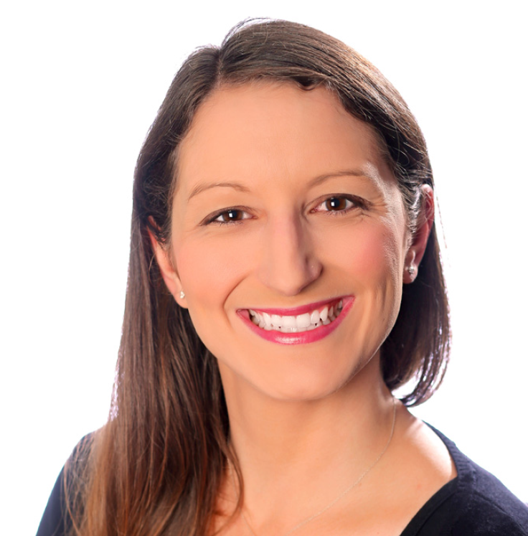
Overview Presentation
Kristen John
NASA JSC
Technical Integration Manager for Lunar Dust Mitigation
Ansel Barchowsky
NASA JPL
Power Electronics Engineer

Slide 13
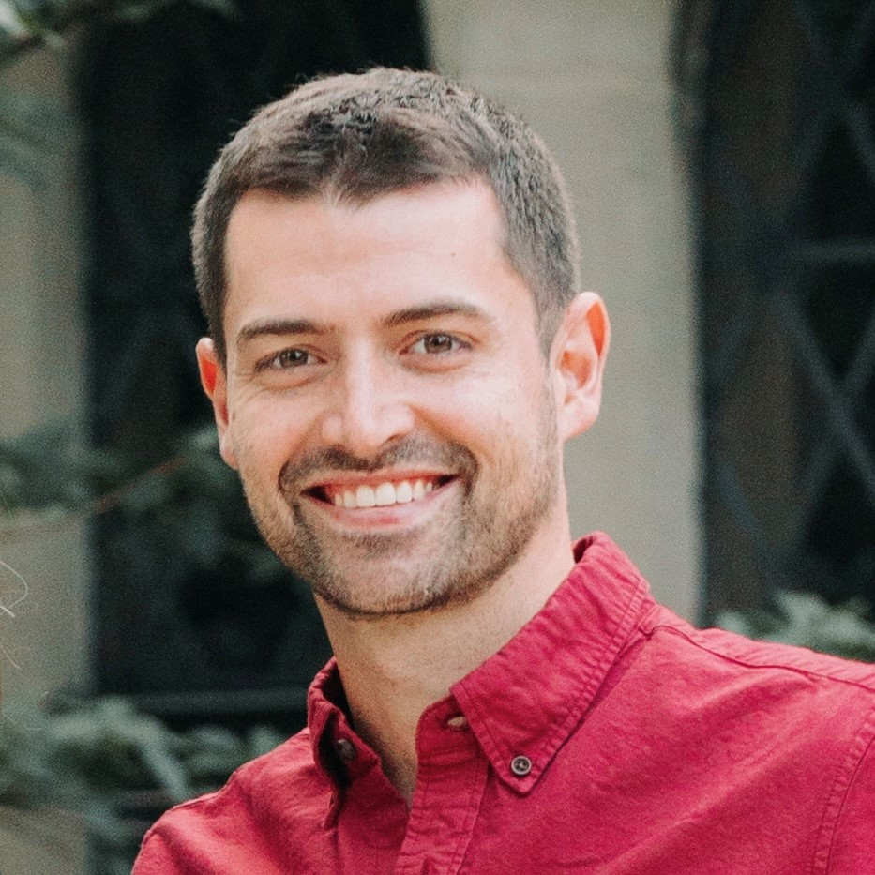
Power Transmission
Matt Zamborsky
Astrobotic
Jeremy Canonge
Astrobotic
Stephen Indyk
Honeybee Robotics

Slide 14
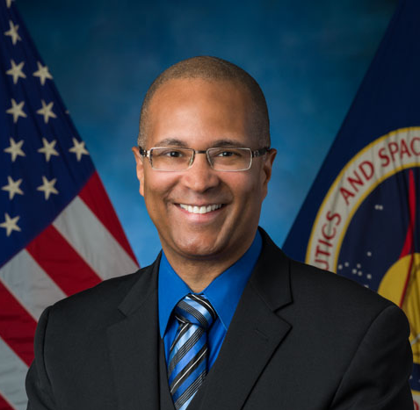
Dust Impact
Brian Troutman
NASA

Slide 15
Joint Discussion / Q&A
Kristen John
NASA JSC
Matt Zamborsky
Astrobotic
Stephen Indyk
Honeybee Robotics
Ansel Barchowsky
NASA JPL
Jeremy Canonge
Astrobotic
Brian Troutman
NASA

