Slide 1

LSIC ISRU Focus Group Monthly http://lsic.jhuapl.edu/ http://lsic-wiki.jhuapl.edu/ (Confluence sign-up required)
June 26, 2024
Jodi Berdis, Karl Hibbitts, Michael Nord, Rick Miller, Anthony Coburger
Jodi.Berdis@jhuapl.edu, Karl.Hibbitts@jhuapl.edu, Michael.Nord@jhuapl.edu, Richard.S.Miller@jhuapl.edu, Anthony.Coburger@jhuapl.edu

Slide 2
Agenda
General updates and house-keeping
  APL is happy to consult as appropriate with ISRU related technologies. This includes site visits!
  Upcoming Meetings
  Funding Opportunities
Lightning Talks! One slide / two minutes each
Zoom Breakout Rooms for each presenter: discuss aspects of their presentation, explore collaboration opportunities, etc.

Slide 3
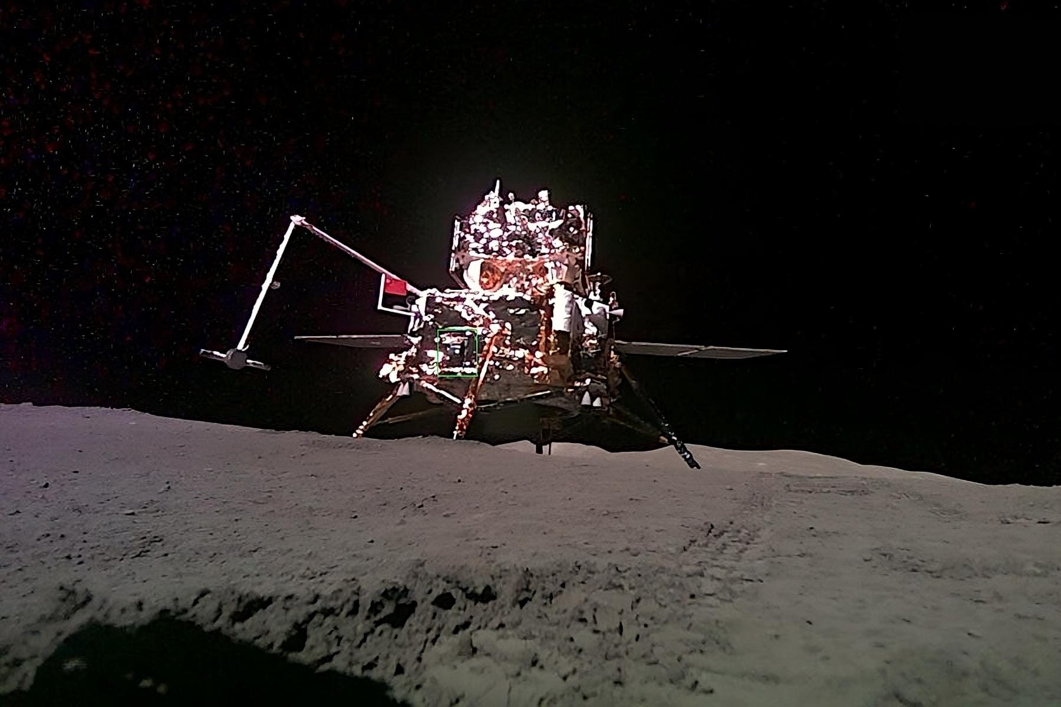
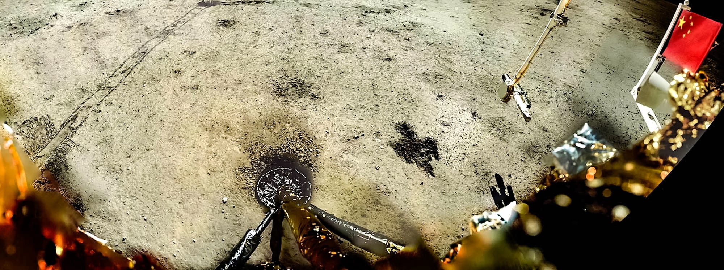
Notable News
Chang’e 6 Sample Return on its way back to Earth!
Lunar surface → orbit June 3, transferred to re-entry module for return to Earth
Touchdown expected June 25

Slide 4
Upcoming Meetings
Joint Crosscutting Capabilities and Surface Power Telecon (Tomorrow, June 27, 11am ET)
  Topic: Dust Effects on Power Cabling
  https://lsic.jhuapl.edu/Events/Agenda/index.php?id=560
E&C’s Lunar Launch and Landing Facilities Workshop (July 23)
  Registration deadline July 11: https://lsic.jhuapl.edu/Events/Agenda/index.php?id=555
International Conference on Environmental Systems (ICES) (July 21-25)
  https://www.ices.space/call-for-paper-2024/
  Sessions include: “Advanced Technologies for In-Situ Resource Utilization”, “Space Architecture”, “Planetary and Spacecraft Dust Properties and Mitigation Technologies”, “Human/Robotics System Integration”
ISRU FG Meetings have moved to third Wednesdays at 11am ET

Slide 5
Funding & Opportunities
2024 SBIR Ignite Phase I: deadline July 30
  Funds U.S. small businesses in their early-stage, high-risk technology development to help make them and their technologies more attractive to private sector investors, customers, and partners.
  Phase I: up to $150k (Idea generation)
  (Phase II: up to $850k (Prototype development))
  https://www.nasa.gov/sbir_sttr/sbir-ignite/
STMD Early Career Faculty Preliminary Proposals Due July 15
  Seeks proposals that are responsive to one of the following two topics:
    Topic 1 – Transformational Advanced Energetic Propulsion
    Topic 2 – Power Systems to Enable Small System Operations in Permanently Shadowed Lunar Regions
https://lsic.jhuapl.edu/Resources/Opportunities.php?f=Job https://lsic.jhuapl.edu/Resources/Funding-Opportunities.php
Notes:
https://lsic.jhuapl.edu/Resources/Funding-Opportunities.php
https://lsic.jhuapl.edu/Resources/Opportunities.php?f=Job
"While DARPA’s traditional purview has been programs in support of national security, as America and its allies return to the Moon, DARPA will support United States Government civil space activities to develop technology purely for non-military applications, to include use by civil space activities on the surface of the Moon."

Slide 6
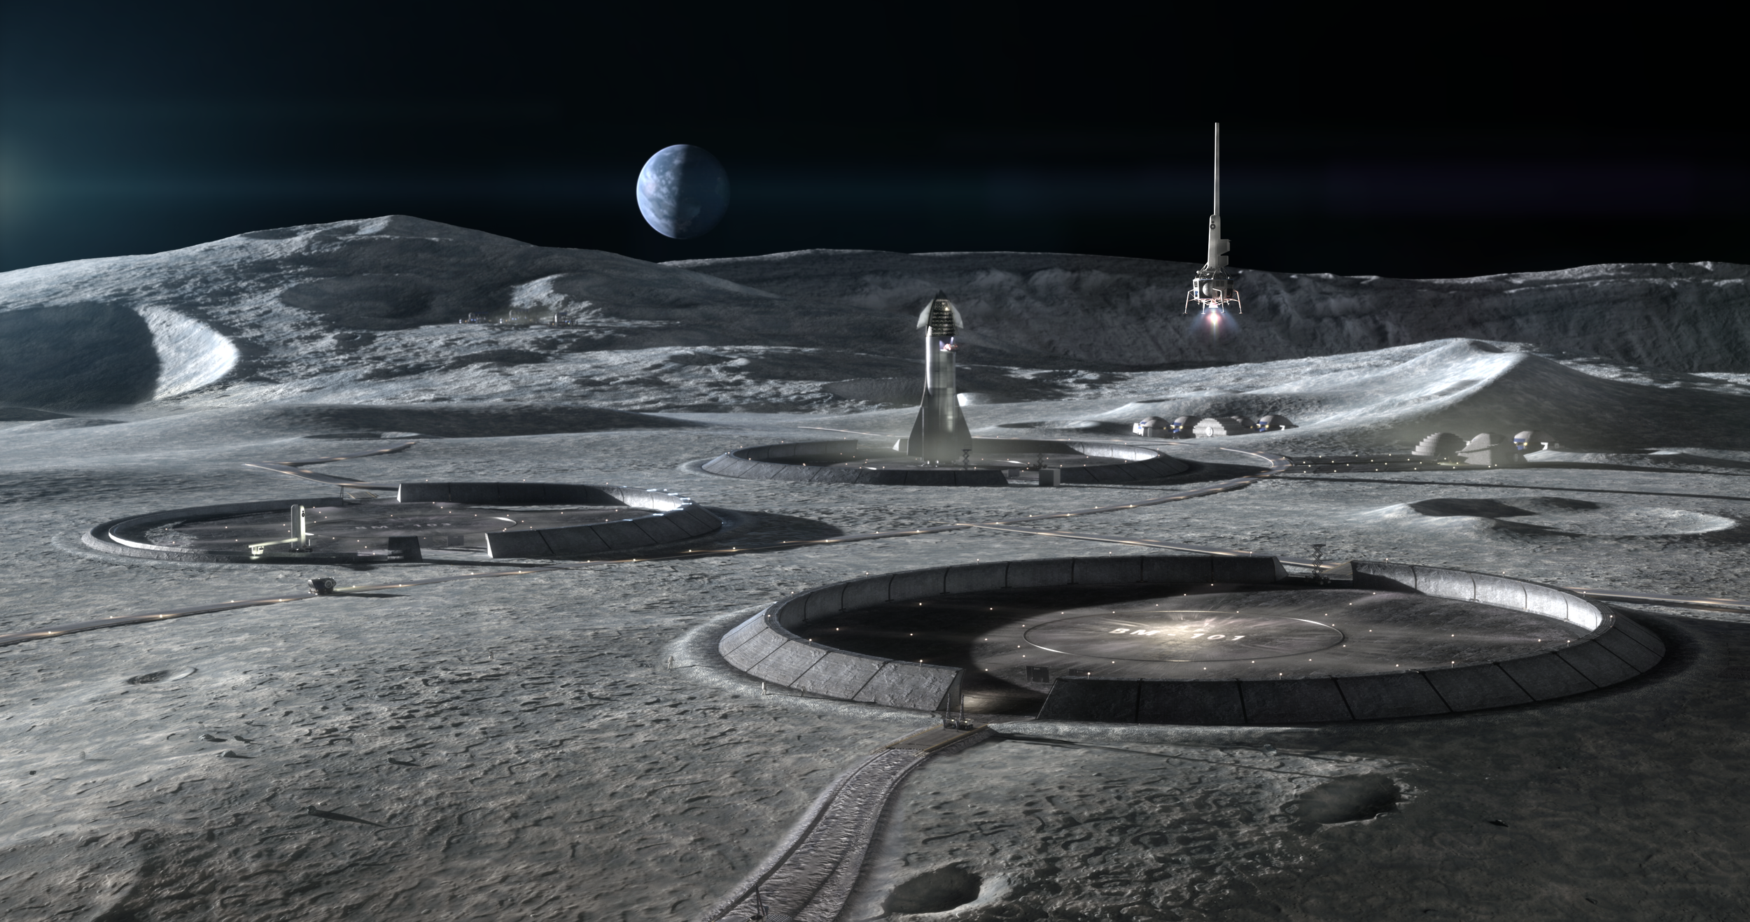
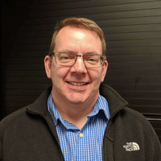
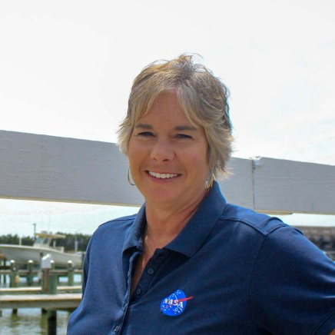
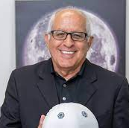
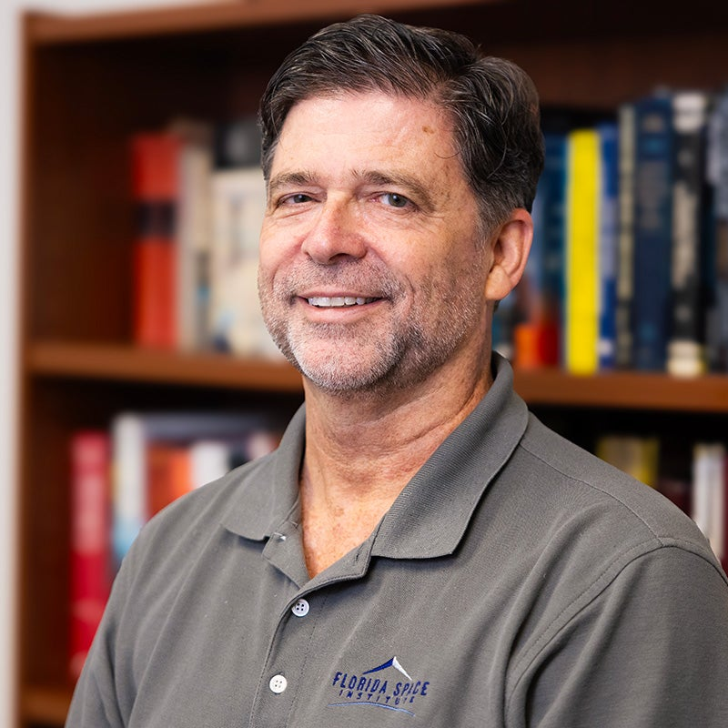
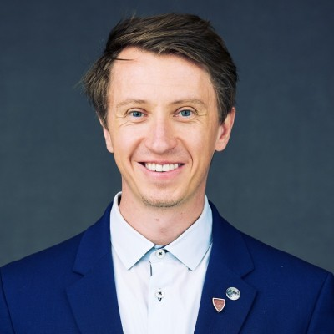

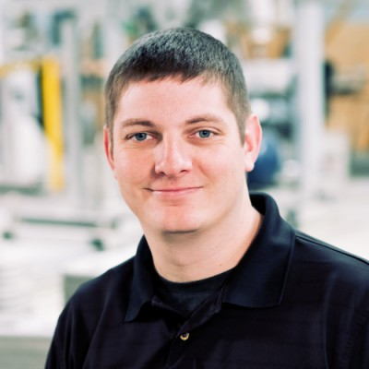
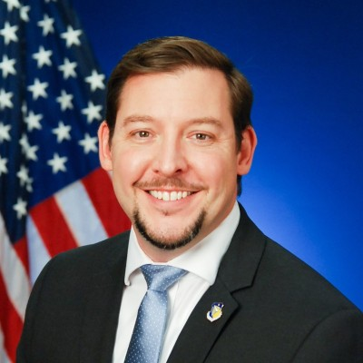
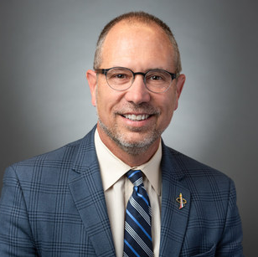
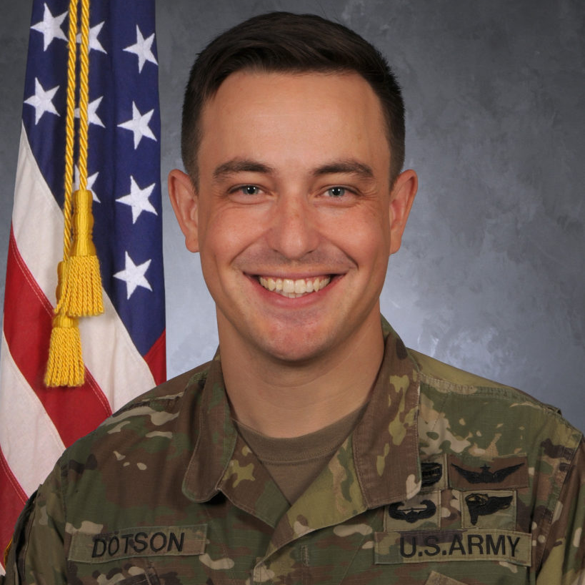
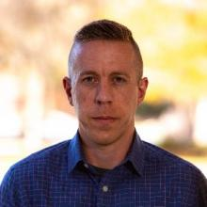
LSIC Excavation and Construction Focus Area
Virtual Lunar Launch and Landing
Facilities Workshop (07/23)
AGENDA:
  Vision for Deploying Landing and Launch Facilities for a sustained presence on the Moon
  Top Level Design Expectations for LLF
  LLF Trade Space Considerations
  State of the Art Landing Pad Analyses - Plume Surface Interaction Analyses and Failure Modes
  Construction Options and Supporting Infrastructure
Credit: ICON Technology
Join LSIC - LSIC.JHUAPL.EDU
Mark Hilburger
(NASA-LARC)
Michelle Munk
(NASA-HQ)
Sam Ximenes
(Astroport)
Phil Metzger
(Univ Central FL)
Ian Jehn
(Colorado School of Mines)
Registration is free and required – Closes July 11th
Evan Jensen
(ICON)
Jason Foley
(AFRL)
Greg Autry
(ASU)
Brandon Dotson
(Univ Central FL)
Kevin Cannon
(Ethos Space)
Interested in Presenting? Email Jibu.Abraham@jhuapl.edu or Sarah.Hasnain@jhuapl.edu

Slide 7
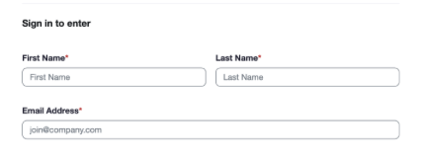
LSIC Monthly Meetings Update
New Zoom Links
LSIC is updating our zoom sign-in! To better serve the community and contact attending members, our zoom links will now require First and Last Name and email addresses. This will not affect how the monthly meetings are attended, and no passcode will be required. If you have any questions or concerns, please reach out to your Focus Area Lead.
New Zoom links start
July 1st

Slide 9
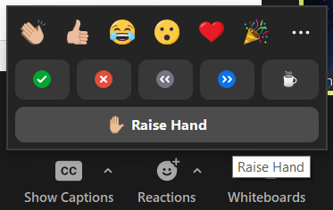
Discussion Etiquette
Please remain muted when not speaking
Welcome to turn on video at your discretion
Content Reminders
  This is a public, international forum
  Respect other speakers and points of view
  No sharing CUI, proprietary, intellectual property, etc.
Questions for Panel
  Write them in the chat
  Raise hand to unmute and ask

Slide 10


Open Discussion with Community
Do you think beneficiation will be required initially for lunar mining?

Slide 11
Open Discussion with Community
Which beneficiation method(s) do you believe will lead to industrial level ISRU mining of the Moon, and what infrastructure will be required beforehand?

Slide 12
Open Discussion with Community
Which will happen first: Oxygen production from MRE/MSE/Carbothermal Reduction or water ice mining in PSRs?
A. Oxygen production from MRE/MSE/Carbothermal Reduction
B. Water ice mining in PSRs

Slide 13
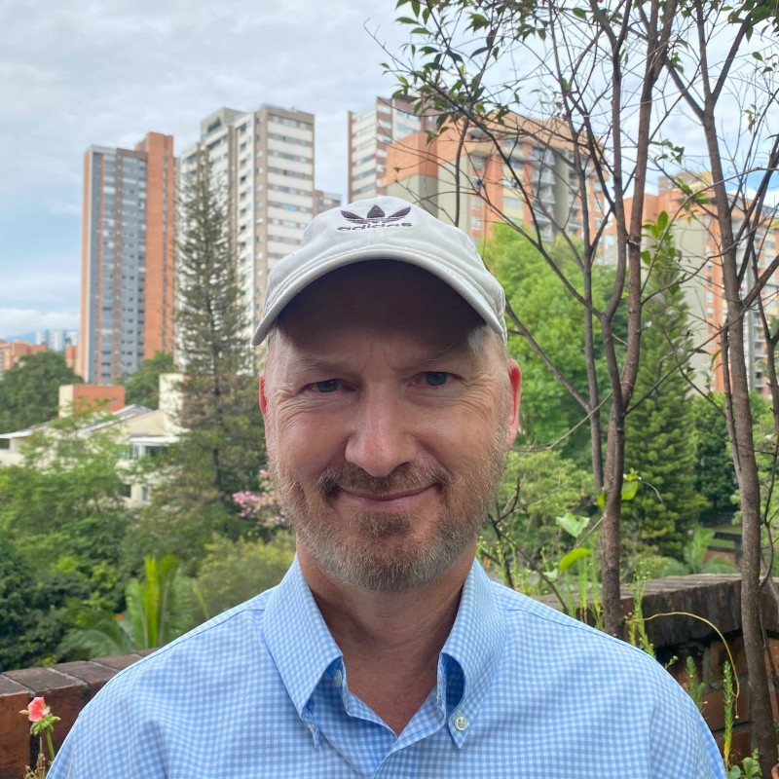

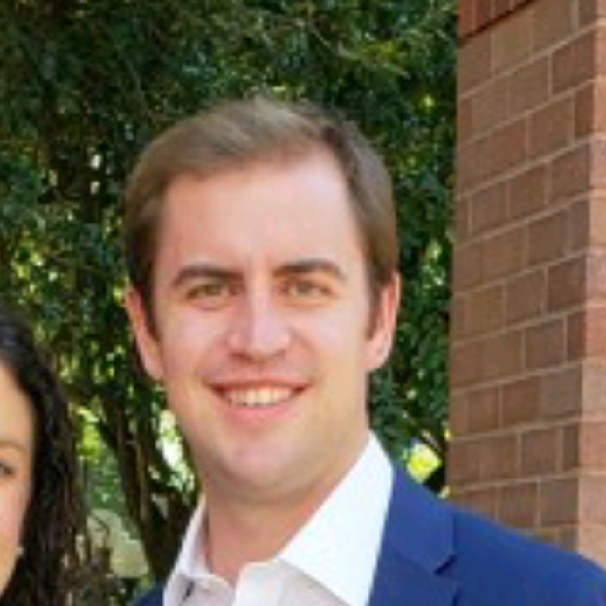
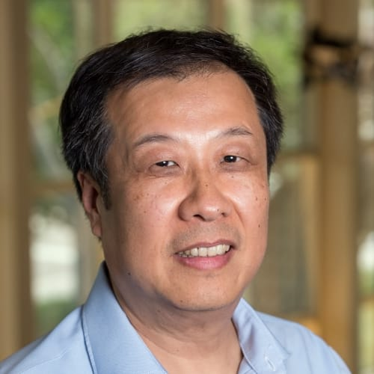
Lunar Beneficiation
Chris Tolton (Colorado School of Mines)
Co-Founder of space startup Orbital Mining Corporation (OMC) in Golden, Colorado.
Graduate student in Space Resources at Colorado School of Mines. Currently building a lunar electrical transmission and storage system under NASA’s Watts on the Moon Challenge (1 of 4 remaining teams). Former US Naval Intelligence Officer with a background in remote sensing. He also holds an MBA from Oxford University.
Kevin Cannon (Colorado School of Mines)
Dr. Kevin Cannon is an Assistant Professor, Geology and Geological Engineering at the
Colorado School of Mines. He holds a Ph.D in Geological and Earth Sciences/Geosciences from Brown University.
David Butler (Schlumberger)
Senior Geophysicist at Schlumberger
Graduate student in Space Resources at Colorado School of Mines (graduated 9 May)
Presenting MCSiFTER (Mines Centrifugal Size Filtering Tool Employing Rotating sieves), a Commercial Payload System payload design for demonstrating beneficiation using nested, centrifugal sieves in a lunar environment. He holds an MS in Geology from the University of Kentucky.
Xu Wang (University of Colorado, Boulder)
Dr. Xu Wang is a research scientist at Laboratory for Atmospheric and Space Physics (LASP) and is affiliated with NASA/SSERVI’s Institute for Modeling Plasma, Atmospheres and Cosmic Dust (IMPACT) at the University of Colorado Boulder. Dr. Wang’s research interests include dust charging and transport, plasma interactions with airless bodies, plasma and dust instrument development, and ISRU and dust mitigation technologies for lunar exploration. He holds a Ph.D in Engineering Physics from the University of Wisconsin (Madison).

