Slide 1
LSIC ISRU Focus Group Monthly http://lsic.jhuapl.edu/ http://lsic-wiki.jhuapl.edu/ (Confluence sign-up required)
July 17, 2024
Anthony Coburger, Jodi Berdis, Karl Hibbitts, Michael Nord, Rick Miller
Anthony.Coburger@jhuapl.edu, Jodi.Berdis@jhuapl.edu, Karl.Hibbitts@jhuapl.edu, Michael.Nord@jhuapl.edu, Richard.S.Miller@jhuapl.edu

Slide 2
Agenda
General updates and house-keeping
APL is happy to consult as appropriate with ISRU related technologies. This includes site visits!
Funding Opportunities
Upcoming Meetings
Eta Space: “Lunar Surface – Long-Term Storage, Transfer, & Liquefaction of Liquid Oxygen”
Nivedha Madhusudhan
Justin Doebel
Community Q&A with Eta Space

Slide 3
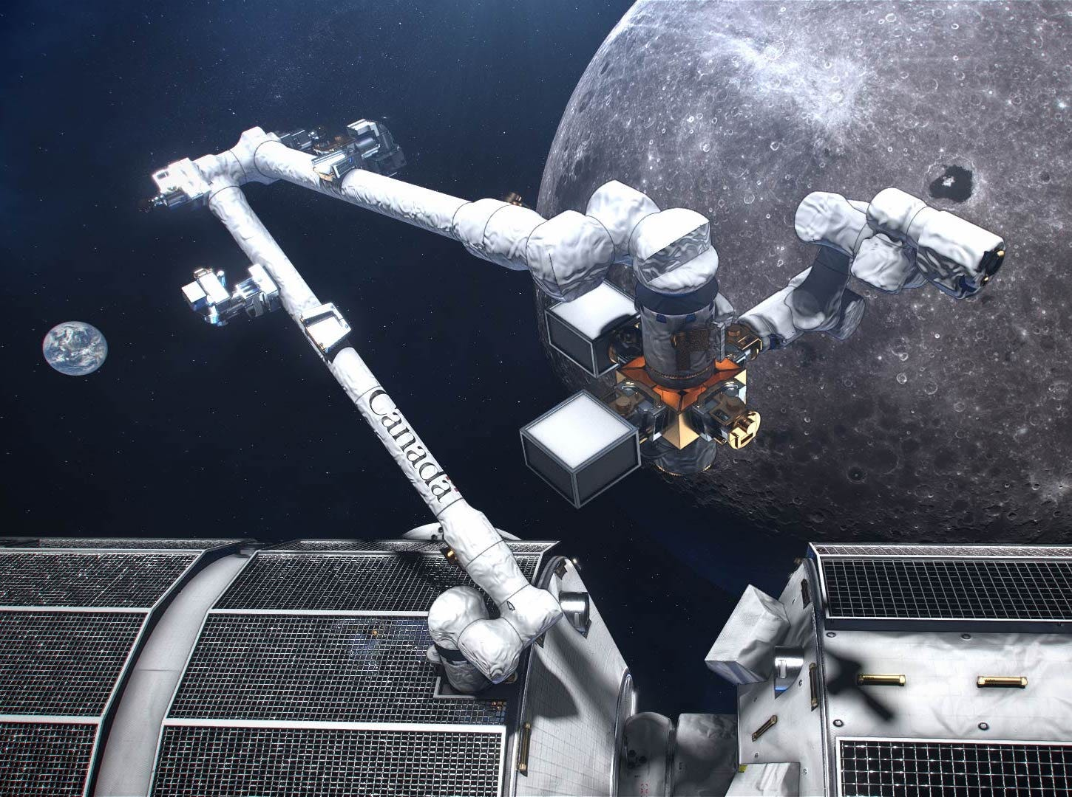
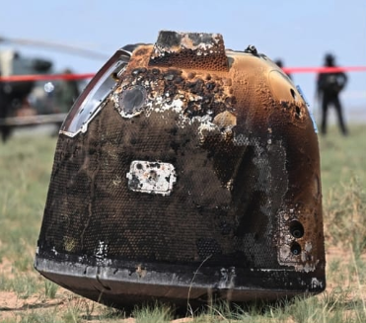
Notable News
Chang’e 6 Sample Returned to Earth!
Container to be unsealed and prepared for storage
Canadarm3 to Service Gateway!
CSA funded MDA Space to design, assemble, and test autonomous robotic system
Image Credit: CSA
Image Credit: Xinhua

Slide 4
Funding & Opportunities
International Moon Day: Tele-operate a robot from anywhere in the world! July 19 & 20
Groups of up to 4 students from each institution can tele-operate a lunar rover prototype in Australia, Canada, Germany or the USA from any location around the world
https://internationalmoonday.org/event/international-moon-day-tele-robotics-2024/
2024 SBIR Ignite Phase I: deadline July 30
Funds U.S. small businesses in their early-stage, high-risk technology development to help make them and their technologies more attractive to private sector investors, customers, and partners.
Phase I: up to $150k (Idea generation)
https://www.nasa.gov/sbir_sttr/sbir-ignite/
Space Resources Webinar Series on “NASA SBIR Opportunities for Innovators”: July 30 at 3:00 PM ET
Michael Vinje (NASA Kennedy Space Center)
https://aiaa.zoom.us/webinar/register/WN_50aytA2PRkayAMb7sUz5Ow
NASA TechRise Student Challenge: deadline November 1
6th – 12th graders: design/build/launch experiments on NASA test flights
https://www.futureengineers.org/NASATechRise
https://lsic.jhuapl.edu/Resources/Funding-Opportunities.php https://lsic.jhuapl.edu/Resources/Opportunities.php?f=Job
Notes:
https://lsic.jhuapl.edu/Resources/Funding-Opportunities.php
https://lsic.jhuapl.edu/Resources/Opportunities.php?f=Job

Slide 5
Upcoming Meetings
E&C’s Lunar Launch and Landing Facilities Workshop (July 23)
Virtual Event
Registration Closed: https://lsic.jhuapl.edu/Events/Agenda/index.php?id=555
International Conference on Environmental Systems (ICES) (July 21-25)
Louisville, Kentucky
Registration Open: https://ices.space/
Sessions include: “Advanced Technologies for In-Situ Resource Utilization”, “Space Architecture”, “Planetary and Spacecraft Dust Properties and Mitigation Technologies”, “Human/Robotics System Integration”
ASCEND (July 30 – August 1)
Las Vegas, Nevada
Registration open: https://www.ascend.events/
Power’s Key Lunar Surface Power Trades Workshop (August 22)
Virtual Event
Registration Open: https://lsic.jhuapl.edu/Events/Agenda/index.php?id=567
Topic: Key Trades for Lunar Surface Power Systems
Joint Telecon with CC and E&C (August 28)
Virtual Event
Topic: TBD
ISRU’s Pilot Plant Systems Engineering Workshop (September 18)
Virtual Event
Topic: Exploring ISRU System Interfaces

Slide 6
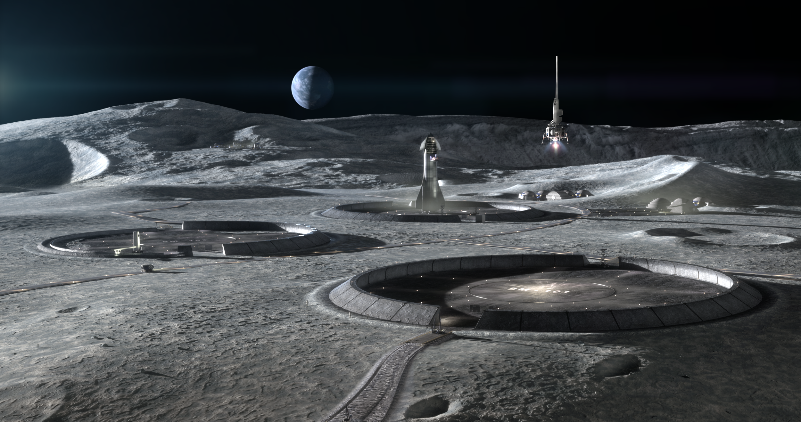
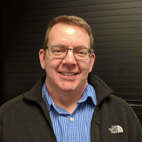
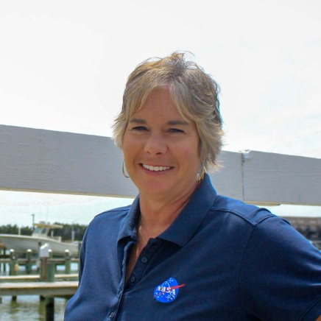
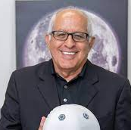
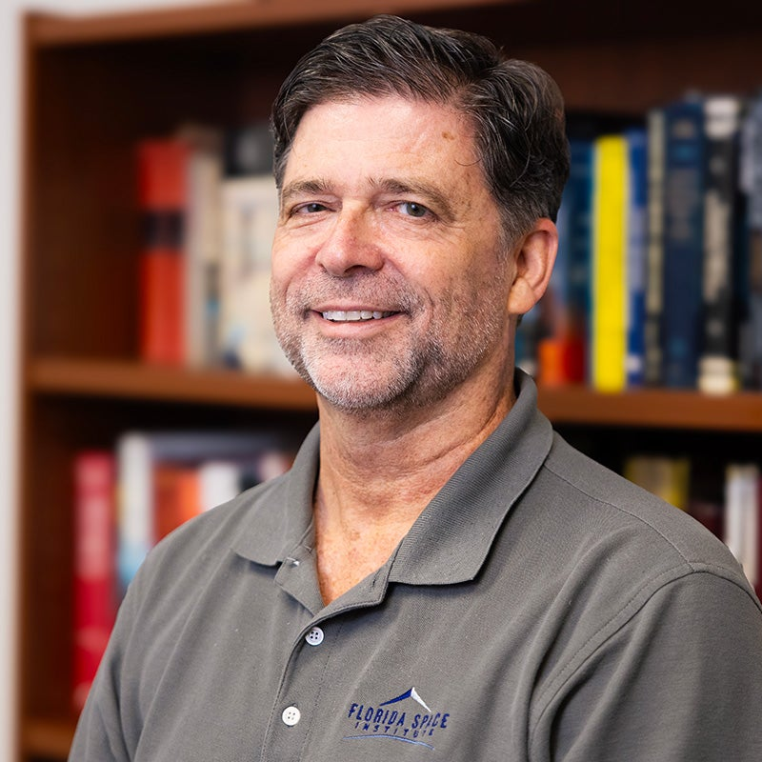
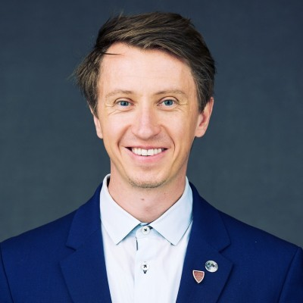
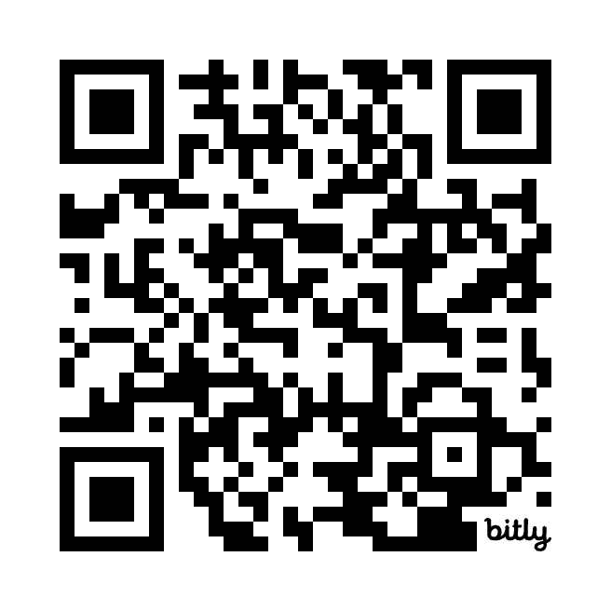
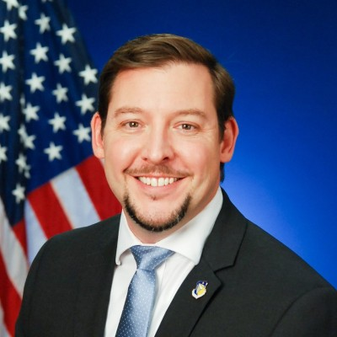
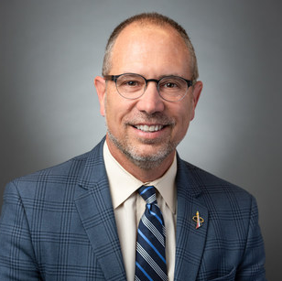
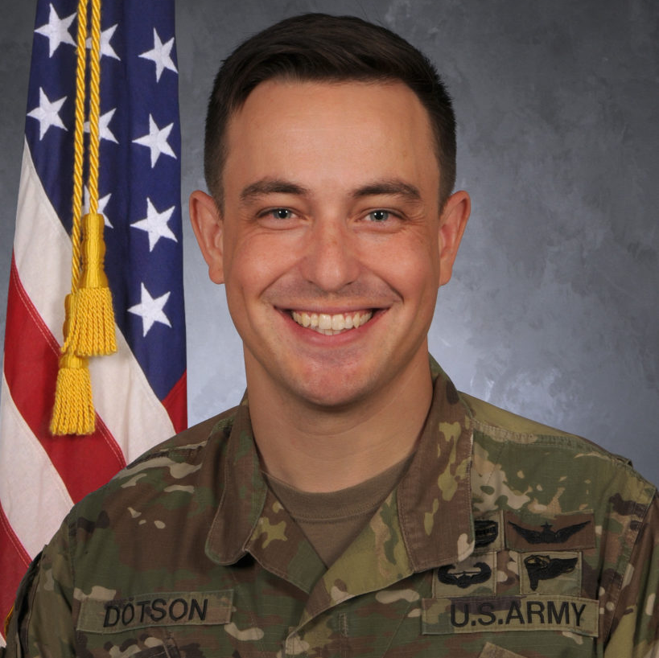
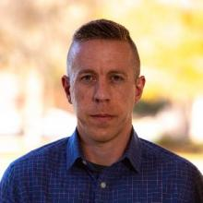
LSIC Excavation and Construction Focus Area Virtual Lunar Launch and Landing Facilities Workshop (07/23)
AGENDA:
Vision for Deploying Landing and Launch Facilities for a sustained presence on the Moon
Top Level Design Expectations for LLF
LLF Trade Space Considerations
State of the Art Landing Pad Analyses - Plume Surface Interaction Analyses and Failure Modes
Construction Options and Supporting Infrastructure
Credit: ICON Technology
Join LSIC - LSIC.JHUAPL.EDU
Mark Hilburger
(NASA-LARC)
Michelle Munk
(NASA-HQ)
Sam Ximenes
(Astroport)
Phil Metzger
(Univ Central FL)
Ian Jehn
(Colorado School of Mines)
Registration is free and required – Closes July 11th
Evan Jensen
(ICON)
Jason Foley
(AFRL)
Greg Autry
(ASU)
Brandon Dotson
(Univ Central FL)
Kevin Cannon
(Ethos Space)
Interested in Presenting? Email Jibu.Abraham@jhuapl.edu or Sarah.Hasnain@jhuapl.edu

Slide 7
LSIC | Key Lunar Surface Power Trades Workshop (08/22)
The Surface Power Focus Group will host a virtual workshop encompassing some of the key trades for Lunar surface power systems on Thursday, August 22
Agenda Items
Overview of key power trades implied by Moon-to-Mars Architecture Definition Document
Continuous power availability panel
Power distribution panel
Community lightning talks
**Accepting abstract submissions on the website NOW!**
Connecting key trades to STMD Shortfalls
Breakout activities
Registration is free and required; closes August 8
https://lsic.jhuapl.edu/Events/Agenda/index.php?id=567
Submit abstracts for lightning talks by August 5
Join LSIC – LSIC.JHUAPL.EDU
Questions? Email us at Facilitator_Power@jhuapl.edu
7

Slide 8
O2fR Pilot Plant Systems Engineering Workshop
Wednesday September 18th, 2024
Virtual Workshop to Explore System Interfaces of an ISRU Pilot Plant
Hosted by LSIC ISRU
Sessions include
Working-Meeting Participation
Survey Results and Discussion
Roundtable Dialogue
Vote-based Q&A
Registration is free and required – Closes September 6th

Slide 9
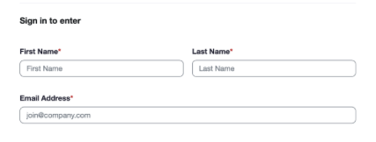
LSIC Monthly Meetings Update New Zoom Links
LSIC is updating our zoom sign-in! To better serve the community and contact attending members, our zoom links will now require First and Last Name and email addresses. This will not affect how the monthly meetings are attended, and no passcode will be required. If you have any questions or concerns, please reach out to your Focus Area Lead.
New Zoom links start
July 1st

Slide 10
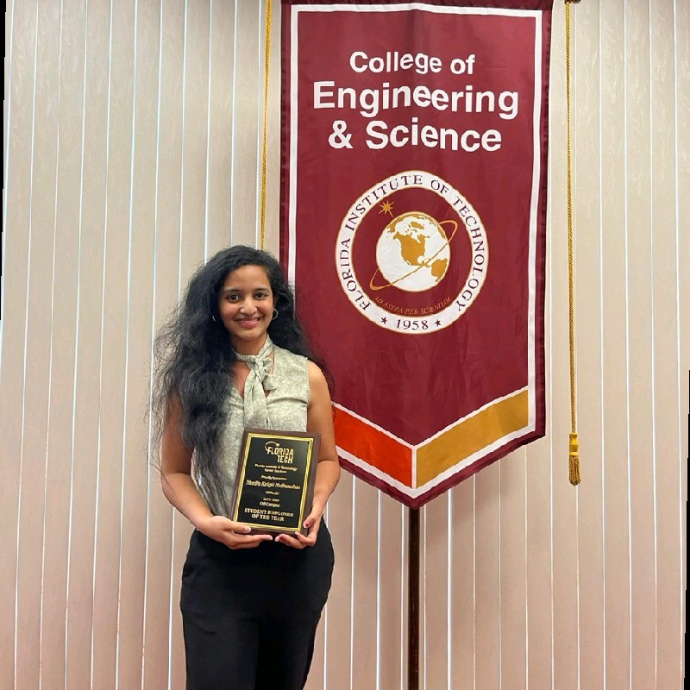
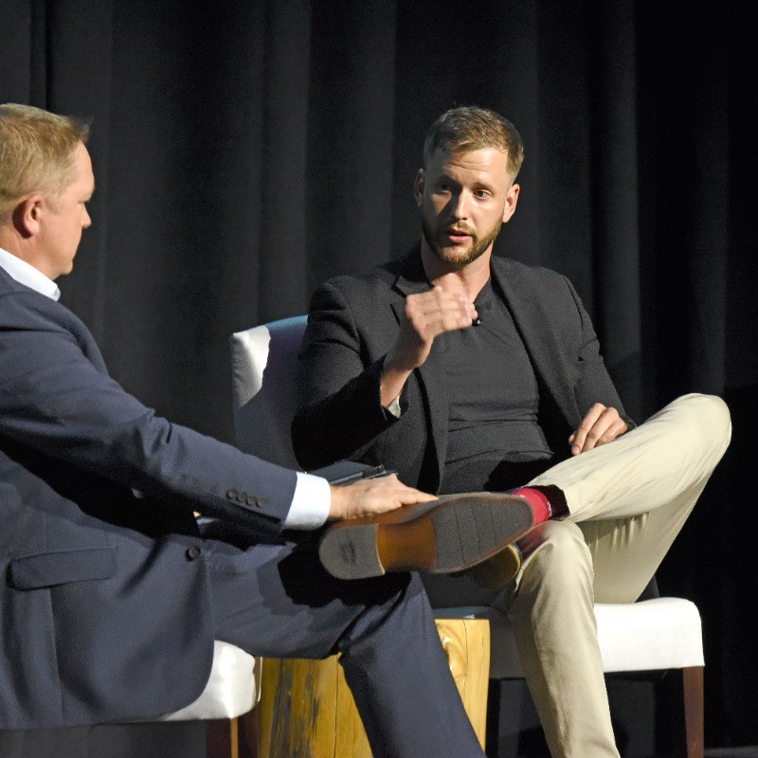
“Lunar Surface – Long-Term Storage, Transfer, & Liquefaction of Liquid Oxygen”
Nivedha Madhusudhan (Eta Space)
Nivedha is a Mechanical Engineer at Eta Space, where she leads the development of the lunar propellant production system. She received her Bachelor’s Degree in Aerospace Engineering and a Master’s degree in Mechanical Engineering, focusing her research on thermal and energy analysis for systems in outer space. Nivedha’s primary focuses is on design for manufacturing and developing analytical models and simulations for various applications.
Justin Doebel (Eta Space)
Mr. Doebel is serving as Director – Business Development – Space & Energy sectors. Mr. Doebel received a Masters of Business Administration in International Business as well as a Bachelors Degree in Supply Chain Management & Logistics from Old Dominion University - Strome College of Business. Mr. Doebel is leading efforts to maximize Eta Space’s technology within the commercial markets for space while simultaneously providing Earth with sustainable energy options to transition the current transportation model to a greener hydrogen future.

