Slide 1


LSIC Autonomy Workshop
Day 1
August 21, 2023

Slide 2




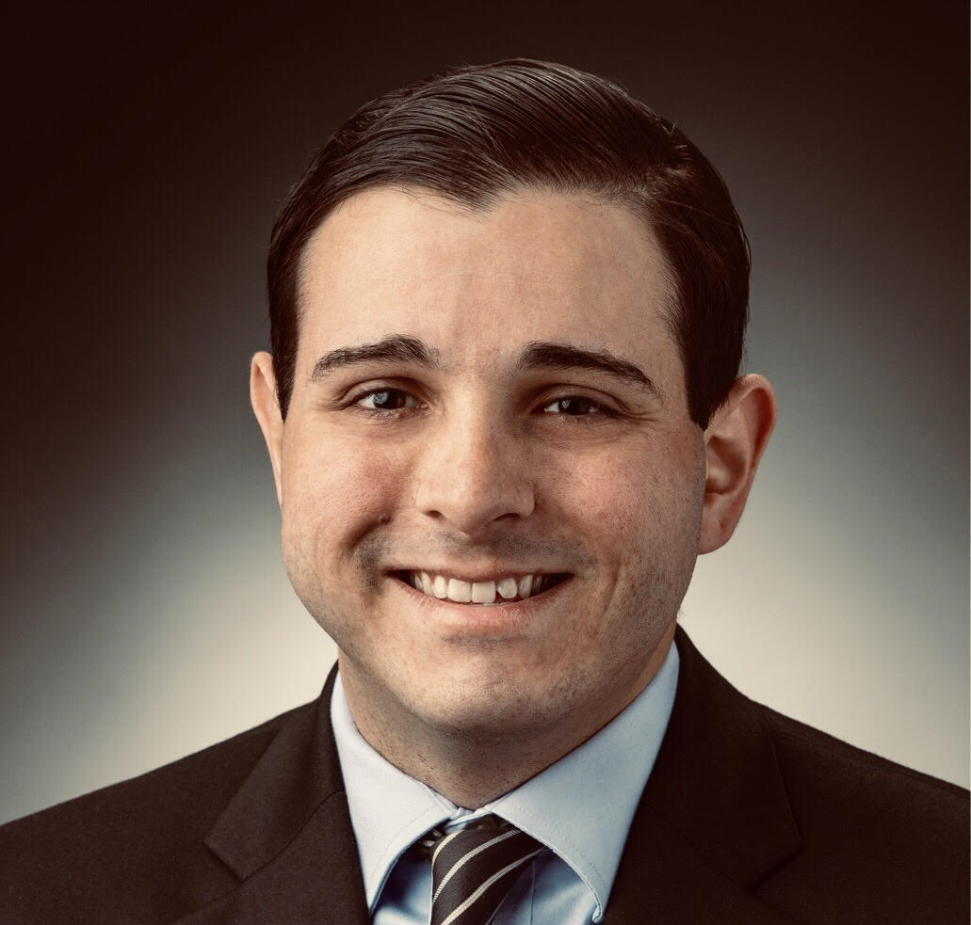
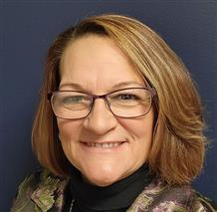
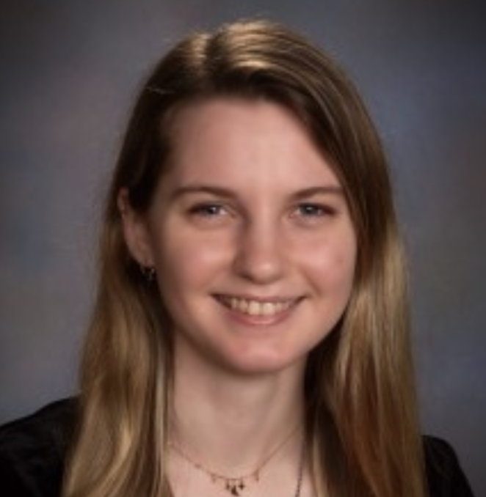
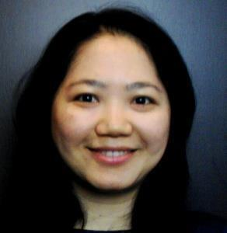

The Planning Committee
Johns Hopkins University
Applied Physics Laboratory
Jibu Abraham
Sarah Hasnain
Mario Lento
Kratina MacKay
Danielle Mortensen
Stacy Teng
Alhassan Yasin

Slide 3
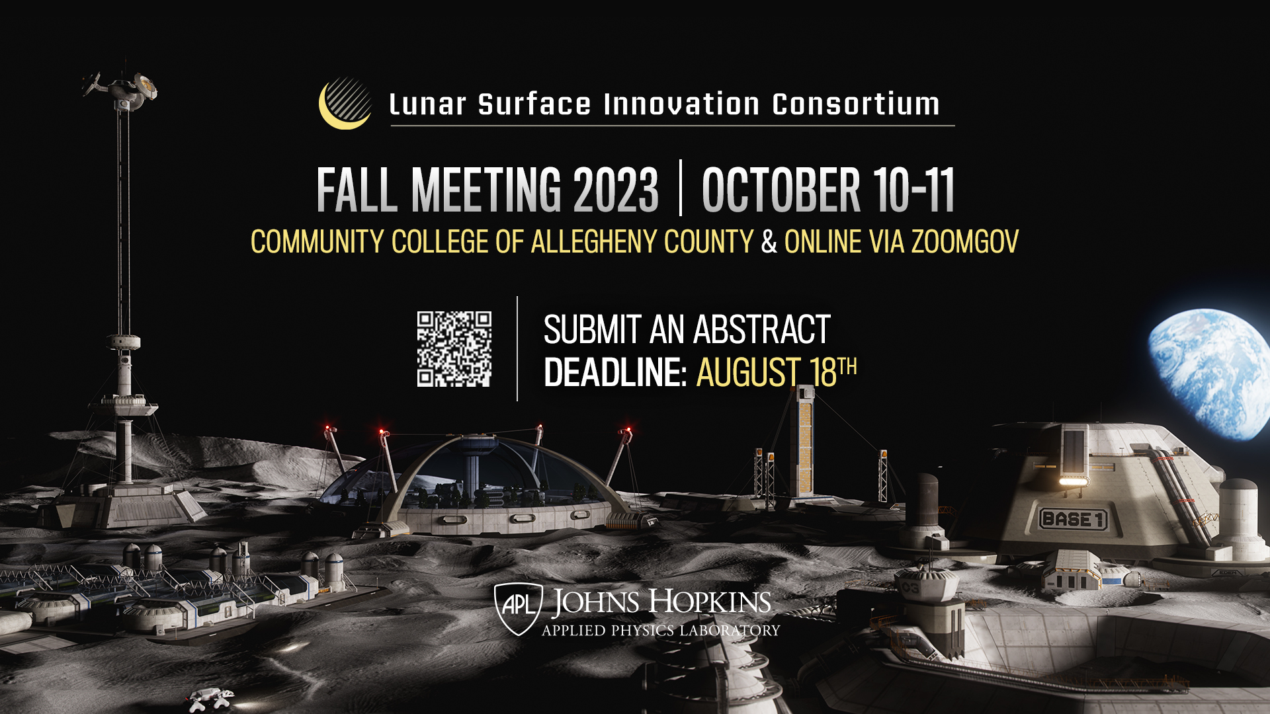
Abstract Submission deadline extended to Aug 25th.
Register now!
Notes:
Dr. Smith is a member of the Principle Professional Staff at JHU/APL with over 35 years of experience analyzing systems from risk, reliability, and safety perspectives. These systems included: NASA and DoD missions, payloads, ground communication systems, air traffic control systems, and missile systems. Dr. Smith is the reliability engineering lead for APL’s Space Exploration. He created and managed NASA’s International Space Station Program Probabilistic Risk Assessment specifically geared toward quantifying the safety risk during operations. He received his B.S. in Aerospace Engineering, M.S. in Engineering Management, and Ph.D. in Reliability Engineering all from the University of Maryland.

Slide 4




LSIC | Meeting Logistics
Use Slido to submit questions and for workshop polls
  https://www.slido.com
  #LSIC-Autonomy
  Password: 2023Workshop
  Polls already open!
Event schedule and program
  https://lsic.jhuapl.edu/Events/Agenda/index.php?id=474
Slido
Event Page
4

Slide 5
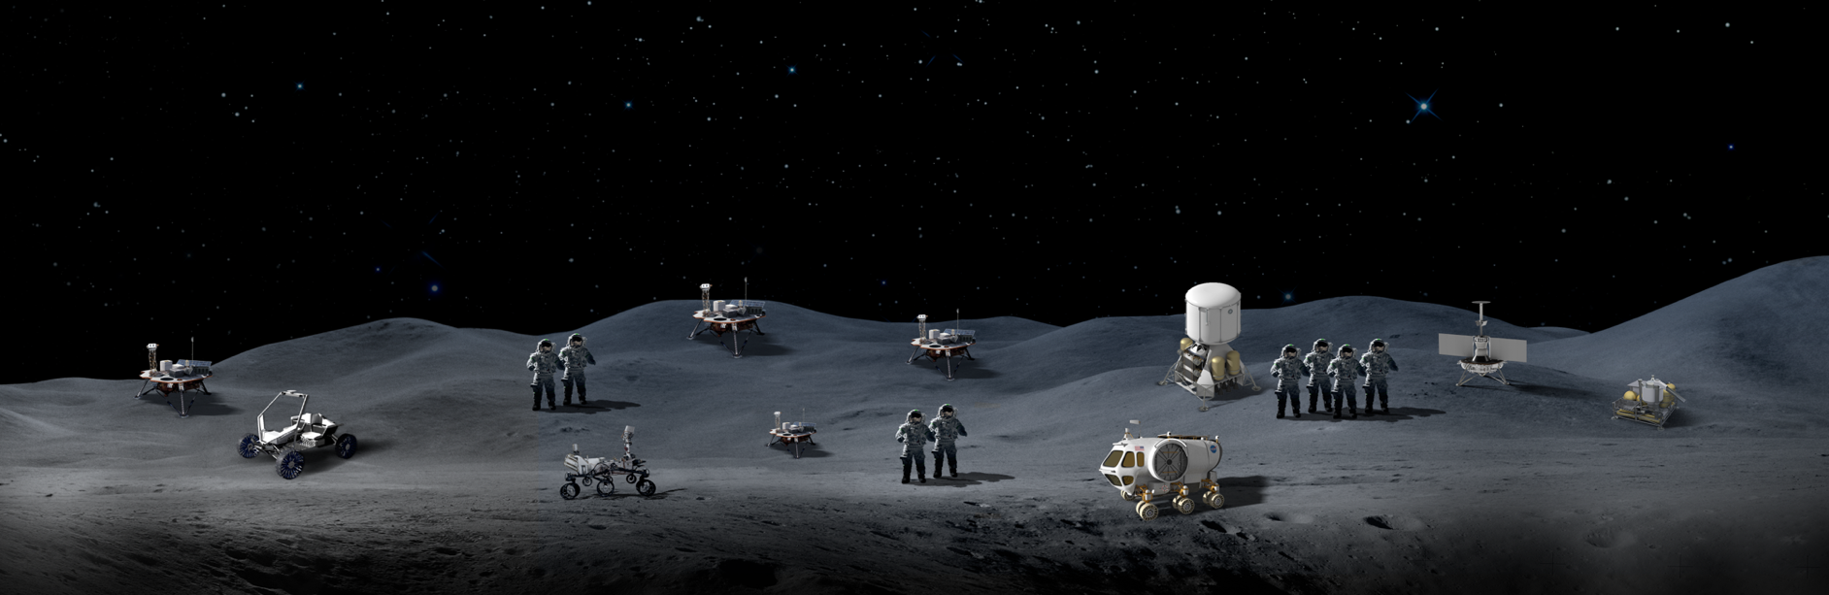


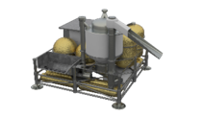
LSIC | Objective
Objective for the Workshop: The goal of this workshop is to gather the Lunar community to exchange ideas on autonomy, as well as identify technology gaps and use cases for establishing a sustainable presence on the Moon and Mars.

Slide 6
LSIC | Introduction
Kevin Somervill
NASA
Deputy Program Director for Technology Maturation, Space Technology Mission Directorate (STMD)
6

Slide 7
Session 1: Autonomous Systems, Situational and Self Awareness, Reasoning and Acting
Facilitator: Alhassan Yasin (JHU/APL)
Notes:
Dr. Smith is a member of the Principle Professional Staff at JHU/APL with over 35 years of experience analyzing systems from risk, reliability, and safety perspectives. These systems included: NASA and DoD missions, payloads, ground communication systems, air traffic control systems, and missile systems. Dr. Smith is the reliability engineering lead for APL’s Space Exploration. He created and managed NASA’s International Space Station Program Probabilistic Risk Assessment specifically geared toward quantifying the safety risk during operations. He received his B.S. in Aerospace Engineering, M.S. in Engineering Management, and Ph.D. in Reliability Engineering all from the University of Maryland.

Slide 8
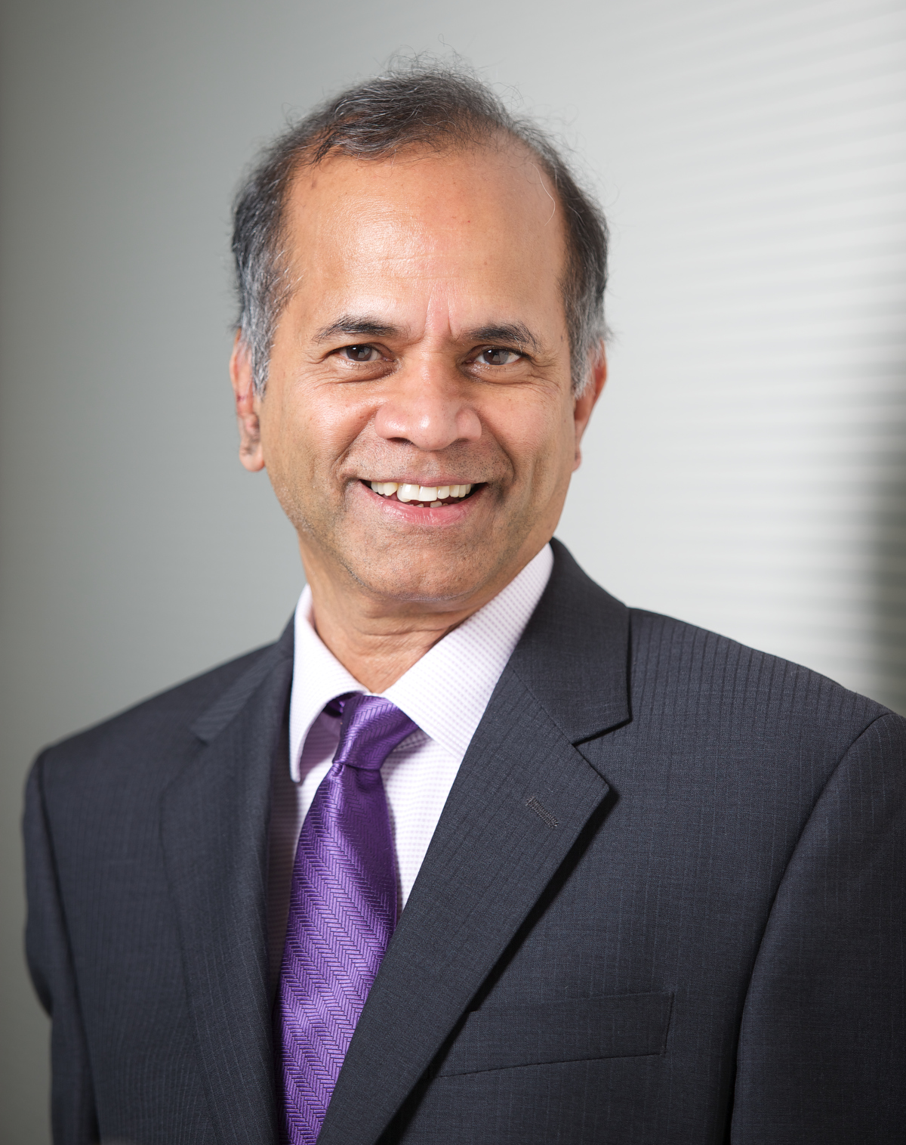
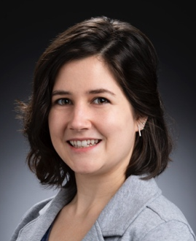
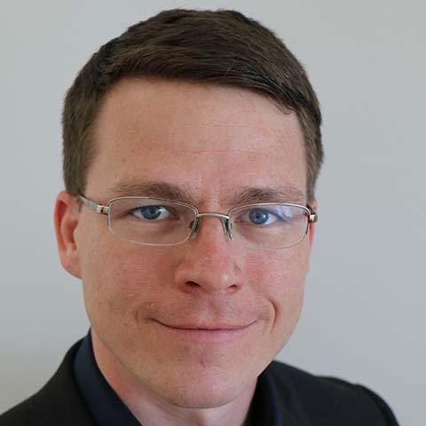
LSIC | Panel Discussion 1
Session 1: Autonomous Systems, Situational and Self Awareness, Reasoning and Acting
Rama Chellappa (JHU)
Emma Holmes (JHU/APL)
Andrew Petruska (CSM)

Slide 9
LSIC | Coffee Break
See you all back
at 11:05 AM ET
Slido Poll:

Slide 10

LSIC | Coffee Break
See you all back
at 11:05 AM ET
Slido Poll:
Password: 2023Workshop

Slide 11
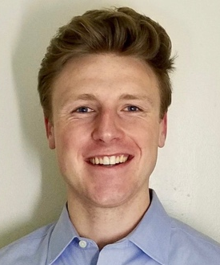

LSIC | Presentation 1a
Session 1: Autonomous Systems, Situational and Self Awareness, Reasoning and Acting
The Future of Precision Lunar Localization
Traditional planetary surface mobility platforms have historically relied on imprecise localization that excels in wide open, long distance traversal applications. The surface systems of the next century, especially within the context of Moon to Mars, however, will require high precision to enable continuous operation in dusty, high dynamic range, high speed, spectrally reflective, and texture-limited environments. Making the problem more challenging are long-term reliability requirements, especially when navigating around surface assets for construction, ISRU and increasingly complex science objectives.
This presentation will focus on discussing the localization difficulties posed by these challenges, tradeoffs in sensing modalities, and recommendations for future technology development to assess and de-risk potential approaches. Discussion will revolve around overcoming the unique environmental constraints inherent to robotic sitework in a lunar environment. Additional presentation emphasis will be on robotic total stations and their applicability to lunar sitework robotics as a particularly promising sensing modality. Lessons learned exploring this modality within a lunar construction context will be shared.
Alex Pletta & Ben Younes (Astrobotic)

Slide 12
LSIC | Presentation 1b
Session 1: Autonomous Systems, Situational and Self Awareness, Reasoning and Acting
Autonomy Technologies for Systems of a Moon Base
The aim of the workshop is to “explore emerging autonomy technologies that could enable or enhance mission capabilities, reduce mission risk, and reduce mission cost.” Enhancing mission capabilities will depend on how capable and trustworthy the autonomy implemented is. As systems increase in complexity, and also with multiple interdependent/interacting systems, current autonomy capability and trustworthiness is very low. A paradigm and technology from NASA that addresses this shortcoming will be discussed, the NASA Platform for Autonomous Systems (NPAS). NPAS also happens to address reduction of mission risk and cost. NPAS will be discussed as a capability that is reaching readiness for space use, but also serves as a reference to develop technologies suitable for integrated autonomous operations of lunar systems; encompassing autonomous systems, situational awareness, and reasoning and acting.
Fernando Figueroa (NASA)

Slide 13

LSIC | Presentation 1c
Session 1: Autonomous Systems, Situational and Self Awareness, Reasoning and Acting
Autonomous Systems, Humans, and Reliability
Autonomy will assume an increasingly critical role in the realm of space exploration, spanning diverse domains. Its application will range from robots operating independently in remote and hostile environments to systems in close and continuously interaction with human counterparts. V&V of autonomous systems remains an outstanding challenge, with failure modes often coming to light only through extensive and costly experimentation. Consequently, the test, break, fix cycle can dominate cost and schedule risk in large AI systems. Further, AI systems interacting with humans have advanced rapidly recently but fall far short in many respects. In this case, the challenge is for AI to understand human objectives as well at the human cognitive and emotional state so that it can carefully structure interactions to mitigate human errors and optimize performance. Thus, while AI already offers powerful new capabilities, there are significant challenges to overcome when high reliability is critical.
Jim Bellingham (JHU)

Slide 14


Password: 2023Workshop
Q&A
Slido Q&A
Session 1: Autonomous Systems, Situational and Self Awareness, Reasoning and Acting

Slide 15
LSIC | Lunch Break
See you all back
at 12:45 PM ET
Slido Poll:

Slide 16

LSIC | Lunch Break
See you all back
at 12:45 PM ET
Slido Poll:
Password: 2023Workshop

Slide 17
Session 1: Autonomous Systems, Situational and Self Awareness, Reasoning and Acting
LSIC | Networking Discussion 1
Situational and Self Awareness
Reasoning and Acting / Trust in Autonomous Systems
Zoom Room 4:
Tim Cole (facilitator)
Danielle Mortensen (facilitator)
John Gersh (SME)
Zoom Room 5:
Karl Hibbitts (facilitator)
Bob Chalmers (SME)
Zoom Room 6:
Sean Young (facilitator)
Julie Obenauer-Motley (SME)
Matt Fifer (SME)
Zoom Room 1:
Lindsey Tolis (facilitator)
Kristin Jaburek (facilitator)
Tom Cheng (SME)
Zoom Room 2:
Raymond Lu (facilitator)
Alhassan Yasin (SME)
Zoom Room 3:
Sam Andrade (facilitator)
Terry Fong (SME)
Coffee Break
1:45 PM – 1:55 PM
ET

Slide 18
LSIC | Coffee Break
See you all back
at 1:55 PM ET
Slido Poll:

Slide 19

LSIC | Coffee Break
See you all back
at 1:55 PM ET
Slido Poll:
Password: 2023Workshop

Slide 20
Session 2: Collaborative Systems
Facilitator: Sarah Hasnain (JHU/APL)

Slide 21
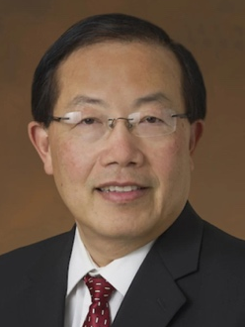
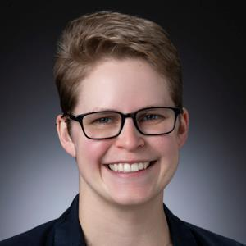
LSIC | Panel Discussion 2
Session 2: Collaborative Systems
Edward Chow (NASA)
Grace Gao (Stanford)
Julie Obenauer-Motley (JHU/APL)

Slide 22
LSIC | Coffee Break
See you all back
at 2:45 PM ET
Slido Poll:

Slide 23

LSIC | Coffee Break
See you all back
at 2:45 PM ET
Slido Poll:
Password: 2023Workshop

Slide 24

LSIC | Presentation 2a
Session 2: Collaborative Systems
Human-Collaborative Robotic Autonomy: Earth-Moon Maturation
The promise of autonomous systems as applied to collaborative operations is clear, and approaches to human-autonomy interaction continue to evolve and improve. On Earth, there are many examples of collaborative robotic system applications and a growing number of human-robot systems that exhibit sufficient technological maturity and performance. The same should apply to surface operations involving autonomy and collaboration on the Moon. Development gaps hindering direct transfer of such capabilities to the lunar surface environment are associated with effectiveness, robustness, and survivability in that domain, more so than with the autonomy technology itself. Most technology gaps may in fact be associated with hardware that can host and execute the autonomy. This brief talk aims to share and support this perspective by highlighting related R&D that has been quite active within fundamental and applied robotics research in past decades, including as driven directly by envisioned lunar and planetary surface mission applications. In lieu of mission opportunities involving more than one surface asset, Earth-proven technology has not undergone the necessary tailoring and forging to achieve readiness for infusion into collaborative lunar or planetary surface systems. With deliberation now resurfacing with the prospect of real missions in mind, some thoughts are shared on what is needed.
Eddie Tunstel (Motiv Space Systems)

Slide 25
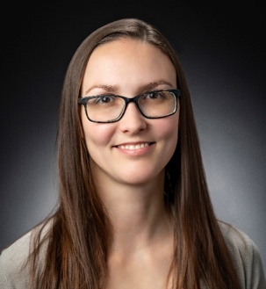
LSIC | Presentation 2b
Session 2: Collaborative Systems
Human-Machine Teaming Challenges for Future Operations
As we consider how to advance and innovate across domains ranging from commercial delivery, to military, to space – advancing the state of the art of technology and machines to perform as teammates to our humans, rather than just tools, will be vital. Human-Machine Teaming is not new, but advances in Artificial Intelligence and robotics are opening a new frontier of both opportunities and challenges for developers, users, and policy makers. A high-level overview of how one team at JHU/APL thinks about this area will be offered in this session.
Lynn Reggia (JHU/APL)

Slide 26
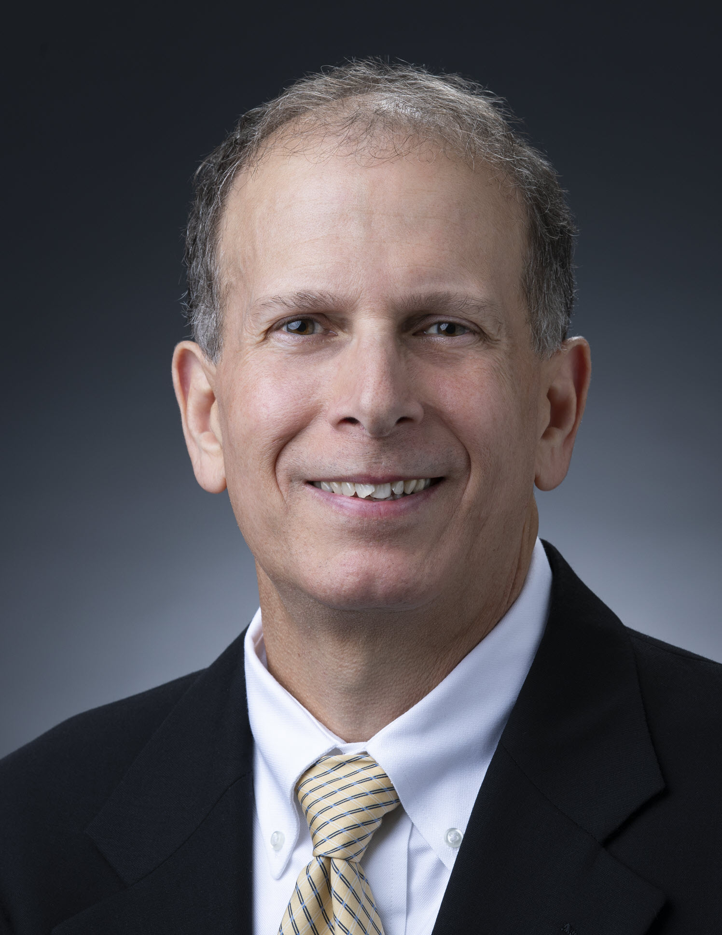
LSIC | Presentation 2c
Session 2: Collaborative Systems
Intuitive Delay-Tolerant Control of Dexterous Dual-Arm Robots
The Johns Hopkins University Applied Physics Laboratory has developed a system that enables a human operator to easily control a dexterous dual-arm robot, even if large distances between the operator and robot cause significant communication time delays. Using an immersive mixed-reality interface, the operator first performs part of the task in real time using a simulated model of the robot. When the operator is satisfied with the motion, commands are sent to the robot, and returned 3D data is used to confirm robot performance. This iterative model-mediated control approach will enable remote operators to help robots complete tasks that are beyond the ability of autonomy.
Dave Handelman (JHU/APL)

Slide 27
Password: 2023Workshop
Q&A
Slido Q&A
Session 2: Collaborative Systems

Slide 28
LSIC | Coffee Break
See you all back
at 3:35 PM ET
Slido Poll:

Slide 29

LSIC | Coffee Break
See you all back
at 3:35 PM ET
Slido Poll:
Password: 2023Workshop

Slide 30
LSIC | Networking Discussion 2
Session 2: Collaborative Systems
Human-Machine Teaming
Machine-Machine Teaming / Swarms
Zoom Room 1:
Karl Hibbitts (facilitator)
Tim Cole (facilitator)
Bobby Wilson (SME)
Zoom Room 2:
Sarah Hasnain (facilitator)
John Gersh (SME)
Zoom Room 3:
Sam Andrade (facilitator)
Sean Young (facilitator)
Matt Fifer (SME)
Zoom Room 4:
Lindsey Tolis (facilitator)
Jean-Pierre de la Croix (SME)
Zoom Room 5:
Kristin Jaburek (facilitator)
Amir Rahmani (SME)
Zoom Room 6:
Danielle Mortensen (facilitator)
Terry Fong (SME)
Bob Bamberger (SME)
Meet back in Main Room at 4:35 PM ET

Slide 31
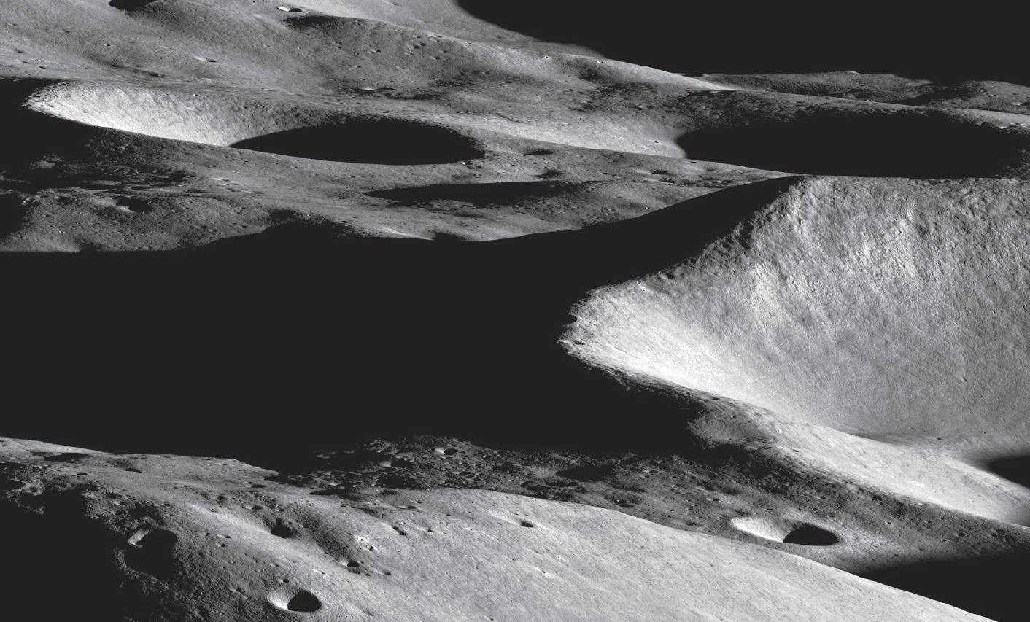
Day 2 starts 10:00 AM ET tomorrow, Aug 22nd!
Acknowledge the moment we’re having.
Day 1 Closing Remarks
Mario Lento
Johns Hopkins University Applied Physics Lab
LSIC Extreme Access Focus Group Facilitator
Lunar Reconnaissance Orbiter Camera image (M1432398306LR; credit: NASA/GSFC/Arizona State University).

Slide 32
LSIC Autonomy Workshop
Day 2
August 22, 2023

Slide 33
LSIC | Meeting Logistics
Use Slido to submit questions and for workshop polls
  https://www.slido.com
  #LSIC-Autonomy
  Password: 2023Workshop
  Polls already open!
Event schedule and program
  https://lsic.jhuapl.edu/Events/Agenda/index.php?id=474
Slido
Event Page
33

Slide 34
LSIC | Introduction
Opening Remarks
&
Summary of Day 1
Athonu Chatterjee
Johns Hopkins University Applied Physics Lab
LSII Excavation & Construction Focus Area Lead
34

Slide 35
Session 3: Lunar Applications in Autonomy
Facilitator: Danielle Mortensen (JHU/APL)

Slide 36
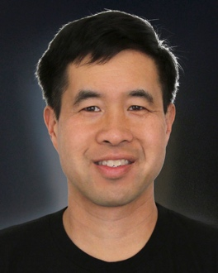
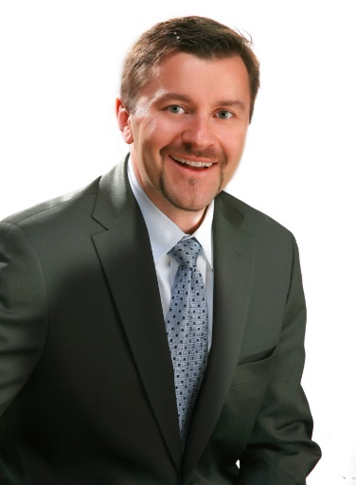
LSIC | Panel Discussion 3
Session 3: Application in Lunar Autonomy
Terry Fong (NASA)
Alhassan Yasin (JHU)
Kris Zacny (Honeybee Robotics)

Slide 37
LSIC | Coffee Break
See you all back
at 11:05 AM ET
Slido Poll:

Slide 38

LSIC | Coffee Break
See you all back
at 11:05 AM ET
Slido Poll:
Password: 2023Workshop

Slide 39
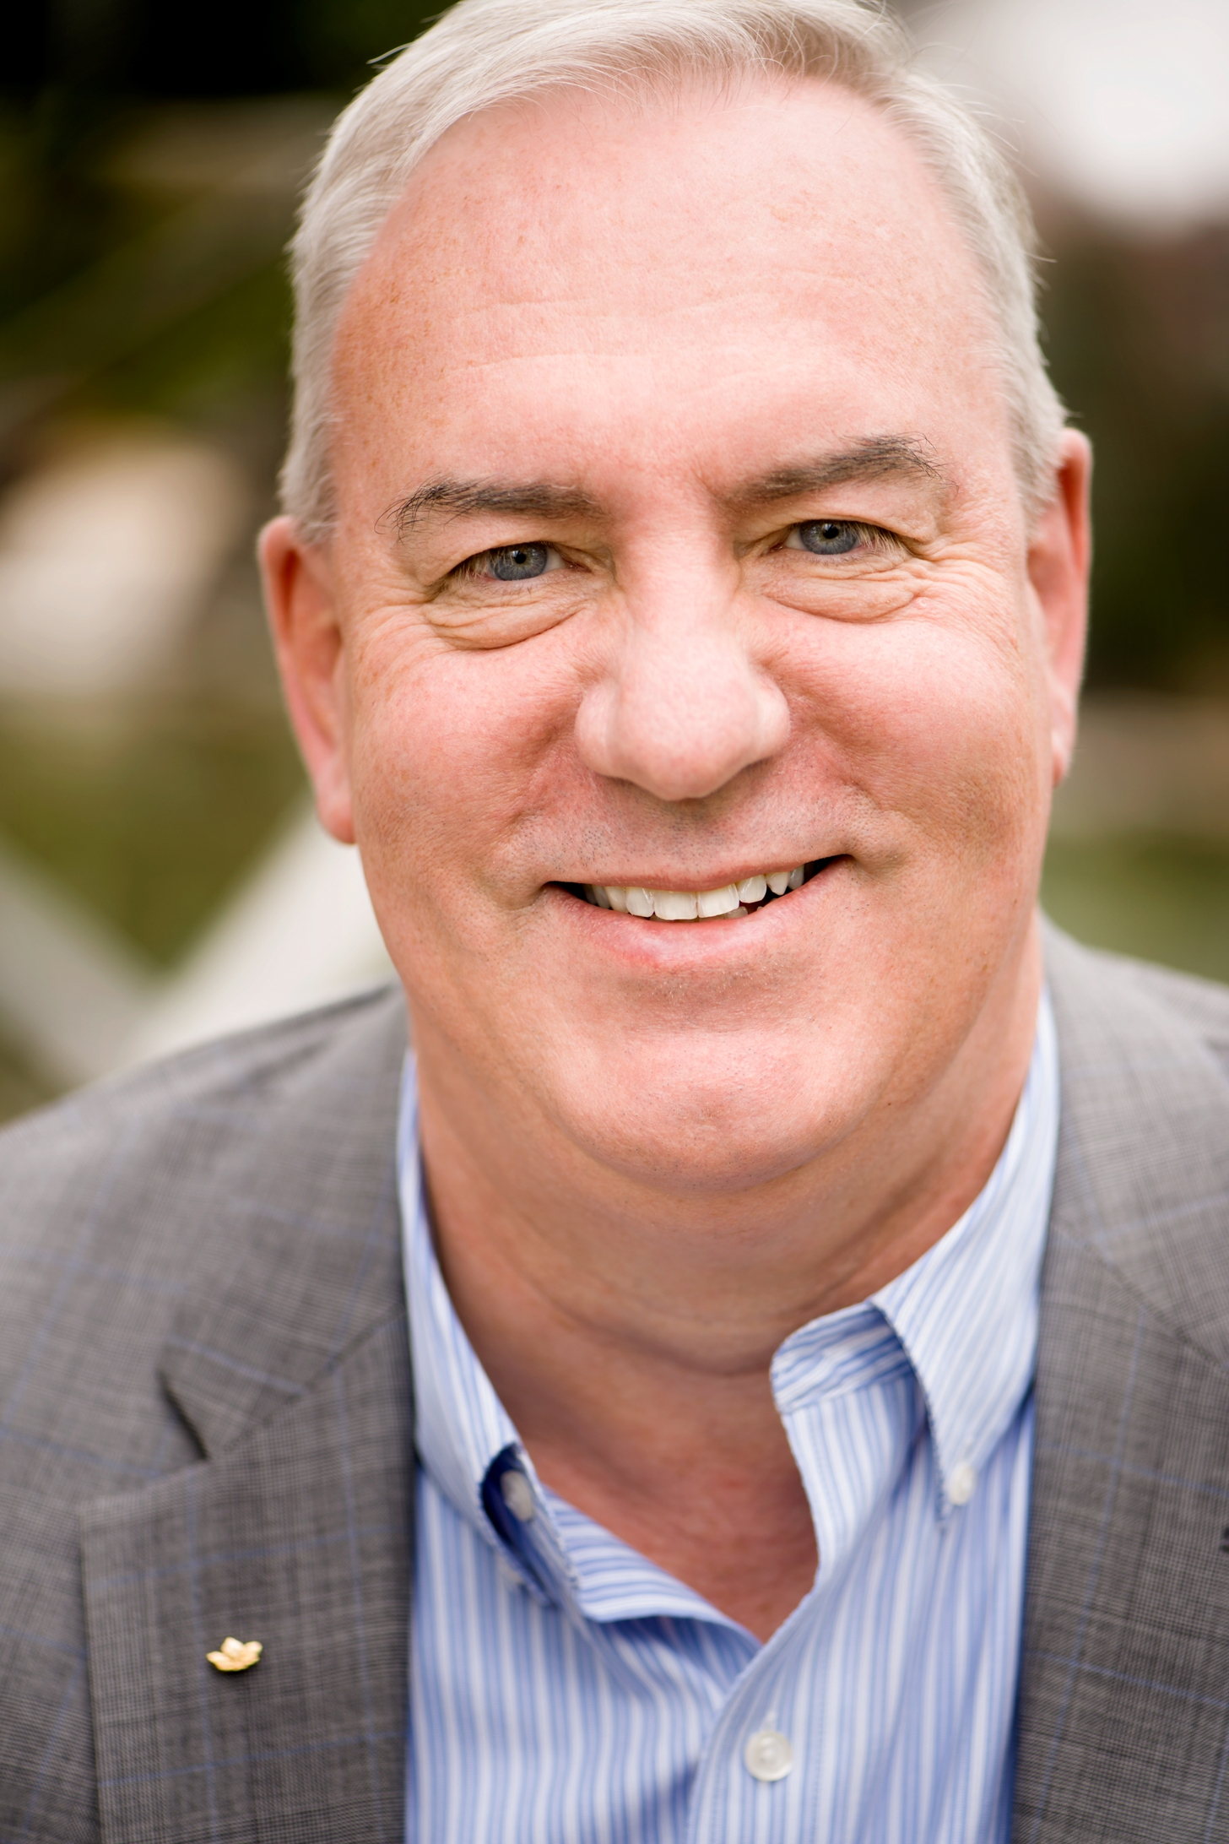
LSIC | Presentation 3a
Session 3: Application in Lunar Autonomy
Mining Technologies for Lunar-Surface Infrastructure
It is 35 years since the metal mining industry made any significant change in its production technology platform and for the last 20 years costs have increased, and productivity has declined. The need to electrify the global economy requires current mine production systems to be transformed if mining is to meet the huge demand increase for metals by 2035. Increasing economies of scale further is not feasible, so the only option is smaller, more effective machines working autonomously, in concert, so mines can produce more metals at prices that out-compete fossil fuels. The mining industry cannot make a transformation of this magnitude without help. Similar autonomous production systems are necessary to build lunar surface infrastructure at scale in the next 10 years, and this convergence of technological imperatives allows the Mining and Space Sectors to operate synergistically, and helps the Space Sector to contribute to reversing Climate Change on Earth.
Doug Morrison (CEMI)

Slide 40
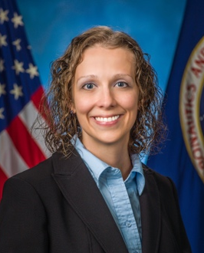
LSIC | Presentation 3b
Session 3: Application in Lunar Autonomy
Gateway – Autonomous Control of Human Spacecraft
NASA’s Lunar Gateway is meant to provide a stepping stone to sustained human presence beyond low Earth orbit, and represents a cornerstone of technology maturation for the entire Artemis campaign. One significant Moon to Mars outlook espoused by Gateway is the concept of autonomous vehicle control, independent of ground control, in crewed and uncrewed configurations. This independence is achieved by many architectural design decisions, one of them being the addition of the Vehicle Systems Manager (VSM) as the highest level onboard software control system and its associated hierarchical and distributed Autonomous Systems Management Architecture over the modules and systems that make up Gateway. This talk will discuss the novel VSM system and its application to human spaceflight in lunar orbit.
Julia Badger
(NASA JSC)

Slide 41
LSIC | Presentation 3c
Session 3: Application in Lunar Autonomy
Autonomous Site Preparation: Excavation, Compaction, and Testing (ASPECT)
The Autonomous Site Preparation: Excavation, Compaction, and Testing (ASPECT) project is a NASA LuSTR funded project to demonstrate autonomous site preparation of the lunar surface for the construction of lunar landing pads. Landing pads are needed on the Moon to ensure safe and reliable human access to the surface. The first step in building a lunar landing pad is clearing a site of rocks, filling craters with regolith, and leveling, smoothing, and compacting the surface. The ASPECT project is building a ground demonstration unit for surface preparation capable of autonomous task planning with no human intervention.
Neil Dantam (CSM)

Slide 42
Password: 2023Workshop
Q&A
Slido Q&A
Session 3: Lunar Application in Autonomy

Slide 43
LSIC | Lunch Break
See you all back
at 12:45 PM ET
Slido Poll:

Slide 44

LSIC | Lunch Break
See you all back
at 12:45 PM ET
Slido Poll:
Password: 2023Workshop

Slide 45
LSIC | Networking Discussion 3
Session 3: Application in Lunar Autonomy
Lunar Perception and Sensing
Lunar Environment
Zoom Room 1:
Stacy Teng (facilitator)
Tim Cole (facilitator)
Terry Fong (SME)
Zoom Room 2:
Lindsey Tolis (facilitator)
John Gersh (SME)
Bob Bamberger (SME)
Zoom Room 3:
Sam Andrade (facilitator)
Issa Nesnas (SME)
Matt Fifer (SME)
Zoom Room 4:
Danielle Mortensen (facilitator)
Sarah Hasnain (facilitator)
Danette Allen (SME)
Zoom Room 5:
Karl Hibbitts (facilitator)
Kristin Jaburek (facilitator)
Kristen John (SME)
Coffee Break
1:45 PM – 1:55 PM
ET

Slide 46
LSIC | Coffee Break
See you all back
at 1:55 PM ET
Slido Poll:

Slide 47

LSIC | Coffee Break
See you all back
at 1:55 PM ET
Slido Poll:
Password: 2023Workshop

Slide 48
Session 4: Challenges in Autonomy
Facilitator: Stacy Teng (JHU/APL)

Slide 49
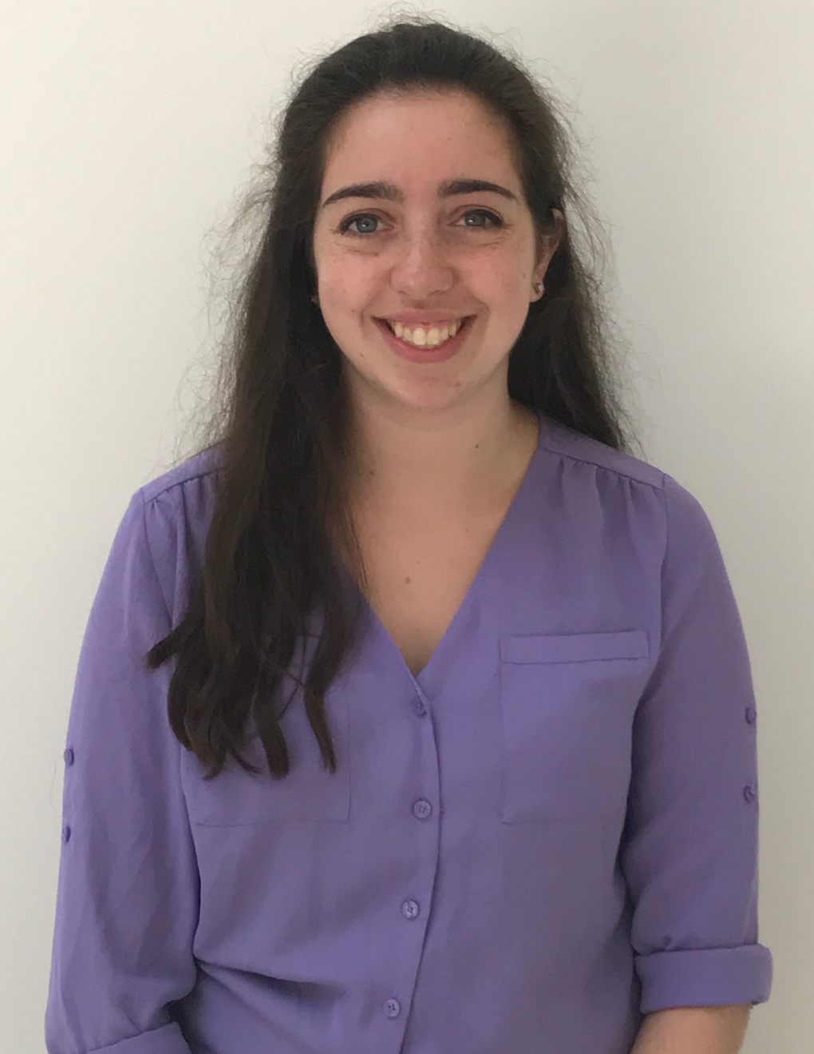
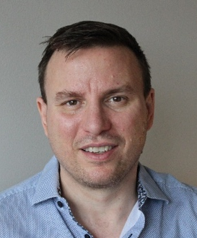
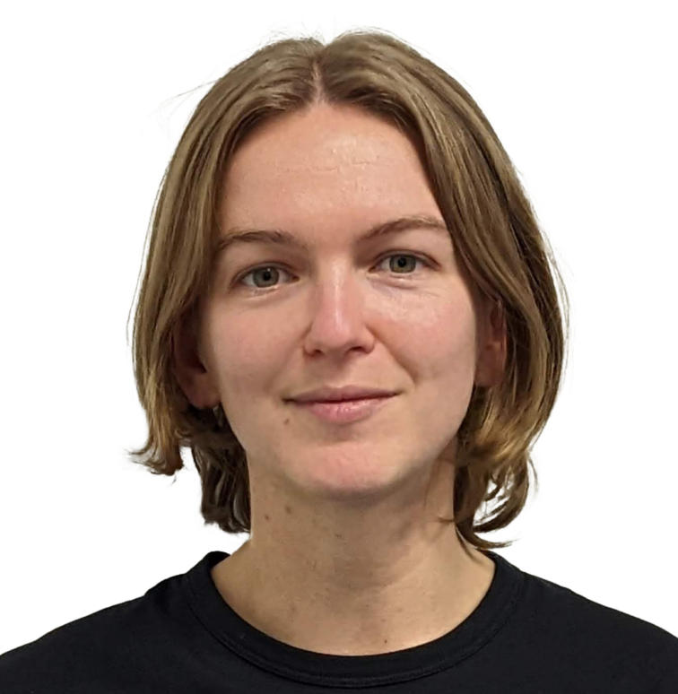
LSIC | Panel Discussion 4
Session 4: Challenges in Autonomy
Julia Antoniou (MathWorks)
Becca Bonham-Carter (MCSS)
Cam Dickinson
(MDA Space)

Slide 50
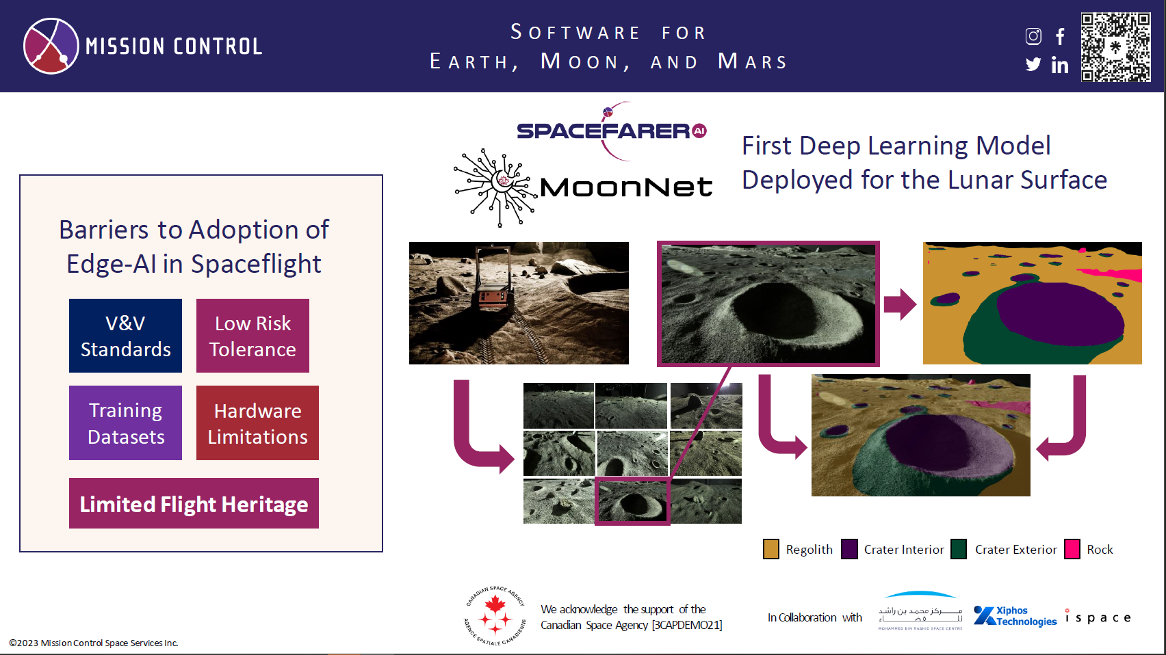

Slide 51
LSIC | Coffee Break
See you all back
at 2:45 PM ET
Slido Poll:

Slide 52

LSIC | Coffee Break
See you all back
at 2:45 PM ET
Slido Poll:
Password: 2023Workshop

Slide 53
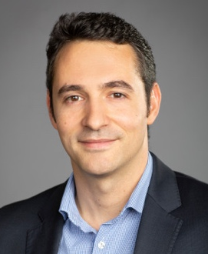
LSIC | Presentation 4a
Session 4: Challenges in Autonomy
Resilient Robotic Autonomy: Methods and Systems
Robotic systems are tasked to operate in an ever-expanding set of environments and conditions. Major breakthroughs in the state-of-the-art have allowed autonomous robots to "conquer" a wide variety of indoor and outdoor settings, yet a multitude of environments remains challenging if not beyond reach. Examples include perceptually degraded GNSS-denied settings with involved confined geometries, clutter, and possibly other dynamic agents. Progress in all individual subdomains of autonomy, from localization and mapping to control and planning, supports the goal of resilience but individually may not be sufficient. In this talk we present a perspective on how to instill resilience in autonomous robots and how a holistic treatment of embodiment, perception and autonomy allows to facilitate robust performance, redundancy against degradation of sensors (or other faults) and overall resourcefulness in the ability of the robot to maintain its autonomous operational capacity despite challenges and adversities. We support this discussion with a selected set of diverse results including those of Team CERBERUS winning the DARPA Subterranean Challenge, as well as earlier and later work from various settings and mission profiles including multiple robot configurations.
Kostas Alexis (NTNU)

Slide 54
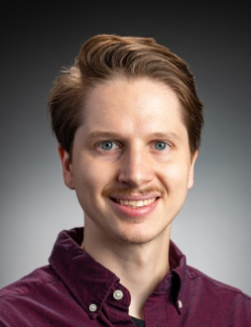
LSIC | Presentation 4b
Session 4: Challenges in Autonomy
Challenges in Developing Advanced Autonomous Navigation for the Moon
Advanced autonomous navigation will provide a critical backbone to autonomous operations on the moon. Navigating from point A to point B safely, efficiently, and quickly enables essential logistic productivity in support of a lunar base and science missions. Recent advances in autonomous navigation on Earth progress towards solving critical navigation challenges, e.g. quadruped navigation over challenging terrain and fast navigation in unstructured environments. However, a number of barriers exist in translating these methods to the moon including extreme environments, reduced human guidance and intervention, lack of relevant and high-quality data, and trust and assurance. I will discuss each of these challenges, how many of these challenges are relevant beyond navigation, and propose potential solutions to enable sustained deployment of autonomous resources on the moon.
Craig Knuth (JHU/APL)

Slide 55
LSIC | Presentation 4c
Session 4: Challenges in Autonomy
Considerations for T&E of Autonomous Systems
Test and evaluation of autonomous systems is as complex as designing and building the autonomy/system itself. Features need to be instantiated in the autonomy framework from the start of development to enable the safe and efficient stimulation of the system in ways that emphasize explain-ability. Many RL/ML approaches result in non-deterministic agents that require significant stimulation repetition to generate a full understanding of behavior. Interactions between multiple autonomous systems, especially ones that operate at different control levels and time scales need special attention.
Ed Brouwers (JHU/APL)

Slide 56
Password: 2023Workshop
Q&A
Slido Q&A
Session 4: Challenges in Autonomy

Slide 57
LSIC | Coffee Break
See you all back
at 3:35 AM ET
Slido Poll:

Slide 58

LSIC | Coffee Break
See you all back
at 3:35 AM ET
Slido Poll:
Password: 2023Workshop

Slide 59
LSIC | Networking Discussion 4
Session 4: Challenges in Autonomy
Software Challenges
Hardware Challenges
Zoom Room 1:
Tim Cole (facilitator)
Terry Fong (SME)
Zoom Room 2:
Lindsey Tolis (facilitator)
Matt Fifer (SME)
Zoom Room 3:
Karl Hibbitts (facilitator)
Raymond Lu (facilitator)
Saptarshi Banyopadhyay (SME)
Amir Rahmani (SME)
Zoom Room 4:
Danielle Mortensen (facilitator)
Kristin Jaburek (facilitator)
Issa Nesnas (SME)
Meet back in Main Room at 4:35 PM ET

Slide 60
Acknowledge the moment we’re having.
Day 2 Closing Remarks
& Next Steps for LSIC
Wes Fuhrman
Johns Hopkins University Applied Physics Lab
LSII Lead
Lunar Reconnaissance Orbiter Camera image (M1432398306LR; credit: NASA/GSFC/Arizona State University).

Slide 61
Abstract Submission deadline extended to Aug 25th.
Register now!
Notes:
Dr. Smith is a member of the Principle Professional Staff at JHU/APL with over 35 years of experience analyzing systems from risk, reliability, and safety perspectives. These systems included: NASA and DoD missions, payloads, ground communication systems, air traffic control systems, and missile systems. Dr. Smith is the reliability engineering lead for APL’s Space Exploration. He created and managed NASA’s International Space Station Program Probabilistic Risk Assessment specifically geared toward quantifying the safety risk during operations. He received his B.S. in Aerospace Engineering, M.S. in Engineering Management, and Ph.D. in Reliability Engineering all from the University of Maryland.

Slide 62

LSIC | Attendee Feedback
Password: 2023Workshop
Please take a few minutes to tell us your thoughts!
Slido:
https://www.slido.com
#LSIC-Autonomy
Password: 2023Workshop

